Slide 1
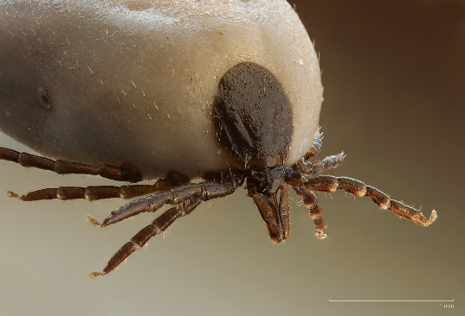
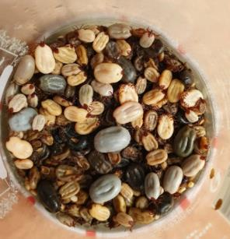
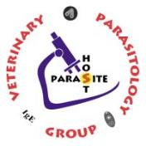
VMP 930 Veterinary Parasitology
Ticks
or Trail Mix?

Slide 2
Ticks: Learning Objectives
Understand what hosts are parasitized by Aragas spp. and the clinical signs of disease
Understand ticks exist as eggs, larva, nymphs and adults and the differences in life cycles of 1-host, 2-host, & 3-host ticks
Know the highlighted specific information about each of the 5 tick species you have been asked to memorize shown below:
Amblyomma americanum - Lone Star tick
Rhipicephalus sanguineus – Brown Dog tick, Kennel tick
Dermacentor variabilis – American Dog tick
Ixodes scapularis – Black-legged tick, Deer tick
Haemaphysalis longicornis – Asian long-horned tick (introduced)
Know the 6 specified points on tick associated pathology (slide 34)
Know the highlighted diseases transmitted by ticks
Understand transovarial and transstadial transmission of pathogens.
Know what acaracides should be avoided in cats

Slide 3
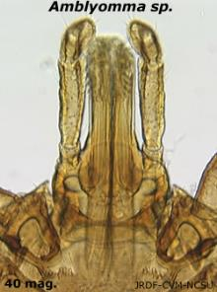
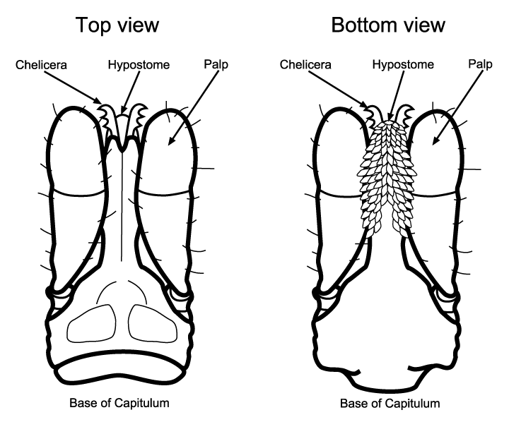
Tick - Anatomy
Capitulum (Gnathostome) = “head”
Basis capitulum
Palps
Chelicerae
Hypostome
Notes:
FYI

Slide 4
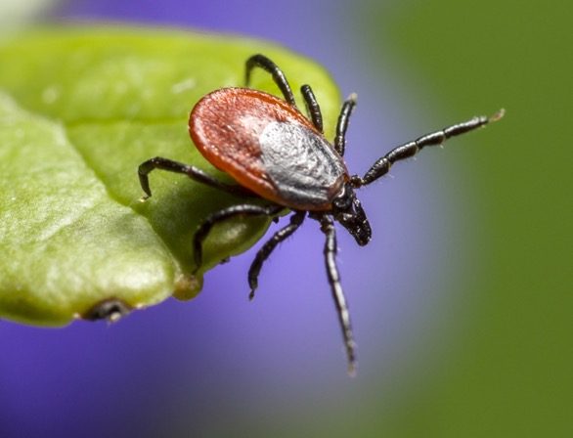
Tick - Anatomy
Idiosoma = “Body”
Body with unsegmented abdomen
Legs
Larvae -> 6 legs
Nymphs & Adults -> 8 legs
1st pair of legs with Haller’s Organ
Sensory organ for detecting hosts
“Questing”
Notes:
Most wait immobile for host to brush against them.
Others climb on to vegetation and actively try to detect hosts passing by.
Questing – Haller’s Organ
Others emerge from cover and actively move toward their hosts

Slide 5
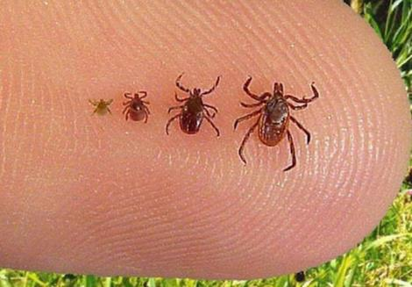
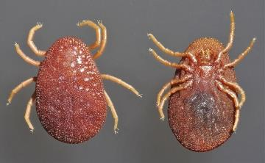
Ticks General History
4 Life Stages
Egg, larva, nymph, adult
Ixodidae – hard ticks
1 nymphal instar
All stages feed for 2 to 14 days
Argasidae – soft ticks
2 to 7 nymphal instars
Adults & nymphs feed for only minutes to hours, but feed multiple times
Most ticks are vectors for disease
larva, nymph adult male, adult female

Slide 6
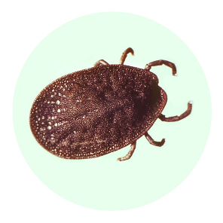
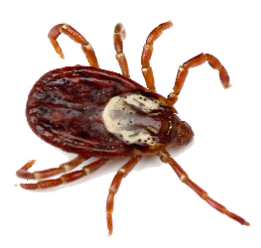
Tick - Groups
Family Argasidae – soft ticks
Only 4 genera of Argasidae
– Argas, Ornithodoros, Otobius and Carios
Family Ixodidae – hard ticks
4 main genera of Ixodidae
– Ixodes, Rhipicephalus, Amblyomma and Dermacentor,
1 Introduced (invasive sp.) Hard Tick
- Haemaphysalis longicornis

Slide 7
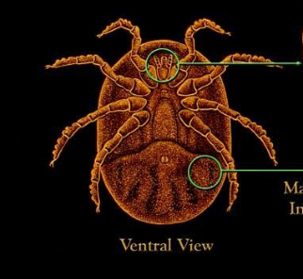
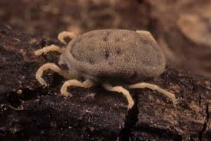
Argasidae - Soft Ticks
Leathery body without plates or scutum
ventral capitulum (gnathostome)
feed on multiple individual hosts - generally live in burrows or nests and lay multiple batches of eggs
Argas spp. (Fowl ticks)
Ornithodoros spp. (Rodent ticks)

Slide 8
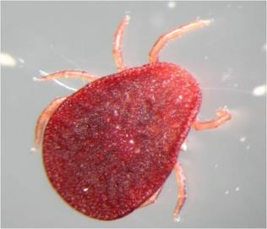
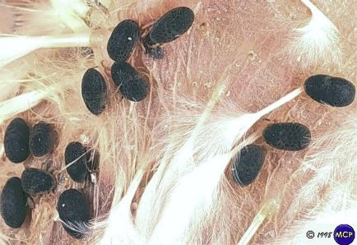
Argas spp. (Fowl ticks)
Primarily parasites of birds
Ecology
Nocturnal: feeds on birds at night
Lives in cracks, crevices, nests during day
egg to adult in as little as 30 days
lay several clutches of 25 to 100 eggs / clutch
may live for up to 12 years with feeding
may live up to 2 years without feeding
Gulf of Mexico & Mexican border in USA

Slide 9
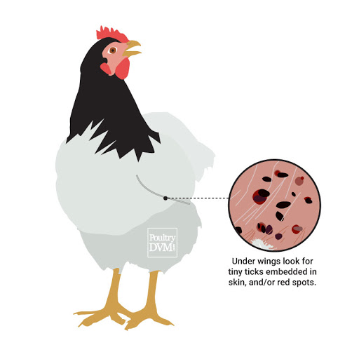
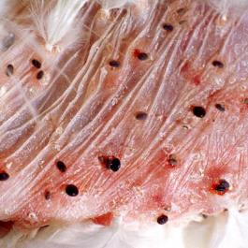
Argas spp. Pathology
Anemia
with mortality in younger birds
Secondary infection at wound site
Decreased egg production
Disease transmission - Fowl borreliosis (Borrelia anserina) in South America
Tick paralysis in chickens

Slide 10
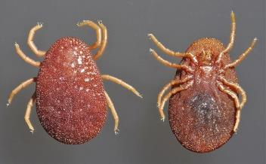
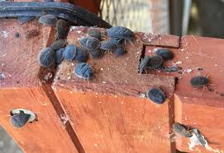
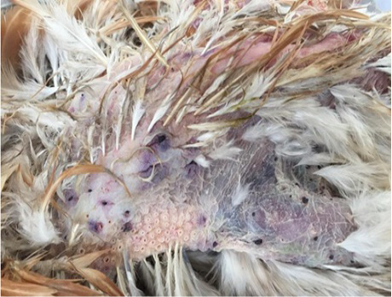
Argas persicus (Fowl tick)
sometimes called
Blue Bugs
Severe infestation of a free-range chicken by larvae of Argas persicus. (Note hemorrhage zones corresponding to the points of attachment of tick larvae) .
Anim. Health Prod. 7(3): 92-98 Http://dx.doi.org/10.17582/journal.jahp/2019/7.3.92.98
Notes:
Primarily parasites of birds
Nocturnal: feeds on birds at night
Lives in cracks, crevices, nests during the day.
Gulf of Mexico & Mexican border in USA
Anemia with mortality in younger birds
secondary infection at wound site
Decreased egg production
Disease transmission - Fowl borreliosis (Borrelia anserina) in South America: The major symptoms of an infection with B. anserina are: anemia, diarrhea, and severe neurological dysfunctions.
Tick paralysis in chickens
The adult and nymphs hide in cracks and crevices in the coop, or tree bark, during the daytime. At night, they leave their hiding spot to feed on the chickens as they sleep. Usually it takes them between 15-30 minutes to feed. They leave behind red spots on the bird's skin, often under their wings.
Their distribution is worldwide, occupying all but the coldest environments. common all along the southern tier of the U.S. Most people may never realize they have them because they feed at night and hide during the day
Effects of Fowl Ticks on Chickens Anemia: As a result of blood loss from the ticks feeding on them at night. Stress Tick fever: Ticks carry the pathogen responsible for causing this disease. Transient paralysis: caused by toxins released in the tick’s saliva

Slide 11
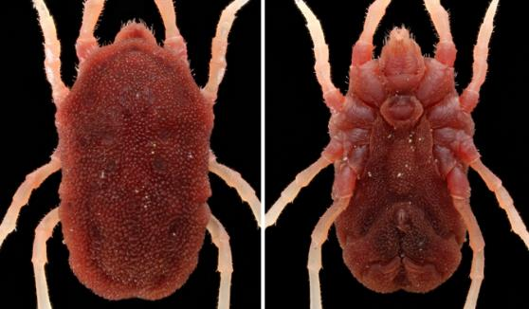
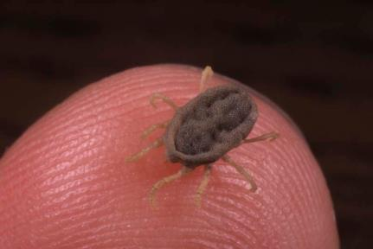
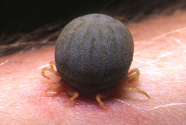
Ornithodoros spp.
Feeds on rodents
Mainly in Rocky Mountain and Pacific Coast region.
Found in burrows
Nocturnal, quick feeding.
A vector for relapsing fever in humans (Borrelia spp.).

Slide 12
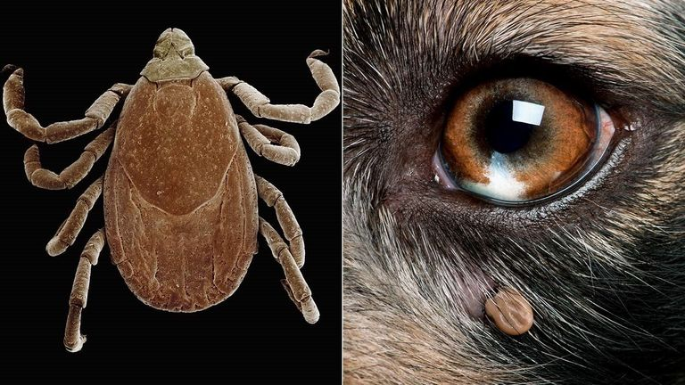
Hard Ticks
lbert Lleal/Getty Images; Alamy

Slide 13
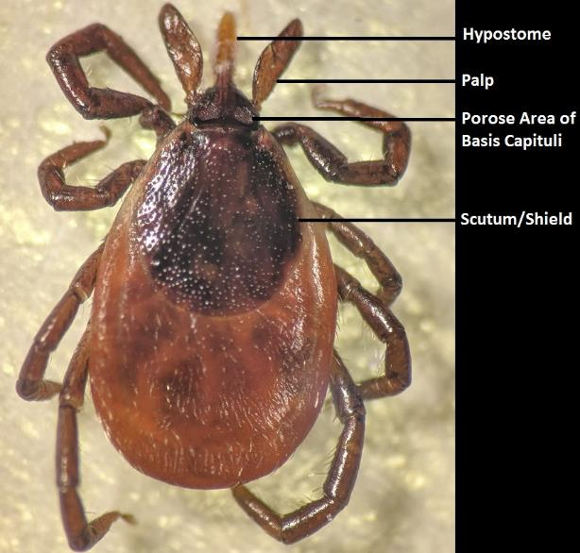
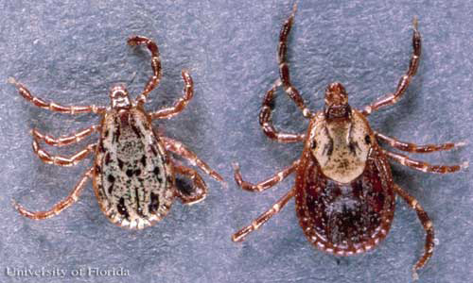
Hard Ticks: General Characteristics
Ornate or inornate scutum covers the full dorsum of males, but only the anterior dorsum of females.
The capitulum (gnathostome) projects anteriorly.
Palps and hypostome part of mouth
Notes:
There will not be any morphology questions or tick identification questions on lecture exams but you may be asked to learn this in the lab portion of this class.

Slide 14
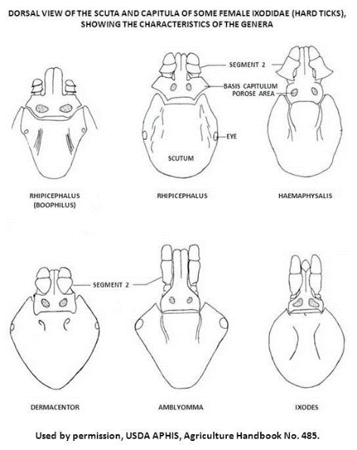
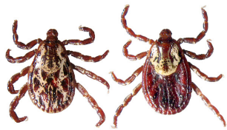
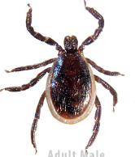
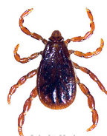
Hard Ticks: Identification
Palps and Capitulum
Scutum
Dorsum coverage?
Ornate?
anterior coverage = FEMALE
full coverage = MALE
YES:
D. variabilis
A. americanum
NO:
R. sanguineus
I. scapularis
H. longicornis
Notes:
There will not be any morphology questions or tick identification questions on lecture exams but you may be asked to learn this in the lab portion of this class.

Slide 15
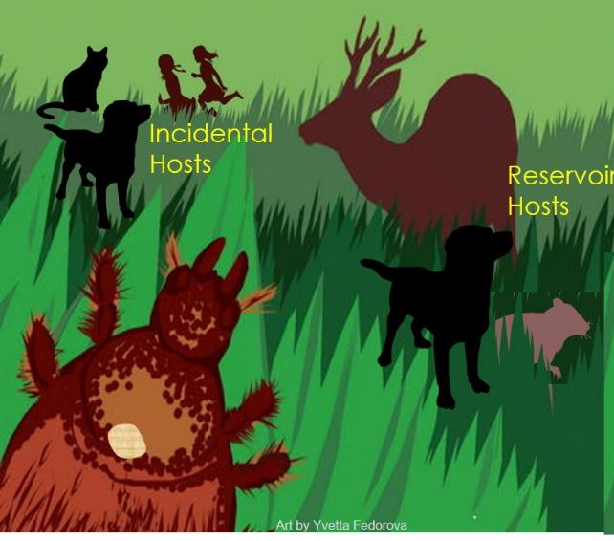
Hard Tick Life Cycles
Hard ticks have 1, 2 or 3 host life cycles
Some of these hosts (mammals, birds, reptiles) may become infected with tick-borne pathogens as:
Reservoir hosts (asymptomatic carriers)
Incidental hosts (usually get sick)

Slide 16
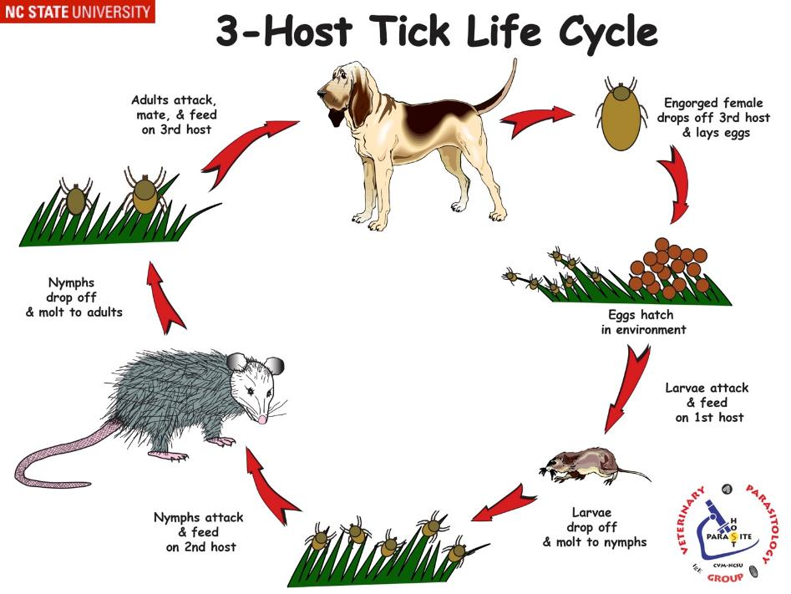
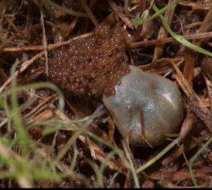
Host species vary depending on the tick
https://cvbd.bayer.com/
Notes:
Three-host life cycle means each active stage (larva, nymph, and adult) feeds only once, then leaves the host to digest the blood meal and molt to the next stage or lay eggs. The three hosts are not always the same species, but may be the same species, or even the same individual, depending on host availability for the tick.

Slide 17
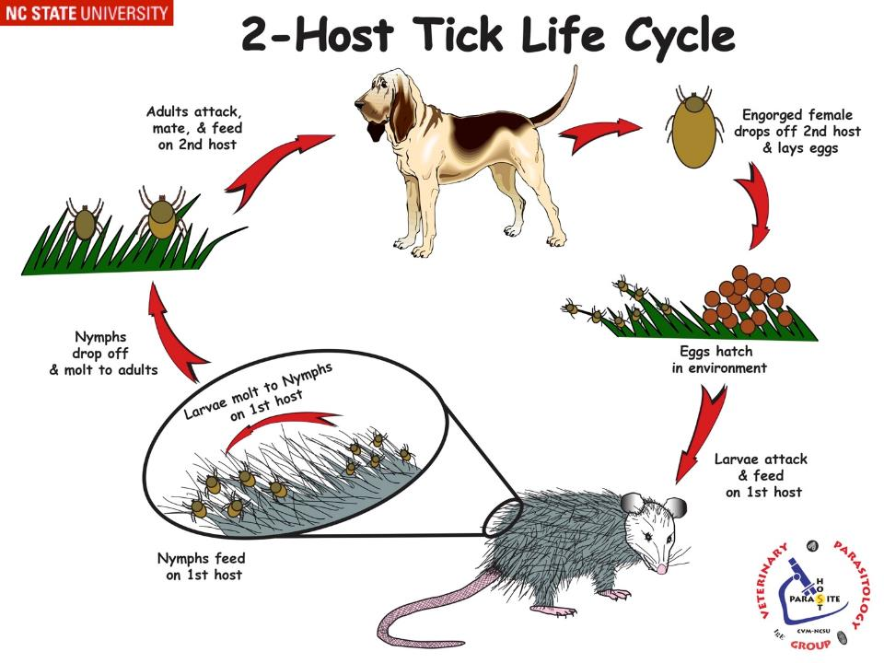
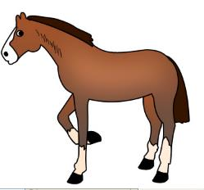
Host species vary depending on the tick
Ex. Rhipicephalus evertsi
Notes:
In a two-host life cycle, the tick molts from larva to nymph on the first host but will leave the host between the nymphal and adult stages. The second host may be the same individual as the first host, the same species, or a second species.
As far as we know, no North American ticks are two-host ticks but some R. evertsi has been found on some zoo animals in NA (probably imported)

Slide 18
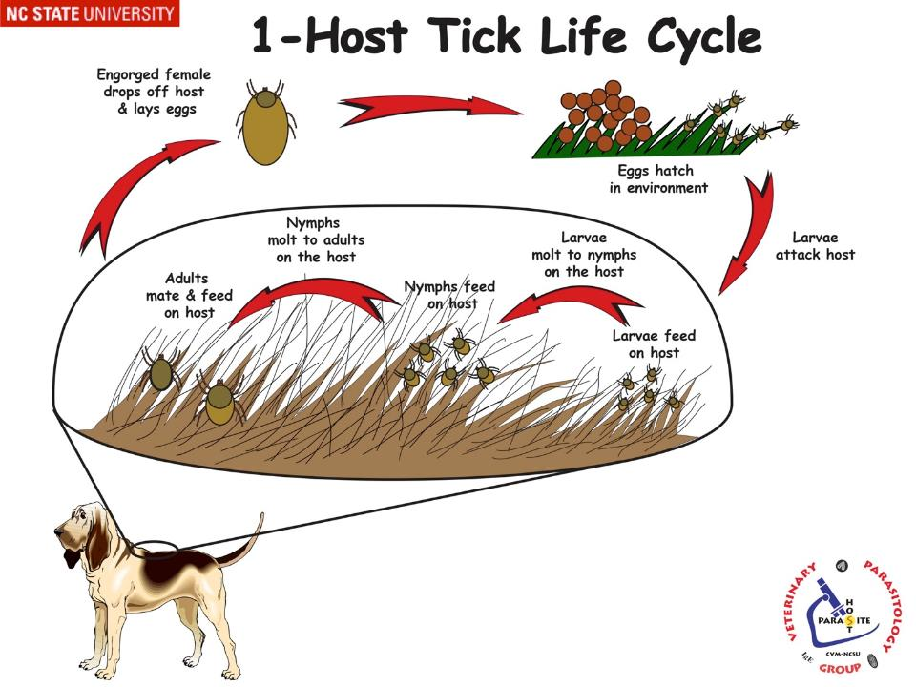
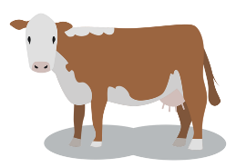
Host species vary depending on the tick
Ex. Rhipicephalus (Boophilus) annulatus
Notes:
During the one-host life cycle, ticks remain on the same host for the larval, nymphal and adult stages, only leaving the host prior to laying eggs.
Rhipicephalus (Boophilus) microplus and relatives, which are cattle ticks, are classic one-host ticks. Deer, elk, and goats can have high numbers of Dermacentor albipictus, also a one-host tick,

Slide 19
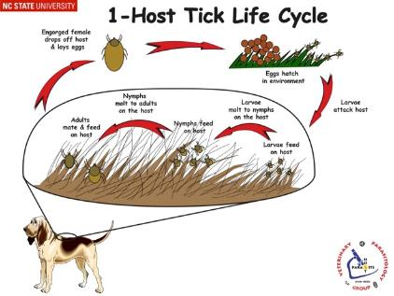
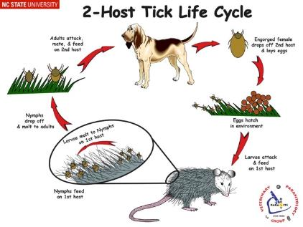
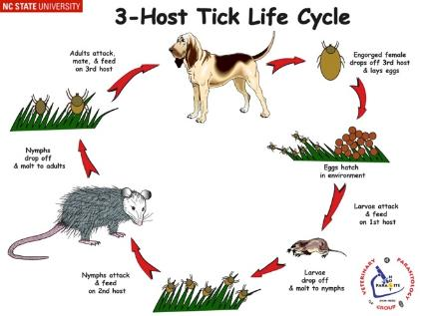
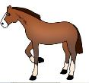
Which Tick is “Easier” to control / eradicate?

Slide 20
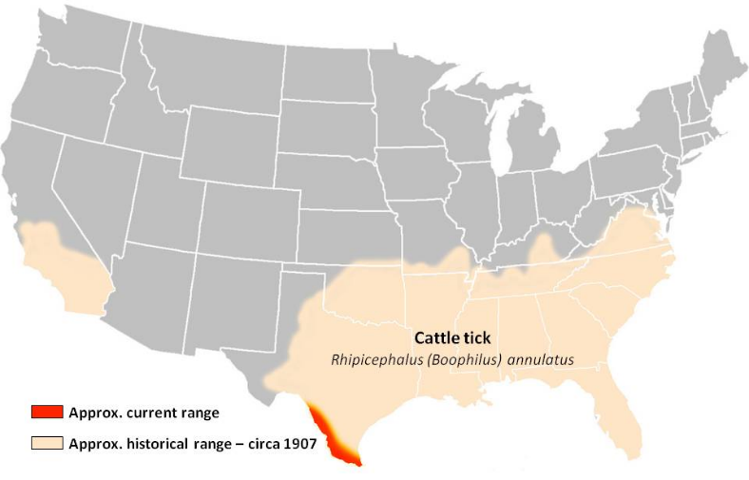
FYI: Eradication of Texas Cattle Fever
Rhipicephalus (Boophilus) annulatus
(1-host tick) vector for Babesia bigemina
Geography images
Notes:
Complete eradication is extremely difficult because of the persistence of ticks, especially multihost ticks, on wild fauna and the ability of adult ticks to live for very long periods away from a host.
Boophilus annulatus was eradicated from the southeastern United States by a program of continuous dipping at short intervals of all livestock in the area.
B. microplus was also eradicated from Florida by a similar procedure, but 20,000 deer, the important alternate host in the area, had to be slaughtered. Concern has been expressed that deer and other wildlife species may threaten efforts to prevent B. microplus and B. annulatus from becoming reestablished in the southern United States after they are introduced from Mexico.
Macrocytic lactones kill larvae but not adults –okay to use to control ticks with one-host life cycles but on 2 and 3 host life cycles because the adults can drop off and feed on another host that is not treated.

Slide 21
Life Cycle: 3-host tick
Important 3-host ticks (to memorize)
Amblyomma americanum - Lone Star tick
Rhipicephalus sanguineus – Brown Dog tick, Kennel tick
Dermacentor variabilis – American Dog tick
Ixodes scapularis – Black-legged tick, Deer tick
Haemaphysalis longicornis – Asian long-horned tick (introduced

Slide 22
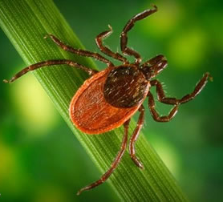
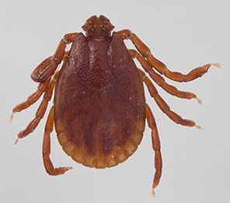
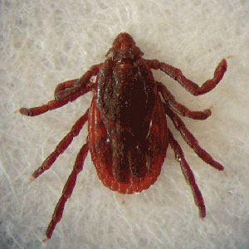
5 Tick Species you should know with scientific and common names
Dermacentor
variabilis
(American Dog Tick)
Haemaphysalis longicornis
(Asian Longhorned Tick)
Ixodes
scapularis
(Black-legged Tick,
Deer Tick)
Amblyomma
americanum
(Lone Star Tick)
Rhipicephalus
sanguineus
(Brown Dog Tick
Kennel Tick)

Slide 23
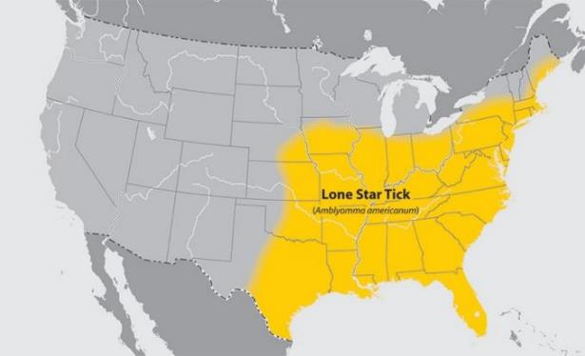
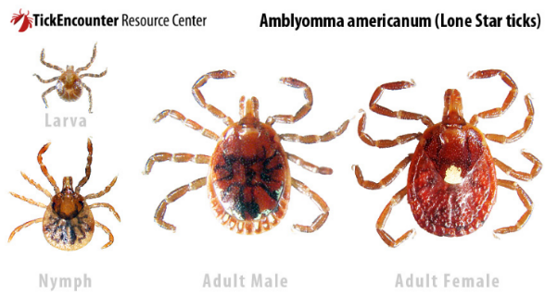
Amblyomma americanum (Lone Star Tick)
Wooded / outdoor habitat
Adults attack various animals
Vector for pathogens:
Cytauxzoon felis
Rickettsia rickettsii (causes Rocky Mountain Spotted Fever).
Ehrlichia spp.
Heavy infestations in cattle:
Decreased performance, weight loss, reduced milk production
Notes:
livestock, horses, pets, and humans

Slide 24
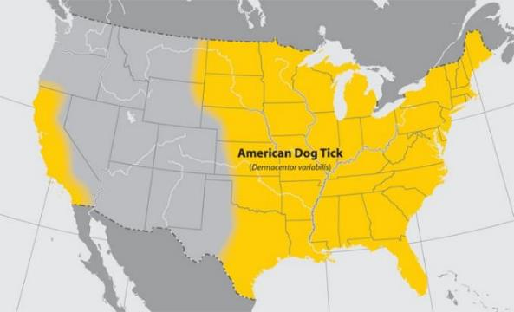
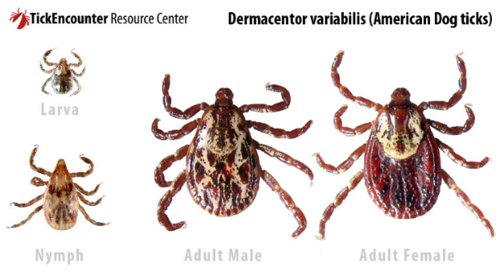
Dermacentor variabilis (American Dog Tick)
FYI: Dermacentor simils
Wooded / outdoor habitat
Larvae & nymphs on rodents
Adults prefer canids but also on larger animals and humans
Vector for Rocky Mountain Spotted Fever – Rickettsia rickettsii

Slide 25
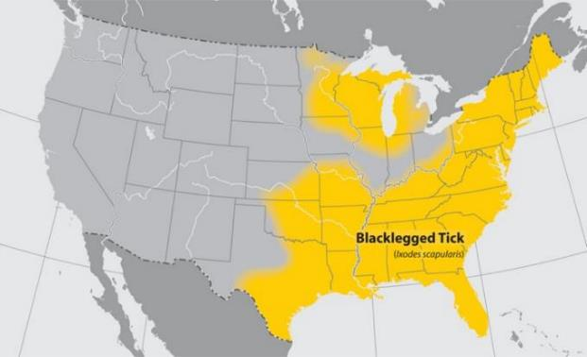
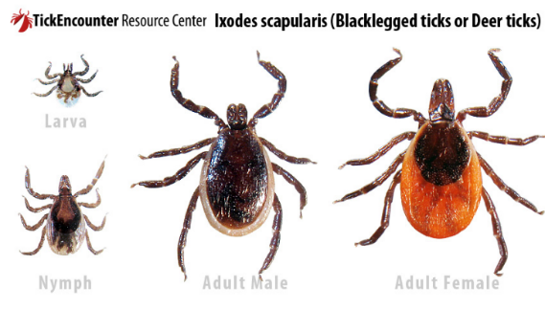
Ixodes scapularis (Black-legged tick or Deer tick)
Wooded / outdoor habitat
Adults primarily on white-tailed deer
Other host animals include livestock, horses, pets, and humans
Vector for many pathogens including:
Lyme Disease – Borrelia burgdorferi
Anaplasmosis –Anaplasma phagocytophilum

Slide 26
Rhipicephalus sanguineus (Brown dog tick/ Kennel tick)
Indoor habitats – kennels, residences, pet resting / bedding areas
Primarily feed on dogs, rarely humans
Vector for many pathogens including:
Babesia vogeli (canine babesiosis)
Ehrlichia canis (canine ehrlichiosis)
Rickettsia rickettsii (RMSF)
Hardy tick – resists desiccation and 3-5 months w/o feeding.

Slide 27
Haemaphysalis longicornis Asian Long-horned Tick
Introduced
Australasian and Western Pacific Region
Confirmed cases in many eastern US states
Emerging parasite problem (primarily for livestock)
Very aggressive, “mob” a host
Potential vector of several viral, bacterial, and protozoan agents
Ecological Success
Females are parthenogenetic, produce 2,000 clones
Notes:
NC bull was exsanguinated by 1000+ ticks
Very aggressive, “mob” a host
100% mortality in H. longicornis adults was observed with all the carbamates (carbosulfan,
benfuracarb, fenobucarb, and carbaryl)

Slide 28
Haemaphysalis longicornis Asian Long-horned Tick in the US
FYI

Slide 29
Haemaphysalis longicornis (introduced tick)

Slide 30
Rhipicephalus vs. Haemaphysalis
Haemaphysalis
Rhipicephalus
FYI
Notes:
FYI

Slide 31
Behind mosquitos, ticks are the second most important group of disease-transmitting ectoparasites.
Notes:
Why are Ticks Excellent Vectors for pathogens?
1. Persistent feeders -- hard to dislodge
2. Slow feeders [R. (B.) annulatus = 6 to 8 days]
much time for transmission of pathogen (wide range of transmission time)
geographic dispersal
3. Low host specificity
4. Longevity -- much time to acquire & transmit a pathogen throughout life
5. Transovarian Transmission -- Pass pathogen to next generation
6. Transstadial Transmission -- Retains pathogen throughout life stages
7. Hardy -- persists in environment
8. High fecundity (Some ticks up to 18,000 eggs per female)
9. Ticks alter host immune system to support pathogen transmission

Slide 32
Why are ticks excellent vectors to transmit pathogens?
1. Persistent and slow feeders -- hard to dislodge, attached for many days
much time for transmission of pathogen (wide range of transmission time)
allows for geographic dispersal (go where their host goes)
2. Low host specificity
3. Transovarian Transmission -- retain pathogen to next generation
4. Transstadial Transmission -- retain pathogen throughout life stages
5. Hardy -- persists in environment
6. High fecundity (up to 18,000 eggs per female)
7. Ticks alter host immune system to support
pathogen transmission
Notes:
Low host specificity -- variety of host sources = potential exposure to various pathogens through reservoirs hosts
Slow feeders [R. (B.) annulatus = 6 to 8 days]

Slide 33
Notes:
Not all ticks can pass a pathogen on to their offspring (transovarian) or through stages of molting (transstadial).
Ticks that can do this can maintain pathogens in the environment easier. Ticks that can’t do this will need to rely more on reservoir hosts if they are to carry and transmit pathogens.

Slide 34
Tick Associated Pathology
Disease transmission (Biological Vector)
Blood loss (may result in severe anemia or death)
“Tick worry” in food animals
Decreased grazing, Weight loss
Wound production
Secondary bacterial infection
Invasion sites for screwworms / blow flies
Damage to hides
Tick paralysis (caused by toxin in tick saliva)
Notes:
These are common ways that ticks cause problems to their hosts

Slide 35
Tick Associated Pathology DISEASE TRANSMISSION
Protozoal diseases
Bovine babesiosis (Ra) (Texas Cattle fever)
Equine babesiosis
Canine babesiosis (Rs)
Feline cytauxzoonosis (Aa, Dv)
Theileriosis (East Coast fever)
Rickettsial diseases
Rocky Mountain Spotted Fever (Dv, Rs, Aa)
Ehrlichiosis (Rs, Aa)
Anaplasmosis (Is)
Heartwater (Cowdria)
Bacterial Diseases
Lyme disease (Is)
Tularemia (rabbit fever)
Spirochetosis of livestock and poultry
Brucellosis
Viral diseases
Nairobi sheep disease
African swine fever
Tick-borne encephalitis
Others?
(tick species abbreviations)
Notes:
You may be tested on the green highlighted disease and their transmitting ticks (in parentheses)

Slide 36
Tick Control
Nonchemical Control
Brush or vegetation removal
Much labor & expensive
Resistant cattle breeds
Hereford least resistant
Brahman most resistant
Vaccines against ticks
Australian tick vaccine
Predators and parasites?
Naturally present but have little impact
Brahman
?
?

Slide 37
Tick Control
Acaricides
Dips or dip-vat
Whole body spray
Topicals, dusts
Impregnated ear tags & collars
Injectant and oral (systemics)

Slide 38
Acaricides that are
Toxic to Cats
Pyrethrins
Pyrethroids (synthetic pyrethrins)
-Permethrin -Deltamethrin
Amitraz
Notes:
cats are significantly more sensitive to pyrethrins than dogs due to a cat's altered liver glucuronidation metabolism. Aside from topical application to the cat, cats that groom dogs following recent topical applications are also at risk for toxicity. Permethrin is the most toxic.
FYI: clinical signs consistent with permethrin toxicosis are muscle fasciculations and seizures
FYI: amitraz administered to cats as a bath caused consistent, mild, transient toxicity even at comparatively low dose levels
α₂-adrenergic effects induced by amitraz (Sedation, loss of reflexes, hypothermia, bradycardia, bradyarrhythmia, hypotension, bradypnea, mydriasis)

Slide 39
FYI: Factors Affecting Tick Control
1. Inconsistencies in client compliance
2. Seasonal and annual fluctuations in tick and reservoir populations
3. Acaricide Resistance? –some reports
Very few reports in ticks important in small animal vet med
Rhipicephalus microplus (cattle fever tick) is resistant to more chemicals than any other tick. WHY?
Notes:
Acaricide resistance is the selection of a specific heritable trait (or traits) in a population of arthropods, due to that population’s contact with a chemical, that results in a significant increase in the percentage of the population that will survive a standard dose of that chemical (or a closely related chemical in the case of cross resistance).
It can be difficult, if not impossible at times, for practitioners to differentiate between parasite resistance and other causes of inefficacy due to a multitude of environmental, host, and client variables.
Some reports of resistance for ticks of interest to veterinarians who treat dogs and cats. There was 1 report of acaricide resistance for Amblyomma americanum, 2 resistance reports for Dermacentor variabilis, and 9 reports for Rhipicephalus sanguineus. Studies suggest resistance varies among different populations of tick species. So the entire species is not resistant, for example.
Acaricide resistance in ticks infesting dogs and cats has not been investigated as extensively as that of cattle ticks, especially Rhipicephalus (Boophilus) microplus. Rhipicephalus microplus resistance to the following chemicals: chlorpyrifos, cypermethrin, deltamethrin, fipronil, flumethrin, and ivermectin

Slide 40
Discussion Questions
Name one pathogen transmitted by:
Ixodes scapularis?
Amblyomma americanum?
Dermacentor variabilis?

Slide 41
Discussion Questions
A poultry farmer has complained about anemia (noticed pale combs) and several of her pullets (young hens) have died.
What are some follow up question you would ask the farmer?
What are 2 parasites that could be causing anemia in these chickens?

