Slide 1

VMP 930
Veterinary Parasitology
Mites

Slide 2
Arachnids
General Arthropod Characteristics
Cephalothorax + abdomen + 8 legs
Simple Metamorphosis (Hemimetabolous)
  Egg, larvae, nymph, adult
Groups of Parasitic Arachnids (Subclass Acari)
  Mites
    Mesostigmatid mites -- Dermanyssus, Ornithonyssus
    Astigmatid mites -- Sarcoptes, Notoedres, Otodectes
    Prostigmatid mites -- Demodex
  Ticks
    Metastigmatid
      Argasid – Soft ticks
      Ixodid – Hard ticks

Slide 3
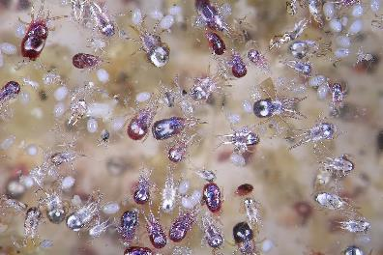
Mesostigmatid Mites
Stigmata (respiratory pores) in the middle of their bodies
Dermanyssus and Ornithonyssus
  Poultry mites
  Blood sucking
  Also, infest wild birds
https://www.mwiah.com/our-insights/of-mice-and-hen
Notes:
Arthropods have a tracheal system that carries O₂ to various parts of the body.
For high level (ex. Suborder) taxonomy, mites are classified by the location of the openings (stigmata) to their tracheal system.
The stigmata of Mesostigmatid mites are located b/w the coxae (hip joints) of the 3rd and 4th legs.

Slide 4
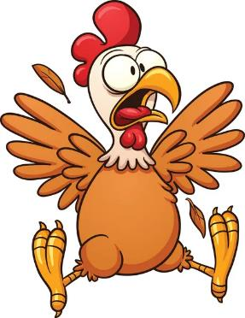
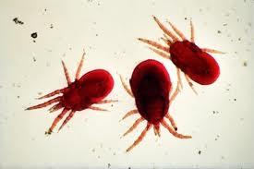
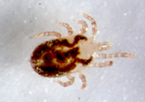
Poultry Mites
Dermanyssus gallinae AND Ornithonyssus sylviarum
Poultry mites, Dg & Os, infest chickens, turkeys, pet birds, etc.
Control
Purchase mite-free birds.
Also, pigeons, doves, sparrows, various wild birds, even rodents, etc.
Control
Secure houses and coops from wildlife.
Spread from farm to farm by egg flats, bird crates, clothing, etc.
Control
Practice good biosecurity.
Pathology
Mite populations and pathology can increase rapidly.
Life cycle may be completed in only 1 week
Control
Frequent Mite surveillance & good sanitation practices to prevent a buildup of mite populations.
FYI only:
Poultry Industry
Which of the following production operations would have the least issues with mites?
Broilers (6-7 weeks old)
Layers
Breeders
Backyard
Broilers
Layers
Breeders
Backyard

Slide 5
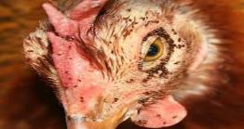
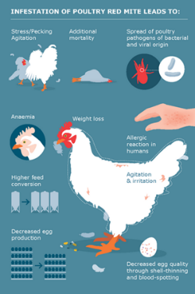
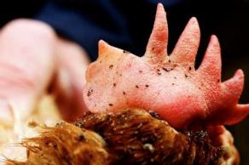
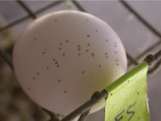
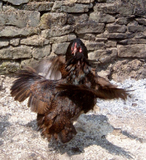
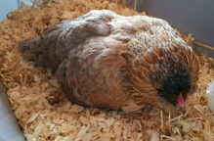
Poultry Mites
Dermanyssus gallinae AND Ornithonyssus sylviarum
Pathology
https://www.vinayakcorporation.com/tag/dermanyssus-gallinae/
Biting Mites → Pruritus & Intense Irritation ➔ Decreased productivity
  Flock is restless and stressed
  Feather-pecking, fighting
  Refuse to use nest boxes / roosts
Feed on Blood → Anemia ➔ Decreased productivity
  pale comb and wattles, weakness, and dullness.
  mortality in cases of extreme infestations
Economic “Pathology”
  decreased egg production
  decreased egg quality
  decreased weight gain
  poor feed conversion.

Slide 6
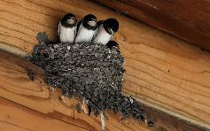
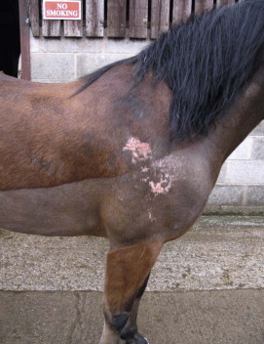
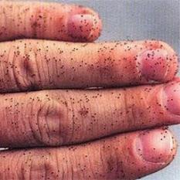
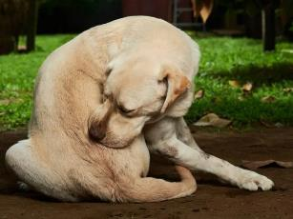
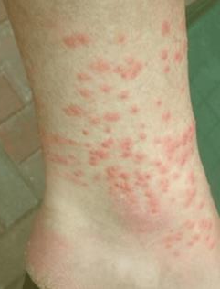
Poultry Mites
Dermanyssus gallinae AND Ornithonyssus sylviarum
  If birds unavailable; feed on other hosts (rodents, horses, dogs, man).
Zoonosis
Irritation to farm workers, other animals, potential DZ vectors
https://www.andylawpestcontrol.co.uk/how-much-do-you-know-about-bird-mites/
https://birdmiteguide.com/bird-mites-on-humans/
https://littlehappypaw.com/can-bird-mites-live-on-dogs/
Knottenbelt and Pascoe’s
Color Atlas of Diseases and Disorders of the Horse
Notes:
Temporary Zoonosis occurs.

Slide 7

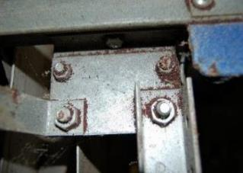
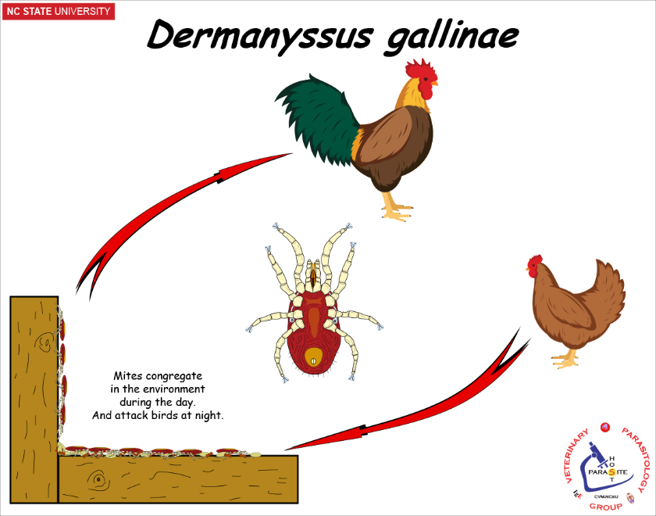
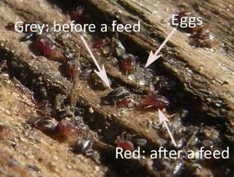
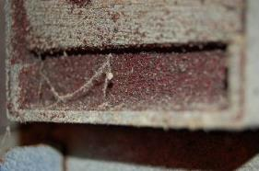
Dermanyssus gallinae
Roost mite or Red Chicken mite
Diagnosis
Mite surveillance → inspect cracks & crevices of chicken house (during day)
Dg mites -- hide in the environment during daytime, feed on birds at night
Treatment
Acaricides: high-pressure sprays, dusts, etc. Primary: environment, secondary: birds
https://www.coremi.eu/about-coremi/mites.html

Slide 8
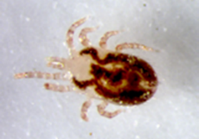
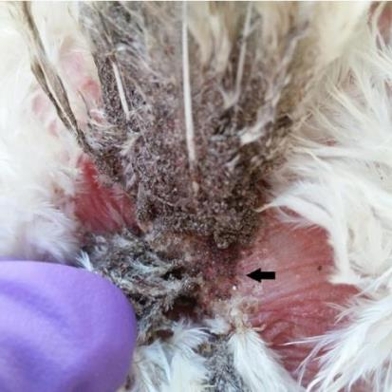
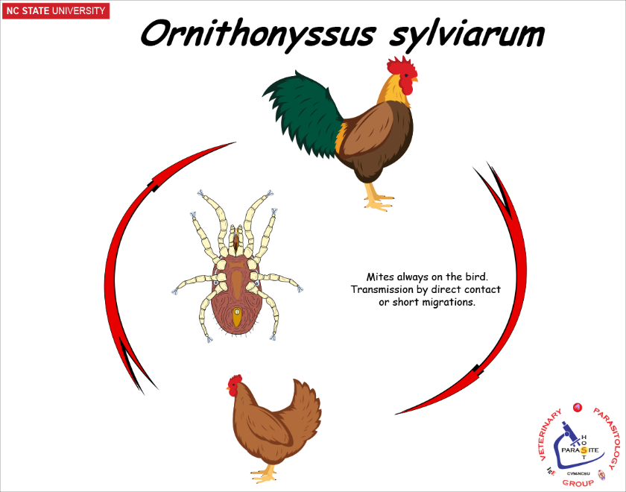
Ornithonyssus sylviarum
Northern Fowl Mite
Diagnosis
Mite surveillance → Soiled & matted feathers, crusty skin, severe scabbing, esp. around the vent.
Os mites -- all stages are on the host & rarely wanders off host
Treatment
Acaricides: high-pressure sprays, dusts, etc. Primary: birds, secondary: environment

Slide 9
Index for Estimating Infestation of Ornithonyssus sylviarum
FYI
0 = No mites
1 = 1 to 50 mites --- Light Infestation
2 = 50 to 1000 mites --- Moderate Infestation = TREAT
  (small clumps of mites on skin and feathers with beginning frass on some feathers)
3 = 1000 to 25,000 mites --- Moderate to Heavy Infestation = TREAT
  (more frass accumulation on feathers and around vent)
4 = 25,000+ mites --- Heavy Infestation = TREAT
  (numerous large clumps of mites on skin and feathers, with dense frass on at least 25% of feathers and skin pocketed with scabs)
  (R. E. Williams. 2010. Veterinary Entomology – Livestock and Companion Animals)
Notes:
This slide is just FYI – you will not be tested on this information.

Slide 10
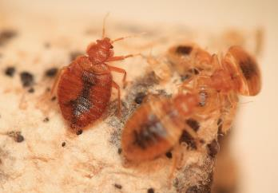
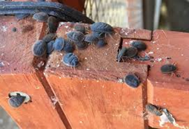
Poultry Mites
Surveillance Program
Regularly inspect for mites.
Dermanyssus gallinae (Inspect what?)
  Sample cracks, crevices of chicken house
  Sample debris from Roosts, Slats, Nest Boxes, etc.
  Use small brush and flashlight/head lamp
  What else “mite” you find?
Soft Ticks
Bed Bugs
Notes:
Bed bugs (Cimex lectularius) also infest poultry houses, like Dermanyssus, they hide in crevices during the day and feed on the host at night.

Slide 11
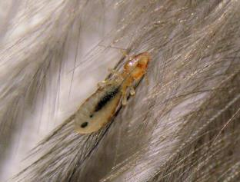
Poultry Mites
Surveillance Program
Regularly inspect for mites.
Ornithonyssus sylviarum (Inspect what?)
  Examine birds directly -- especially the vent area
  Use flashlight / head lamp
  Examine several birds weekly to monthly
  What else “mite” you find?
Lice
Notes:
Like Ornithonyssus, lice stay on the host all the time. Only chewing (Mallophagan) lice infect birds.

Slide 12


Poultry Mites Comparison
Ornithonyssus sylviarum
Dermanyssus gallinae
Northern Fowl Mite
Roost Mite or Red Chicken Mite
Chickens, turkeys, pigeons, wild birds, etc.
All stages are on the host; rarely wanders off host
Complete LC in 7 days., populations increase rapidly
Survive for 2 to 3 weeks in absence of avian host.
Feeds on Blood => anemia. Pale Combs & Wattles. Lethargy. Death in young birds.
Soiled & matted feathers, crusty skin, severe scabbing, esp. around the vent.
Carried on fomites (egg crates, clothing, etc.)
Treatment Target: Primarily Birds
If birds unavailable; feed on other hosts (rodents, horses, dogs, man).
Chickens, turkeys, pigeons, wild birds, etc.
Mites hide in the environment during daytime, feed on birds during night
Complete LC in 1 week; populations increase rapidly.
Survive without a blood meal for several months.
Feeds on Blood => anemia. Pale Combs & Wattles. Lethargy. Death in young birds.
Any where on the bird at night.
Carried on fomites (egg crates, clothing, etc.)
Treatment Target: Primarily Environment
  If birds unavailable; feed on other hosts (rodents, horses, dogs, man).
New Veterinarian: Production Animal
Consult / Network with Local Extension Agent regarding local / farmer preferred SOP’s

Slide 13
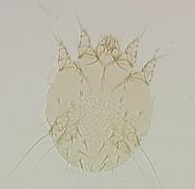
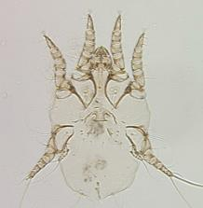
Astigmatid Mites
Lack stigmata (no respiratory openings)
    respiration is through the integument
Includes the ‘Mange’ mites
    Knemidocoptes, Otodectes, Notoedres, Sarcoptes

Slide 14
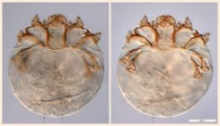
Knemidocoptes mutans
Scaly-leg Mite
Production birds
Burrow into epidermis of legs causing scales to thicken.
    legs & feet become thickened & deformed
Treat with topical acaricides, also oral or IM ivermectin (0.2mg/kg) or 50% topical

Slide 15
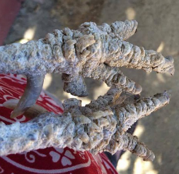
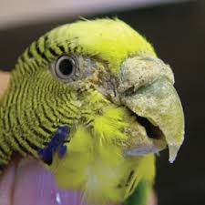
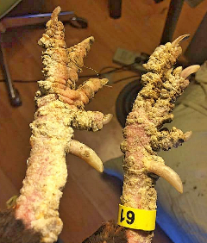
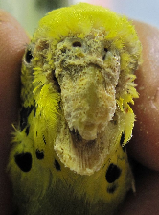
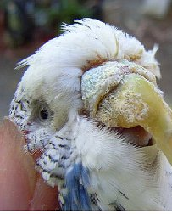
Knemidocoptes spp.
K. mutans
Scaly-leg in Chicken
K. pilae
Scaly face in Budgerigars

Slide 16
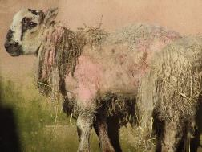
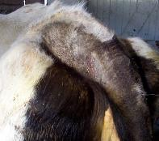
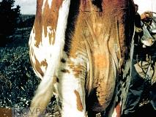
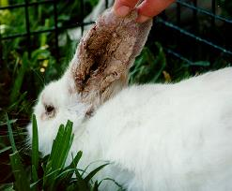
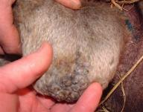
Mammal Astigmatid Mites
Psoroptes sp.
Scab mite of Sheep
Canker Ear Mite of Rabbits
Chorioptes bovis
Mange of tail head, udder, scrotum
New Veterinarian: Production Animal
Consult / Network with Local Extension Agent regarding local / farmer preferred SOP’s

Slide 17
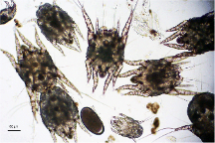
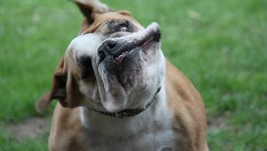
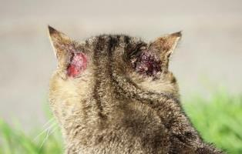
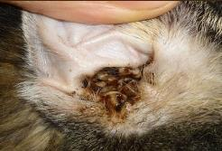
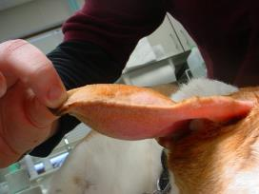
What is your Diagnosis?
What is Your Diagnosis?
What Clinical Signs do you observe?
Head shaking
Pinna Hematoma
Self-trauma excoriations
Otodectes cynotis
Copious cerumen

Slide 18
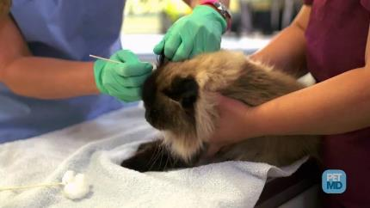
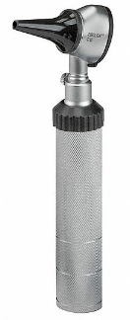
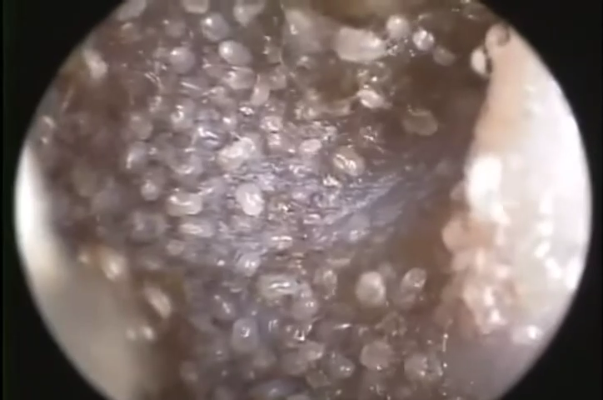
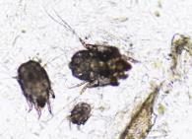
Diagnostics
How would you confirm your diagnosis of Otodectes cynotis?
Ear Swab
Otoscope

Slide 19
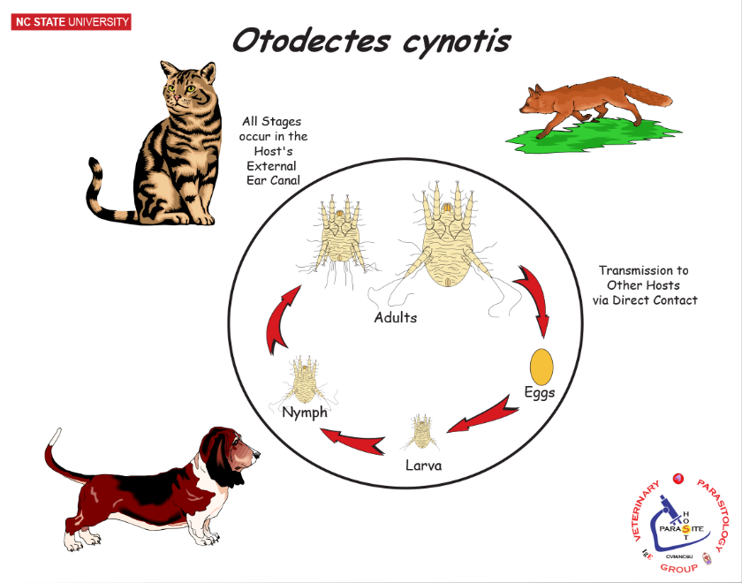
Otodectes cynotis
Ear mites (cat, dog)
Live and reproduce in the external ear canal
Contact transmission
Topical Selamectin, Subcutaneous Ivermectin, Otic Suspensions
  Pre-treatment cleaning
  Also, treat traumatic lesions and potential pyoderma.
Intense irritation, otitis, copious cerumen production
Self-trauma
  Scratching
  Pinna hematoma from shaking head
Mites observed on swabs of ear canal
  swab ear with cotton swab and place under warm light
Also visualize with an otoscope

Slide 20
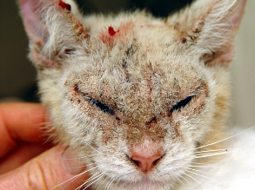
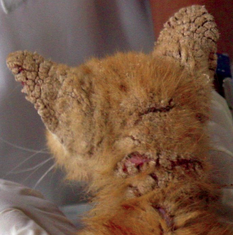



Notoedres cati
Notoedric Mange

Slide 21
Notoedres cati
Feline Scabies
Rare but highly contagious disease of cats and kittens
    can opportunistically infest other animals, including people.
Life cycle
    All stages in epidermis
    Transmission by direct contact
Pathology
    Pruritus is severe.
    Crusts, Alopecia, Thickened skin, & Skin folds
      Particularly on the ears, head, and neck, and can become generalized.
Diagnosis
  Mites easily found in skin scrapings.
Treatment
  Both topical and systemic therapies.
    Selamectin (spot-on)
    Imidacloprid-moxidectin ( spot-on).
    Ivermectin (SC)
    Lime sulfur dips at 7-day intervals.

Slide 22



Notoedres cati
Notoedric Mange
Tommy the Orange Tabby
Notes:
Feral cat before and after treatment.

Slide 23


Sarcoptes scabiei
Scabies mite (General)
Infects dogs, pigs, man, sheep, goats, cattle, horses
    But different subspecies for each host species
    Some transient transfer may occur, unless immunocompromised → More permanent infection

Slide 24


Sarcoptes scabiei
Scabies mite (General)
Entire life cycle on host
    burrows extensively in epidermis
    (Lives, breeds, poops in skin)
Pruritus +/- Alopecia +/- Excoriations +/- Pyoderma
Hyperkeratosis +/- Skin Folds
Clinical Signs
    transmission via direct contact or fomites
Control
Isolate infected hosts
Sanitize kennels, stalls, equipment, etc.
    treatments don’t affect eggs
Treatment
Repeat Treatment in 10 to 14 days

Slide 25


Sarcoptes scabiei
Scabies mite (General)
Some Asymptomatic carriers.
Clinical signs 10 days to 8 weeks after contact with an infected animal.
Intense pruritus is characteristic and probably due to hypersensitivity to mite products.
Early lesions consist of papulocrustous eruptions with thick, yellow crusts, excoriation, erythema, lichenification*, and alopecia. Secondary bacterial and yeast infections often develop.
Typically, lesions start on the ears, elbows, hocks, and ventrum.
  Areas with minimal hair
* Lichenification – thickening of skin & hyperpigmentation.
Chronic, generalized disease
  hyperkeratosis, severe thickening of the skin with fold formation and crust buildup, seborrhea*, peripheral lymphadenopathy, and emaciation.
  *seborrhea - abnormal increase in secretion of sebum

Slide 26





Sarcoptes scabiei
Scabies mite (General)
Diagnosis
  History of a sudden onset of severe pruritus
  History of possible exposure to infected animal
  Several extensive skin scrapings
    ears, elbows, and hocks (non-excoriated areas)
    flotation of several scrapings may increase chances of finding the mites or mite eggs.
    commercially available ELISA for swine.
  Negative Skin Scrapings but continued pruritus ??
    therapeutic trial is warranted.
Can float scrapings to increase sensitivity.

Slide 27







Sarcoptes scabiei suis
Scabies mite of Swine
B
C
Clinical Signs?
A
D
E
F
A = Alopecia
B = Alopecia, Erythema, Skin thickening with folds
C = Alopecia, Skin thickening with folds
D = Pruritus
E = Crusts and scabbing
F = Aural hematoma
Severe hypersensitive (allergic) mange

Slide 28


Sarcoptes scabiei suis
Scabies mite of Swine
Economic “Pathology”
Poor growth/weight gain
Poor feed conversion
Destruction of pens & equipment

Slide 29




Sarcoptes scabiei suis
Scabies mite of Swine
Swine Herd Management
TREATMENT
  Injectable, In-feed, Pour-on Acaricides
  Repeat in 10 to 14 days (Why?)
  Don’t forget withdrawal times
  Don’t forget to treat traumatic lesions and pyoderma.
Injectables
Pour-on
In-Feed
Notes:
Repeat treatment as eggs are resistant to treatment

Slide 30
Sarcoptes scabiei suis
Scabies mite of Swine
Swine Herd Management
PREVENTION
  Isolate new pigs and take skin scrapings from any suspect lesions. If in doubt treat 10 days apart with ivermectin, doramectin, or related compounds.
  Sows and boars are the permanent reservoirs for infection.
    Sow is the original source to nursing piglets
    Treat the sow seven days prior to farrowing to prevent the sow infecting her piglets. Also treat sows every six months
    Treat boars regularly every three months
  Cull pigs with chronic lesions that will not resolve with treatment
  The mite will only live in the environment for about five days.
    With a miticide, wash down pens that have had infected pigs; then leave pens pig-free for five to six days.
Consult / Network with Local Extension Agent regarding local / farmer preferred SOP’s

Slide 31




Cherry Blossom
Notes:
Neglected / abandoned pig before and after intense prolong treatment.

Slide 32



Sarcoptes scabiei var. canis
Canine Scabies
(Early Form)

Slide 33


Sarcoptes scabiei var. canis
Scabies mite of Dogs
Notes specific for Canine Scabies
Diagnosis
  See General Scabies information
  Also, for dogs:
    Involvement of the elbows and hocks is considered pathognomonic.
    Pinnal‐pedal response often present
      Rub tip of ears → hind leg makes scratching motion
“Scabies incognito”
  well-groomed dogs but pruritic
  mites hard due to lack of crusts

Slide 34

Sarcoptic Mange
Canine Scabies
(Chronic Form)
Notes:
Abandoned puppy before and after treatment.

Slide 35
Sarcoptes scabiei var. canis
Scabies mite of Dogs
Topical Treatments:
    Spot–on’s
      Imidacloprid + Moxidectin (Advantage multi®)
      Selamectin (Revolution®)
    Bath topicals
        Amitraz (Mitaban®), lime-sulfur, etc.
Off-label systemics
    Ivermectin - subcutaneous injection
      Contraindications: avermectin-sensitive dogs or microfilaremic dogs
Don’t forget to treat traumatic lesions and pyoderma
Clinical Cure w/o Parasitic Cure = Recurrence
Notes:
Know that topicals, baths, and injectable (systemic) treatments are available – you won’t be asked to name specific treatments.

Slide 36



Prostigmatid Mites
Stigmata (respiratory pores) in anterior of their bodies.
Includes the Follicle mites
  Demodex spp.
Neotrombicula autumnalis
“Chigger”
Demodex canis
Follicle mite
Cheyletiella yasguri
“Walking Dandruff”
Notes:
In Demodex the stigmata are just anterior to the coxae (hip-joint) of the 1st leg.

Slide 37

Demodex spp.
Demodex canis -- red mange
Demodex cati
Demodex bovis - cattle follicular mite
    Normal fauna, but if disease develops (nodules on neck and forequarters); then usually incurable
Demodex folliculorum, D. brevis -- humans
Notes:
You will only be responsible for Demodex canis (red mange) in dogs.

Slide 38

Demodex canis (Demodectic Mange)
Demodex commonly lives in hair follicles and sebaceous glands
    Most are commensal with no pathology.
Demodicosis
    Inflammation, Alopecia, and Scab formation
    AKA: Red mange
Notes:
Note: pruritis does not always accompany red mange.

Slide 39

Demodex canis
Life cycle & Epidemiology
  Small numbers of mites is normal fauna, large numbers cause pathology
  Pathology occurs when host immune system cannot limit mite population
      Fomite or direct contact with mangy dog does not result in disease. Why?
  Puppies acquire mites at nursing
      1st found in follicles of muzzle
      Cesarean section puppies do not have Demodex
Notes:
An immunological defect is primary

Slide 40
Demodectic mange:
Disease Presentation
Localized demodicosis
  1 to 5 small areas of alopecia, scaling, erythema, +/- pruritus
  Mainly lips, face, periorbital, forelegs, chest
  Dz of young dogs (3-6 months of age)
    most resolve spontaneously
    ~ 10% progress to generalized demodicosis
  comedone formation
  +/- follicular papules, pustules
  +/- mild pruritus due to 2ndary bacterial infection

Slide 41


Localized Demodicosis
Comedones
Alopecia, patch of dry silvery scaly skin, on foreleg
Patchy alopecia, w/ erythema on lips
Alopecia, ruptured pustules in periorbital area
Alopecia, ruptured pustules forming crusts, hyperpigmentation

Slide 42
Demodectic mange:
Disease Presentation
Generalized Demodicosis
  Prognosis is guarded, intractable
  Large areas of body involved
  Alopecia, erythema, folliculitis, furunculosis, exudation, crusting, rancid seborrhea, lymphadenopathy,
  Possible pruritus with secondary pyoderma
  Chronic DZ
Pododemodicosis
  Often seen simultaneously with Generalized Demodicosis
  Digital, interdigital, plantar disease
  Always complicated by 2ndary bacterial infection

Slide 43






Generalized Demodicosis
Alopecia, Erythema, skin thickening with wrinkles, crusting
Patchy alopecia
Generalized Alopecia, Erythema
Alopecia on chest, legs and paws, ruptured pustules, crusting, scabbing
Pododemodicosis – pustules, pyoderma, painful – often an issue during generalized demodicosis
Generalized Alopecia and Erythema

Slide 44
Types of Demodicosis
Localized demodicosis
  In puppies, often resolves spontaneously
  Immature immune response
Juvenile-onset demodicosis (3-18 months old)
  Localized demodicosis (10%) → Generalized demodicosis
  No spontaneous cure as dog matures
  Mite-Specific immuno-deficiency
    Not all immunosuppressed dogs get demodicosis
    Dogs with demodicosis don’t simultaneously suffer from viral, bacterial, etc. infections.
Adult-onset demodicosis (18+ months old)
  Event-mediated demodicosis
  Some stress or medical event triggers immunosuppression, which in turn allows the development of demodicosis.
  Often transient, depending on dog’s immune status.

Slide 45




Demodex canis
Diagnosis
Diagnose and monitor using deep skin scrapings, trichogram (hair pluck), biopsy
Hair Pluck
Skin Scrape
Notes:
Deep skin scrape with dull blade. Scrape until capillary blood oozes.

Slide 46

Demodex canis
Diagnosis
A fecal float may reveal an asymptomatic infection.

Slide 47
Demodex canis
Risk factors
Age
  Puppies → Localized Demodicosis → resolves spontaneously
Immune suppression, malnutrition, neoplasia with chemotherapy, endocrine disease
  adult-onset demodicosis – cure immunosuppressive issue and demodicosis should resolve.
Immunosuppression triggered by stress
  Recurrence of generalized demodicosis with each heat cycle
Genetic connection
  Juvenile-onset demodicosis – an immunological deficiency.

Slide 48
Demodex canis
Treatment
Topical moxidectin (weekly)
Daily oral milbemycin, moxidectin or ivermectin
Isoxazoline products
    (NexGard®, Credelio®, Bravecto®,Simparica®)
Amitraz rinses (weekly or biweekly)
Topical or oral antibiotics or antifungals for pyoderma
Monitor treatment success with skin scraping
Continue treatment 4-8 weeks post-remission
    Clinical cure w/o Parasitic cure = recurrence
Avoid immunosuppressive medications. Why?
Notes:
Know that topical , oral, and rinse treatments are available – you won’t be asked to name specific treatments.
Don’t forget to treat the pyoderma.
Elimination of all mites is difficult, so extended treatments are needed.

Slide 49
Demodex canis
Control
Controlling Demodicosis is an added benefit of heartworm and flea prophylaxis with Macrocyclic lactones and Isoxazolines.
Spay / Neuter dogs with Demodicosis
  Heat-cycle demodicosis
  Hereditary link
    Dog with juvenile-onset demodicosis

Slide 50


Canine Mange Mites
Demodex v/s Sarcoptes
Demodex canis, Follicle Mite, Red Mange
Hair and sebaceous follicles
Skin Scrape, Trichogram
Alopecia, Erythema, Comedones, Pustules
+/– prutitus, +/- self-trauma, +/- pyoderma
Local: Lips, periorbital, forelimbs – usually puppy
General: Patchy, Pododemodicosis, less skin thickening
Etiology = genetic defect -> immune defect -> overgrowth of mite population.
  Non-contagious, non-zoonotic
Sarcoptes scabiei canis, Scabies Mite, Scabies
Epidermis
Skin Scrape, Pinnal–Pedal response
Alopecia, Erythema, Lichenification
Intense pruritus, self-trauma, pyoderma
Acute = Ear margins, elbows, hocks, ventrum
General = Over much of body, skin thickening & crusts
Etiology = pathogenic mite.
  Contagious, zoonotic

Slide 51



Mite Issues
What “mite” be the problem ?
Poultry Mite
Control Issue ?

Slide 52
Quiz 1: Protozoa
Tomorrow: 8/31/23
Quiz #1: Protozoa Quiz (Moodle)
5 Multiple Choice questions
Opens: Thursday, August 31, 2023, 1:00 PM
Closes: Thursday, August 31, 2023, 4:00 PM
Open-Book, Non-Collaborative
Location: Student's choice
Once Started, each student has 1hr to complete

Slide 53

Wellness Break
Take a 5-minute wellness break:
Heartbeats
(Live Acoustic Performance)
--
Eabha
(“AVA”)
https://www.youtube.com/watch?v=6nZvWkngrus

