Slide 1
VMP 930 Veterinary Parasitology
Flea & Lice
(questions)

Slide 2
Flea - Life Cycle
True or False
Fleas have a Simple metamorphosis (= Hemimetabolous). This means that all the life stages (Larva (x3), Pupa, Adult) are similar in appearance.
The larvae of fleas feed on debris in the environment.
Fleas show high host specificity

Slide 3
Flea - Life Cycle
List
1. List the life stages of Fleas that are NOT parasitic.
Multiple Choice
___ 2. Which stage(s) of the flea life cycle can often be found in the environment ?
A. All the following D. Pupae
B. Egg E. Adult
C. Larvae

Slide 4
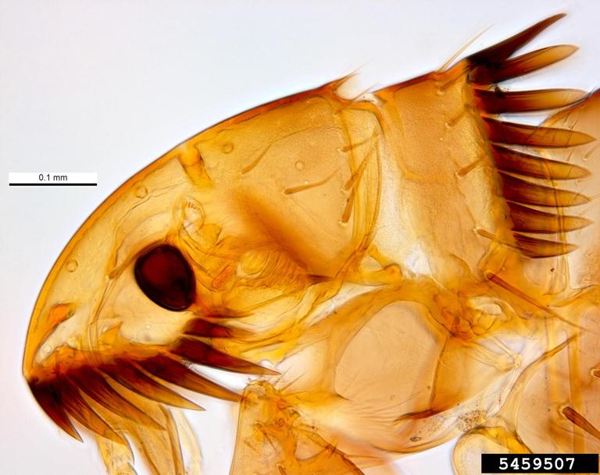
Fleas of Veterinary Importance
Fill in the Blank.
The most prevalent flea species on dogs and cats in NC are
_________________
Pest and Diseases Image Library , Bugwood.org

Slide 5
Flea Preferred Habitat
Matching
Which habitat characteristic leads to ↑ Survival v/s ↑ Mortality ?
____ 1. ↑ Temperature
____ 2. Arizona
____ 3. ↑ Humidity
A. ↑ Survival
B. ↑ Mortality

Slide 6
Fleas - Pathology
Multiple Choice
___ 1. Which of the following is not a pathology concern for flea infestations?
A. Pruritus D. Flea Allergy Dermatitis
B. Dipylidium caninum E. Pruritus + excoriations + pyoderma
C. Toxoplasma gondii F. Blood Loss

Slide 7
Flea Allergy Dermatitis
Fill in the Blank
What is the primary target for a veterinarian, who is presented with a pet suffering with Flea Allergy Dermatitis ?
________________________________________________
What should the owner do to help prevent future incidence of Flea Allergy Dermatitis ?
____________________________________________

Slide 8
Flea Allergy Dermatitis
Matching
Regarding Flea Allergy Dermatitis; match the pet with its most common FAD presentation.
____ 1. “The Flea Triangle” (w/ corners at Mid-back, tail head, back leg)
____ 2. Miliary Dermatitis on face, neck, and back
A. Cat
B. Dog

Slide 9
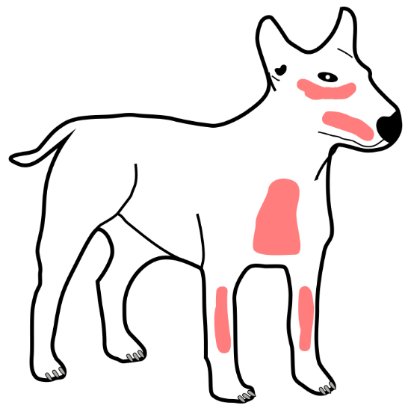
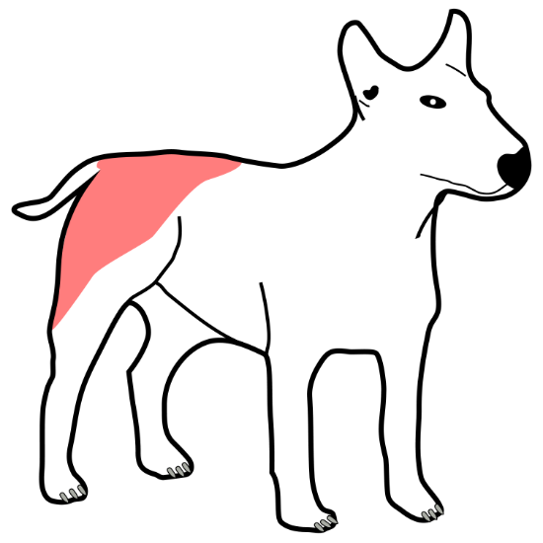
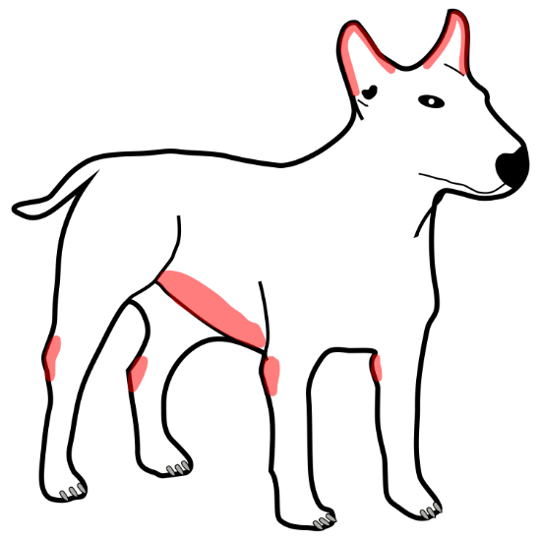
Flea Allergy Dermatitis
Matching
Match the pathogen with the primary presentation of canine dermatitis.
(Fleas, Sarcoptes, Demodex)

Slide 10
Flea Control
Fill in the Blank
To decrease most of the total flea population one should target the ___________________
Integrated Flea control includes: ___________________________________________________
Flea products (insecticides) that are toxic to cats contain _________________________

Slide 11
Lice – Biology
Matching
Compare and contrast the life cycles of fleas and lice.
____ 1. Simple Metamorphosis
____ 2. Low Host Specificity
____ 3. All Life Stages on Host
____ 4. Environmental Control Required
____ 5. Insects
A. Fleas
B. Lice
C. Both

Slide 12
Lice - Treatment
Fill in the Blank
1. The lice ___________ are cemented to the hair or feathers of their host.
2. When treating a lice infestation, a repeat treatment is required because
________________________________.
3. When treating a lice infestation, it is not necessary to treat the environment
because _____________________________.
4. Why don’t systemic insecticides work against poultry lice ?
_____________________________.

Slide 13
Lice – Life Cycle
List
1. List one way, in which lice are transmitted.

Slide 14
Lice – Ecology
Multiple Choice
___ 1. In which season do lice populations and transmission tend to be highest ?
A. Winter B. Summer
___ 2. Which of the following does not promote an increase in lice populations and transmission ?
A. Cold weather stress B. Thicker hair coats
C. Increased Pasture Height D. Increased huddling behavior
E. Kept in barns

Slide 15
Lice – Groups
Matching
Compare and contrast the two groups of lice.
____ 1. Narrow head
____ 2. Mammal hosts
____ 4. Anemia
____ 5. Bird hosts
____ 6. Feeds on fur, hair, feathers, epidermal debris.
____ 7. Decreased productivity
____ 8. Systemic Insecticides
A. Mallophagan (chewing)
B. Anopluran (sucking)
C. Both

Slide 16
Lice - Genera
Matching
In which group of lice does each taxonomic genus belong?
____ 1. Trichodectes
____ 2. Notoedres
____ 3. Felicola
____ 4. Haematopinus
____ 5. Bovicola (Damalinia)
____ 6. Linognathus
____ 7. Menacanthus
A. Mallophagan (chewing)
B. Anopluran (sucking)
C. Neither

