Slide 1
VMP 930 Veterinary Parasitology
Flies
(Filth Flies, Maggots, Bots)

Slide 2
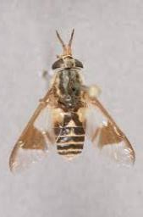
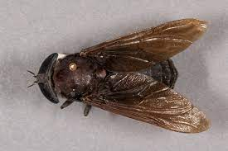
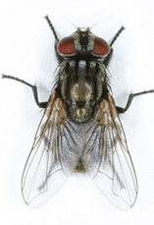
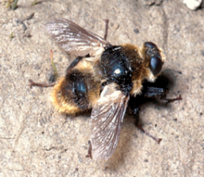
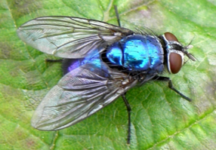
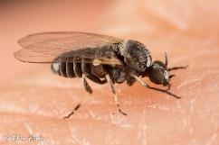
What Fly is this ?
Deer fly
(Chrysops sp.)
Filth fly
Bot fly
(Hypoderma sp.)
Horse fly
(Tabanus sp.)
Black fly
(Simulium sp.)
Blow fly

Slide 3
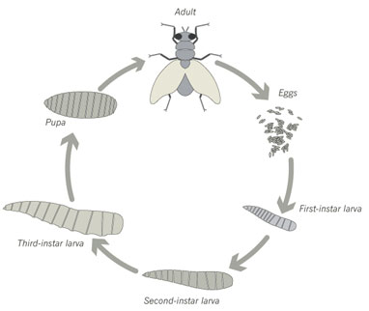
Filth Flies (Muscidae) - in general
Family Muscidae
Musca domestica - house fly
Musca autumnalis - face fly
Stomoxys calcitrans - stable fly
Haematobia irritans - horn fly
What is the common name for the larvae of most dipteran flies?
Complete metamorphosis
(Holometabolous)
Maggots
Fly-bother
Decreased thriftiness
Decreased weight gain to weight loss
Low productivity (ex. Milk)
Low feed conversion
What insect group, (already discussed) also has complete metamorphosis?
What insect group, (already discussed) has simple metamorphosis?
Vector
Mechanical vector = transport host
Biological vector = intermediate host
Required host for pathogen development
Fleas
Lice

Slide 4
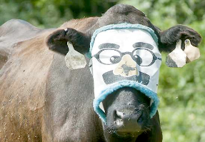
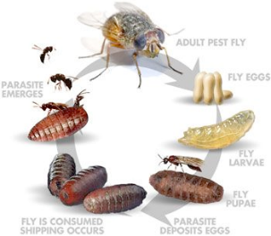
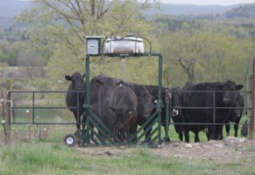
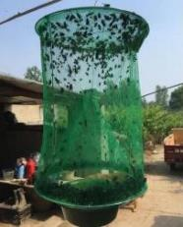
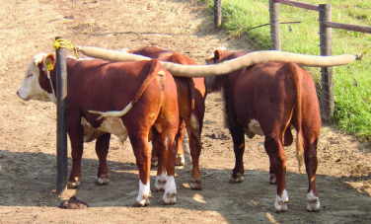
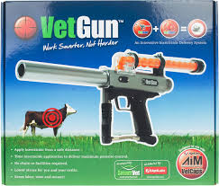
Filth Flies (Muscidae) - in general
Fly control
Target Adult flies
Topical insecticides on animals
(sprays, dusts, ear tags, rubs)
Fly Strips & Traps
Fly masks
Fly vacuum
Target Immature flies
Target Larvae / pupae
Eliminate breeding habitat
In-feed insecticides
pass-through insecticides
Biological Control
Parasitoid wasps
(Insecticide = abamectin)

Slide 5
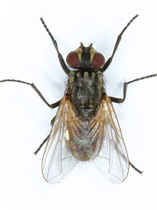
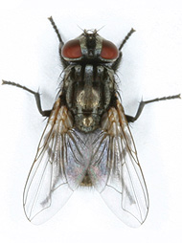
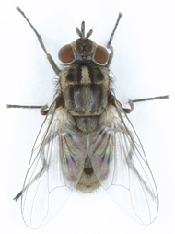
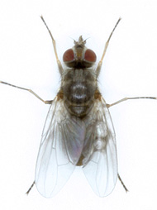
FILTH FLIES
Musca domestica
Musca autumnalis
Stomoxys calcitrans
Haematobia irritans
http://www.centralflycontrol.com/insect-identification.php
Notes:
Adult filth flies look very similar with black and gray bodies.

Slide 6
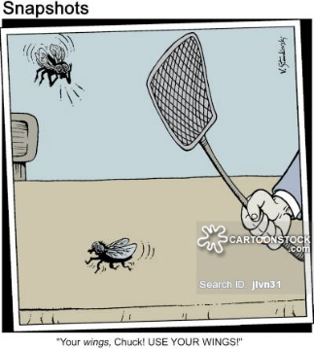
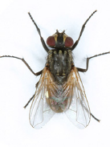
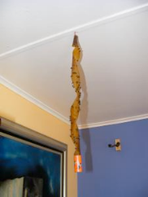
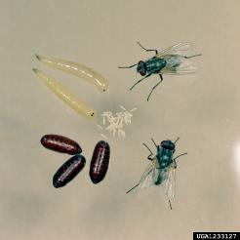
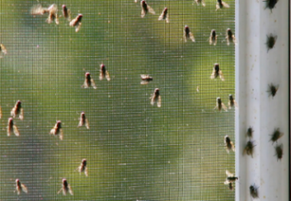
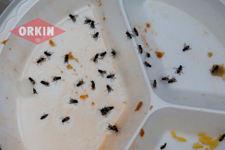
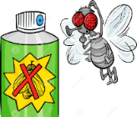
Musca domestica - house fly
Sponging mouth parts
Breed in any decaying matter
Decaying plant or animal matter
Mechanical vector
Bacteria, virus, protozoa, etc.
Control Target
Adult flies
Breeding habitat

Slide 7
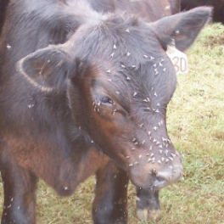
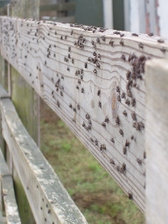
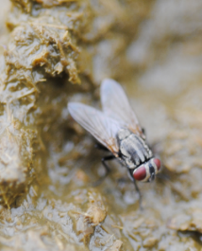
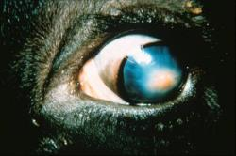
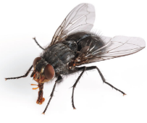
Musca autumnalis - face fly
Sponging mouth parts
Prefer face, eyes, nose
Breeds in fresh cow manure
Pathology
Fly-bother
Mechanical vector
pinkeye = keratoconjunctivitis (Moraxella bovis)
Biological vector
eye worm (Thelazia)
Control Target
Adult flies
Larvae & Breeding habitat
How would one target the larvae and breeding habitat?
In-feed/pass-thru insecticides

Slide 8
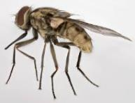
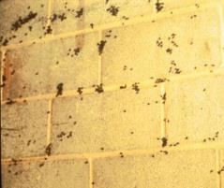
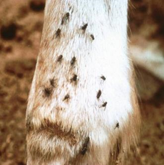
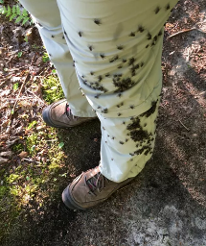
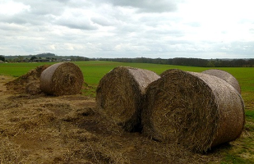
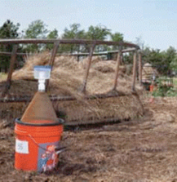
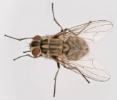
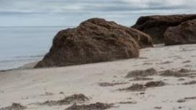
Stomoxys calcitrans - stable fly
Piercing mouth-parts → feeds on blood
Attacks any body part
Breeds in rotting plant matter
decaying hay/straw/silage/etc.
Pathology
Very painful bites
Fly-bother
Biological vector
Horse stomach worm (Habronema)
Control Target
Adult flies
Eliminate breeding habitat

Slide 9
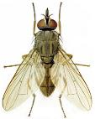
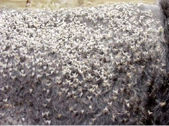
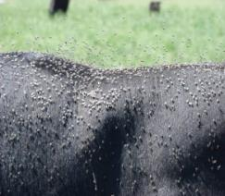
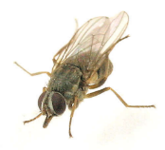
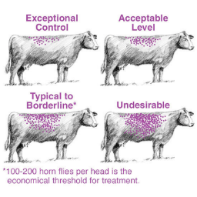
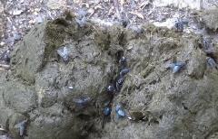
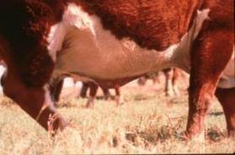
Haematobia irritans - horn fly
Piercing mouth-parts → feeds on blood
Prefers Back or Ventral mid-line
Adults always on the host (except in-doors)
Breeds in fresh cow manure
Pathology
Fly-bother -> decreased productivity
Biological vector
Cattle filarial worm (Stephanofilaria)
Control Target
Adult flies
Larvae & Breeding habitat
Heavily infested cattle may lose 0.5 pounds of flesh per day and milk production reduced by 10 to 20%.
How would one target the larvae and breeding habitat?
In-feed/pass-thru insecticides

Slide 10
Neighbors of a dairy complained to the farm manager that when seated outside during the summer; they would frequently experience painful bites from flies, which they suspect were coming from his farm. The manager assured his neighbors that he was controlling flies by giving his cows an in-feed insecticide that kills developing larvae in cattle manure. Further he has seen a major reduction in flies on the faces and backs of his cattle. However, the neighbors continued to experience fly bites. Which fly is the likely source of the neighbors’ continued irritation?
Musca domestica
Stomoxys calcitrans
Haematobia irritans
Musca autumnailis

Slide 11
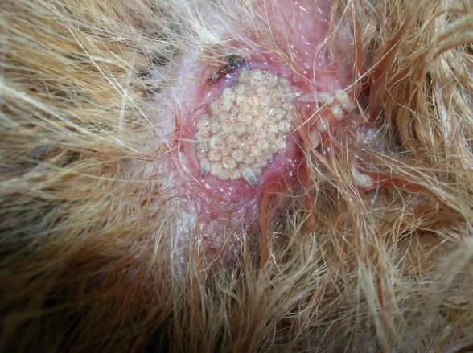
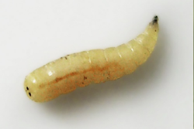
What’s up with that?
Maggots
“Fly strike”
Myiasis
Diagnosis ?
Treatment ?
Mechanical removal
CAPSTAR® (nitenpyram)
Don’t forget wound care and antibiotics
Debride necrotic tissue

Slide 12
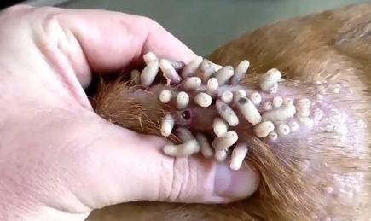
Myiasis - general
Invasion of tissue by dipterous larvae (maggots or bots)
Facultative (accidental) myiasis
These maggots prefer dead tissue but may invade living tissue.
Attracted to wounds with necrotic tissue (saprophytic)
Blow flies, bottle flies, flesh flies, secondary screwworm
Obligate myiasis
These maggots require living tissue.
Some attracted by fresh wounds
Others simply attack host
Primary screwworm, mango worm, bots
Obligate
Facultative
Search ”Mangoworms” for videos

Slide 13
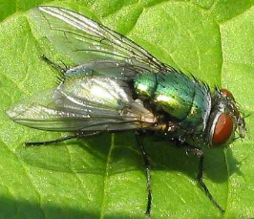
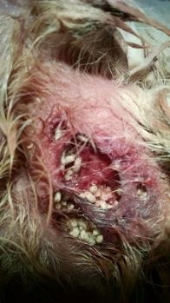
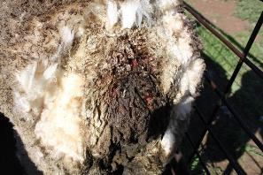
Blow flies
Facultative Myiasis
Blue Bottle Fly
(Calliphora vomitoria)
Green Bottle Fly
(Phaenicia (Lucilia) sericata)
Fly Strike
Black Blow Fly
(Phormia regina)
Secondary Screwworm
(Cochliomyia macellaria)

Slide 14
Primary screwworm (Cochliomyia hominivorax)
Obligate Myiasis
Lives only in the living flesh of warm-blooded animals.
Any small wound will permit infestation.
barbed wire scratch, tick bite, dehorning, castration
Female fly copulates only once.
Florida Key deer
2016 outbreak
“Zombie Deer”
How did this biological characteristic allow eradication from the US?
Release of irradiated pupae
→ Sterile males mated with females → sterile eggs.

Slide 15
Bots
What’s up with that?
Cuterebra
Gasterophilus
Oestrus
Hypoderma

Slide 16
Bot Flies & Bots: Morphology
Obligate Myiasis
Adult Fly - large, heavy bodied like honeybees or bumble bees, but lack mouth parts.
Larvae = Bots
Large, stout bodied, somewhat rounded on both ends, may have tegumental spines, bumps, or ridges.
Respiratory spiracles identify genera.

Slide 17
Cuterebra emasculator
Rodent Bot or Emasculating fly
Lays eggs in habitat, not on host
https://www.youtube.com/watch?v=fs4jBtL62oI
Squirrels, Rodents, & Rabbits
Various parts of the body, including the scrotum.
Dogs & Cats
Usually on the head or neck
Migration to the brain is fatal
Why should care be taken when removing a Cuterebra?
Severe anaphylactic RXN

Slide 18
Gasterophilus spp. Horse Stomach Bots
Adult flies annoy horses.
L1 & L2 damage mouth mucosa
L3 Damage mucosa of stomach / duodenum, may block pylorus
Treatment / Control
L1 to L3
Late summer & Fall “deworming” with a macrocyclic lactone.
Nits
Nit Combs
Wash nits
Warm water with insecticide → G. intestinalis

Slide 19
Oestrus ovis Sheep Nasal Bot
Larviposit directly in the nostrils of sheep & goats. (No egg stage)
Develop in the sinuses.
Feed on mucosa.
Crawl back to nostrils to be sneezed out.
Heavy infestations
Great distress, sneezing, head shaking, etc.
purulent discharge
loss of appetite
penetration into the cranium is fatal.

Slide 20
Hypoderma spp. Heel Fly, Gadfly, Cattle Grub, Ox Warble
Hypoderma bovis
Northern Cattle Grub
Larvae migrate through the spinal canal and loin muscles to the back.
Hypoderma lineatum
Common Cattle Grub
Larvae migrate to the esophageal submucosa and loin muscles to the back.
What are the consequence of migration through the loin muscles and hide?
Economic: condemnation of carcass, down grade hide for leather

Slide 21
Hypoderma spp.
Systemic Macrocyclic lactones
Pour-ons: Doramectin, ivermectin, eprinomectin, moxidectin
Injectables: Ivermectin Long-acting Injection – Ivomec Gold
Prophylactic or Therapeutic
Cattle should be treated as soon as possible after the end of the adult fly season.
Why treat soon after adult fly season?
What is the danger of treatments while larvae are in the spinal cord or esophagus?
Kill larvae before they reach vital organs (i.e. - Avoid post-treatment pathology)
Post-treatment Pathology:
Migratory larvae killed by systemic drugs will cause immune reaction, inflammation, abscess, etc.
H. lineatum -- occlusion of esophagus & fatal bloat
H. bovis -- spinal cord affected; posterior limb paralysis.
Why not treat during fly season?
Inefficient, Not economical.
Consult with an Extension Agent in your area !

Slide 22
Wellness Break
Take a 5-minute wellness break:
Wildflowers
--
Eabha
(“AVA”)
https://www.youtube.com/watch?v=bOQIyyWmr9o

