Slide 1
VMP 930 Veterinary Parasitology
Cestodes
Tapeworms

Slide 2
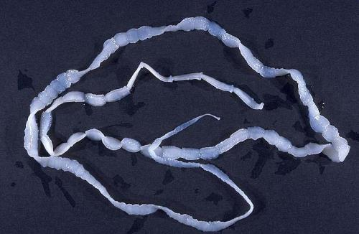
Cestodes
Tapeworms
General Flatworm Characteristics
Except lacks Digestive Tract
Absorbs food directly across Tegument
Adult Body
Scolex => Holdfast organ
Usually has suckers, retractable or non-retractable rostellum of hooks
Neck
Germinative region produces "segments“, asexually
Strobila
Series of Maturing "Segments" or Proglottids
Immature, mature, gravid proglottids in series
Each Proglottid is an individual reproductive unit

Slide 3
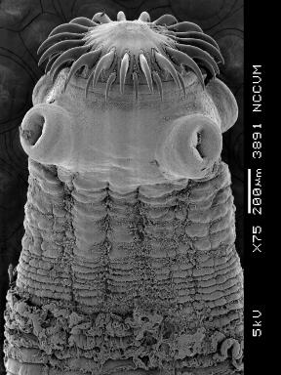
Scolex & Neck
Taenia sp.

Slide 4
Immature Proglottids
Taenia sp.

Slide 5
Mature Proglottids
Genital pore
Testes
Yolk gland
Ovary
Taenia sp.

Slide 6
Gravid Proglottid
Uterus packed with eggs
Genital pore
Taenia sp.

Slide 7
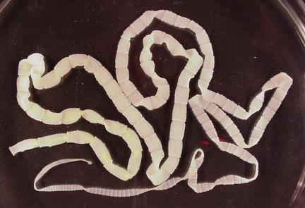
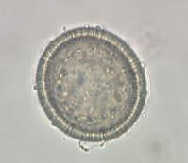
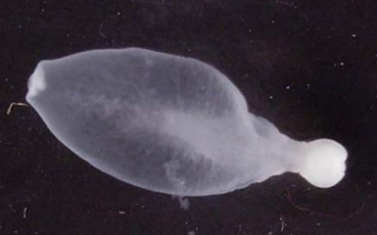
Cestodes
Complex Life Cycle
Definitive Host
Adult Worms
Sexual Reproduction
Ova
1 or 2 Intermediate Hosts
Larval tapeworms
“Metacestodes”
various types depending on species
Some show Asexual Reproduction
Cysticercus – bladder worm

Slide 8
Basic Tapeworm Life Cycle
Notes:
Adult tapeworms are in the small intestine of the definitive host.
Segments are passed in the feces; Segments disseminate eggs in the environment.
Intermediate host ingests eggs, Larval stage develops in the intermediate host
Definitive host ingests the larval tapeworm when it eats the intermediate host.

Slide 9
Cestode Groups
Large Animals
Adult Tapeworms
Anoplocephala (equine)
Moniezia (ruminants)
Larval Tapes (condemnations)
Taenia saginata (cattle)
Taenia solium (swine)
Small Animals
Adult Tapeworms
Taenia pisiformis (dogs)
Taenia taeniaformis (cats)
Echinococcus granulosus (dogs)
Dipylidium caninum (dogs, cats)
Spirometra sp. (dogs, cats)
Human “Zoonosis”
Adult Tapeworms
Taenia saginata
Taenia solium
Dipylidium caninum
Human Zoonosis
Larval Tapeworms
Echinococcus sp.
Taenia solium
Spirometra sp.
Notes:
This is a list of tapeworms that we will discuss.
Not only will we discuss the adult tapeworms, but we will also discuss pathogenic larval tapeworms.

Slide 10
Taenia spp.
of Pets

Slide 11
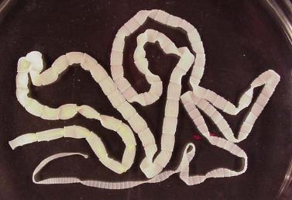
Taenia pisiformis
Large tapeworm of dogs
Scolex with non-retractable armed rostellum and 4 suckers
Strobila (up to 6 ft long) made of rectangular proglottids with single irregularly alternating unilateral genital pores
Life Cycle
DH: Dogs, fox, coyote, wolf (small intestine)
Gravid proglottids passed in feces
Ova disseminated in environment
IH: Rabbits or Squirrels
Cysticercus larvae (bladder worm) in liver and mesenteries.
Ingested by the Definitive host
Worldwide
Not Zoonotic
Notes:
The rectangular shape of the proglottid and the single genital pore helps with the diagnosis of segments passed in the feces.
The life cycle of Tania pisiformis the large dog tapeworm. Practice describing this life cycle.
1. What is the ecological relationship between the definitive host and the intermediate host of tapeworms? Predation (predator / prey)
2. Where do the adult tapeworms reside within the definitive host? Small intestine

Slide 12
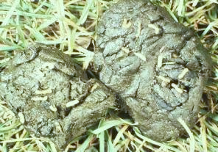
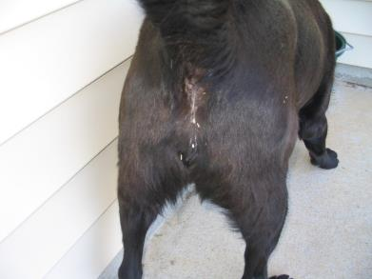
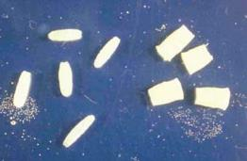
Taenia pisiformis
Pathology, Diagnosis
No Pathology
(maybe nutrient competition in malnourished hosts)
"Client Worry” (proglottid aesthetics)
Active Segments on Poop or Pet
Clinical Signs
Segments presented by Client
Pet usually shows no signs
Occasionally dog drags tail
Dietary History -- possibility of rabbit diet
Diagnosis
Segment Squash
Rectangular segment
Single Spherical eggs with striated shell.

Slide 13
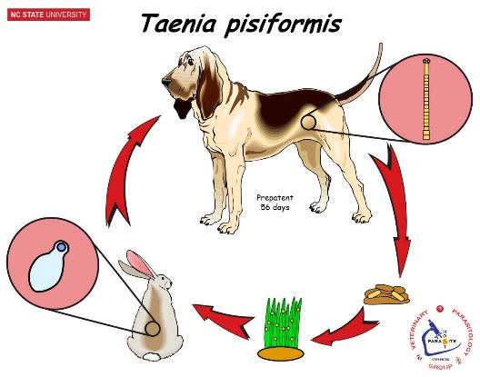
Taenia pisiformis
Treatment, Control
How would you prevent re-infection?
Praziquantel (Droncit) (5mg/kg)
Pyrantel+Praziquantel+Febantel (Drontal Plus Tablets)
Pyrantel+Praziquantel (Virbantel Flavored Chewables)
Ivermectin+Pyrantel+Praziquantel (Iverhart Max Chewable Tablets)
Epsiprantel (Cestex) (5.5 mg/kg)
Fenbendazole (Panacur) (50 mg/kg SID for 3 days)
(Praziquantel & epsiprantel are the drugs of choice for tapeworms.)
Restrict access to Rabbits

Slide 14
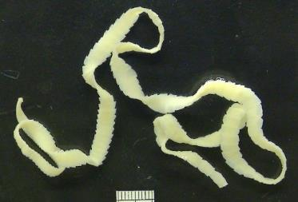
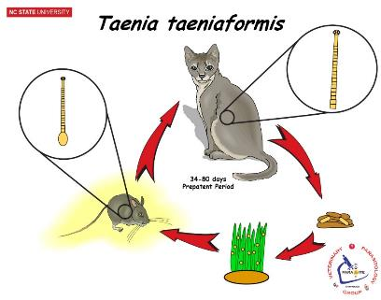
Taenia taeniaformis
Large tapeworm of cats
Scolex with non-retractable armed rostellum and 4 suckers
Strobila (up to 2 ft long) made of rectangular proglottids with single irregularly alternating unilateral genital pores
Worldwide
Not Zoonotic
Life Cycle
DH: Cats, Lynx (small intestine)
Gravid proglottids passed in feces
Ova disseminated in environment
IH: Rodents
Strobilocercus larvae in liver.
Ingested by the Definitive host
Treatment
Praziquantel (Droncit)
Pyrantel+Praziquantel (Drontal tablets)
Emodepside+Praziquantel (Profender)
Epsiprantel (Cestex)
Fenbendazole (Panacur) [extra-label]
Pathology
No Pathology
(maybe nutrient competition in malnourished hosts)
"Client Worry” (proglottid aesthetics)
Clinical Signs
Segments presented by Client
Pet usually shows no signs
Occasionally cat drags tail
Dietary History -- possibility of rodent diet
Diagnosis
Segment Squash
Rectangular segment
Single Spherical eggs with striated shell.
Control ??
Restrict access to Rodents
Notes:
Practice describing the life cycle of Taenia taeniaformis the large cat tapeworm.
Eggs from the segments are ingested by rodents.
Cats ingest larval tapeworm in rodents.
Adult tapeworm develops in the small intestine of cats

Slide 15
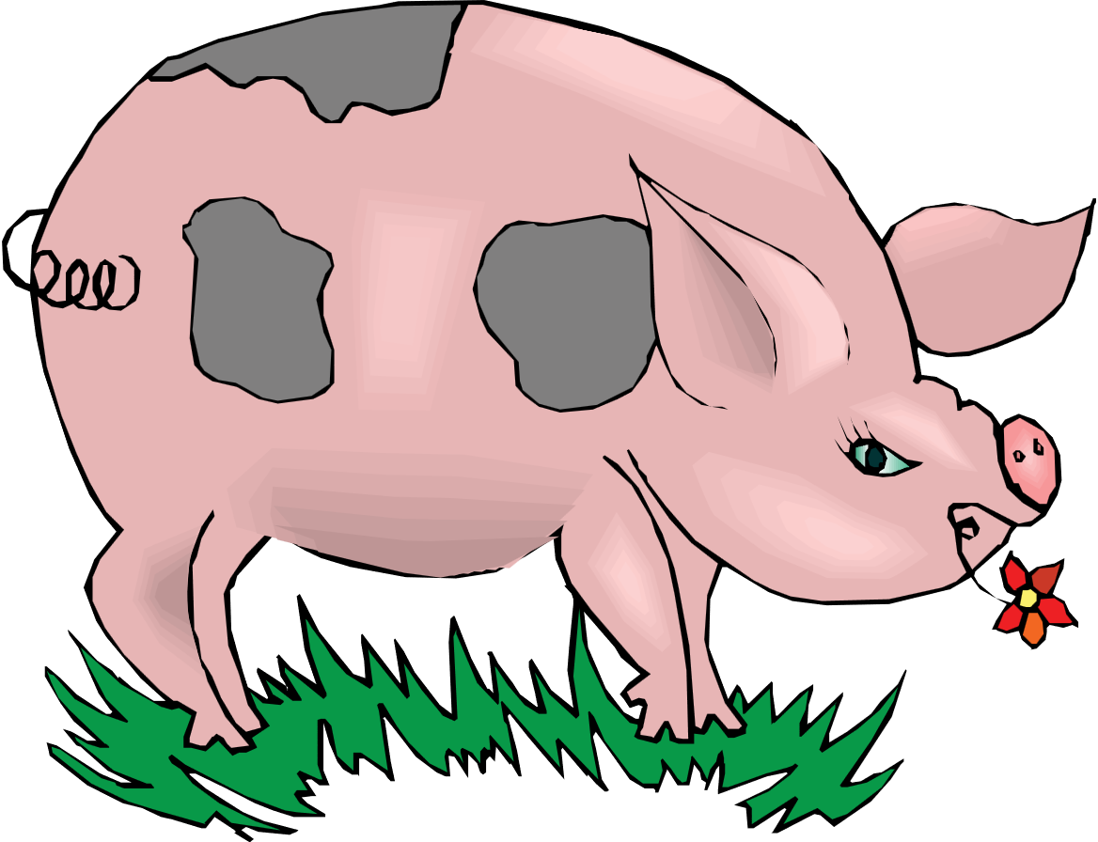
Taenia spp.
of Humans

Slide 16
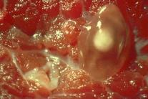
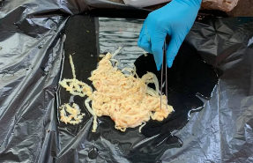
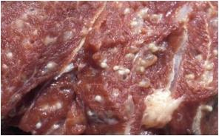
Taenia saginata
Beef tapeworm of humans
Worldwide
24 to 75 ft long, survives “many years”
Larval tapeworms in cattle
Control ?
Restrict human defecation in cattle pastures.
Restrict human from eating raw beef.
USDA condemnation of "Measly beef".
USDA guidelines for cooking beef.
Life Cycle
DH: Humans (small intestine)
Gravid proglottids passed in feces
IH: Cattle
Cysticercus bovis (bladder worm) in muscles.
Ingested by the Definitive host
Pathology
Human (DH)
Proglottid aesthetics
Nutrient competition in malnourished hosts
Cattle (IH)
Cysticercus bovis: Muscle & Heart damage
Beef Condemnation ("Measly Beef") [economic loss]
Measly Beef
Diagnosis
Human (DH) – Tapeworm in feces
Cattle (IH) - Cysticercus bovis @ slaughter
18 ft from raw-beef eater
Treatment
Human (DH) – Niclosamide
Cattle (IH) - Cysticercus bovis → control measures
Notes:
Eggs from the segments are ingested by Cattle.
Humans ingest larval tapeworm in poorly cooked beef.
Adult tapeworm develops in the small intestine of humans

Slide 17
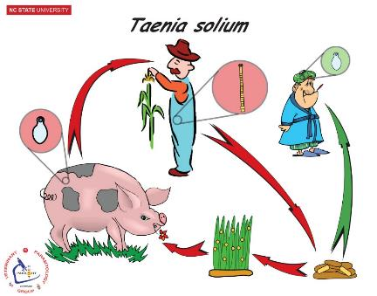
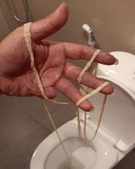
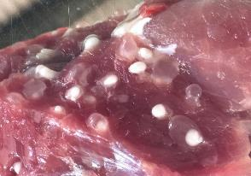
Taenia solium
Pork tapeworm of humans
Worldwide
15 to 24 ft long, survives 25 years
Larval tapeworms in swine
Treatment
Human (DH) – Niclosamide
Cattle (IH) - Cysticercus cellulosae → control measures
Life Cycle
DH: Humans (small intestine)
Gravid proglottids passed in feces
IH: Swine [humans]
Cysticercus cellulosae (bladder worm) in muscles.
Ingested by the Definitive host
Control ?
Restrict human defecation in swine pastures.
Restrict human from eating raw pork.
USDA condemnation of "Measly pork".
USDA guidelines for cooking pork.
Pathology
Human (DH) (adult tapeworm)
Proglottid aesthetics
Nutrient competition in malnourished hosts
Swine (IH) & [humans]
Cysticercus cellulosae: Muscle damage
Pork Condemnation ("Measly pork") [economic loss]
Measly Pork
Diagnosis
Human (DH) – Tapeworm in feces
Swine (IH) - Cysticercus celulosae @ slaughter
Notes:
Eggs from the segments are ingested by Swine
Humans ingest larval tapeworm in poorly cooked pork.
Adult tapeworm develops in the small intestine of humans

Slide 18
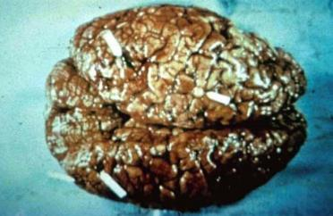
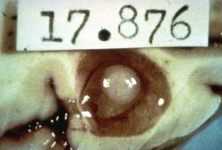
Taenia solium -- Cysticercosis
Larval pork tapeworm in humans
Very Important Pathogenic Human DZ
Most important cause of neurologic DZ in Latin America
Humans as intermediate hosts. HOW ?
cysticerci in muscles, eyes, brain.
Neural Cysticercosis
If humans ingest ova from human feces; then cysticercosis.

Slide 19
Echinococcus spp.

Slide 20
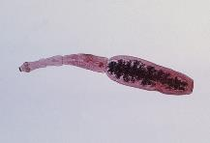
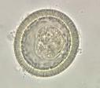
Echinococcus granulosus
Minute tapeworm of Canids
Sporadic distribution
Larval tapeworms in various animals & humans
Major Zoonotic concern
Diagnosis
Dog (DH) – Tapeworm or Ova in feces
Various IH – Hydatid Cyst @ slaughter
Serology, Radiographs
Humans : CDC has ELISA to distinguish between the two species found in humans.
Life Cycle
DH: Dogs, Wild Canids (small intestine)
Gravid proglottids passed in feces
IH: various ruminants & swine [humans]
Hydatid Cyst in various organs
Ingested by the Definitive host
Treatment
Canid (DH) – Praziquantel, Epsiprantel
Various (IH) - Aggressive Mebendazole or Albendazole
Pathology
Canids (DH)
No Pathology
Various (IH) & [humans]
Hydatid Cyst DZ
Organ damage – Pressure atrophy
Risk of anaphylaxis if cyst ruptures
Control
Restrict canine access to ruminant pastures.
Do not feed canids uncooked offal
Regular deworming of dog
Eliminate stray or wild canids
Notes:
Eggs from the segments are ingested by ruminants or swine.
Dogs ingest larval tapeworm in ruminant / swine internal organs.
Adult tapeworm develops in the small intestine of dogs
Most dogs get infected through scavenging dead carcasses or scraps thrown out when a backyard slaughter occurs.
Echinococcus eggs (Single, spherical, striated shell) are indistinguishable from Taenia eggs (Single, spherical, striated shell)
Don’t allow canids to poop in pastures. This may be difficult due to stray & wild canids. (ex. dingoes in Australia).
Offal is the internal organs left over from the slaughter of ruminants and pigs. “Field dressing” is an analogous activity for deer hunters.

Slide 21
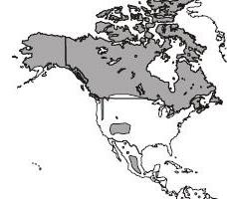
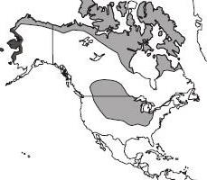
Geographic Distribution
Sporadic Global Distribution
E. granulosus
E. multilocularis

Slide 22
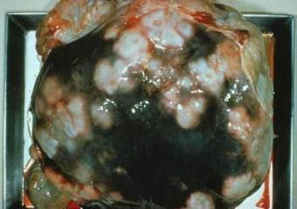
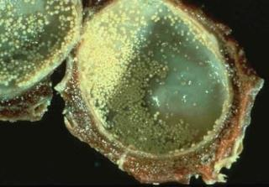
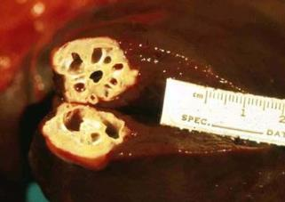
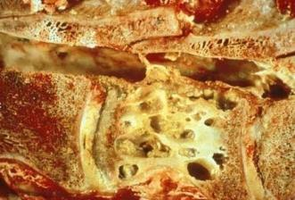
Echinococcus spp. – Hydatid Cyst DZ
Larval tapeworm in various animals
Multilocular Cyst in Cow Liver
Unilocular Hydatid Cyst
Multilocular Cyst in Horse Liver
Multilocular Cyst in Vertebra
Notes:
Unilocular - Hydatid cyst usually are spherical. They are filled with fluid and continually grow larger. Also the germinative inner lining of the hydatid cyst continually buds-off (asexual repro) “hydatid sand” (=proto-scolicies – each of which can develop into an adult tapeworm if eaten by a dog).
Multilocular - The larval cysts of some Echinococcus species act like malignant tumors.

Slide 23
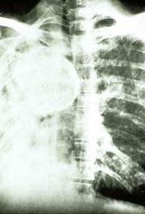
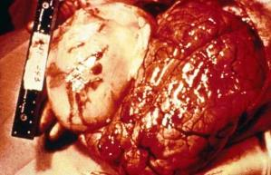
Echinococcus spp. – Hydatid Cyst DZ
Larval tapeworm in Humans
Very Important Zoonotic DZ
Humans act as intermediate hosts. HOW ?
Hydatid Cyst in Liver, Lungs, Brain.
If humans ingest Echinococcus ova from dog feces; then Hydatid Cyst DZ
Hydatid Cyst DZ
Notes:
This is the second of three tapeworms that illicit human health concerns due to humans becoming infected with the larval stage. What was the 1st that we have already discussed? __________________________
2nd = Echinococcus; 3rd = Spirometra.
NOTE: I test a lot on tapeworms that cause human health concerns. What is the tapeworm? What stage is infecting the human? How does the human become infected with that tapeworm stage?

Slide 24
To Contemplate is to Exercise the Intellect
If you choose; contemplate the following “in the mirror”:
“If you believe:
‘My group is the sum of all good in the world. My group represents the highest aspirations of humankind. So, my group’s interest is the universal interest. And if anybody threatens my group; they threaten virtue, then I have warrant for [bullying]. By [bullying] them I am protecting virtue.’ ”
Professor Stephen Reicher
Psychologist & Holocaust Scholar
University of St. Andrews

