Slide 1
VMP 930 Veterinary Parasitology
Cestodes 2
More Tapeworms

Slide 2
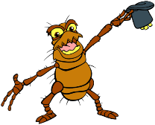
Dipylidium caninum
Flea Tapeworm of Pets

Slide 3
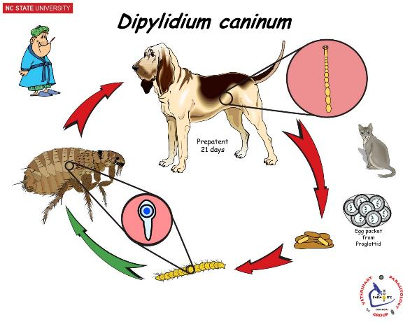
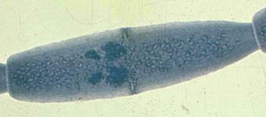
Dipylidium caninum
Flea tapeworm of dogs & cats
Most common tapeworm of dogs and cats
Scolex with retractable armed rostellum and 4 suckers
Strobila made of oval proglottids with bilateral genital pores.
Life Cycle
DH: Canids & Felids (small intestine)
Gravid proglottids passed in feces
Ova disseminated in the environment
IH: Fleas & Lice (How do fleas get infected?)
Cysticercoid larvae in hemocoel.
Ingested by the Definitive host
Yolk gland
Ovary
Genital pore
Testes
Worldwide
Zoonotic - Yes
Children have been infected with adult worms. (How?)
Genital pore
Notes:
Dipylidium caninum is sometimes called the flea tapeworm, because dogs and cats get infected from eating infected fleas.
The Dipylidium segment is oval shaped and has 2 genital pores and 2 sets of repro organs.
(Di = two pyl = pore)
Larval fleas are detritus feeders, which eat any debris. The larval flea ingests Dipylidium egg packet and the larval tapeworms develop in the flea larva. When the flea larva pupates and develops into an adult the larval tapeworms are retained in the fleas body. When an infected flea bites a pet and they nip at the flea then the flea w/ tapeworm larvae get ingested.
If children accidentally ingest an infected flea, then they may develop an adult Dipylidium in their small intestine. Such cases cause little Pathology, except to the mother’s “mental health”.

Slide 4
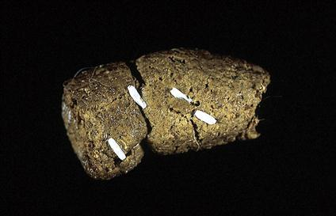
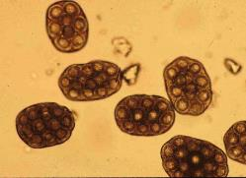
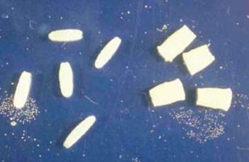
Dipylidium caninum
Pathology, Diagnosis
No Pathology
(nutrient competition in mal-nourished hosts)
"Client Worry” (proglottid aesthetics)
Clinical Signs
Segments presented by Client
Pet usually shows no signs
Occasionally pet drags tail
Observation of fleas
History
Lack of Flea Control
Diagnosis
Segment Squash
Oval Segment
Eggs in packets.

Slide 5
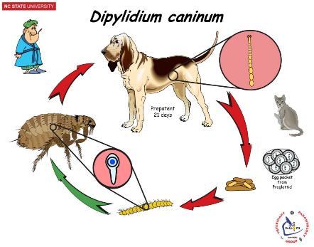
Dipylidium caninum
Treatment, Control
Praziquantel (Droncit) (5mg/kg) [dog & cat]
Pyrantel+Praziquantel+Febantel (Drontal Plus Tablets) [dog]
Pyrantel+Praziquantel (Virbantel Flavored Chewables) [dog]
Ivermectin+Pyrantel+Praziquantel (Iverhart Max Chewable Tablets) [dog]
Pyrantel+Praziquantel (Drontal Tablets) [cat]
Emodepside+Praziquantel (Profender) [cat]
Epsiprantel (Cestex) [dog & cat]
Resistance – emerging issue
Some Dipylidium isolates have been reported to be resistant to praziquantel & epsiprantel.
Treatments with nitroscanate or compounded pyrantel/praziquantel/oxantel were successful against the resistant isolates. (2018. Chelladurai et al. Am. J. Trop Med Hyg 99: 1201-1205)
“in these patients, off-label use of nitazoxanide (100 mg/kg) may prove helpful.” -- CAPC (https://capcvet.org/guidelines/dipylidium-caninum/)
Note from one practicing veterinarian:
used nitazoxanide at the 100 mg/kg dose once orally → cleared tapeworm infection.
side effects: vomiting about 5-6 hours post-treatment + loose stool, lethargic. Lasted 1 day.
The dose for a ~40 lb dog was about $230 after using a GoodRX coupon.
How would you prevent re-infection?
X
Flea Control Program
Notes:
Praziquantel & epsiprantel are the drugs of choice for tapeworms.
Resistant Dipylidium cases are getting more common. However, one needs to verify that there is client compliance with flea control before “diagnosing” a resistant Dipylidium. Also, one needs to confirm that the tapeworm is not a Taenia tapeworm => do a Segment Squash whenever presented with a tapeworm infection.

Slide 6
In-Class Discussion
For tapeworms, some clinics use a 21-day automatic re-treatment schedule.
Would you?
Taenia pisiformis - prepatent period = 56 days
Taenia taeniaformis – prepatent period = 40 days
Dipylidium caninum - prepatent period = 21 days
Notes:
This re-treatment seems to be targeting Dipylidium.
Do a segment squash to make sure it is not Taenia.
Assumes pet will pick up flea from a contaminated home when they leave the clinic. Without flea control, pet will get Dipylidium again even after the re-treatment.
Thus, confirm offending tapeworm species followed by client education.

Slide 7
In-class Discussion
An irate client storms into your office and complains that you are a quack because about 2 months ago you charged him an “excessive amount of money” to treat tapeworms and yet his dog still has tapeworms. Are you a quack? Why or why not?
Taenia pisiformis - prepatent period = 56 days Taenia taeniaeformis - prepatent period = 40 days Dipylidium caninum - prepatent period = 21 days

Slide 8
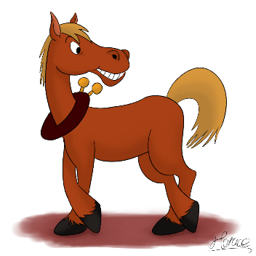
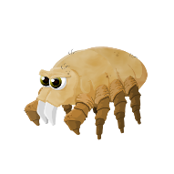
Tapeworms
of Livestock

Slide 9
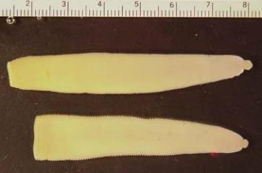
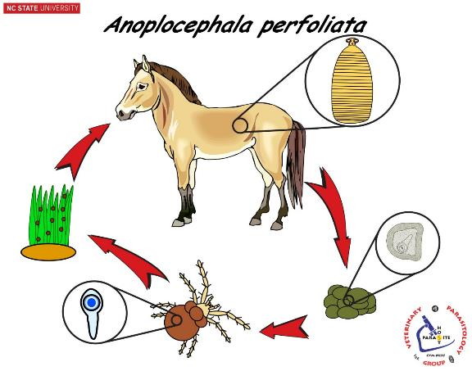
Anoplocephala perfoliata
Tapeworm of Equine
Scolex with unarmed rostellum and 4 suckers
Strobila made of many short, wide proglottids with unilateral genital pores.
Life Cycle
DH: Equids (ileocecal junction)
Eggs are passed in the feces
IH: Pasture mites
Cysticercoid
Ingested by the Definitive Host
Worldwide
Not Zoonotic
Notes:
The horse tapeworm
Horses are infected when they accidentally ingest an infected pasture mite while grazing.
Adult worms have very thin segments.
So, the segments disintegrate within the intestine lumen, releasing eggs into the fecal bolus.

Slide 10
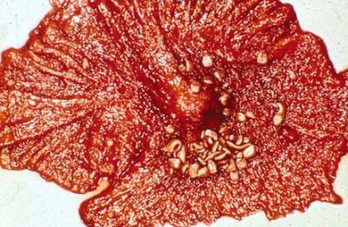
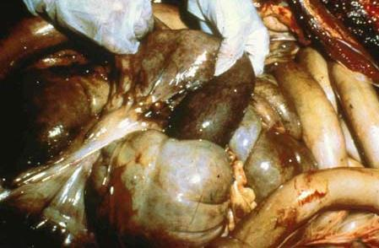
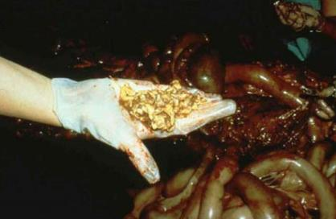
Mucosal Ulceration
Anoplocephala perfoliata
Pathology
Ulceration & inflammation of mucosa
Possible bowel wall rupture
Possible Intussusception of ileum into cecum
Intussusception
Intestinal Rupture

Slide 11
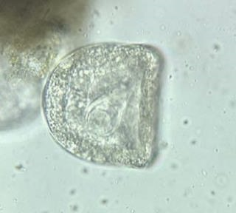
Anoplocephala perfoliata
Diagnosis, Treatment, Control
Diagnosis
Diagnosis difficult.
Ova not always readily found during fecal exam.
Use fecal centrifugation for detection (not McMasters)
Tests currently in Development:
Antibody test.
PCR test.
Treatment
Pyrantel (Extra-label)
Pyrantel pamoate (Strongid-T)
(double the nematode dose)
Praziquantel
Ivermectin + Praziquantel
Zimectrin Gold & Equimax
Moxidectin + Praziquantel
Quest Plus
Control
Perform regularly scheduled treatments, as detection of ova is not reliable.
Notes:
The eggs are very sporadic -- although one may see eggs on a McMasters, fecal centrifugation increases the sensitivity.

Slide 12
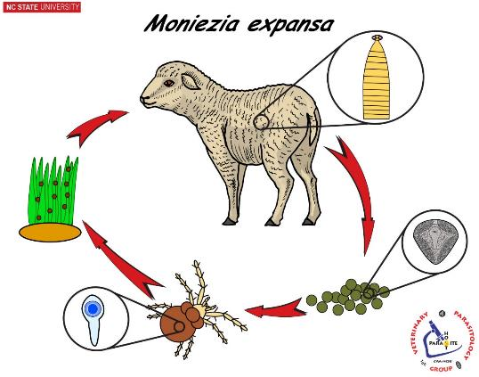
Moniezia sp.
Tapeworm of Ruminants
Scolex with 4 suckers only (no hooks)
Strobila made of many short, wide proglottids with bilateral genital pores and reproductive organs.
Life Cycle
DH: Ruminants (small intestine)
Gravid proglottids & eggs released in feces
Ova disseminated in the environment
IH: Pasture mites
Cysticercoid
Ingested by the Definitive Host
Worldwide
Not Zoonotic
Notes:
The ruminant tapeworm
Ruminants are infected when they accidentally ingest an infected pasture mite while grazing.

Slide 13
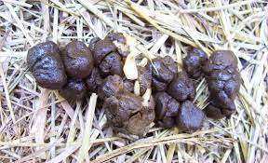
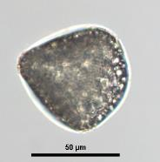
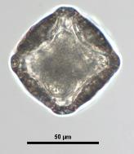
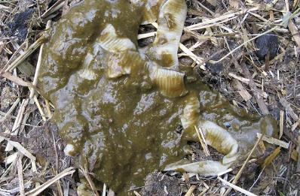
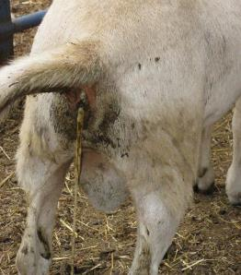
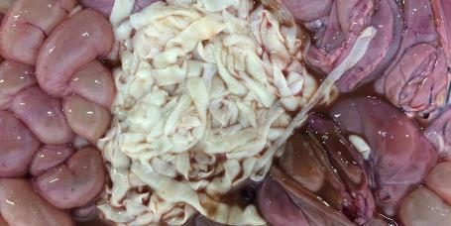
Moniezia sp.
Pathology, Diagnosis
Pathology
Considered non-pathogenic.
“Client Worry” (decreased marketability)
Diagnosis
Segments (individual or in groups) seen in feces.
Ova found on fecal float or McMasters.
Notes:
If one is trying to sell their stock and a potential buyer sees the sections of tapeworms in the feces; the buyer may decide not to buy.
One can often see segments in the feces of TAU sheep or goats.
Note shape of egg. Eggs in the Anoplocephalid group usually have angles and at least one flat side.

Slide 14
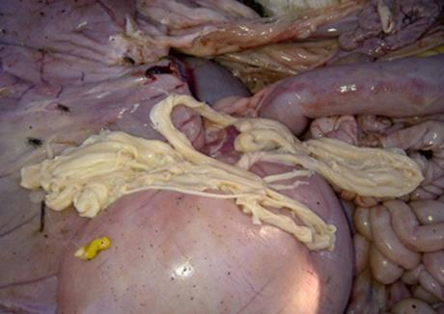
Moniezia sp.
Treatment, Control
Treatment
Fenbendazole (Panacur or Safe-Guard) [cattle]
Albendazole (Valbazen Suspension PI) [cattle, sheep, goats]
Oxfendazole (Synanthic Bovine Dewormer Suspension) [cattle]
Praziquantel (Droncit) [sheep & goats] (extra-label)
Always check Restrictions & Withdrawal Times
Control
Perform regularly scheduled treatments, spring & fall.

Slide 15
Spirometra sp.
Wildlife Tapeworm

Slide 16
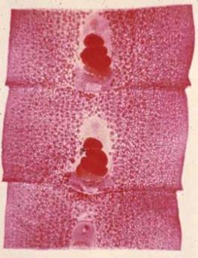
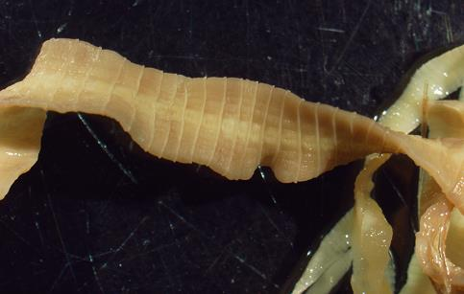
Spirometra sp.
Wildlife Tapeworm
Genital pore
Testes & Yolk glands
Scolex with 2 bothria (grooves) only
Strobila made of square proglottids with single ventral genital pore.
Uterus
Ovary
Bothrium
aka “Zipper tapeworm”
scolex
Notes:
Spirometra is generally known as the wildlife tapeworm, it is also called the “zipper worm” because of its ventral genital pores.. Spirometra and similar tapeworms (Pseudophyllidea) are considered more primitive than the previous tapeworms (Cyclophyllidea) that we have discussed.
The scolex of Spirometra does not have sucker. Instead, it holds on to the intestinal lining with 2 slits (bothria) on the scolex.
The segments are rectangular, with the genital pore on the ventral surface. Eggs are released into the gut lumen, not segments

Slide 17
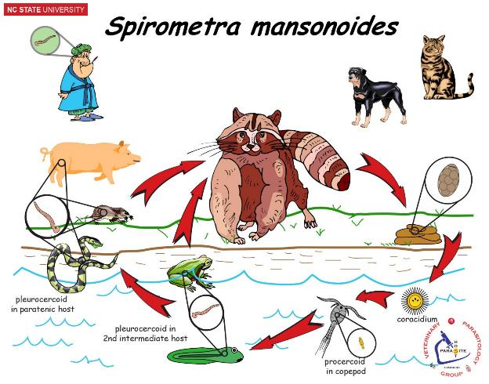
Spirometra sp.
Life Cycle
Definitive Hosts
Dogs & Cats (small intestine)
Raccoon, bobcat, fox, etc.
Ova (not segments) released in feces
Ova in water, develop and hatch.
Free-swimming Coracidium ingested by 1st IH
1st IH: Copepod (Procercoid)
2nd IH: Tadpole or Frog (Pleurocercoid (spargana))
PH: Snake, rodents, pigs, humans, etc. (Pleurocercoid (spargana))
Ingested by the Definitive Host
Geographic Distribution
North America
Feline and canine cases in North Carolina rather common.
NC raccoons and fox also.
Notes:
This is the Life Cycle of Spirometra. Practice describing this life cycle.
FYI: The Raccoon’s name is “Aaarnold”.
FYI: In the whole of the Tapeworm kingdom, the coracidium is the only free-living stage. No other stage in all of “Tapedom” is free-living. The coracidium is considered an indication of Spirometra being less advanced than tapeworms such as Taenia.
The 1st Intermediate host (copepod) ingests the Spirometra coracidum and the procercoid larva develops in the copepod.
A tadpole or frog ingests the copepod and a pleurocercoid larva develops in the tadpole or frog.
The tadpole or frog may be ingested by a paratenic host (snake, rodent, pig) and the pleurocercoid larvae will transfer to the new transport host.
The definitive host will become infected when it eats an infected Frog (2nd IH) or an infected paratenic host – the resulting adult tapeworm will reside in the pet’s small intestine.
If a human ingests a copepod (via stream water) or a raw frog, snake, rodent or pig, the human will get a pleurocercoid larvae (aka spargana) in their organs (a form of visceral larval migrans) – this disease is called sparganosis
Spirometra sp. are common in wildlife. The CVM has diagnosed many pets being infected with Spirometra.

Slide 18
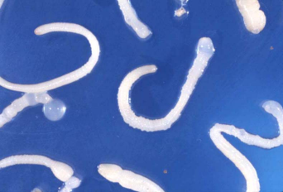
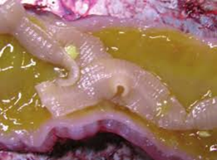
Spirometra sp.
Pathology
Adults in small intestine
Usually not pathogenic but may cause enteritis, with intermittent diarrhea
Proliferative sparganosis
Extremely rare
Larval stages proliferate throughout the body
Extremely poor prognosis
FYI Canine Case of Proliferative Sparganosis FYI
Case Description -- A 21-month-old spayed female Border Collie. Fenced yard in Tampa, Fla, that contained a small area of marshy terrain.
Complaint -- Progressive right forelimb lameness, signs of pain, & subcutaneous edema.
Clinical Finding
The subcutis and intermuscular fascia contained multiple cystic cavities filled with larval cestodes (plerocercoids or spargana) and cloudy red fluid.
The dog developed a progressively worsening fever, dyspnea, mature neutrophilia, and hypoproteinemia. Septic pleuritis and peritonitis complicated the later stages of the disease.
Treatment -- Treatment with praziquantel, fenbendazole, and nitazoxanide failed to control the proliferation and dissemination of larval cestodes.
Outcome -- The dog was euthanatized after 133 days of treatment.
Necropsy
Numerous parasitic tissue cysts were present in the subcutis and intermuscular fascia; these cysts were most abundant in the soft tissues of the forelimbs and cervical musculature.
The pleural and peritoneal cavities contained multiple larval cestodes and were characterized by neutrophilic inflammation and secondary bacterial infection.
(J Am Vet Med Assoc 2008; 233:1756–1760)
Notes:
Proliferative Sparganosis is rare, with a poor prognosis.
There likely were raccoons in the area that contaminated the marshy area.
The dog probably ingested infected copepods from this marshy area.

Slide 19
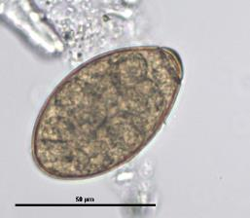
Spirometra sp.
Diagnosis, Treatment, Control
Diagnosis (for adults in intestine)
Operculate ova in fecal sedimentation or smear.
Clinical signs: intermittent diarrhea
Sections of tapeworm passed in feces or vomitus are often presented by owner.
Treatment
Praziquantel (Droncit)
High doses, multiple treatments
Operculum
Control
Adult tapeworm: Prevent access to snakes, frogs, rodents.
Sparganosis: Prevent access to copepods
Notes:
Note: Other pet tapeworms release segments in the feces. Spirometra passes large numbers of eggs in the feces.
Note the operculum may be difficult to visualize. Sometimes clinicians get Spirometra and Paragonimus eggs confused. Compared to Paragonimus eggs; Spirometra is a small egg, gray in color and lacks the opercular rim that is seen in Paragonimus. But also remember Paragonimus is the lung fluke, so clinical signs would be respiratory v/s the intermittent diarrhea seen with Spirometra infections.

Slide 20
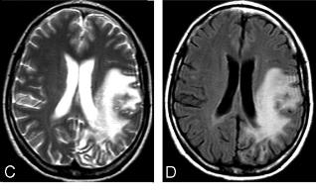
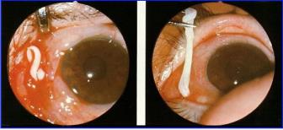
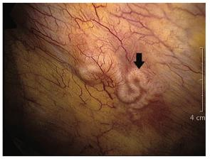
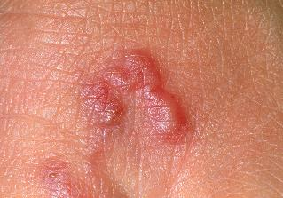
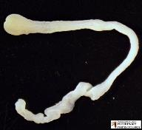
Spirometra sp.
Zoonosis
Sparganosis (in humans)
When spargana [pleurocercoids] invade various organs and muscles)
Ingestion of procercoid in copepod
Ingestion of pleurocercoid in raw paratenic host (swine, snake, frog)
Use of Poultice
Cerebral sparganosis
Ocular sparganosis
Pleural sparganosis
Extracted spargana
Cutaneous sparganosis
Notes:
When humans are infected with Spirometra larva, the zoonotic disease is called Sparganosis.
Zoonotic infections may occur when humans-
accidentally drink an infected freshwater copepod with stream, pond, creek, etc. water that has not been boiled.
Accidentally ingest a raw infected frog, snake or pork.
Or via poultice (a natural remedy) – if one gets a wound; some cultures slice open a frog and bind it on the cut. If the snake or frog is infected with a Spirometra pleurocercoid larva, then the larvae might migrate from the poultice (frog or snake) into the human.

Slide 21
FYI Pleurocercoid Growth Factor in Paratenic Host
Notes:
FYI: The pleurocercoid (spargana) larval stage produces a Pleurocercoid Growth Factor. This hormone analogue can cause intermediate hosts to become large and obese. Such obese and slow animals are more easily caught by the definitive hosts of Spirtometra.

Slide 22
Final Exam
Monday, November 13 @ 9:00am in B112
ExamSoft Exam (1 pt / question)
40 questions: Nematodes - Hammerberg
33 questions: Protozoa & Ticks - Qurollo
27 questions: Arthropods & Platyhelminthes - Flowers
12 questions - Arthropods (other than ticks)
Mites (4), Fleas (2), Lice (2), Fly (2), Bot (2)
8 questions – Trematodes
7 questions - Cestodes

Slide 23
Wellness Break
Take a 5-minute wellness break:
You Are Home
--
Eabha
(“AVA”)
https://www.youtube.com/watch?v=BCdCgiINblM

