Slide 1
VMP 930 Veterinary Parasitology
(aka Infection & Immunity III)
Dr. Bruce Hammerberg
Dr. Barbara Qurollo
James Flowers, PhD
(Office hours by appointment)

Slide 2
Syllabus -- Objectives
Diagnosis of Major Parasites of Domestic Animals
Clinical signs, diagnostics, diagnostic stages
Become Knowledgeable of the Life Cycles of Major Parasites and apply to their Treatment & Control.
Treatment for acute issues.
Control strategies to prevent re-infection or keep parasite population below disease levels.

Slide 3
Syllabus – Recommended Text
Course packet
You are not responsible for material in the Appendices of the Lecture Notes.
Georgis’ Parasitology For Veterinarians
11th edition
Many good quick-reference tables
Diagnostic stages, prepatent periods, transmission
Section on Current Anti-Parasitics
Section with Annotated Lists of parasites for many domestic animals

Slide 4
Syllabus – Schedule
Lectures & Lecture Exams:
M @ 8:00 in B112 [South Theater]
W @ 8:00 in B112 [South Theater]
Labs:
H @ 1:00 thru 4:00 in B104D [Microscope Lab]
3 Groups (A, B, C) of 35 students each
1-2; 2-3; 3-4pm (See website for group order/lab)
Special Notes
First 3 and Last Lab Periods will be Lectures
H @ 1:00 in B112 [South Theater]
August 10, August 17, August 24, November 09

Slide 5
Syllabus – Examinations
Two lecture exams (closed-book; on-site)
Protozoa & Arthropods (15%) [September 13] {ExamSoft}
Nematodes (15%) [October 30] {ExamSoft}
One laboratory exam (closed-book; on-site)
Cumulative (10%) [November 02]
Five Lecture Quizzes (closed-book; on-site)
(5% each) {Moodle Quizzes}
1 Protozoa, 1 Arthropod, 2 Nematode, 1 Platyhelminthes
During the unused portion of some labs.
Final Exam (closed-book; on-site)
Cumulative (35%) [November 13] Monday {9am, B112}
Must acquire an excused absence from Academic Affairs prior to Make-up Exam consideration.

Slide 6
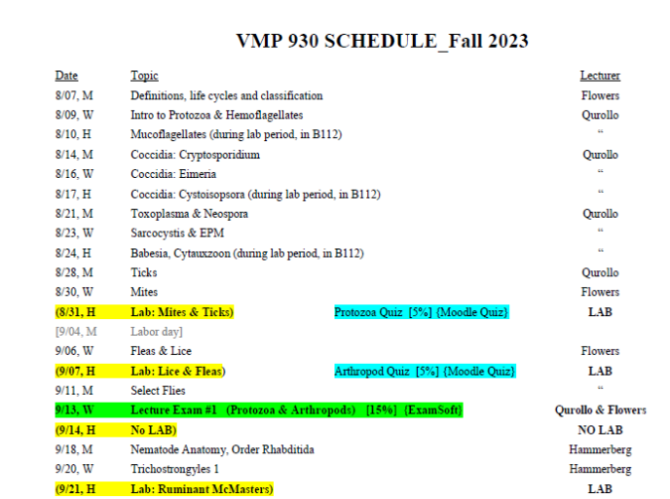
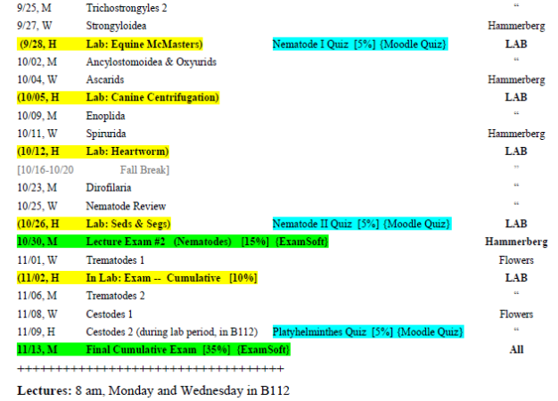
Syllabus – Schedule

Slide 7
Parasitology Website
http://parasitology.cvm.ncsu.edu

