Slide 1
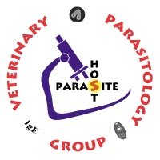
VMP 930 Veterinary Parasitology
(aka Infection & Immunity III)
Dr. Bruce Hammerberg
Dr. Barbara Qurollo
James Flowers, PhD
(Office hours by appointment)

Slide 2
Parasitism
Intimate relationship between two hetero-specific organisms, in which the parasite, usually the smaller symbiont, is metabolically dependent on the host.
One symbiont (host) is harmed, while the other symbiont (parasite) benefits.

Slide 3
Studies in Infectious Diseases
Microbiology
Virology
Bacteriology
Mycology
Parasitology
Medical & Veterinary Protozoology
Helminthology
Medical & Veterinary Entomology

Slide 4
Parasites in Practice
In a veterinary practice how much effort & time is spent on Parasite issues?
What parasites are often diagnosed in a veterinary practice?
What parasites do veterinary practices often “just treat”?
What parasites do veterinary practices often try to manage?
What has made parasites more difficult to manage?

Slide 5
Parasite Impact on the Host
Pathogenesis
Production or Development of Disease
Forms of Pathogenesis
Trauma
Nutrient Robbing
Toxin Production
Interactions with Host immune / inflammatory responses.

Slide 6
Important concepts of Parasitic Infections
Infection = presence of an agent that has the potential to cause disease
Infectious = capable of causing infection
Disease = the occurrence of dysfunction
Infection ≠ Infectious ≠ Disease
Clinical judgement: “Is the effect on the patient important enough to justify treatment?”

Slide 7
Infection, Disease, and/or Infectious?
A. The dog showed no adverse symptoms to the 2 female Dirofilaria immitis in its pulmonary arteries.
Infection
B. 1,000 juvenile Haemonchus contortus were causing severe anemia in the lamb.
Infection + Disease
C. Cats suffering from large bowel diarrhea due to Tritrichomonas blagburni pass active trophs in their stool.
Infection + Disease + Infectious
D. After using the bathroom, she was horrified to see that she had passed several active segments of the beef tapeworm, Taenia saginata.
Infection

Slide 8
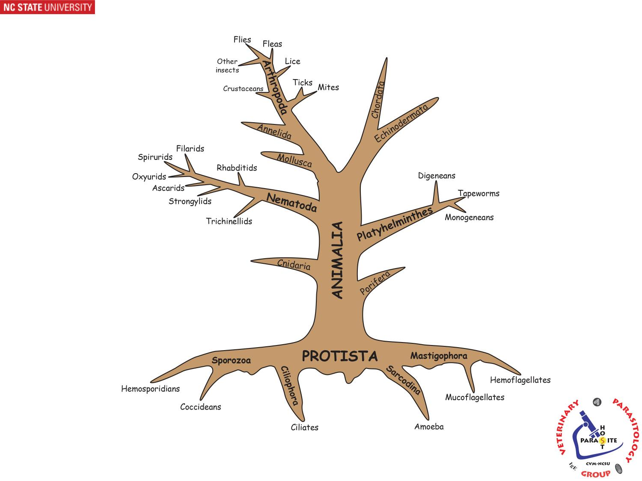

Slide 9
Protozoa
Microparasites
Small (single cell) parasites
(Protozoa, [bacteria, viruses])
Intracellular & Extracellular
Individual organisms Multiply in the host.
“mechanism” of protozoan induced pathology

Slide 10
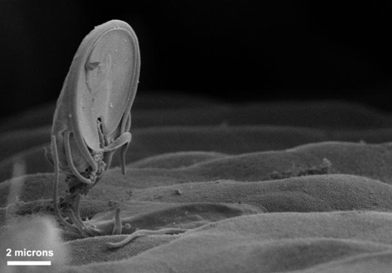
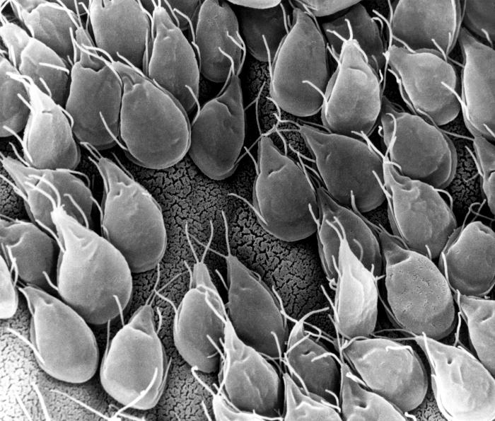
Giardia sp.
& other extracellular protozoa
Pathology:
Host organ dysfunction
Replication
(binary fission)

Slide 11
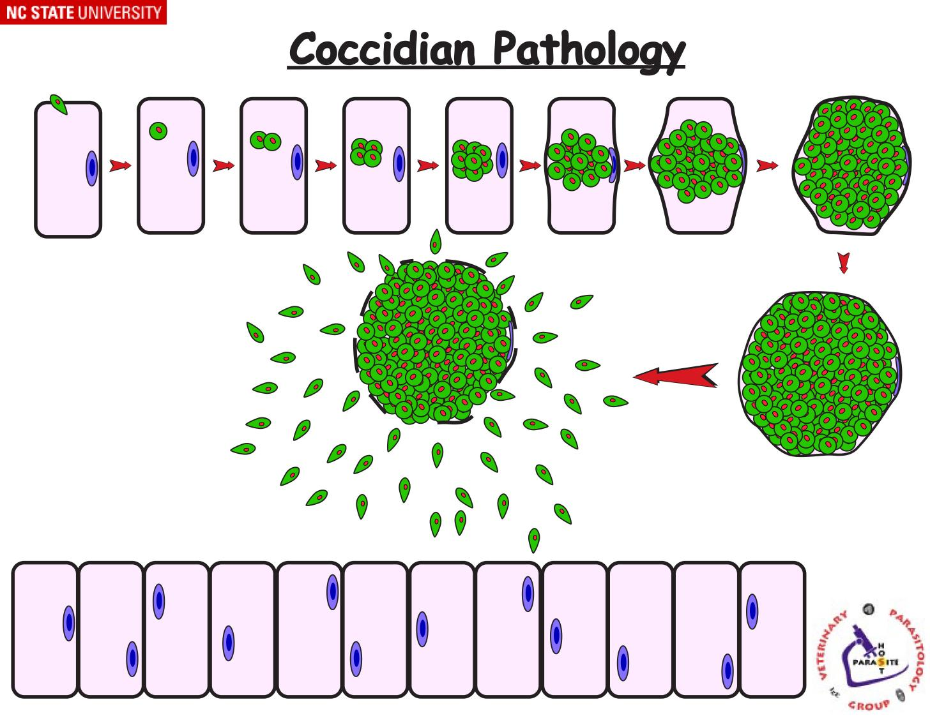
Pathology:
Cellular trauma
Organ dysfunction

Slide 12
Notes:
Direct LC,
Definitive Host,
Sanitation,
Coccidiostats to decrease level of infection,
Calf hutch system

Slide 13
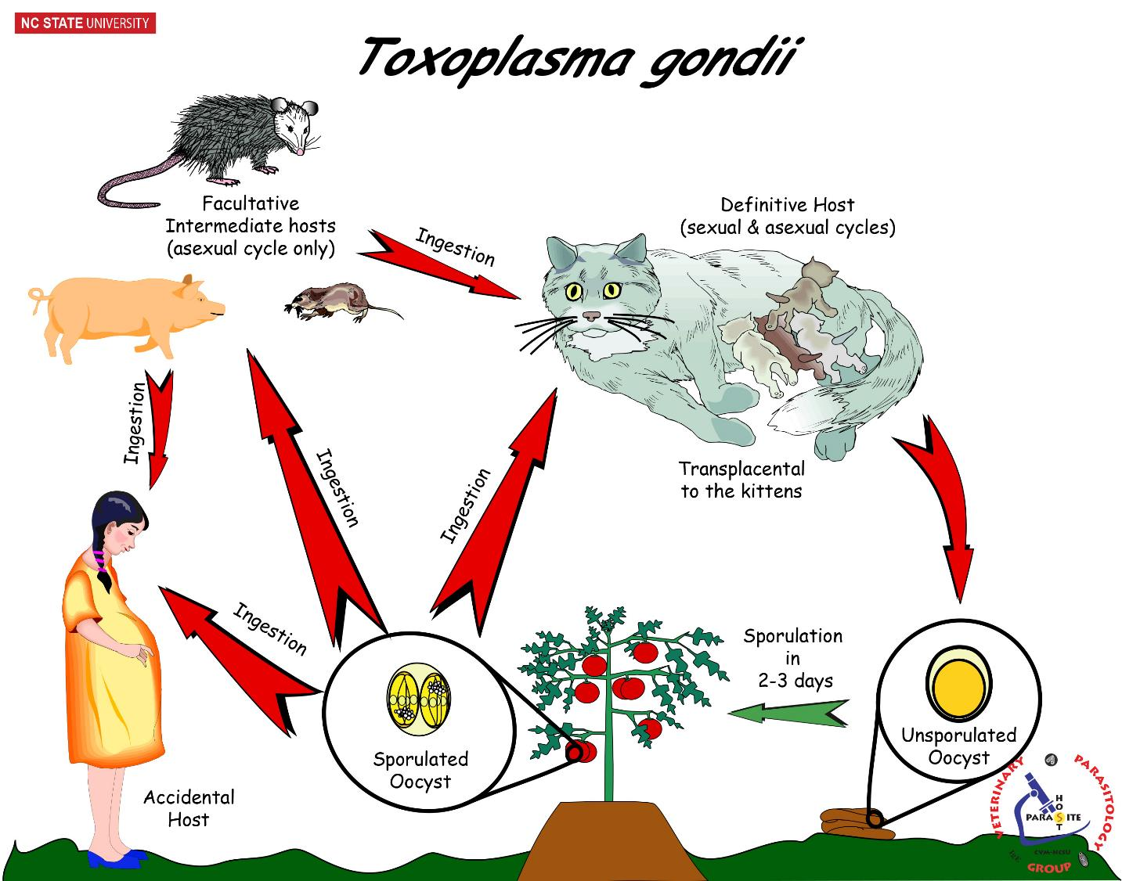
Notes:
Direct LC,
Definitive host,
Paratenic host,
Accidental host,
Sanitation control & Pest control

Slide 14
Notes:
Indirect Life Cycle,
Definitive host,
Intermediate host,
Pest control

Slide 15
Trematodes
Macroparasites
Large parasites
Individual ADULT organisms do Not multiply in the host.

Slide 16
Notes:
Indirect LC,
DH & IH,
Aquatic LC

Slide 17
Notes:
Indirect LC,
DH & IH,
Terrestrial LC

Slide 18
Cestodes
Macroparasites
Large parasites
Individual ADULT organisms do Not multiply in the host.

Slide 19
Notes:
Indirect LC,
DH & IH,
Pest Control

Slide 20
Notes:
Indirect LC,
DH & IH,
Pest control

Slide 21
Nematodes
Macroparasites
Large parasites
Individuals do Not multiply in the host.

Slide 22
Notes:
Direct Life Cycle,
Quick build-up of environmental contamination
Sanitation
Transmammary thus expect disease of the very young.

Slide 23
Notes:
Direct Life cycle,
Definitive Host,
Sanitation

Slide 24
Notes:
Direct LC,
Pasture contamination = Sanitation,
Theoretically could rotate pastures every 3 to 5 days.

Slide 25
Notes:
Direct LC,
Definitive host,
Accidental host/ zoonosis, Transmammary thus expected DZ of very young,
Sanitation,
2 week repeat treatment due to repeat infection from mother’s milk (& environment).

Slide 26
Notes:
Direct LC,
Defintive Host,
Paratenic Hosts,
Transmammary & Uterine = expected DZ of young,
Sanitation & Pest management,
Repeat treatment.

Slide 27
Notes:
Direct LC,
Sanitation

Slide 28
Notes:
Indirect LC,
Definitive host,
Intermediate Host,
Paratenic Host,
Low Host specificity,
Pest Control

Slide 29
Notes:
Indirect LC,
Definitive host,
Intermediate host,
Moderate host specificity,
Prophylactic control

Slide 30
Arthropods
Macroparasites
Individual organisms do Not replicate themselves in or on the host.
Although the pathology of some arthropods (mites & lice) is due to their reproduction on the host.
Vectors for other disease agents
Notes:
Mites, Ticks, Lice, Fleas, Bugs, Flies

Slide 31
Notes:
Lice - High Host specificity,
All stages on host,
Nits resistant thus repeat treatments required (1 week)
Sanitation & Quarantine Control

Slide 32
Notes:
Fleas – Low host specificity,
eggs, larvae, pupae, adults in environment so control more challenging.
Control: treatment & sanitation

Slide 33
Notes:
LC on single host,
Contact transmission
Sanitation & Quarantine Control

Slide 34
Notes:
3 host tick,
hard to control,
Vector RMSF

Slide 35
Controlling Parasites
Assume you are working at a Wildlife Rehab
facility with limited funds.
1. Which of the following 3 parasites would likely cause the most concern for re-infection & a build-up of parasites?
2. What would you generally do to control reinfection?

Slide 36
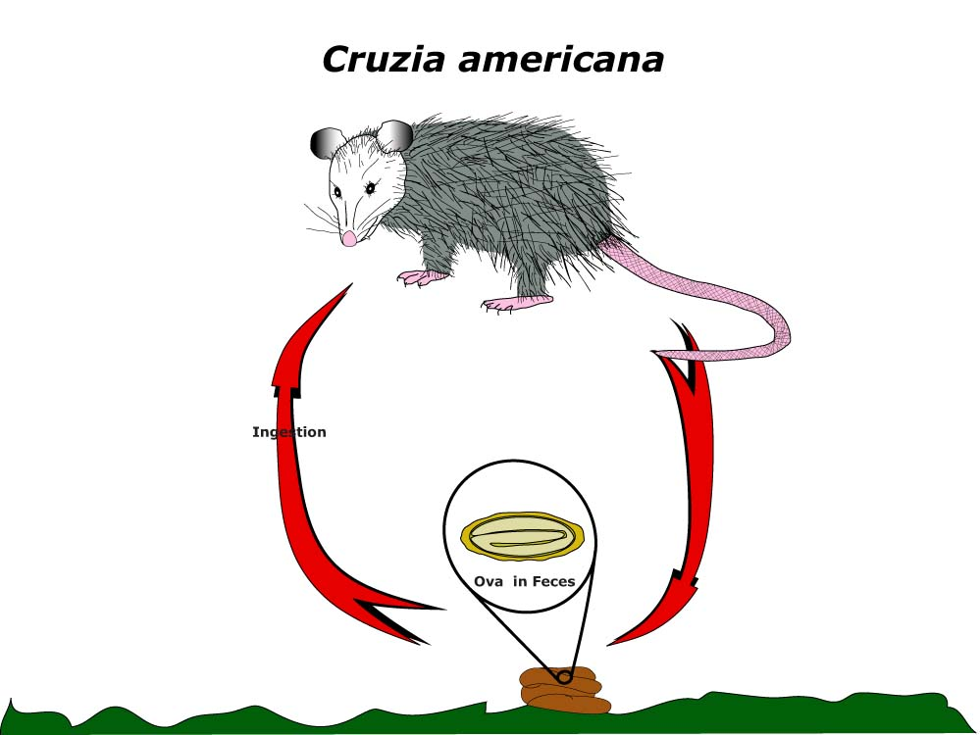
Concern for reinfection,
build up of large
parasite population
in the host ?
+ low concern
++ moderate concern
+++ high concern
Notes:
High Concern,
Direct LC,
Quick build up w/o sanitation

Slide 37
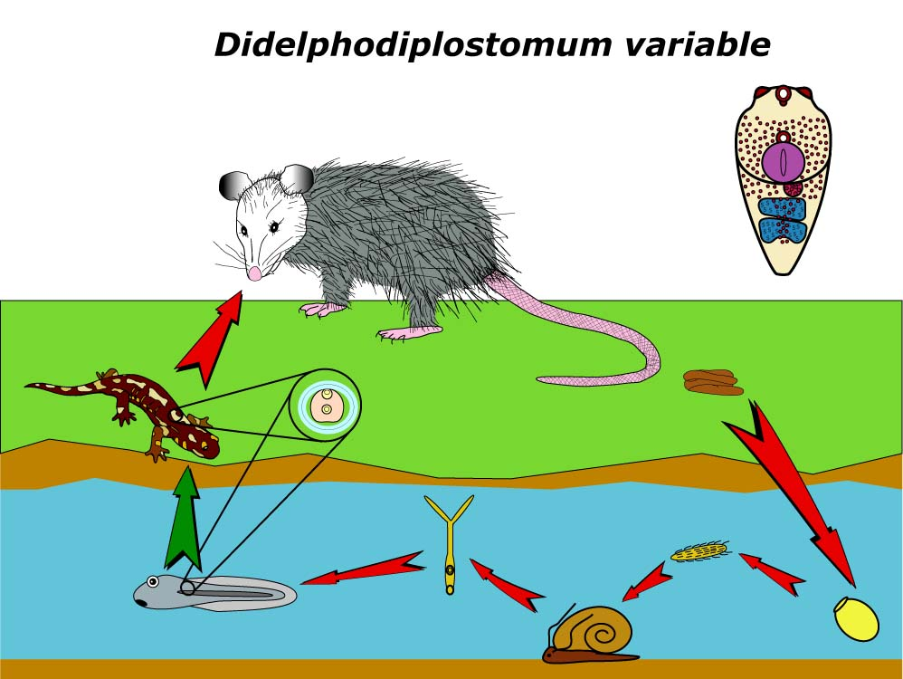
Didelphodiplostomum variable Life Cycle
Concern for reinfection,
build up of large
parasite population
in the host ?
+ low concern
++ moderate concern
+++ high concern
Notes:
No concern,
Indirect LC,
Two IH,
Aquatic LC,
No chance of reinfection.

Slide 38
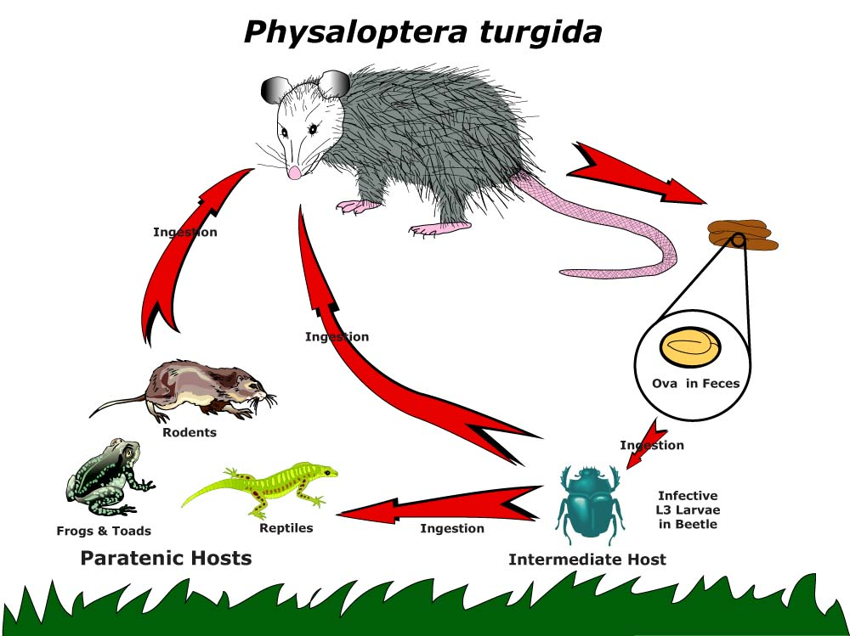
Concern for reinfection,
build up of large
parasite population
in the host ?
+ low concern
++ moderate concern
+++ high concern
Notes:
Moderate concern,
Indirect LC & Paratenic Host,
Pest control.

Slide 39
Take Home
Importance of knowing life cycles for successful clinical cases and disease control.
Concepts that should become “second nature”:
Infection v/s Infectious v/s Disease
Host Specificity: Low v/s High
Life Cycles: Direct v/s Indirect

Slide 40
Take Home
Concepts & Definitions that should become “second nature”:
Prepatent v/s Patent
Parasite Stage: Larval v/s Adult
Hosts: Definitive v/s Intermediate v/s Paratenic
Zoonosis

