Slide 1
VMP 930 Lecture 16a
Objectives:
Name the four Superfamily groupings of nematodes in the Order Strongylida
List the characteristics of each superfamily and how they are similar and different

Slide 2
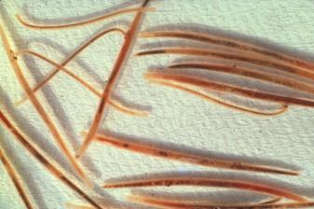
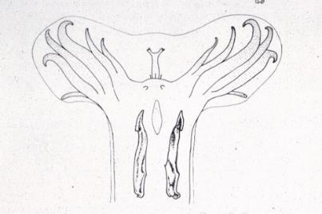
Order Strongylida - general morphology
“Bursate worms”: males have a distinctive copulatory bursa.
Lobes (braket) supported by rays (arrow).
lobe
ray
Notes:
The nematodes in the Order Strongylida are a completely different group of nematodes from the ones we just described in the Order Rhabditida that included Strongyoides. Be careful not to be confused by the genus name Strongyloides in the Order Rhabditia and some of the genus names in the Order Strongylida. In the top figure you see the smaller males grasping the larger females at the vulvar opening using its copulatory bursa.

Slide 3
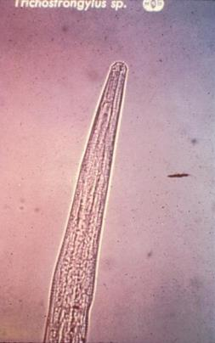
Order Strongylida - general morphology
Buccal area (mouth): used to subdivide these worms into 4 superfamilies.
1. Trichostrongyloidea - very small buccal cavity, in ruminant abomasum or small intestine
Buccal cavity

Slide 4
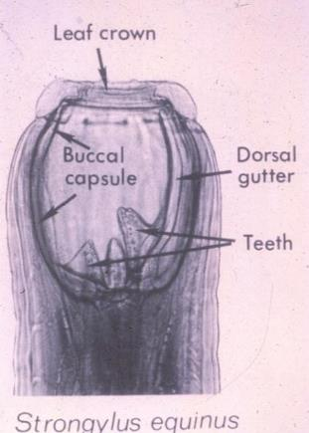
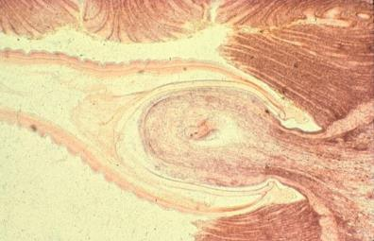
Order Strongylida - general morphology (cont.)
2. Strongyloidea - very large buccal cavity with leaf crown on buccal capsule, in equid large intestine.
Host mucosa
Buccal capsule

Slide 5
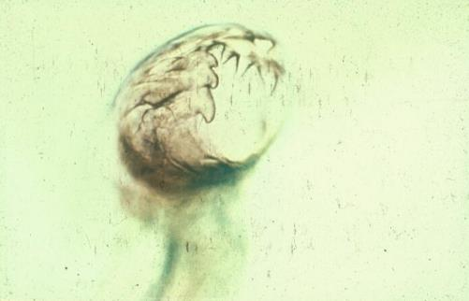
Order Strongylida - general morphology (cont.)
3. Ancylostomoidea (hookworms) - buccal cavity is bent dorsally, buccal capsule has teeth or cutting plates at anterior opening.
teeth
Axis of worm body

Slide 6
Order Strongylida - general morphology (cont.)
4. Metastrongyloidea - lacks buccal cavity, worms found in lungs or nervous system.

Slide 7
Order Strongylida - general life cycles
Three superfamilies have free-living larval forms that must develop to infective L₃ in the environment outside of the host.
Most produce strongyle type eggs (aka ova), with exceptions of those that develop larvae before passed in feces.
Metastrongyloidea superfamily is the exception in that its genera require mollusk or annelid intermediate hosts.
Notes:
Many of you will recognize “strongyle type” ova or eggs as hookworm ova, but this is the same ova type as produced by trichostrongyles in ruminants and by small and large strongyles in horses.

Slide 8
Order Strongylida - general life cycles (cont.)
Routes of infection: 1. Ingestion with herbage while grazing is the only significant route for Trichostrongyloidea (trichostrongyles) in ruminants and Strongyloidea (strongyles) in horses.

Slide 9
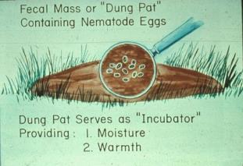
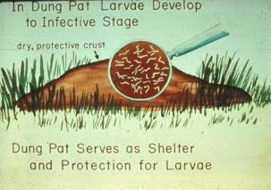
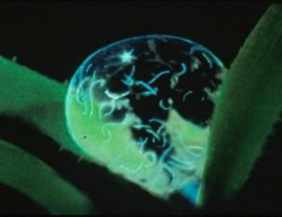
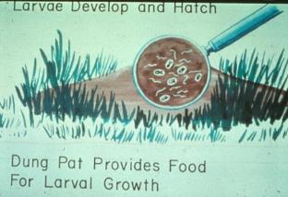
Route of Infection Trichostrongyles and Strongyles
1
3
2
“deadly dew-drop”
Notes:
Transmission of pasture borne nematodes of ruminants and equids is highly dependent on environmental conditions.

Slide 10
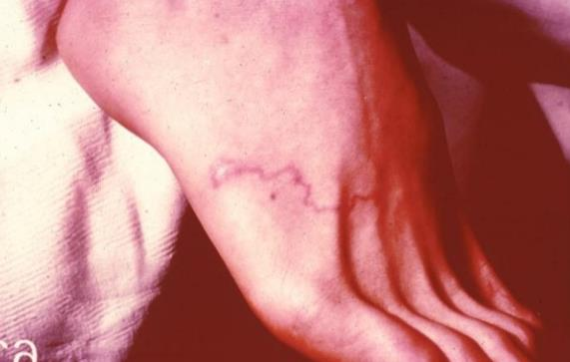
Order Strongylida - general life cycles (cont.)
Routes of infection (cont.): 2. Skin penetration and ingestion, including lactogenic, is used by Ancylostomoidea (hookworm).
Cutaneous larval migrans lesion from infective larva
Notes:
What other distantly related nematode we just covered uses these routes of infection?

Slide 11
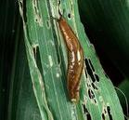
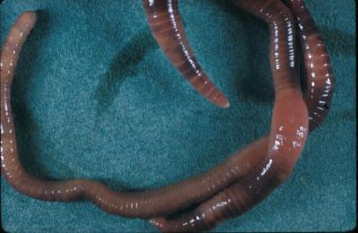
Order Strongylida - general life cycles (cont.)
Routes of infection (cont.): 3. Ingestion of infected intermediate host is used by Metastrongyloidea genera.
Slug (or snail) containing L₃
Earthworm containing L₃
Notes:
Requirements for an intermediate host is important to know for controlling infection. Without the intermediate host there is no transmission of infection.

Slide 12
Discussion Question
How many superfamilies of nematodes have genera that produce eggs with the same strongyle-type morphology?
What is required to get this type of egg to develop to an infective stage?

Slide 13
VMP 930 lecture 16b
Objectives:
Compare cattle with small ruminants regarding trichostrongyle nematode infection and disease.
Know the host location and adult worm morphology of Trichostrongylus axei, Ostertgia ostertagi, Haemonchus contortus, and Cooperia.

Slide 14
Superfamily Trichostrongyloidea commonly called trichostrongyles
Haemonchus, Ostertagia, Trichostrongylus (HOT) plus Cooperia are the genera that infect the abomasum and duodenum of grazing ruminants.
Sheep and goats are most severely affected by Haemonchus contortus.
Cattle are most severely affected by Ostertagia ostertagi.

Slide 15
Trichostrongylus spp.
Trichostrongylus axei - found in the abomasum of ruminants and stomach of horses.
Trichostrongylus colubriformis - found in the small intestine of ruminants.
Both Trichostrongylus sp. also infect rabbit, pig and man (be careful where you graze).
Notes:
Wash your garden vegetables, especially if you are using sheep manure as a fertilizer.

Slide 16
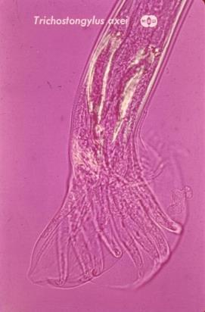
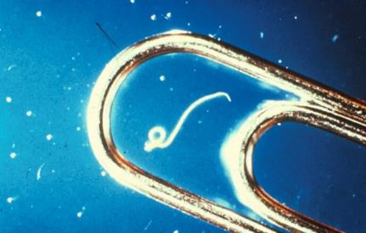
Trichostrongylus axei
Trichostrongylus axei. - Adults are less than 7 mm long.
spicules
T. axei adult male
Copulatory bursa

Slide 17
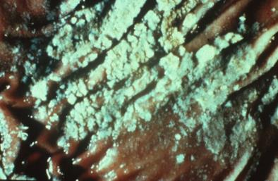
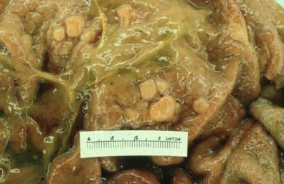
Trichostrongylus axei
Rarely causes clinical disease alone.
Exception: horses can develop clinical disease.
Risk of being pastured with sheep.
Catarrhal gastritis
Nodular hyperplasia
Notes:
Sheep can tolerate fairly high numbers of Trichostrongylus axei without clinical signs; whereas, horses can develop clinical disease from lower infection levels. The upper figure shows pathological lesions on the abomasal surface of a heavily infected sheep. The lower figure shows nodular formations on the stomach mucosal surface of an infected horse.

Slide 18
Ostertagia spp.
Ostertagia ostertagi - most important helminth parasite of cattle.
Teladorsagia (O.) circumcincta - infects sheep, goats and llamas.
Host species specific. Does not cross infect.
Common name - brown stomach worm.
Notes:
The lack of cross infection of Ostertagia between cattle and sheep may be useful for pasture utilization when co-grazing of cattle and sheep is a consideration.

Slide 19
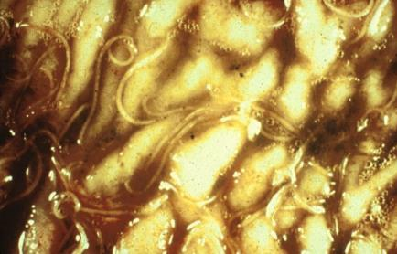
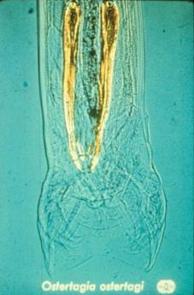
Ostertagia sp.
Adult worms are 7 to 14 mm long, brown in color.
Fecal egg counts above 200 indicate high worm burden.
Adult worms on gastric mucosa. Note bubbles due to protein loss into lumen.
adult male copulatory bursa & spicules

Slide 20
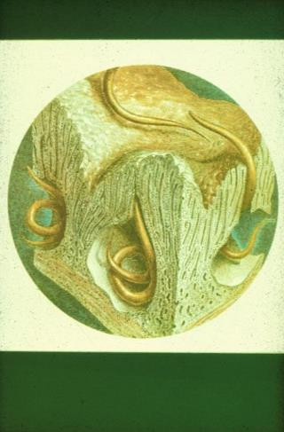
Ostertagia sp.
emerging, metabolically active L₄
Ostertagia sp. pathogenesis:
1. L₃ ingested from pasture enter the gastric glands and develop to L₄ then emerge to gastric lumen or are hypobiotic in glands.
Prepatent time is 3 weeks.
hypobiotic, arrested L₄

Slide 21
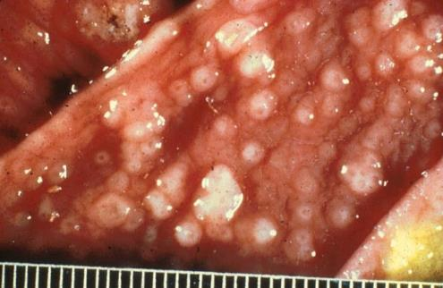
Ostertagia sp.
Ostertagia sp. pathogenesis (cont.):
2. Cells lining gland dedifferentiate, stop producing acid. Abomasal pH increases.
3. Mucosal cells at entrance of gland proliferate, small nodules = moroccan leather appearance of mucosal surface.
nodules of proliferating gastric mucosal cells

Slide 22
Ostertagia sp.
Ostertagia sp. pathogenesis (cont.):
4. Leaky mucosa causes loss of protein and fluid to abomasal lumen.
5. Systemically there is increased protein catabolism and nitrogen excretion in urine.
6. Hypoproteinemia.

Slide 23
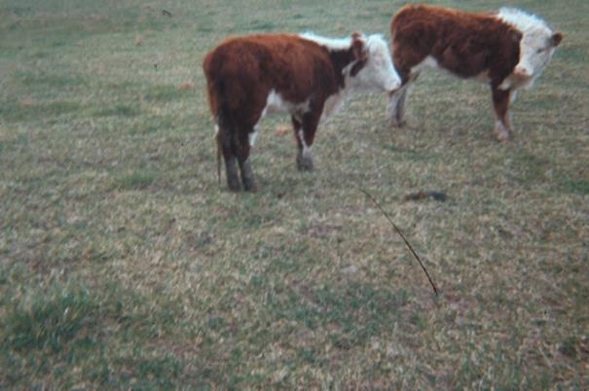
Ostertagia sp.
Ostertagia clinical signs: 1. Anorexia - loss of appetite.
calves showing no interest in grazing

Slide 24
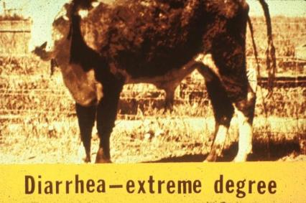
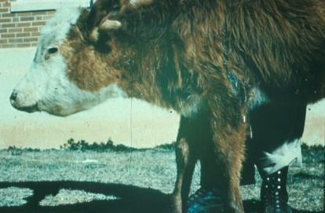
Ostertagia sp.
2. Diarrhea - watery diarrhea in calves.
3. Edema – due to protein loss.
intramandibular edema

Slide 25
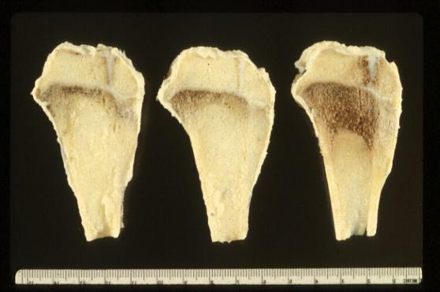
Ostertagia sp.
infected, unlimited feed
uninfected, feed equal to infected intake
uninfected, unlimited feed
4. Decreased weight gain, poor growth due to anorexia and protein catabolism.
5. Subclinical effects revealed by anthelmintic therapy.
proximal tibia showing haversian canal growth activity

Slide 26
Ostertagia sp.
Ostertagia in cattle causes clinical signs in young, growing calves.
Due to age resistance mature cows seldom show clinical disease.
Notes:
Compare this with Haemonchus infections in small ruminants.

Slide 27
Haemonchus sp.
Haemonchus contortus:
most important helminth parasite of sheep and goats.
Reports of H. contortus infecting cattle,
but not as pathogenic as in sheep.
Haemonchus placei: species specific for cattle.
Common name = barber pole worm.

Slide 28
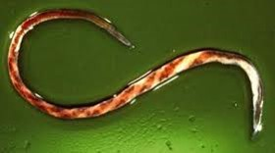
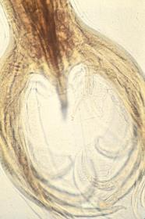
Haemonchus sp.
Found in the abomasum
adults up to 30 mm long,
blood-filled worm gut and twisted reproductive tract
gives red & white barber pole affect.
Fecal egg counts above 1000 indicate high worm burden.
Adult female showing barber pole affect
Adult male copulatory bursa

Slide 29
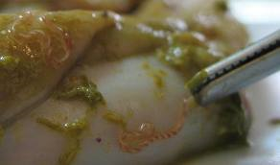
Haemonchus sp.
Haemonchus pathogenesis:
prepatent (3 weeks)
adult worms in lumen of abomasum
blood feeders
loss of blood leading to anemia and hypoproteinemia
can be severe within one week of ingestion of large number of infective larvae.
adult worm showing blood-filled digestive tract

Slide 30
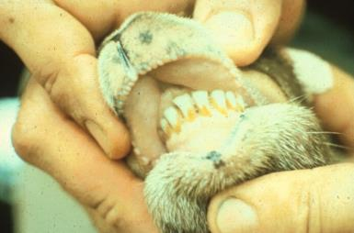
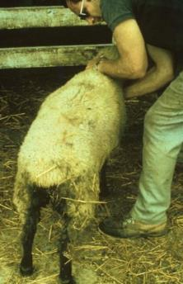
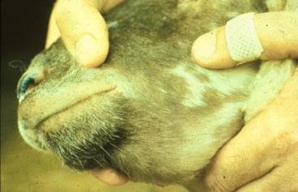
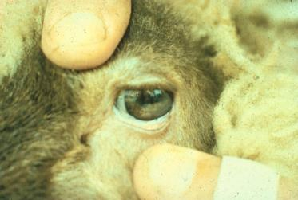
Clinical Signs
Haemonchus sp.
edema of lips
intramandibular edema
pale conjunctiva, FAMACHA score?
black tarry feces,
not diarrhea
Notes:
Upper left figure showing black, tarry feces; not watery diarrhea. Upper right and lower left show edema resulting from hypoproteinemia. Lower right showing FAMACHA measurement of anemia resulting from blood loss due to Haemonchus feeding.

Slide 31
Haemonchus sp.
Clinical signs:
Signs of blood loss, anemia
pale mucous membranes,
low hematocrit,
rapid shallow breathing and high heart rate,
prostrate.
Body condition may be good in acute infections.
Black, tarry feces. Not diarrhea.
Edema of lips, intramandibular region, limbs.

Slide 32
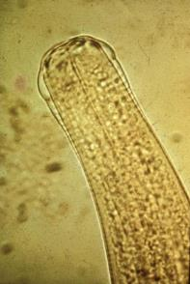
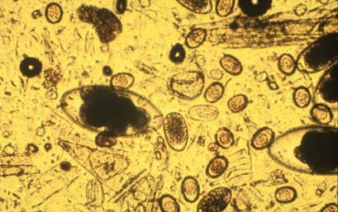
Other trichostrongyles
Cooperia and Nematodirus are trichostrongyles that infect the proximal small intestine of ruminants.
Cooperia drug resistance is a growing concern in cattle.
adult stage, anterior end
Nematodirus ova
strongyle-type ova
Notes:
Cooperia infections in cattle are no where near as pathogenic as Ostertagia infections. Cooperia nematodes require a higher anthelmintic drug dose to be killed compared to Ostertagia, thus they are becoming the main source of fecal ova which may mislead decisions to treat based on fecal ova counts when assuming all ova are from Ostertagia. What would you need to do to determine whether Ostertgia or Cooperia was the source ova seen in feces? Remember, their ova have the same strongyle-type morphology.

Slide 33
Other trichostrongyles
As with Trichostrongylus, they are important as mixed infections with Ostertagia or Haemonchus.

Slide 34
Discussion Question
Describe a scenario for the occurrence of clinical disease from Haemonchus infection in sheep.
Describe a scenario for the occurrence of clinical disease from Ostertagia infection in cattle.

