Slide 1
VMP 930 lecture 17a
Trichostrongyle transmission
Strategic control

Slide 2
Trichostrongyle Transmission and control
Objectives:
Describe egg to infective larva development on pasture including highest risk for infection
Compare Type I with Type II ostertagiasis
Describe various control measures for pasture-borne trichostrongyle infections

Slide 3
Trichostrongyle: Transmission
Source of infection = Pasture
Adult worm population inside grazing hosts determines number of eggs shed on pasture.

Slide 4
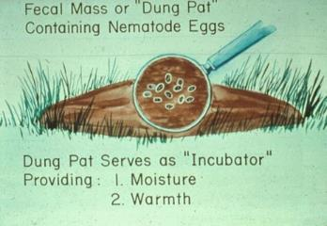
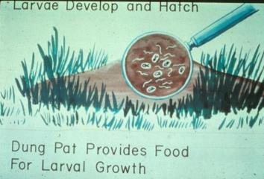
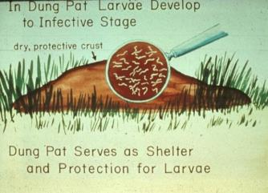
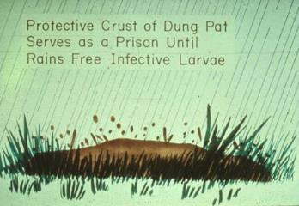
Trichostrongyle: Transmission
Appropriate conditions (moisture, warmth, O₂) allow eggs to hatch and L₁ become L₃
Requires 5 – 7 days under optimal conditions
1
2
3
4

Slide 5
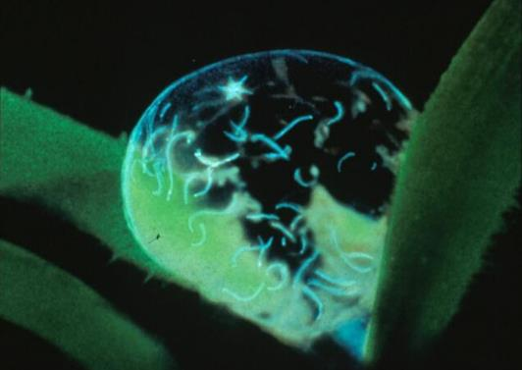
Source of infection = Pasture
How is a large population of adult worms generated? Remember adult worms do not replicate.
infective larvae (L₃) in dew drop on grass

Slide 6
Source of infection = Pasture (cont.)
How is a large population of L₃ established on pasture?
Type I ostertagiasis
when L₄ do not arrest
they emerge and become egg laying adults in 3 weeks.
Calves show clinical signs in the Fall in cool temperate regions; or, in the Spring in hot, semi-arid regions.
Why?
Notes:
Late in the grazing season infective larvae will have accumulated on pasture making it the time for greatest transmission and largest number of adult worms in susceptible hosts (young calves). The grazing season in cool temperate regions such as western North Carolina is from April to September. The grazing season in hot, semi-arid regions such as Texas and Louisiana is September to March.

Slide 7
Source of infection = Pasture (cont.)
Type II ostertagiasis
When larvae in arrested development in abomasal mucosa emerge they can be a source of adults producing eggs to contaminate pasture and cause of disease.
Long yearlings (grazed the previous season) develop adult worms
That contaminate spring pastures with ova in the North.
Southern grazed calves moved to feedlots (anywhere) in the Fall have potential for Type II disease.

Slide 8
Source of infection = Pasture (cont.)
Periparturient haemonchosis in ewes.
Emergence of L₄ stimulated by parturition.
Adults develop and produce eggs to contaminate pastures for lambs to ingest L₃.
Ewes debilitated by large adult worm burden.

Slide 9
Control
Tactical treatments - when susceptible animals are on heavily contaminated pastures you must treat repeatedly due to re-infection; or, treat and move to a clean pasture.
Strategic treatments - soon after uninfected animals are put on pasture and become infected they are treated to prevent adult worm from generating eggs to contaminate pasture (sustained release or repeated macrolid drug). Infected animals are treated before being put on pasture. Spring and Fall.

Slide 10
Control: Strategic
In the cool temperate regions: treat calves with repeating or long lasting adulticide in spring when put on pasture; treat re-stocking calves with adult and L₄ killing drugs in late fall.
In subtropical regions: treat calves, long-yearlings in early fall (wet season) with adulticidal drugs; treat calves in late spring/early summer at start of dry season with adult and L₄ killing drugs.

Slide 11
Control of trichostrongyles
To get optimal milk production, first lactation cows are treated just before calving.
To prevent disease and minimize pasture contamination pregnant ewes and goats are treated before parturition.

Slide 12
Control: Sustainable Approach with Minimal or no Drugs
Selective treatment for small ruminants based on FAMACHA to reduce drug resistance development in an untreated refugia worm population.
Accelerated rotational grazing. Requires a lot of fencing (many individual pastures) and moving the herd every three days or less. “Mob grazing” like migratory herds.
Unlike small ruminants, mature cattle are very resistant to large worm burdens and clinical disease. Use them to remove infective larvae and reduce exposure to young calves.
Reduced herd density
Notes:
Selective treatment of small ruminants based on FAMACHA anemia results allows the development of a “refugia” population of worms in untreated resilient hosts. These worms have not been selected for resistance by treatment and should create a population of worms that can be killed by current anthelmintics.
Accelerated rotational grazing by moving herd to new pasture every 3 days or less has been successful locally near Mebane, NC in a grass-fed cow calf herd. No anthelmintics used for 6 years. This farm has 17 pastures.

Slide 13
Discussion Question
Why do one-year-old calves grazed in Texas and Louisiana and being put on feedlots in Iowa in September usually require deworming even though they have low eggs per gram fecal egg counts?
Hint: Type II ostertagiasis.

Slide 14
VMP 930 lecture 17b
Dictyocaulus
the only trichostrongyle inhabiting the lung

Slide 15
Dictyocaulus
Objectives
Describe the pathology and adult worm location (tissue and organ) in the host
Know host specificity and risks of co-grazing horses with donkeys
Know how Dictyocaulus is transmitted

Slide 16
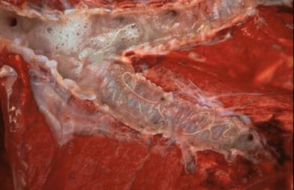
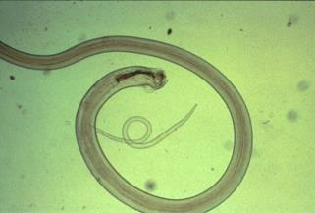
Dictyocaulus sp.
Lung worm of cattle (D. viviparus), sheep and goats (D. filaria), equine (D. arnfieldi)
Adults found in bronchi and trachea are up to 80 mm long and thin.
adult worms in bronchi
male adult worm
L₁ stage from fresh feces
Notes:
Dictyocaulus species are host specific. Dictyocaulus in cattle do not infect sheep and vice versa. Dictyocaulus in equine do not infect ruminants and vice versa. Donkeys permit patent infections, while horses often do not even though they show clinical disease that is often not seen in infected donkeys. Do not co-graze donkeys and horses if you find larvae in the feces of donkeys.

Slide 17
Dictyocaulus sp.
Life cycle predicts onset of clinical signs and when to treat:
7 days after ingestion of L₃ from pasture,
first season grazing calves begin showing respiratory signs.
Adult worms present in bronchi at 3-4 weeks after ingestion of L3,
severe pneumonia.
Results in strong immunity.

Slide 18
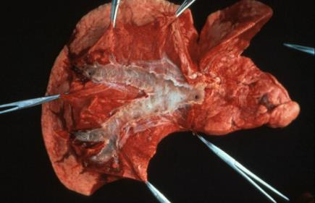
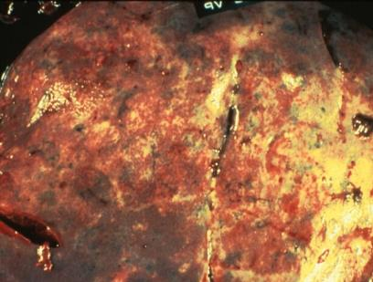
Dictyocaulus sp.
Pathogenesis: worms and inflammatory exudate block air flow.
inflammatory exudate blocking air flow
consolidated lung

Slide 19
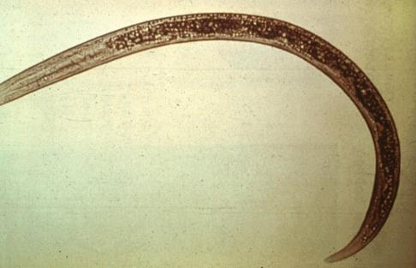
Dictyocaulus sp.
Clinical signs:
young animals on pasture first year showing rapid breathing and coughing.
L₁ in feces (not eggs).
diagnostic larva found in fresh feces. note dark granules.

Slide 20
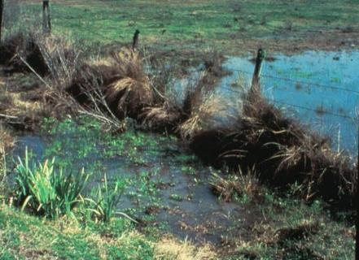
Dictyocaulus sp.
Treatment and control:
treat at first signs of coughing
(about one week after put on contaminated pasture).
Avoid low, wet pastures. Local foci of contaminated pastures.
Problem for mountain pastures as snow cover protects L₃ over winter.
Do not co-graze donkeys and horses.
Notes:
Horses mount a much more intense inflammatory response to Dictyocaulus than donkeys and suffer severe lung pathology without showing a patent infection; whereas, donkeys do not have as severe lung inflammation and do permit patent infections that contaminate pastures.

