Slide 1
VMP 930 lecture 18a
Superfamily Strongyloidea
Large strongyles of horses

Slide 2
Order STRONGYLIDA
Superfamilies:
Trichostrongyloidea
Strongyloidea
Metastrongyloidea = infect lungs
Ancylostomatoidea
Notes:
Moving on from the superfamily Trichostrongyloidea that contained the pervasive trichostrongyle nematodes infecting the abomasum and small intestine of ruminants. The superfamily Stongyloidea includes the strongyle (small and large) nematodes that infect the large intestine and cecum of most horses.

Slide 3
Superfamily STRONGYLOIDEA
Horses -- strongyles of large intestine
Ruminants -- nodular worms of large intestine
Swine -- kidney worms and nodular worms
Birds -- tracheal “gapeworms”
Notes:
In addition to the really important strongyles in equids this superfamily also contains nodular worms, kidney worms and avian tracheal gapeworms. We will not cover kidney worms in pigs (Stephanurus dentatus), but if you have a swine intereset please see the appendix of your lecture notes.

Slide 4
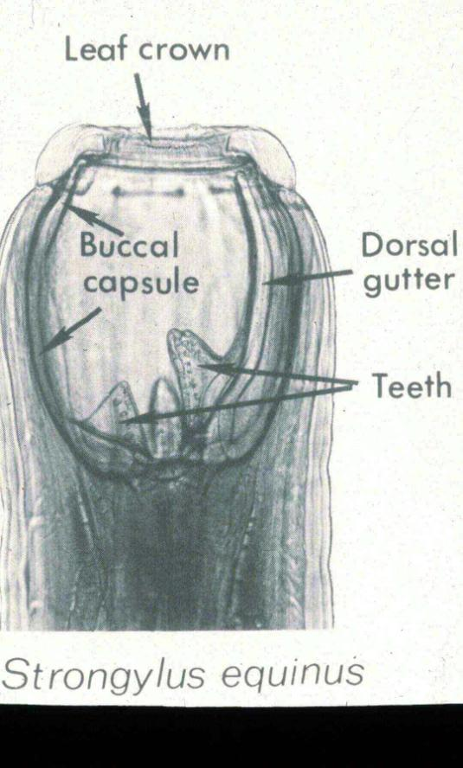
Strongyle Morphology
large, thick body
large buccal cavity
leaf crown
teeth (+/-)
Notes:
This figure shows the details of the buccal cavity of Strongylus equinus as an example of the features you may see in the three species of the genus Strongylus (large strongyles); and, also in the 40 or more species of small strongyles.

Slide 5
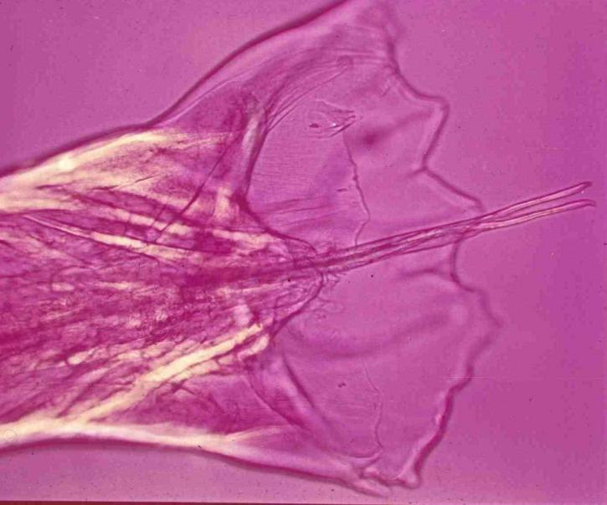
Strongyle Morphology
Male worm
Copulator bursa is well-developed
Notes:
This figure shows a typical male copulatory bursa of large and small strongyles.

Slide 6
Strongyles in Horses
LARGE and SMALL strongyles in large intestine
Notes:
Strongyles, especially small strongyles, are the most important nematode infecting horses globally.

Slide 7
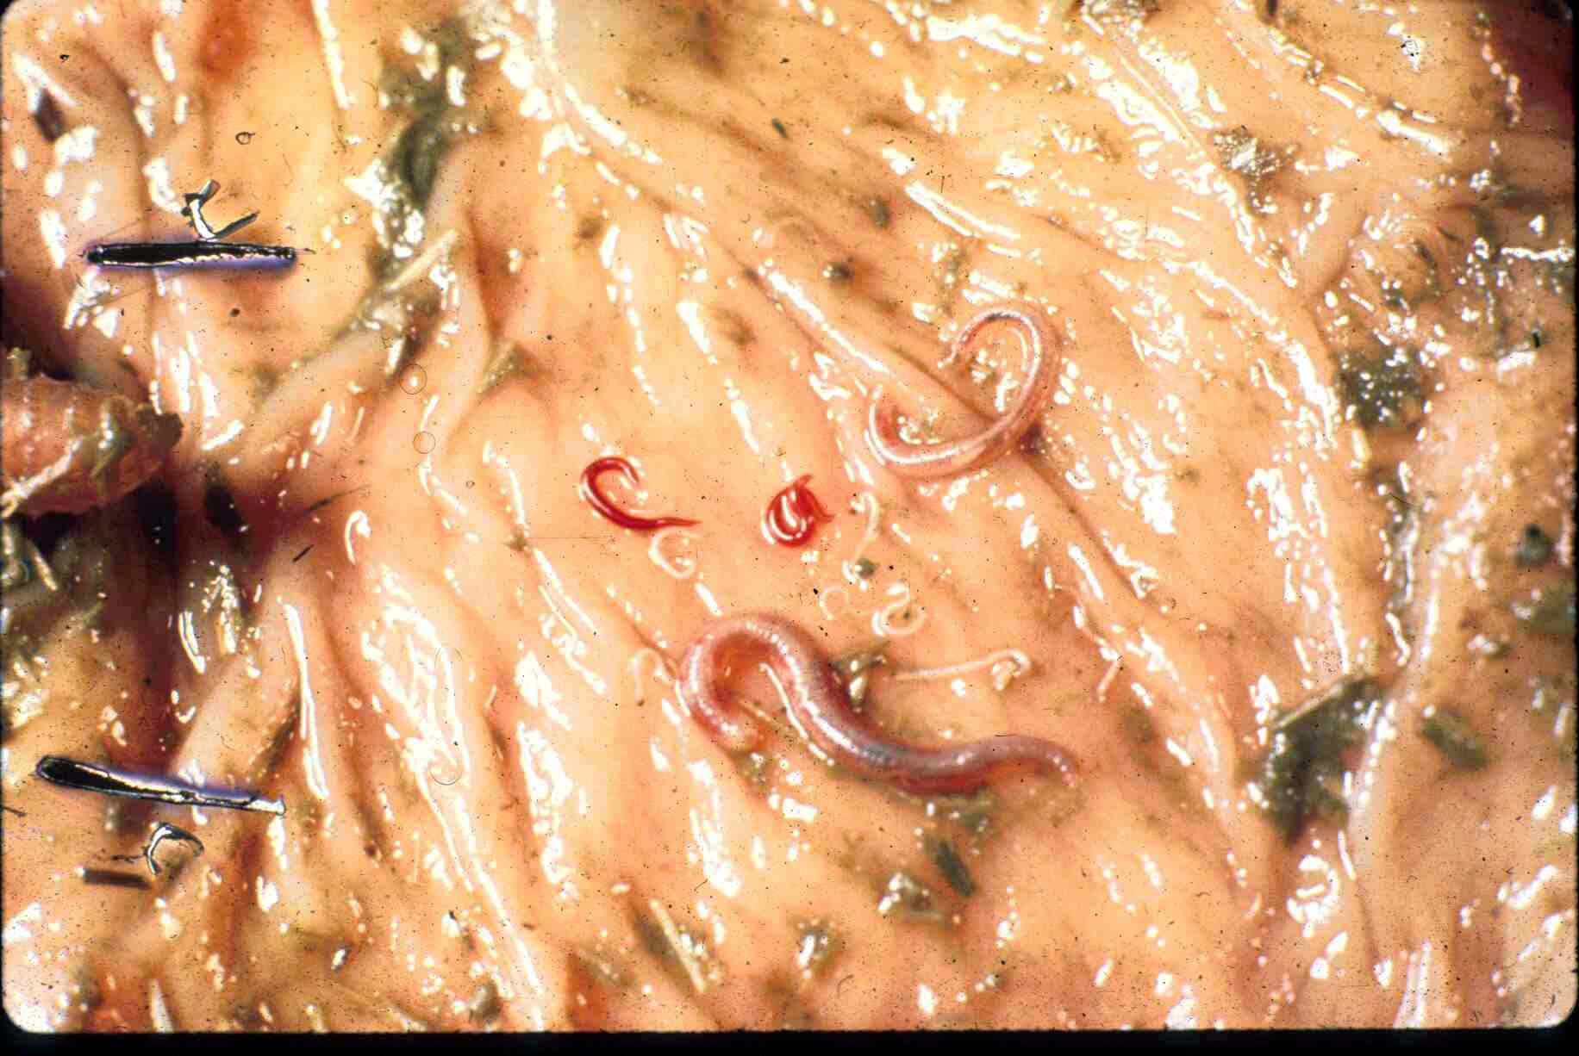
Large intestine mucosal surface
large strongyle
small strongyles
large strongyle
Notes:
This figure shows a mix of adult large and small strongyles. Note that some species of small strongyles are bright red in color, but this does not mean they are blood-feeders. You may see these red worms on your rectal exam glove or your client may see them passed in the feces of their horse.

Slide 8
Superfamily Strongyloidea in Horses
Strongylus species (large strongyles)
S. vulgaris
S. edentatus
S. equinus
Triodontophorus species
Cyathostomes (small strongyles)
Notes:
Of the three species of Strongylus (large strongyles), S. vulgaris is historically the most important due to the pathology caused by its migrating larval stages. In current times cyathostomes, or cyathostomins, are the most important and pervasive nematode infecting horses. Why is Strongylus vulgaris no longer the most important nematode infecting horses?

Slide 9
Strongylus vulgaris: Life-cycle
L3 ingested when horse is grazing on infected pasture (only route of infection). (Just like trichostrongyles in ruminants.)
larva penetrates intestinal wall (~1-7 days)
Larva migrates in vessel wall up to the cranial mesenteric artery or aorta taking 8-21 days
L₄ break into blood stream and carried back to colon & cecum, develop to adult stage during 2-4 months
total prepatent period ~6 months

Slide 10
Prepatent periods of large strongyles
Large strongyles are easily controlled and not found often.
Why?
Remember these strongyles do not arrest, and no hypobiosis.
Current drugs are effective against all stages.
Hint: how often would you need to treat to prevent patency?
Notes:
You are not responsible for the details of the life cycles of Strongylus edentates and Strongylus equinus, just that their prepatent times are even longer than Strongylus vulgaris and their migrating larval forms are readily killed by current anthelmintic drugs. Remember that the prepatent time for Strongylus vulgaris is 6 months.

Slide 11
Strongylus vulgaris: Signs/Pathology
Acute disease
fever, depression, colic, diarrhea/constipation
due to infarction/obstruction of arteries and inflammation from entering larvae
soon after turnout
Chronic disease
Episodes of colic, with/without sudden death
Sudden death from thromboemboli and/or rupture of an aortal aneurism

Slide 12
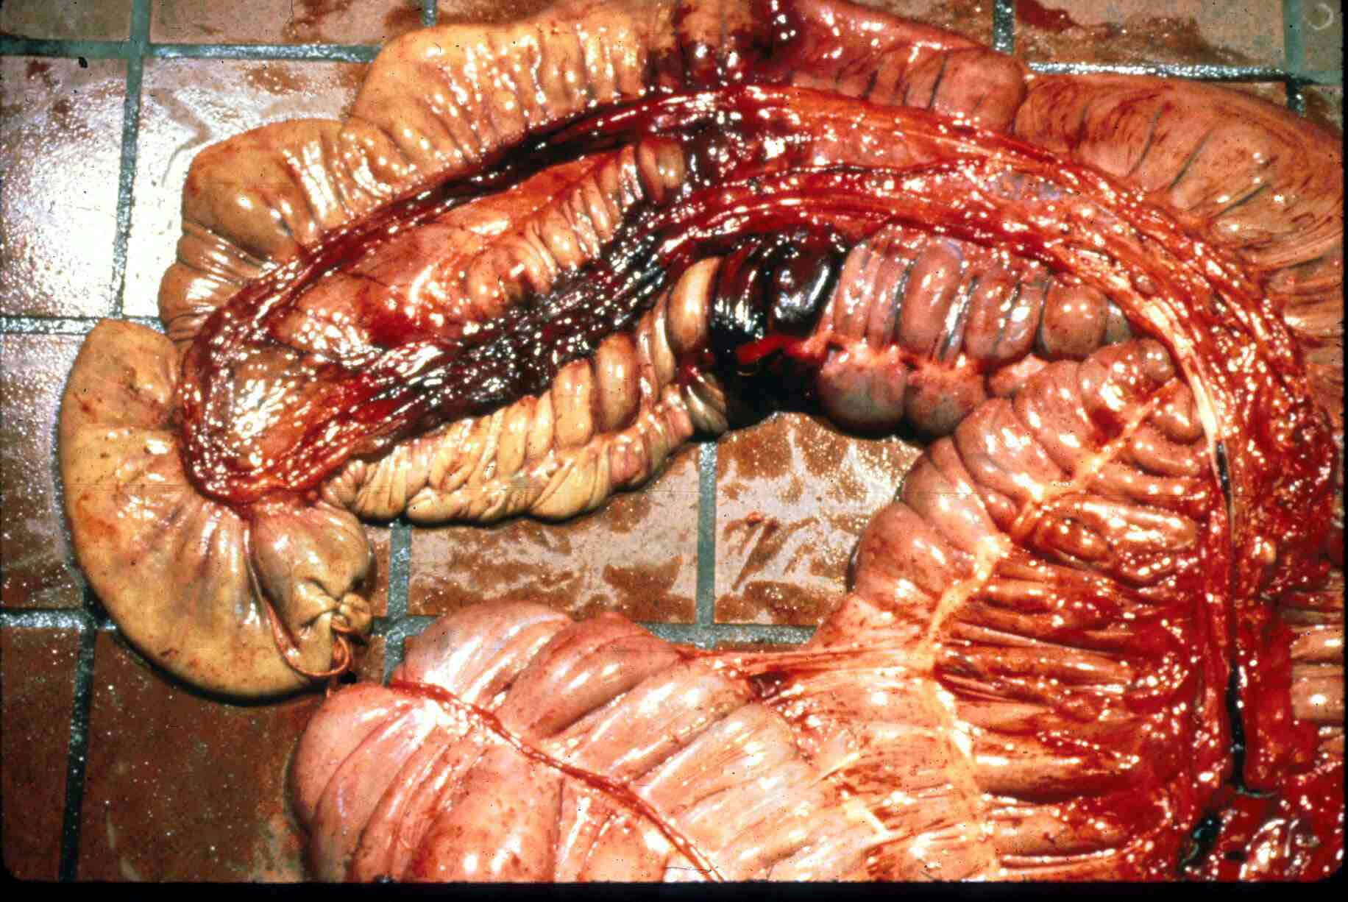
Infarction
Ischemia
Notes:
Damage caused by infective larvae entering small arteries flowing to the cecum. Acute disease.

Slide 13
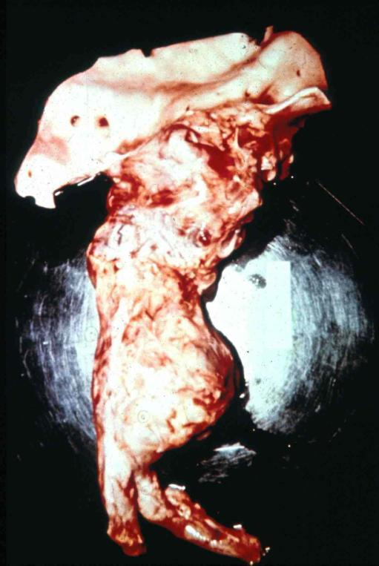
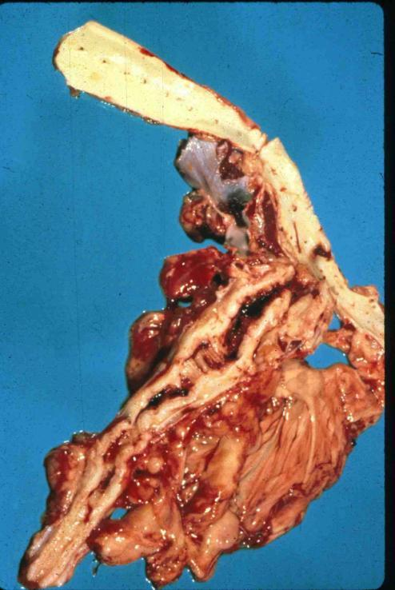
aorta
aorta
Cranial mesenteric artery
Cranial mesenteric artery
Aneurism of cranial mesenteric artery
Felt on rectal palpation
Hypertrophy of arterial walls
Notes:
Chronic disease from repeated migrations of larvae within the wall of the cranial mesenteric artery.

Slide 14
Pathology
COLIC:
blood flow disrupted
thrombo-embolism
mechanical damage to intestine
altered motility
allergic irritation
innervation abnormalities

Slide 15
Pathology
Blood chemistry:
Eosinophilia
Hypergammaglobulinemia
hypoalbuminemia, esp. with migratory larvae

Slide 16
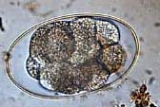
Diagnosis
Eggs in feces, but same type as small strongyles
...BUT IF.....clinical signs are positive and fecal is negative
What’s your explanation?

Slide 17
VMP 930 lecture 18b
Superfamily Strongyloidea
Small strongyles of horses

Slide 18
Cyathostomes = small strongyles
This nematode is the target of routine deworming of horses on pasture.
World-wide cost of control (not cure) of cyathostome infections in horses is very large.

Slide 19
Cyathostomes, the small strongyles
>40 species in large intestine of horses
also species specific to elephants, pigs, marsupials, turtles
distinct buccal capsules
'smaller' than the large strongyles, ~15 mm
Notes:
Cyathostomes do not have larvae that migrate deep into host tissues, but their ubiquitous transmission on pastures make them the most important nematode infection in horses world-wide.

Slide 20
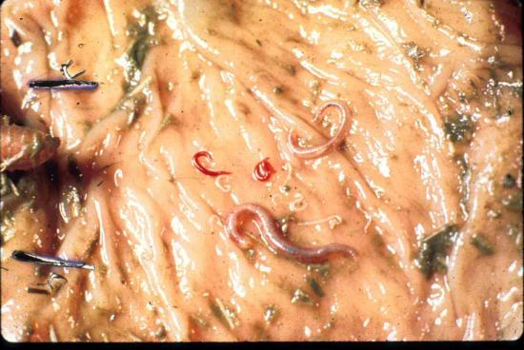
Cyathostomes
larvae do NOT migrate beyond large intestine
L₄ can arrest in intestinal mucosa and reactivate at later times, especially when horse is stressed or in springtime/foaling season or after removal of adult worms by deworming.
prepatent period is ~ 2.5 - 3 months without arrest

Slide 21
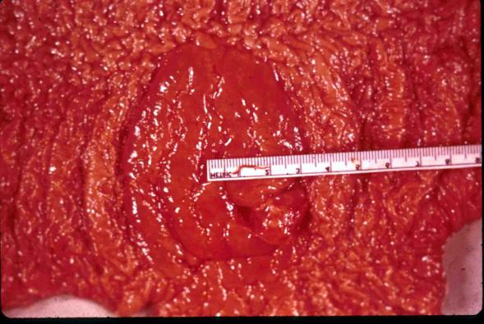
Cyathostomes
granulomatous colitis from larvae in mucosa
major loss of protein, not blood, edema
Progressive emaciation
emerging larvae=colitis+diarrhea
Massive numbers of emerging larvae
Notes:
The figure shows larval forms emerging from the mucosa of the large intestine.

Slide 22
Cyathostomes
Control:
All ages of horses can be sources of pasture contamination
Arrested larval forms are not easily killed by many drugs
Adult worm drug resistant strains have evolved
Steroid therapy in face of clinical signs
Notes:
Adult worm drug resistance to fenbendazole and pyrantel is prevalent. Drug efficacy evaluation for a herd is done that same way as for small ruminants: collect feces for egg count measurement (McMasters) at the time of treatment and 7 to 14 days later. Reduction should be 90% or better.

Slide 23
Treatment & Control
pasture management
remove manure;
keep grass short
avoid mixing foals with yearlings (Why?)
monitor fecal egg counts (McMasters) on individual horses as a basis for selective deworming at 3 years of age and older.

Slide 24
Control program against strongyles
deworming schedule - strategic
during grazing season
with larvicidal drug at beginning and end of grazing period
use a larvicidal drug q 6 months to kill emerging and arrested L4s
e.g. fenbendazole elevated/prolonged dosage, or moxidectin
Any drug that kills metabolically active larvae will kill adults
Notes:
Currently there is wide-spread (global) adult worm resistance to fenbendazole and to pyrantel. So far no resistance to avermectin drugs.

Slide 25
Eggs per Gram (EPG)
Strongyle-type eggs
Genus??
Variability in results: technique is important
20% of individuals in herd produce 80% of eggs deposited on pasture.
Justification for “selective deworming”.
Interpretation of data for tactical (response to the current situation) treatment. Horses: >200 -500 epg

Slide 26
EPG tells you the horse is……
Infected with mature strongyle adult worms; probably also has larval stages in mucosa.
But low or negative epg does not rule out mucosal larval stages that may be causing disease.
Adult worms are contaminating the pasture with eggs (which will become infective larvae)

Slide 27
“So, what’s a good deworming schedule for horses?!!!”
See American Association of Equine Practitioners Guidelines 2016. (Summary in your lecture manual.)
First year:
(foals, weanlings, yearlings)
deworm at least 4 times starting at 2-3 months of age
again at 4-6 months old, 9 months and 12 months if on pasture.
>3 years old:
two treatments at six-month interval minimum for small strongyles (also covers large strongyles, tapeworms, bots and stomach worms).
Do fecal egg counts to adjust treatment frequency upward on individual basis.
Notes:
It is important to know that there are recommendations for parasite control endorsed by the AAEP that would be considered as “best practices”. These have been published in many lay journals.

Slide 28
Some common dewormers: (FYI only)
Pyrantel
STRONGID-C (Pellets; tartrate salt; daily)
STRONGID-T (Paste; pamoate salt)
Fenbendazole
PANACUR
Ivermectin
EQVALAN paste/liquid, DURAMECTIN, ZIMECTIN (with praziquantel)
Moxidectin
QUEST GEL
Abamectin/Praziquantel
EQUIMAX

Slide 29
VMP 930 lecture 18c
Superfamily Strongyloidea
Oesophagostomum (nodular worm)
Syngamus trachea (gape worm)

Slide 30
Oesophagostomum spp.
There are many species of Oesophagostomum
Most species are host specific

Slide 31
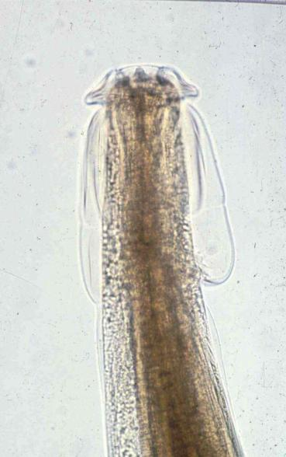
Oesophagostomum
cephalic collar
NODULAR worm of cattle, sheep, goats, swine and primates
Adult worms:
in large intestine
15-20 mm long, stout
cephalic collar at anterior end

Slide 32
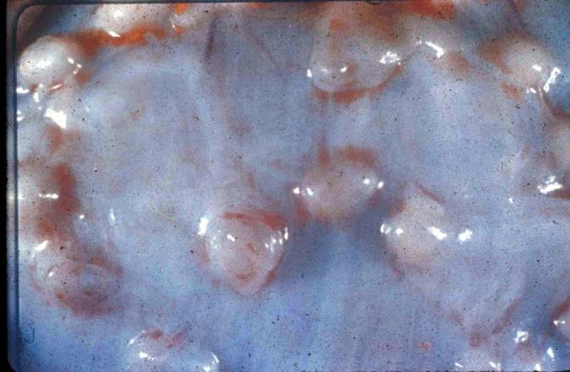
Oesophagostomum
L3s are ingested while grazing
Larvae are within encapsulated cysts (aka Nodules) in both large and small intestine.
Serosal view of cystic nodule response to larvae

Slide 33
Oesophagostomum
Pathogenesis
due mostly to larvae
adhesions, calcified cysts
Enteritis/diarrhea when L4s emerge
i.e. acute inflammatory reaction
Mucosal view of response to emerging larvae
Notes:
Adults are found in the large intestine, but they are not as pathogenic are the larval form.

Slide 34
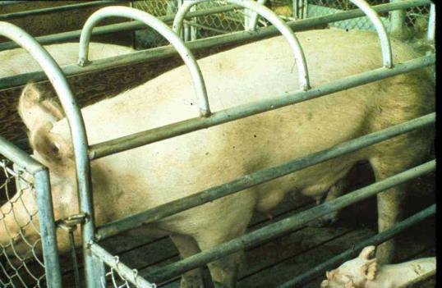
Oesophagostomum in Swine
Ingestion of infective larvae
Much transmission of infection to piglets
due to peak worm-egg production in sow at ~6 weeks after farrowing
Notes:
Infective larvae develop in soil with or without pasture. Infection is by ingestion of larvae with soil while routing and or nursing mom with dirt on her nipples. No significant transmission in confinement reared pigs.

Slide 35
Syngamus trachea (FYI only)
aka “gapeworm”
Avian host
turkey, pheasants, fowl, captive emus in NC
2-20 mm long adults, in permanent copula
Unlike other genera in the Strongyloidea superfamily this worm has double operculated ova.
permanent copula
small male
large female

Slide 36
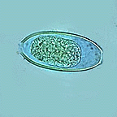
Syngamus trachea (FYI only)
Life-cycle
direct ingestion of egg OR
via a transport host (earthworm, snail, slug)
After ingestion
larvae migrate into the airways and mature in lungs
PPP ~3 weeks
eggs are coughed up and swallowed
bi-operculated egg in feces
Birds show signs of tracheal obstruction
opercula
Notes:
Common name originates from the clinical signs of tracheal obstruction by mature worms. Birds stand with necks extended, beaks open, gasping for air.

Slide 37
VMP 930 lecture 18d
Superfamily Metastrongyloidea
Metastrongylus in pigs
Aelurostrongylus abstrusus in cats

Slide 38
Order Strongylida
Superfamilies:
Trichostrongyloidea
Strongyloidea
Metastrongyloidea = infect lungs
Ancylostomatoidea
Notes:
The nematodes of the superfamily Metastrongyloidea, as the name implies, are different from the members of the two previous superfamilies of the Order Strongylata in life cycle and the adult worm location inside the host (excepting Dictyocaulus and Syngamus).

Slide 39
Metastrongyles
Metastrongyles
Mostly respiratory system
but some affect the vascular and nervous systems.
None enteric
Life-cycle can be:
INDIRECT requiring snails, slugs, earthworms
Direct (Filaroides sp. not covered here)

Slide 40
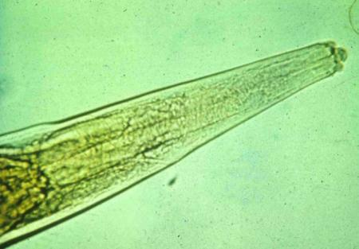
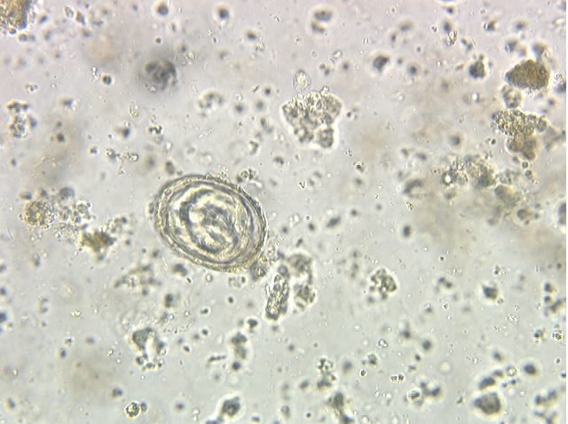
Metastrongylus (lung worms of swine)
adult worms
large, white
in bronchi
larvated eggs are released from the female in the bronchi, coughed up, swallowed and passed out in feces
2 trilobed lips
Notes:
Larvated eggs hatch when ingested by earthworms where infective larvae develop before the earthworms are eaten by pigs. No transmission in confinement-reared pigs.

Slide 41
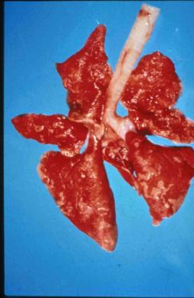
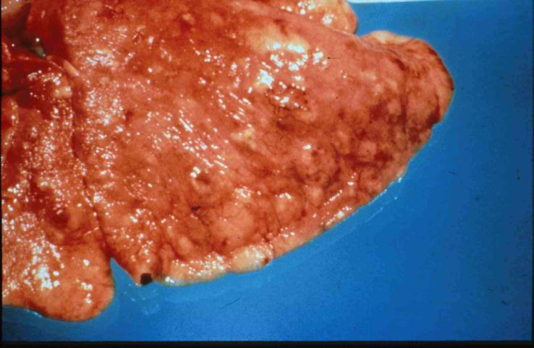
Aelurostrongylus abstrusus (lung worm of cats)
Adults in lung parenchyma of CATS
Occasionally seen in N.C.
Grayish subpleural nodules

Slide 42
Aelurostrongylus abstrusus
Can be the cause of severe disease in indoor/outdoor cats.
Diagnosis requires special technique to find motile larvae in feces or sputum.

Slide 43
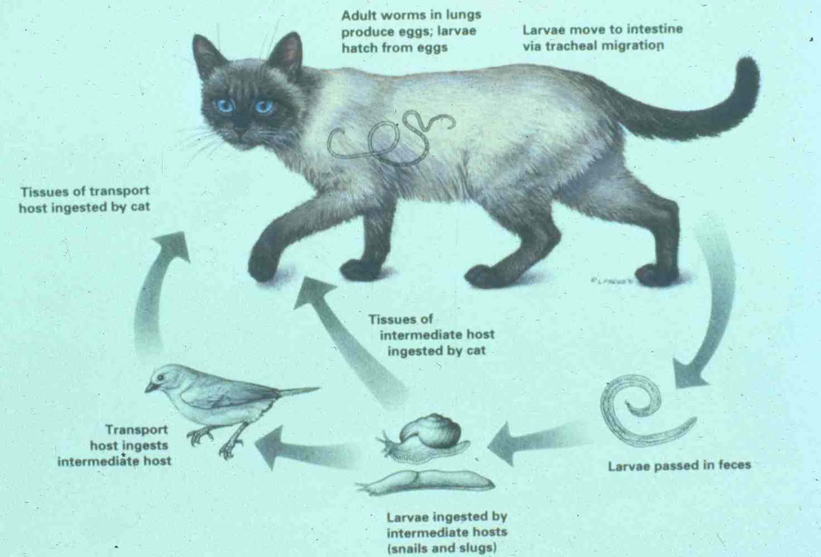

Slide 44
Aelurostrongylus abstrusus
Cat infected by eating
infected snail/slug
infected paratenic host (e.g. bird)
Larvae migrate from stomach to lungs
Prepatent period is 5-6 weeks
L1 coughed up, swallowed, in feces

Slide 45
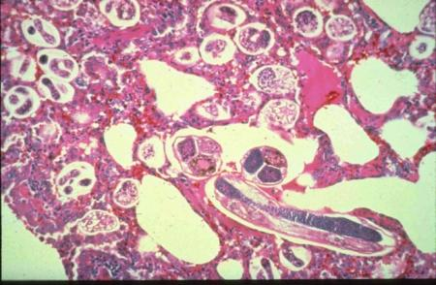
Aelurostrongylus abstrusus
Pathogenesis
Egg masses
small, grayish subpleural nodules
Adult worms
7-10 mm long
Cause smooth muscle hyperplasia and pulmonary hypertrophy
Heavy burdens can be fatal

Slide 46
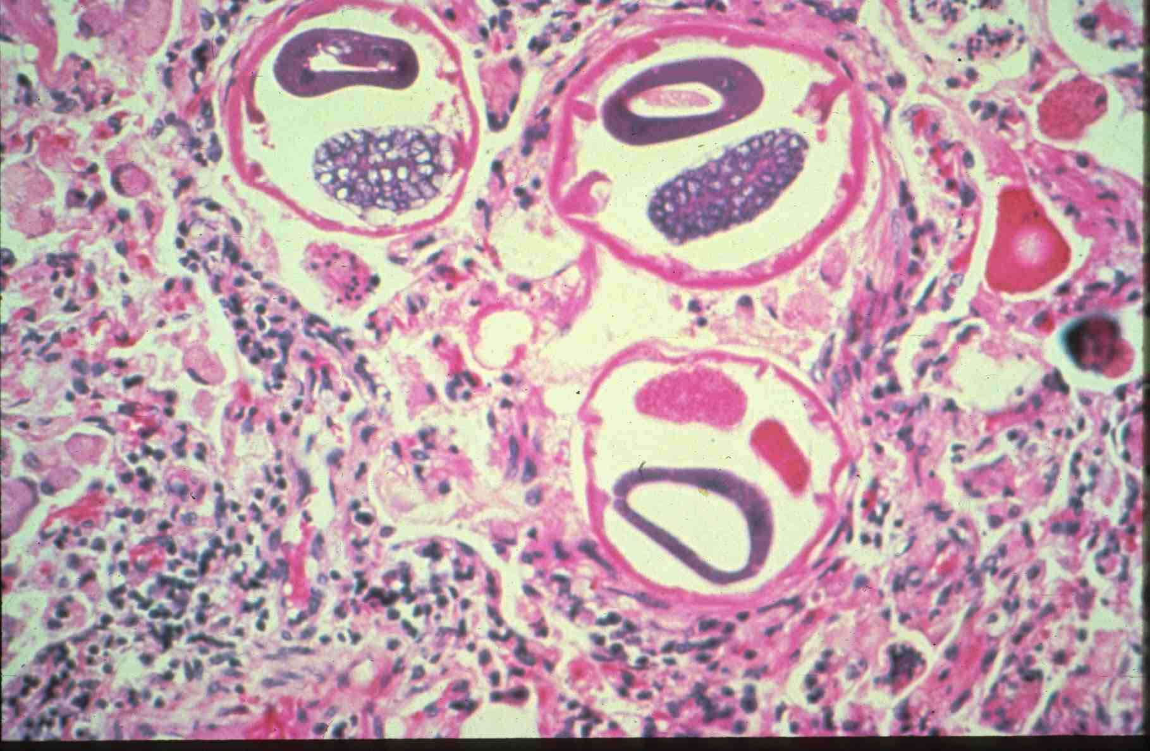
intestine
uterus
Adult worms in cross-section
cuticle
Aelurostrongylus abstrusus

Slide 47
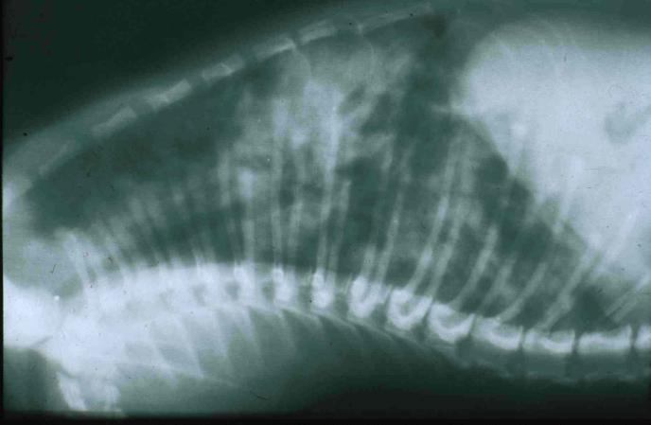
Aelurostrongylus abstrusus
Diagnosis
Respiratory signs
Thoracic radiographs
parenchymal densities

Slide 48
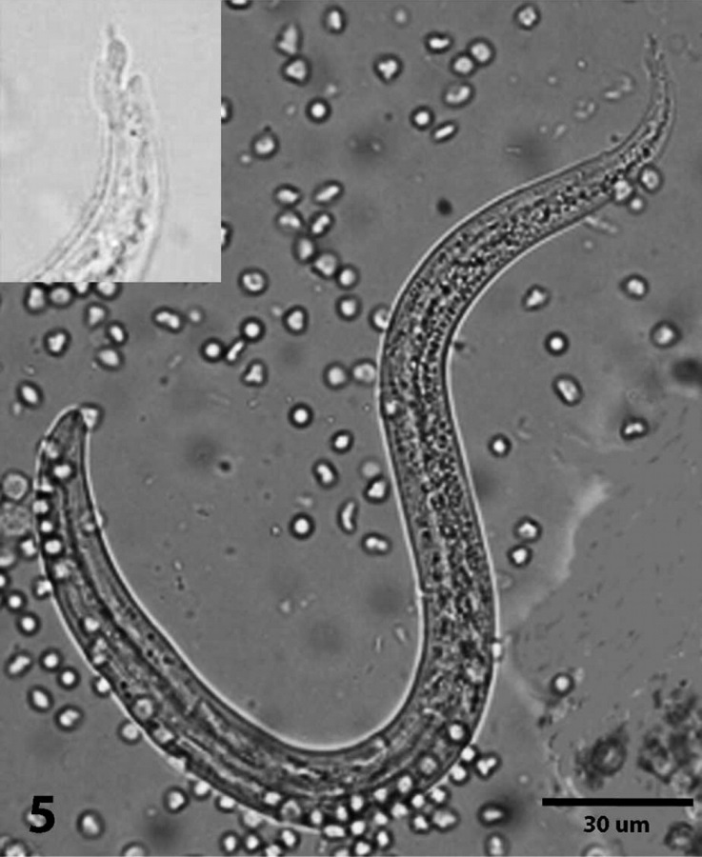
Aelurostrongylus abstrusus
Diagnosis
L1 larvae in feces or sputum
Baermann OR direct smear
Spine at posterior end
Baermann funnel

Slide 49
Aelurostrongylus abstrusus
Control
fenbendazole, ivermectin
restrict access to paratenic hosts

