Slide 1
VMP 930 lecture 19a
Superfamily Ancylostomatoidea
Hookworm

Slide 2
Order Strongylida
Superfamilies:
Trichostrongyloidea
Strongyloidea
Metastrongyloidea
Ancylostomatoidea (hookworms)
Notes:
Hookworm infections in dogs (Ancylostoma caninum) are common in dogs of all ages and an important cause of clinical disease (anemia) in puppies.

Slide 3
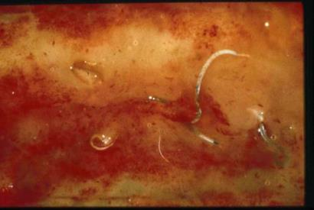
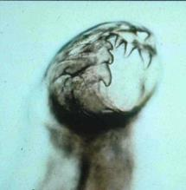
Ancylostomatoidea
Lumen of small intestine
Note blood caused by feeding hookworms
adult worm
HOOKWORMS
Adults
dorsally flexed anterior
Buccal cavity w/ cutting teeth or plates
10-16 mm long
Infect the host’s small intestine
Anterior of hookworm
Note buccal cavity with teeth
Notes:
The upper figure shows the anterior end of Ancylostoma caninum.

Slide 4
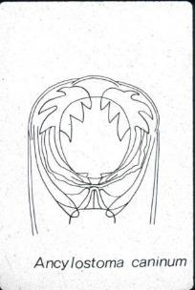
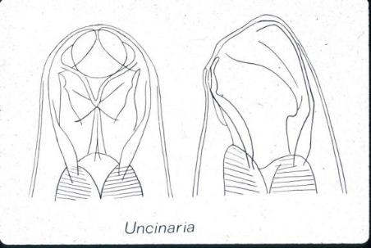
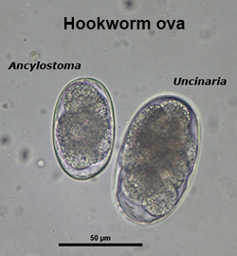
TEETH
Morphology
Anterior morphology
Ova morphology
Strongyle-type eggs in dog or cat feces = “HOOKWORM” eggs
CUTTING PLATES
Ancylostoma
Uncinaria
Notes:
Ancylostoma and Uncinaria eggs are morphologically the same. Same egg type as found in ruminant and horse feces. If a dog eats horse feces it will pass strongyle-type eggs in its feces while not infected with hookworms.

Slide 5
Ancylostoma species of importance
Ancylostoma caninum --- DOGS
Ancylostoma tubaeformae --- CATS
Ancylostoma braziliense --- DOGS & CATS
Ancylostoma duodenale --- HUMANS

Slide 6
Ancylostoma caninum
SOUTH-EASTERN STATES, most prevalent enteric helminth in dogs
~20-40% in shelter dogs

Slide 7
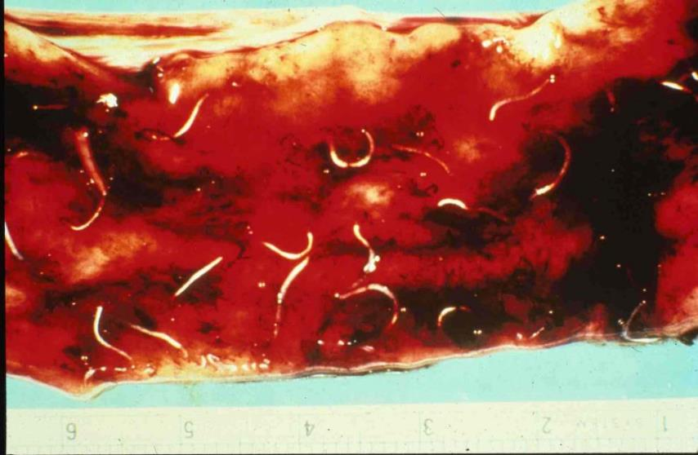
Blood-feeding parasites
Morbidity and potential mortality!
Notes:
Neonatal or very young puppies under 6 weeks of age are at highest risk for acute disease and death due to blood loss.

Slide 8
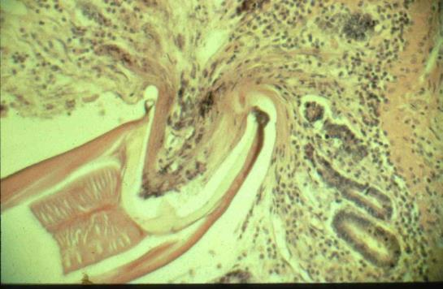
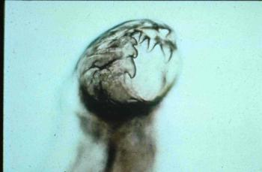
A. caninum: Pathogenesis
Ancylosotma caninum adult
…taking a ‘bloody’ bite of mucosa!

Slide 9
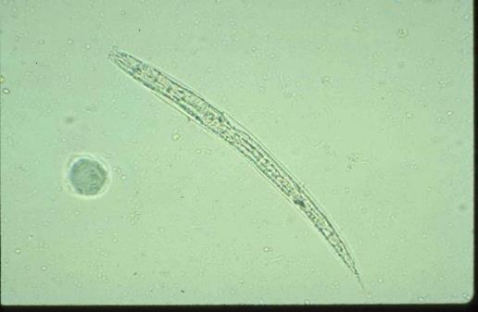
A. caninum: Ecology
Egg → L1 → L2 → L3
5-7 days in warm, moist soil
Infective L3 larva
Notes:
Just like trichostrongyles infecting ruminants and strongyles infecting horses, hookworm ova passed in feces develop to the L3 infective stage in the environment, typically, warm, moist soil.

Slide 10
A. caninum: Transmission
Infection from the environment by:
Ingestion of L3
Skin penetration by L3
(Ingestion of paratenic host)

Slide 11
Development within the host
Two choices for an L3 larva after entering host:
1. NORMAL DEVELOPMENT
L3 L4 Adult
OR
2. ARRESTED DEVELOPMENT
(‘hang out’ as L3 in muscle, organs)

Slide 12
Development within the host
When do arrested L3 larvae reactivate?
DEWORMING
STRESS
PREGNANCY
REACTIVATION of tissue-arrested L3s
REACTIVATION of tissue-arrested L3s
SELF-REPOPULATION
L3 to adult stage
in small intestine
TRANSMAMMARY TRANSMISSION
L3 in milk to pups
(but not kittens)

Slide 13
Transmammary transmission
Migration to mammary glands
Transmission in milk to nursing pups during lactation
Experimental observation:
1 infection of dam can contribute to transmission of infection to at least 3 subsequent litters!

Slide 14
Getting rid of arrested larvae?
metabolically quiescent
relatively resistant to host defense mechanisms and to drugs
negative fecal analysis ?

Slide 15
Ancylostoma transmission
What are the different ways by which dogs and cats can acquire Ancylostoma infections?
Ancylostoma caninum
Ancylostoma tubaeformae
Primary route is lactogenic
Ingestion from environment
Skin penetration from environment
No lactogenic transmission in cats
Primary is ingestion from environment
Notes:
Only the L3 larva is infective, not ova. The L3 larva in milk that came out of arrest when lactation began is the same L3 larva that entered the host by skin penetration or by ingestion.

Slide 16
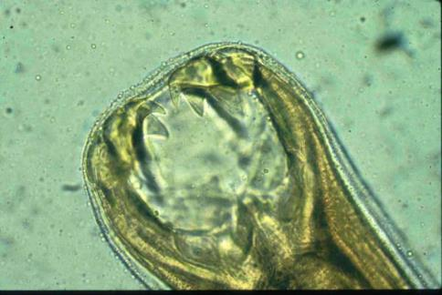
Pathogenesis & Clinical signs
Adult worms are blood-feeders
need oxygen/nutrients
Consequences to the host:
ANEMIA
BLOODY DIARRHEA

Slide 17
Pathogenesis
Hemorrhage: bite sites continue to bleed
(Why does blood not clot?)
Some damage to intestinal mucosa
Larval migrations may cause some pathology (e.g. respiratory signs but this is not common)

Slide 18
Clinical Disease
Acute anemia in nursing puppies
PCV down to 10+% from 35-57% (normal)
Blood loss from 50-100 adults ~3 ml/day
Mortality between 8 and 24 days of age
Chronic disease: weight loss, poor body condition, especially in older or immunocompromised animals
Clinical disease very common in dogs but not in cats

Slide 19
Host resistance - Adult dog
acquired immunity (not complete)
prone to re-infection
premunition (inhibition of further infection due to residual population)
ability to compensate for blood loss

Slide 20
Treatment & Control
Warm, moist conditions favor L3 survival, do not tolerate desiccation
Newly emerging multi-drug resistant Ancylostoma caninum. Seen in mature dogs. Originally rescue Greyhounds.
Newborns
TREAT with anthelmintic at first sign of disease (Improvement = Diagnosis)
+/-BLOOD TRANSFUSION
+/- Iron supplementation, vitamins, protein

Slide 21
Treatment & Control
Puppies: deworm every 2-3 weeks, until starting monthly heartworm preventative
Keep runs clean and dry; bleach washes

Slide 22
Treatment & Control
Treating pregnant dogs to prevent infections in puppies
Fenbendazole - every day from day 40 of gestation to day 14 of lactation (~ 40 days!)
Selemectin and possibly other monthly avermectin prophylactic drugs timed to coincide with whelping. Much easier than above

Slide 23
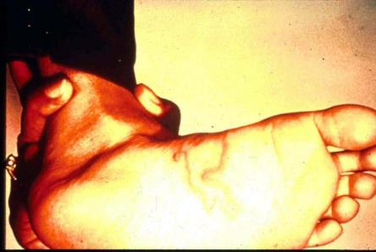
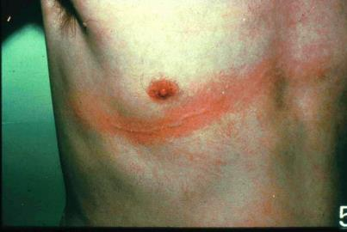
Zoonosis
Infective L3 can penetrate human skin and cause cutaneous larva migrans
erythematous pruritis
A. braziliense; A. caninum

Slide 24
Uncinara sp.
less common hookworm of dogs
found in cooler temperate regions
relatively non-pathogenic
only infected by ingestion of L3
(no transmammary transmission)

Slide 25
VMP 930 lecture 19b
Order Oxyurida
Oxyuris equi (pinworm of horses)
Notes:
This an entirely different Order from all the previous worms we have presented in the Order Strongylata.

Slide 26
Order OXYURIDA
Pinworms of the large intestine
Adult worms have long tapering tail
Worm most often seen by horse owner
Host-specific
Enterobius is a human pinworm
Cats and dogs do NOT have pinworms
Horses: Oxyuris equi

Slide 27
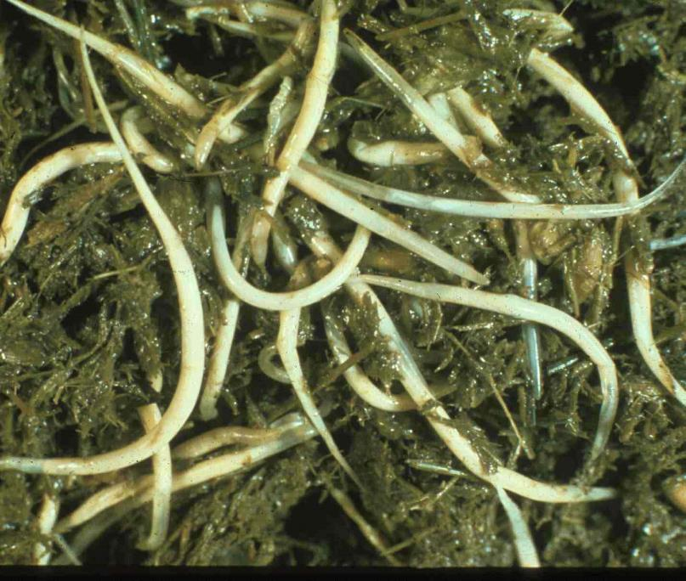
Oxyuris equi
Long tapering posterior
large, white, thick-bodied adults

Slide 28
Oxyuris equi
Life Cycle
Host: Horses
Adult female in large intestine, migrates to the anus and deposits eggs in a sticky fluid on perianal area
Fluid dries and flakes off with eggs contaminating food and water containers
Infective L3 mature within the eggshell in 4-5 days; ingested by the horse
L3s in large intestine mature to adulthood
Prepatent period ~ 5 months
Notes:
The long prepatent time allows control with twice yearly treatment, but drug resistance requires using anthelmintics other than ivermectin and moxidectin. Sanitation including cleaning tack, water and food containers is important.

Slide 29
Oxyuris equi
Pathogenesis & Clinical Signs
Large numbers of adults and developing L4 - L5 larvae in the large intestine cause colitis
Eggs/sticky fluid cause perianal itching and a bare or scruffy ‘tailhead’

Slide 30
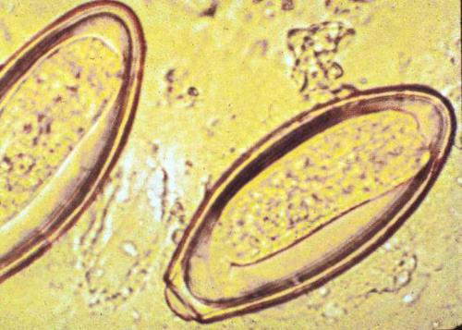
Oxyuris equi
Diagnosis
‘scotch-tape’ pressed around previously cleaned perianal area; examine for operculated eggs
Eggs w/ single operculum
operculum
embryo
Notes:
Diagnosis requires cleaning the perianal area the day before using scotch tape to dap the perianal area and look for operculated ova.

Slide 31
Oxyuris equi
Treatment
Benzimidazoles (fenbendazole) recommended
Drug resistance to avermectins including ivermectin and moxidectin.

