Slide 1
VMP 930 lecture 21a
Order Enoplida
Trichinella

Slide 2
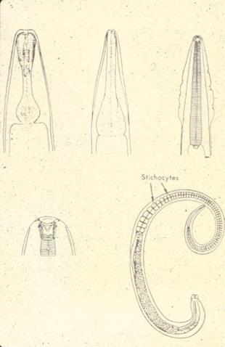
Order Enoplida
rhabditiform
strongyliform
filariform
Three important genera
all have the stichosome esophagus Trichinella spiralis Trichuris Capillaria (Eucoleus)
Stichosome esophagus
Notes:
The stichosome esophagus is composed of glandular stichocyte cells lining the esophagus, especially prominent at the posterior portion of the esophagus.

Slide 3
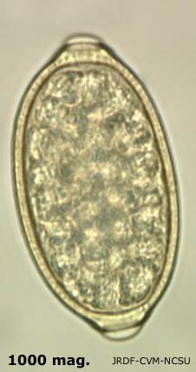
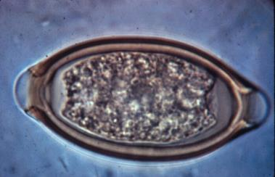
Order Enoplida
Capillaria egg
Trichinelloidea genera and Dioctophyme have eggs with bipolar plugs.
(Also Syngamus trachea in birds, which is not in this Order).
Capillaria above
Trichuris below
Trichinella does not produce eggs
shell with tiny pits or ridges
Trichuris egg
shell is very smooth

Slide 4
Trichinella spiralis
The same species infects all warm-blooded animals
Causes a zoonotic disease of major public health concern
where pigs are raised outside, and pork is not cooked well or frozen
when omnivore/carnivore game species are eaten without thorough cooking

Slide 5
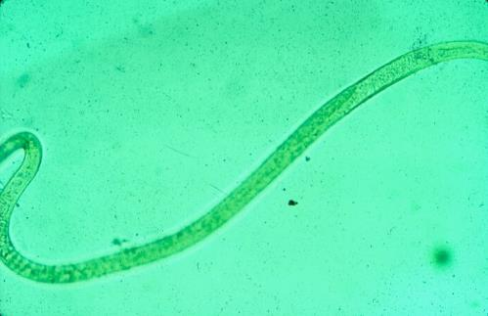
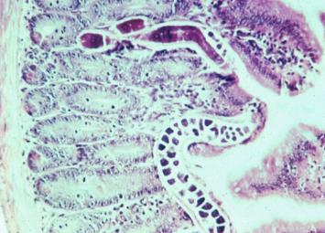
Trichinella spiralis
Tiny adults are found in the mucosa of the small intestine.
Adult stage isolated from intestine
stichocytes
small intestine
adult female

Slide 6
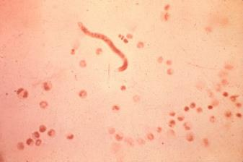
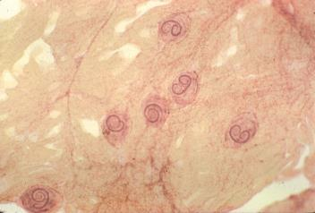
Trichinella spiralis
Larvae produced by the females are distributed to the host muscle tissue of the same host where they remain until eaten by the next host.
Consequences of infection.
What is the risk of humans getting infected from eating undercooked beef compared to eating undercooked pork?
L₁ larva in blood
L₁ larva encysted in muscle

Slide 7
Trichinella spiralis
Clinical disease seen in humans, rarely in other species.
Signs of transient enteritis early after infection, then larvae cause myositis and possibly muscle paralysis in heavy infections.
Diagnosis:
clinical signs shortly after eating raw or under-cooked meat.
Antibody titers.
Notes:
Diagnosis is mainly by clinical signs and history supported by serology showing antibodies specific for Trichinella.

Slide 8
Trichinella spiralis
Do not eat raw or rare meat!
Even horse meat may contain Trichinella. How?
Do not feed uncooked garbage to pigs.
Rodent control to prevent pigs from eating “ratburgers”.
Treatment:
benzimidazoles and concurrent corticosteroids.
Notes:
Horses being fed meat scrapes is reported to occur in Eastern Europe. Also, alfalfa hay cubes containing rodent carcasses can result from close cutting hay fields.

Slide 9
VMP 930 lecture 21b
Trichuris (whipworm)
Capillaria / Eucoleus

Slide 10
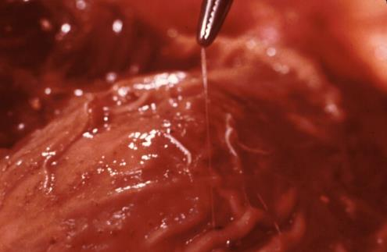
Trichuris sp.
Adults found in the tip of the cecum and large intestine.
Unlike Trichinella, Trichuris is very species specific.
Mucosal surface of cecum
adult Trichuris posterior end
anterior end embedded in mucosa

Slide 11
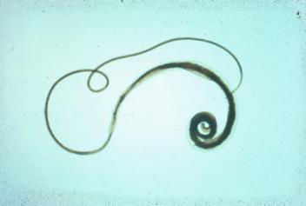
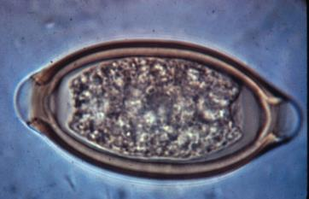
Trichuris sp.
Long thin (hair-like) anterior end and thicker posterior 1/3 (big butt).
Females produce double operculated, bipolar eggs characteristic of the Order, including Capillaria.
Trichuris egg with smooth shell

Slide 12
Trichuris
Transmission
Egg containing infective larva must be ingested. Route of infection = fecal/oral.
But eggs require 3 weeks to become infective.
Prepatent time in dogs is 12 weeks.
PPT in Pigs = 6 weeks.

Slide 13
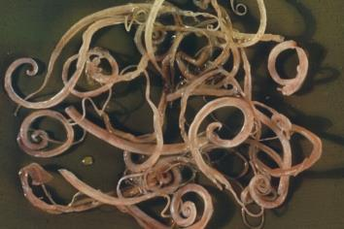
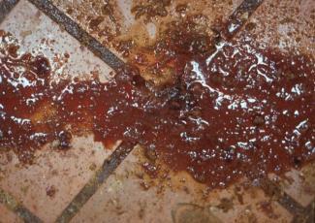
Trichuris
Clinical signs
seen mostly in dogs (T. vulpis) and pigs (T. suis)
characteristic of colitis, and often hemorrhagic.
Pathology
due to bacteria invading mucosa compromised by Trichuris
blood in diarrhea feces

Slide 14
Trichuris
Diagnosis is problematic.
Long prepatent times must be observed
Adult females are sporadic egg producers
thus diagnosis by fecal exam is difficult.
Fecal antigen diagnostic tests for prepatent worms and adult worms are available for send out commercially. This is very helpful for problematic Trichuris infection.
Notes:
Fecal antigen diagnostic tests for prepatent and adult worms are available for send out commercially. This is very helpful for problematic Trichuris infection.

Slide 15
Trichuris
Control is problematic.
long prepatent time must be observed
larval stages are not easily killed by most drugs.
eggs are highly resistant and larvae inside are long-lived like ascarid eggs.
change environment and repeat treatments for the length of the prepatent time at least.
shorten heartworm monthly prophylaxis to three-week interval (milbemycin containing products work best for this)

Slide 16
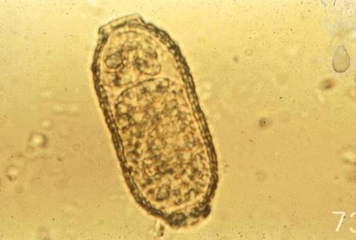
Capillaria sp. (Eucoleus)
A multitude of species that are site specific and somewhat host specific.
All have a stichosome esophagus and are hair-like.
Females produce bipolar eggs that must be differentiated from Trichuris eggs.
Capillaria egg with ridges on shell

Slide 17
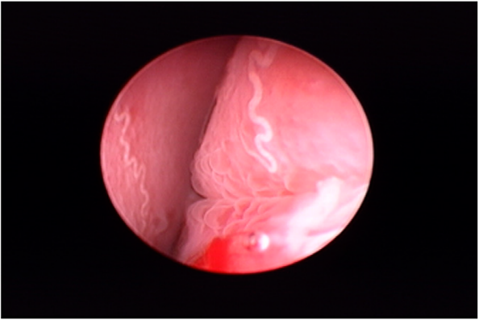
Capillaria sp.(Eucoleus)
Nasal sinuses and airways of dogs and cats.
Differential diagnosis with allergic rhinitis important for correct treatment (corticosteroid vs anthelmintic)
Urinary bladder of dogs and cats.
Digestive tract of birds.
Eucoleus bohmi on nasal sinus mucosa – endoscopic view
Notes:
Different organ sites harbor different species of Eucoleus. These species are host and organ specific.

Slide 18
Capillaria sp. (Eucoleus)
FYI not on test
Treatment of companion animals
fenbendazole (Panacur) at very high doses for 1-2 weeks
OR ivermectin (0.2mg/ml).
Treatment of production animals
Pyrantel tartrate as continuous medication in feed is used to kill larvae emerging from eggs, as with ascarids and Trichuris.

