Slide 1
VMP 930 lecture 21c
Order Spirurida
Require arthropod intermediate hosts

Slide 2
Urbanized Raccoons as Sources of Helminth Infection to Dogs
Macracanthorhynchus ingens (thorny headed worm)
Heterobilharzia americana (blood fluke)
Dracunculus insignus (related to human guinea worm)
Physaloptera (stomach worm of dogs and cats)
Baylisascaris procyonis (raccoon ascarid)
Notes:
This is a list of uncommon helminths that should be considered if your practice is in an area where raccoons are frequently seen. Macracanthorhynchus information is in the appendix of your lecture manual but will not be on tests. Dr. Flowers will cover Heterobilharzia. Dracunculus and Physaloptera will be covered in this section.

Slide 3
Order Spirurida - general features
What is in this Order? Dracunculus insignus – subcutaneous. Physaloptera - stomach worm of dogs, cats. Habronema & Drashia - found in stomach of horses. Onchocerca - found in ligaments of horses. Dipetalonema - subcutaneous in dogs. Dirofilaria - dog heartworm.

Slide 4
Order Spirurida - general features
Require arthropods as intermediate host.
Routes of infection:
ingestion of arthropod, or ingestion of a paratenic host that ate the infected arthropod.
infective larvae delivered to host when arthropod feeds on the host.

Slide 5
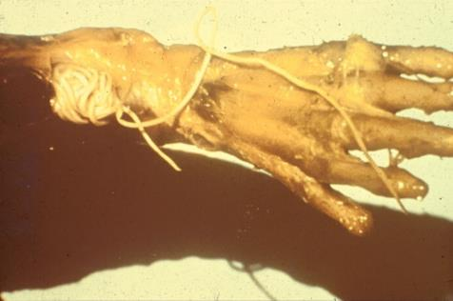
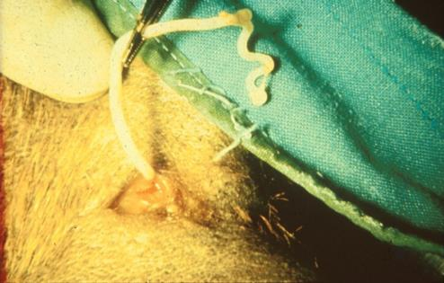
Dracunculus insignis
Raccoon: skinned fore limb
Dracunculus adults
Surgical removal from a dog
Dracunculus insignus – occurs in North Carolina in dogs, raccoon reservoir (also, reported in 2 cats)

Slide 6
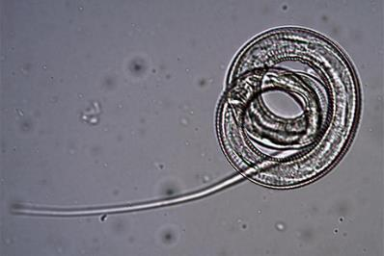
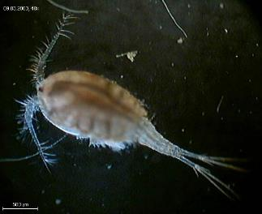
Dracunculus insignis
Life cycle:
adult female opens skin lesion to release L₁
L₁ are eaten by copepod intermediate host.
Copepod or paratenic host frog eaten by raccoon/dog.
Prepatent time in dog = 300-400 days.
Dracunculus L1 from adult female
Copepod containing infective L3

Slide 7
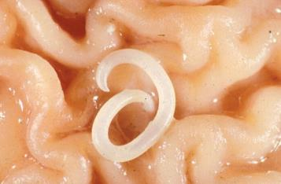
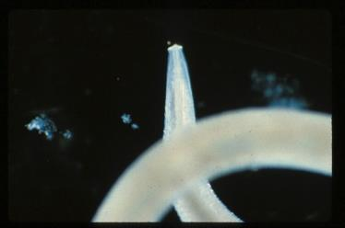
Physaloptera sp.
Thick-bodied up to 40 mm long with anterior collar
don’t confuse with Toxocara or Toxascaris.
Adults in stomach of raccoons (reservoir host), dogs and cats.
Cephalic collar

Slide 8
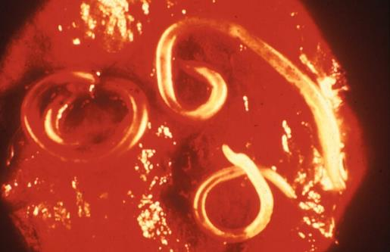
Physaloptera sp.
Beetles are the intermediate hosts
but rodents can be paratenic hosts.
Pathogenesis: gastritis, bleeding, ulcers.
Notes:
The figure shows an endoscopic view of adult worms embedded in the mucosa of the stomach.

Slide 9
Physaloptera sp.
Diagnosis:
difficult due to few and hard to float eggs.
Vomited worm
don’t assume it is Toxocara.
Endoscopic exam.
Treatment:
Pyrantel at 20mg/kg, repeated if vomiting persists.
Other anthelmintics effective as well.

Slide 10
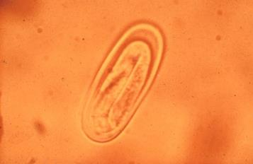
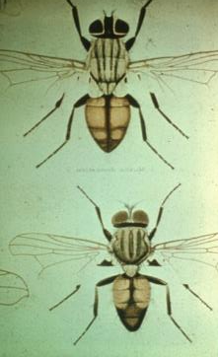
Habronema and Drashia
Stomach worms of horses
Up to 20 mm long, thicker than Trichostrongylus axei
Life Cycle
larvated egg, passed in feces
hatches and L₁ ingested by maggot of Stomoxys or Musca flies
L₃ deposited on horse by fly - when fly is feeding around lips, eye or wounds.

Slide 11
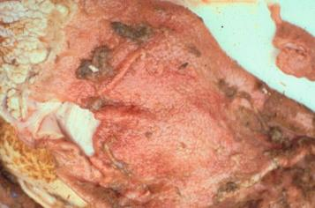
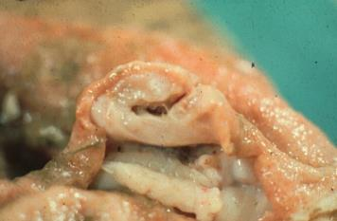
Habronema and Drashia
Internal Pathogenesis:
gastritis and ulcers from Habronema adults
fibrous “tumors” in stomach wall containing adult Drashia.

Slide 12
Habronema and Drashia
External Pathogenesis
cutaneous habronemiasis
occurs when larval stages remain in the skin and cause eosinophil/granulomatous lesion.

Slide 13
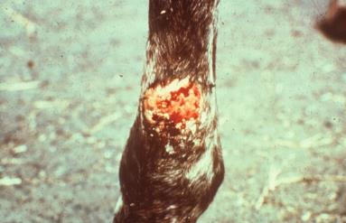
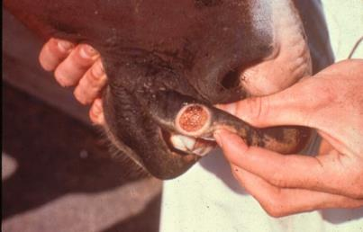
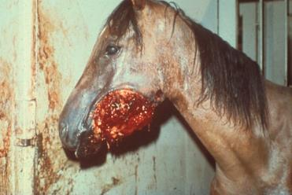
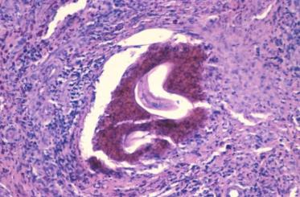
Habronema and Drashia
Notes:
Lower right figure shows biopsy of the lesion showing eosinophil infiltrate and larval worm.

Slide 14
Habronema and Drashia
Diagnosis:
Anorexia
cutaneous lesions
response to anthelmintics.
Treatment:
systemic fenbendazole or ivermectin
also topical application.
Control:
compost manure and fly control if indoors.
Use fly repellant on abrasions.

Slide 15
Dipetalonema (Acanthocheilonema)
A filarial worm of dogs
Adults in subcutaneous tissue cause no signs
but microfilariae in blood can be confused with Dirofilaria immitis.

Slide 16
Onchocerca sp.
Filarial worm
Species in horses was very common before ivermectin, now seen in horses under minimal management.
Adult worm in ligaments of neck cause no pathology there.
Microfilariae produced by adults congregate in skin of ventral abdomen where intermediate host, Culicoides (midge) bite.

Slide 17
Onchocerca sp.
Pathogenesis:
summer sores develop on ventral abdomen
This localized dermatitis is very itchy (pruritic).
microfilariae found in skin snip.
Treatment:
systemic ivermectin clears skin lesions.
May precipitate transient edema.

Slide 18
Dirofilaria immitis
Canine Heartworm
https://www.heartwormsociety.org/veterinary-resources/american-heartworm-society-guidelines
Read American Heartworm Society Guidelines for Dogs.
Read American Heartworm Society Guidelines for Cats.
Come ready to discuss in class.
These Guidelines are published “Best Practice Guidelines” viewed by your clients
http://heartwormsociety.org

