Slide 1
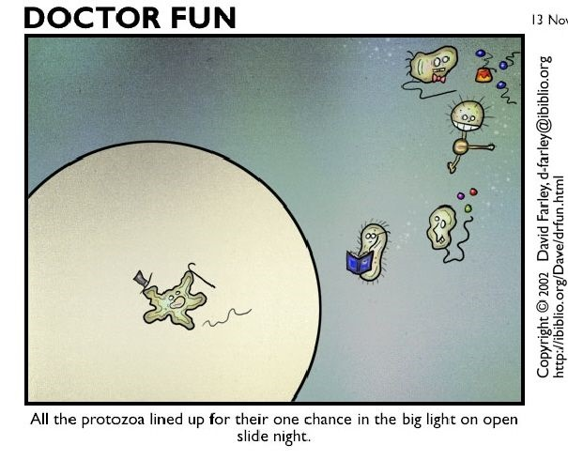
Introduction to Protozoa:
Lecture 2

Slide 2


Parasitic
Protozoa
One cell menaces
Dr. Qurollo (cue-rah-low)

Slide 3
Introduction to Protozoa: Learning Objectives
(no test questions directly from these Introduction slides)
Introduction to the 5 general traits shared by all protozoa
Introduction to protozoa terminology and the pathogens we will cover.
Introduction to the different topics we will cover for each pathogen and why it is important to know, as veterinarians.
Introduction to the 4 primary mechanisms of protozoa pathology.

Slide 4

Protozoa Traits
1. Single cell, eukaryotes
2. Most protozoa are not pathogenic nor require a host
3. Most reproduce by binary fission (asexual multiplication)
  -some reproduce sexually and asexually (Apicomplexa group)
4. Asexual multiplication provides the mechanism for
developing pathogenic protozoan populations.
Notes:
These are basic traits that all protozoa share.

Slide 5


Protozoa Taxonomy changes
Illustration by Allie Brosh, http://hyperboleandahalf.blogspot.com/
Notes:
In the past, I have fallen into a wormhole trying to update myself on the organization of protozoa!
Over time, protozoa names and organization have changed as parasitologists learn more about these organisms, especially with more genome sequence knowledge.
I will introduce you to old and new taxonomic organization and terminology, since you will hear and read these terms in your notes and textbooks.
You will not be asked test questions related to taxonomy.

Slide 6
PROTOZOA
FYI: Taxonomy
This is an older classification but organization/terms still relevant
APICOMPLEXA (phylum)
SARCOMASTIGOPHORA (phylum)
CONOIDASIDA (class)
MASTIGOPHORA (subphylum)
COCCIDIA (subclass)
ZOOMASTIGOPHORA (class)
CRYPTOSPORIDIIDAE (family)
KINETOPLASTIDA (order)
CRYTOSPORIDIUM (genus)
TRYPANOSOMATIDAE (family)
EIMERIIDAE (family)
TRYPANOSOMA (genus)
EIMERIA (genus)
LEISHMANIA (genus)
SARCOCYSTIDAE (family)
DIPLOMONADIDA (order)
TOXOPLASMA (genus)
GIARDIA (genus)
NEOSPORA (genus)
SARCOCYSTIS (genus)
PARABASALIA (phylum)
CYSTOISOPORA (genus)
TRITRICHOMONADIDA (order)
ACONOIDASIDA (class)
PIROPLASMIDA (order)
TRITRICHOMONADIDAE (family)
TRICHOMONAS (genus)
BABESIIDAE (family)
BABESIA (genus)
THEILERIIDAE (family)
CYTAUXZOON (genus)
Levine et al. A Newly Revised Classification of the Protozoa. J. Protozoo/ 27(1), 1960, pp. 37-58

Slide 7
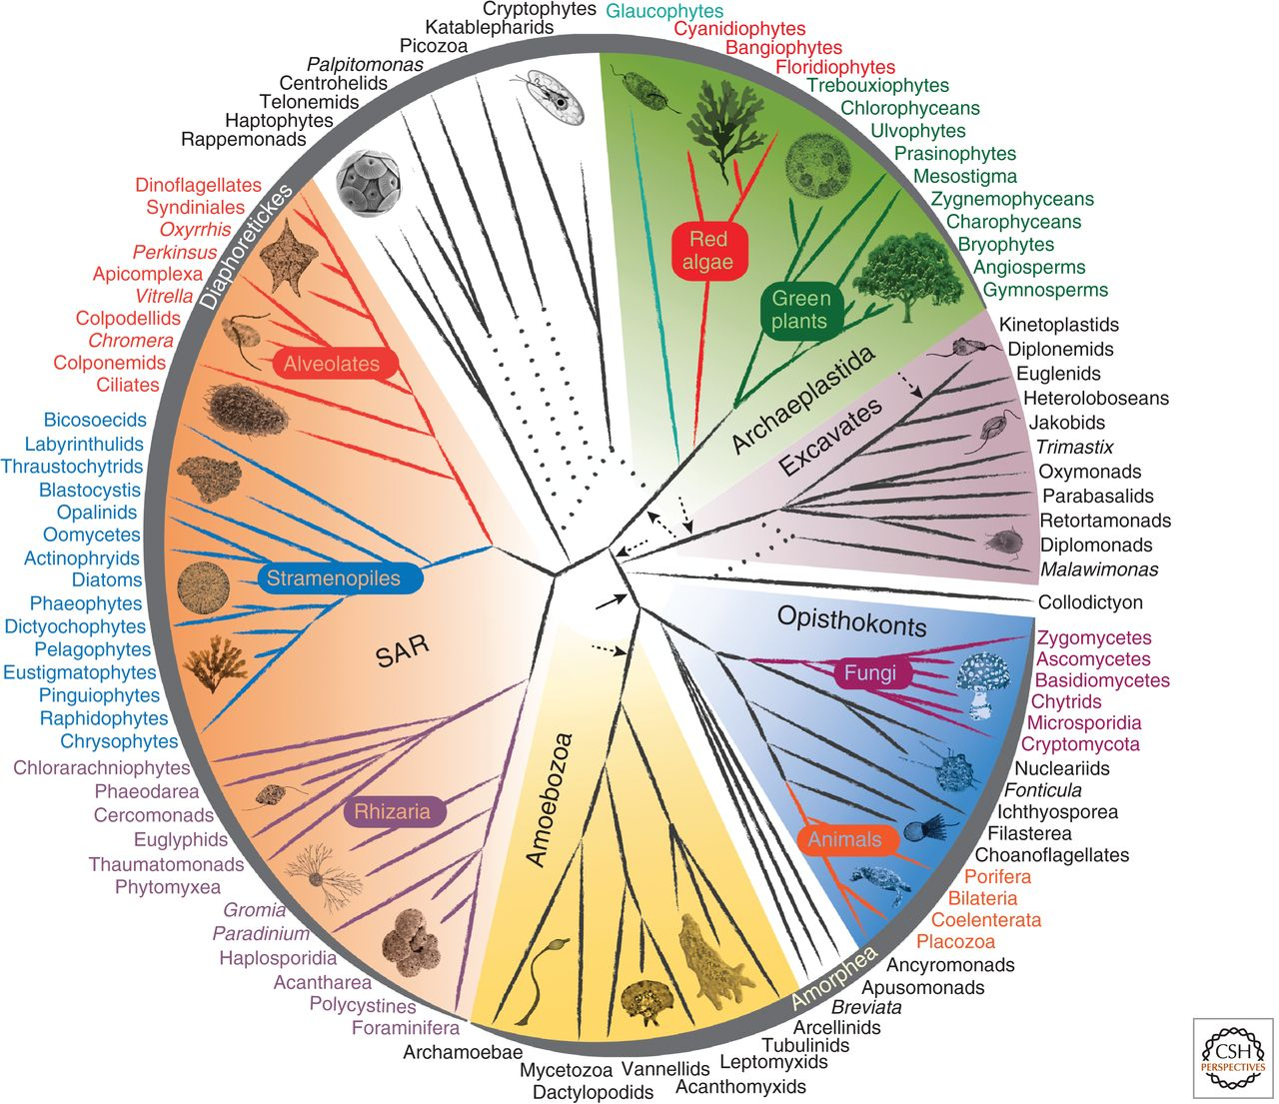
New Classification:
Eukaryote
Supergroups
FYI: Taxonomy
Alveolates
Excavates
1. Adl SM, et al. The new higher level classification of eukaryotes with emphasis on the taxonomy of protists. J Eukaryot Microbiol (2005)52:399-451
2. Keeling, Patrick J., et al. "The tree of eukaryotes." Trends in ecology & evolution 20.12 (2005): 670-676.
3. Burki, Fabien. "The eukaryotic tree of life from a global phylogenomic perspective." Cold Spring Harbor perspectives in biology 6.5 (2014): a016147.
Notes:
Protista kingdom is dead

Slide 8
Alveolates (supergroup)
Excavates (supergroup)
Apicomplexa
Kinetoplastids
BABESIA (genus)
TRYPANOSOMA (genus)
CYTAUXZOON (genus)
LEISHMANIA (genus)
TOXOPLASMA (genus)
Parabasalians
NEOSPORA (genus)
SARCOCYSTIS (genus)
TRITRICHOMONAS (genus)
CYSTOISOPORA (genus)
Fornicatas
CRYTOSPORIDIUM (genus)
GIARDIA (genus)
EIMERIA (genus)
Notes:
The protozoa genera we will learn this year
Most of the pathogen we will cover fall under the large phylum Apicomplexa:
this group of organisms have a unique organelle called an apicoplast which helps them penetrate cells (all intracellular); they move by gliding (so generally all without flagella or cilia)
Excavates classified based on their flagellar structures and membranes

Slide 9
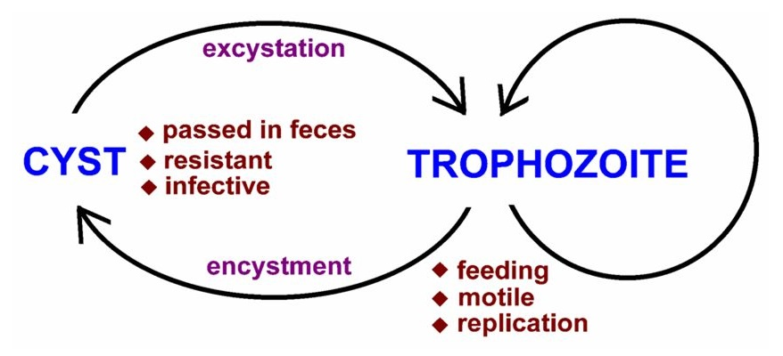
Protozoa: topics we will discuss for each pathogen
Life cycle strategies
  Transmission
  Stages
  Reproduction: sexual and asexual
  Hosts
Pathology
Host clinical signs from infection
Diagnosis
Treatment / Control
Geographic location / Epidemiology
fecal-oral
Fecal-oral diagram: Salak JS, Shirey JL, Strickl GT. "Successful treatment of symptomatic entamoeba polecki infection". Am J Trop Med Hyg 1979;28(2):190-3
Notes:
For each pathogen, we will cover these 6 categories. I will highlight the specific points within these categories that you should know for each pathogen.
Life cycles are important for veterinarians to understand (not just parasitologist) because you will be able to intervene to disrupt life cycles. Also, you may diagnose the pathogen at different points in the life cycle, where it may have a different form.
Pathology is how the pathogen causes disease. This is important for you to understand, as it will inform you of what types of clinical disease to look for in patients.
Recognizing a host’s clinical signs will help you diagnose a protozoal infection and help you chose which diagnostic tests to run.
There are many ways to diagnose these protozoal pathogens. We will talk about the different diagnostic options available, how to interpret results and discuss the limitations of the dx tests.
We will generally go over different treatments for each pathogen, including limitations of treatments, but you will not be expected to know doses and in most cases, the name of the drug, in lecture exams.
Understanding geography and epidemiology will help you with diagnosing protozoal infections and understanding risk factors for certain animals, breeds, signalment, living situations etc for each pathogen.
Again this will help you with diagnosing and intervention.

Slide 10
Protozoa: Life Cycle Strategies
  Direct Life cycle -- uses only a single host species (e.g. Eimeria)
  Indirect/complex Life cycle -- requires an intermediate host (e.g. Sarcocystis, Trypanosoma)
  Asexual stages only – thus “clonal” (e.g. Giardia)
  Sexual and asexual stages (all of the apicomplexans)
  Continuous life cycle
    Without host immunity, organism would continue multiplying (e.g. Plasmodium, Trypanosoma)
  Single direction life cycle
    Once the life cycle is completed then all organisms are gone (except in the case of re-infection) “all in – all out” (e.g. Eimeria)
  High Host specificity (e.g., Sarcocystis, Toxoplasma – sexual stages only)
  Low Host Specificity (Cryptosporidium, Toxoplasma – asexual stages only).
  Infection strategies
    Infectious when passed (Giardia)
    Requires time in environment to become infectious (Eimeria)
Notes:
These are the different life cycle strategies that we will discuss for the various protozoa pathogens. You will not be quizzed about these terms directly.
This slide is meant to introduce you to the life cycle strategies.

Slide 11
Protozoa: Pathology (how the pathogen causes disease)
  Direct destruction of the host cells
  Indirect destruction of host cells
  Changes in host immune system
  Excretion of toxins (most all parasitic protozoa)
Notes:
Excretion of toxins: glycoproteins and proteases are produced that can damage host cells, for examples. Protozoa toxins not as virulent as bacteria, in general

Slide 12
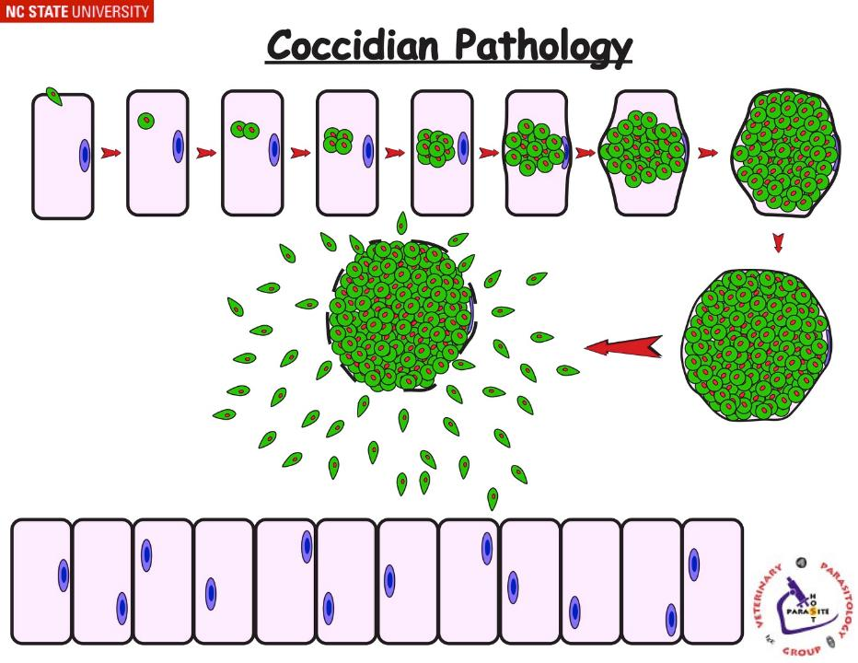
Protozoa: Pathology (how the pathogen causes disease)
  Direct destruction of the host cells
Reproduces inside cells → Cellular trauma → Organ dysfunction
e.g. Coccidiosis, Babesia, Cytauxzoon, T. cruzi
Notes:
Direct destruction = the protozoa multiply within a host cell causing the host cells to rupture. The cellular trauma can cause damage to the organ of the infected cells. For example, intestinal coccidia go through asexual multiplication inside enterocytes, destroying the cells when they rupture causing damage to the intestinal tract, thus causing diarrhea.

Slide 13
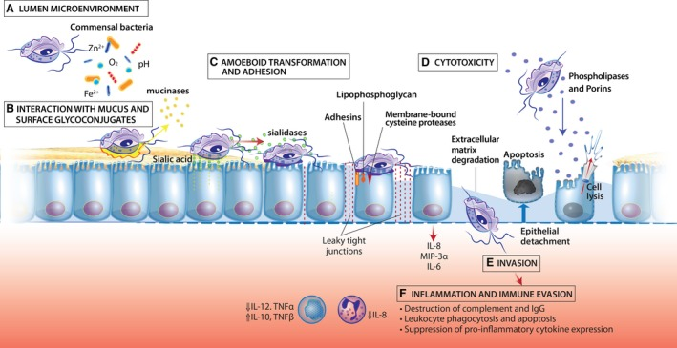
Protozoa: Pathology (how the pathogen causes disease)
  2. Indirect destruction of host cells
Causes cell death without having to penetrate the cell wall or grow inside the host cells. e.g. causes host cell apoptosis
Tritrichomonas foetus Pathology
  e.g. T. foetus, Giardia
Notes:
Indirect destruction = the protozoa produce products and/or interact with host cells that cause impairment, damage or apoptosis of the host cells.
alter the lumen microenvironment
degradation of mucus
adhesion to the epithelial cells
Increases permeability, epithelial cell detachment and apoptosis
Secretory proteins of trichomonads can directly promote epithelial cell lysis
activate the immune system
For example, Giardia or T. foetus can cause impairment of digestive and absorptive functions of intestinal cells (enterocytes). These mucoflagellates are not multiplying inside the enterocytes like coccidia are.

Slide 14
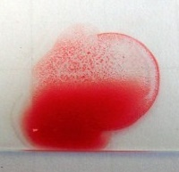
Protozoa: Pathology (how the pathogen causes disease)
  3. Changes in host immune system
Autoimmune Reactions
Autoantibodies directed against host cells
(e.g. hemolytic anemia)
Antibody-Antigen complexes in kidney or other tissues
Immunomodulation/suppression
Stimulate antibody-producing B-cells that are not antiparasitic
Proliferation of suppressor T-cells → release immune inhibitory cytokines
Protozoa produce specific immune suppressing substances
  e.g. Babesia, Leishmania, Trypanosoma
Notes:
Some protozoa can alter the host’s immune system, which can cause disease in the host.
These are examples of different autoimmune diseases initiated by protozoa. You do not need to know these specific examples. Just understand that some protozoa can cause changes in the hosts immune system such as autoimmune diseases and immunomodulation or suppression in their hosts.
For example, Babesia can cause an autoimmune reaction against red blood cells (erythrocytes) causing hemolytic anemia.
Leishmania can alter the immune system (drive it to a humoral response), which supports Leishmania pathogens’ survival inside host cells (intracellular survival).

Slide 15
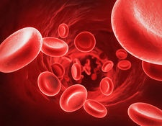


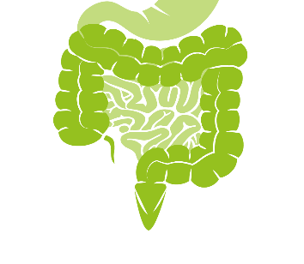
(know terms on this slide)
Parasitic
Protozoa
Grouped by Infection Site and Motility
Apicomplexa
(Alveolates)
Flagellates
(Excavates)
Blood apicomplexa (piroplasms)
Hemoflagellates
Blood/
tissue
Babesia spp.
Trypanosoma cruzi
Cytauxzoon felis
Leishmania infantum
Systemic apicomplexa
systemic
Toxoplasma gondii
Trypanosoma cruzi
Neospora caninum
Leishmania infantum
Sarcocystis spp.
intestines
Intestinal apicomplexan (coccidia)
Mucoflagellates
Cryptosporidium parvum
Tritrichomonas foetus
Eimeria spp.
Tritrichomonas blagburni
Cystoisospora spp.
Giardia spp.
Notes:
On this slide, I’ve grouped the protozoa we will cover by where they cause infection in the host and a morphological trait that allows for motility (+/- flagellum).
This slide also serves as a guide to the different genus and species of protozoa we will cover in detail in this course.
Terms in parenthesis, like piroplasm and coccidia are common terms used in the medical field and scientific literature to describe certain protozoa. We will use these terms as well.
You may notice the hemoflagellates T. cruzi and L. infantum are in blood but also in the system section (tissues). This is because these infections may start in the blood or skin but can go systemic and infect many different organs.
Today we are going to start with Hemoflagellates

Slide 16
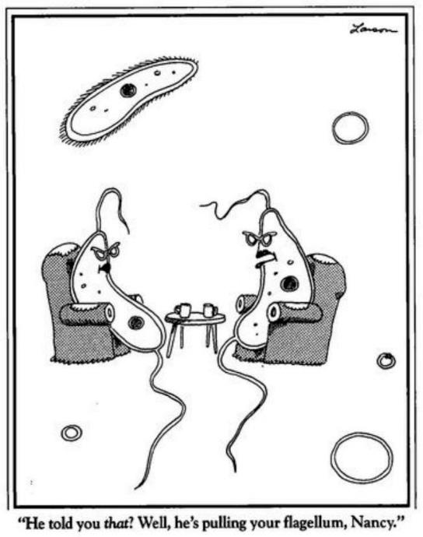
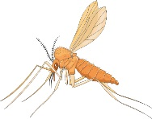
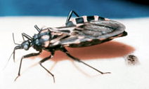
Hemoflagellates
Leishmania infantum
Trypanosoma cruzi
Vector-borne pathogens
Notes:
Now let’s move on to the hemoflagellates.
Tri-AT-O-MINE
Phelbotomus

Slide 17
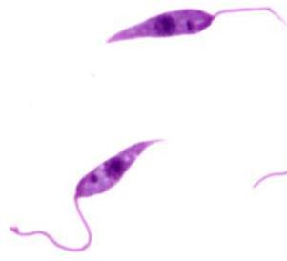
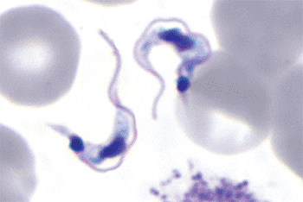
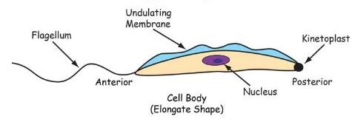
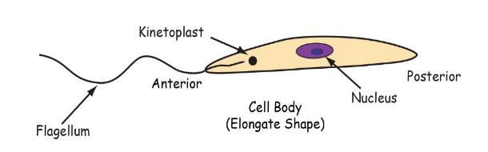
Hemoflagellates
FYI: other terms include Trypanosomastids or Kinetoplastida
erythrocyte
flagellum
Leishmania infantum
Trypanosoma cruzi
Notes:
Hemo = blood
Flagellates = organisms with a flagellum
the hemoflagellates will have intermediate insect vector hosts.

Slide 18
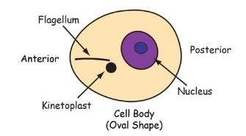
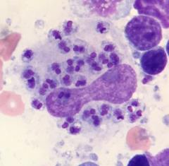
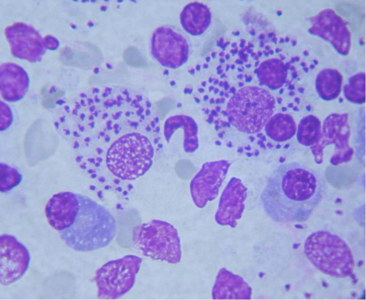
Hemoflagellates
Exist in different forms depending on the hemoflagellate, host and life stage
Amastigotes in lymph node aspirate
Trypanosoma cruzi
Leishmania infantum

Slide 19
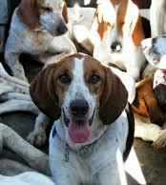
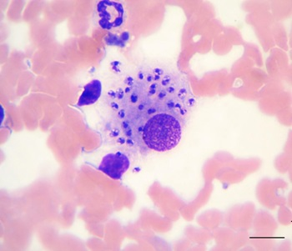

Hemoflagellates
Leishmania infantum
Notes:
Leishmania infantum is a vector-borne disease spread by sandflies. There are hundreds of Leishmania species that can cause varying degrees of disease in people and animals. We will focus on L. infantum (AKA L. chagas in Latin America), but I will briefly mention L. mexicana later in the presentation, as this is naturally transmitted to animals in TX.

Slide 20
Learning Objectives: Leishmania infantum
Life cycle: know that it is an indirect life cycle, the different forms of Leishmania in the 2 hosts, and specified life cycle details.
Transmission: know the 3 main routes of transmission
Pathogenesis: know the primary cell infected in the host and the effect a strong or weak cell-mediated immune response has on disease progression.
Clinical signs: know the 4 specified common clinical signs of canine leishmaniasis
Diagnosis: know the 3 main ways we can diagnose Leishmania
Epidemiology: know risk factors for canine leishmaniasis for dogs in the US and that leishmaniasis is zoonotic in people via sandflies in other parts of the world.

Slide 21
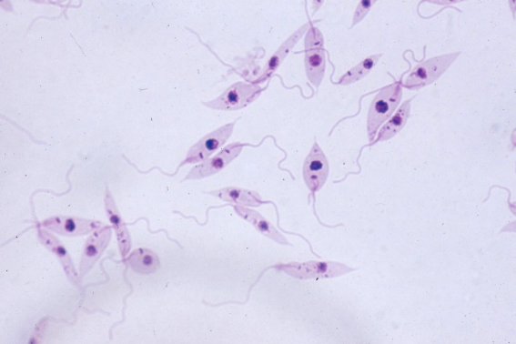




Indirect Life Cycle
Promastigote
insect (vector) form
(transient in mammal)
sandflies
Amastigote
mammalian form
Notes:
Leishmania has an indirect life cycle (meaning it requires an intermediate host, which in this case is a sandfly). It is spread between a sandfly and a verterbrate host (primarily mammals). We often call this a vector-borne disease because the sandfly is the vector transmitting the pathogen.
The promastigote form exists in the sandfly and the amastigote form exists in the vertebrate host. When a sandfly transmits the infective promastigote to the vertebrate, it changes to the amastigote form (lives inside macrophages).
I expect you to know these two forms and where they exist (ie in the sandfly or the mammal host).
You do not need to know the labeled morphological features on the organisms (kinetoplast, flagellum etc).

Slide 22
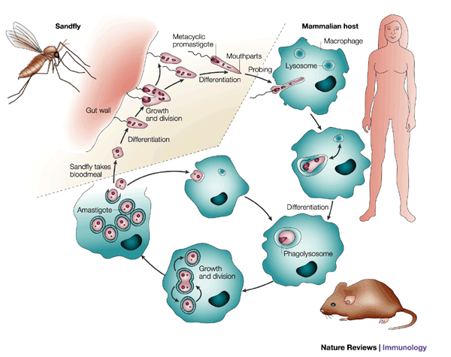

infective promastigotes are regurgitated just before a blood meal
salivarian transmission
Replicates in fly midgut
Promastigote phagocytized by host macrophage
Sandfly takes up macrophages in blood meal and amastigote transforms into promastigote in the sandfly gut
Disseminates throughout host
macrophage
Asexual Replication
Notes:
This is a detailed picture of the life cycle. You are responsible for the blue highlighted, bolded information.

Slide 23
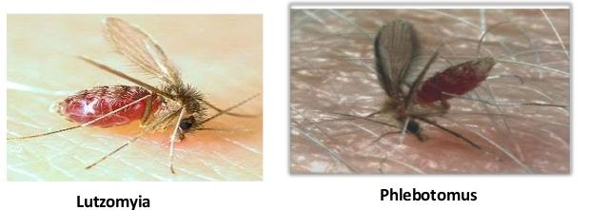
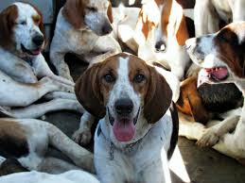
Transmission
Leishmania
1. Vector-borne
  female sandflies
    only 2 genera proven to transmit (Lutzomyia and Phlebotomus)
  salivarian
2. Blood transfusion
3. Transplacental (vertical)
  e.g. American Foxhounds
4. Others? (direct or perinatal)
  e.g. American Foxhounds
Incubation: ~3 months to 7 years
New World
(Americas)
Old World
(Europe/Middle East/Africa)
Notes:
As veterinarians, it’s important for you to know the different routes of transmission of this pathogen. You’ve learned its natural route of transmission, through the bite of a sandfly; however, it can be transmitted in other ways.
You should know these transmission routes:
1. Vector-borne, salivarian transmission by a sandfly
2. Blood transfusion (it’ important to screen blood donors for this pathogen!)
3. Transplacental (this is why it’s endemic in our foxhound breed…more on this later)
There’s evidence to suggest there are other routes, sexually, dog bites etc, but you are only responsible for the 3 main routes listed above.
The incubation from infection to disease has a wide time variation. Dogs are, in many countries, asymptomatic reservoirs for Leishmania (meaning they are infected and serve as a reservoir for sandflies to take up the organism). Some dogs never develop leishmanisis even though they are infected. Others may develop the disease. WHY? More on this next…

Slide 24
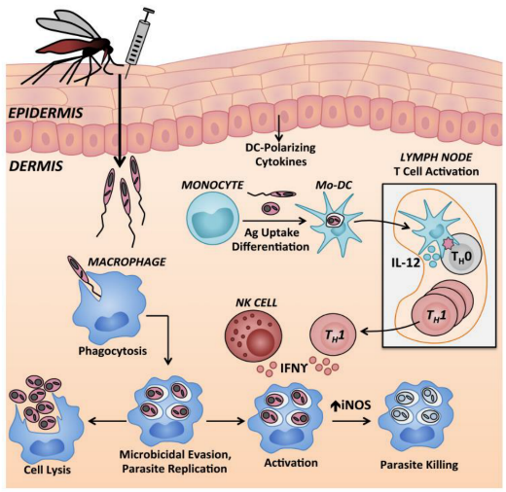
Pathogenesis: Leishmania
direct damage
immune modulation
FYI: image details
tissue damage by sandfly → recruit phagocytic immune cells
phagocytosed by macrophages and other immune cells
cell-mediated
immune response
CD4+
production of cytokines by CD4⁺ (T_{H}1) cells leads to enhanced killing by macrophages
(no or poor
cell-mediated response)
more severe disease
persistent infection
mild disease
immune clearance
Notes:
There’s a lot of extra information on this slide about what happens inside the vertebrate host after infection.
For this class, all you need to understand is this:
Macrophages are the most commonly infected cell in the host.
If the host mounts a strong cell-mediated immune response, disease is mild or cleared.
If there is no or a poor cell-mediated immune response, the host will have more severe disease.
This immune response, which may or may not occur, or may occur at different durations of infection, is one reason we can see a wide range of clinical disease and incubation time in animals that are infected.
Lesions occur from inflammatory response, pathogen proliferation. Disseminate to infect macrophages of the bone marrow, lymph node, liver and spleen, as well as the kidneys
Deep dive! See below if you want way more information than you are expected to know for the test.
Promastigotes are deposited in the dermis in a mixture of immunomodulatory salivary secretions and parasite-derived proteophosphoglycans. The impact of these factors on local phagocyte function is poorly defined. Promastigotes from the initial inoculum (or those that have been released from infected neutrophils) are phagocytosed by tissue-resident macrophages and dermal dendritic cells (DCs). Capillary and other tissue damage resulting from the mechanical trauma of the bite may result in the recruitment of neutrophils.
After being phagocytosed by macrophages, Leishmania use a variety of virulence mechanisms to suppress the host cell microbicidal response and replicate intracellularly. Infected macrophages can either facilitate intracellular survival and/or replication, or if infected macrophages are exposed to activating signals (cell-medicated immune responses) such as IFNγ from T_{H}1-type cells or NK cells, the macrophages can upregulate iNOS and kill the pathogen (yay!).

Slide 25
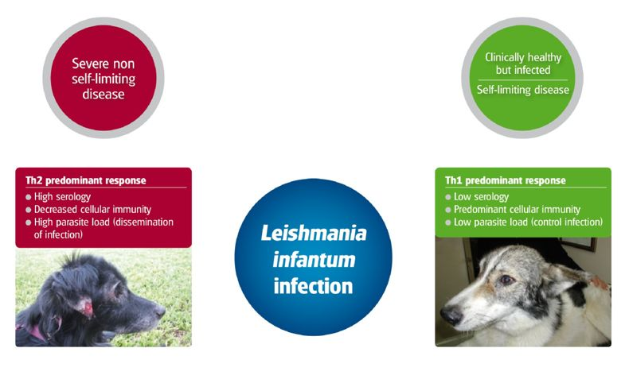
Pathogenesis: Leishmania
POOR
cell-mediated
immunitry
STRONG
cell-mediated
immunity
Range of disease severity
FYI: High serology!
It will be important when you are trying to diagnose leishmaniasis
Solano-Gallego, Laia, et al. "LeishVet guidelines for the practical management of canine leishmaniosis." Parasites & vectors 4.1 (2011): 86.
This is a great reference if you ever have to manage a Leishmaniasis case
Notes:
Th1/Th2 paradigm is an oversimplification
B cells and antibodies are generally not considered to be of major importance in protective immunity against Leishmania.
Antibodies are not effective at killing the parasite as it hides inside cells
High levels of Leishmania specific antibodies are observed in patients with VL and other severe forms of leishmanial disease and there are accumulating evidence that B cells and antibodies correlate with pathology.
Immunization with, the for dogs licensed vaccine, Leishmune, which confers some protection against leishmaniasis, result in seroconversion and an increase in the proportion of B cells

Slide 26
Clinical Disease
Dogs can be reservoirs, living asymptomatically for years until change in immune system
Leishmania
Incubation period from 3 months to years
Clinical findings (stage disease from I – IV)
  Dermal lesions (dry exfoliative lesions, ulcers, alopecia),
  Lymphadenopathy, fever, splenomegaly, ocular dz (uveitis)
  Hyperglobulinemia, hypoalbuminemia, anemia (non-regenerative anemia)
  Kidney dz (azotemia, proteinuria) → poor prognosis
severity
Notes:
It’s important for veterinarians to recognize the clinical signs associated with Leishmaniasis.
I expect you to know the 4 blue bolded abnormalities for this class.
The following slides highlight more abnormalities and include pictures, FYI.

Slide 27
FYI: Factors that dictate clinical disease severity
Immune system
Leishmania
spp.
TH₁,
cell-mediated
parasite
killing
L. mexicana
Disease
Manifestation
L. infantum
severity
TH₂
Humoral
co-infxs
pathogen
load
Notes:
This slide is FYI. You won’t be tested on this slide but it highlights the different variables that can dictate clinical severity if you patients are infected with Leishmania.

Slide 28
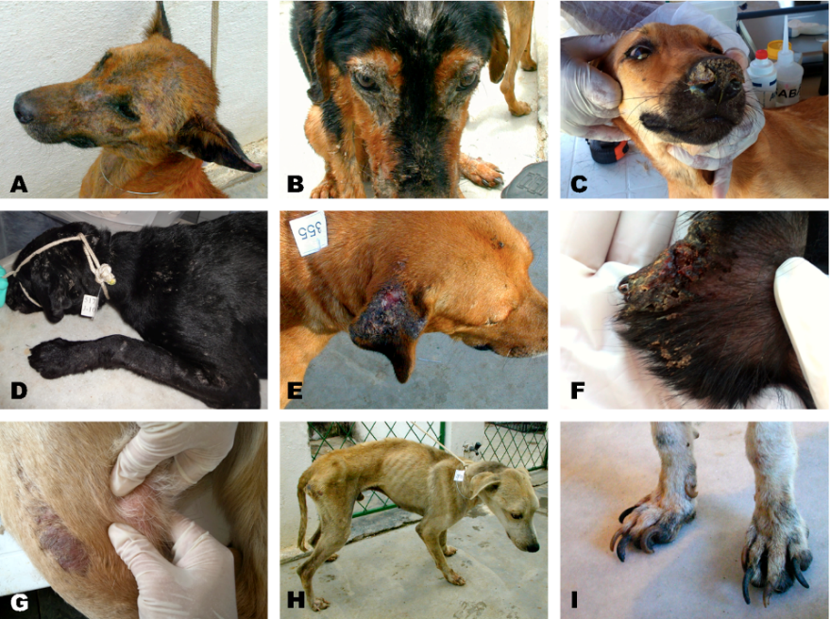
Figure 1
New Advances in the Diagnosis of Canine Visceral Leishmaniasis.
Patrícia Sampaio Tavares Veras, Deborah Bittencourt Mothé Fraga, Manuela da Silva Solcà
Notes:
Descriptions of abnormalities are on the next slide

Slide 29
Figure 1. Major clinical signs associated with Canine Leishmaniasis.
A: alopecia on the muzzle
B: periocular dermatitis with keratoconjunctivitis and hyperkeratosis;
C: hyperkeratosis of the nasal mucosa;
D: generalized non-pruritic exfoliative dermatitis;
E: ulcerated lesion in the ear;
F: crust with vascular injury on the tip of the ear;
G: lymphadenomegaly of the popliteal lymph node;
H: cachexia (wasting syndrome); (ka-kex-ea)
I: onychogryphosis (hypertrophy of claws). (on-i-ko-gri-fo-sis)
Photos of animals infected by L. infantum belong to archives from Laboratory of Pathology and Biointervention (LPBI - CPqGM).
https://www.intechopen.com/books/leishmaniasis-trends-in-epidemiology-diagnosis-and-treatment/new-advances-in-the-diagnosis-of-canine-visceral-leishmaniasis

Slide 30
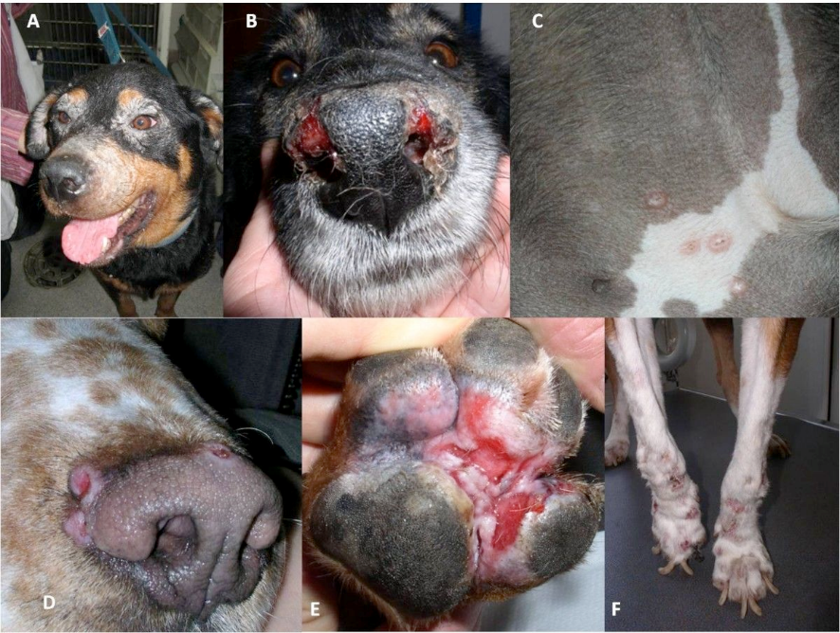
Figure 2
Laia Solano-Gallego. LeishVet guidelines for the practical management of canine leishmaniosis. Parasites & Vectors20114:86 (https://doi.org/10.1186/1756-3305-4-86)
Notes:
Descriptions of abnormalities are on the next slide

Slide 31
Figure 2: Different patterns of cutaneous lesions in Canine Leishmaniasis.
A) Exfoliative periocular alopecia and blepharitis;
B) Ulcerative nasal mucocutaneous lesions;
C) Papular dermatitis in the inguinal region;
D) Nodular crateriform lesions bordering the muzzle;
E) Ulcerative erythematous lesions on the plantar surface of the paw and between pads;
F) Onychogryphosis. (on-i-ko-gri-fo-sis)
https://parasitesandvectors.biomedcentral.com/articles/10.1186/1756-3305-4-86

Slide 32
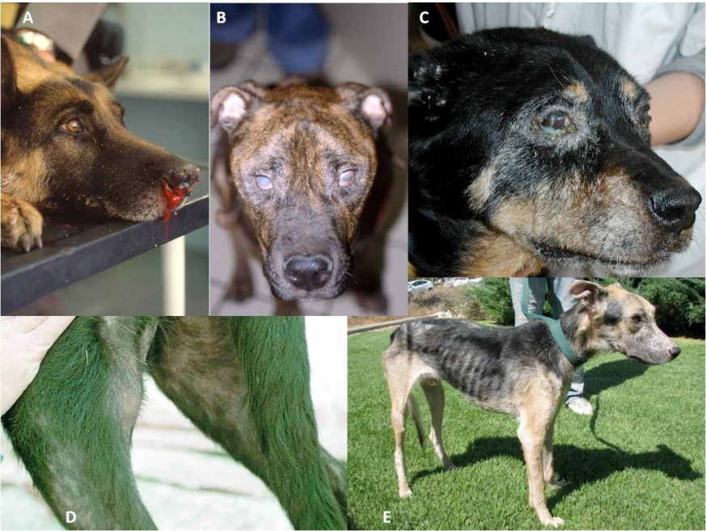
Figure 3
Notes:
Descriptions of abnormalities are on the next slide

Slide 33
Figure 3: Some clinical signs found in Canine Leishmaniasis:
A) Epistaxis (nosebleed);
B) Bilateral uveitis and corneal opacity;
C) Purulent conjunctivitis and blepharitis;
D) Exfoliative alopecia in the rear leg and popliteal lymphadenomegaly;
E) Marked cachexia (wasting) and generalized exfoliative alopecia.
https://parasitesandvectors.biomedcentral.com/articles/10.1186/1756-3305-4-86

Slide 34

Diagnosis
Leishmania
  Serology: Immunofluorescence (IFA), ELISA
    - high serology titers in leishmaniasis indicate a low cell-mediated immune response and likely more severe disease
    -antibodies may cross-react with T. cruzi
  PCR (lymph node, blood, bone marrow, spleen, conjunctiva, cutaneous lesions)
  Amastigotes in cytology specimens
  - lymph nodes, skin, spleen, etc.
    - not very sensitive
ASK ABOUT TRAVEL HISTORY!
Rescue groups bringing in dogs from Leishmania endemic countries
Notes:
Know the 3 main ways to diagnose leishmaniasis, highlighted in bolded blue font.

Slide 35
Serology: Immunofluorescence (IFA)

Slide 36
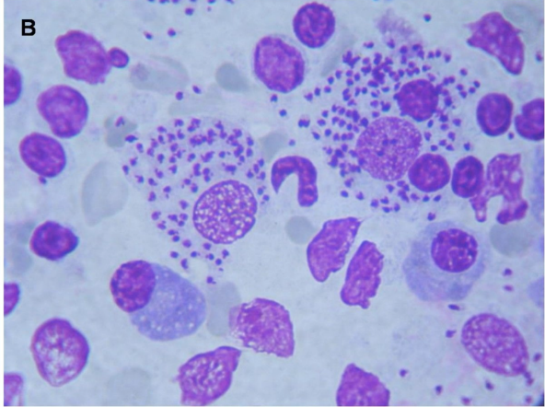
FYI only
Interpretation
of cytology
https://parasitesandvectors.biomedcentral.com/articles/10.1186/1756-3305-4-86
Notes:
B) High numbers of intracellular and extracellular Leishmania amastigotes in a fine needle aspirate of a reactive lymph node from a dog with clinical leishmaniosis (x100, modified Giemsa stain).

Slide 37
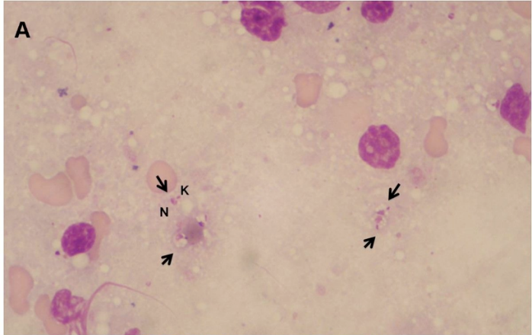
FYI only Interpretation of cytology
https://parasitesandvectors.biomedcentral.com/articles/10.1186/1756-3305-4-86
Notes:
Interpretation of cytology requires time and expertise for the detection of Leishmania amastigotes when parasites are in low numbers and freed from the cells. Note the nucleus (N) and the kinetoplast (K) of extracellular amastigotes (arrows) in a fine needle aspirate of a reactive lymph node from a dog with clinical leishmaniosis (x100, Diff-quick stain);

Slide 38
FYI: Leishmaniasis Treatment
Combination therapy
  Meglumine antimoniate (not available in US)
  Miltefosine
  Liposomal amphotericin B
  Allopurinol –initial tx and use long-term alone
1. Combine allopurinol with meglumine antimoniate or miltefosine followed by long-term allopurinol.
  2. Temporary clinical improvement; difficult to clear infection

Slide 39
FYI: Control
Canine Leishmaniasis
Vector Control
  Insect(sandflies) repellents; collars, spot-on’s, etc.
Breeding control
  prevent transplacental transmission
Screen blood donors
  prevent transfusion transmission
Vaccines have been developed in Brazil & Europe (70-80% efficacy)
  (Leishmune, Leish-Tec, CaniLeish, Letifend)

Slide 40
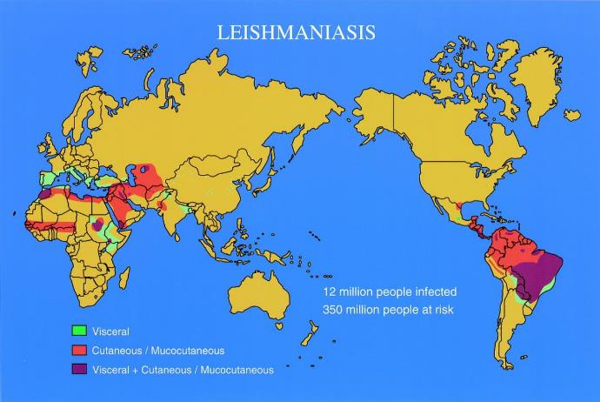
FYI: Geographic Distribution
Southern Europe, Africa, Asia, Caribbean, Central & South America
Notes:
Most of this info is FYI. But I do want you to understand that dogs that have been to countries outside the US may be infected and you may have to deal with this disease. There are currently no regulations for dogs entering the US to be screened for this zoonotic disease.

Slide 41
Leishmania infantum in Hounds in the US
Foxhound cases identified in1980/90s
Outbreak of canine leishmaniasis in Foxhound kennel in NY in 1999
Vertical transmission over many
generations
~ 10 % of American Foxhounds are infected with L. infantum
- many are asymptomatic
Consider Bassets and Beagles too
Gaskin, Amanda A., et al. "Visceral leishmaniasis in a New York foxhound kennel." JVIM16.1 (2002): 34-44.
Notes:
For this slide, just know that America Foxhounds, Bassets and Beagles can be infected with L. infantum in the US even if they haven’t travelled outside the US and transmission is primarily vertical (we don’t have the sandfly species in the US that can transmit L. infantum –as far as we know).

Slide 42
Leishmaniasis in the United States
Risk of contracting leismaniasis in the US (autochthonous) is very low!
We are NOT endemic for L. infantum, but we do support L. mexicana transmission cycle (sandflies and reservoirs in southern US)
RISK FACTORS for canine leishmaniasis in the US
1. Dogs that were imported from or travel history to Europe, Mediterranean, Middle East (usually L. infantum endemic areas)
2. US Foxhounds with L. infantum transmitted vertically (Bassets and Beagles)
3. Dogs (and cats) from TX can become infected with L. mexicana (causes skin lesions)
autochthonous = aw-tok-tha-nus = contracting dz in the same place
Notes:
Know that the US is not endemic for L. infantum and the 3 main risk factors for canine leishmaniasis

Slide 43
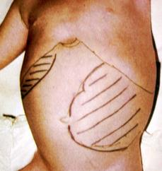
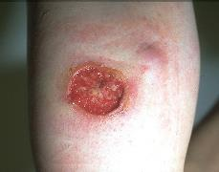
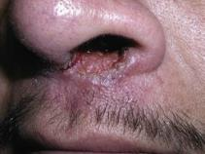
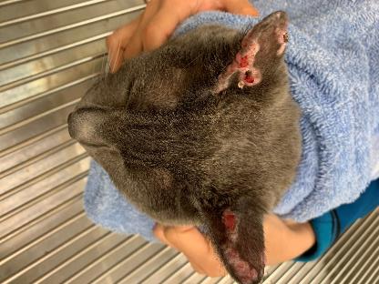
Zoonosis
Leishmania
Organomegaly in a child highlighted with marker
12 million people infected via sandfly transmission
Dogs are important reservoirs for human infections around the world
http://www.enetmd.com/content/leishmaniasis
Kalman Watsky, MD https://clinicalgate.com/protozoa-and-worms
Cats
  Mucocutaneous Leishmaniasis - L. infantum
  Cutaneous – L. mexicana
  Overall, few Leishmania cases in cats in endemic regions
Notes:
For this slide, just know that Leishmania is a zoonotic disease and people become infected primarily through bites from infected sandflies

Slide 44
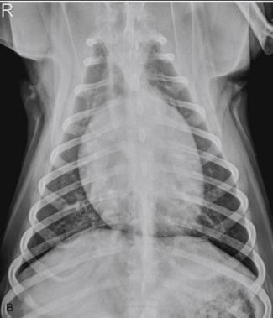

Hemoflagellates
Trypanosoma cruzi

Slide 45
Learning Objectives: Trypanosoma cruzi
Life cycle: know that it is an indirect life cycle, the 2 different forms of T. cruzi in the mammal host, and specified life cycle details.
Transmission: know the 4 main routes of T. cruzi transmission
Pathogenesis: know primary pathology is direct destruction of host cells. T. cruzi can infect any nucleated cell but we often see disease when cardiac cells are destroyed.
Clinical signs: know the different phases of disease and the main specified clinical signs associated with each phase.
Diagnosis: know the 2 specified methods and which to use for acute or chronic phases of the disease.
Epidemiology: know dogs in the southern US are more likely to be exposed to T. cruzi and it is a zoonotic disease, transmitted to people by the vector

Slide 46
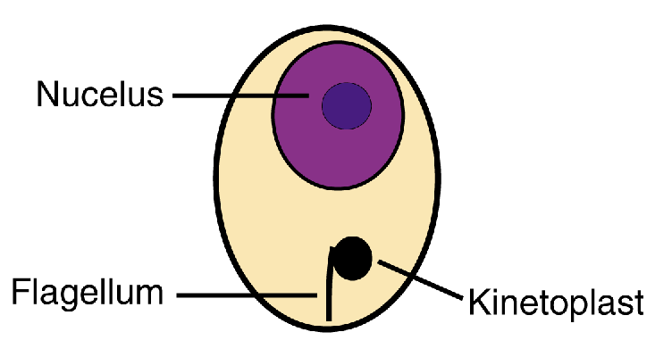
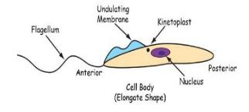
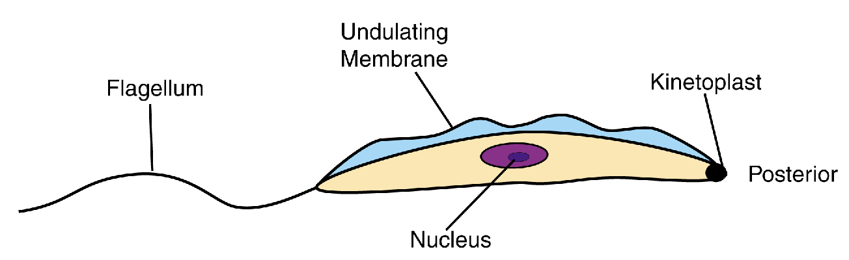
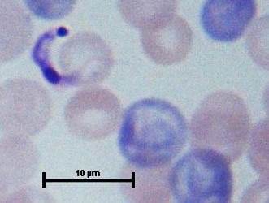
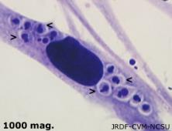
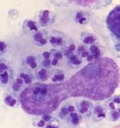
Trypanosoma cruzi
FYI: Epimastigote Insect
Trypomastigote blood
Amastigote intracellular
-Replicate asex in bug
midgut
-Infective stage
cardiac
macrophage/
monocyte
-Mammalian blood (doesn’t divide)
-Transforms into infective
metacyclic trypomastigote
and is excreted
-Transforms into amastigotes (divide)
-Found in mammalian tissue
-vector ingests trypomastigote form
-Replicates by binary fission
Notes:
These are the 3 stages of T. cruzi.
Epimastigote is specific for the vector, triatomine bugs
Trypomastigote is the infective stage so it exists in the bug and the mammal host in this form
Amastigote is in the mammal host.
You are responsible for the bolded font

Slide 47
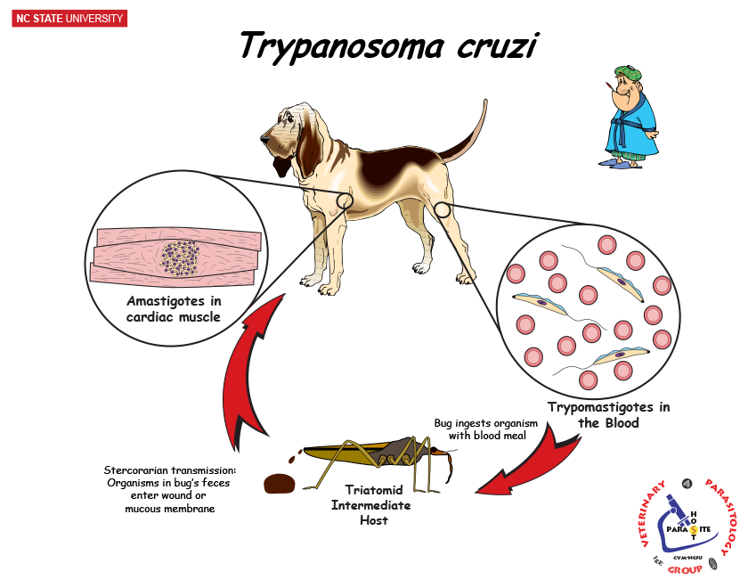
Trypomastigote
stercorarian
Notes:
Know the information on this slide.
This is a picture of the indirect life cycle, with the tiatomine bugs and canine host. You are responsible for the bold blue font. Stercorian transmission is when the pathogen is transmitted from the vector feces into a wound or mucous membrane of the mammalian host.
FYI Deep dive:
An infected triatomine insect vector (or "kissing" bug) takes a blood meal and releases trypomastigotes in its feces near the site of the bite wound (trypomastigotes then enter the vertebrate host through the bite wound or penetrate intact mucous membranes –incase of dogs or cats eating the bugs). Trypomastigotes enter the host through the wound or through intact mucosal membranes. Inside the host, the trypomastigotes invade cells (host cell, most commonly macrophages or myocardiocytes) near the site of inoculation, where they differentiate into intracellular amastigotes . The amastigotes multiply by binary fission and differentiate into trypomastigotes, and then are released into the circulation as bloodstream trypomastigotes . Trypomastigotes infect cells from a variety of tissues and transform into intracellular amastigotes in new infection sites. The bloodstream trypomastigotes do not replicate (different from the African trypanosomes). Replication resumes only when the parasites enter another cell or are ingested by another vector. The “kissing” bug becomes infected by feeding on human or animal blood that contains circulating parasites . The ingested trypomastigotes transform into epimastigotes in the vector’s midgut . The parasites multiply and differentiate in the midgut and differentiate into infective metacyclic trypomastigotes in the hindgut .

Slide 48
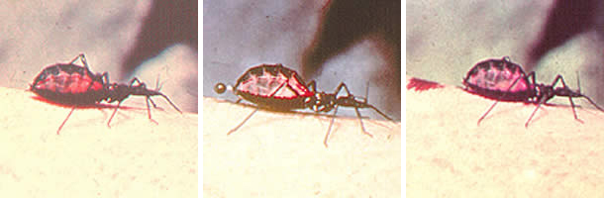
T. cruzi
Transmission
1. Vector-borne -- Triatomid bugs via stercorarian
2. Transplacental
3. Blood Transfusion
4. Ingestion of infected bugs or animals (contact with mucous membranes)
Notes:
Know these 4 transmission routes.
For dogs, it’s likely ingestion of bugs or infected prey animals is the most common route.

Slide 49
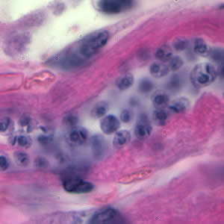
Pathology
Cardiac Histology
T. cruzi (Chagas Disease)
1. Infect and destroy any nucleated cell –primarily cardiac cells
2. Intracellular multiplication of parasites with direct destruction of cells (cardiac cells).
3. Immune modulation and autoimmune destruction of host tissues
Notes:
Know bolded blue font
Clinical disease occurs in phases, with cardiac disease in chronic and final stage.

Slide 50
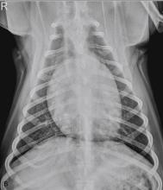
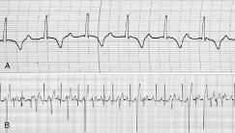
Clinical Disease: T. cruzi
Acute Phase (1st month)
  Lymphadenopathy, febrile disease
  diarrhea, vomiting, anorexia, lethargy
  Severe mycocarditis and death has been described → young
chronic
Latent Phase (months to years post-infection)
  usually asymptomatic; often for years
Chronic Phase (maybe years post-infection)
  Gradual decline to death, usually about 2 years after dx
  Signs related to heart damage
Notes:
Know the different phases of disease post-infection and the main clinical signs associated with that phase (blue bold font)
Signs related to heart damage
Chronic weakness, hepatomegaly, ascites, myocarditis
Ventricular arrhythmias, ECG abnormalities, enlarged heart

Slide 51
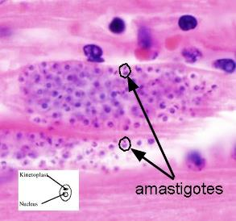
Diagnosis
T. cruzi
1. Parasite detection (better for acute)
  PCR: blood or tissue
  Blood smear -- trypomastigotes
  Lymph node aspirate -- amasitgotes
  Cardiac biopsy / histology -amastigotes in pseudocysts
  Xenodiagnosis
2. Antibody detection (better for chronic)
  Serology (IFA or ELISA) (may cross-react with Leishmania)
  Better for testing animals in chronic or latent stage of disease
Notes:
Know that PCR is good for acute disease and serology is better for chronic or latent form of the disease.

Slide 52
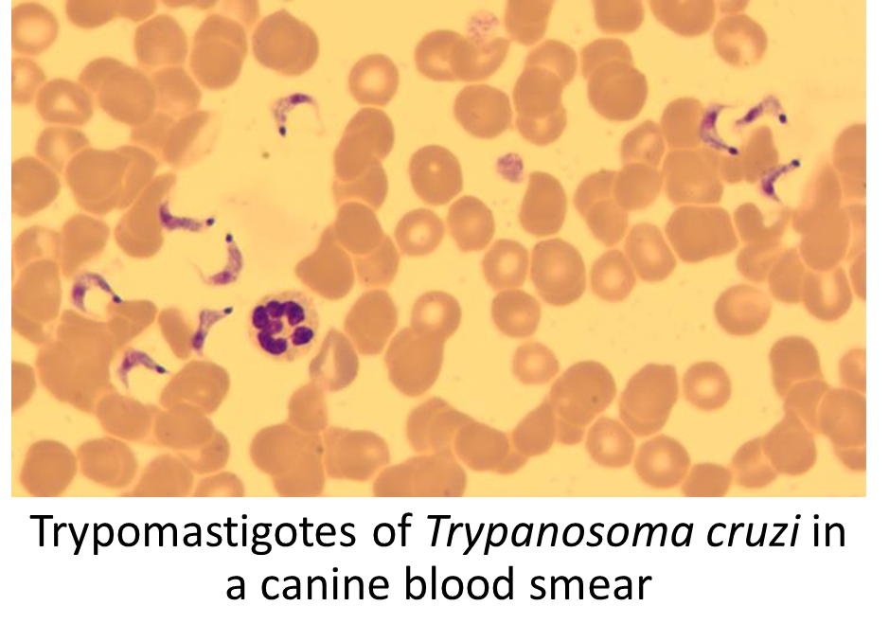

T. cruzi amastigotes in LN aspirate
http://www.capcvet.org/capc-recommendations/trypanosomiasis
Notes:
FYI: images

Slide 53
FYI: Treatment
T. cruzi
1. No approved treatments for Vet med
2. Mainly symptomatic treatments
-management of heart disease
3. Human approved antitrypanosomal drugs
-Benznidazole
-Nifurtimox

Slide 54
FYI: Control
T. cruzi
No vaccination
Vector control
  identify triatomids & their habitat
  avoid outdoor lights
  control sylvatic reservoirs (don’t let dogs
  eat other mammals)
Breeding control
  prevent transplacental transmission
Screen blood donors -prevent transfusion transmission

Slide 55




Geographic Distribution
T. cruzi
Central & South America
Canine cases in southern USA
  Texas, Louisiana, Oklahoma, Tennessee, Virginia, California, Georgia, and South Carolina
Notes:
T. cruzi infection has been reported in dogs from a number of other states, including California Georgia,
Louisiana, Oklahoma, South Carolina, Tennessee, and Virginia
Know that it’s found in Central and South America and southern US states, especially TX and Louisiana have higher prevalence of T. cruzi exposure in dogs.

Slide 56


Zoonosis
T. cruzi
Zoonotic Human Chagas Disease
  Cardiomyopathy, megaesophogus, megacolon
  Endemic areas:
    Mexico, Central America, South America
  Triatomid transmission, thrive in poor housing conditions
    Mud Walls, Thatched Roofs
  Dogs and other small mammals are
  important reservoirs for human infections
Notes:
Know that it is a zoonotic disease transmitted by the vector bug

Slide 57

Case-based Questions
4 yr old MN Golden Retriever presents with exfoliative dermatitis, alopecia and crusting on pinna.
History: was adopted a year ago from a rescue group
Physical exam: skin lesions and popliteal
lymphadenomegaly
What are some follow-up questions you might ask the owner?
What are good samples to collet for diagnostic testing and which tests would you use?

Slide 58
Case-based Questions
A 6 yr old MN mixed breed from Michigan presents with increasing exercise intolerance.
History: Moved from southern Texas a year ago.
Imaging: Thoracic rads show enlarged heart
Labs:
HW tests – negative
What’s an infectious disease you should check for?
You can only perform serology or PCR to support your infection suspicion, which do you choose?

Slide 59

Have Questions?
barbara_qurollo@ncsu.edu
Illustration by Allie Brosh, http://hyperboleandahalf.blogspot.com/
Notes:
If you email me with a question, I will send the question and answer to the entire class but will keep you anonymous. So, don’t be shy!

