Slide 1
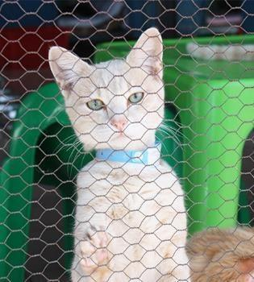
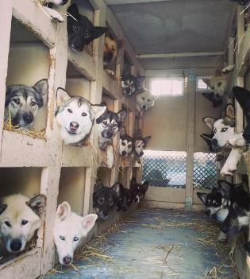
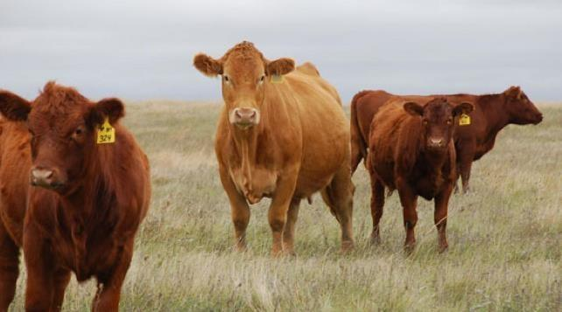
Mucoflagellates
Tritrichomonas foetus
Tritrichomonas blagburni
Giardia

Slide 2
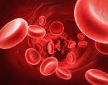
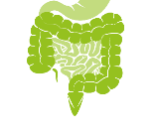
(know terms on this slide)
Parasitic
Protozoa
Grouped by Infection Site and Motility
Apicomplexa
(sg =Alveolates)
Flagellates
(sg = Excavates)
Blood apicomplexa (piroplasms)
Hemoflagellates
Blood/
tissue
Babesia spp.
Trypanosoma cruzi
Cytauxzoon felis
Leishmania infantum
Systemic apicomplexa
systemic
Toxoplasma gondii
Trypanosoma cruzi
Neospora caninum
Leishmania infantum
Sarcocystis spp.
intestines
Intestinal apicomplexan (coccidia)
Mucoflagellates
Cryptosporidium parvum
Tritrichomonas foetus
Eimeria spp.
Tritrichomonas blagburni
Cystoisospora spp.
Giardia spp.

Slide 3
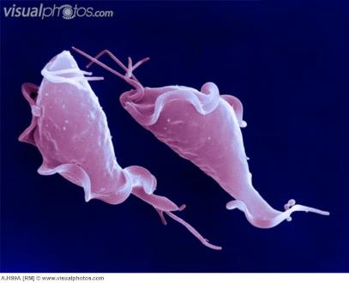
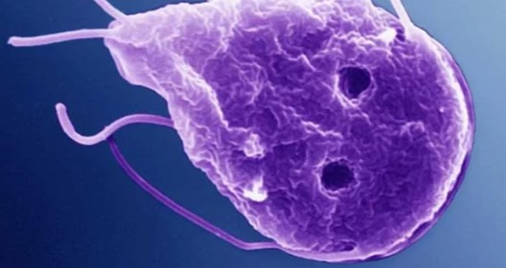
Mucoflagellates Introduction
Tritrichomonas spp.
Giardia spp.
Credit: David Gregory & Debbie Marshall, Wellcome Images
Pear or spindle-shaped with flagellum (multiple)
Only asexual replication
Reside in mucous membrane-lined anaerobic-to-microaerophilic, non-sterile organ cavities (urogenital tract or gastrointestinal tract)
Notes:
Now we are starting the Flagellates. These organisms only reproduce asexually, so their life cycles will be a little less complicated. The mucoflagellates only have direct lifecycles but the hemoflagellates will have intermediate vector hosts (later lectures).

Slide 4
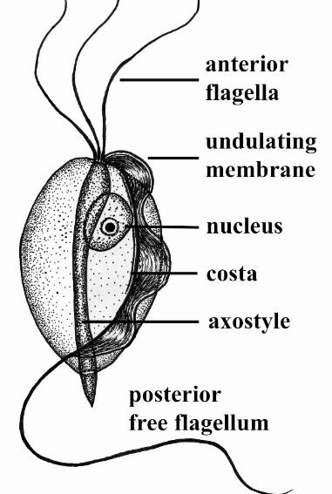
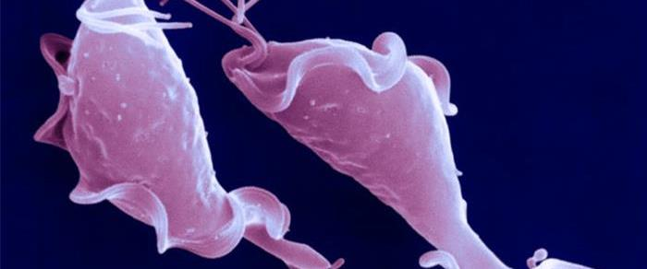
Tritrichomonas foetus and T. blagburni Introduction
Obligate parasite; exists only as trophozoite
Urogenital and Gastrointestinal tracts
Specific host-pathogen interactions
Bovine Tritrichomoniasis
Feline Tritrichomoniasis
Notes:
We will cover Tritrichomonas spp. that cause disease in cattle (venereal) and cats (diarrhea). A new term has been introduced in this slide, trophozoite.
Trophozoite is a term used to describe a growing life stage. Some Tritrichomonas spp. can have a dormant stage (Giardia) where they form environmentally stable cysts. Tritrichomonas spp. do not form cyst. This is important to understand because Tritrichomonas will not be able to survive outside of its host. Thus, environmental sanitation will be easier with this pathogen.
You will not be tested on the morphological features of Tritrichomonas.

Slide 5
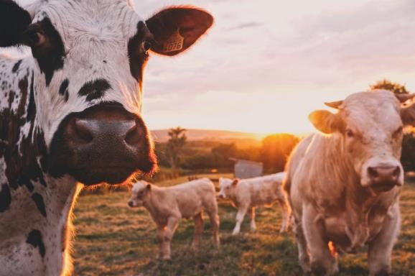
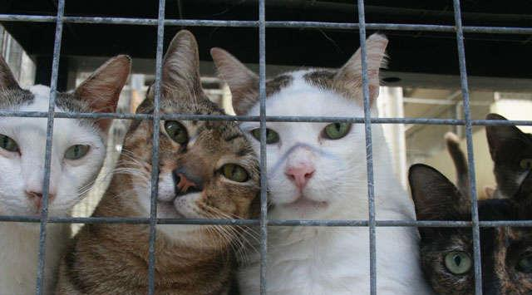
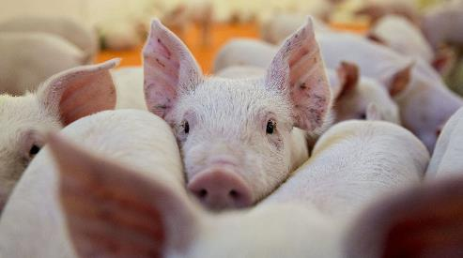
~1% difference genome
likely the same
T. foetus
T. blagburni
T. foetus – feline genotype → GI dz
T. foetus – bovine genotype → Venereal dz
T. suis – porcine commensal
T. blagburni infects cats
Are these the same organism?
T. suis (FYI)
Notes:
For many years, it was thought that T. foetus and T. blagburni were the same organisms. Tritrichomonas GI infections in cats and Tritrichomonas venereal disease in cattle were thought to be caused by T. foetus. But genetic analysis has shown enough difference in the genome that the Tritrichomonas pathogen infecting cats got a new name, T. blagburni. Cross-transmission studies between cats and cattle suggest there are differences in pathology between the two host-adapted strains.For this course we will use the new, correct names. However, in many of the textbooks and literature, you will see feline tritrichomonas as T. foetus.
T. suis is FYI. This is believed to be the same as T. foetus and does not cause any clinical disease in pigs. T. suis resides in the nasal cavity, stomach, cecum, colon and occasionally small intestine of pigs

Slide 6
Tritrichomonas Introduction
(T. blagburni)
(T. foetus)
Large Bowel Feline Trichomoniasis
Bovine Genital Trichomoniasis
Colonize urogenital tract
Colonize large intestine
Venereal disease, causes infertility, abortions in cows and heifers
Large bowel diarrhea
Economic loss
Notes:
The two organisms we will cover will be T. foetus (cattle venereal dz) and T. blagburni (feline diarrhea). Learning objectives will be provided for each pathogen.

Slide 7
Learning Objectives: Tritrichomonas foetus
Life cycle: know that it is a direct life cycle, and specified life cycle details (hosts, transmission, stages and reproduction).
Transmission: know the 2 main routes of transmission.
Pathogenesis: know the pathology and differences between infection in bulls and cows.
Clinical signs: know the 3 specified main clinical signs in cows.
Diagnosis: know diagnosis is typically made due to recognition of abortions and diagnostic testing of the bulls; positives are reportable.
Control: Know the 4 highlighted biosecurity and farm management practices.
Epidemiology: know highlighted risk factors.

Slide 8
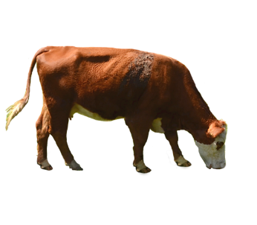
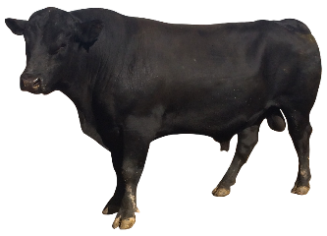
T. foetus: Bovine Genital Trichomoniasis
Direct Life Cycle
Primary Hosts
1. cows/bulls
Transmission
1. sexual (bulls → cows, cows → bulls)
2. artificial insemination
Stages
1. Trophozoite
2. No cyst stage
Reproduction
1. binary fission in
urogenital tract

Slide 9
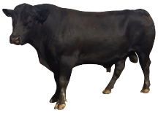
T. foetus-bovine Pathology – not well understood
Cows/
Heifers
trophozoites cause indirect damage to epithelial cells in reproductive tract
vaginitis and endometritis → abortion, infertility, pyometra
infection is self-limiting; clearance ~20 weeks post-infection
trophozoites attach to epithelial cells lining the penis, prepuce, and distal portion of the urethra
Bulls
no damage to cells, no change in semen quality or sexual behavior
essentially serve as reservoirs (persistently infected)
Notes:
Cows have Indirect damage from inflammation/autoimmune response
Cows and heifers show clinical disease from this infection. Cells are damaged in the reproductive tract causing a wide range of abnormalities. The infection is usually self-limiting.
Infection usually self-limiting in cows and they can develop immunity that will last ~2-6 months.
Some cows can become chronic carriers.
Bulls are the reservoirs, meaning they will be infected, but no damage occurs to the epithelial cells. The organisms can live there and then be transferred to cows in the semen (sexual or artificial insemination).

Slide 10
Clinical Signs: Bovine Genital Trichomoniasis
Main complaints:
1. abortions (early to mid-term)
2. failed pregnancy, infertility suspect
3. more open and late cows
Pathological findings
Vaginitis, cervicitis, pyometra, endometritis, mummified fetus
Notes:
Know the 3 main complaints/clinical signs in cows
Open = cows in heat when they should be pregnant
The number of cows that calve can be reduced by 20% to 40% and the avg calving date will be later and the calving season will be spread out longer than in non-infected herds.
The first sign is that infected cows and heifers return to estrus one to three months after breeding. A period of infertility may last for another two to six months as a result of the infection.

Slide 11
Diagnosis: Bovine Genital Trichomoniasis
Most diagnostics used to detect T. foetus in bulls
Cow – History of abortions
Bull -- Preputial wash or scrapings
1. Microscopic examination of of fresh wet-mounts for trophozoite
2. Culture kits (~95% SE); successive cultures(~99.5% SE) (3 cultures)
3. PCR
Testing method based on state requirements
Positive results - REPORTABLE
Notes:
Know that to diagnose Tritrichomonas you will:
Typically have a history of abortions
Diagnostic tests are performed on bull used to fertilize the cows through preputial washing or scraping
This disease is reportable.
Cervical mucus from the cow can be inoculated into the In Pouch and cultured for identification.

Slide 12
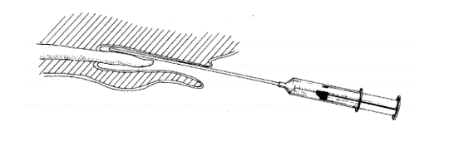
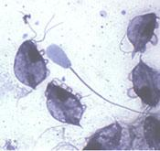
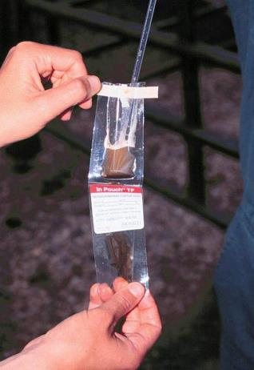
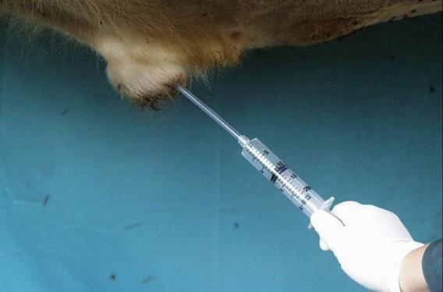
Diagnosis: Bovine Genital Trichomoniasis
Preputal washings for diagnostic culture
https://www.merckvetmanual.com/reproductive-system/trichomoniasis/overview-of-trichomoniasis-in-cattle
Notes:
Prepuce sampling in a bull.
sterile insemination pipette and performing a vigorous back and forth scraping motion along the glans while applying negative pressure with an attached 10 ml syringe.
Placing the preputial scraping in a commercial transport media
The inoculated media should be kept at 65° F to 75° F until it is incubated. It is especially important to avoid overheating or freezing

Slide 13
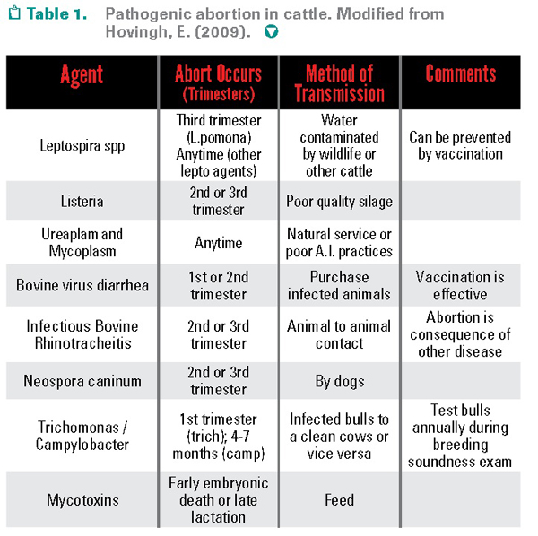
Differential Diagnosis
abortion in cattle
Bovine tritrichomonas history and clinical signs are ~ bovine genital campylobacteriosis
Protozoa you should know that cause abortion in cows:
T. foetus
Neospora caninum
Sarcocystis cruzi
FYI: this chart
Notes:
FYI

Slide 14
Control: Bovine Genital Trichomoniasis
Good Farm Management and Biosecurity!
Strict surveillance of bulls/closed herds/no commingling
Cull all positive bulls
Replace bulls >4 yrs
Use hygienic artificial insemination
a. T. foetus can survive the process used for freezing semen
Vaccines (not-complete protection)[Trichguard, TrichGuard V5L]
Treatment: none
Notes:
Good farm management and biosecurity are the best ways to prevent tritrichomonas.
Know the 4 blue highlighted management tools.
Older bulls are more likely to be carriers (they’ve been around and been with more cows). Replacing older bulls with younger ones is one way to reduce to risk of transmission to the cows.
A vaccine may help infected animals clear the infection more rapidly resulting in improved calving rates compared to non-vaccinates.

Slide 15
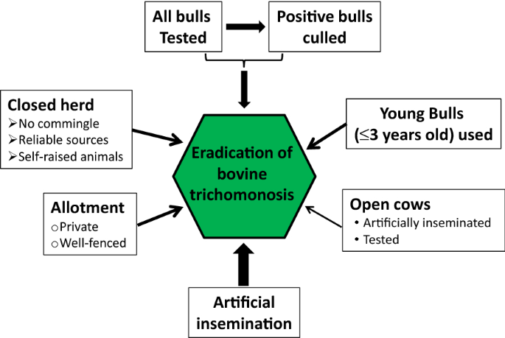
Yao, C. Control and eradication of bovine trichomonosis in Wyoming, USA by testing and culling positive bulls. Vet Res 52, 129 (2021). https://doi.org/10.1186/s13567-021-00996-w

Slide 16
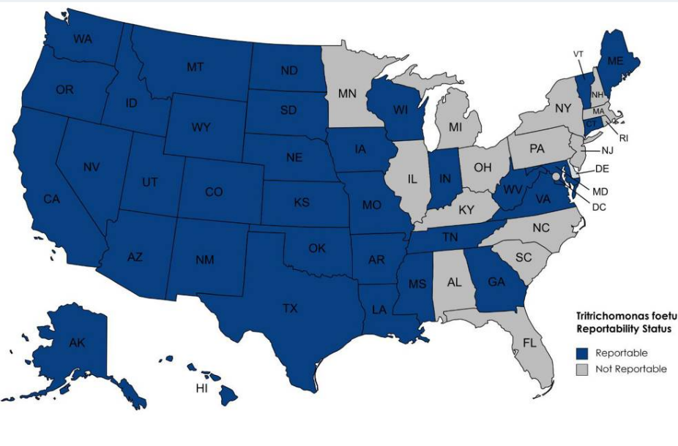
FYI: Geography:
States where bovine trichomoniasis is reportable
Contact your state’s veterinarian to find out updated regulations
Notes:
Currently, there are no Federal regulations specific to curbing spread of trichomoniasis in the U.S. cattle population. However, a growing number of states have independently adopted trichomoniasis control and management regulations regarding the interstate movement of cattle to limit disease spread.

Slide 17
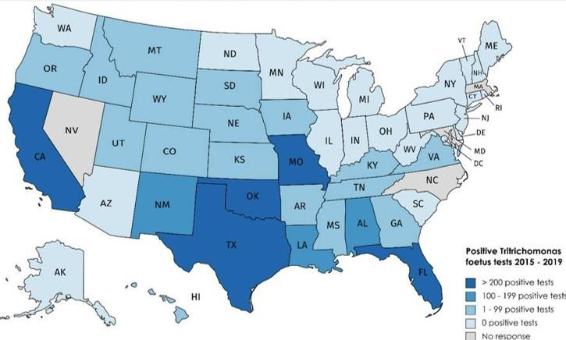
FYI: Geography:
Bovine Genital Trichomoniasis (2015-2019)
Western US – historically more challenges
with management
Martin KA, Henderson J, Brewer MT. Bovine Trichomonosis Cases in the United States 2015-2019. Front Vet Sci. 2021 Aug 9;8:692199. doi: 10.3389/fvets.2021.692199. PMID: 34434984; PMCID: PMC8382153.
Notes:
Surveyed state vets where cases were reported
States in the western United States have the most challenges associated with management and control of T. foetus in beef herds due to extensive ranges for cattle grazing and the use of natural service.
Wyoming started its journey for control and eradication of bovine trichomonosis in the year 2000 when it started a state rule called “Chapter 15” that mandates testing all bulls grazing on open/public allotments or being traded or leased for reproduction and culling T. foetus-positive bulls as well as prohibiting import of T. foetus-positive bulls. At the same time the rule listed bovine trichomonosis a state notifiable disease.

Slide 18
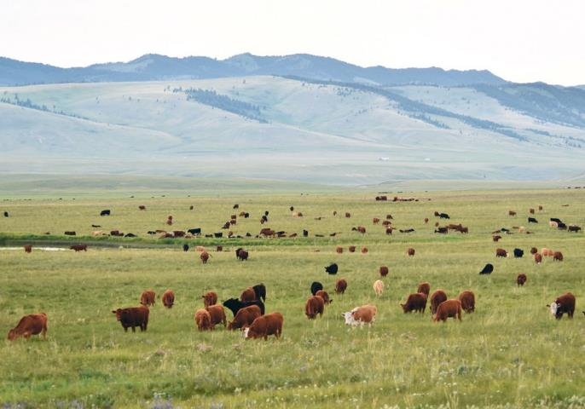
Bovine Genital Trichomoniasis
Epidemiology/Risk Factors:
Bulls ≥4 yrs age
Grazing on public land / commingling herds
Herds with ≥500 cows
Large sire herds

Slide 19
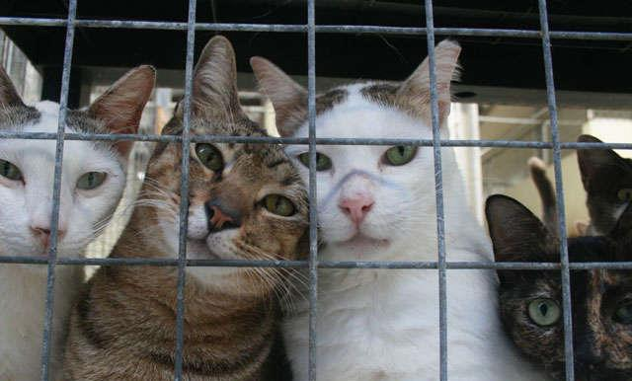
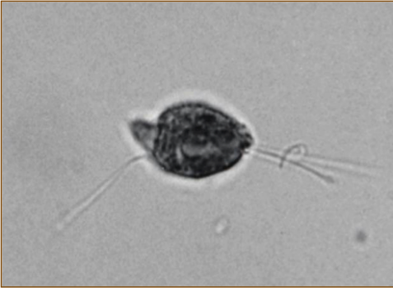
Tritrichomonas blagburni
Feline Trichomonosis
A cause of persistent Large Bowel Diarrhea in Cats
Notes:
This is a great review and resource about T. blagburni.
The conundrum of feline trichomonosis – The more we learn the ‘trickier’ it gets
Gookin, Hanrahan, Levy. 2017. J. Feline Medicine & Surgery. 19: 261-274

Slide 20
Learning Objectives: Tritrichomonas blagburni
Life cycle: know that it is a direct life cycle, and specified details (hosts, transmission, stages and reproduction).
Transmission: Fecal-oral
Pathogenesis: Indirect, destruction of large intestines.
Clinical signs: know the 4 specified main clinical signs in cats
Diagnosis: know the 3 specific methods for diagnosing
Treatment: Ronidazole
Control: strict hygiene and understand why it’s important to know this organisms exists only as a trophozoite (with respect to sanitation).
Epidemiology: know what groups of cat this infection is most prevalent

Slide 21
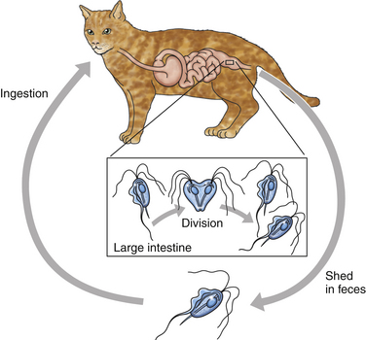
T. foetus: Large bowel Feline Trichomoniasis
Direct Life Cycle
Primary Host
1. cats, large bowel
Transmission
1. Fecal-oral –ingest trophozoites
Stages
1. Trophozoite
2. No cyst stage (why is this important?)
Reproduction
1. binary fission in feline GI tract
https://veteriankey.com/trichomoniasis/
Notes:
Pay attention to infection location in primary hosts.
For example, T. blagburni colonizes the large bowel. Clinical signs of large bowel diarrhea are different than small bowel.
In the next section, you will learn about Giradia infections. They can infect cats too. This pathogen colonizes the small bowel so clinical signs will be different.

Slide 22
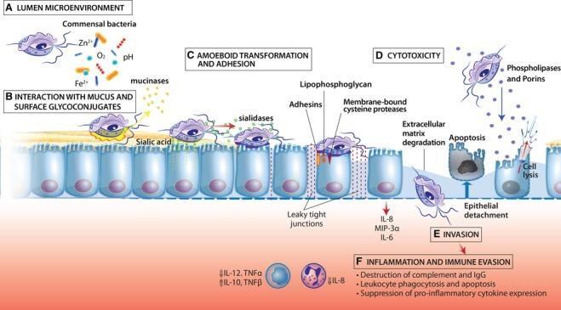
Pathology: Large bowel Feline Trichomoniasis
Theorized pathogenic mechanisms of T. blagburni
Indirect tissue destruction of large intestines: extracellular, has a cytotoxic effect when interacting with the surfaces of host cells.
(rare)
FYI: this illustration
Illustration by Alice MacGregor Harvey © North Carolina State University
Notes:
Just know that pathogenesis is indirect tissue destruction of GI tract
FYI contributing factors = adherence to host mucus and epithelium, interactions with bacterial flora, cytotoxins, enzymes, activation of inflammation

Slide 23
Clinical Disease: Large Bowel Feline Trichomoniasis
Diarrhea: waxing and waning, chronic
Usually feces in hair around anus (messy rear)
Semi-formed to “cow-pie” diarrhea
+/- mucus; +/- fresh blood
Urgency and straining (tenesmus)
Usually, no other clinical signs
Worse in kittens and younger cats
Some cats are subclinical
Notes:
The clinical signs of trichomoniasis are variable and range from subclinical infection to chronic intractable diarrhea. The signs often are intermittent
Disease of the large intestine including the colon and rectum:
pass small amounts of loose stool very often, usually more than 5 times daily
strains to pass stool
If blood in the stool, it is red in color
slimy with mucus, tenesmus, urgency
not usually vomit or lose weight with large bowel diarrhea.
Worse in kittens may = fecal incontinence and increased inflammation of anal region “fecal scalding”

Slide 24
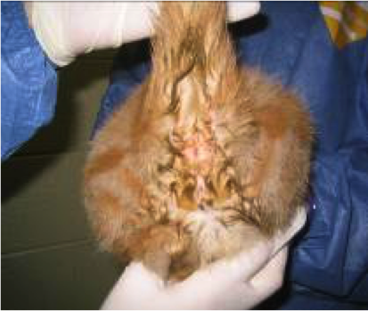
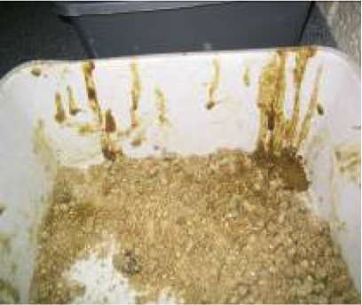
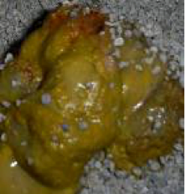
Clinical Disease: Large Bowel Feline Trichomoniasis
messy rear
frequent dribbling
fresh blood or mucus
Semi-formed to cow-pie

Slide 25
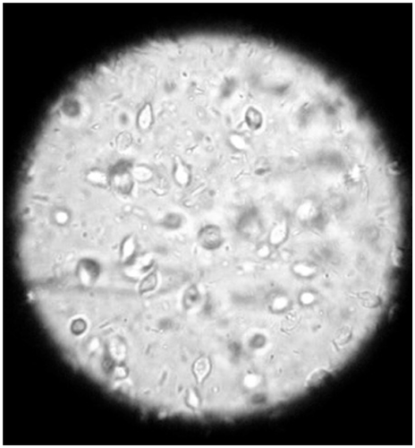
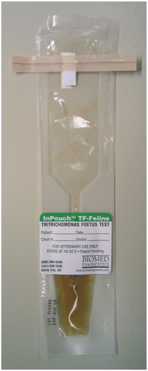
Diagnosis: Large Bowel Feline Trichomoniasis
Fresh wet-mounts and light microscopy
to view motile trophozoites
don’t confuse with Giardia
low sensitivity (≤14%)
2. In-vitro culture kit (InPouch TF Feline for culturing)
perform in clinic; use with wet mount
3. PCR: T. foetus Diagnostic Laboratory at NC State
Fecal sample (pathogen dead or alive)
high sensitivity
https://cvm.ncsu.edu/research/labs/clinical-sciences/tfoetus/#tabsPnl1-tab-1
Notes:
You may be tested on the 3 highlighted methods. You won’t be tested on the details.

Slide 26
Diagnosis: Large Bowel Feline Trichomoniasis
3. PCR: T. foetus Diagnostic Laboratory at NC State
FYI: Fecal loop increased sensitivity for T. foetus PCR
Retrospective analysis. T. foetus PCR test results from 1808 fecal samples submitted for diagnostic testing were examined for their association with method of fecal collection and prior antimicrobial treatments
Fecal samples collected via fecal loop had increased probability of positive PCR test results (odds ratio 2.04, 95% confidence interval1.31-3.17, P = .002)
Maybe fecal loop promotes collection of samples from the surface of the colonic mucosa where the trichomonads are found to adhere to the mucus and epithelial lining
Hedgespeth, Barry A., et al. "Association of fecal sample collection technique and treatment history with Tritrichomonas foetus (blagburni) polymerase chain reaction test results in 1717 cats." Journal of veterinary internal medicine 34.2 (2020): 734-741.
Notes:
Note: Fecal loops are not sufficient to collect enough feces for good fecal float analysis.

Slide 27
FYI: Cytological preparation
of cultured feline
Tritrichomonas
(a) posterior flagellum
(b) undulating membrane
(c) anterior flagella
(d) axostyle
(e) nucleus
Wright-Giemsa, x100 magnification
Gookin et al. The Conundrum of Feline Trichomonosis The more we learn the “trickier” it gets. JFMS (2017) 19, 261-274
Notes:
FYI. Good slide for seeing what they organisms look like if you stained a culture. You will not need to know the morphological identifications.

Slide 28
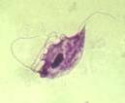
Diagnosis: Large Bowel Feline Trichomoniasis
wet mount
T. foetus
Spindle-shaped
Forward motility
Giardia
Petal shape
Falling leaf motility
http://www.JodyGookin.com
Notes:
Tritrichomonas and Giardia look similar on a wet mount
Giardia will have a concave appearance, like a rose petal, and sluggish motility (falling leaf)
Trichomonads are tear drop shaped, undulating membrane, vigorous motility
Co-infections can occur

Slide 29
Treatment: Large Bowel Feline Trichomoniasis
Ronidazole {Tricho Plus}
30 mg/kg every 12 or 24 hrs for 14 days
(note: you won’t be tested on drug dosages)
Be alert for neurotoxicity (narrow safety margin)
Resistant populations increasing
Pradofloxacin may be alternative therapy in suspected resistance –stay tuned
Enterococci-containing probiotics and fiber?
Diarrhea may resolve without treatment ~ 9 months
Unresponsive to metronidazole
The FDA prohibits Ronidazole for use in food animals.
Notes:
Know Ronidazole is the treatment.

Slide 30
Control: Large Bowel Feline Trichomoniasis
Strict hygiene in group housing, cattery, shelter, and cat shows.
No cyst form (exists only as a trophozoite), so the organism does not persist for more than a few hours in dry, aerobic environments
It can survive for several days in feces and 1 day in water or urine
Notes:
Know that for control, best is strict hygiene and because this does not form a cyst (like giardia), it doesn’t not survive for long in dry, aerobic environments.

Slide 31
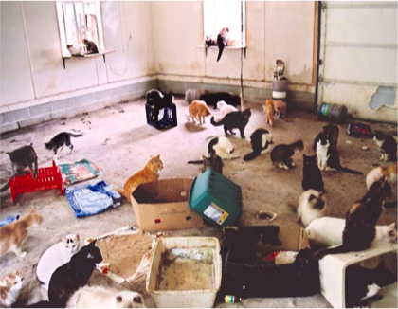
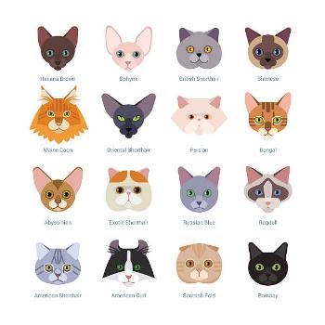
Epidemiology: Large bowel Feline Trichomoniasis
Most prevalent in:
1. Young cats
Older cats may be asymptomatic
2. Cats from high density populations, PUREBRED CATS!
(FYI: Abyssinian, Bengal, and Siamese cats most common in the US based on some studies)
Occurs worldwide
Not zoonotic
Notes:
Catteries – Breeding and boarding
Pure-breed show cats
Hoarding situation

Slide 32
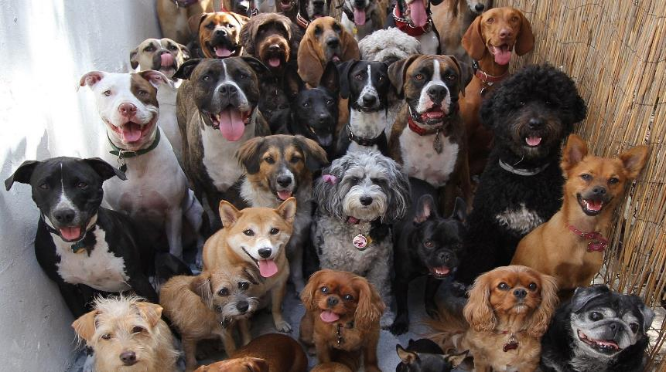
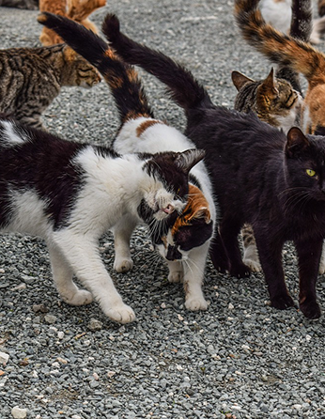
Mucoflagellates
Giardia

Slide 33
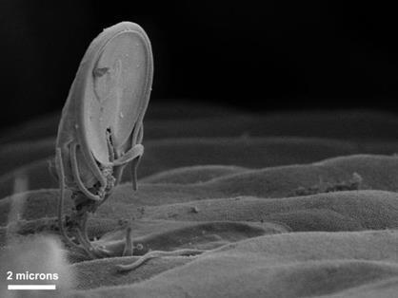
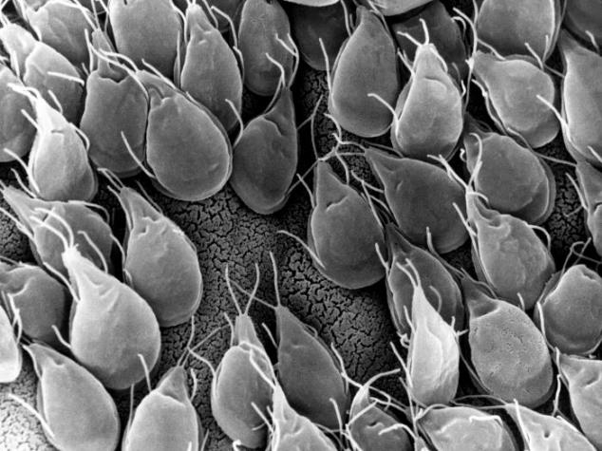
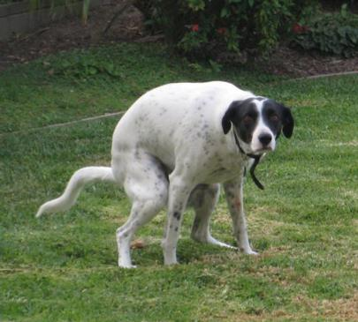
Giardiasis
Can cause small bowel diarrhea
G. duodenalis is part of a species complex including G. intestinalis, G. lamblia.
Notes:
You will not be asked to differentiate between any Giardia spp.
Giardia duodenalis (also known as G. intestinalis, G. lamblia)
a species complex is a group of closely related organisms that are very similar in appearance to the point that the boundaries between them are often unclear.

Slide 34
Learning Objectives: Giardia
Life cycle: know that it is a direct life cycle, and specified details (hosts, transmission, stages and reproduction).
Transmission: Fecal-oral, ingests cysts
Pathogenesis: Indirect, destruction of small intestines.
Clinical signs: know the main clinical signs
Diagnosis: know the 2 specific methods highlighted
Control: strict hygiene and understand why it’s important to know this organism is in a cyst form (with respect to sanitation).
Epidemiology: more common in highly dense populations
Zoonosis: Giardia have high host specificity, so zoonosis is rare
Credit: David Gregory & Debbie Marshall, Wellcome Images

Slide 35
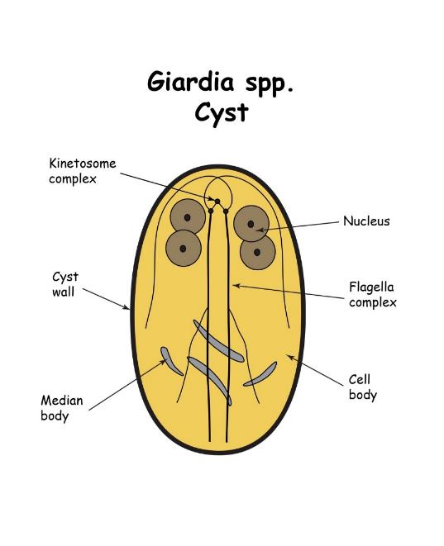
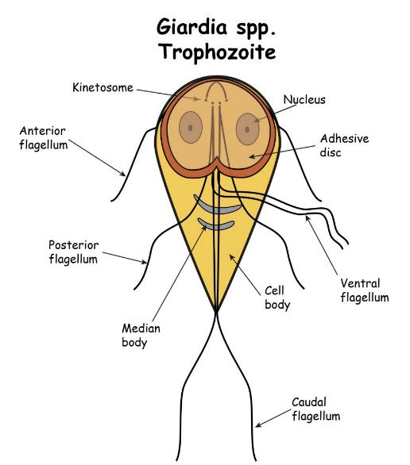
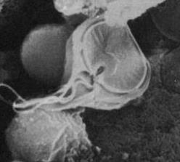
FYI: Morphology

Slide 36
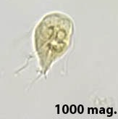
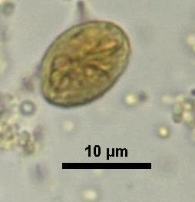
Microscopic Diagnosis: Giardia
Trophozoite
Cyst
More fluid the stool the more trophs
More solid the stool the more cysts
Notes:
You will not be asked to identify these organisms in lecture exams

Slide 37
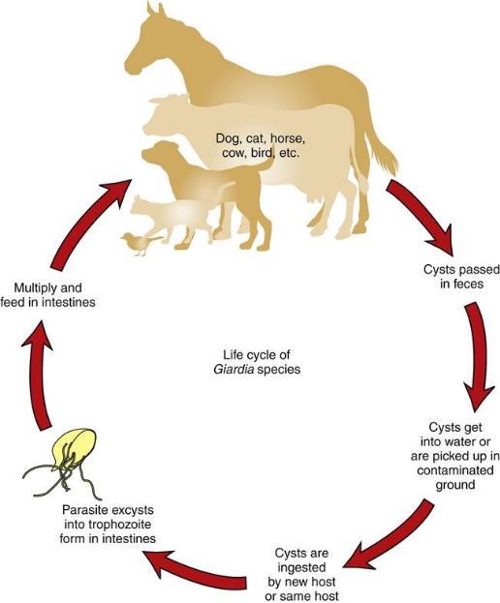
Direct Life Cycle: Giardia
Primary Host
1. many species
2. colonizes small intestines
on mucosal surface
Transmission is Fecal-oral
1. Ingest cysts
a. feces
b. contaminated water,
food, fomites, self-grooming
2. Not trophozoites (they will not survive the stomach)
Stages
1. trophozoite (active, noninfective)
2. cysts (dormant, infective)
Reproduction
1. binary fission of trophozoites
Direct Life Cycle
horse-to-horse,
dog-to-dog
cat-to-cat
etc
Image: https://veteriankey.com/common-protozoans-that-infect-domestic-animals/
Notes:
Note differences between T. blagburni and Giardia.
For example, Giardia infects the small intestines but T. blagburni infects the large intestines.
Giardia forms cysts, T. blagburni does not.
Giardia trophozoites cannot survive ingestion, but T. blagburni trophozoites do (T. blagburni does not have a cyst stage)
Giardia transmission is through ingestion of the cyst form. The cyst form will then change into trophozoite once in the intestines. This is where the damage occurs (pathogenesis)

Slide 38
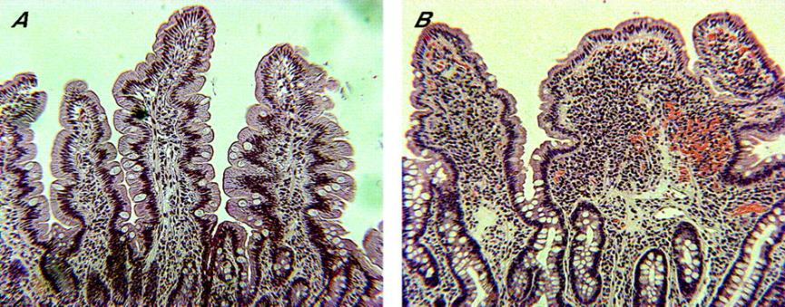
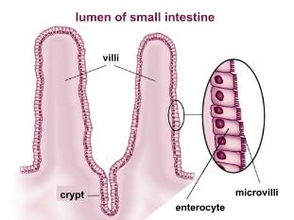
Pathology: Giardia
Indirect destruction: trophozoite attaches to small intestinal epithelial cells
damages epithelial cells, blunts intestinal villi → reduced surface area
Dysfunctional enterocytes → maldigestion, malabsorption, diarrhea
Normal duodenum
Chronic giardiasis:
blunted villi; reduced surface area of enterocyte
Image: Troeger, Hanno, et al. "Effect of chronic Giardia lamblia infection on epithelial transport and barrier function in human duodenum." Gut 56.3 (2007): 328-335.
Notes:
Know the blue highlighted information for testing
The pathogenesis of giardiasis in dogs is not completely understood, and there are likely multiple pathways by which parasites can cause disease. Alterations of normal flora, production of toxins, blunting of microvilli, inhibition of enzymes, and hypersecretion of chloride ions have all been proposed. Apoptosis of enterocytes?

Slide 39
Clinical Disease: Giardia
Persistent Diarrhea: mucoid, pale, soft, loose, fatty (blood is uncommon)
+/- vomiting, anorexia, dehydration
Some animals are subclinical but shed giardia
(Giardia also a commensal organism??)
Malabsorption syndrome
signs of poor nutrition – lethargy, weight-loss, etc.
FYI: Common co-infections associated with diarrhea include Giardia/Cryptosporidium or Giardia/Tritrichomonas
Notes:
Know the clinical sings in blue
Develop ~ 2 - 3 weeks post infection
Why do you think you will see more systemic clinical signs (vomiting, weight loss) with Giardia infections rather than T. foetus infections?
DDx
All causes of small bowel diarrhea including Cystoisospora spp., Cryptosporidium spp., bacterial infections such as salmonellosis, nematode infections, dietary intolerance, exocrine pancreatic insufficiency, and inflammatory bowel disease

Slide 40
Diagnosis: Giardia
Antigen (cysts) detection kits, ELISA
Rapid in-house; ↑ Specificity
Direct microscopic fecal analysis
May need to do several over time (b/c intermittent shedding)
Loose stool: motile trophozoites on fresh wet-mounts
(don’t confuse with Tritrichomonas in cats)
Fecal float centrifugation
Solid stool: cyst stage (don’t confuse with yeast)
use fecal float centrifugation with zinc sulfate solution
combine
↑ Sensitivity
Saleh, Meriam N., et al. "Comparison of diagnostic techniques for detection of Giardia duodenalis in dogs and cats." JVIM (2019).
Uiterwijk, Mathilde, et al. "Comparing four diagnostic tests for Giardia duodenalis in dogs using latent class analysis." Parasites & vectors 11.1 (2018): 439.
Notes:
SNAP Tests, VetScan
Fresh wet mounts use saline
Because of intermittent shedding, 3 negative fecal floats over time to show the dog is truly negative
It’s best to combine these approaches.
In a study using Bayesian statistical approach, the IDEXX POC kit (SNAP Giardia) showed a sensitivity of 88.9% and a specificity of 95.8% with PPV and NPV of 89.6% and 95.4%, respectively, when used on dog specimens.
One diagnostic laboratory has begun to offer a PCR panel that detects nucleic acid from 20 different parasites, and differentiates zoonotic assemblages of Giardia (A and B) from other assemblages of Giardia (assemblage non-specific assay) (KeyScreen GI Parasite PCR, Antech Diagnostics, USA). A 2019 article reported that the sensitivity and specificity of a real-time PCR assay for G. duodenalis that was incorporated as a component of a diarrhea panel was 95.1% and 92.1%, respectively, when compared with a reference real-time PCR assay. 50 However, Giardia PCR assay results can also be falsely negative because of the presence of PCR inhibitors in feces. In one study, false negative results were obtained in 41% (11/27) specimens using a real-time PCR assay in comparison with direct FA or fecal flotation

Slide 41
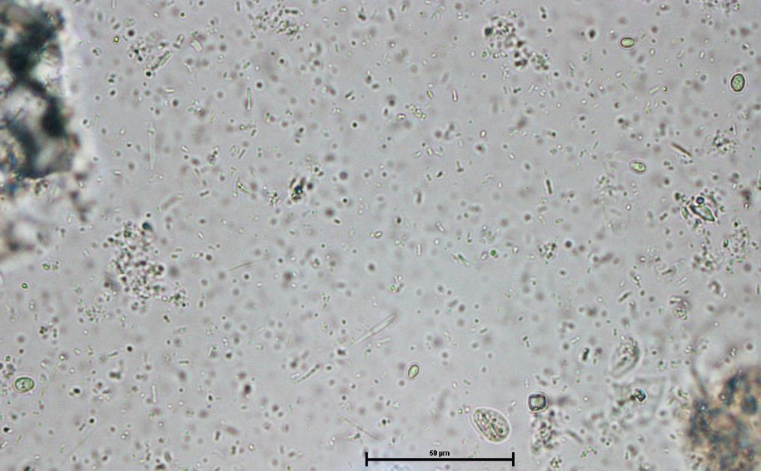
40x objective
(mag. 400x)
Giardia
Yeast
Zinc sulfate fecal flotation showing Giardia cysts and yeast

Slide 42
Giardia cysts from a cat -zinc sulfate centrifugal flotation
Iodine-stained
unstained
Notes:
FIG. 101.4 Giardia cysts concentrated from the feces of a cat by the zinc sulfate centrifugal flotation technique. (A) Cyst wall, nuclei, axonemes, and median bodies are apparent in several of the cysts (iodine, ×1100). (B) Unstained with numerous cysts showing concavity (×1100).

Slide 43
Diagnosis: Wet mount Giardia
T. foetus
Spindle-shaped
Forward motility
Does NOT form cysts
Giardia
Petal shape
Falling leaf motility
Forms cysts
http://www.JodyGookin.com
Notes:
Tritrichomonas and Giardia look similar on a wet mount
Giardia will have a concave appearance, like a rose petal, and sluggish motility (falling leaf)
Trichomonads are tear drop shaped, undulating membrane, vigorous motility
Co-infections can occur

Slide 44
Treatment: Giardia
Fenbendazole [Panacur] or Metronidazole [Flagyl]
Combo of Febantel-pyrantel-praziquantel [Drontal plus]
Probiotics and fiber (psyllium)
Treatment duration depends on drug but range 3-8 days
Follow-up with strict environmental decontamination, bathing the animal, etc. to prevent reinfection.
Treat only symptomatic dogs & cats to decrease development of resistance to antiprotozoal drugs.
Companion Animal Parasite Council (CAPC) for up-to-date management recommendations (https://capcvet.org/)
Drug names are FYI
Notes:
All drugs are used off-label
Because Giardia infection may be difficult to eliminate in dogs and cats, the primary goal is to resolve diarrhea
Fenbendazole = benzimidazole
negligible differences in Gut Microbiome were seen between time points of FBZ treatment indicating that FBZ did not significantly alter the canine GM. https://doi.org/10.30802/AALAS-JAALAS-19-000113
Metronidazole is a synthetic antiprotozoan drug that was first introduced into medical practice in 1960. It suppresses the development of trichmonad, giardia, ameba, lambliosis, bacteriods, fusobacteria, and a few other diseases. It is effective with respect to obligate anaerobic bacteria
Pyrantel is a pyrimidine-derivative anthelmintic agent for the oral treatment of various parasitic worm infections including ascariasis, hookworm infections, enterobiasis (pinworm infection), trichostrongyliasis, and trichinellosis
Praziquantel is an anthelmintic agent with activity against a broad spectrum of trematodes and cestodes
A combination of febantel, pyrantel, and praziquantel (FPP) (Drontal Plus Tablets, Bayer, Shawnee Mission, KS), using a variety of dosage protocols, has had variable results in the treatment of giardiasis in dogs and cats. 40 , 69-75 Two different formulations of the drug exist (see Table 101.8), and dose differences may be responsible for some of the discrepancies between results of efficacy studies.
Nitazoxanide? Maybe, used in human med

Slide 45
Giardia Treatment Tips (FYI)
Start with Fenbendazole, fiber, probiotic
If you suspect treatment failure, then next round use metronidazole
Start with Drontol Plus, fiber, probiotic
If you suspect treatment failure, then next round, use metronidazole

Slide 46
FYI: Follow-up: Giardia
Symptomatic, Giardia (+)
Different Tx
Treat
Refractory Case
Symptoms resolved
Still symptomatic
Yes
No
No need for follow up
Re-infected from environmental contamination?
If contact with immunocompromised humans, confirm NEG
Fecal float and Smear NOT ELISA
Giardia (+)
Giardia (-)
Other GI dz?
Perform 3 fecal centrifugation over 5 days
Notes:
It is recommended to perform a fecal flotation with centrifugation primarily for detection of cysts in solid or semisolid stools. ELISA tests may remain positive even after treatment for variable periods of time and should not be used as a guide to determine reinfection or failure of treatment.
Follow-up investigation can be done 24 to 48 hours after the completion of treatment. It is wise to use centrifugal fecal flotation for detection of cysts instead of an ELISA or antigen detection kits since asymptomatic animals may be antigen-positive for some time. Infections that are refractory to treatment may be a sign of resistance, immune compromise or another underlying disease condition.
Treatment failures may result from: reinfection, inadequate drug levels, immunosuppression, drug resistance and Giardia sequestration in the gallbladder or pancreatic ducts.

Slide 47
Control: Giardia
Strict prevention of fecal contamination
Outdoor environment: pick up, dispose of feces
Indoor environments:
-clean (soap/water) followed by disinfection with diluted bleach (~1/20 = 5% bleach) or quaternary ammonium compounds
-raise temperature for 24 hours to dry out cysts
Bathing contaminated fur (chlorhexidine product)
Giardia cysts can survive for months in the right conditions
Refer clients to CDC website
https://www.cdc.gov/parasites/giardia/prevention-control-pets.html
Notes:
Because Giardia exists in cyst form in the environment, disinfection will need to include diluted bleach
Disinfection: Pet bowls, toys, etc., should be disinfected in either boiling water or in a high-temperature dishwasher. Upholstery and carpeting should be steam-cleaned and allowed to dry. Hard surfaces can be disinfected with a dilute bleach solution (3/4 cup of bleach mixed with 1 gallon of water) or a disinfecting household cleaning product
FYI: did you know that bleach becomes inactive when in contact with organic material (like poop!). Thus, it’s important not to use bleach as a cleaning solution but rather a disinfectant after you have cleaned the environment.
bathing and moving dogs into disinfected kennels while disinfecting their original kennels with a quaternary ammonium solution, and then raising the temperature in the room for 24 hours to promote drying of Giardia cysts, eliminated Giardia excretion in 34 dogs
FYI: Cysts can survive the following conditions
soil → cool (<39.2 °F) ~ 7 weeks; room temp ~1 week
dry, warm surface with direct sunlight ~2 days
moist, cool surface ~ 2 weeks
water → <50 °F ~3 months; >50 °F, less time, summer ~4 days

Slide 48
Epidemiology: Giardia
FYI: In the US
Dog: 7.07%
Cat: 3.98%
More common in:
High density situations (catteries, kennels, shelters, dog parks)
Younger animals
More likely to spread:
Btwn same species “house mates”.
Common co-infections are:
Giardia/Cryptosporidium
Giardia/Tritrichomonas
Notes:
CAPC map: Data provided by IDEXX and Antech

Slide 49
Zoonosis: Giardia
Giardia spp. contain molecular assemblages (differences in the genome) A-H
Most of the molecular assemblages seem to be host specific –zoonosis rare.
Assemblage A-I – Humans, dogs, cats, others
Assemblage C & D – Canines
Assemblage F – Felines
Some concern for immunodeficient patients
High host specificity
Notes:
For this slide, just understand that Giardia spp. have high host specificity and zoonosis is rare.
Owners will be concerned if their dogs have Giardia because they know people also get giardia infections. It is rare for people to get giardia from their pets.
Assemblages and transmission cycles of giardiasis. Most human infections are anthroponotic, and involve sub-assemblages AI, AII, BIII, and BIV. Sub-assemblage AI has zoonotic potential, and involves livestock, wild ruminants, nonhuman primates, cats, and dogs. Occasional reports of transmission of assemblages C, E, and F have been reported, likely originating from the animals predominantly infected by these assemblages.

Slide 50
Giardia new spp. names? Stay tuned…
Assemblage Proposed Species Name Main Host
A Giardia duodenalis Humans and other mammals
B Giardia enterica Humans and other mammals
C Giardia canis Domestic and wild canids
D Giardia canis Domestic and wild canids
E Giardia bovis Hoofed animals
F Giardia cati Cats
G Giardia simondi Rodents
H None proposed Pinnipeds
FYI

Slide 51
In-Class Discussion
their cat’s
A cat owner is complaining because of apparent fecal incontinence.
What are some additional questions you might ask?
Infectious differentials?
Diagnostics?
Cross species or Zoonosis ?

Slide 52
In-Class Discussion
3-year-old Labrador Retriever has repeatedly tested positive for
giardia cysts in a fecal despite a course of fenbendazole. Waxing
and waning diarrhea persists.
What are some additional questions you might ask the owner?
What would you recommend for this dog?
Zoonosis?

Slide 53
Have Questions?
barbara_qurollo@ncsu.edu
Illustration by Allie Brosh, http://hyperboleandahalf.blogspot.com/

