Slide 1
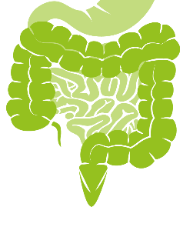
Coccidia Part 1
(intestinal apicomplexans)
Cryptosporidium parvum

Slide 2
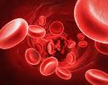




(know terms on this slide)
Parasitic
Protozoa
Grouped by Infection Site and Motility
Apicomplexa
(sg =Alveolates)
Flagellates
(sg = Excavates)
blood/
tissue
Blood apicomplexa (piroplasms)
Hemoflagellates
Babesia spp.
Trypanosoma cruzi
Cytauxzoon felis
Leishmania infantum
Systemic apicomplexa (coccidia)
systemic
Toxoplasma gondii
Trypanosoma cruzi
Neospora caninum
Leishmania infantum
Sarcocystis spp.
intestines
Intestinal apicomplexan (coccidia)
Mucoflagellates
Cryptosporidium parvum
Tritrichomonas foetus
Tritrichomonas blagburni
Eimeria spp.
Giardia spp.
Cystoisospora spp.
Notes:
Here’s our road map. We will continue with intestinal apicomplexa, starting with Cryptosporidium parvum

Slide 3
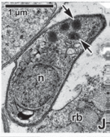
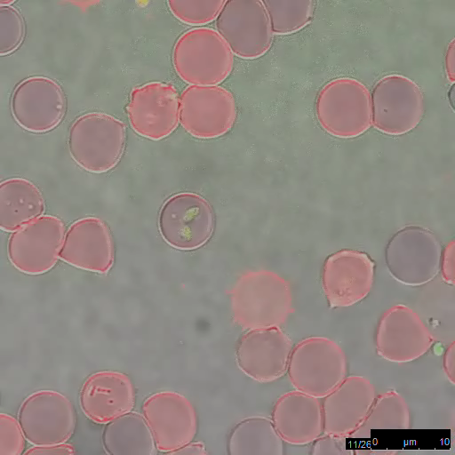
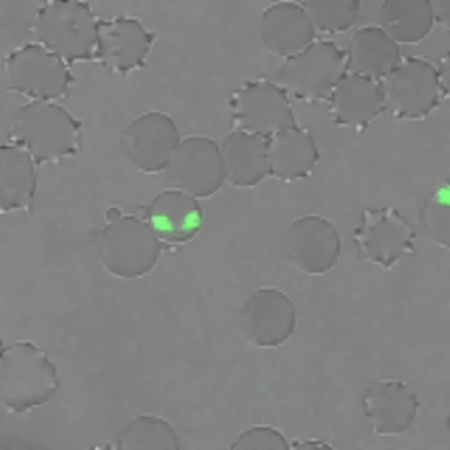
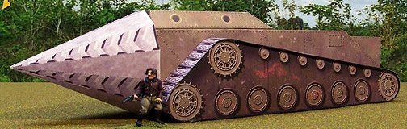
Apicomplexan:
Select Characteristics
Intracellular with apical complex
Gliding motility
Life cycle alternates b/w sexual and asexual reproduction
Many morphological stages = “zoites” and “-onts”
Notes:
These pathogens are designed to get inside cells. The are obligate intracellular pathogens.
They have both sexual and asexual reproduction stages as well as different morphological stages.
apical complex – organelle for invasion of host cell
Time-lapse video microscopy of a B. bovis merozoite engaged in gliding. Video S1 is shown at 6.7× real time.
https://doi.org/10.1371/journal.pone.0035227.s001
Time-lapse video microscopy of B. bovis merozoite egress from a RBC, gliding to and invasion of a new RBC. Video S3 is shown at 15.4× real time.
https://doi.org/10.1371/journal.pone.0035227.s003

Slide 4
Apicomplexan: Terms
  Sporozoite = infective stage; spore-like cells
  Merozoite = sporozoite that is inside host cell, will start asexual replication
merozoite = schizozoite (ski-zō-zōite)
Some other “-zoites” terms
  Tachyzoite = fast growing zoite & Bradyzoite = slow growing zoite
Merogony = merozoite asexual replication in host cells
merogony = schizogony (ski-zog-ō-ne)
Meronts = a bag of merozoites
meront = schizont (skizont)
Meront
Sporozoite
Meronts (schizonts),
containing many
Merozoites (schizozoites)
Merozoite
(inside host cell)
Merogony
(asexual replication)
infects
host cell
Notes:
Merozoite = schizozoite.
Merogony = schizogony.
Meront = schizont
The terms are used interchangeably. You will see one or the other in the literature or textbooks.
When a merozoite is in a host cell, it can sometimes be called a trophozoite, tachyzoite or bradyzoite depending on growth rate, metabolic stage etc.
I mention this because you may see these terms later in some life cycles.

Slide 5
Apicomplexan: Replication
  Asexual replication (this is how the tissue damage in the host occurs)
Merogony (schizogony) → replication of merozoites
Sporogony (sporulation) → replication within the oocyst resulting in sporozoites
  Sexual replication (this is how oocysts are made)
Gametogony→ merozoite develops into a gamete
microgamete = male
macrogamete = female
Fertilization→ microgamete fertilizes a macrogamete,
which develops into a zygote then an oocyst
Notes:
Terms you may encounter as we go over life cycles for apicomplexa pathogens.
You are not going to be tested directly on these terms.
This slide is here for reference when you come upon these terms in the life cycles depictions

Slide 6
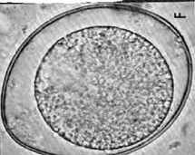

Animated Slide
Apicomplexan: General Life Cycle
male (microgametes)
female (macrogametes)
unsporulated
oocyst
sexual fertilization
gametes
zygotes → oocysts
sporogony (sporulation)
gamont
(bag of gametes)
sporulated
oocyst
gametogony
sporocysts
sporozoites
merozoites
sporozoites
(infective)
Merogony
asexual replication
inside host
host cell
Meront
(bag of merozoites)
Notes:
Here is a general Apicomplexa life cycle.
This has animation so if you put it in slide show view and advance (may be less confusing)

Slide 7
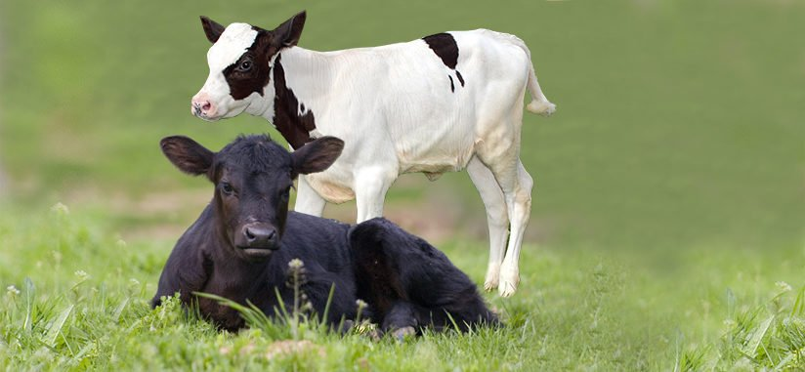
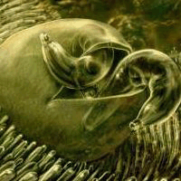
Infective
sporozoites
Cryptosporidium parvum
Intestinal pathogen of calves
C. parvum has very low host specificity!
There are many Cryptosporidium spp. that are more host specific (C. ryanae, C. bovis, C. canis, C. felis etc)

Slide 8
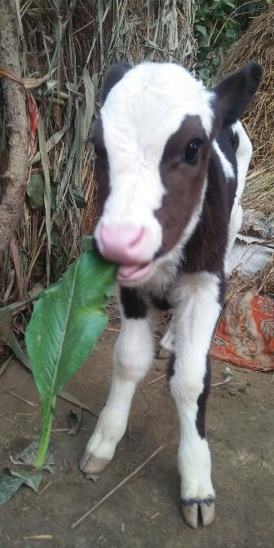
Learning Objectives: Cryptosporidium parvum
Morphology: know that they are small, have 4 sporozoites
Life cycle: know direct life cycle, fecal-oral, where sporulation occurs and why that is important
Transmission and Dissemination: sporulated oocysts are ingested; understand autoinfection and the implications of oocysts having a thin vs thick wall.
Pathogenesis: know the primary method of cell destruction and where it occurs.
Clinical signs: know the main clinical signs.
Diagnosis: know the main method of diagnosis.
Treatment: Understand the most effective and important way to treat diarrhea in calves
Control: Understand best way to control C. parvum, prevent diesease and how long oocysts are viable for in the environment.
Epidemiology: Know the 4 common risk factors for calves
Zoonosis: understand C. parvum is highly zoonotic and the primary way most people are infected.

Slide 9
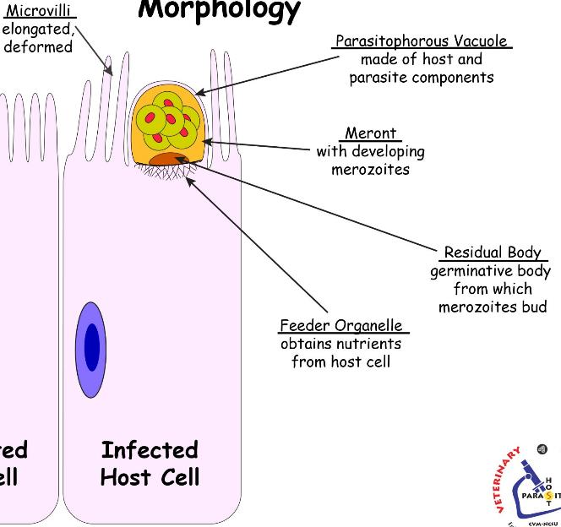
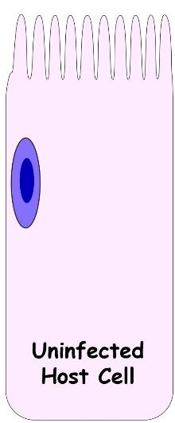
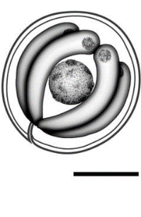
Morphology: C. parvum
infective sporozoite
Oocyte
w/ 4 sporozoites
“superficial”
location
in the
enterocyte
5-8 um (very small)
thick or thin walls
Notes:
Notice how the pathogen infects the enterocyte but doesn’t go into the cell. It stays in a space called the parasitophorous vacuole and destroys the microvilli.

Slide 10
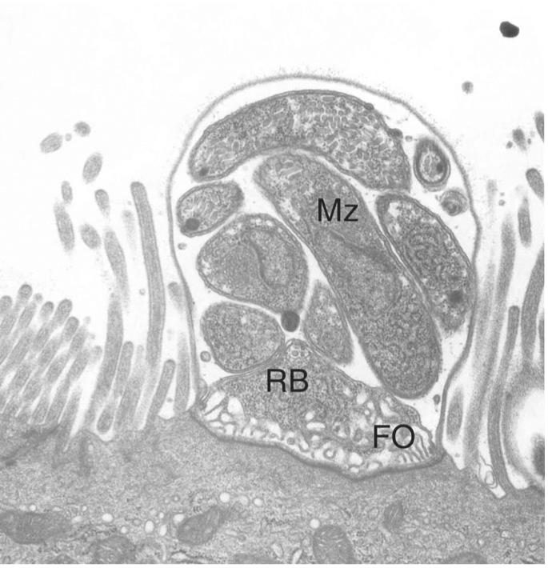
Morphology: C. parvum
PV
FYI
parasitophorous vacuole (PV)
feeder organelle (FO)
residual body (RB)
merozoites (Mz)
The enterocyte microvilli immediately adjacent to the parasite are typically elongated.
https://www.ncbi.nlm.nih.gov/pmc/articles/PMC3368497/
Notes:
FYI, more pictures

Slide 11
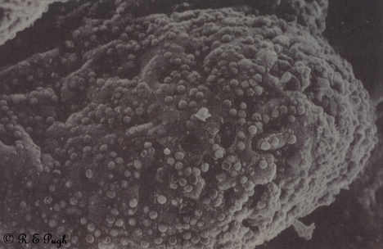
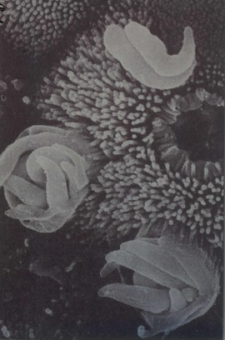
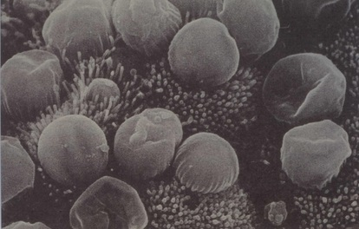
http://parasite.org.au/pugh-collection/
SEM’s of Crypto
FYI

Slide 12
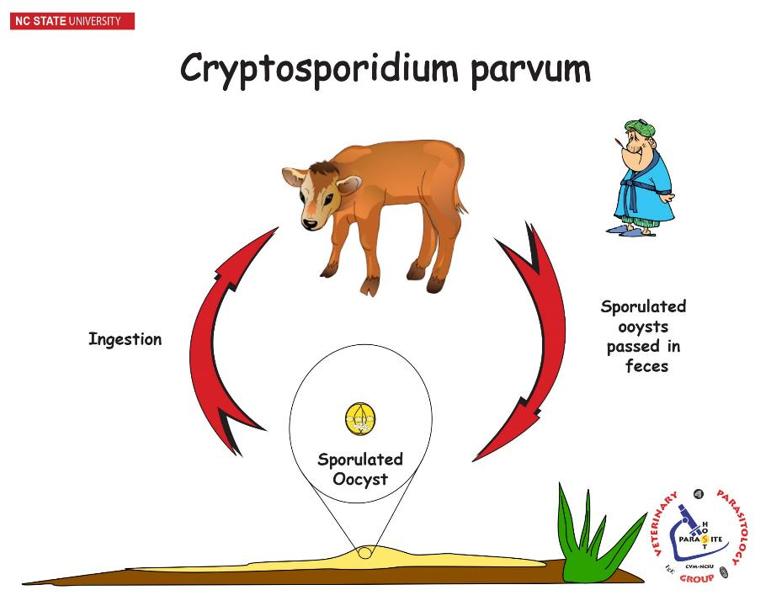
Direct life cycle
Zoonotic!
Notes:
Pretty simple, right? Fecal-oral, direct life cycle.
Let’s look closer at what is happening inside the cow, once the enterocytes become infected.

Slide 13
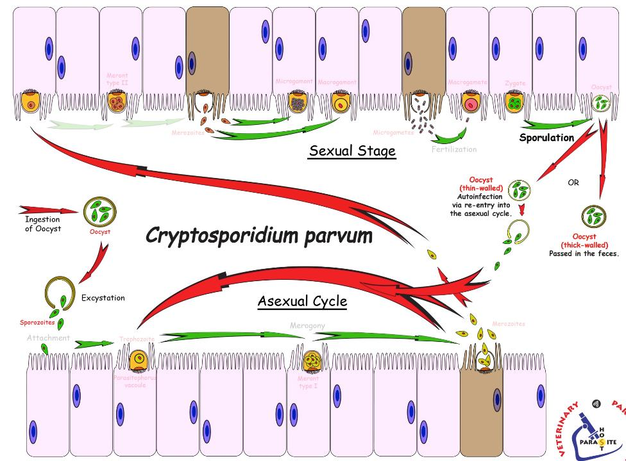
Life Cycle:
C. parvum
zygote
oocyst
microgametes
macrogametes
merozoites
Gametogony
fertilization
start here
Merogony
merozoites
small intestines
Notes:
Here is where we can start to see the Apicomplexa life cycle you learned in the introduction slides.
Asexual replication occurring first in the enterocyte (in the parasitophorous vacuole). Enterocyte microvilli are destroyed during this. Merozoites break out, infect neighboring cells and repeat the process. Eventually there’s a signal telling some merozoites to become gametes (micro or macrogamets). The process of becoming gametes is gametogony. Then a macrogamete is fertilized by a microgamete (fertilization), ultimately making an oocyst. Inside the oocyst, sporogony (aka sporulation) occurs where sporozoites are made. For C. parvum, sporulation occurs in the lumen of the intestines, thus every oocyst that passes in the feces is infective (because it has sporozoites inside). Only sporulated oocyts are infective to a host. Because sporulation occurs in the intestines for C. parvum, the host can reinfect themselves with the thin-walled oocysts (because the wall breaks open and sporozoites can reinfect the host) The thick-walled oocyst are passed in the feces to infect new hosts after ingestion.
Not all intestinal apicomplexa go through sporulation inside the intestines and not all apicomplexa have thin-walled oocysts. Some other apicomplexa species pass unsporulated oocysts, where sporulation occurs in the environment.

Slide 14
Life Cycle: C. parvum
Transmission
  Direct life cycle – fecal-oral, ingestion of sporulated oocyst
Invasion
  Sporocysts excyst from oocyst and invade microvillus border of enterocyte
Asexual reproduction (small intestines: Ileum, less in cecum & colon)
  Merogony (schizogony)
Sexual reproduction
  Final generation of merozoites infect other enterocytes and undergo gametogony (production of gametes)
  Fertilization – a microgamete fuses with a macrogamete eventually forming an oocyte

Slide 15
Life Cycle: C. parvum
Sporogony (= Sporulation) – oocyst forms 4 sporozoites
  Sporulation occurs within the host gut = oocyst immediately infectious.
Dissemination
  Thin-walled Oocysts
    Autoinfection: oocysts have thin walls and excyst within the same host
      Normal immune system → low grade chronic pathology (diarrhea)
      Immunocompromised → hyperinfection / severe pathology / mortality.
  Thick-walled Oocysts
    Exit the host in the feces
      Contaminate the environment and transmission to the next host.
      Infectious when passed

Slide 16
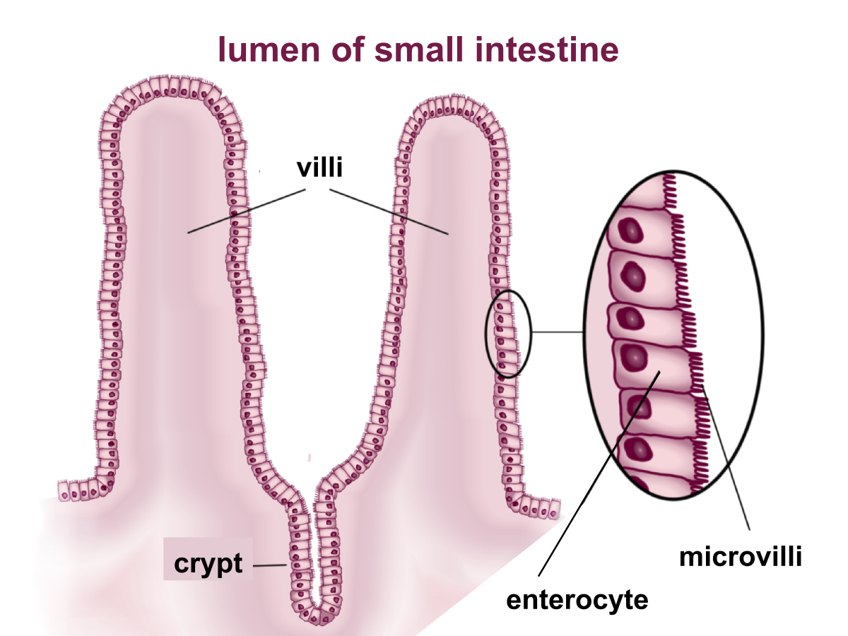

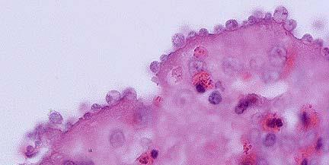
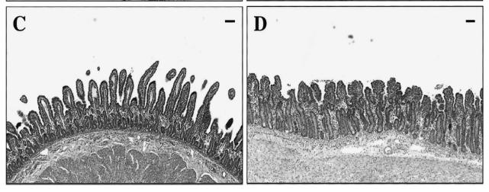
C. parvum Pathogenesis
→ Watery Diarrhea
  Direct damage (inside microvilli)
  SI villus atrophy and dysfunction
  ↓ surface area
  ↓ absorption
  Crypt hyperplasia causes
  ↑ secretory activity
  Indirect damage
  Inflammation
  ↑ permeability, with loss of fluids into the gut lumen.
https://www.askjpc.org/wsco/wsc/wsc96/96wsc01.htm
Healthy Crypto
Image: Gookin, Jody L., Shila K. Nordone, and Robert A. Argenzio. "Host responses to Cryptosporidium infection." Journal of veterinary internal medicine 16.1 (2002): 12-21.
Notes:
The primary route of pathogenesis is direct damage to the small intestines (SI) microvilli, causing villus atrophy and disfunction
Villous atrophy is the reduction in villous surface area that results from ongoing loss of surface enterocytes. This ongoing loss is compensated for by hyperplasia of the crypt epithelium

Slide 17
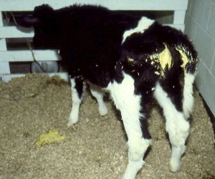
Clinical Disease: C. parvum
Mild to severe watery diarrhea
  usually in neonatal calves (1-2 weeks)
  “Calf Scours”
  Most cases are self-limiting (2-3 days)
  dehydration, weight loss, and emaciation.
  Severe / lethal in immunodeficient hosts
  Also see clinical disease in small ruminants
http://www.vetserviceswairarapa.co.nz/news/article/16/calf-scours-feeder-calf-rearing/

Slide 18
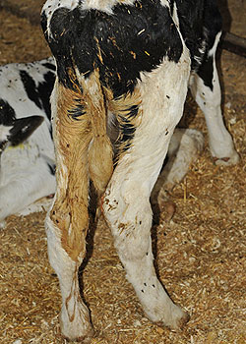
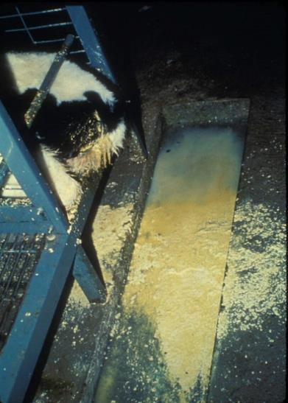
Clinical Disease:
C. parvum
“Calf Scours”
http://calfcare.ca/calf-care-corner/feeding-to-fight-disease/
http://coloradodisasterhelp.colostate.edu/prefair/disease/dz/Cryptosporidiosis.html

Slide 19
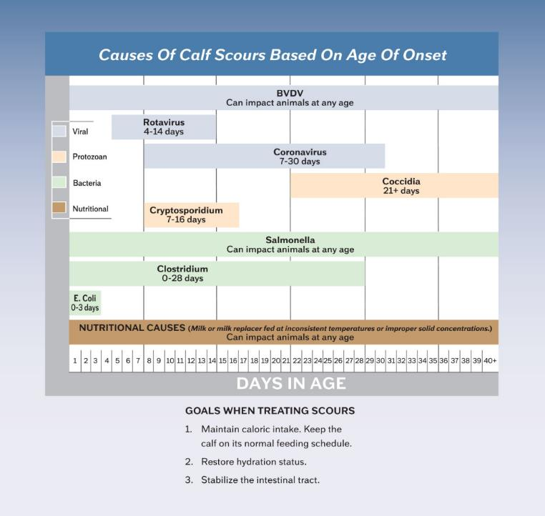
Differential Diagnoses
“Calf Scours”
Cryptosporidium 7-16 days
Coccidia (e.g. Eimeria) 21+ days
Rotavirus
Coronavirus
Bovine viral diarrhea virus (BVDV)
Salmonella
Clostridium
E.coli
Nutritional causes
Know the age difference between
Crypto and Eimeria infections
(other differentials are FYI)
FYI: this chart
  http://crystalcreeknatural.com/causes-of-calf-scours-based-on-age-of-onset/
Notes:
FYI: You will not be tested on these other differentials for this class. You will need to know this info later in vet school and NAVLE.
For this class you will need to know Crypto onset usually with 1-2 weeks of age and coccidia (Eimeria spp. coming up in later lecture), usually >3weeks of age.

Slide 20
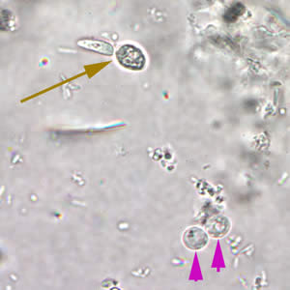
Diagnosis: C. parvum
Fecal Float Centrifugation
  very small oocysts
  don’t confuse with yeast
Thin fecal smear with special staining
  acid fast stains
Molecular diagnostics
  Fluorescent antibodies bind oocysts, ELISA, PCR
yeast
C. parvum
Use concentrated sucrose for fecal float
https://mcdinternational.org
Notes:
Know Fecal float and the sporulated oocysts are very small. You won’t be asked to id oocysts in lecture exams
focus on the thin layer of fluid above bubbles
The prepatent period for C parvum is 3 to 4 days, though first shedding is more often detected at 6- to 7-days old and can last 4 to 18 days

Slide 21
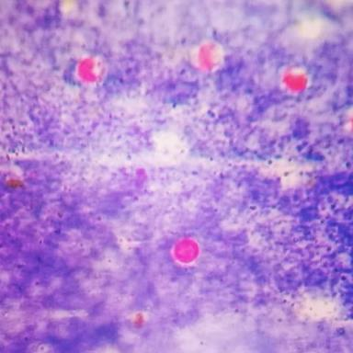
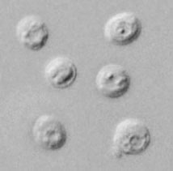
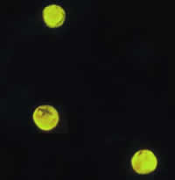
Diagnosis: C. parvum
Acid-fast Stain
Wet Mounts
Fluorescent stain
https://mcdinternational.org
http://www.imgrum.org/media/1000074980669288494_423165795
https://www.cdc.gov/dpdx/cryptosporidiosis/
Notes:
FYI

Slide 22
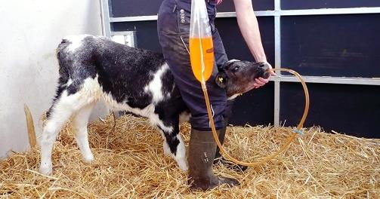
Treatment: C. parvum
Some drugs are only suppressive (Paromomycin, Azithromycin, etc.)
Coccidiostats don’t work
Infection is usually self-limiting in immunocompetent hosts (only need supportive care)
Fluid-replacement therapy for the dehydration caused by the diarrhea is the main way to treat C. parvum.
Electrolyte solution
Allow calf to feed on milk

Slide 23
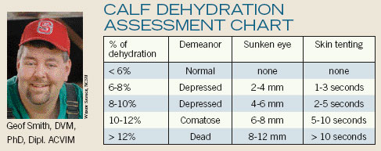
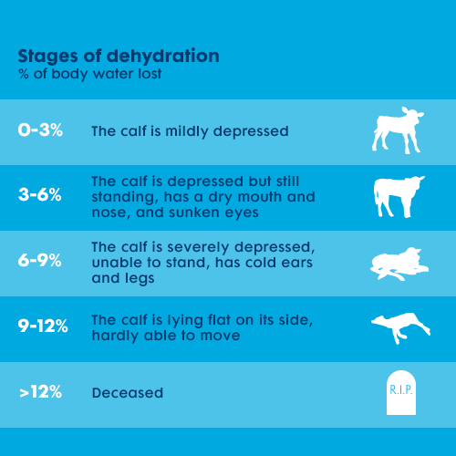
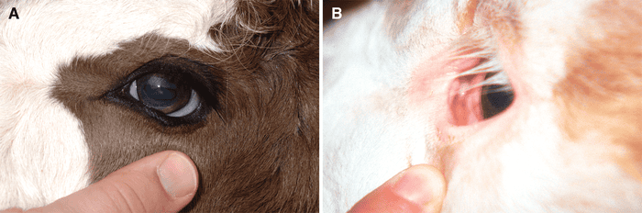
FYI: Dehydration
Decisions
Oral and IV fluid replacement decisions made based on severity of dehydration.
https://www.farmosan.com/en/ruminants/beef-farming/calf-rearing/scours/
FYI

Slide 24
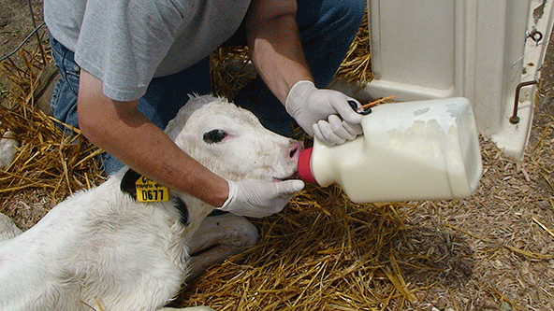
Control: C. parvum
Sanitation and hygiene
Isolation/separation (sick/young)
  Hutch system for dairy calves
Colostrum
Oocysts are viable for months unless exposed to:
  extreme temps (0°C or <65 °C), drying
  disinfectants (5% ammonia, 3-6% H2O2 or 10% formaldehyde)
No Vaccines Available
Notes:
Examples of good barn sanitation that decreased C. parvum shedding:
Decreased use of hay bedding, smaller herd sizes, dry environment, slope (5-10%) in housing to increase drainage, separating feeding supplies for calves under 5 days old,
Survival time of oocysts is ~ 3 months at 15-20°C and a year at cooler temps (4-6°C )
Cryptosporidium spp. oocysts are resistant to most frequently used disinfectants, such as commercial bleach (5.25% sodium hypochlorite, see Chapter 14). Routine chlorination of drinking water does not affect oocyst viability. 97 Because filtration of this small organism is difficult, the organism can enter treated municipal water supplies. Formol saline (10% solution) and ammonia (5% solution) destroyed oocyst viability, but the required contact time was 18 hours. Concentrated ammonia solutions (50%) inactivate Cryptosporidium oocysts after 30 minutes. 98 Formaldehyde and hydrogen peroxide also have activity against oocysts. 99 Moist heat (steam or pasteurization [over 55°C]), freezing and thawing, or thorough drying are more practical means of disinfection. Exceptional sanitation and use of boiling water for the cleaning of water and food bowls should decrease the possibility of contamination within crowded environments.

Slide 25
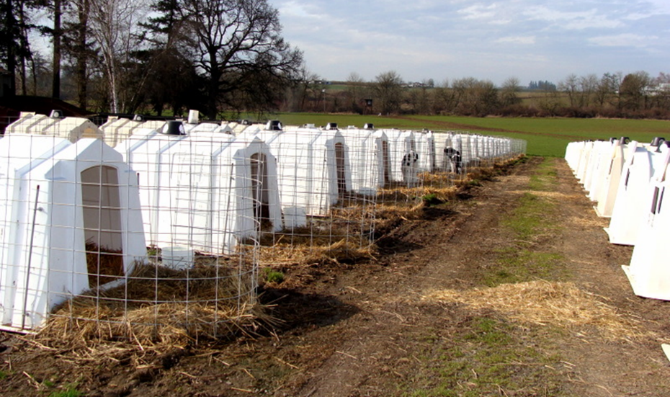
Calf hutches

Slide 26
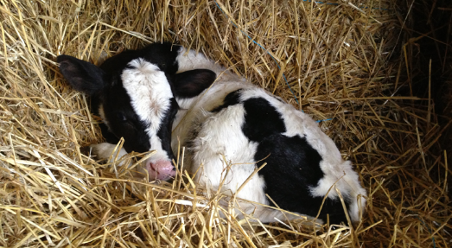
Epidemiology
  Disease is primarily in neonatal calves (and small ruminants)
Concurrent infections with rotavirus & coronavirus tends to make disease worse, than with Crypto alone.
Risk factors for calf scours:
Dirty or contaminated environments
Stress factors
Housing sick calves with healthy calves
4. Not enough or low-quality colostrum
Notes:
Please know these 4 risk factors. Understanding risk factors for disease allows you to mitigate disease

Slide 27

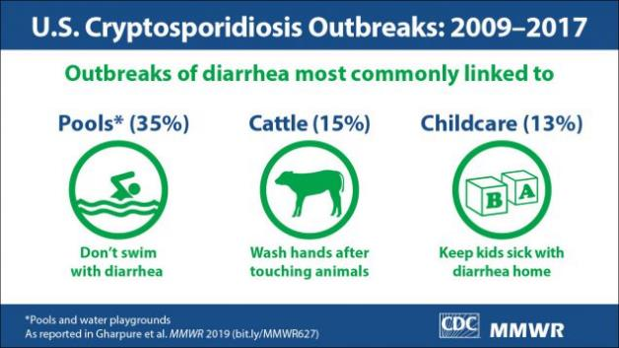
Zoonosis: C. parvum (C. hominis in humans, too)
Highly zoonotic
Transmission:
  Predominantly human-to-human (anthroponotic)
  Direct contact with animals
  Contamination of drinking water
  Food-borne outbreaks
  Farm workers at high risk
Very dangerous in the immunocompromised.
Resistant to chlorine
Notes:
Know that this is highly zoonotic and the primary way people get Crypto is fecal-oral contamination from human to human
Zoonotic cryptosporidiosis is caused largely by C. parvum
Cryptosporidium hominis was formerly known as C. parvum anthroponotic genotype or genotype 1)
The high prevalence and oocyst-shedding intensity of C. parvum leads to heavy environmental contamination, resulting in the common occurrence in humans via animal contact and consumption of contaminated food and water. Therefore, in areas with intensive farming, the zoonotic C. parvum is responsible for more human infections than C. hominis

Slide 28
Zoonosis: C. parvum
Levine, Levy, Walker, Crittenden. 1988.
Cryptosporidiosis in veterinary students.
JAVMA. 193: 1413-1414.
Abstract: Cryptosporidiosis was diagnosed in 10 veterinary students. Exposure to the pathogen was associated with direct contact with infected calves and contact with contaminated materials. Affected students had fever (50%), headache (50%), nausea (70%), diarrhea (80%), and vomiting (40%). Clinical signs persisted for 30 hours to 16 days after the onset of clinical signs of disease. Although one student required hospitalization, the remaining students recovered without treatment.
FYI
Notes:
For most of the general public, human to human is likely how they would contract crypto, HOWEVER, veterinarians and farm workers are at higher risk for contracting from infected animals.
Fomites on human clothing, hands, and footwear may transfer the parasite to other calves, pets, or family members when work clothing or footwear are worn home

Slide 29
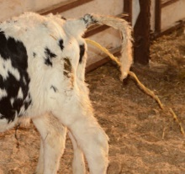
In-Class Discussion
A 12-day old calf is showing severe scours.
Treatment plan?
Zoonotic concerns?
What if this calf was 1 month old??

Slide 30


Have Questions?
barbara_qurollo@ncsu.edu
Illustration by Allie Brosh, http://hyperboleandahalf.blogspot.com/

