Slide 1
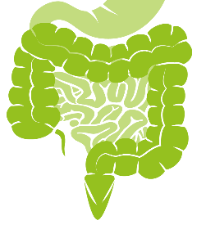
Coccidia Part 2 (intestinal apicomplexans)
Eimeria spp.
(coccidia of hooved stock and poultry)

Slide 2
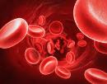
(know terms on this slide)
Parasitic
Protozoa
Grouped by Infection Site and Motility
Apicomplexa
(sg =Alveolates)
Flagellates
(sg = Excavates)
blood/
tissue
Blood apicomplexa (piroplasms)
Hemoflagellates
Babesia spp.
Trypanosoma cruzi
Cytauxzoon felis
Leishmania infantum
Systemic apicomplexa (coccidia)
systemic
Toxoplasma gondii
Trypanosoma cruzi
Neospora caninum
Leishmania infantum
Sarcocystis spp.
intestines
Intestinal apicomplexan (coccidia)
Mucoflagellates
Cryptosporidium parvum
Tritrichomonas foetus
Tritrichomonas blagburni
Eimeria spp.
Giardia spp.
Cystoisospora spp.
Notes:
Here’s our road map. We will continue with intestinal apicomplexa looking at Eimeria spp. The first part of this lecture will focus on Eimeria in general. The second half will cover specific species in host animals.

Slide 3
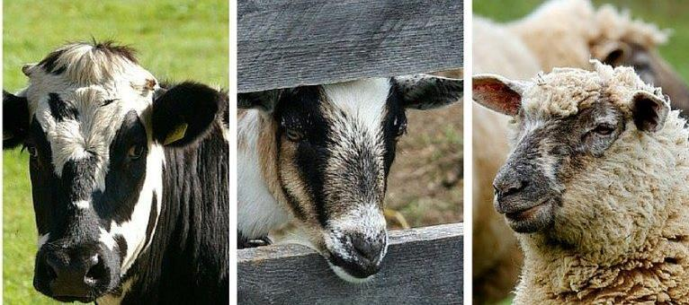
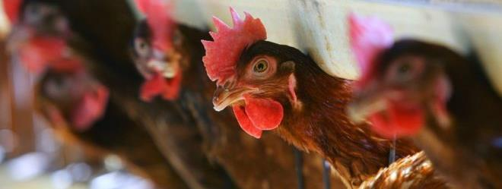
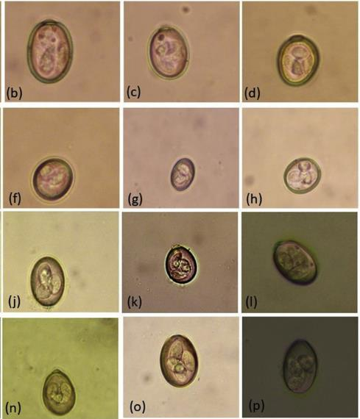
Eimeria spp. (Coccidosis)
Common coccida of hooved stock and poultry
Direct Life Cycle
Intracellular parasites of enterocytes…diarrhea!
Many Eimeria spp. with very high host specificity
Notes:
Claves <30 days

Slide 4
Learning Objectives: Eimeria spp.
Life cycles: understand highlighted components of the Direct Life Cycle
Transmission: know specified routes of transmission
Pathogenesis: understand the specified methods of pathology: direct destruction of enterocytes.
Clinical signs: understand the specified clinical signs and what you might seen in both an individual animal or in a herd or flock of animals
Diagnosis: understand the specified ways to diagnose coccidiosis and know that you should rule out other causes of diarrhea even if you identify Eimeria.
Treatment: know the highlighted information about treating Eimeria, the main reason you would use anticoccidials and specified warnings
Control: Know the highlighted practices to control Eimeria
Zoonosis: know Eimeria is not zoonotic, that species are very host specific and the specified risk factors (host and environmental)
Know the highlighted, specific details for host species (ruminants and poultry)

Slide 5
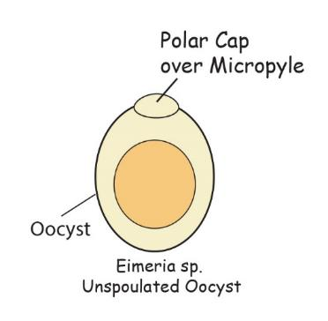
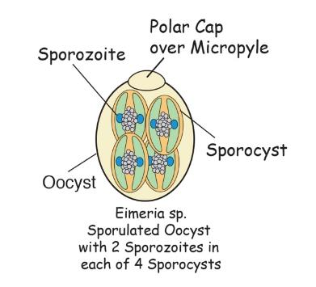
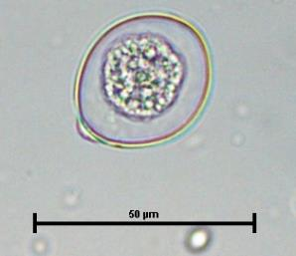
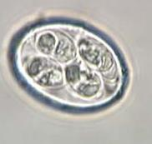
Eimeria Morphology
Unsporulated
Sporulated
Which one of these oocyst is infective?

Slide 6
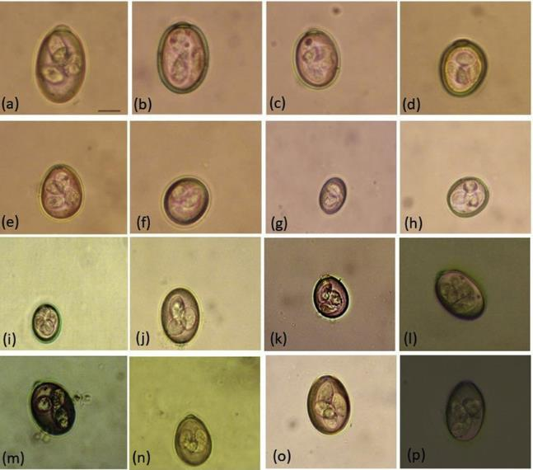
Eimeria Morphology
Oocyst Species-specific
de Macedo, Lucia Oliveira, et al. "Morphological and epidemiological data on Eimeria species infecting small ruminants in Brazil." Small Ruminant Research 171 (2019): 37-41.
Notes:
Each host can be parasitized by several host-specific eimeria species. This is example of different eimeria species in small ruminants
Identify species by morphology of the oocyst size, shape, outer coat, presence or absence of polar cap, etc

Slide 7
Direct Life Cycle
Notes:
Pretty simple, right? Fecal-oral, direct life cycle.
Let’s look closer at what is happening inside the cow, once the enterocytes become infected

Slide 8
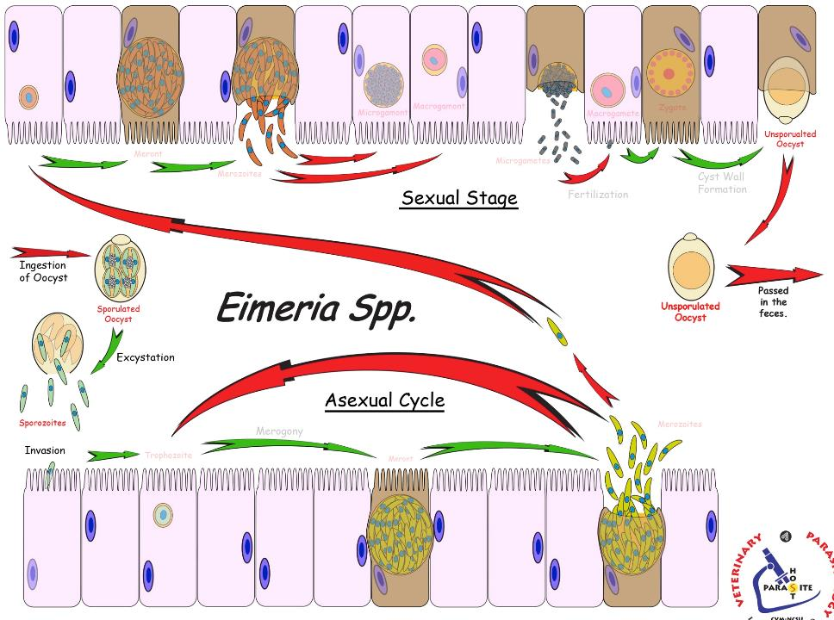
Eimeria
Life Cycle
Ingestion of sporulated oocyst
Gametogony
Sexual
Fertilization
start here
dissemination
Asexual
invade enterocyte
Merozoites
Merogony
sporogony
(Sporulation)
infective
Intestines
Notes:
Let’s look closer at what’s going on inside the GI tract of the hosts
Transmission
Direct life cycle – fecal-oral, ingestion of oocyst
Sporozoites excyst from oocyst and invade enterocyte
Asexual reproduction
Merogony (schizogony)
[multi-nuclear division followed by cytoplasmic division]
Merozoites exit the enterocyte and infect other enterocytes and goes through merogony again.
Sexual reproduction
Final generation of merozoites exit the enterocyte, infect other enterocytes, and go through gametogony (production of gametes)
Fertilization – a microgamete fuses with a macrogamete forming an oocyst which is passed in the feces.
Dissemination
Oocysts (unsporulated) exit the host in the feces and contaminate the environment.
Sporogony (= Sporulation)
Sporogony occurs in the environment. (v/s Crypto?)
Appropriate temperature, moisture, and oxygen are required for sporogony.
Some species can take as little as 1 day to sporulate in optimal conditions
After sporulation, the oocyst is infective and ready for transmission to the next host.

Slide 9
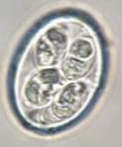
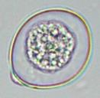
Eimeria Life Cycle (cont)
Sporogony (= Sporulation)
Sporogony occurs in the environment. (v/s Crypto?)
Appropriate temperature, moisture, and oxygen required
Some species can take as little as 1 day to sporulate in optimal conditions
After sporulation, the oocyst is infective and ready for transmission to the next host.

Slide 10
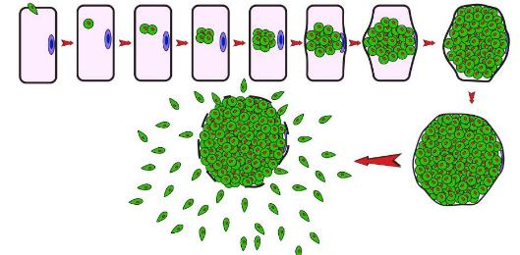
Eimeria Pathogenesis
Direct destruction of enterocytes with each asexual (merogonic) cycle.
Destruction of epithelial lining causes:
Hemorrhagic ulcers = blood (hemorrhagic enteritis)
↓ absorption (no enterocytes!) = malabsorption
Traumatic permeability = loss of fluids and blood into the gut lumen
Inflammation = ↑ permeability and ↑ secretion = fluid loss
Degree of pathogenicity varies; depends on many factors:
Eimeria spp., dose of pathogen, host health status (young animals more susceptible), immunological competence
Notes:
Pathogenicity depends on many factors; such as parasite species, viability, infectivity, virulence, tropism, host age, nutritional status, immunological competence, as well as prevailing environmental conditions (temperature, moisture) and management practices
Some Eimeria species invade deeper and have high replication potential, like E. bovis, for example. This is likely a reason for its increased virulence.

Slide 11
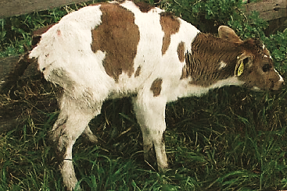
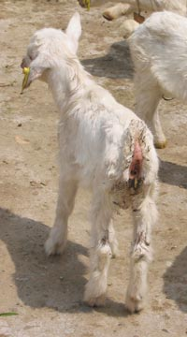
Eimeria Clinical Disease
Mild to severe diarrhea
bloody, mucoid, or watery
most often reported in young or naïve animals.
http://www.vetent.co.nz/dairy-disease-management/coccidiosis.html
Notes:
Range of Pathology
Watery to hemorrhagic diarrhea tenesmus, fever, anemia, weakness, weight loss, death

Slide 12
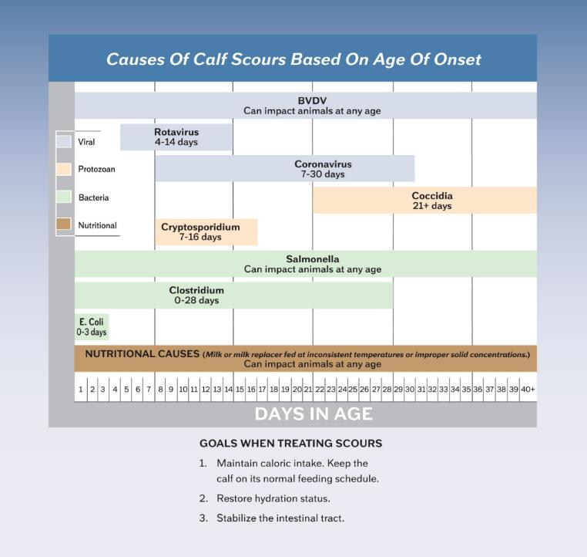
FYI: this chart
Differential Diagnoses
“Calf Scours”
Cryptosporidium 7-16 days
Coccidia (e.g. Eimeria) 21+ days
Rotavirus
Coronavirus
Bovine viral diarrhea virus (BVDV)
Salmonella
Clostridium
E.coli
Nutritional causes
http://crystalcreeknatural.com/causes-of-calf-scours-based-on-age-of-onset/

Slide 13
Eimeria Clinical Disease
Various manifestation of coccidiosis clinical disease
Primarily a herd disease
Individual animal –different manifestations
Non-clinical, but large numbers of oocysts in feces
Acute, severe, fatal, bloody diarrhea (v/s Crypto?)
oocyst may not be in feces if prior to patency (patency = time oocysts are shed)
Disease caused by
1) An overwhelming dose of oocysts OR
2) a moderate dose + stress (immunocompromised)
Herd or flock
Regularly recurring diarrhea issues with each successive cohort of young animals

Slide 14
Eimeria Diagnosis
Fecal Float Centrifugation
If no oocysts present may be prior to patency
Multiple fecal samples over several days ↑ SE
There are a lot of nonpathogenic Eimeria sp. so… diarrhea + oocysts doesn’t always = coccidiosis disease
Consider clinical signs (blood?), which Eimeria sp.
Eimeria sp. identification important (let sporulate to help ID)
Regular episodes of diarrhea in successive groups of animals?
Molecular techniques (yes, but practical for routine use?)
Why not just treat any Eimeria infection?
Notes:
Know that diagnosis is made by identifying oocyst on fecal float centrifugation and that there are a lot of Eimeria that don’t cause disease and it might be an incidental finding, not really causing the diarrhea.
Some spp. of Eimeria very pathogenic/virulent and it’s important to diagnose accurately
Some instances quantification is helpful, using a McMaster’s technique. For example, 500 or more oocysts per gram of feces of a pathogenic Eimeria is considered significant findings for an individual’s health.

Slide 15
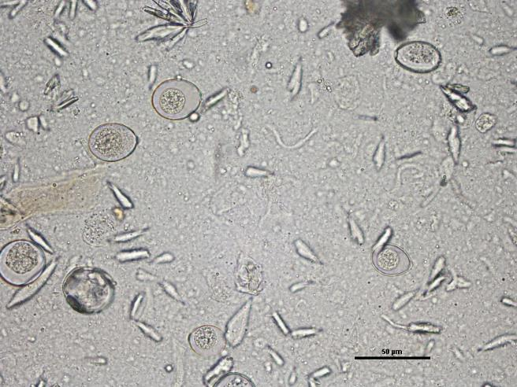
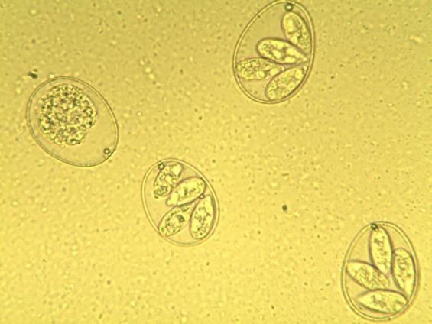
Eimeria Oocysts on Fecal
Unsporulated
Sporulated
let sporulate to help w/ identification
Notes:
You won’t be asked to id these oocysts in lecture exams

Slide 16
Eimeria Treatment
Anticoccidial Drugs, Supportive care
Ionophores (Monensin, Lasalocid, etc.) – coccidiocidal (Toxic to Horses)
Sulfonamides (Sulfadimethoxine, Sulfadiazine, etc) – coccidiostat
Treatment is mainly effective against reinfection and facilitates recovery.
Isolate animals showing disease for treatment & therapy
Give supportive fluid-therapy for symptoms (most important!)
Treat prophylactically for control – medicated feed or water with coccidiostats for entire herd
Notes:
Once an animal in a herd or flock is diagnosed with Eimeria, you have to assume the entire herd or flock has it. Still you should isolate this animal and treat appropriately. Treatment consists mainly of supportive care (especially fluid therapy), coccidostats may help some be preventing incoming coccidia from developing but it’s not going to clear or cure the current infection.
Treatment is mainly effective against reinfection and facilitates recovery.
Inhibits development of incoming coccidial organisms
Does not eliminate the ones already causing pathology
Best if given during acute infection (before oocysts are shed)
Coccidostats are best used prophylactically for control, typically added to feed for young animals.

Slide 17
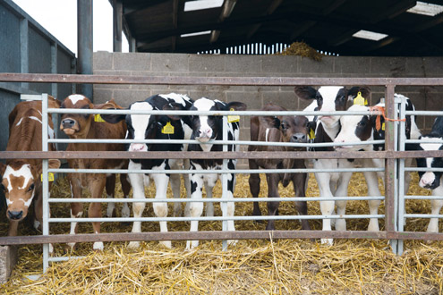
Eimeria Control
Protect young and naïve animals (sanitation/monitoring)
Dry environment (direct sunlight / dryness = best disinfectants).
Separate age groups or hutches
Prevent fecal contamination (food, water, boots and trucks between farms)
Reduce stresses (weaning, sudden food changes, shipping)
Prophylactic coccidiostats or -cidals
Notes:
Control is very important. Assume young and naïve animals will be exposed. The following slides outline the important measures to take in controlling and preventing infection. You don’t need to know specific coccidiostat names.
Oocysts sporulate in moist areas
Monitor calves closely during ↑ stress and isolate if clinical signs

Slide 18
Eimeria Control-Anticoccidials
Coccidiostats or coccidiocidals act to limit the number of successful coccidial organisms, especially in young hosts
Inhibit most entering organisms, but not all
Development of immunity without disease “natural vaccine”
Extremely important in systems of intensive and / or confinement rearing of poultry, ruminants, swine.
Goal: limit infections in newly exposed host to allow immunity to develop, without clinical disease
Notes:
Prophylactics given before infection and metaphylactic given after infection but before patency (the latter may better support this concept of allowing but limiting infection, so herds develop immunity)

Slide 19
Eimeria Control-Anticoccidia Drugs
Uses as prophylaxis (FYI: the specific drugs)
Decoquinate (Deccox),
Monensin (Rumensin)- coccidiocidal
Lasalocid (Bovatec)-coccidiocidal
Amprolium (Corid),
“Sulfa Drugs”: Sulfaquinoxaline, Sulfamethazine, Sulfamethoxine
Rotate coccidiostats to slow the development of resistance to a single coccidiostat
WARNING -- some anticoccidials are highly toxic to horses (IONOPHORES like Monensin, Lasalocid (Bovatec), ETC.)
Notes:
Horse toxicity = Anorexia, sweating, abdominal pain, apparent depression, incoordinated walking, rapid heart rate and arrhythmias, recumbency and death
You do not need to know specific names of the anticoccidials

Slide 20
WARNING Horses, accidental exposure
The FDA inspection of the facility found that cattle feed containing monensin was mixed on the same day as the special mix equine feed purchased by the horse owner, and that the machinery was not adequately cleaned out to remove the monensin before mixing the horse feed.

Slide 21
Eimeria Control
Often requires a coordinated control strategy (including all these components)
Coccidiostats
Sanitation
Good Nutrition/Low stress (especially young/naïve)
Don’t mix age groups
Adults are source of environmental contamination and source of infection for young animals.
At first sign of disease
Separate sick animals
supportive care
reduce exposing other animals to high loads of infective oocyst
Begin treatment of whole herd / flock.
Notes:
During primary infections, ruminants can shed more than a million oocysts per each gram of feces

Slide 22
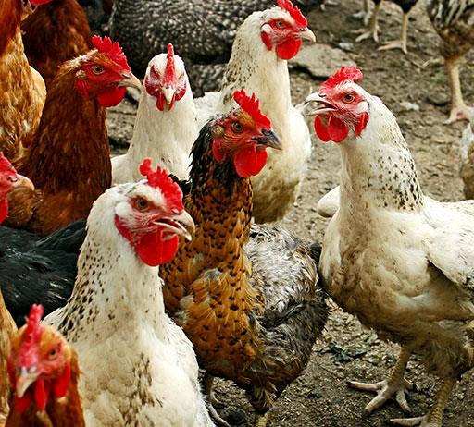
Eimeria Control Poultry Vaccines
Vaccines
Used in Poultry coccidiosis
FYI: Oocyst cocktails, irradiated, mutated
ex. Inovocox vaccine

Slide 23
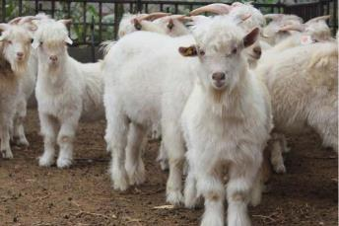
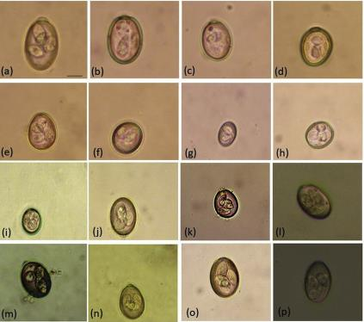
Eimeria Epidemiology
Ubiquitous
Each host species may have many Eimeria species, but few are pathogenic
Very, very host specific
no cross-species infection or zoonosis

Slide 24
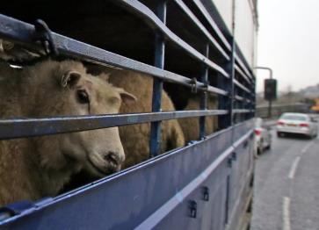
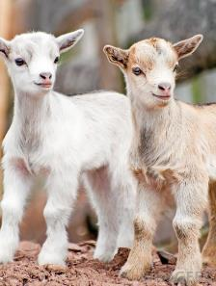
Eimeria Epidemiology
Host Risk Factors
Immunodeficient: young, stressed, poor nutrition
Immunologically naïve: young, new import.
Immunity is coccidian-species specific.
Ex. An E. bovis infection does not confer protection against E. zuernii
Immunological experience provides incomplete or complete protection
Incomplete = reinfection usually leads to asymptomatic shedding of oocyst.

Slide 25
Eimeria Epidemiology
Environmental risk factors
Primary infective dose – pathology proportional to infecting dose
Moist, warm to cool habitats promote sporulation of oocysts
Spring, Fall -- higher risks
Crowded conditions
Environ. can quickly become highly contaminated with oocysts
Increases stress; thus decrease immune-competence
Notes:
Upper 60s-70s temp

Slide 26
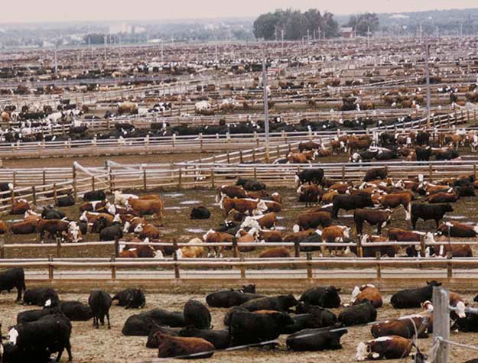
Eimeria Epidemiology
Which is more likely to have a serious coccidian outbreak?
Confinement chickens v/s Free-range chickens.
Pastured calves v/s Feedlot calves.
Notes:
The confinement & feed lot will more likely show pathology as these will get large numbers of oocysts at one time (i.e. the oocysts are concentrated in a small area) ; Even though free-range & pasture are not sterile and thus animals are likely to be infected, the oocyst doses they receive are so low that disease does not develop and they develop some immunity without disease (i.e. the oocysts are spread out in a large area).

Slide 27
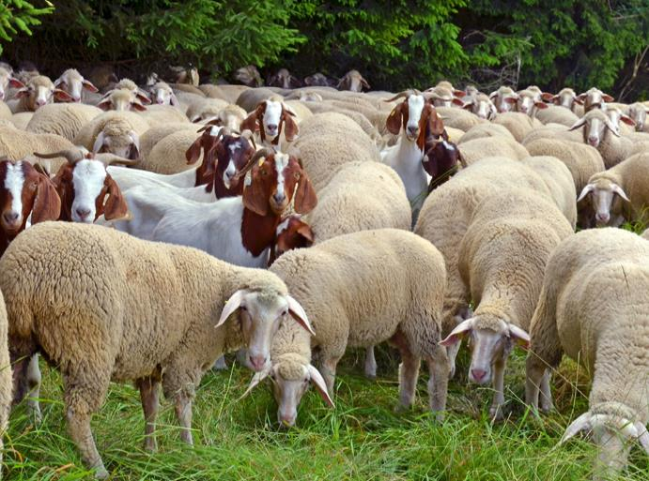
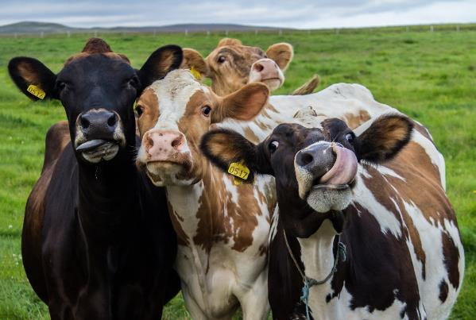
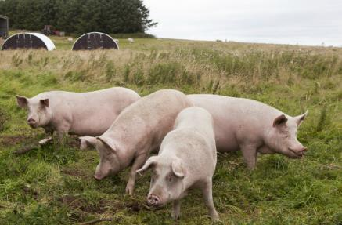
We will discuss specific pathogenic Emeria spp. and their hosts.

Slide 28
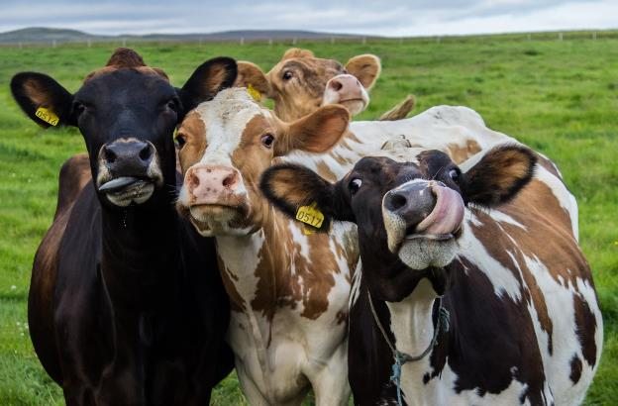
Bovine Coccidiosis
Eimeria zuernii, E. bovis
Once oocysts appear in
feces, it is too late (to stop infection)
Chronic or subclinical
Unthrifty, some scours w/ watery diarrhea, +/- blood
Severe coccidiosis (more systemic signs)
Thin, bloody diarrhea, fever, anorexia, depression, dehydration, weight loss.

Slide 29
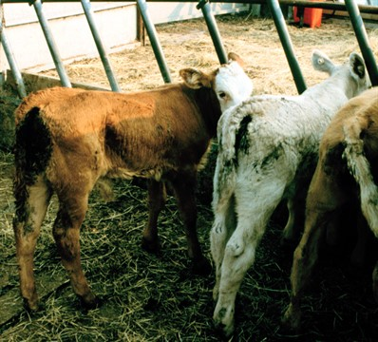
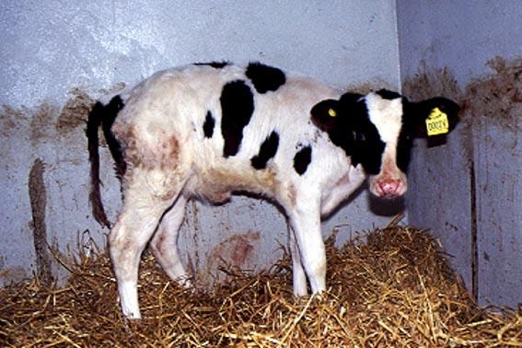
Bovine Coccidiosis
http://www.nadis.org.uk/bulletins/coccidiosis-in-cattle.aspx
http://www.farmersjournal.ie/coccidiosis-common-cause-of-blood-scour-167382

Slide 30
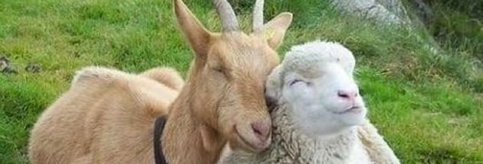
Sheep & Goat Coccidiosis
Sheep -- Eimeria ovinoidalis
Associated with stress
Goats -- Eimeria arloingi, E. ninakohlyakimovae
More susceptible to coccidiosis
Diarrhea
Dehydration, weakness, anorexia, weight loss, death
Secondary concerns: Fly Strike & Bacterial enteritis
Lambs & Kids: 1-6 months old most vulnerable
Notes:
Sheep clinical coccidiosis more commonly occurs due to stress (after shipping)
Goats, in general more susceptible to coccidiosis –clinical signs follow weening
12 different intestinal Eimeria species found in sheep
10 different intestinal Eimeria species found in goats

Slide 31
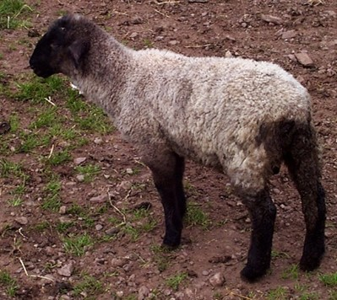
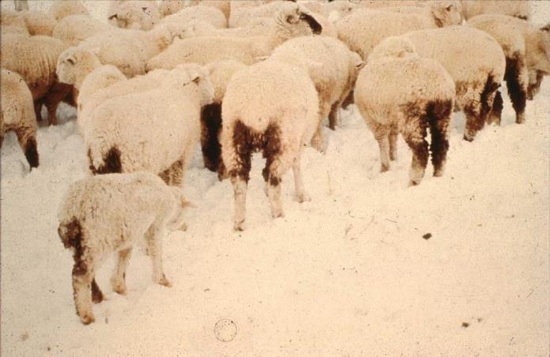
Sheep Coccidiosis
http://www.nadis.org.uk/bulletins/coccidosis-in-lambs.aspx
Notes:
The sheep in the snow (oocysts sporulate in cool to warm temperatures - hot causes desiccation and cold slows / stops sporulation)
One would think the sheep would not have clinical coccidiosis in the snow-bound winter.
This was an actual case. These sheep were in the mountainous west, the snow cover prevented grazing, so the farmers had to bring in hay ... via helicopter.
The problem was that they would drop the hay in the same place, consequently the sheep developed coccidiosis.
winter stress.
concentrated poop around / in the hay.
the fermentation of the hay created enough heat for the oocysts to sporulate.

Slide 32
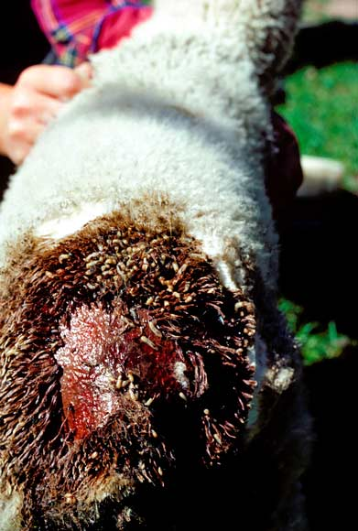
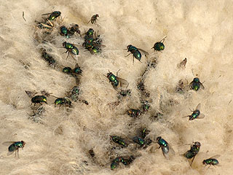
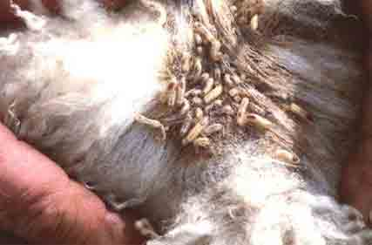
Coccidia assisted Fly-Strike
http://hartslock.org.uk/blog/?page_id=103
https://seedstockcentral.com.au/2016/03/31/sheep-producers-urged-to-monitor-flocks-for-fly-strike/
https://teara.govt.nz/en/photograph/17443/fly-strike
Notes:
Wool contaminated with urine and fecal material provide breeding ground for maggots even in the absence of a wound.

Slide 33
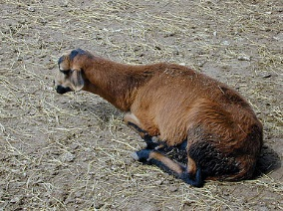
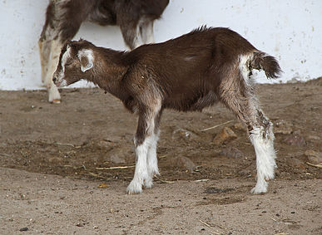
Goat Coccidiosis
https://www.sheepandgoat.com/coccidiosis

Slide 34
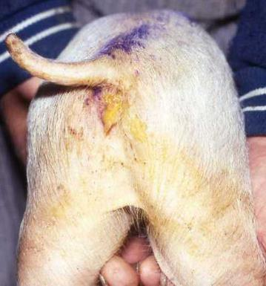
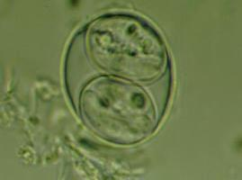
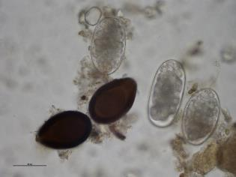
Swine & Horse Coccidiosis (low pathogenicity)
Piglet Scours
Swine
8 Eimeria spp. but low pathogenicity
(Cystoisospora suis is more important)
Horse
Eimeria leuckarti
non-pathogenic
Teaser for
NEXT Lecture!!
Cystoisospora suis

Slide 35
Poultry Coccidiosis
Poultry
Massive destruction of epithelial cells - hemorrhage, malabsorption.
often prior to patency (before shedding oocyst)
young birds at greatest risk
Chickens -- E. tenella (<4wk old), E. necatrix (>6wk old), E. acervulina, E. maxima, E. mivati, and E. brunetti.
Turkeys -- E. adenoides, E. meleagrimitis
Can be self-limiting or high mortality
What are two factors that may influence the severity of disease?
Huge economic loss –poor weight, reduced egg production
Quiroz-Castañeda, Rosa Estela. "Avian Coccidiosis, New Strategies of Treatment." Farm Animals Diseases, Recent Omic Trends and New Strategies of Treatment (2018): 119.
Notes:
Low dose exposure can result in low to no clinical disease and immunity

Slide 36
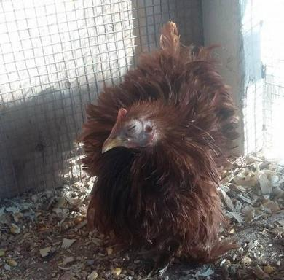
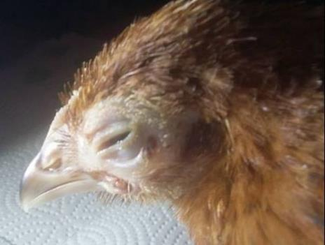
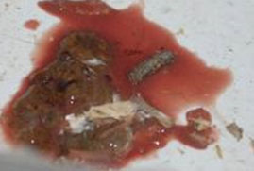
Poultry Coccidiosis
Clinical Signs
+/- high mortality
+/- bloody feces
Pale combs
Ruffled feathers
Lack of appetite
Coagulated blood in ceca on necropsy and other intestinal lesions
vary based on Eimeria sp.
https://www.chickenheavenonearth.com/cecal-coccidiosis-signs-symptoms--treatments-chicken-health-chicken-heaven-on-earth.html
http://www.bhwt.org.uk/information/coccidiosis-in-chickens/

Slide 37
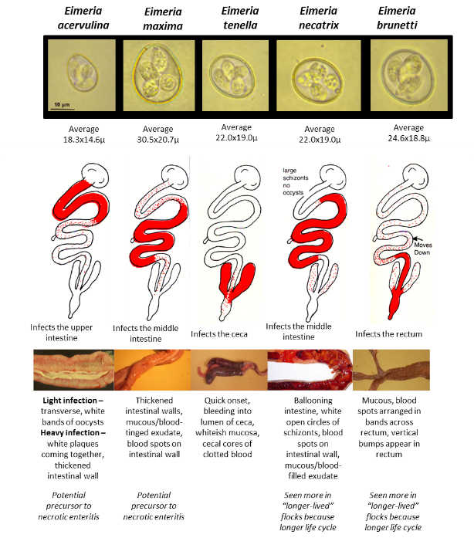
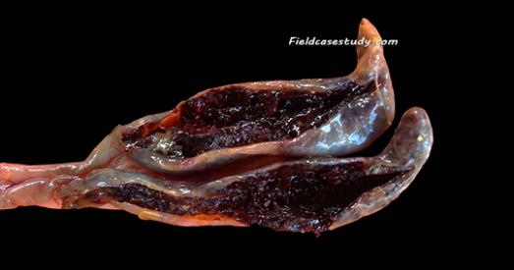
Poultry Coccidiosis
Different Eimeria spp. infect different regions of GIT
FYI: this chart
Eimeria tenella infects the ceca
https://fieldcasestudy.com/2017/05/01/coccidiosis/
http://www.uoguelph.ca/omafra_partnership/ktt/en/johnbarta/Monitoring-for-success---Lesion-Scoring.asp
Notes:
Not all will have bloody diarrhea (maxima, tenella and burnetti = bloody)

Slide 38
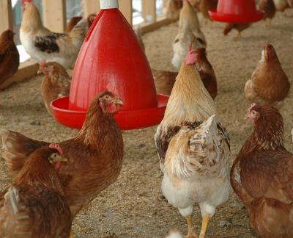
Cocciosis Management in Poultry
Farm management
-raised floor, dry surroundings, direct sunlight,
raised water and food
-sanitation can be difficult, very resistant to
chemicals
- thin liter (deep liter system promotes oocyst
sporulation)
- keep young birds separate
Use of coccidiostats (rotation of drugs b/c of resistance issues) or vaccines.
If one chicken is sick, treat the flock

Slide 39
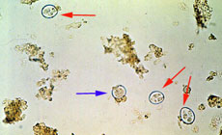
Diagnosing Poultry Coccidiosis
Speciate by location of intestinal lesions, size of oocyst
Slides made of thin GI mucosa smear to identify schizonts
Fecal Floatation to identify oocysts
PCR
http://cal.vet.upenn.edu/projects/parasit06/website/lab2.htm
E. tenella oocysts from chicken feces: blue arrow = unsporulated; red arrows = sporulated
Notes:
COCCIMORPH which uses oocyst morphology in the identification of Eimeria species

Slide 40
What’s good and what could be better?
https://fieldcasestudy.com/2017/05/01/coccidiosis/
Notes:
Modern poultry production can encourage more severe infection

Slide 41
In-Class Discussion
A 1-month-old a dairy calf develops scours
Coccidiosis or Cryptosporidiosis?
What type of diarrhea would you expect to see?
What is your treatment plan?
How will you diagnose?

Slide 42
(20- 40µm)
(16-20µm)
Cryptosporidium is smaller
and sporulated
Bovine Eimeria spp.
oocysts (µm)

Slide 43
What’s good and what could be better?

Slide 44
Have Questions?
barbara_qurollo@ncsu.edu
Illustration by Allie Brosh, http://hyperboleandahalf.blogspot.com/

