Slide 1
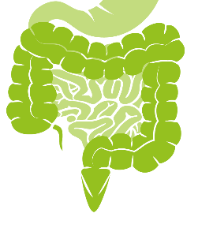
Coccidia part 3 (intestinal apicomplexans)
Cystoisospora spp.
(coccidia of carnivores)

Slide 2
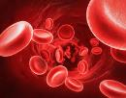
(know terms on this slide)
Parasitic
Protozoa
Grouped by Infection Site and Motility
Apicomplexa
(sg =Alveolates)
Flagellates
(sg = Excavates)
blood/
tissue
Blood apicomplexa (piroplasms)
Hemoflagellates
Babesia spp.
Trypanosoma cruzi
Cytauxzoon felis
Leishmania infantum
Systemic apicomplexa (coccidia)
systemic
Toxoplasma gondii
Trypanosoma cruzi
Neospora caninum
Leishmania infantum
Sarcocystis spp.
intestines
Intestinal apicomplexan (coccidia)
Mucoflagellates
Cryptosporidium parvum
Tritrichomonas foetus
Tritrichomonas blagburni
Eimeria spp.
Giardia spp.
Cystoisospora spp.
Notes:
Here’s our road map. We will continue with intestinal apicomplexa looking at Cystoisospora spp. (formally known as isospora). The first part of this lecture will focus on Cystoisospora in general. The second half will cover specific species in host animals. You will not be tested on specific Cycstoisospora species.

Slide 3
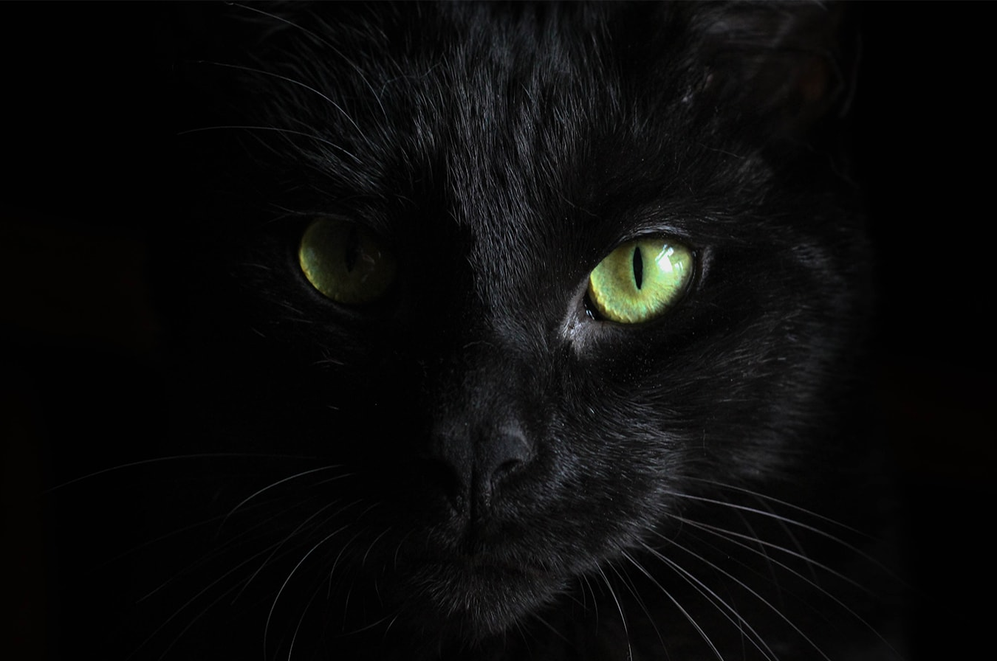
Cystoisospora spp. (Coccidosis)
Common Coccidian of Carnivores
Direct Life Cycle
Diarrhea!
Many Cystoisospora spp. have very high host specificity

Slide 4
Learning Objectives: Cystoisospora spp.
Life cycles: understand highlighted components of the Direct and Indirect Life Cycles
Transmission: know specified routes of transmission (ingestion of oocysts vs. ingestion of paratenic host).
Pathogenesis: understand disease due to direct destruction of enterocytes.
Clinical signs: understand the specified clinical signs
Diagnosis: understand the specified ways to diagnose coccidosis
Treatment: know the highlighted information about treating
Control: Know the highlighted practices to control Cystoisospora
Epidemiology: know this is not zoonotic, that Cystoisospora species are very host specific and the specified risk factors (host and environmental)
Know the highlighted, specific details for host species (kittens, puppies and piglets)

Slide 5
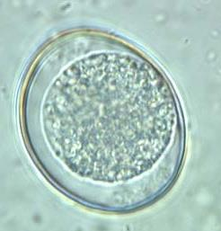
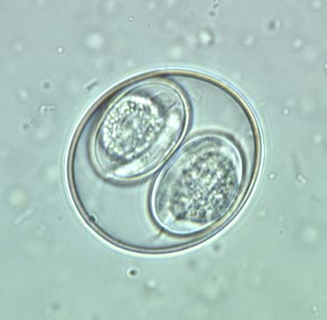
Morphology: Cystoisospora
Oocyst
Species-specific size, shape,
Unsporulated when passes
Sporulated oocyst contains 2 sporocysts with 4 sporozoites each = 8 sporozoites total
unsporulated
sporulated
Notes:
usually oval to spherical, single-cell embryo

Slide 6
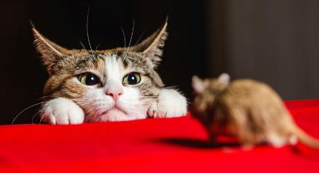
Life Cycle: Cystoisospora
Direct life cycle
Transmission
Fecal-oral, ingestion of sporulated oocyst
Invasion
Sporozoites excyst from oocyst and invade enterocyte
OR
Facultative (optional) Indirect life cycle
Transmission
Rodent or bird paratenic host (sporozoites live in various tissues in the host)
Invasion
Sporozoites excyst from prey tissue and invade enterocyte

Slide 7
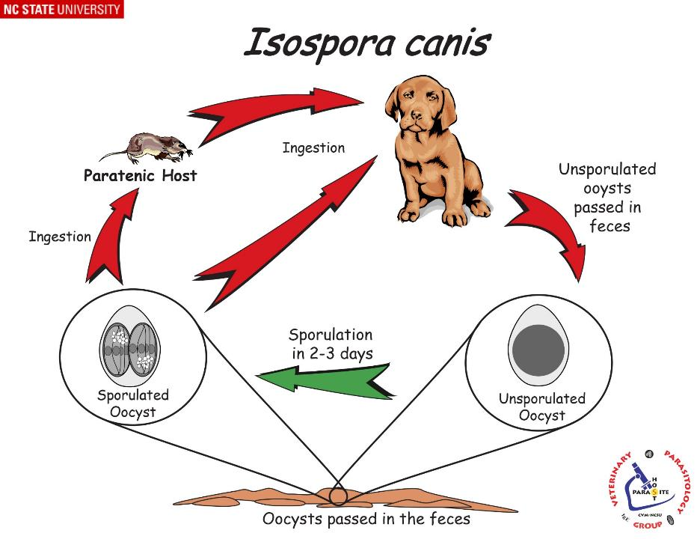
Cystoisospora canis
FACULTATIVE INDIRECT
Definitive host
(asex. and sex. replication occurs)
DIRECT
Paratenic = not needed for the development of the parasite but helps to maintain the parasite's life cycle.
Notes:
Because the hosts we are talking about are carnivores, we have to introduce a new route of transmission into the life cycle…eating an infected host. These hosts are called paratenic (not necessary for the life cycle but can play a role).
FYI: Zoites, which may be sporozoites or merozoites, are found in extraintestinal tissues (i.e., mesenteric lymph nodes, liver, or spleen) of definitive host or paratenic (transport hosts) such as mice, rats, hamsters, and other vertebrates.

Slide 8
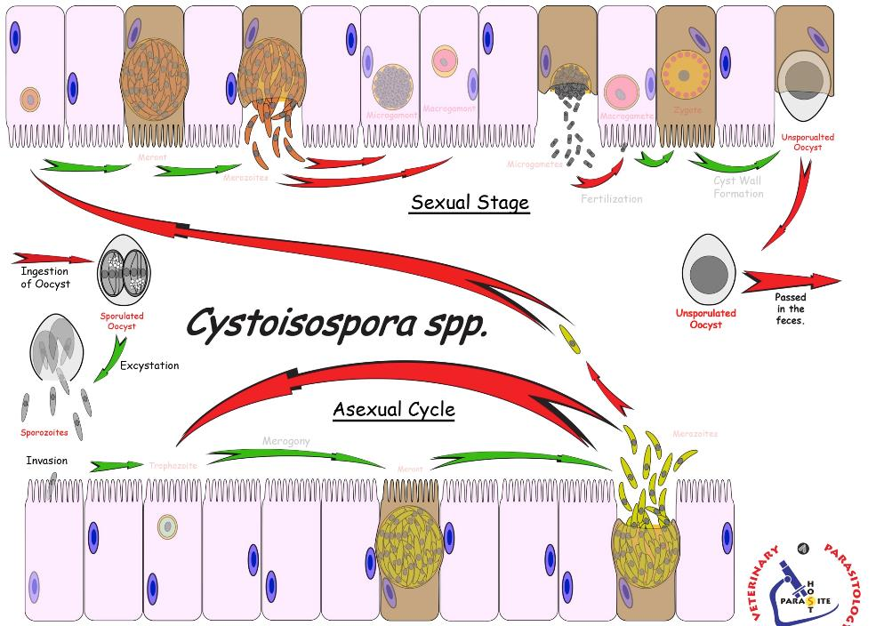
Gametogony
Ingestion of sporulated oocyst
Sexual
fertilization
Start here
dissemination
Asexual
sporulation
invade enterocyte
merogony
Intestines of definitive host
infective
Notes:
Let’s look closer at what’s going on inside the GI tract of the hosts
Ingestion of sporulated oocyst by definitive host
Sporozotie excysts from oocyst and invades enterocytes
Asexual reproduction
Merogony (schizogony)
[multi-nuclear division followed by cytoplasmic division]
Sexual reproduction (occurs only in definitive host)
Final generation of merozoites exit the enterocyte, infect other enterocytes, and go through gametogony (production of gametes)
Fertilization – a microgamete fuses with a macrogamete eventually forming an oocyst and is passed in the feces.
Dissemination
Oocysts (unsporulated) exit the definitive host in the feces and contaminate the environment

Slide 9
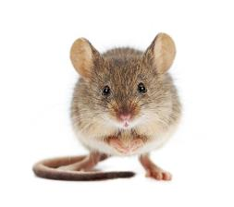
Life Cycle: Cystoisospora (cont)
Sporogony (= sporulation) → Sporogony occurs in the environment.
Ingestion of sporulated oocyst by definitive host
OR
Ingestion of sporulated oocyst by paratenic host
Lindsay, David S., et al. "Developmental biology of Cystoisospora (Apicomplexa: Sarcocystidae) monozoic tissue cysts." The Journal of parasitology 100.4 (2014): 392-398.
Notes:
Sporogony occurs in the environment.
Appropriate temperature, moisture, and oxygen are required for sporogony.
Some species can take as little as 1 day to sporulate in optimal conditions
Ingestion of sporulated oocyst directly by definitive host
Ingestion of sporulated oocyst by paratenic host which then infects and encyst in tissue of paratenic host forming a “cystozoite”
Lymphatic tissue, spleen for isospora, which can then be ingested by the definitive host
Image: Cystoisospora felis stages in mesenteric lymph nodes of a mouse fed oocysts
Lindsay, David S., et al. "Developmental biology of Cystoisospora (Apicomplexa: Sarcocystidae) monozoic tissue cysts." The Journal of parasitology 100.4 (2014): 392-398.

Slide 10
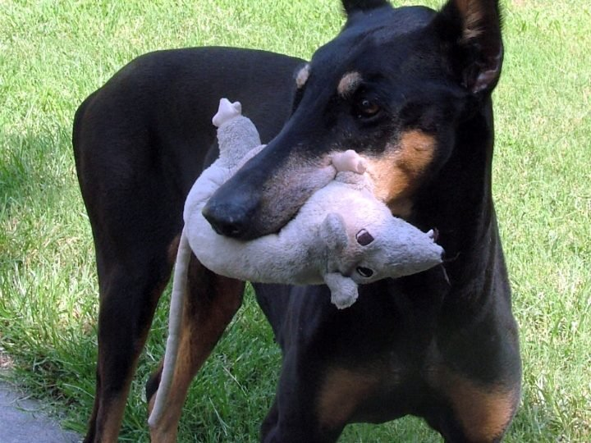
Life Cycle: Cystoisospora (cont)
Ingestion of sporulated oocyst by paratenic host
Sporozoites infect and encyst in tissue of paratenic host forming a “cystozoite”
Cystozoites can form in paratenic hosts and even definitive hosts.
Cystozoites act as a latent stage and do not cause clinical disease.

Slide 11
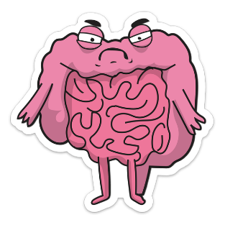
Pathogenesis: Cystoisospora
Pathogenesis
Direct destruction of enterocytes (small intestines)
destruction of epithelial lining and (rare hemorrhagic ulcers)
malabsorption
Trauma ↑ permeability, with loss of fluids and sometimes blood
Immune response causes hyper-secretion
The Awkward Yeti
by Nick Seluk

Slide 12
Clinical Disease: Cystoisospora
Complaint
Mild to moderate diarrhea
loose, mucoid, sometimes watery;
sometimes bloody (rare)
Most often reported in nursing or recently weaned pets
Immunocompromised or stressed animals may break with coccidiosis
shipping stress, shelter stress, kennel stress
Large infective dose of sporulated oocysts → worse clinical disease

Slide 13
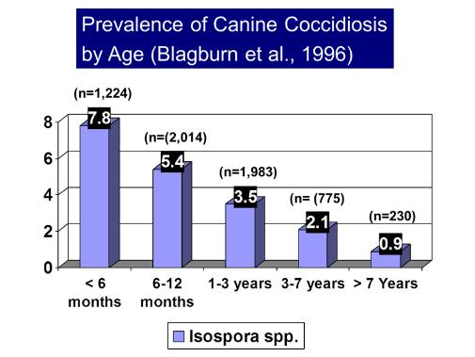
Diagnosis: Cystoisospora
Clinical Signs
Animal age and history
young? immune compromised? stress?
Fecal Float Centrifugation
look for unsporulated oocysts in fresh sample
may see sporulated oocysts in older sample
Diarrhea may occur prior to oocyst excretion (prepatent period)
May need to differentiate between Eimeria (coprophagy) vs. Cystoisospora

Slide 14
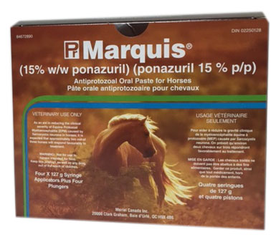
Treatment: Cystoisospora
Anticoccidials
“Sulfa drugs” Sulfadimethoxine (Albon) -static
Albon®, Bactrovet®, or Tribrissen®
Efficacy against acute disease unclear
Ponazuril (off label)-cidal
Toltrazuril sulfone®, Marquis®, Ponalrestat®
Studies indicate may be more effective
Give supportive therapy for symptoms
Once infected, have immunity against that species
Notes:
Canticoccidials = Coccidiostats and coccidiocidal
Sulfonamides are coccidiostatic, so ecal analysis may remain positive for oocysts during the course of therapy
Ponazuril is coccidiocidal commonly used for EPM in horses but has recently gained popularity as an off‐label treatment for canine and feline coccidiosis

Slide 15
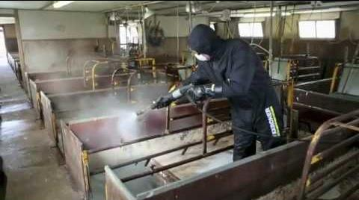
Control: Cystoisospora
Sanitation
Young and naïve animals
Kennels & catteries
Pig farrowing houses
Sporulated oocysts are resistant, can survive (year) in moist, protected environments
Susceptible to freezing or extremely high temperatures; ammonia solution
Prevent access to paratenic hosts
Mainly rodents
Good nutrition important
Keep Stress Low
Kärcher UK,Dec 3, 2014
Notes:
Very important for pig farrowing houses

Slide 16
Epidemiology: Cystoisospora
Cystoisospora spp.
Ubiquitous
Very host specific no cross-species infections or zoonosis
Host risk factors
Immunodeficient: young, stressed, poor nutrition
Environmental risk factors
Moist, unsanitary conditions promote sporulation of oocysts occurs within 2-4 days
Access to paratenic hosts (mostly rodents)

Slide 17
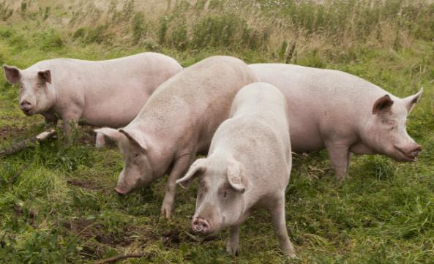
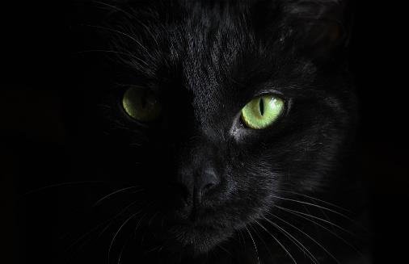
Host species and
Pathogenic
Cystoisospora spp.

Slide 18
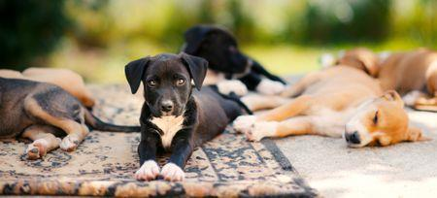
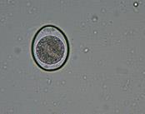
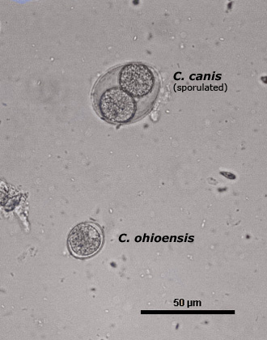
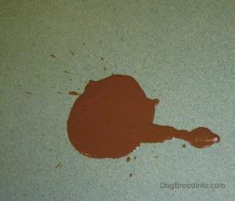
Canine Cystoisospora
Cystoisospora canis
Puppy Diarrhea!
copious, watery, may persist for weeks (small bowel diarrhea)
Cystoisospora canis
Large, oval oocyst
Diarrhea (low pathogenicity in adult dogs)
C. ohioensis
Small-medium size, spherical oocyst
May cause diarrhea
https://www.dogbreedinfo.com/diarrhea.htm

Slide 19
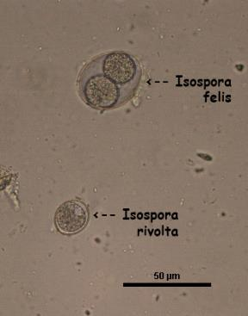
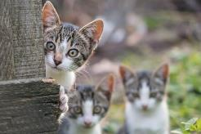
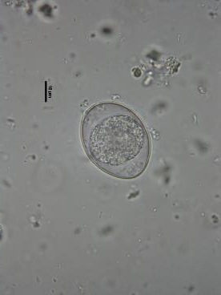
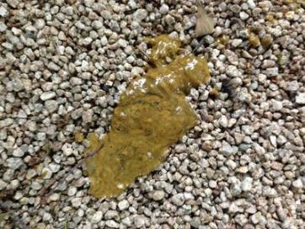
Feline Cystoisospora
Kitten Diarrhea!
Small-bowel diarrhea
www.catster.com
Cystoisospora felis
Large, oval oocyst,
Small bowel diarrhea
pathogenic for kittens
C. rivolta
Small-medium spherical oocyst
small bowel diarrhea in newborn kittens
www.catster.com
http://www.organic-pet-digest.com/dogs-recurring-diarrhea-after-multiple-antibiotics-treatments.html
Notes:
Know Cystoisospora causes diarrhea in kittens for exam

Slide 20
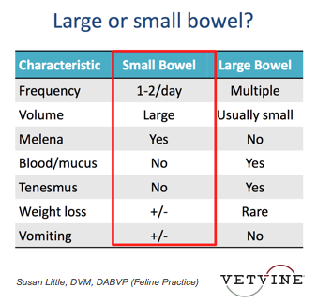
FYI Large or Small bowel diarrhea?
Cystoisopora
Tritrichomonas?
frank
Giardia?

Slide 21
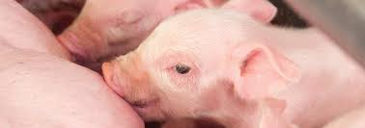
Porcine Cystoisospora
Swine -piglets
Cystoisospora suis
Develops entirely in one host (direct life cycle –NO Facultative Cycle)
Neonatal DZ – 1-2-week-old suckling piglets
Non-hemorrhagic diarrhea, dehydration, weight loss (SI infection)
High morbidity, Low mortality; very short course of disease (~4days)
Impaired growth, economic loss
As piglet gets older, ↓susceptibility and pathology
Immunity is complete against reinfection
Notes:
Can occur in older pigs (5-6 weeks) usually associated with weaning

Slide 22
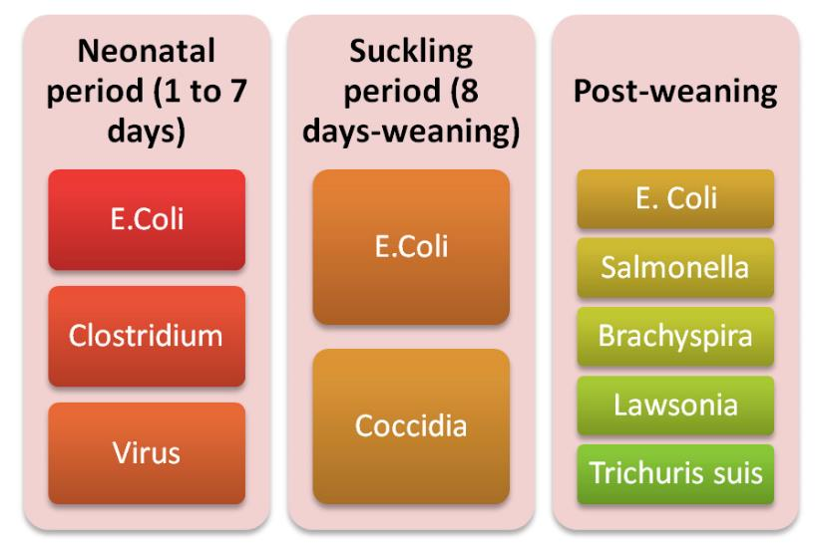
Piglet Scours
Important to distinguish b/w coccidiosis, viral or bacterial piglet diseases
FYI: other specific infectious agents
Notes:
Co-infections can occur and may increase mortality

Slide 23
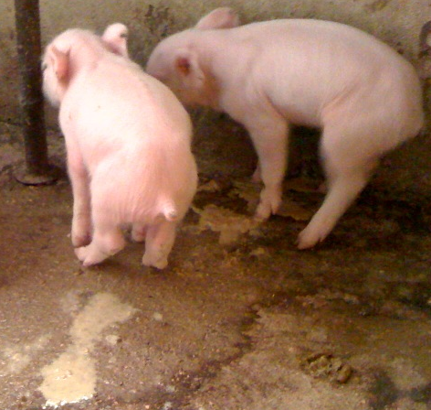
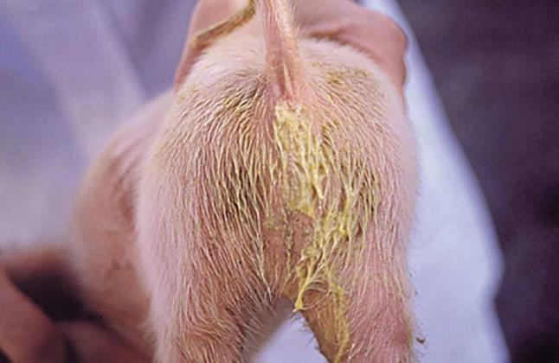
Cystoisospora suis
Notes:
Yellowish to grayish diarrhea is the major clinical sign.
The feces are initially loose or pasty and become more fluid as the infection progresses.
Piglets become covered with the liquid feces, causing them to stay damp and have a rancid odor of sour milk.

Slide 24
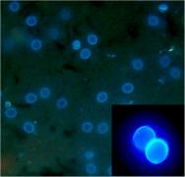
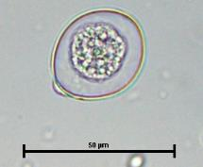
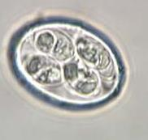
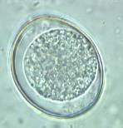
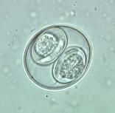
Porcine Cystoisospora
Diagnose
Diagnose with fecal float, stained fecal smears,
autofluorescence microscopy
Test multiple sample days (sporadic shedding)
8 Eimeria spp. so differentiate by oocyst morphology
Cystoisospora have 2 sporocysts / no polar cap
Eimeria have 4 sporocysts / polar cap
Treatment/Control
Coccidiostats have proven to be moslty ineffective
Toltrazuril treatment suppress oocyst excretion and improve piglet health
Rigorous sanitation with steam cleaning; slatted floors
Notes:
Diarrhea in nursing pigs 7–14 days of age that does not respond to antibiotic treatment is suggestive of neonatal C. suis infection.
Upon UV excitation, the walls of the oocysts (and in sporulated oocysts those of the sporocysts) emit a bright blue light that greatly facilitates detection

Slide 25
In-Class Discussion
A 6 month-old kitten is brought in with diarrhea
What are your top protozoal infectious differentials?
Notes:
C. Rivolta in newborns

Slide 26
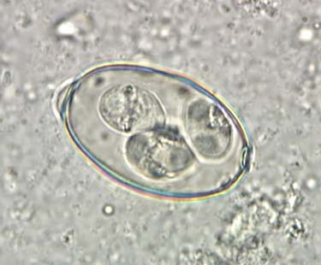
In-Class Discussion
Name that Coccidian (genus) from a goat
Is it infective?

Slide 27
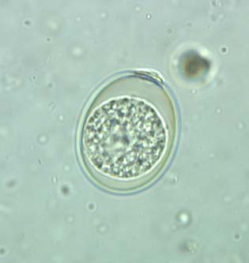
In-Class Discussion
Name that Coccidian (genus and species)
From young sheep with diarrhea that were just transported to a new state

Slide 28
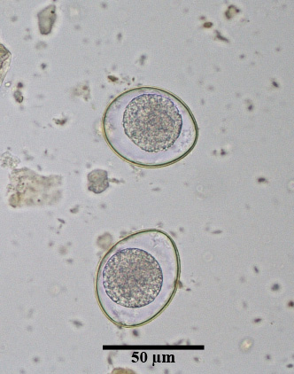
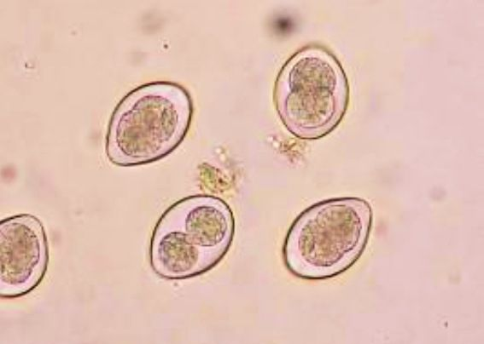
In-Class Discussion
Name that Coccidian (genus and species)
From Dog
Hint: it’s big!

Slide 29
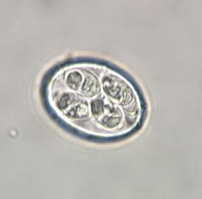
In-Class Discussion
Name that Coccidian (Genus)
From a Turkey

Slide 30
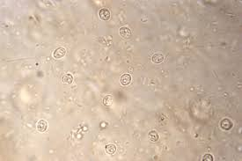
In-Class Discussion
Fecal float from a calf
Hint: it’s tiny!
5 µM

Slide 31
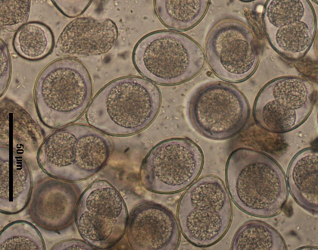
In-Class Discussion
Name that Coccidian (genus and species)
From an older kitten
Notes:
2 sporocysts; mixed unsporuated and sporulated

Slide 32
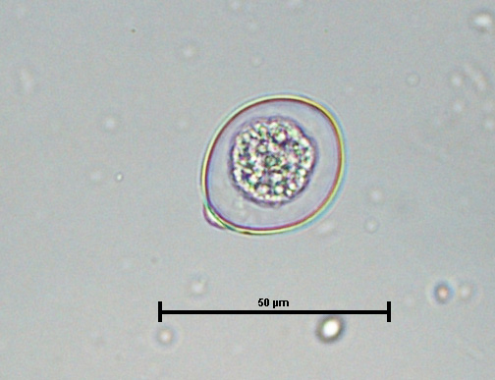
In-Class Discussion
Name that Coccidian (genus)
From Cow

Slide 33
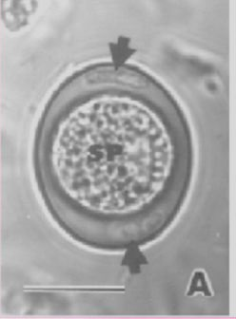
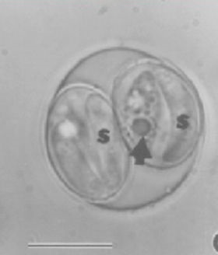
In-Class Discussion
Name that Coccidian
From Piglet

Slide 34
Notes:
Fecal flotation from a cat that was co-infected with Toxoplasma gondii, Cystoisospora felis, and Cryptosporidium felis. The image is magnified approximately 2000×. The black arrows are sporulated T. gondii oocysts; the white arrow shows Cystoisospora felis; the white circles surround Cryptosporidium felis oocysts.

Slide 35
Have Questions?
barbara_qurollo@ncsu.edu
Illustration by Allie Brosh, http://hyperboleandahalf.blogspot.com/

