Slide 1
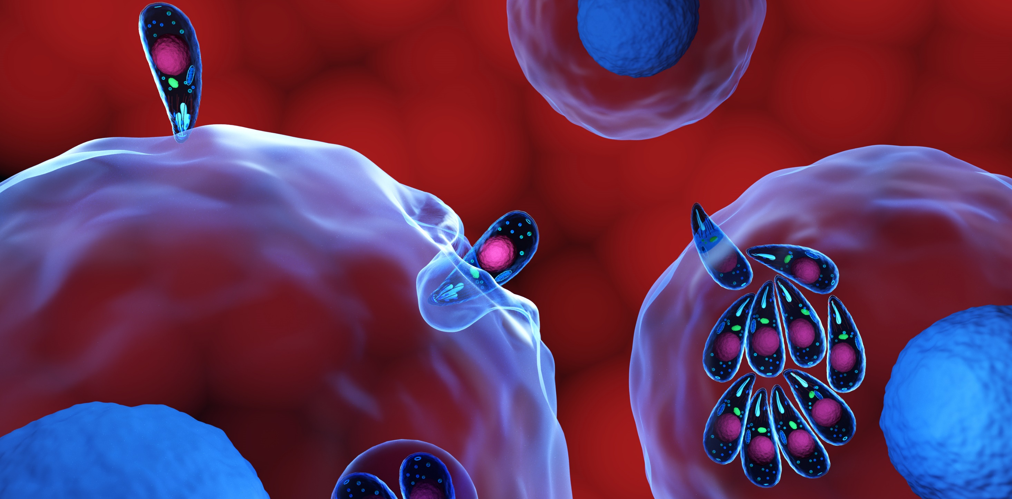
Toxoplasma gondii & Neospora caninum
Systemic Apicomplexans:

Slide 2
Let’s Review Apicomplexan Asexual Lifecycle
animated slide
ingested
Sporozoites
Meronts,
containing many
Merozoites
infect
enterocyte
Merozoite
Merogony
(asexual replication)
Systemic
GI Tract
i.e. brain, muscle, liver cells
Tachyzoites (fast)
Bradyzoites (slow)
Infect more cells
Fast asexual replication
Slow asexual replication
some get past enterocytes and infect other tissues (become systemic)
eventually slow down
Bradyzoite cyst = less damage, asymptomatic and chronic stage
Tachyzoite cyst = Acute, more damage and disease
Notes:
Let’s review the apicomplexa life cycle. This slide shows asexual replication stages of apicomplexa pathogens. So far we have just studied the apicomplexa where most of this takes place in the GI tract (DIARRHEA!) These next set of pathogens move beyond the GI tract and cause disease, thus we have grouped them as Systemic apicomplexa. These organisms will move past the enterocytes and into other tissues.
Tachyzoite cysts and bradyzoite cysts form cysts in host tissues. If a predator eats a host with these tissue cysts, that predator can become infected. You will see this as part of the life cycle.

Slide 3
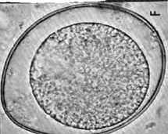
Apicomplexan Asexual and Sexual Lifecycle
animated slide
ingested
Sporozoites
Meronts (schizonts),
containing many
Merozoites (schizozoites)
infect
enterocyte
Merozoite
(in host cell)
Merogony
(asexual replication)
sporocyst
sporozoite
A signal tells some merozoites to become gametes (gametogony)
sporogony
(sporulation)
sexual fertilization
gametes
male (microgametes)
female (macrogametes)
sporulated
oocyst
(infective oocyst)
oocysts
GI Tract of Definitive Host = the host that makes the sporulated (or infective) oocysts
Notes:
An important concept to understand in apicomplexan life cycles is that Sexual reproduction (which is how infective oocytes are produced) only occurs in the definitive host.
The definitive host is the host that shed infecting oocytes (which contain the infective sporocytes).
As we cover the different systemic and intestinal apicomplexa, you will learn about the different infective forms of the parasite.
All the following are infective if ingested:
Sporozoites
Sporocysts
Sporulated oocysts
Bradyzoites or tachyzoites in tissue cysts (i.e. if a predator eats a host with these tissue cysts, that predator can become infected)

Slide 4
Systemic Apicomplexa Terminology
In general, Systemic Apicomplexa are coccidia that start out in a host’s GI tract but relocate into other tissues, depending on the host species.
Systemic Apicomplexa Terms
Definitive host – species in which the sexual stage of the parasite occurs, making infective oocysts
Facultative intermediate or paratenic host – species which supports the multiplication (asexual) stage of parasite, can carry parasites through food chains to the definitive host, but are not required for life cycle of the parasite
Accidental host – “dead-end” host, parasites can’t complete life-cycle
Tachyzoite – fast growing infective stage
localize in neural and muscle tissue, fast growing; will eventually develop into tissue cysts with bradyzoites
Bradyzoite – slow growing infective stage
cysts in tissue (including neurons and skeletal muscle cells) remains semi-dormant (chronic infections)
Notes:
These are some terms to understand as we go through apicomplex life cycles.

Slide 5
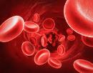
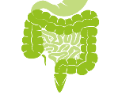
(know terms on this slide)
Parasitic
Protozoa
Grouped by Infection Site and Motility
Apicomplexa
(sg =Alveolates)
Flagellates
(sg = Excavates)
blood/
tissue
Blood apicomplexa (piroplasms)
Hemoflagellates
Babesia spp.
Trypanosoma cruzi
Cytauxzoon felis
Leishmania infantum
Systemic apicomplexa (coccidia)
systemic
Toxoplasma gondii
Trypanosoma cruzi
Neospora caninum
Leishmania infantum
Sarcocystis spp.
intestines
Intestinal apicomplexan (coccidia)
Mucoflagellates
Cryptosporidium parvum
Tritrichomonas foetus
Tritrichomonas blagburni
Eimeria spp.
Giardia spp.
Cystoisospora spp.
Notes:
Here’s our road map. We will now start on the systemic apicomplexa looking Toxoplasma gondii and Neospora caninum.

Slide 6
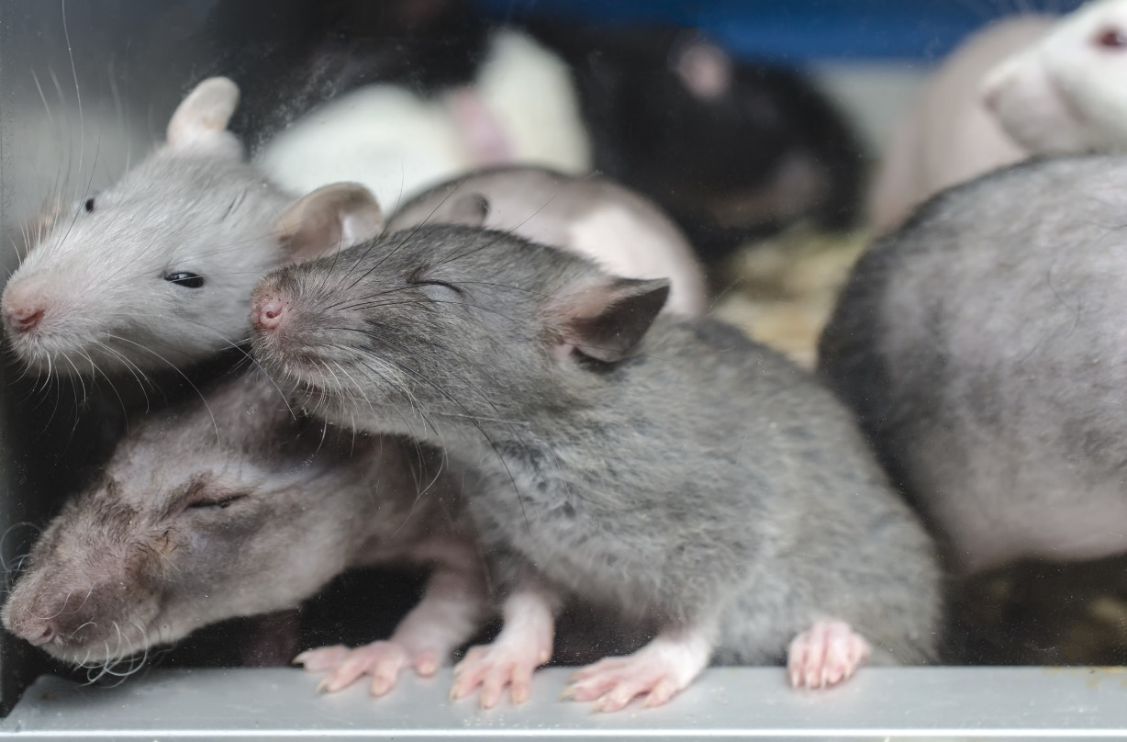
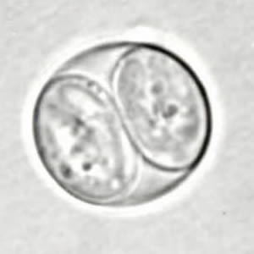
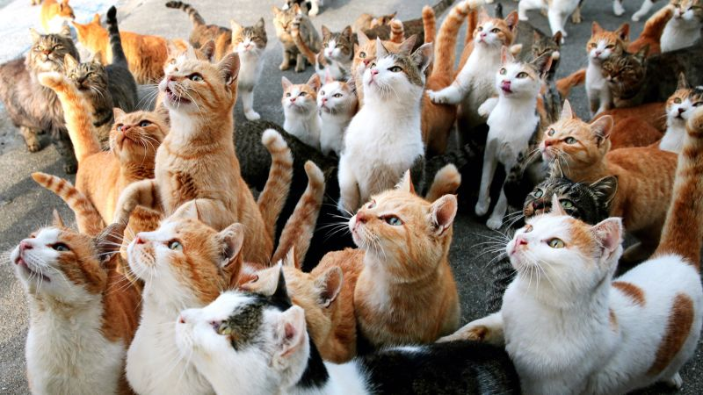
Photography by vladans/Thinkstock
Toxoplasma gondii
Feline coccidan of zoonotic importance
Complex Life Cycle
Direct and Facultative Indirect

Slide 7
Learning Objectives: Toxoplasma gondii
Life cycles: understand specified components of the Direct Life Cycle (cat-to-cat) and the Facultative Indirect Life Cycle (paratenic host-to-cat).
a. Know the difference between tachyzoites and bradyzoites
Transmission: know routes of transmission to the cat.
Pathogenesis: understand the difference between intestinal and systemic phases. Specifically, that T. gondii causes direct destruction of cells from tachyzoite growth and clinical signs are dependent upon which cells are infected, & latent infections occur.
Clinical signs: Understand the clinical signs in cats, dogs, small ruminants.
Diagnosis: understand how to diagnose toxoplasmosis in cats with GI signs and cats with systemic disease.
Control: Know the highlighted practices to control T. gondii in cats and in people.
Zoonosis: understand difference between infected immunocompromised and in immunocompetent adults; understand how humans get infected with T. gondii; and understand why it’s so important for pregnant mothers to avoid exposure to T. gondii and how to advise pregnant women who own cats.
Notes:
There is a lot of information to know about T. gondii. T. gondii and the other two systemic apicomplexa are probably the apicomplexa with the most complicated life cycles.

Slide 8
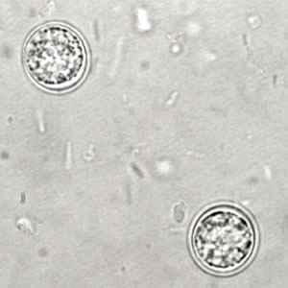
Morphology: Toxoplasma gondii
Oocyst
small, sub-spherical, smooth coat, no polar cap
Unsporulated when passes
Sporulated oocyst contains 2 sporocysts with 4 sporozoites each = 8 sporozoites total
Cystoisospora felis
Toxoplasma gondii
Cryptosporidium felis
infective
https://www.cdc.gov/dpdx/toxoplasmosis/index.html
Notes:
You will not be asked to identify oocysts or sporulated oocysts in lecture exams

Slide 9
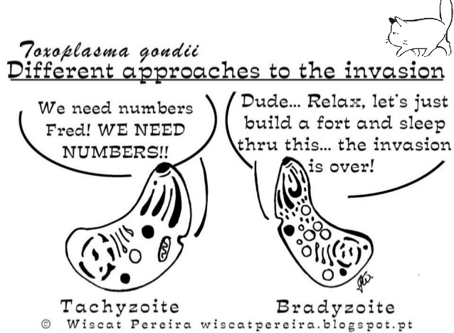
ACUTE INFECTION
CHRONIC INFECTION
Notes:
Know that tachzoites are fast growing, part of acute infection and responsible from acute disease clinical signs
Know that bradyzoites are slow growing, part of chronic infection, milder clinical signs

Slide 10
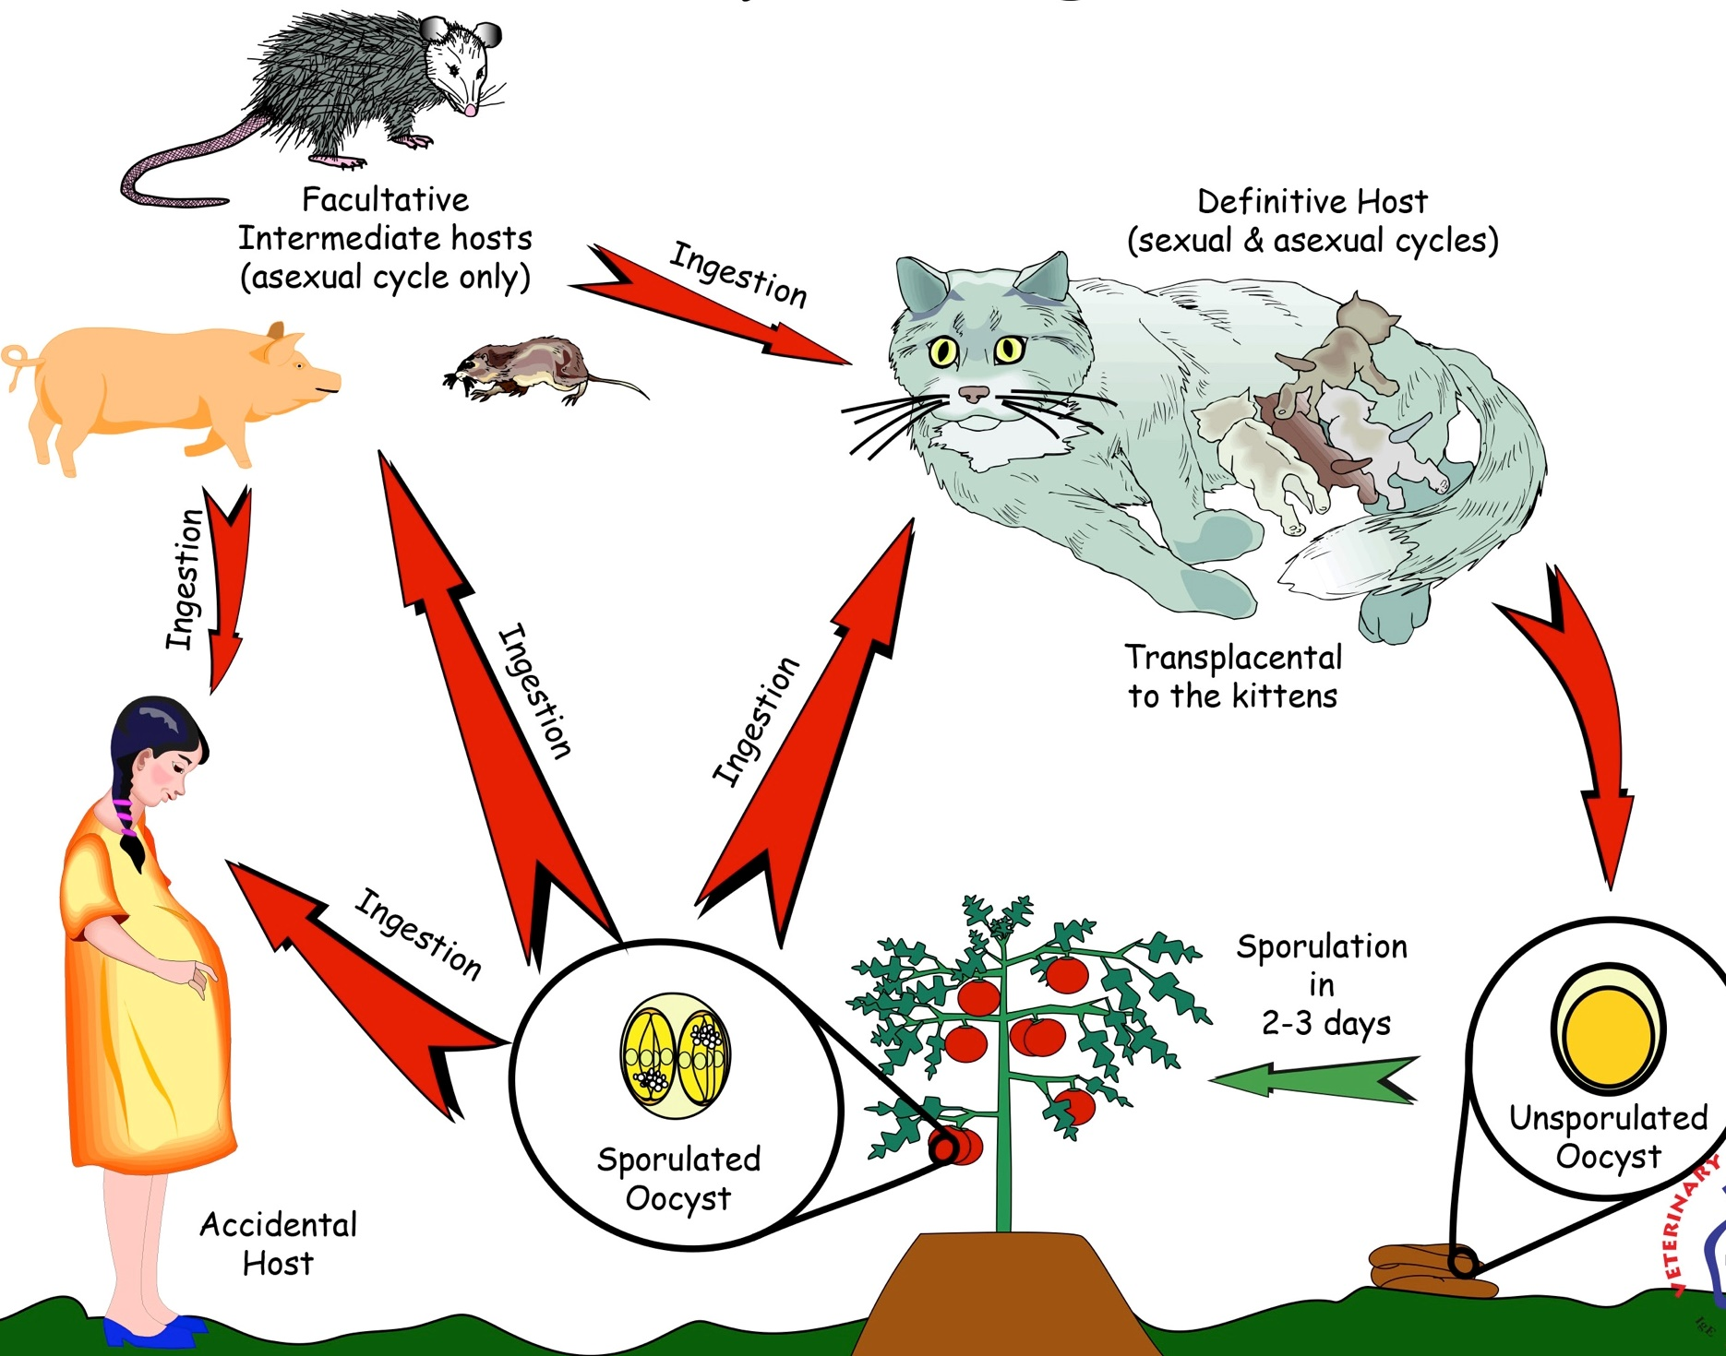
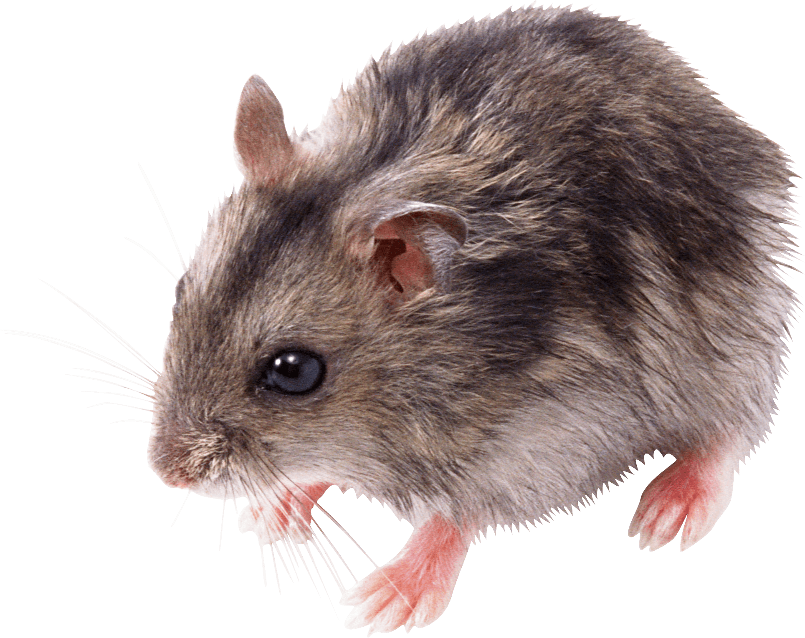
Life Cycles: T. gondii
T. gondii facultative intermediate/paratenic hosts = any warm-blooded animal
Direct Life Cycle:
cat → cat
Facultative Indirect Life Cycle:
cat → paratenic host
paratenic host → cat
and transmammary
paratenic host → paratenic host
contaminated
food
Notes:
These are the 3 different life cycles that can occur with T. gondii.
I will expect you to understand specified components of the Direct Life Cycle (cat to cat) and the Facultative Indirect Life Cycle (paratenic host to cat), highlighted on the following slides.

Slide 11
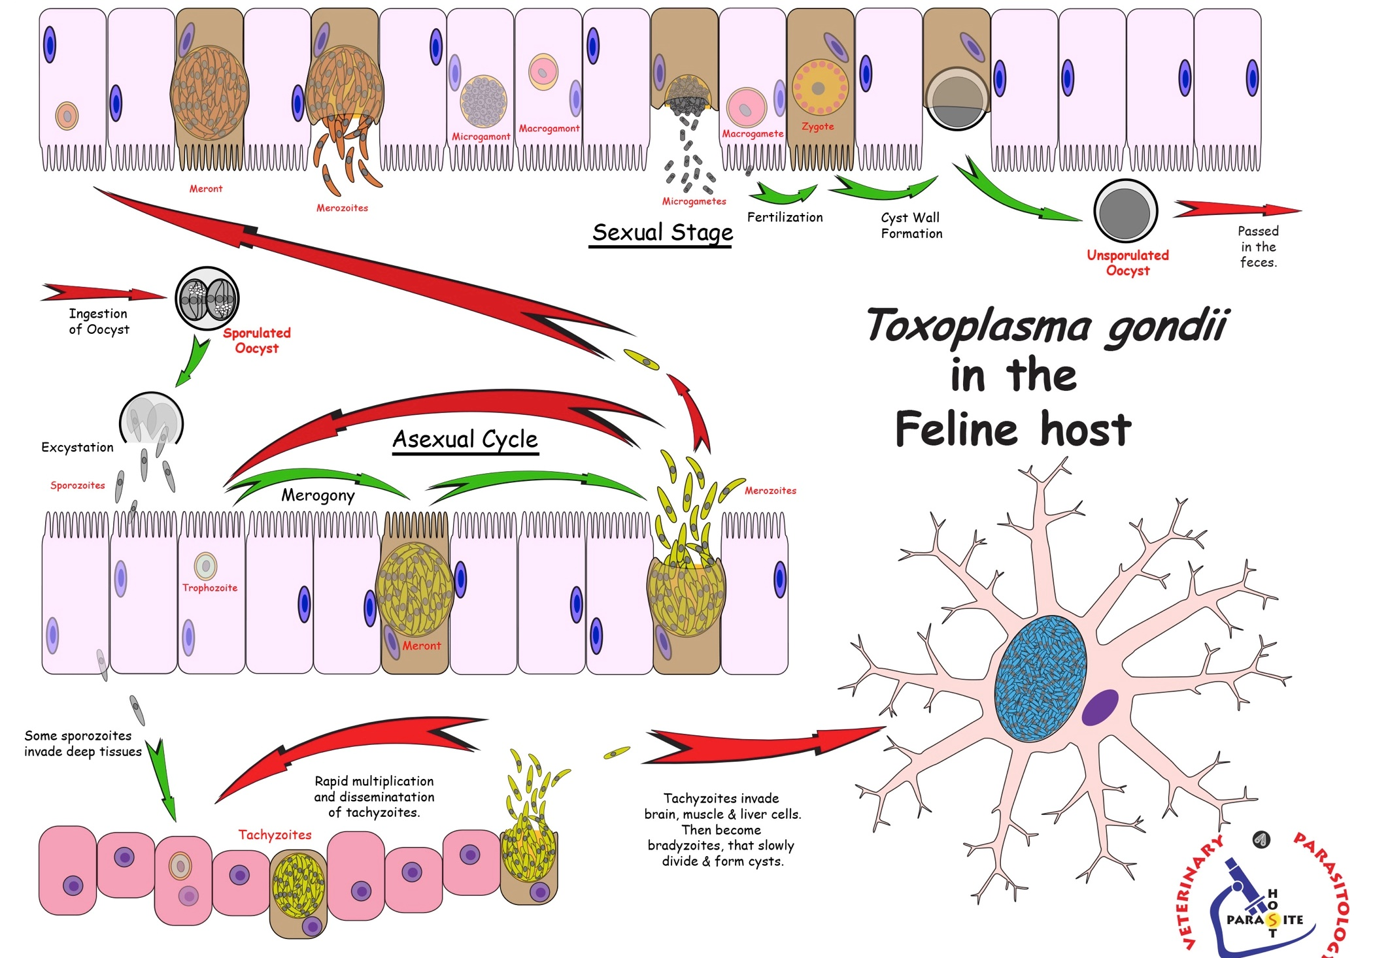
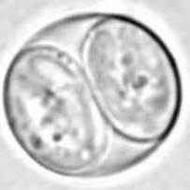
Direct
Oocysts
made
Sexual Repro
start here
Transmission= fecal-oral
Toxoplasma gondii
in the
feline host
(Sporogony)
Asexual Repro
Invasion of enterocytes
Sporulated
Oocyst
(infective)
Sporulated oocysts
Sporulated oocysts
Dissemination
Dissemination
some invade deeper
Notes:
Direct Life Cycle: T. gondii: Cat to Cat
Direct Life Cycle
Definitive host = Felids only
Transmission -- fecal-oral, ingestion of oocyst
Invasion -- Sporozoites excyst from oocyst and invade enterocyte
Asexual reproduction in the enterocytes
Causes either no or mild pathology in the cat
Some sporozoites invade deep tissues (CNS, muscle, viscera) multiply & disseminate as tachyzoites, and eventually form bradyzoite cysts
Sexual reproduction (only occurs in the Felids -enterocytes)
Gametogony → Fertilization → Oocyst
Dissemination
Oocysts exit the host in the feces and contaminate the environment
Felids are the only hosts to pass oocysts
Prepatent period (time from when a sporulated oocyst ingested to when a new oocyst is passed): 19 - 48 days
Felids usually only shed oocysts once in their life-time
Oocysts highly resistant and remain infectious for many months
Second infections in a cat may result in very low level and short duration of oocyst shedding

Slide 12
Direct Life Cycle: T. gondii in the Cat
1-3 days
Dissemination
Oocysts exit the host in the feces and contaminate the environment
Felids are the only hosts to pass oocysts
Felids usually only shed oocysts once in their life-time
dependent upon duration between infections, immune status of cat, & strains of T. gondii
It takes 1-3 days for oocysts to sporulate (become infective)
Oocysts highly resistant and remain infectious for many months
Notes:
Second infections in a cat may result in very low level and short duration of oocyst shedding
cats usually only shed oocysts once. I want to emphasize that there are scenarios where cats are more likely to shed and those are cases where the cats are on immunosuppressive therapy or are clinically ill.
UPDATE on cats and re-shedding of oocysts: The re-shedding of oocysts by cats remains an important aspect in the epidemiology of T. gondii. It was previously believed that, after the first infection, cats would excrete thousands of oocysts, and then elimination would no longer occur during the life of the animal. However, recent studies have demonstrated re-shedding after experimental application of immunosuppressive therapy...or in clinically ill cats.

Slide 13
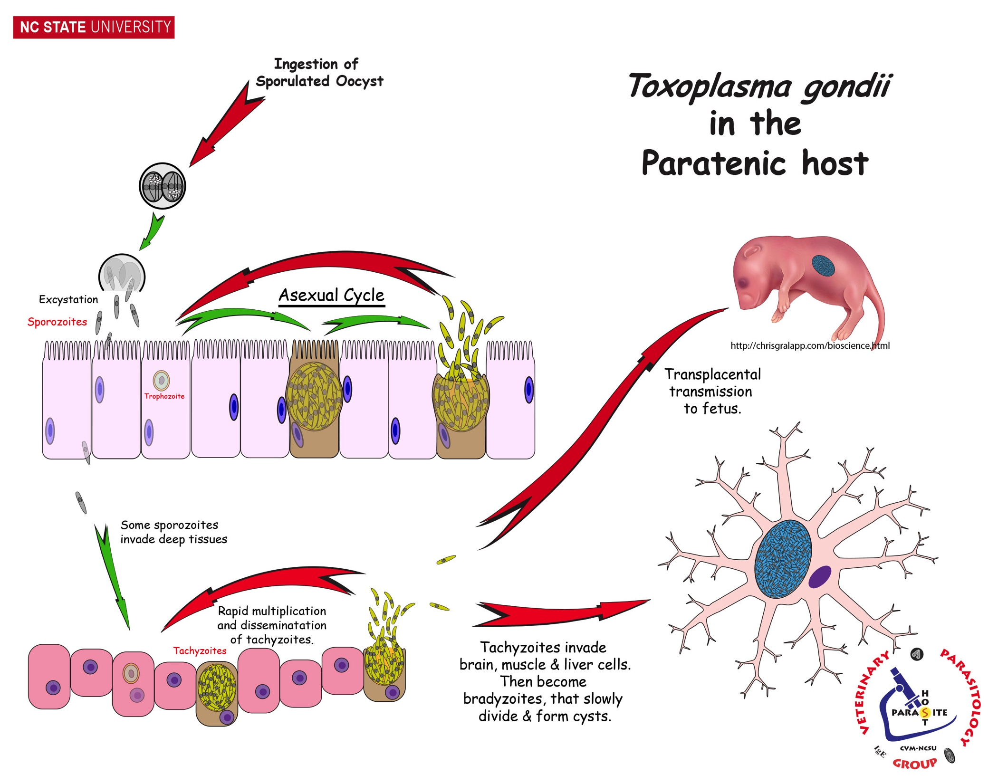
start here
T. gondii in the
Paratenic host
(facultative indirect life cycle)
Asexual Repro
Paratenic host = any warm-blooded animal
Transplacental transmission!
No sexual cycle (i.e. no oocysts made)
Asexual Repro
Disease!
Notes:
Facultative Indirect Life Cycle: T. gondii Cat to Paratenic host
Facultative Indirect Life Cycle (heteroxenous)
Paratenic host – Any warm-blooded animal, including felids
Transmission
Paratenic host ingests a sporulated oocyst from the feces of a felid
Mother’s ingestion of oocyst from cat feces could lead to toxoplasmosis in fetus
Invasion
sporozoites enter intestinal cells and lymph cells, divide then transform into tachyzoites (fast growing)
Asexual reproduction (extra-intestinal cells)
Tachyzoites
Disseminate and invade deep tissue, throughout the body
Fast growing → rapid destruction of host cells → acute / severe disease
Transform into bradyzoites
Tachyzoites may be transplacentally transmitted
Bradyzoites (slow dividing zoites)
Stationary (= non-disseminating) and form tissue cysts
Tissue cysts
Slow growing → chronic pathology in the paratenic (and human) hosts
Occur in and cause damage to the brain, liver, lungs, striated muscles
Remain viable for the life of the paratenic host

Slide 14
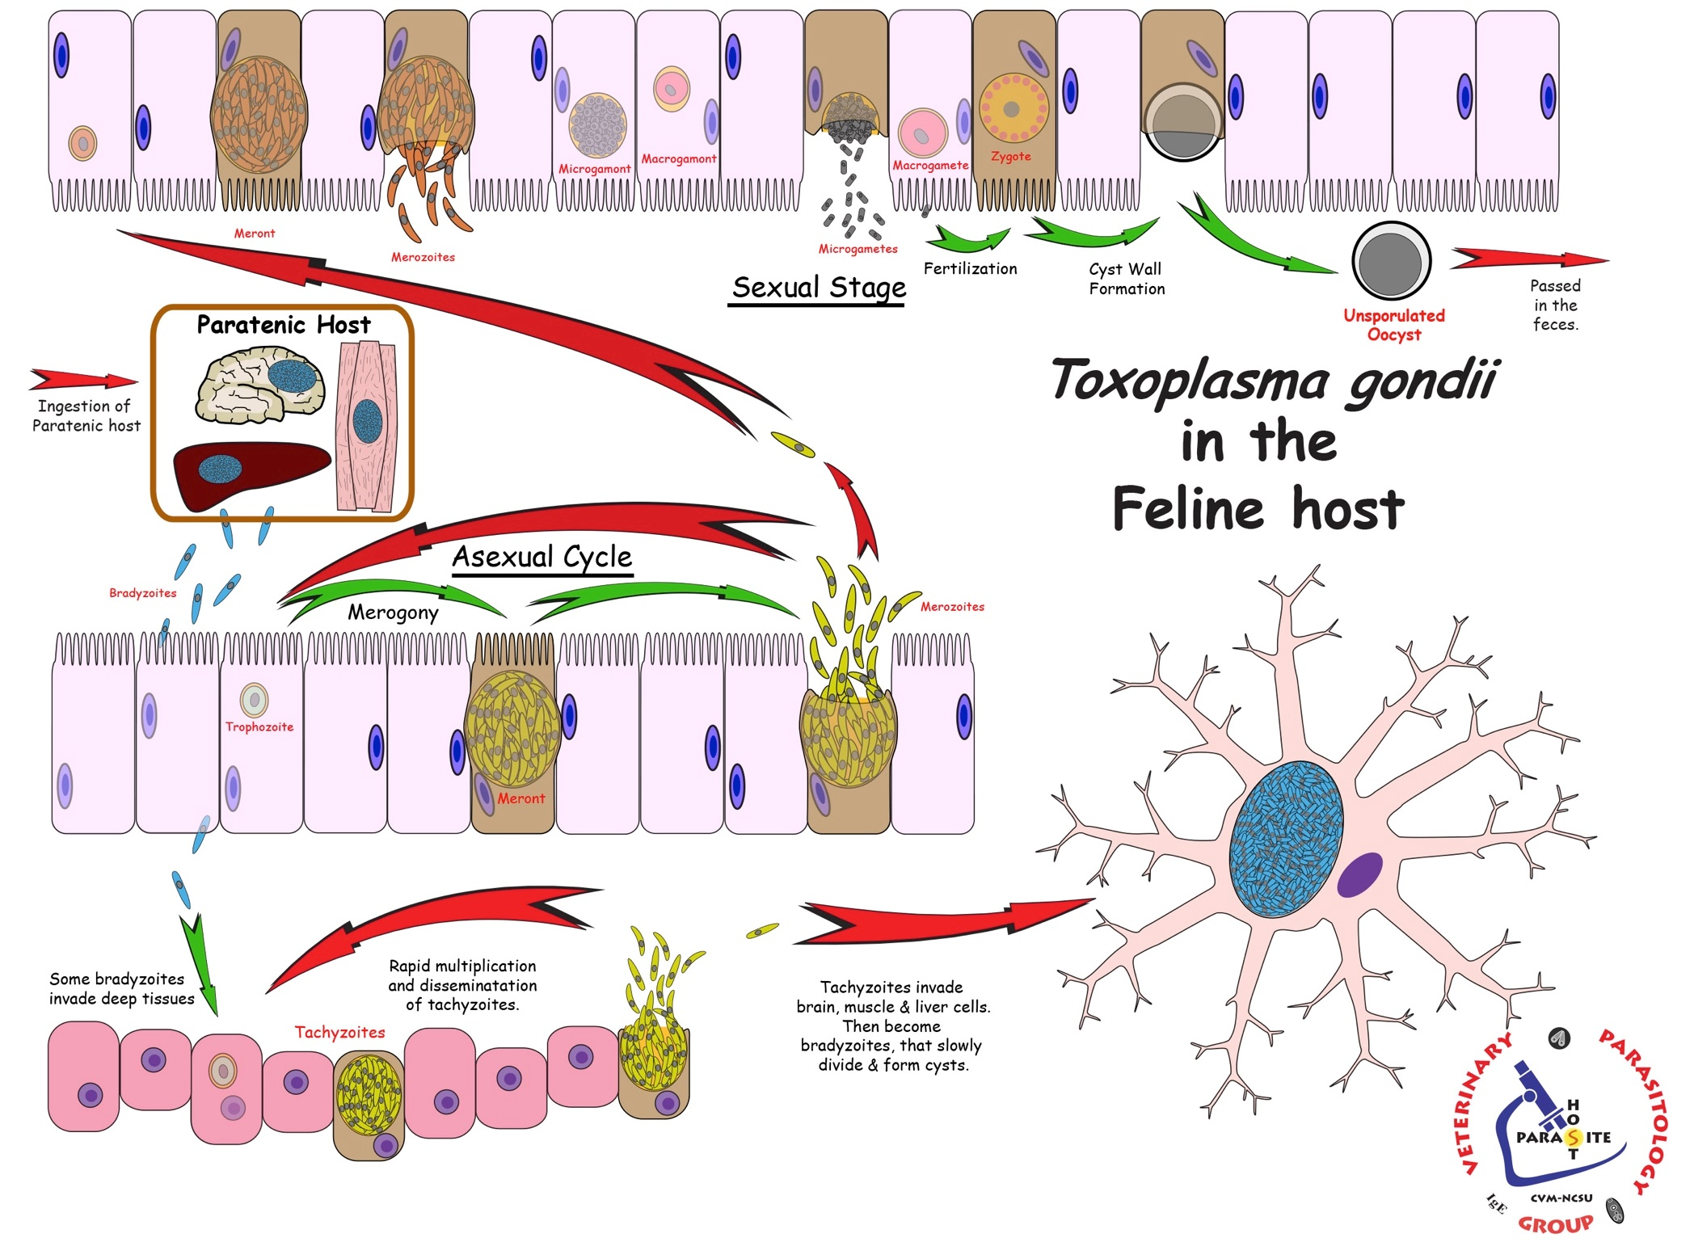
Facultative
Indirect
start here
Toxoplasma gondii
in the
feline host
(Sporogony)
Carnivorism:
shorter prepatent period when infected with bradyzoites
Notes:
Facultative Indirect Life Cycle: T. gondii Paratenic host to Cat
Infected paratenic host (bradyzoites in tissue cysts)
Transmission – carnivorism → cat ingests a tissue cyst from a paratenic host
Bradyzoites released from ingested tissue cysts, develop into merozoites in enterocytes
The rest of life cycle follows that of “Cat to Cat”
Asexual cycle in Intestinal epithelium
Merozoites → sexual stage resulting in an unsporulated oocyst, passed in the feces
Some merozoites → invasion of deep tissues to form tachyzoites then bradyzoite cysts
Prepatent period (time from ingesting tissue cyst to passing oocysts) = 3 to 10 days vs. the 19-48 days in cat-to-cat cycle
Cats ingesting sporulated oocysts from other cat feces vs. cats ingesting tissue cysts. Cats ingesting tissue cysts (i.e. becoming infected from eating rodents) is shorter, so these cats may start shedding infective oocysts earlier. Another reason to suggest clients keep cats indoors so they don’t kill wildlife.

Slide 15
T. gondii Paratenic host to Paratenic host
Transmission (no oocysts b/c no cat)
Carnivorism
Bradyzoites released from tissue
cysts develop into tachyzoite
Tachyzoites may be
transplacentally transmitted
Notes:
T. gondi facultative intermediate/paratenic hosts = any warm-blooded animal
Transmission
Carnivorism → ingestion of a tissue cyst from a paratenic host
Bradyzoites released from tissue cysts develop into tachyzoites
Invasion and Asexual reproduction is the same as “Cat to Paratenic Host” (slide 12)
General Notes
Tachyzoites may be transplacentally transmitted.
Mother’s ingestion of raw meat with tissue cysts may lead to toxoplasmosis in the fetus

Slide 16
Pathogenesis: Toxoplasma gondii
Intestinal phase in felids → minimal
Systemic disease in felids, paratenic hosts or humans
massive direct destruction of host cells by explosive replication of tachyzoites
Most often affects brain, liver, lungs and striated muscles.
Acute immune response
Tissue cysts cause physical cell/tissue damage and are a source for latent disease

Slide 17
Clinical Disease: Toxoplasma gondii
cats only
Intestinal/Acute Disease – usually no complaint
Oocysts noticed on routine fecal
10-20% of cats develop self-limiting small bowel diarrhea
Systemic Disease -
Non-specific disease: Pneumonia is most common (especially in FIV+ cats), fever, anorexia, vomiting, diarrhea, myositis, uveitis, enlarged lymph nodes, encephalitis, nephritis, death
Can transmit congenitally to kittens (not as common)
Notes:
Transplacental transmission, the cat is infected during pregnancy.
Do kittens with toxoplasmosis develop disease? YES Kittens may be born with congenital toxoplasmosis when the queen is infected with T. gondii during gestation. Clinical signs are more likely to manifest in kittens if the queen is infected in the final 1/3 stage of gestation and severity is dependent on the strain (type) of T. gondii, dose of organisms, and stage of kitten development. Diseases that have been documented in kittens with congenital toxoplasmosis include interstitial pneumonia, necrotizing hepatitis, myocarditis, skeletal and glossal myositis, non-suppurative encephalitis affecting the cerebrum, brain stem, and spinal cord, uveitis, necrotizing adrenal adenitis, and interstitial nephritis.

Slide 18
Diagnosis: Toxoplasma gondii
cats only
Intestinal/Acute Disease
Oocysts in feces (fecal float centrifugation)
Systemic Disease
Serologic tests – measure IgG and IgM antibodies
good to rule-out if seronegative;
If seropositive, not useful at proving Toxo is cause of disease. WHY?
Definitive diagnosis – detection of tachyzoites in effusions, tissue aspirates or biopsy samples
Notes:
For Dx: know that if a cat presents with diarrhea, then run a fecal float to look for oocysts
If you suspect systemic Toxoplasmosis in a cat, you can use serology to rule out T. gondii if results are seronegative and use detection of tachyzoites in samples to definitively diagnose as positive for T. gongii.
The reason you wouldn’t use serology to definitively diagnose T. gondii in a cat is because many cats may have been exposed to T. gondii in the past and have antibodies. For example, if a cat comes into the vet hospital with nonspecific clinical signs, the cause of those clinical signs could be due to so many etiologies. If the cat is T. gondii seropositive, it could just be an incidental finding (antibodies from previous exposure). If the cat is seronegative for T. gondii, then T. gondii is likely NOT the cause of the clinical signs –unless the infection is so acute the cat hasn’t made antibodies yet (takes ~ two weeks for animals to mount a detectable antibody response). To fully rule it out, consider acute and convalescent titers.

Slide 19
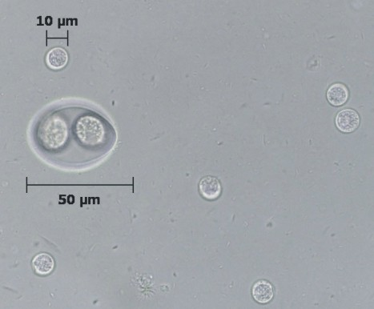
Diagnosis: Fecal Float Centrifugation
cats only
Toxoplasma gondii
Cystoisospora felis
https://www.cdc.gov/dpdx/toxoplasmosis/index.html
http://people.upei.ca/sgreenwood/html/protozoa.html
Notes:
Know fecal float centrifugation used to id oocysts in cats. You will not be asked to identify images of oocysts for lecture tests.

Slide 20
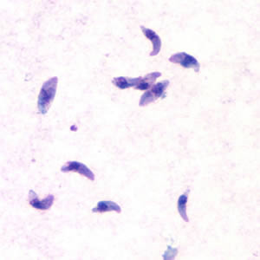
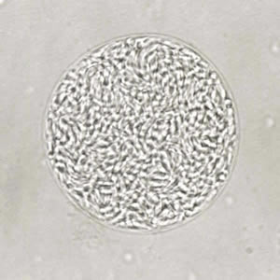
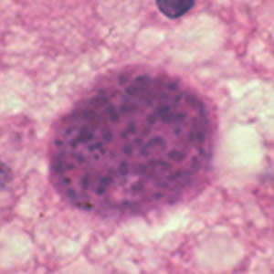
Diagnosis for System Disease Aspirates or Necropsy
Tachyzoites from
effusion or aspirate
Bradyzoite cyst from Necropsy / Histology
https://www.cdc.gov/dpdx/toxoplasmosis/index.html
https://www.cdc.gov/dpdx/toxoplasmosis/index.html

Slide 21
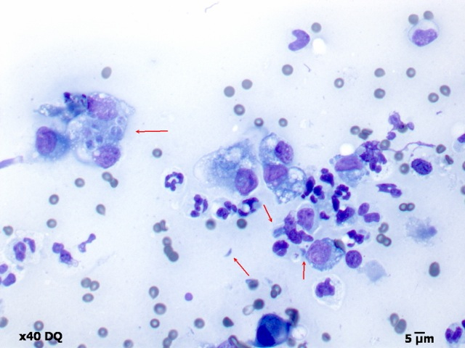
Cytology of a fine needle aspirate of a cat with pulmonary toxoplasmosis
Picture by George Reppas, Vetnostics, Australia

Slide 22
Treatment: Toxoplasma gondii
cats only
Intestinal / Acute Disease (shedding oocysts)
Pyrimethamine plus triple sulfa drugs
Clindamycin
Ponazuril
Hospitalize cat during oocyst shedding to reduce zoonosis
Systemic Disease (clinically ill)
Clindamycin for at least 4 weeks
Supportive treatment depending on clinical signs
No good treatment to clear tissue cysts
FYI
Notes:
Cats usually only shed ~1-2 weeks
Ponazuril was used safely for weeks in the treatment of keratoconjunctivitis due to T. gondii in a dog after treatment with clindamycin failed (Swinger R.L, Schmidt Jr. K.A, Dubielzig R.R. Keratoconjunctivitis associated with Toxoplasma gondii in a dog. Vet Ophthalmol . 2009;12:56–60. PMID: 19152600_

Slide 23
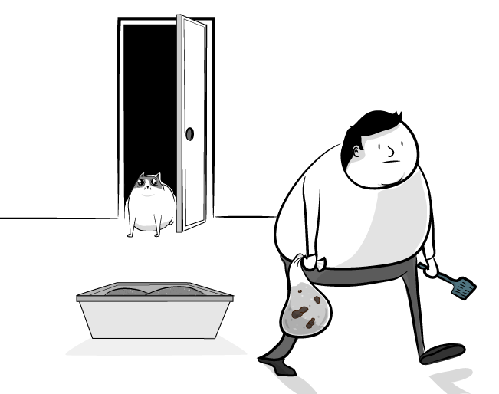
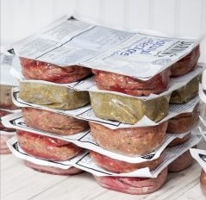
Control: Toxoplasma gondii in cats
Sanitation
Clean litter box daily (environmental sporulation in 1-3 days)
Don’t let cats outside to defecate or hunt
No raw meat for cats
https://theoatmeal.com/comics/universe_cat
Notes:
Know these 3 main ways to control T. gondii in cats

Slide 24
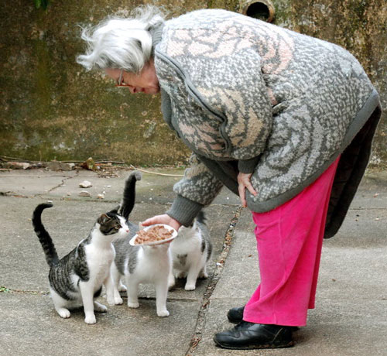
Epidemiology: Toxoplasma gondii
Worldwide distribution
Higher prevalence:
warmer climates
high human population densities (likely due to higher cat populations)
Risk Factors for exposure to T. gondii:
For cats – younger, outdoors, males
Eating undercooked foods
Living in highly dense population

Slide 25
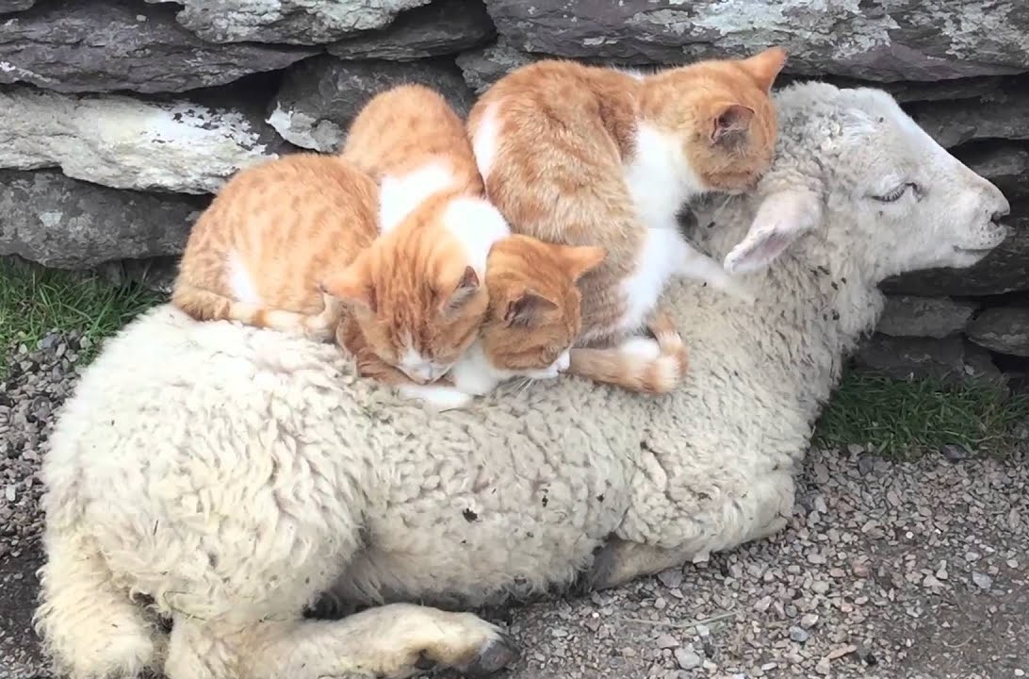
Toxoplasma gondii
Non-felid paratenic hosts
Dogs
Systemic toxoplasmosis
Less commonly develop clinical disease
Fever, neurological, ocular or respiratory signs
Rule-out Neospora caninum infection
Sheep & Goats
Systemic & Congenital toxoplasmosis
Systemic – CNS signs (circling, etc.)
Congenital – abortion
Toxovac S48 live vaccine available
Notes:
Carnivores get it by either eating oocysts shed from cats or eating paratenic hoses
Herbivores get it by eating oocysts from cats
Abortion more common in sheep

Slide 26
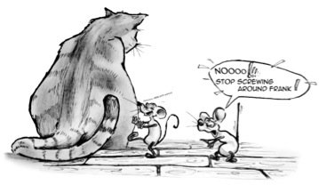
Toxoplasma gondii
Non-felid paratenic hosts
Cattle
Congenital toxoplasmosis (Very rarely, can cause abortion)
Horse
Systemic toxoplasmosis, low pathology
Rodents
Systemic toxoplasmosis
Decreased fear of cats
Major source of infection for cats and pigs

Slide 27
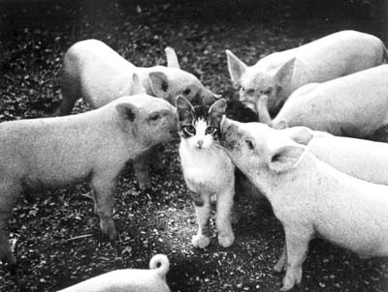
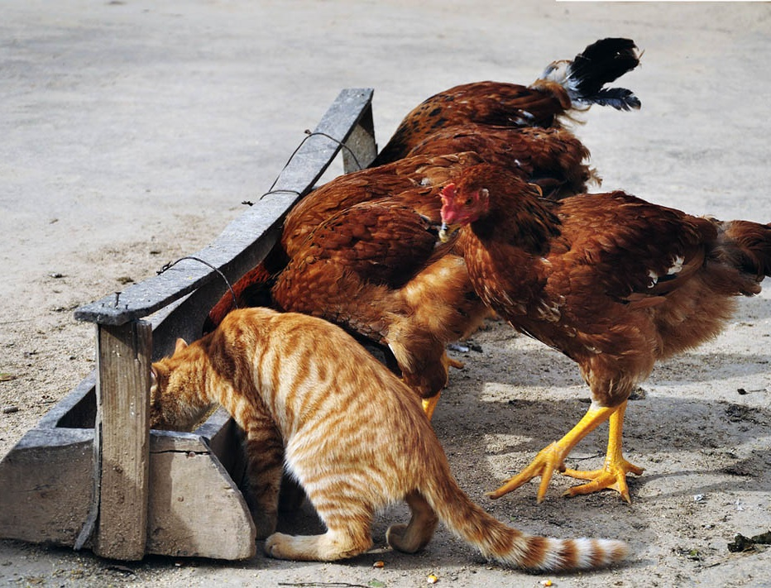
Toxoplasma gondii
Non-felid paratenic hosts
(important sources of human infections)
Swine
Systemic toxoplasmosis
Fever, respiratory signs
Highly prevalent in free-range pigs
Important source of infection for humans
Poultry
Systemic toxoplasmosis
Prevalent in free-range and back-yard chickens
Important source of infection for humans
Notes:
Know that uncooked pork and poultry are important sources for human infection

Slide 28
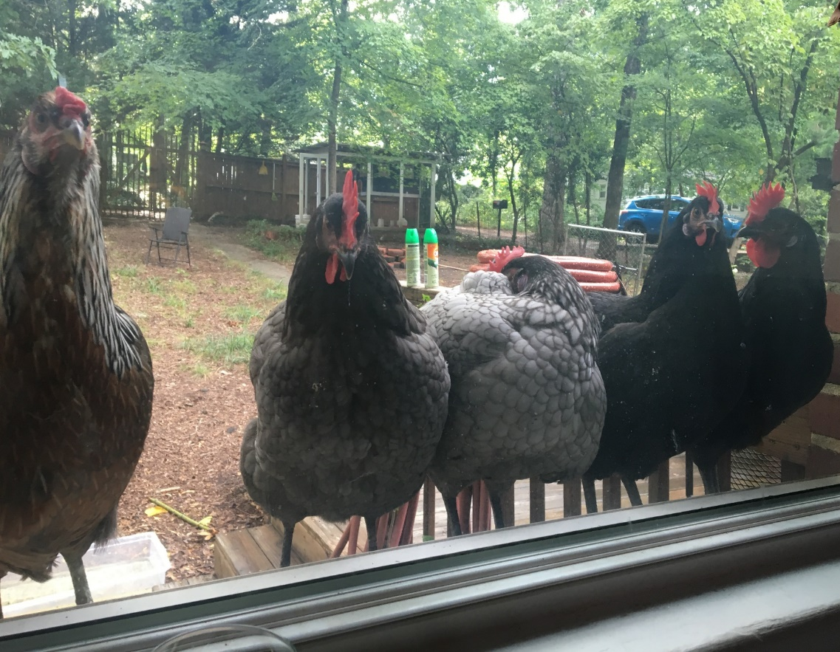
Zoonosis: T. gondii
Transmission
Food-borne (ingestion)
Cysts from undercooked /unpasteurized food
mutton, goat
free-range pork
free-range chicken
goat’s milk
Oocysts on unwashed vegetables
Ingestion of oocysts from cat feces/unclean hands
Blood transfusions and organ transplants (rare)
Notes:
Unpasteurized milk

Slide 29
Zoonosis: T. gondii
Immunocompetent Person: mild disease
1st exposure
“flu-like” illness or asymptomatic
Future exposures
immune-protected, no pathology
Can remain latently infected with cysts
Neurological or psychiatric syndromes?
Notes:
Know the difference in dz severity between infection of T. gondii between an immunocompetent person and an immunocompromised person. You won’t be tested on the details of this slide
“flu-like” illness that may last for weeks = Fever, myalgia, sore throat, lymphadenopathy

Slide 30
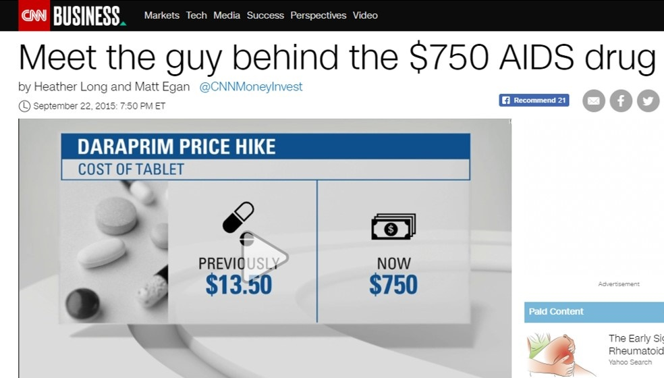
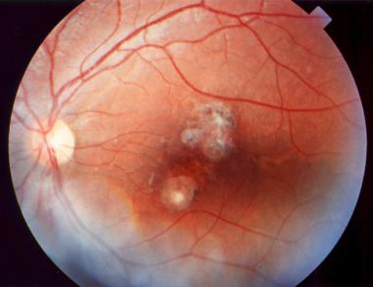
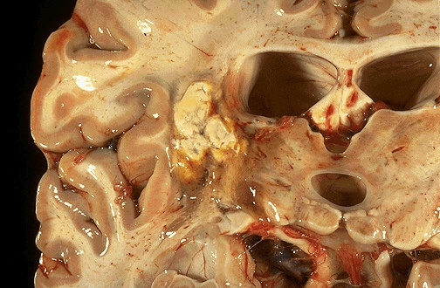
Zoonosis: T. gondii
Immuno-deficient Person
Higher risk for infection and disease
Elderly & those w/ Immunosuppressive dzs
Severe disease
Respiratory, CNS, ocular, etc.
Often from recrudescence of latent infection after immune-suppression
Pyrimethamine
http://emedicine.medscape.com/article/229969-overview#showall
Notes:
Know blue font
Pyrimethamine is a medication to treat parasite diseases. Pyrimethamine was approved as a generic in the United States in February 2020
chorioretinitis

Slide 31
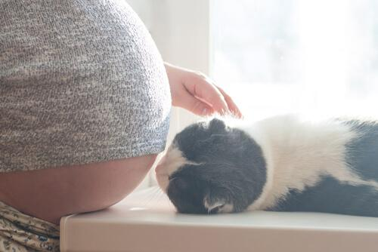
Zoonosis Congenital Toxoplasmosis (know this)
Transmission
Infection of Mother
Ingestion of oocysts or tissue cysts
Infection of Fetus
Transplacental Transmission
https://myanimals.com/latest-news/adoption/cats-adoption/myths-about-pregnancy-and-cats/
Notes:
Know this. The additional slides are important too as you will be asked about toxoplasmosis by pregnant cat owners.
~1/3000 – 1/10,000 births

Slide 32
Zoonosis Congenital Toxoplasmosis (know this)
Fetal Toxoplasmosis
Severe Disease
congenital malformation
intellectual disability
death
https://myanimals.com/latest-news/adoption/cats-adoption/myths-about-pregnancy-and-cats/

Slide 33
Test for T. gondii antibodies
just prior to pregnancy or newly pregnant
T. gondii seronegative
T. gondii seropositive
1. The mother-to-be has not been previously exposed to T. gondii
1. Represents previous exposure (?)
2. Antibodies are protective (if immune competent)
2. No protective antibodies
3. High risk of congenital toxoplasmosis if mother exposed for 1st time during pregnancy
3. Low risk of congenital toxoplasmosis if mother exposed again during pregnancy
Notes:
It’s important for veterinarians to understand this because pregnant cat owners will need help understanding this and may mistakenly believe they have to get rid of their cats.
If mother’s 1st exposure occurs:
During pregnancy (i.e. if mother does NOT have protective antibodies from a previous exposure)
Transplacental transmission could occur and infect fetus
Prior to pregnancy,
then mother’s immune system will control toxoplasmosis, unless mother is immune-deficient
Newly pregnant women tested for antibodies → if seropositive then that’s good! → mother and fetus are protected if exposed while pregnant

Slide 34
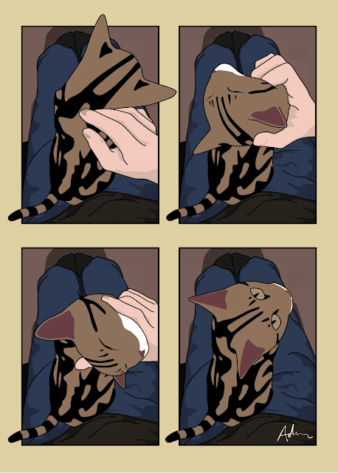
Zoonosis (know this)
Veterinary Advice to Pregnant Cat Owners
Get antibody tested: Mother & Cat
Seropositive then low worries!
Cats usually only shed oocysts once
Avoid cat feces (sporulation in 1-3 days)
Avoid uncooked meat, unclean hands/vegetables/knives/cutting boards.
Casual contact with cats is very low risk.
Indoor cats less risky than outdoor cats
If outdoors, old cats less risky than young cats
"What? Did you hear me say stop? No, I didn't think so."
http://www.ataleoftwocats.co.uk
Notes:
Pregnancy Advice
Get antibody tested: Mother & Cat
Seropositive then no worries!
Cats usually only shed oocysts once in their life, so seropositive cat usually = a previous exposure/infection
Avoid cat feces (sporulation in 1-3 days)
Avoid uncooked meat, unclean hands/vegetables/knives/cutting boards.
Casual contact with cats is very low risk.
Indoor cats less risky than outdoor cats
Old outdoor cats less risky than young outdoor cats
UPDATE on cats and re-shedding of oocysts: The re-shedding of oocysts by cats remains an important aspect in the epidemiology of T. gondii. It was previously believed that, after the first infection, cats would excrete thousands of oocysts, and then elimination would no longer occur during the life of the animal. However, recent studies have demonstrated re-shedding after experimental application of immunosuppressive therapy...or in clinically ill cats.

Slide 35
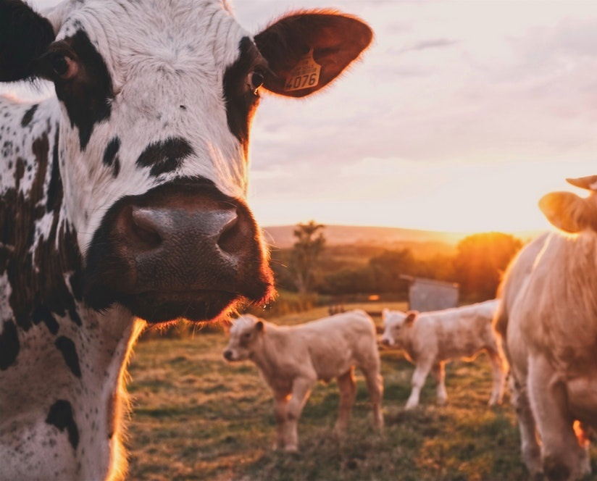
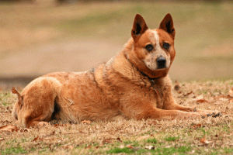
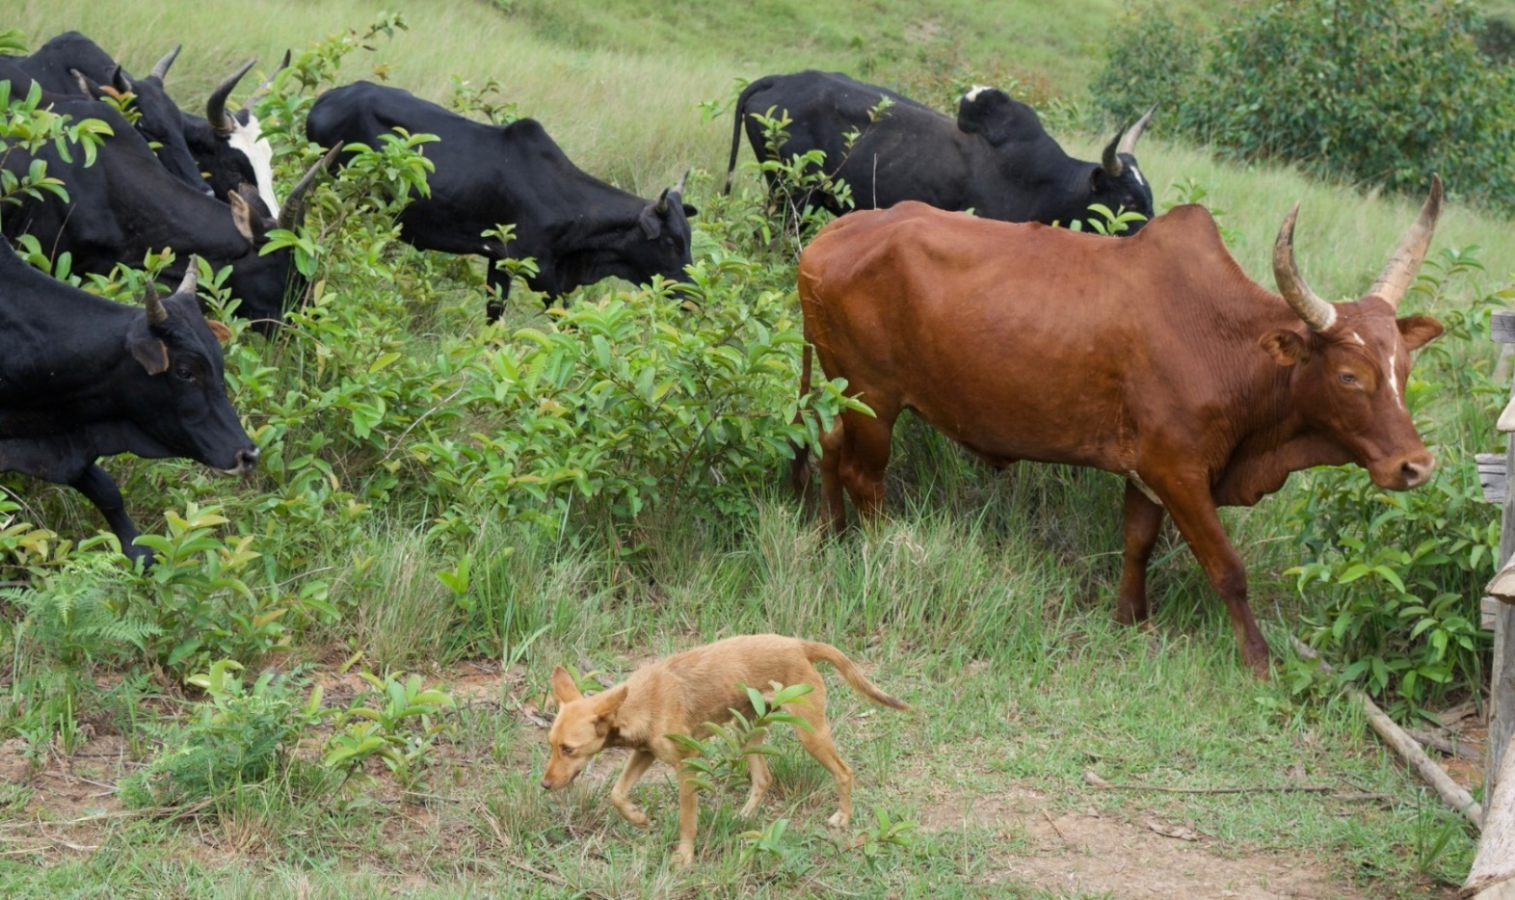
https://homesteadontherange.com
Neospora caninum
Canine coccidan
Bovine abortion
Canine neurologic disease
Complex Life Cycles

Slide 36
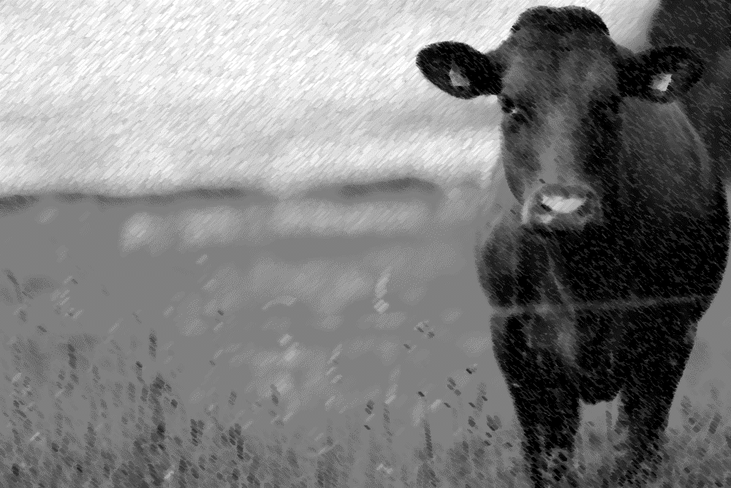
Learning Objectives: Neospora caninum
Life cycles: understand specified components of the Indirect Life Cycle (dog-cow) and the Transgenerational infection cycle (cow-to-calf).
Transmission: know specified routes of transmission: dog-to-cow, cow-to-dog, cow-to-cow (transplacental, trans-generational) and dog-to-dog (transplacental).
Pathogenesis: understand the systemic phase = direct cell destruction from tachyzoite growth and bradyzoite cysts are usually source of latent infection and can be reactivated.
Clinical signs: Understand the clinical signs in dogs (adults and puppies)and cows, including those in transgenerational offspring.
Diagnosis: understand you can run bovine abortion panels on cows and/or fetal tissue.
Control: Know the risk factors and highlighted practices to control N. caninum
Zoonosis: not zoonotic

Slide 37
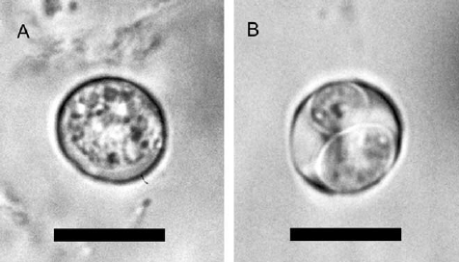
Morphology Neospora caninum
Oocyst
Small, sub-spherical, smooth coat, no polar cap, single embryo when passed = unsporulated (sporulate after 1-3 days)
Sporulated oocyst contains 2 sporocysts with 4 sporozoites
https://www.researchgate.net/figure/8663822_fig2_Fig-2-PCR-for-Neospora-caninum-and-Hammondia-heydorni-using-DNA-extracted-from-oocysts
Notes:
You will not be asked to identify oocysts or sporulated oocysts on the lecture exam

Slide 38
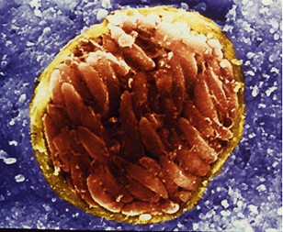
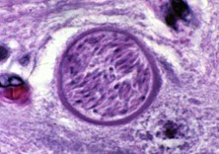
Morphology Neospora caninum
Bradyzoite cyst (cysts found in tissue); facilitate persistent infection
www.k-state.edu
www.cmgm.stanford.edu
Notes:
Thick walled help differentiate from t. gondii
You will not be asked to identify these in the lecture exam.

Slide 39
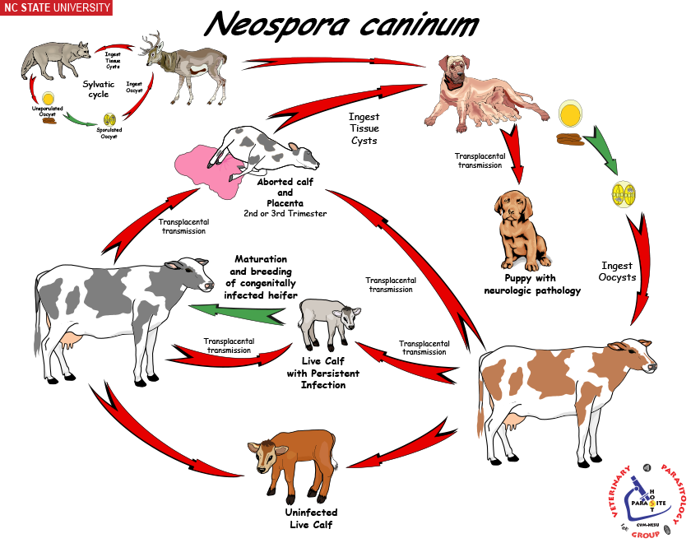
Definitive Host = canids
Obligate Indirect Life Cycle
Trans-generational Infection Cycle
Intermediate Host = herbivores (cattle)
Notes:
For this pathogen, we will go over the indirect life cycle between the cow and the dog and we will also cover the transgenerational infection cycle.
Obligate Indirect Life Cycle
Definitive host – Canids only (Dog, Coyote, Wolf, etc.)
Intermediate Host (IH) – Cattle and other animals
Transmission to dog -- carnivorism, ingestion of tissue cysts from aborted cattle fetus, placenta etc
Invasion -- Zoites excyst from tissue cyst and invade enterocytes
Asexual reproduction (in intestinal cells – but no pathology)
Sexual reproduction (only occurs in canids)
Gametogony, Macrogamete, Microgamete, Exflagellation, Fertilization, Zygote, Oocyst formation.
Dissemination
Oocysts (unsporulated) exit the canid in the feces and contaminate the environment ~ 4 days post ingestion → sporulate after 1-3 days
Canids (definitive hosts) are the only hosts to pass oocysts
Oocysts highly resistant and remain infectious for many months.

Slide 40
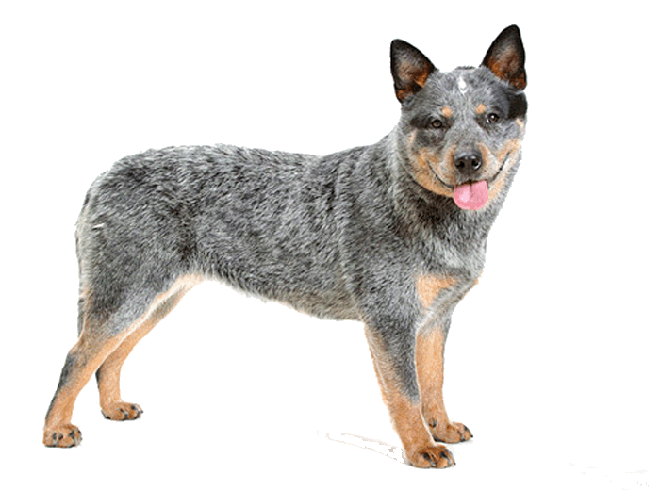
Obligate Indirect Life Cycle: N. caninum
Obligate Indirect Life Cycle
Definitive host – Canids only (Dog, Coyote, Wolf, etc.)
Intermediate Host – Cattle and other herbivores
Transmission
To dog: ingestion of tissue cysts from aborted cattle fetus
To cow: ingest infective oocyst
Invasion -- Zoites excyst from tissue cyst and invade enterocytes
Asexual reproduction (in intestinal cells – but no pathology)
Sexual reproduction (only occurs in canids)
Dissemination
Oocysts (unsporulated) exit canid (only host to pass oocyst), contaminate the environment
Ranges 5-13 days post ingestion of tissue cysts → sporulate after 1-3 days
Oocysts highly resistant and remain infectious for many months.
Notes:
Prepatent period ranges from 5-13 days

Slide 41
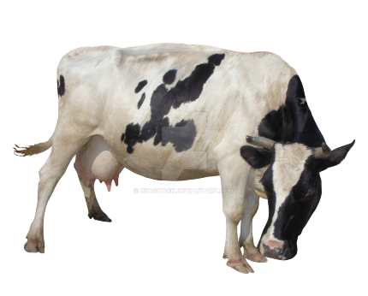
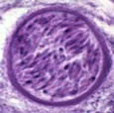
Transmission: Cow to Dog
Transmission - Dog ingest tissue cysts from aborted cattle fetus, placenta and other bovine tissues
Invasion
Intestinal
Some zoites infect intestinal cells to complete sexual cycle → oocyst in the feces
Systemic
Other zoites go to deeper tissue and go through asexual cycles → tachyzoites develop and then become tissue cysts with bradyzoites (predilection for neural tissue).
Notes:
Understand that dogs transmit N. canium to cows via passing oocysts in the environment and transmit N. caninum to their own puppies via transplacental infections. It’s important to know the because infected puppies will have clinical disease.
While consumption of aborted bovine fetuses does not appear to be an important source of N. caninum infection in dogs, the consumption of bovine fetal membranes may be a source of N. caninum for dogs. The parasite has been found in naturally infected placentas, and dogs fed placentas from freshly calved seropositive cows can shed N. caninum oocysts.

Slide 42
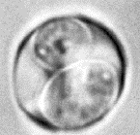
Transmission: Dog to the Cow
Transmission - Cattle ingest sporulated oocysts from canid feces
Invasion
Intestinal – sporozoites penetrate intestinal lining (no replication and no invasion of enterocytes)
Systemic - zoites move to extra-intestinal cells (neural, muscle, heart, placenta, fetus) → asexual replication
Tachyzoites → bradyzoite (neural, muscle, myocardial, placenta, fetus)
Notes:
Invasion
Intestinal – sporozoites penetrate intestinal lining (no replication and invasion of enterocytes)
Systemic - zoites move to extra-intestinal cells (neural, muscle, heart, placenta, fetus) → asexual replication
tachyzoites (fast replication and transform into bradyzoites)
bradyzoite (slow replication, form tissue cysts in neural, muscle, myocardial, placenta, fetus)

Slide 43
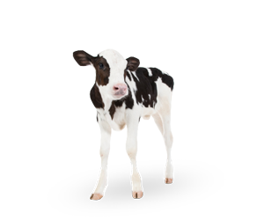
Transmission: Congenital and Transgenerational
Congenital Transmission
Bradyzoites transform back to tachyzoites infect fetus:
Mid to late abortion or calf is born early, impaired, persistent infection
Transgenerational Transmission
Infected fetus survives → pass infection on to offspring
Offspring infected in utero → pass infection on to their calves, without reinfection from sporocyst in dog feces
These calves are usually seropositive and less likely to have abortions
Notes:
Congenital Transmission
Infected fetus:
Mid to late abortion
or calf is born early, impaired, persistent infection
Infected fetus survives, and passes infection on to offspring = Trans-generational infection
Cows infected in utero will in-turn infect their calves, without reinfection from sporocyst in dog feces
These calves are usually seropositive and less likely to have abortions

Slide 44
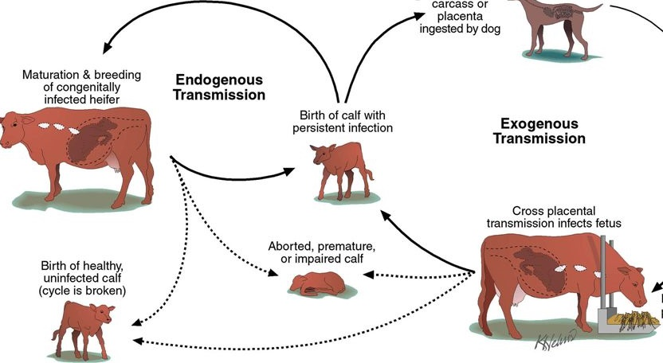
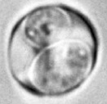
Congenital and Transgenerational Life Cycle: N. caninum (cow-to-cow)
intermediate host
intermediate host
Transgenerational Infection
“re-activated” bradyzoites invade the placenta and fetus
(bradyzoites)
Ingest sporulated oocyst from dog
Congenital Infection
Notes:
N. caninum can be transmitted congenitally (from mother to offspring) through the placenta. In some cases, infected offspring are born, grow up and have offspring, which they will transmit pathogen to. This is transgenerational infection cycle.

Slide 45
Dog-to-Dog : N. caninum
Dog-to-dog via sporulated oocysts -has not been reported
FYI: If ingested, the parasite may go systemic & transplacental (not Intestinal) –like intermediate host
Dog-to-dog via transplacental (dam to puppies)
Dam infected during pregnancy or reactivation of latent infections (can occur repeatedly)
Notes:
Understand that infected dams can transmit via transplacental (congenital) to puppies. As far as we know, dogs do not experience transgenerational infections like cows do.
Dog-to-dog via sporulated oocysts -has not been reported
Sporulated oocyst ingestion does not result in oocyst production
FYI: If ingested, the parasite may go systemic & transplacental (not Intestinal) –like intermediate host

Slide 46
Pathogenesis: N. caninum
Intestinal phase = no pathology
(only in canids)
Extra-intestinal phase = systemic disease
(occurs in canids or intermediate hosts)
Explosive multiplication of tachyzoites
massive direct destruction of host cells
acute immune response
Tissue cysts w/ bradyzoites
may cause tissue damage; low inflammation; latent
“Re-activation” source for transplacental transmission

Slide 47
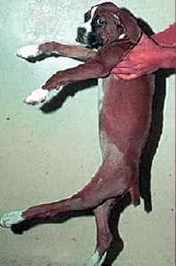
Clinical Disease in Dogs: N. caninum
More commonly a neuromuscular disease of puppies after transplacental infection
If adults develop dz = neuromuscular dz = muscle atrophy, rigid hyperextension, paralysis, head tilt, gait abnormality, dysphagia, seizure, cerebellar atrophy
Localized infections can cause nodular dermatitis
Overall, relatively rare disease despite high exposure
Pure breeds and dogs being immunosuppressed at risk
FYI: Other non-specific clinical signs: pneumonia, urine incontinence, fecal incontinence, nephritis, myocarditis, polymyositis
rigid hyperextension
http://www.vin.com/apputil/content/defaultadv1.aspx?meta=Generic&pId=11157&id=3857014
Notes:
~7% seropositivity in dogs residing in 35 states (1999 study) In a prospective study, only 3% (4 of 118) of pups from 17 seropositive bitches were seropositive. Overall, 80% of pups born to seropositive bitches were considered to be uninfected with N. caninum.
Dubey, J. P., and D. S. Lindsay.1996. A review of Neospora caninum and neosporosis. Vet. Parasitol.67:1-59
Dubey, J. P., E. Knickman, and C. E. Greene.2005. Neonatal Neospora caninum infections in dogs. Acta Parasitol.50:176-179.

Slide 48
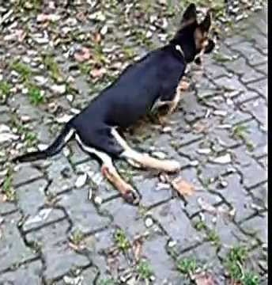
Clinical Disease in Dogs: N. caninum
Congenital Neosporosis
Myositis and polyradiculitis of lumbosacral spinal nerve roots
Puppy with signs of paralysis of 1 or both rear limbs at starting at 3-8 weeks of age (ascending paralysis) up to 6-months age
Puppies with flaccid hind limb paresis, affecting multiple littermates (up to 50%)
Notes:
Litter-mates dying with signs of polyradiculitis (inflammation of the nerve roots, especially of the hind limbs) –involves the lumbosacral spinal nerve roots.
This is manifested as ascending paralysis, muscle atrophy, and fibrous muscle contracture with arthrogryposis (joint contracture), hyperextension of the pelvic limbs, and loss of patellar reflexes
Early signs of disease include exercise intolerance, ataxia, a high-stepping gait, splaying of the pelvic limbs, a “bunny hopping” gait, urinary incontinence, and/or muscle pain.
Clinical signs progress in some dogs to lethargy, tetraplegia, inability to fully open the mouth, dysphagia, and respiratory difficulty. Involvement of esophageal muscle may lead to megaesophagus
Up to 50% of puppies in a liter can be infected, but not all puppies develop signs simultaneously, sometimes only one puppy in litter develops clinical signs.

Slide 49
Clinical Disease: N. caninum
Cattle
Infertility and abortion!
Abortions (2nd – 3rd trimester)
Usually with 1st post-infection pregnancy; autolysis of fetus
Later pregnancies usually go to term, but calves are infected (maintenance of dz in herds)
Transgenerational infections
Seropositive calves give birth to seropositive calves – without reinfection via sporocyst ingestion
↓ milk production and ↓ weight gain
https://www.cityu.edu.hk/ph/en/Research/VDP.html
Notes:
10-20% of abortions caused by N. caninum

Slide 50
Cattle Abortions
FYI this chart
http://genex.crinet.com/page4393/AbortionInDairyCattleGeneralConcepts

Slide 51
Diagnosis: N. caninum
cyst filled with bradyzoites
Dogs
Puppy – classic flaccid hind limb
Serology, molecular tests-PCR
Organism on biopsy, necropsy of litter mates
Usually, negative oocysts on fecals
Cattle
Diagnostic arrays for multiple abortion infectious agents (cows and fetuses)
Serology, PCR, histology
Antibody tests for whole milk
N. caninum
https://www.koofers.com/flashcards/cpb-exam-2-egglist-add-ons/review
T. gondii
Notes:
Dubey, J. P., et al. "Redescription of Neospora caninum and its differentiation from related coccidia." International journal for parasitology 32.8 (2002): 929-946.

Slide 52
Treatment: N. caninum
Dogs
No drugs available to kill tissue forms
Clindamycin and TMS (static), or
ponazuril (-cidal) may help with clinical signs
Earlier the treatment starts the better
Cattle
No drug therapy available
FYI
Notes:
FYI

Slide 53
Epidemiology, Control & Zoonosis N. caninum
Not Zoonotic
Epidemiology -worldwide
Risk factors = presence of dogs on farm
Pure breed / immunosuppressed dogs at higher risk for neosporosis
Control
Limit cattle exposure to wild and domestic canids
Farm hygiene (remove abortus)
Cull seropositive cows? Cull cows with midterm abortions?
Don’t let dogs have access to raw meat, offal or dead animals
Spay female dogs with infected liters
Notes:
Not known to be zoonotic. N. caninum has been detected in horses (herbivore IH), birds, and recently in China, pigs
~7% seropositivity in dogs in 35 states

Slide 54
In-Class Discussion
A pregnant client wants to get rid of their cat due to concerns about toxoplasmosis.
How would you educate your client?

Slide 55
Have Questions?
barbara_qurollo@ncsu.edu
Illustration by Allie Brosh, http://hyperboleandahalf.blogspot.com/
Notes:
If you email me with a question, I will send the question and answer to the entire class but will keep you anonymous. So, don’t be shy!

