Slide 1
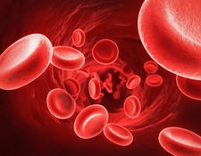
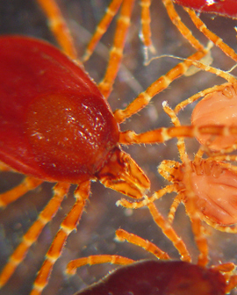
Blood Apicomplexans: Introduction to Piroplasmidia (Babesia spp. and Cytauxzoon felis)

Slide 2
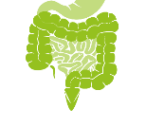
(know terms on this slide)
Parasitic
Protozoa
Grouped by Infection Site and Motility
Apicomplexa
(sg =Alveolates)
Flagellates
(sg = Excavates)
blood/
tissue
Blood apicomplexa (piroplasms)
Hemoflagellates
Babesia spp.
Trypanosoma cruzi
Cytauxzoon felis
Leishmania infantum
Systemic apicomplexa
systemic
Toxoplasma gondii
Trypanosoma cruzi
Neospora caninum
Leishmania infantum
Sarcocystis spp.
intestines
Intestinal apicomplexan (coccidia)
Mucoflagellates
Cryptosporidium parvum
Tritrichomonas foetus
Eimeria spp.
Tritrichomonas blagburni
Cystoisospora spp.
Giardia spp.

Slide 3
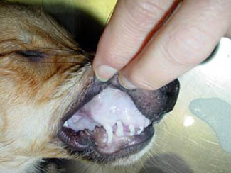
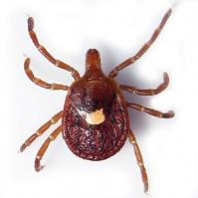
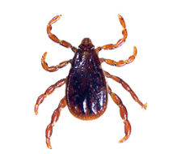
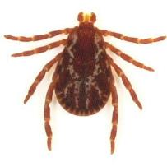
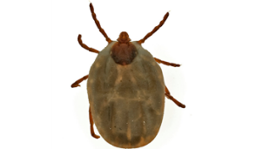
What Are Piroplasms?
Piroplasms are vector-transmitted protozoal parasites
Infect and replicate in blood cells
Include: Babesia, Theileria, and Cytauxzoon (all these are tick-transmitted)
Amblyomma americanum
Dermacentor variabilis
Rhipicephalus sanguineus
Haemaphysalis spp.

Slide 4
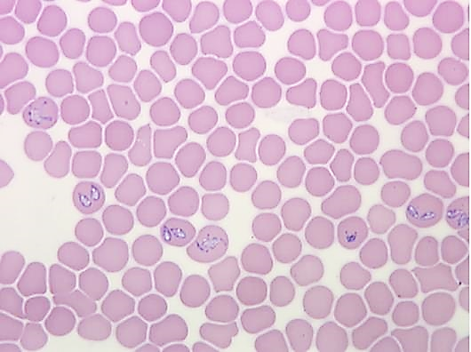
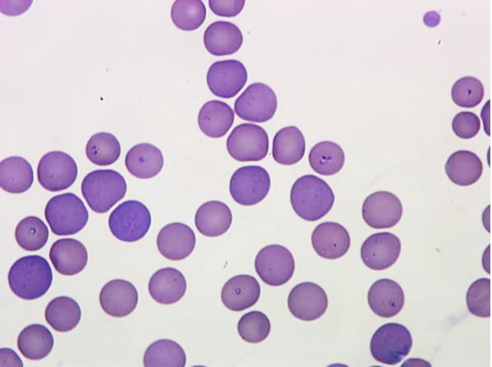
Morphology: Piroplasmidia
Piroplasms are zoites (trophozoites, merozoites) that infect erythrocytes (and white blood cells for some pathogens)
When identified in erythrocytes, they are classified as…
Large
Small

Slide 5
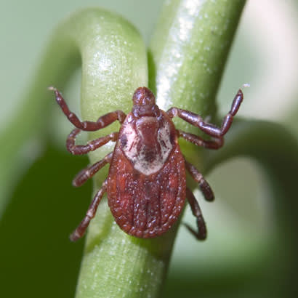
Piroplasms are Vector-Transmitted
Invertebrate-vector hosts (often referred to as intermediate host but are actually the definitive host!)
Vertebrate Hosts
(often referred to as definitive hosts but are the intermediate hosts)
Notes:
I won’t ask you to differentiate these as definitive or immediate hosts. I may for other apicomplexa, though.
Definitive hosts are the host where sexual replication occurs and for these tick-borne apicomplexa, this occurs in the tick

Slide 6
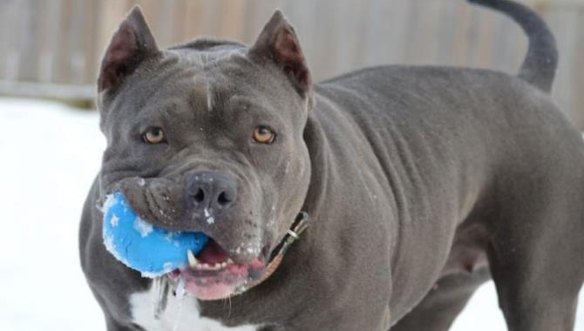
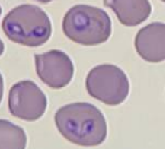
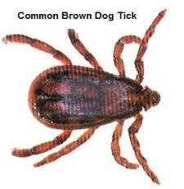
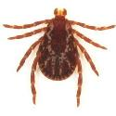
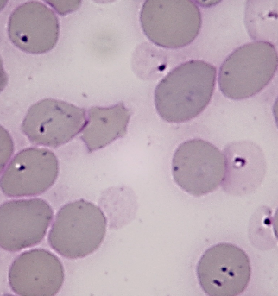
Babesia spp.
Canine* piroplasm
Anemia/Thrombocytopenia
Indirect Life Cycles
-Tick-borne disease
* There are Babesia spp. that infect other mammals too
https://houndsavers.org/adopt-a-greyhound/

Slide 7
Learning Objectives: Babesia spp.
Life cycle: know that it is an indirect life cycle and the specified life cycle details.
Transmission: know how B. vogeli and B. gibsoni are primarily transmitted.
Pathogenesis: know the 2 highlighted causes of disease
Clinical signs: know the 6 specified common clinical / laboratory findings for babesiosis and the difference in disease severity between acute and chronic infections.
Diagnosis: know the 3 ways we can diagnose babesiosis, and of the 3, which is the most useful and why.
Treatment: Understand that treatment is different for large Babesia vs. small Babesia.
Epidemiology: know the risk factors for canine babesiosis, and understand which breeds are more commonly infected with which Babesia spp.

Slide 8
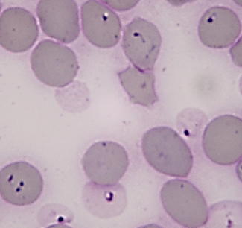
She has Canine Babesiosis
Molly is a 4-year-old female spayed American Staffordshire terrier who presents to the NCSU VHC Small Animal Internal Medicine service for decreased appetite and lethargy.
Thrombocytopenia and anemia.

Slide 9
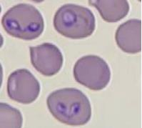
Babesia spp. that infect dogs
Babesia species | Size | Tick Vector | Reported Distribution
B. canis | Large | Dermacentor spp. | Europe
B. vogeli (B. canis vogeli) |  | Rhipicephalus sanguineus | Worldwide
B. rossi |  | Haemaphysalis elliptica | South Africa
B. coco |  | Amblyomma americanum? | North America
B. gibsoni | Small | Haemaphysalis spp. | Worldwide
B. conradae |  | ? | California
B. vulpes (B. microti-like) |  | ? | Europe and North America
FYI this chart, except B. vogeli and B. gibsoni

Slide 10
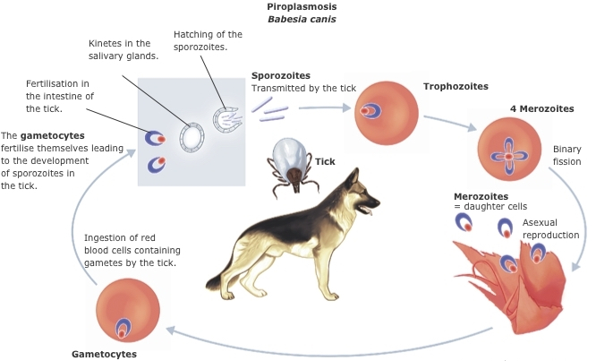
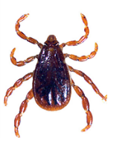
Indirect Life Cycle: Babesia
Notes:
Know Babesia has an indirect life cycle (requires tick and dog host); the tick vector transmits Babesia sporozoites through a tick bite which infect host erythrocytes throughout the dog. It’s important to know this because those infected erythrocytes will be an important cause of the pathology and disease seen in the dog.

Slide 11
Indirect Life Cycle: Babesia
Canine Vertebrate Host
Transmission
Sporozoites injected by tick host
Dog-to-dog (B. gibsoni)
Invasion -- Sporozoites invade erythrocytes
Asexual reproduction
Merogony→merozoites burst out of the erythrocytes and infect other erythrocytes
Sexual reproduction (FYI)
Some merozoites exit the erythrocytess, infect others, and go through gametogony (production of pre-gametes).
The pre-gametes within the RBCs are then ingested by a tick host with its blood meal.

Slide 12
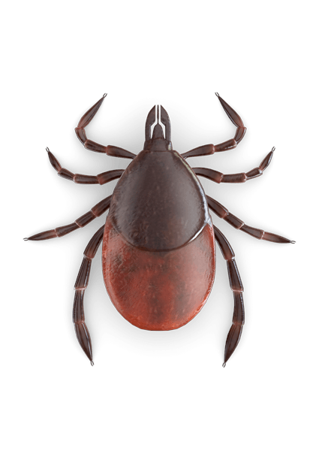
Indirect Life Cycle: Babesia
Tick Invertebrate Host (aka Vector)
Transmission – Pre-gametes are ingested by Tick host
Fertilization – Microgametes fertilize Macrogametes in the tick gut
The resulting zygote goes through Sporogony
Sporozoites invade various tick organs and cells
Salivary glands => transmission to the next dog
Ovaries => Transovarian & Transstadial transmission (depends on tick spp.)
Transovarian = parasite from mother tick to offspring (trans-generational)
Transstadial = tick retains parasite infection throughout its life stages - from egg to larvae to nymph to adult tick
When the tick feeds it transfers sporozoites to the dog host.

Slide 13
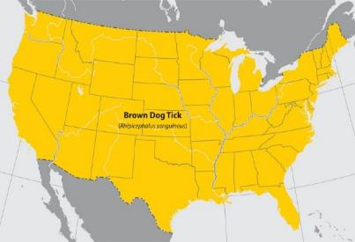
Transmission: Babesia in US
Babesia vogeli
(AKA B. canis or B. canis vogeli)
Babesia gibsoni
Rhipicephalus sanguineus
Haemaphysalis spp.
United States?
Ticks?
Dog bites / fighting
Blood transfusion
Notes:
Know that B. vogeli is transmitted by Rhipicephalus sanguineus and B. gibsoni is transmitted primarily by dog bites or fighting and blood transfusion in the US.
Babesia canis vogeli is now just referred to as B. vogeli.
In the united states, you will often here B. vogeli referred to as B. canis. Long story but B. canis used to be classified into 3 subspecies (B. c. vogeli in US, B. c. canis in Europe and B. c. rossi in Africa). They have since be designated individual species. So we have B. vogeli in US, B. canis is in Europe and B. rossi in Africa.
In Asia, Haemaphysalis ticks transmit B. gibsoni. In the US B. gibsoni was found primarily in fighting breed dogs (pitbull breeds) because some infected dogs were brought over from asia. We don’t know if there are ticks here that can transmit B. gibsoni. But there are dogs infected with B. gib, where owner swear there was never a dog bite.

Slide 14
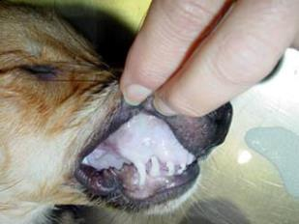
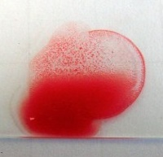
Babesiosis Pathogenesis
1. Direct destruction of erythrocytes during multiple asexual cycles is cause of disease
2. Autoimmune Reactions
Autoantibodies directed against host
erythrocytes and platelets

Slide 15
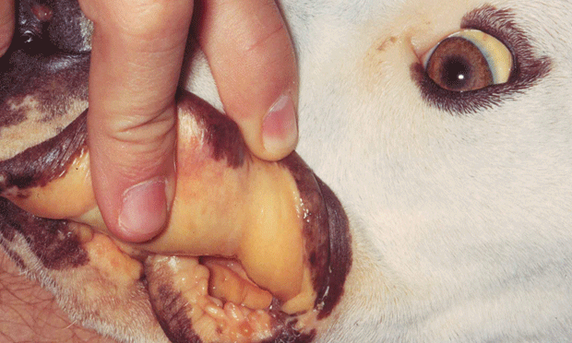
Babesiosis Clinical Signs
Acute or chronic
History
Any age dog
Lethargy
Depression
Pale mucous membranes (MM)
Discolored urine
Physical Exam Findings
Fever
Splenomegaly
Pale MM
Lymphadenomegaly
Jaundice
Normal?
Notes:
Dogs can present with acute disease (may have more severe symptoms) or they may be chronically infected, with milder symptoms.
These are some of the more common presentations and PE findings to know

Slide 16
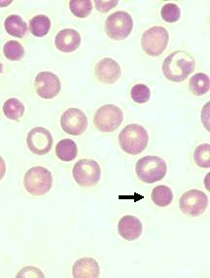
Babesiosis Hematological findings
Thrombocytopenia (more common)
Anemia
Spherocytes
If it looks like IMHA or ITP
You’d better think about Babesia!
Autoagglutination
Notes:
IMHA = immune mediated hemolytic anemia (low red blood cells, damaged RBCs = spherocytes)
ITP = immune mediate thrombocytopenia (low platelets)

Slide 17
Babesiosis Biochemical findings
+/- Hyperglobulinemia
+/- Hyperbilirubinemia
+/- Increased liver enzymes (mild)
+/- Mild azotemia
+/- Metabolic acidosis
No pathognomonic biochemical findings!

Slide 18
Babesiosis Diagnosis
Parasite visualization
Serology (testing for antibodies)
PCR (will allow you to speciate the Babesia spp.)
All 3 tests are useful, but PCR is probably the “best test” if you choose only 1
Notes:
Why is knowing the species important? You will learn when you see treatment options.

Slide 19
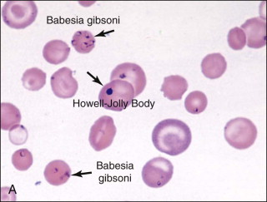
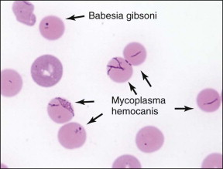
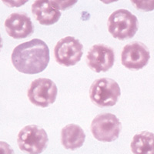
FYI: Babesia Parasite Visualization
Diff-Quik stain with oil immersion
Capillary blood = ear or toenail
Look at the entire slide(s)
False positives (artifacts etc)
Not very sensitive (a negative slide exam does not rule out babesiosis)
water artifact
Notes:
Howell–Jolly bodies are nuclear remnants

Slide 20
Babesia Parasite Visualization
Babesia vogeli (large)
Babesia gibsoni (small)
Large
Small
Notes:
Know that B. vogeli is a large Babesia and B. gibsoni is a small Babesia

Slide 21
Babesia Serology
Serology is not species-specific
Antibodies against B. vogeli may cross-react with B. gibsoni test (vise versa)
You can’t speciate an infection with serology
There are not always antibodies present in an infected dog at time of testing
Run acute and convalescent titers

Slide 22
Babesia PCR Testing
A positive PCR is consistent with infection
DNA sequencing of PCR product can determine the infecting Babesia species
A negative PCR = true negative OR the parasite load is too low to be detected (false negative)

Slide 23
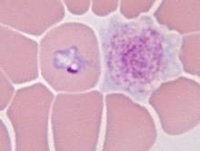
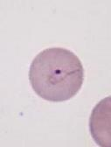
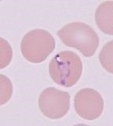
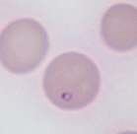
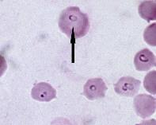
Babesia Diagnostic Summary
All Dots in Red Blood Cells Are Created Equal (can’t speciate by microscopy!)
Microscopy and serology are NOT able to definitively identify the species of Babesia
Molecular testing (PCR, DNA sequencing) is required to differentiate Babesia
It’s better to do microscopy, PCR and serology for all species
If you can only do one test, PCR
If trying to confirm negative, ideally obtain two consecutive negative tests

Slide 24
Why should you care so much about speciating Babesia infections?

Slide 25
Treatment: Babesia spp.
Babesia species | Piroplasm Size | Recommended Rx
B. canis | Large | Imidocarb dipropionate
B. vogeli (B. canis vogeli)
B. rossi
B. coco
B. gibsoni | Small | Azithromycin + Atovaquone
B. conradae
B. vulpes
Optimal treatment is different for large vs. small Babesia spp.
Notes:
Knowing the species is important when choosing the optimal treatment.

Slide 26
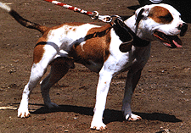
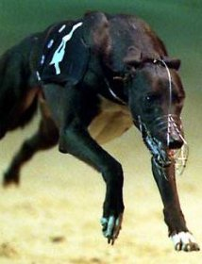
Babesia Epidemiology
Worldwide distribution (B. gibsoni and B. vogeli)
Not Zoonotic
Any dog breed can become infected
Breed
Babesia vogeli (greyhounds)-R. sanguineus kennel ticks
Babesia gibsoni (APBT) –dog-to-dog transmission
Dog bite (APBT)
Exposure to ticks
Transfusions
Splenectomy
Risk Factors for Canine babesiosis
APBT = American Pit Bull Terrier
Notes:
When dogs have been splenectomized, it’s harder for them to clear a potential infection so these animals will often be chronically infected even with treatment.
B. vogeli is prevalent in greyhounds because of their life living in kennels in between racing. We know B. vogeli is transmitted by R. sanguineus (AKA kennel ticks, which like to live in dry, indoor environments).

Slide 27
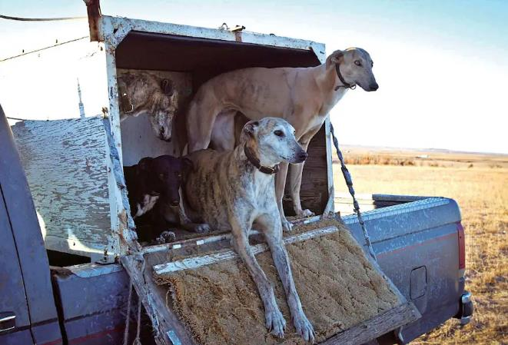
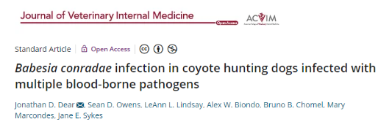
Babesia Epidemiology
Greyhounds and Babesia conradae
Aggressive interactions with other canids may play a role in B. conradae transmission.
Dogs take a break from a Coyote hunt. (Scott Squire/Courtesy of University Press of Mississippi). https://www.washingtonpost.com/news/in-sight/wp/2015/12/17/the-beauty-and-controversy-of-hunting-coyotes-with-hounds/
FYI

Slide 28
Babesiosis Take-Home Points
This disease can be Acute or Chronic
Thrombocytopenia more common than anemia
Pit Bulls, Greyhounds, Ticks
PCR best way to definitively diagnose
Correct identification (by PCR) needed for best treatment

Slide 29
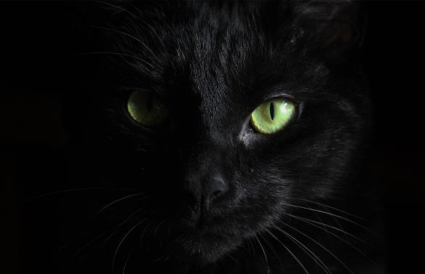
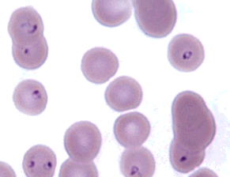
Cytauxzoon felis
Feline piroplasm
Severe Feline Disease
Indirect Life Cycle
-Tick-borne disease
Notes:
Dermacentor variabilis and Amblyomma americanum

Slide 30
Learning Objectives: Cytauxzoon felis
Life cycle: know that it is an indirect life cycle and the specified life cycle details.
Transmission: know it is transmitted by ticks (specifically A. americanum and D. variabilis).
Pathogenesis: know disease is related to direct destruction and inflammation. Understand how schizont-laden macrophages cause disease in cats.
Clinical signs: know the 3 specified clinical / laboratory findings for cytauxzoonosis.
Diagnosis: know the 2 main ways we can diagnose cytauxzoonosis
Treatment: know that treatment affords ~60% survival and the cat will require a lot of supportive care.
Epidemiology: know where this disease is most prevalent and that outdoor cats are at higher risk

Slide 31
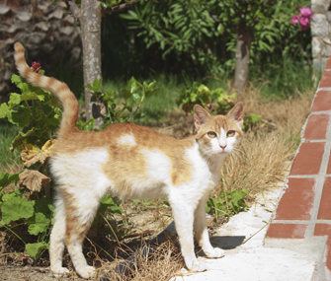
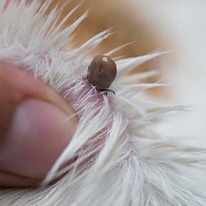
Thinkstock
Whirley is 14-month-old FS DSH cat who lives in NC, is primarily indoors but is allowed to go outside during the day.
7-day history of lethargy, fever and vomiting
She presents to the NCSU VTH ER recumbent
An engorged tick was attached
CBC showed marked pancytopenia (anemia, neutropenia, thrombocytopenia)
Feline Cytauxzoonosis

Slide 32
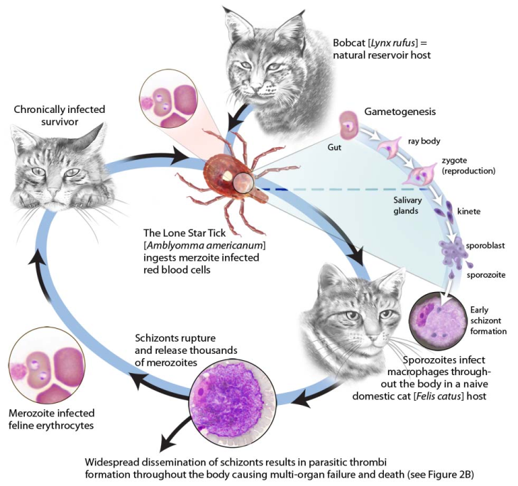
Indirect Life Cycle: Cytauxzoon felis
Bobcat Natural Reservoir hosts (asymptomatic)
= know
Sexual Repro and Sporogeny
Domestic cat aberrant hosts (symptomatic)
Notes:
Know C. felis has an indirect life cycle (requires tick and cat host); the tick vector transmits C. felis, sporozoites through a tick bite which infect host macrophages and disseminate as schizonts (remember what those are?) throughout the cat. It’s important to know this because those schizonts will be a main reason for the pathology and disease seen in the cat.
FYI: owners will ask how long it takes to transmit disease from a tick attachment. It’s different for different pathogens.
One study showed transmission time of C. felis from A. americanum was between 36 – 48 hours and that ingestion of the tick was not a likely route of transmission.

Slide 33
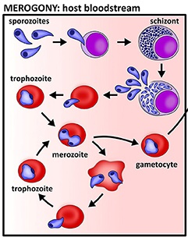
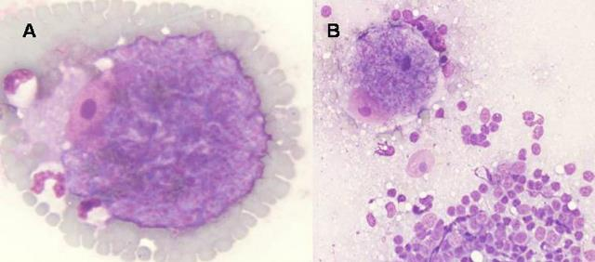
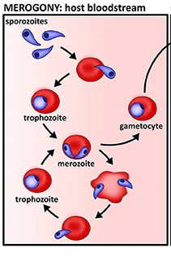
Indirect Life Cycle: Cytauxzoon felis
Cytauxzoon in the cat
WBCs and RBCs
Schizonts inside monocytes at feathered edge of a blood smear
Babesia only in the dog in RBCs
Schizonts infect monocytes and macrophages
Notes:
From this slide, understand that infected macrophages are schizonts. These infected macs will play a big role in pathogenesis

Slide 34
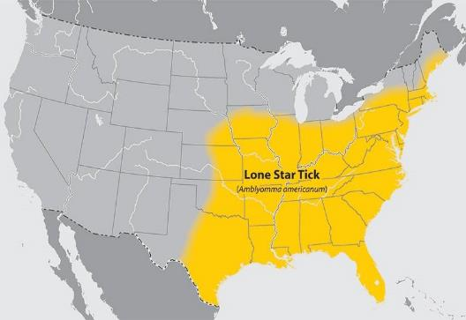
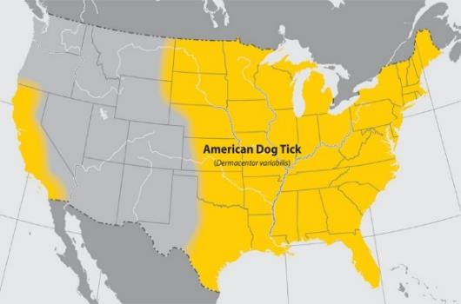
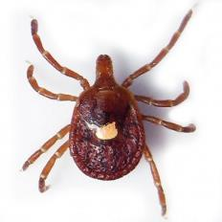
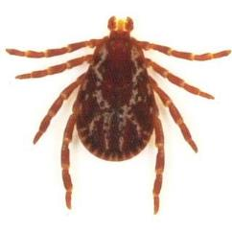
Transmission of Cytauxzoon felis
Amblyomma americanum
Dermacentor variabilis

Slide 35
Cytauxzoon felis Pathogensis
Direct destruction
Widespread dissemination of schizont-laden macrophages → become lodged in vessels → multi-organ failure and death
Inflammation → strong inflammatory response
Infection of cats with merozoites stages in RBCs only results in minimal disease
Most of the clinical signs and death are due to the schizogenous phase
Notes:
This schizongenous phase is when asexual reproduction occurs leading to expansively large macrophages (up to 250µm)
Know the bolded information

Slide 36
Schizont-laden Macrophages in vessels
https://agri.ohio.gov/wps/portal/gov/oda/programs/animal-disease-diagnostic-lab/news-and-events/feline-cytauxzoonosis
Macrophages laden with C. felis schizonts in vessel lumens of a section of liver (left) and lung (right) from a 6-year-old DSH cat that died from this infection.

Slide 37
Cytauxzoonosis: Clinical Signs/History
Acute febrile disease
Access to outdoors
History of ticks
Lethargy
Dyspnea
Neurologic disease
Jaundice / icteric
FYI:
Some evidence for subclinical infections of domestic cats
Whirley is icteric

Slide 38
Whirley’s CBC
Anemia:
PCV: 17% (32 – 48)
PP: 5.3 G/DL (6.8 – 8.3)
WBC: 3.3x10³ (4.28 – 14.3)
Plt: 60x10³ (198 – 434)
Segs: 660/ul (2.773 – 6.975)
Hypoproteinemia:
Leukopenia:
Thrombocytopenia:
Neutropenia:
pancytopenia
Notes:
Know that pancytopenia (multiple cell lines are low) as a major clinical sign for cytauxzoonosis

Slide 39
C. felis: Laboratory Findings
CBC
Leukopenia
maybe leukocytosis
Thrombocytopenia
Anemia
Organisms
Serum Biochemistry
Elevated liver enzymes
Not always severe
Hyperbilirubinemia
Hyperglycemia
Hypoalbuminemia
Azotemia (pre-renal)
Electrolyte/acid-base disorders
Pancytopenia
Notes:
Know that pancytopenia and hyperbilirubinemia are common finding in Cytauxzoonosis

Slide 40
C. felis: Diganostics
PCR (stat if available)→ very sensitive
NO serology tests
Blood smear to look for organisms (not very sensitive but may get immediate diagnosis)
Piroplasms and/or Schizonts (feathered edge of blood smear)
Notes:
Know that PCR and Blood smear are the two diagnostic tests to confirm C. felis infection. This disease needs to be diagnosed quickly! OR you might consider proceeding with treatment if all the clinical signs, tick exposure, region add up to = cytauxzoonosis. You won’t always see piroplasms or schizonts and PCRs can be falsely negative.

Slide 41
Are these clumped platelets on blood smear exam?

Slide 42
Closer examination… this is a schizont!
Remember this?
Schizonts contain many
schizozoites

Slide 43
These are clumped platelets

Slide 44
You may also see piroplasms in RBCs

Slide 45
Course of events following C. felis infection of cats
Entire process is very quick
Signs begin 12-15 days after infection
Progress from ADR → coma in days
Tissue schizonts accompany the illness
Piroplasms may or may not be evident
Death within 5 days of clinical signs is typical
Without treatment, almost all cats die from cytauxzoonosis.
Notes:
FYI but may give you better picture of this disease

Slide 46
Cytauxzoonosis Treatment
Atovaquone and
Azithromycin
~60% survival
Demonstrated to have efficacy against related protozoan parasites
Supportive Care
Avoid all of it with
TICK PREVENTION
Notes:
Just know that with treatment and supportive care, there’s ~ 60% survival. And in most cases, it takes a lot of supportive care ($$$) for many days

Slide 47
Atovaquone /Azithromycin Full-scale Trial (FYI)
An open-label, randomized prospective study compared survival in cats treated with atovaquone (15 mg/kg PO q 8 hrs) and azithromycin (10 mg/kg PO q 24 hrs) or imidocarb (3.5 mg/kg sc)
80 acutely ill cats with confirmed Cytauxzoon felis infection treated at one of 18 veterinary clinics in 4 states
Notes:
FYI

Slide 48
Atovaquone /Azithromycin Full-scale Trial (FYI)
32 of 54 cats (60.5%) treated with A&A survived
7 of 27 cats (26%) treated with imidocarb survived
Clinical data was not available for most cases
NCSU cats were VERY VERY VERY SICK!!!
ICU patients, needed oxygen therapy, treatment for shock, etc.
Clinical recoveries were NOT rapid, patients slowly recovered after 4-7 days of intensive care
Mild hemolytic anemia during second week
Notes:
FYI

Slide 49
But….
Atovaquone /Azithromycin Full-scale Trial (FYI)
By 10-14 days after discharge these cats were acting COMPLETELY normal
There was complete resolution of hematological and biochemical abnormalities during follow-up visits
Detection of parasites post-treatment was variable
Survivors continued to do well 5 years post-treatment
Notes:
FYI

Slide 50
Cytauxzoon felis Epidemiology
Not Zoonotic
World-wide distribution
Outdoor cats at higher risk for disease
US Geographical location = Southeast, Midwest
FYI
Pittsboro
Southern Pines
Wang et al. Clinical microbiology reviews, 30(4)
coastal
North Carolina
Birkenheuer et al. JAVMA 2006;228(4)
Shock et al. Vet Parasitol, 2011;175(3)
Notes:
Know that this disease is prevalent in the Southeast and Midwest US and outdoor cats are at higher risk for exposure.
FYI hotspots in NC
Birkenheuer AJ, Le JA, Valenzisi AM, et al. Cytauxzoon felis infection in cats in the mid-Atlantic states: 34 cases (1998-2004). JAVMA 2006;228(4):568-571.
Shock BC, Murphy SM, Patton LL, et al. Distribution and prevalence of Cytauxzoon felis in bobcats (Lynx rufus), the natural reservoir, and other wild felids in thirteen states. Vet Parasitol 2011;175(3-4):325-330.

Slide 51
Notes:
FYI: This tick is expanding northward. Just because you may practice in NE, don’t think your cats are safe!

Slide 52
Highest prevalence in spring and summer
Cytauxzoon felis Seasonal Distribution

Slide 53
Cytauxzoon felis Prevention
Acaricides (without permethrin)
Preventatives tested against A. americanum
Seresto (imidacloprid and flumethrin collar)
Revolution Plus (selamectin and sarolaner topical solution)
Other tick preventatives probably effective
Notes:
Two products, approved for use on cats in the United States, have demonstrated efficacy for blocking the transmission of C. felis to cats by preventing or interrupting feeding of infected A. americanum: Seresto (imidacloprid and flumethrin collar) and Revolution Plus (selamectin and sarolanertopical solution)
Reichard, Mason V., et al. "Efficacy of a topical formulation of selamectin plus sarolaner against induced infestations of Amblyomma americanum on cats and prevention of Cytauxzoon felis transmission." Veterinary parasitology 270 (2019): S31-S37.
Reichard, M.V.; Thomas, J.E.; Arther, R.G.; Hostetler, J.A.; Raetzel, K.L.; Meinkoth, J.H.; Little, S.E. Efficacy of an imidacloprid 10%/flumethrin 4.5% collar (Seresto (R), Bay

Slide 54
Cytauxzoon Take Home Points
Acute Febrile Illness
Outdoor access
Pancytopenia
Hyperbilirubinemia
Blood smear and stat PCR!
Diagnose and treat quickly!
60+% Survival
Tick-borne disease, Southeastern, Midwestern US

Slide 55
Discussion Questions
A dog (or cat) presents to you with a fever and multiple ticks attached.
What CBC abnormality is most common in tick-transmitted piroplasmids?
You can only run 1 tick-borne disease diagnostic test…which one would you choose?

Slide 56
Have Questions?
barbara_qurollo@ncsu.edu
Illustration by Allie Brosh, http://hyperboleandahalf.blogspot.com/

