Slide 1

VMP 930
Veterinary Parasitology
Platyhelminthes
Flatworms

Slide 2
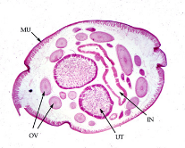
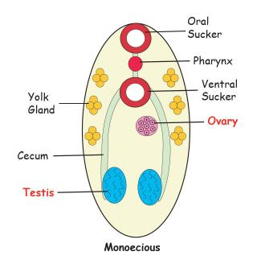

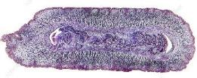
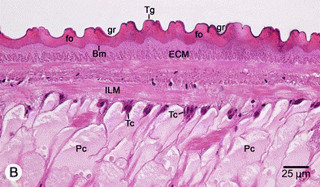
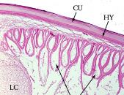


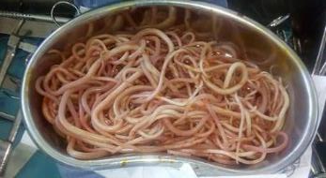
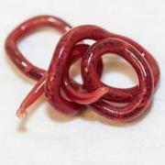
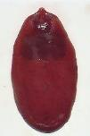
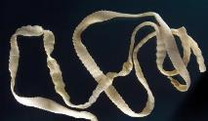
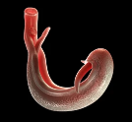
Nematoda
v/s
Platyhelminthes
A’
A
B
B’
C’
D
C
D’
Roundworm (N) ?
OR
Flatworm (P) ?
P
Blood Flukes
(dioecious exception)
P
Taenia
P
Fascioloides
N
Dioctophyme
N
Ascaris
(from 14-year-old)
Notes:
Nematoda
A - Pseudocoelomate
B – Dioecious
C – Secreted Cuticle
D – Complete GI tract
Platyhelminthes
A’ - Acoelomate
B’ – Monoecious
C’ – Living Tegument
D’ – Incomplete GI tract

Slide 3
Platyhelminthes Groups
Class Turbellaria = Planarians
Class Monogenea = Monogeneans
Class Trematoda = Flukes
  Subclass Aspidogastrea
  Subclass Digenea
Class Cestoda = Tapeworms
Notes:
There are 4 main Platyhelminthes classes
Class Turbellaria – the free-living planarians
Class Monogenea – the parasitic monogeneans
Class Trematoda – the parasitic flukes, including the Aspidogastreans and the Digenetic Trematodes
Class Cestoda – the tapeworms
Later lectures will focus on members of the Digenetic Trematodes and the Cestodes.

Slide 4
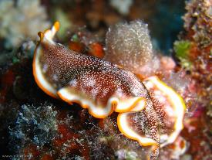
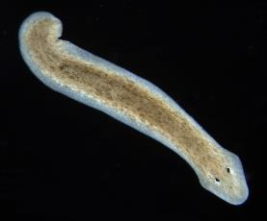
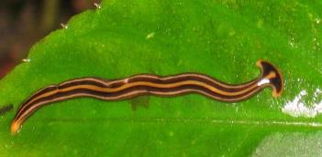
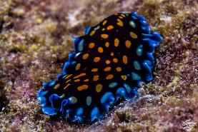
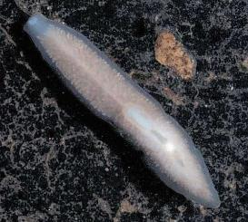
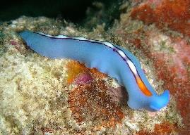
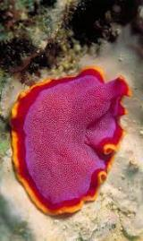
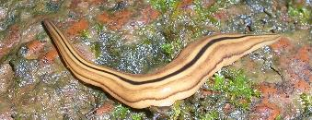
Class Turbellaria
Planarians
Free-living Flatworms
Bipalium (Hammerhead worm)
a pseudoparasite
Freshwater Flatworms
Land Flatworms
Marine Flatworms
Notes:
The Turbellarians, also called planarians are free-living flatworms.
Examples are the freshwater planarian, Dugesia, which is often an example used in basic biology classes.
The colorful Marine flatworms often found on coral reefs.
And terrestrial flatworms, such as Bipalium.
Although a free-living flatworm, Bipalium does have a connection with parasitology. These worms are often eaten by pets then regurgitated or the worm is seen in the pet’s water bowl or in the pet yard. Owners, thinking that Bipalium is a parasite, often sends specimens to veterinarians for identification. Such suspect but non-parasitic organisms are called pseudoparasites.

Slide 5
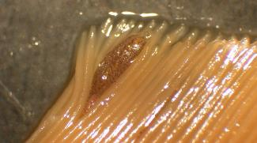
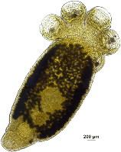
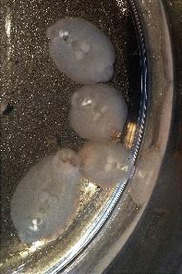
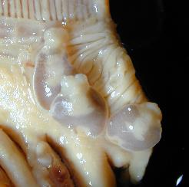
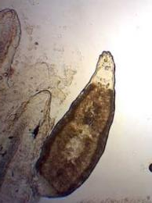
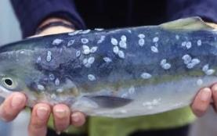
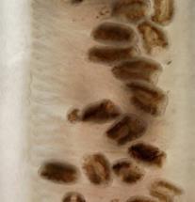
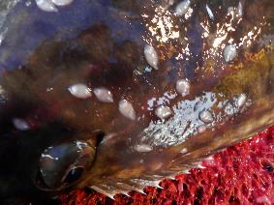
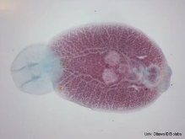
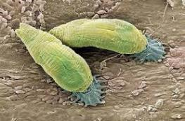
Class Monogenea
Veterinary Importance
Gyrodactylus sp.
Polystomum sp.
Benedinia sp.
Ecto-Parasites of Fish
Monogenetic flukes
Notes:
The Monogeneans are important ectoparasites of fish and other aquatic animals.
Their posterior holdfast organs, called opisthaptors, often have hooks, anchors, suckers, and /or chitinous clamps.
The holdfast organs, as well as the worm grazing on the skin or gills, cause much irritation. To counter this irritation the fish may produce excessive amounts of gill mucus, that may essentially suffocate the fish.
Although these are important parasites for aquarists and aquaculturists, we will not discuss these further.

Slide 6

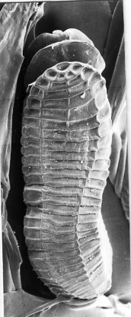
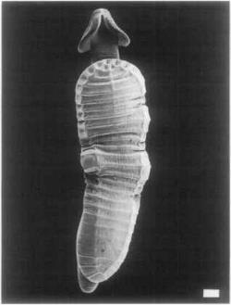
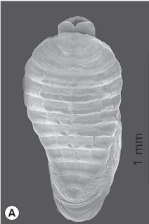
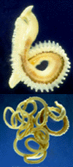
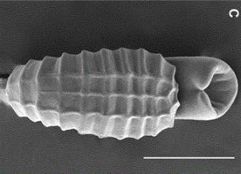
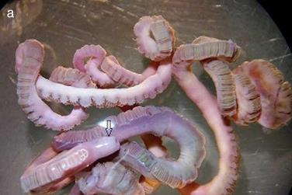
Class Trematoda
Subclass Aspidogastrea
Aspidogaster sp.
Cotylogaster sp.
Lobatostoma sp.
Ecto-Parasites of Mollusks, Fish, Reptiles
Notes:
The Aspidogastreans are a small group of ectoparasite of clams, snails, fish and turtles. The large ventral holdfast organ is their most prominent feature. These worms are of evolutionary interest, but little veterinary importance.

Slide 7
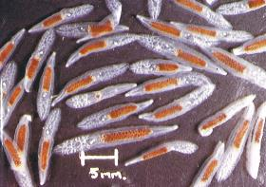
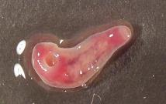
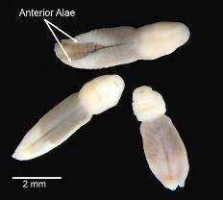
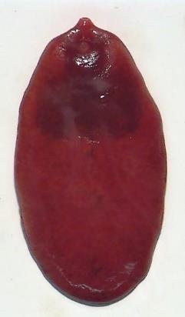
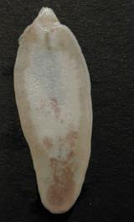
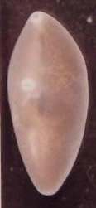

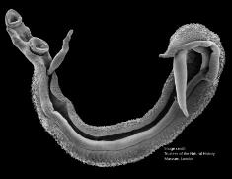
Endo-Parasites of Vertebrates
Class Trematoda
Subclass Digenea
Veterinary Importance
Fasciola sp.
Paragonimus sp.
Heterobilharzia sp.
Digenetic flukes
Notes:
The Digenetic Trematodes are important endoparasites of all groups of vertebrates and are a group of veterinary importance. Certain pathogenic species will be discussed in this course.

Slide 8
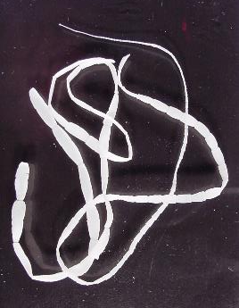
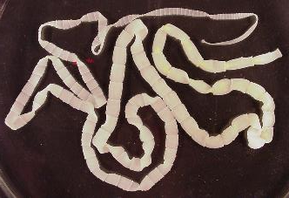
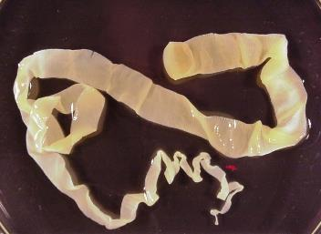
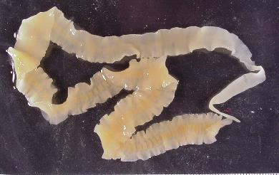
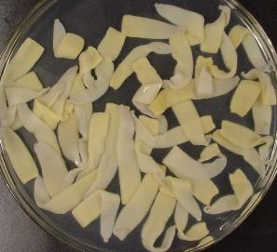
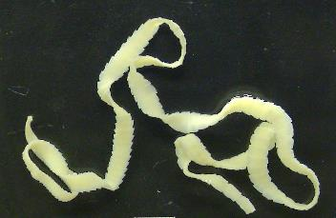
Taenia sp.
Dipylidium sp.
Anoplocephala sp.
Veterinary Importance
Class Cestoda
Tapeworms
Notes:
The Cestode or Tapeworms are important endoparasites of all groups of vertebrates and are a group of veterinary importance. Certain pathogenic species will be discussed in this course.
Taenia sp. is a common parasite of carnivores.
Anoplocephala sp. is a common parasite of horses.

Slide 9
Digenetic Trematodes

Slide 10
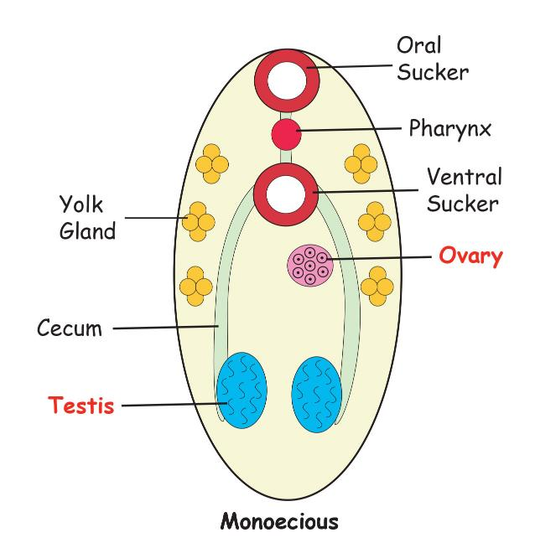
Digenetic Trematodes
Digenea (di = two), (genea = beginnings)
Sexual Reproduction => Adult worms in definitive host
Asexual Reproduction => Larval worms in snail host
Morphology
1. General Flatworm Characteristics
2. Suckers and/or holdfast organs
3. Incomplete gut
4. Reproductive organs
(testes, ovary, vitellaria)
Notes:
This lecture is for information only, you will not be tested on specific content within this lecture
You should gain a general understanding of the digenetic trematodes: -- their general morphologic characteristics and their basic life cycle.

Slide 11
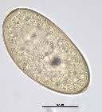
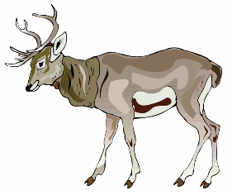






Complex Life Cycle
Digenetic Trematodes
1. Definitive Host
a. Adult Worms (Sexual Reproduction)
2. Environment
a. Ovum (Distribution)
b. Miracidium (Distribution)
3. Snail 1st Intermediate Host
a. Sporocysts and/or Rediae (Asexual Reproduction)
4. Environment
a. Cercaria (Distribution)
5. 2nd Intermediate Host or Environment
a. Metacercaria (Transmission)
Notes:
One of the most unique characteristics of digenetic flukes is their very complex life cycles, with multiple life stages and at least 2 animal hosts.
The basic digenean life cycle is as follows:
Adult worms live in the definitive host where sexual reproduction occurs, and eggs are produced.
Ova are distributed throughout the environment, usually in the host’s feces
Within the ova, a larval stage called a miracidium develops. For some flukes, when the egg enters water, the ciliated miracidium hatches and swims through the water in search of a snail host.
Within the snail host, many larval stages (called sporocysts and redia) are produced asexually by internal budding.
Eventually another larval stage, the cercaria is produced. The cercaria, meaning tail-bearing, leave the snail host and utilizes its tail in search of a 2nd intermediate host or environmental substrate.
On the environmental substrate or within the 2nd intermediate host, the cercariae develops into an encysted infective stage, the metacercaria.
After being ingested by the definitive host, the metacercaria excysts and develops into an adult worm.

Slide 12
Client Education
A cattleman is very concerned that he has lost much profit because of the condemnation of his cattle’s livers. He was told by the abattoir meat inspector that many of his steers had “flukey livers”. It is determined that the fluke is Fasciola hepatica. Using the Fasciola hepatica life cycle illustrated in the next slide, explain the life cycle, as you would to your client.

Slide 13


Slide 14
Digenean Groups
In general, flukes are grouped by their habitat within the definitive host.
Small Animals
Liver Fluke & Pancreatic Fluke
Platynosomum (cats)
Eurytrema (cats)
Lung Fluke
Paragonimus (dogs, cats)
Intestinal Fluke
Nanophyetus (dogs)
Blood Fluke
Heterobilharzia (dogs)
Large Animals
Liver Flukes
Fasciola (ruminants)
Fascioloides (ruminants)
Dicrocoelium (ruminants)
Intestinal Fluke
Acanthatrium (bat/horse)
Notes:
This slide lists the specific fluke parasites that we will be discussing in this course.
Notice that the common name of many flukes corresponds to the habitat of the adult worm within the definitive host.

Slide 15


Trematodes = Zebras
Most of the time
Geography plays an important role in fluke diagnostics.
Fluke endemicity is tied to the geographic range of their snail hosts.
When beginning practice in a new area, consult with experienced vets and/or extension agents to be aware of endemic fluke diseases.

Slide 16
The Liver Flukes
Fasciola hepatica
Fascioloides magna
Dicrocoelium dendriticum
Notes:
The following lectures on Trematodes will be used for quizzes & exams.

Slide 17


Fasciola hepatica
Common Liver Fluke
Life Cycle HIGHLIGHTS
Aquatic
Definitive Hosts -- Cattle, Sheep, Goats & Camelids
  Liver & Bile Ducts
Pond / Puddle snail hosts
“2nd Intermediate Host” -- Semi-aquatic Vegetation
Juvenile flukes migrate throughout liver parenchyma (→ Acute DZ)
Adult worms live in the bile ducts (→ Chronic DZ)
Zoonosis
Human Fascioliasis
  Europe, Africa, Cuba, South America
Halzoun (accidental zoonosis)
  Ingestion of raw liver
  Adult flukes attach to naso-pharynx
  Middle East

Slide 18


Fasciola hepatica
Geographic Distribution
https://www.wikiwand.com/en/Fasciola#/Geographic_Distribution
Orange - Worldwide distribution
Red - Most impacted by Fascioliasis
In USA
  Gulf Coast States, Pacific Northwest, Eastern Canada
  Not endemic in North Carolina (WHY?)
Dr. Foster_Liver Disease of Ruminants – VMP 962 lecture
Notes:
Fasciola are widespread and inhabit 70 countries and parts of all continents except for Antarctica. The regions most impacted by Fasciola are the northern Andes and the Mediterranean region.
Even in non-endemic areas, knowledge of livestock origins (Herd History) would be helpful with evaluating diagnosis.
Currently the absence of F. hepatica’s snail host in North Carolina has excluded endemicity of fascioliasis in NC.

Slide 19




Fasciola hepatica
Pathology: Acute DZ
Pathology is density dependent
  Depends on number of infective larvae ingested
  Due to larvae migration in liver parenchyma
Acute (mainly an issue for Sheep & Goats)
  > 2000 infective larvae over a short period
  Seasonal issue in sheep and goats
  Severe liver damage, hemorrhage, inflammation
  CS: Distended, painful abdomen; unwilling to stand; acute anemic pallor; sudden death
Subacute
  500 - 1500 infective larvae over a longer period
  Death is not sudden
  Extended period of liver damage prior to death
  Death due to hemorrhage and anemia
Acute: sudden death
Subacute: depression, weakness
Acute: anemic pallor
? What is a much more common parasite in small ruminants that causes these same clinical signs?
Distended, painful abdomen, unwilling to stand
Hemorrhagic tracts, pale liver,
Gall bladder filled with blood
Notes:
Acute and subacute is a clinical / pathology issue.
Acute and subacute Fascioliasis is the direct result of the liver damage / trauma caused by migrating juvenile flukes; (not the adult flukes in the bile ducts).
If an acute fascioliasis is the premier infection, would eggs be seen on fecal diagnostics?

Slide 20





Fasciola hepatica
Pathology: Chronic DZ
Clinical Signs
  Cattle - usually subclinical DZ
    Chronic diarrhea, weight loss, bottle jaw
  Small ruminants & Camelids - usually clinical DZ
    Unthriftiness, rough hair coat, loss of condition, weakness, anemic pallor, bottle jaw.
Chronic (small ruminants, camelids & cattle)
  200 – 500 larvae over a long period
  Due to adults in bile ducts
  Progressive liver damage
  Anemia, hypoproteinemia
  Bile duct fibrosis, stenosis
    Eventual calcification
      Pipe stem bile ducts
? What is a much more common parasite of cattle that causes these same clinical signs?
Fibrous tracks from the previous migrations of immature flukes
Chronic diarrhea & weight loss
Bile duct calcification
”Pipe-stem liver”
Bottle Jaw
Bile duct Stenosis
Notes:
In Cattle, chronic Fascioliasis is usually an economic issue, causing loss of productivity as well as liver condemnation at the slaughterhouse.
In Sheep, Goats and Camelids, chronic Fascioliasis presents as as a clinical disease, often leads to death.
Would eggs be seen on fecal diagnostics?

Slide 21

Fasciola hepatica
Production Consequences
Cattle
  Economic loss
    poor doers & liver condemnation
      Reduced feed conversion, weight loss, reduced milk production, etc.
      Liver Condemnations – ordered rankings:
        Puerto Rico, FL, NV, OR, ID, UT, WA, CA
Small ruminants and camelids
  Acute DZ -- sudden death
  Chronic DZ -- poor doers

Slide 22



Fasciola hepatica
Diagnostics
Fecal Sedimentation
  Chronic infections
ELISA
  Blood or fecal
  Acute or Chronic infections
Liver enzymes
  elevated GGT (Gamma-glutamyl transferase)
Herd History
  Geographic origins
Farm Observations
  Ponds / puddles / swamps in pastures?
Necropsy
  Acute – hepatic hemorrhage and juveniles in the parenchyma
  Chronic – bile duct stenosis and adults in the bile ducts
Any sign of potential Fasciola infection?
Indistinct operculum
Fasciola eggs - Large, yellow to tan, operculate eggs
Even tractor ruts can be habitat for snail hosts

Slide 23

Fasciola hepatica
Treatment & Control
True or False.
Ivermectin is an excellent dewormer against Fluke or Tapeworm infections.
Common Flukicides
Clorsulon (Curatrem & Ivomec Plus)
  Kills adults and migrating juveniles
Albendazole (Valbazen Suspension PI)
  Kills adults only
Strategic deworming is key to fluke control
  Considerations for Strategic Deworming
    Whole cattle herd manipulations are time consuming & expensive.
    Some treatments only kill adult flukes = 1.5 to 2 months post-infection
    Most livestock losses occur 5-6 months post-infection
  Treat at the end of the transmission period
    Gulf States
      Transmission is in the winter thru early summer
      Treat in mid-summer to late summer
    Northwest
      Transmission is highest in late spring thru fall
      Treat in Winter
Snail Control (unrealistic)
Grazing Control
  Restrict access to wet areas
Notes:
Although Fasciola hepatica’s prepatent period is 2 months, the expense & time of whole cattle herd manipulations make treatments every 2 months untenable.
Remember to always check restrictions and withdrawal times.
Since the discovery of the life cycles of human fluke diseases (especially Schistosomiasis (blood fluke DZ)), there has been efforts to control snails, but none have worked completely. Some snails survive treatments, other snails are transported on birds to repopulate bodies of water.

Slide 24


Fasciola-associated diseases
Some bacterial diseases of livestock are associated with the hepatic migrations of the juvenile flukes.
Bacillary Hemoglobinuria
Infectious Necrotic Hepatitis
Necrosis from juvenile fluke migrations allows Clostridium novyi type B to cause Black Disease
Primarily a disease of sheep & goats
Acute Death
  Depression, fever, tachypnea just prior to death
Necrosis from juvenile fluke migrations allows Clostridium hemolyticum to cause Red Water Disease
Primarily a disease of cattle
Acute Death
  Depression, fever, tachypnea, hemoglobinuria, and icterus prior to death
  Reddish urine
Notes:
Clostridial toxins are the direct cause of Black Disease or Red Water Disease.
The use of clostridial vaccines has reduced this disease.

Slide 25


Fascioloides magna
Giant American Liver Fluke
Live flukes recently necropsied from a deer liver.
Life Cycle HIGHLIGHTS
Aquatic
Definitive Hosts -- Cervids (deer, elk)
  liver cavitations
Pond / Puddle snail hosts
2nd Intermediate Host -- Semi-aquatic Vegetation
Young flukes migrate through liver parenchyma before maturing in cysts with connections to bile ducts
Dead-end Hosts (dead-end for fluke)
  Sheep, Goats, Camelids: migration of young flukes cause liver damage & death
  Cattle: Adult worms walled off in fibrotic cysts.
Not Zoonotic
Notes:
Fascioloides magna is commonly called the Giant American Liver Fluke
These flukes are as large as 3 inches long.
Practice explaining Fascioloides magna’s life cycle in the way that you would explain it to a client. Especially, how it infects / threatens their livestock.
Important points
Small ruminants, camelids and cattle are dead-end hosts for Fascioloides magna. Dead-end hosts = hosts in-which the parasite cannot complete its life cycle (i.e. host is a dead-end for the parasite.)
In small ruminants and camelids, juvenile flukes migrate through the parenchyma of the liver causing a severe traumatic hepatitis which results in sudden death. => no fluke eggs are produced.
In cattle, adult worms are walled off in fibrotic cysts. => no fluke eggs can exit the liver.

Slide 26


Fascioloides magna
Geographic Distribution
Mainly endemic in wild cervid populations
Scattered throughout US
Prevents goat & sheep production in Minnesota & Michigan
Sporadic in white-tailed deer in North Carolina
  Recent goat, sheep, camelid, cattle infections in NC
Notes:
Important points
Fascioloides magna is endemic in scattered area’s in the US and Canada, especially in cervid populations.
North Carolina has many disjointed endemic areas and seems to be spreading in the state. Cases of Fascioloides magna in North Carolina have been reported and becoming more prevalent.
FYI -- Fascioloides magna was introduced into Europe with the import of elk from North America, into game reserves of Europe. F. magna has become endemic in a few European countries.

Slide 27




Fascioloides magna
Pathology
Wild Cervids
  Liver cavitations containing adult flukes and melanoid (hematin) fluid
  Subclinical, unless very, very heavy infection
  (118 flukes from 1 deer, but not debilitated) (Pursglove et al. 1977)
Parenchymal, encapsulated, cavitated lesions, Fascioloides magna, liver. Black excretory pigment (hematin) deposited by the fluke.
Sheep, Goats, & Camelids
  Severe liver damage, hemorrhage, inflammation, sudden death
  Juvenile migratory trauma may precipitate "black disease"
Cattle
  Subclinical, minor damage, unless very heavy infection
  Liver Condemnations
Two Fascioloides from a fibrotic cavitation.
Melanoid (hematin) tracts from migrations.
Live Fascioloides magna flukes necropsied from the livers of 2 white-tailed deer.
Notes:
In sheep, goats, and camelids; hepatitis, hemorrhage, and death caused by the migrations of juvenile flukes in the liver parenchyma.
Trauma caused by these migrations may precipitate the clostridial disease called “black disease”.
In cattle; the adult flukes are walled off.

Slide 28



Fascioloides magna
Diagnosis, Treatment, Control
Snail Control (unrealistic)
Grazing Control
  Restrict livestock access to wet areas
  Restrict wild cervids access to wet pastures
Wild Cervids
  Fecal Sedimentation
  Necropsy
  Treatment
    Clorsulon (Curatrem);
    Albendazole (Valbazen)
Fascioloides egg from deer feces
Melanoid tracts on surface of liver at necropsy
Domestic Ruminants
  (non-patent)
  Necropsy
  Wet pastures shared with wild cervids.
  No good treatment

Slide 29
In-Class Discussion
You are a large-animal vet in eastern North Carolina. An accountant, recently turned cattleman, is very concerned that he has lost much profit because of the condemnation of his cattle’s livers. He was told by the abattoir meat inspector that many of his steers had “flukey livers”.
Worm differentials?
Contrast necropsy results?
Contrast herd history, diagnostics, & farm visit observations?

Slide 30



Dicrocoelium dendriticum
Lancet Fluke
Hosts
  Terrestrial (1st – Land Snails & 2nd - Ants)
  Small Ruminants (Sheep & Goats) – bile ducts
  Variety of Hosts (cattle, camelids, rabbits, pigs, cervids, etc.)
Geographic Distribution
  Widely Distributed around the World
  Northeast US & Canada
Pathology
  Non-pathogenic in younger animals
  Bile duct hyperplasia, hepatic cirrhosis
  Chronic wasting disease.
  Decreased productivity in older animals (ewes)
Diagnosis
  Edema & emaciation in older stock
  Ova in sedimentation
Treatment
  Albendazole, Praziquantel
Control
  Eradicate Ant hills
Zoonosis
  Yes - a few human cases
Notes:
Dicrocoelium dendriticum is commonly called the Lancet Fluke because of its pointed posterior and anterior ends.
These flukes are the smallest (approx. 8 mm) of the 3 liver flukes of livestock.
The internal organs (testes, ovary, uterus, and vitellaria (yolk glands)) are easily discernable.
Although the definitive hosts are mainly small ruminants, other animals may also become infected, including humans.
In the US, endemic areas are found in the Northeastern states.
Each fluke is rather small and causes minimal pathology.
Most cases of young livestock are sub-clinical.
Pathology is usually due to a chronic progressive pathogenesis, especially in older livestock, which have been infected for an extended period and have an ever-increasing fluke population.

Slide 31
Lab Exam: Practice Setup
Wednesday, November 01 @ 10am
to
Thursday, November 02 @ 10am
21 (uncovered) microscopes set up
5 (covered) available for studying arthropod slides
DO NOT use 100x objective
Last person turn off microscopes Please.

Slide 32
Lab Exam: Rules
Check in & check out
Cannot take the exam with an earlier group
Each group can start early only if the previous group has left.
Turn in exam at card for last name
Do not move slides
Do not switch objectives, all are already on 40x
You can fine focus up and down

Slide 33
Lab Exam
Thursday, November 02 w/ assigned group in B104D
Microscope identifications (25 stations @ 4 pts / question)
  Nematodes – 10
  Cestodes – 2
  Trematodes – 2
  Protozoa – 2
  Mites – 3
  Ticks – 1
  Lice – 3
  Fleas - 1
  Free Parking -1

Slide 34
To Contemplate is to Exercise the Intellect
If you choose; contemplate the following “in the mirror”:
“When our emotions restrain reason and make it their slave, we cannot see how others are using us as pawns in an ideological game.”
--- Thomas Aquinas
“Beware those who would weaponize your compassion for their own ideological motives” --- Noelle Mering

