Slide 1
VMP 930 Veterinary Parasitology
Lung Fluke
Blood Fluke
Minor Flukes

Slide 2
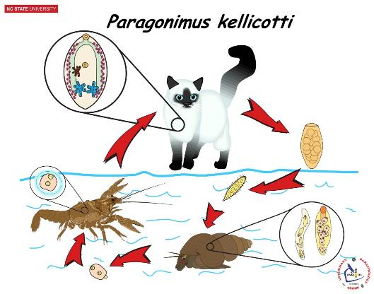
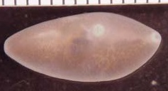
Paragonimus kellicotti Lung Fluke of Pets
Life Cycle HIGHLIGHTS
Aquatic
Definitive Hosts -- Dogs & Cats (Pigs, Raccoon, Mink, etc.)
Lung Parenchyma
River snails
2nd Intermediate Host -- Crayfish
Zoonosis
Paragonimus kellicotti
Wildlife lung fluke in North America
Zoonosis has been reported.
Human infection from eating raw or undercooked crayfish
Paragonimus westermani
human lung fluke in orient
Geographic Distribution
Throughout North America
Cases in North Carolina (dogs, cats, mink, raccoons, bobcats)
Notes:
This is the Life Cycle of Paragonimus kellicotti. Practice explaining this life cycle, but in the way that you would explain it to a client. (Try not to explain “over their heads” but be sure to include the important points so they understand your control advice. [But also be prepared to give a more in-depth explanation if the client asks questions.]

Slide 3
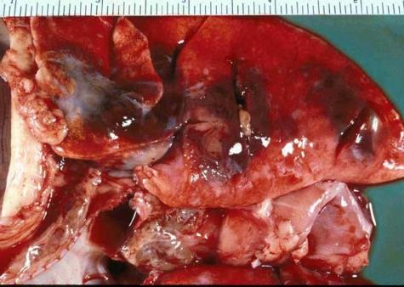
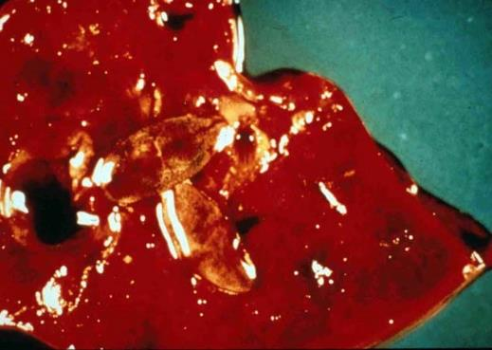
Paragonimus kellicotti Pathology
Bronchiolar inflammation
Eosinophilic granulomas in the lung parenchyma.
Rare instances of acute Pneumothorax & sudden death
2 Adult flukes
Fluke Cysts

Slide 4
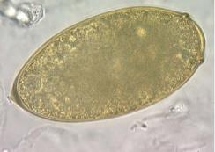
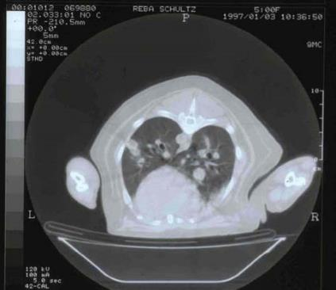
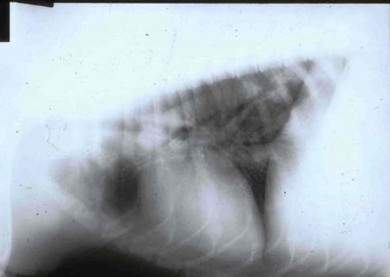
Paragonimus kellicotti Diagnosis
Sedimentation
Clinical signs: lethargy, chronic intermittent cough, "rusty" sputum.
Fecal Sedimentation
Sputum Smear
Radiology: radiographs; CT scan
History of possible access to crayfish
Rim around operculum
CT scan
Radiograph
[Cysts indicated by arrows]
Notes:
Paragonimus kellicotti has similar clinical signs to Heartworm.
Although sedimentation is the main diagnostic technique, one may also find eggs in rusty sputum with a direct smear.
[See CT scan] Important Point: If cysts, near the margin of the lung, rupture then pneumothorax and sudden death may occur.
(On one case I was checking the dog’s feces and before I could forward the results, the dog had a pneumothorax and died.)

Slide 5
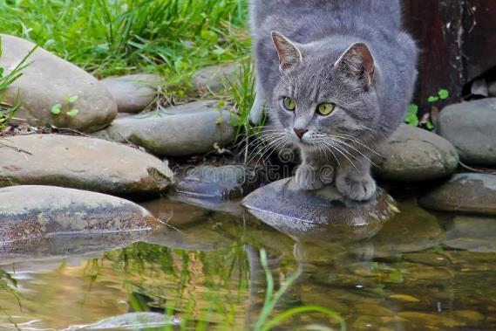
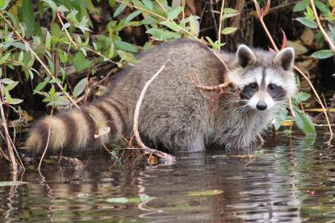
Paragonimus kellicotti Treatment & Control
Praziquantel (Droncit)
23 mg/kg TID for 3 days
Fenbendazole (Panacur)
50 mg/kg daily for 10-14 days
Albendazole
25 mg/kg BID for 10 days
Snail Control (unrealistic)
Molluscicides: check government restrictions
Environmental Control
Restrict access to crayfish (streams, creeks, rivers)
Notes:
Many common anthelminthics can be used (at increased and repeat doses) to treat Paragonimus kellicotti.
Important point: When one thinks of fluke or tapeworm infections, one should think of Praziquantel.
As these are stream / river snails, which are likely considered public water ways; it is unlikely that the government will allow use of molluscicides.

Slide 6
Class Discussion
A cat owner, from Hillsborough has brought in her 5-year-old cat to your clinic. She has noticed that her cat has developed a cough and lately has become significantly less rambunctious. The cat is indoor / outdoor and has access to the Eno River.
Respiratory Worms?
Diagnostics?
Notes:
How does the knowledge that the cat has access to the Eno River affect your differentials?

Slide 7
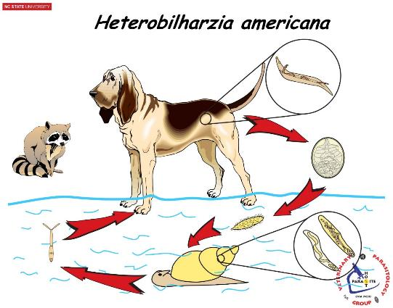
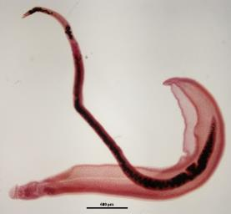
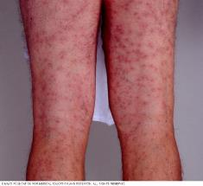
Heterobilharzia americana Blood Fluke of Dogs
Unique morphology of blood flukes
Dioecious elongate flukes.
Female resides in the gynecophoric canal of the male.
Male
Female
Geographic Distribution
Texas, Gulf Coast States, Georgia, South Carolina, North Carolina
Life Cycle HIGHLIGHTS
Aquatic
Definitive Hosts -- Dogs & Raccoons (wild canids, bobcat, nutria, etc.)
Mesenteric veins
Ova developed when passed & hatches when it enters water.
Pond / puddle snails
Skin Penetration (No 2nd Intermediate Host)
Zoonosis
Swimmer’s itch or Swamp itch
Human Blood Flukes –Schistosoma spp.
Notes:
The blood flukes (including Heterobilharzia and Schistosoma, the human blood flukes), are the only group of digenetic trematodes that are dioecious. However, the males and females are in continual copula, with the female lying in the male’s gynecophoric canal.
Important Points: What 4 things are unique about the biology of blood flukes? 1. Dioecious, 2. No 2nd intermediate host, 3. Skin penetration (not predation), 4. Non-operculate eggs
Important Points in bold:
The main reservoir host for Heterobilharzia is raccoon, but it also infects other animals including dogs.
Eggs are fully developed and ready to hatch when they are passed in the feces.
When the egg lands in water the larval stage hatches immediately and infects a pond / puddle snail.
After asexual reproduction in the snail, the next larval stage (cercaria) leaves the snail host.
Swimming, the cercaria searches for and penetrates the skin of the definitive host.
The southern states including NC, are the original endemic areas for Heterobilharzia.
However, endemic foci occur in Kansas and other midwestern states due to hunters translocating (infected) raccoons to midwestern states.
Swamp itch, also called swimmer’s itch, is a form of cutaneous larval migrans that presents like a really bad case of poison ivy.

Slide 8
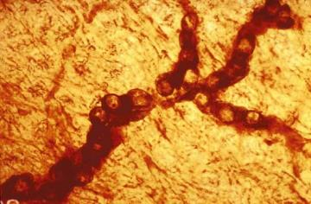
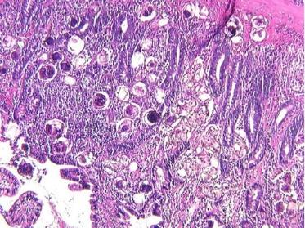
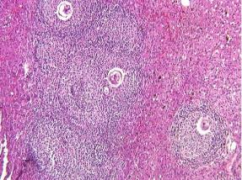
Heterobilharzia americana Pathology
Adult flukes
Minor to no pathology.
Ova
Eggs lodge in mesenteric venules
Infarctions, ischemia, destruction of intestinal mucosa.
Intestinal dysfunction that leads to wasting and death.
Eggs transported to other organs.
Granulomatous reaction in liver and other organs
Inflammation & Fibrosis around eggs and egg clusters.
Eggs in Blood Vessels
Eggs in Liver
Eggs in Intestinal Epithelium
Notes:
The Adults in the mesenteric vessels cause little to no pathology; but they produce very large numbers of eggs which lodge in mesenteric vessels causing ischemia and ischemia related pathologies. Some eggs also make it to the liver causing granulomatous & fibrotic foci.

Slide 9
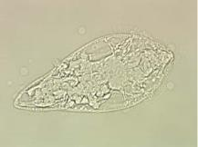
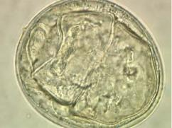
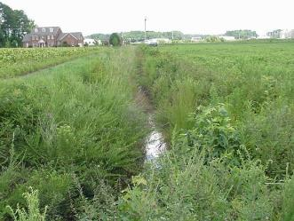
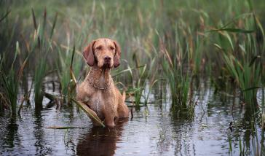
Heterobilharzia americana Diagnosis, Treatment, Control
Clinical signs: lethargy, anorexia, intermittent vomiting, bloody liquid diarrhea, dehydration.
Fecal saline sedimentation or smear.
Miracidial Hatching
Laparotomy
PCR fecal test from Texas A&M http://vetmed.tamu.edu/gilab/service/assays/heterobilharzia-americana
History of possible access to water habitats while in endemic areas.
Water-Loving Breeds
Miracidium
Egg
Fenbendazole (Panacur): 40 mg/kg daily for 10 days
Praziquantel (Droncit): 25 mg/kg daily for 2-3 days
Prevent access to freshwater habitats (ponds, lakes, streams, creeks, rivers, ditches, etc.)
Infested Habitat (Confirmed)
Notes:
To do a fecal sedimentation to look for Heterobilharzia eggs, one must use saline instead of water. If one uses water then the larvated eggs will hatch and one will lose the egg as a diagnostic stage, the saline “fools” the larvae in the eggs to “think” they are still in the dog gut – so they won’t hatch.
However, the spontaneous hatching of Heterobilharzia eggs can also be utilized for diagnostics. Miracidial Hatching – Within a flask with a long narrow neck, mix suspect feces in water . Add water to near the top of the flask neck. Let sit for 10 to 20 minutes. The eggs will hatch, and the ciliated larvae will swim to the top layer of water in the flask neck. Pipette off the top 5 to 10 mls of fluid into a petri dish. Exam fluid under a dissecting microscope and look for the motile miracidia, which look like ciliated protozoa swimming around the petri dish.
Many infections have been diagnosed through Laparotomy, because many veterinarians do not know about Heterobilharzia.
Note the roundish egg lacks an operculum (most other fluke eggs have an operculum). In living egg specimens, the larva (miracidium) will be moving inside the egg.
Extended repeat high doses of anthelmintics is required for treatment.
FYI only:
We had a case of Heterobilharzia. The golden retriever was from Greenville, NC. The dog’s house was about 100 yards from this irrigation ditch in this tobacco / soybean field. I visited this ditch and collected aquatic snails from the ditch, as well as noted raccoon tracks. Back in the lab, the snails released the forked-tailed larvae (cercaria) of Heterobilharzia. The ditch was likely a “highway” for raccoons, and being a water-loving breed, the golden retriever likely played in the ditch often. The dog was successfully treated.

Slide 10
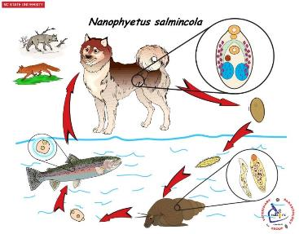
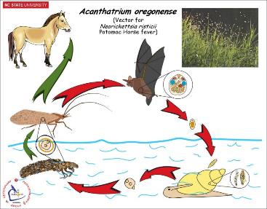
Nanophyetus salmincola Salmon Poisoning Fluke
Acanthatrium oregonense Potomac Horse Fever Fluke
FYI
Life Cycle -- aquatic
Canids (Small Intestine)
River snails
Fish (Salmon / trout)
Pacific Northwest (WA, OR, north CA)
Vector for Salmon Poisoning
Affects Canids only
Neorickettsia helminthoeca
Severe pathology - hemorrhagic enteritis
(50% to 90% mortality)
FYI
Life Cycle -- aquatic
Bats (small intestine)
River snails
Caddisflies & Mayflies
Horse (dead-end host)
Accidental ingestion of caddisflies or mayflies infected with fluke metacercariae that are infected with Neorickettsia. risticii
Sporadic throughout US
Vector for Potomac Horse Fever
Neorickettsia risticii
Colitis — diarrhea, fever, depression
Notes:
Nanophyetus
Adult Nanophyetus shows low host specificity and can infect numerous pet and wildlife species as well as man.
Although N. salmincola has a restricted geographic range, pets on vacation may become infected.
N. salmincola causes only subclinical issues. The real issue is the rickettsial organism that it carries in its tissues. The rickettsial disease, Salmon Poisoning, is a serious disease for canids.
The definitive host is infected by eating raw or undercooked fish.
By eating raw or undercooked fish, a human may become infected with the fluke, but will not be affected by the rickettsial organism.
Acanthatrium
Adult A. oregonense live in the intestine of bats. Bat feces with fluke eggs are dropped into rivers or streams.
River or stream snails are the 1st intermediate hosts. Caddisflies and Mayflies are the 2nd intermediate host – both have aquatic larval stages which become infected by aquatic fluke larvae. The aquatic stages of caddisflies and mayflies develop into adult flies which are terrestrial. The bat becomes infected when it (intentionally) ingests a caddisfly or mayfly.
While grazing, horses may accidentally ingest swarming adult mayflies or caddisflies.
Adult flukes do not develop in the horse, but the rickettsia from the fluke tissues does affect the horse.

Slide 11
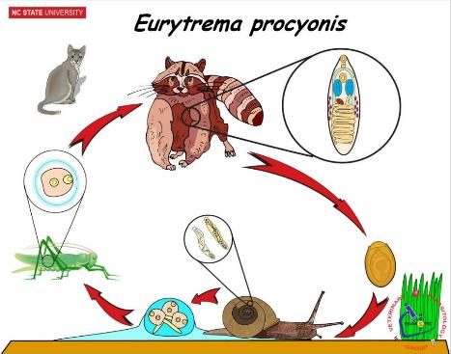
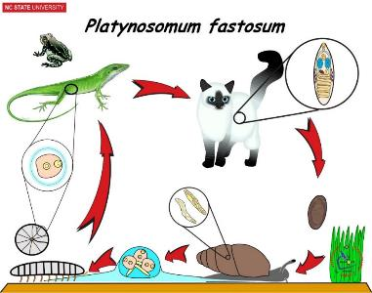
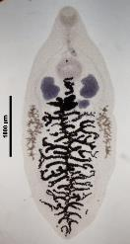
Platynosomum fastosum Bile Duct Fluke of Cats
Eurytrema procyonis Pancreatic Fluke of Cats
Life Cycle -- Terrestrial
Cats (Bile ducts)
Land snails
2nd: Roly-Poly bug
Paratenic: Lizards or toads
FL, HI, Caribbean, Malaysia, South America, Central America, Caribbean, West Africa
No pathology → mild, temporary inappetence with hepatic dysfunction → progressive icterus & possibly death. ("lizard poisoning")
Clinical signs: diarrhea, jaundice, vomiting.
FYI
Life Cycle -- terrestrial
Cats (Pancreatic duct) [Raccoons, Fox, Bobcats]
Land snails
Grasshoppers & Crickets
Sporadic (NY, CT, MD, KY, NC)
Pathology - Pancreatic duct fibrosis, Pancreatic atrophy
Clinical Signs: Vomiting & chronic weight loss
FYI
Notes:
Platynosomum
Note Platynosomum uses terrestrial snail hosts and terrestrial intermediate hosts.
Traveling with the pet cat would be a clue to put this fluke on the differential list.
Eurytrema
The main hosts are wildlife like raccoon, fox and bobcats, but domestic cats may also be infected.
Eurytrema uses terrestrial snail hosts and terrestrial intermediate hosts.

Slide 12
Wellness Break
Take a 5-minute wellness break:
One More Day
--
Eabha
(“AVA”)
https://www.youtube.com/watch?v=DQ45bOPiRnU

