Slide 1
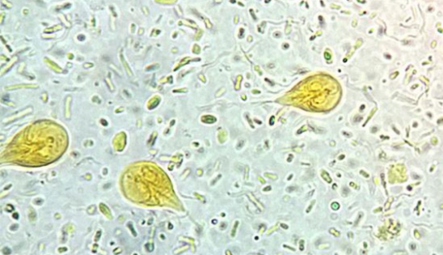
Intro to Protozoa Cases
Learning outcomes:
To gain awareness for how to work through a few protozoan cases

Slide 2
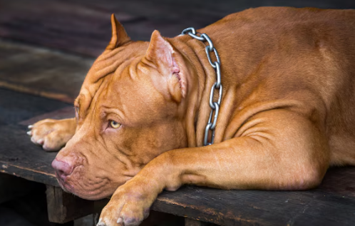
…no test questions
RELAX

Slide 3
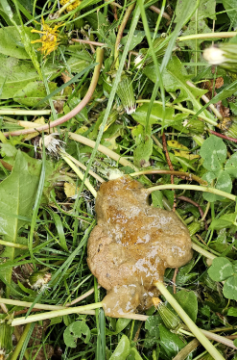
From this text, what do you know already?
Puppy
immunosuppressed? unvaccinated?
dewormed?
Hey Doc!
just got a new puppy from the shelter. Is
this normal? This is Amy Smith btw.
Around other dogs
infectious?
How’d u get my number?
Stressful environment immunosuppressed?
Hey Doc!
just got a new puppy from the shelter. Is
this normal? This is Amy Smith btw.
Nvm
No this is not normal. Please bring your new baby in to see me
Stool characteristics small bowel?

Slide 4
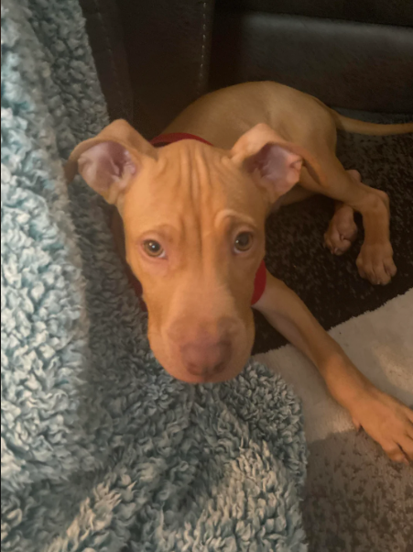
History
“Frye” 3 mo, MN viszla-pitbull mix
Recently adopted from shelter
Diarrhea was noticed as soon as he was brought home
Diarrhea ~ 3x a day, is like soft serve ice cream, no blood, no urgency, no straining
O not aware of any weight loss
Dewormed in shelter?
Not yet on HW and GI worm prevention
Appetite is good
Bright and alert, playful

Slide 5
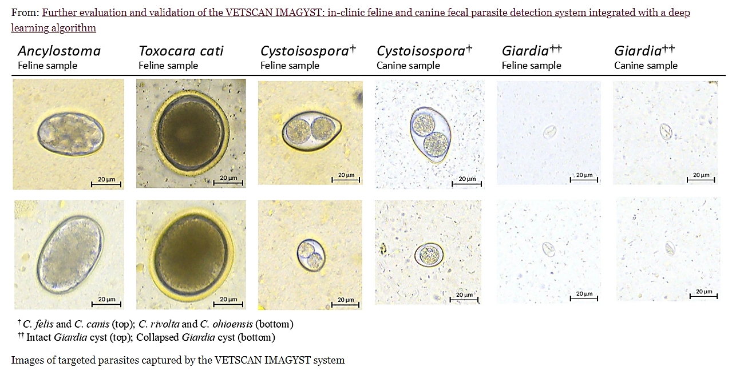
Differentials for infectious diarrhea in a puppy
Infectious organisms
Viral (Parvo, Corona, Distemper)
Bacterial (Salmonella, Campylobacter, Clostridium, E. coli
Protozoal (Giardia, Cysystoisospora)
Worms (Toxocara, Ancylostima, Uncinaria)

Slide 6
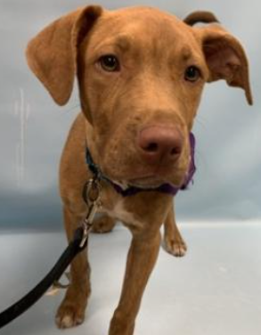
Physical examination findings
Pale, soft, loose stool
BCS 4/9
Everything else WNL

Slide 7
Diagnostics
Fecal float centrifugation
Solid stool: cyst stage
+/- Antigen detection ELISA kit

Slide 8
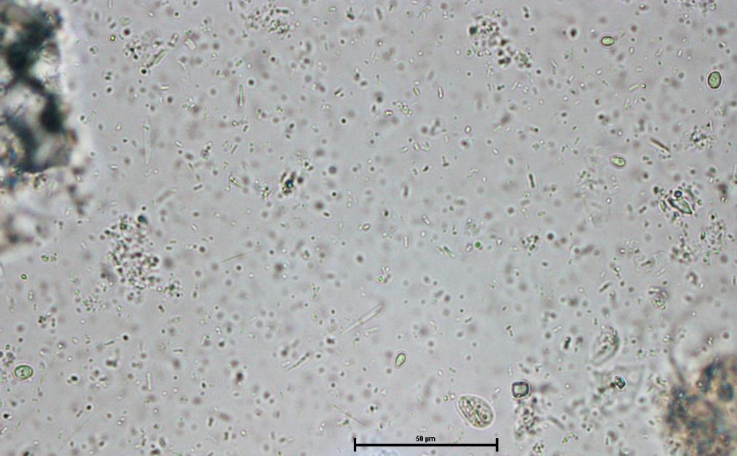
40x objective
(mag. 400x)
Giardia
Yeast
Zinc sulfate fecal flotation showing Giardia cysts and yeast

Slide 9
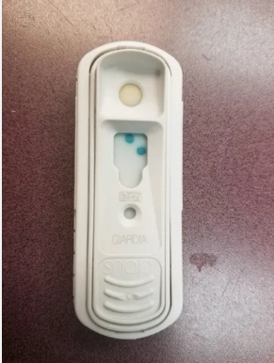
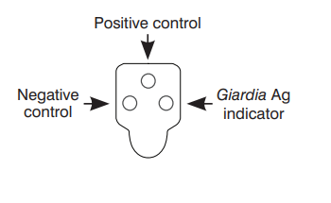
Antigen (cysts) detection kits, ELISA
Rapid in-house; ↑ Specificity
detection of soluble Giardia antigen

Slide 10
Diagnosis: Giardia
Direct microscopic fecal analysis
Loose stool: motile trophozoites on fresh wet-mounts
(don’t confuse with Tritrichomonas in cats)
Fecal float centrifugation
Solid stool: cyst stage (don’t confuse with yeast)
use fecal float centrifugation with zinc sulfate solution
Recommended for routine screening
Sensitivity
Antigen (cysts) detection kits, ELISA (IDEXX or VetScan)
Rapid in-house; ↑ Specificity
Not recommended for routine screening
PCR
KeyScreen GI Parasite (Antech); ↑ Specificity and Sensitivity; assemblage typing
Not recommended for routine screening in asymptomatic animals unless living with immunocompromised owners
Saleh, Meriam N., et al. "Comparison of diagnostic techniques for detection of Giardia duodenalis in dogs and cats." JVIM (2019).
Uiterwijk, Mathilde, et al. "Comparing four diagnostic tests for Giardia duodenalis in dogs using latent class analysis." Parasites & vectors 11.1 (2018): 439.

Slide 11
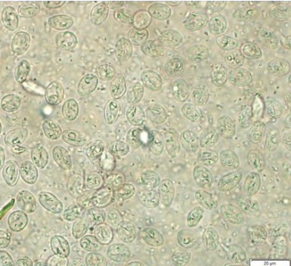
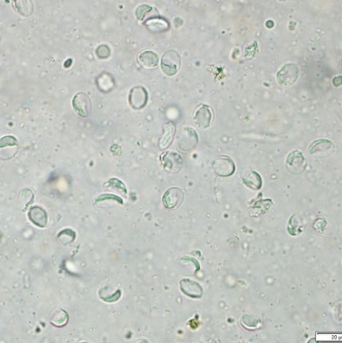
Fecal float centrifugation
use fecal float centrifugation with zinc sulfate solution
zinc sulfate solution (SG = 1.18)
Sheather's sugar solution (SG = 1.275)

Slide 12
Treatment: Giardia
Goal is to resolve clinical signs
Fenbendazole (Febantel, Drontal Plus) or Metronidazole (puppy?)
Probiotics and fiber (psyllium), bland diet
Treatment duration depends on drug but range 3-8 days
Treat only symptomatic dogs & cats to decrease development of resistance to antiprotozoal drugs.
Some animals will persistently shed cysts despite treatment and resolution of clinical signs
Companion Animal Parasite Council (CAPC) for up-to-date management recommendations (https://capcvet.org/)

Slide 13
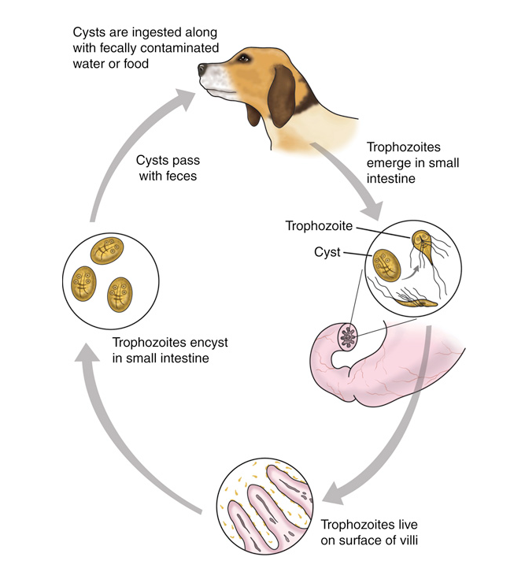
Control: Giardia
Strict prevention of fecal contamination
Outdoor environment
-pick up, dispose of feces
Indoor environments
-clean (soap/water), disinfect
-dry out cysts
Bathing contaminated fur
Notes:
FYI: Cysts can survive the following conditions
soil → cool (<39.2 °F) ~ 7 weeks; room temp ~1 week
dry, warm surface with direct sunlight ~2 days
moist, cool surface ~ 2 weeks
water → <50 °F ~3 months; >50 °F, less time, summer ~4 days

Slide 14
Treatment and recommendations
Drontal Plus 3 days
Add a scoop of unsweetened canned pumpkin to food, 2x daily
Recommended probiotic (FortifFlora)
Disinfection (details on what to disinfect and how –steam cleaning, diluted bleach)
Bathing with chlorehexidine shampoo
Post treatment diagnostics if diarrhea does not resolve

Slide 15
Treatment Follow-up: Giardia
Different Tx and look for co-infection (crypto or tritrich)
Symptomatic, Giardia (+)
Treat
Refractory Case
Symptoms resolved
Still symptomatic
Yes
No
No need for follow up
Re-infected from environmental contamination?
If contact with immunocompromised humans, confirm NEG
Fecal float and Smear NOT ELISA or PCR
24-48 hrs after tx
Giardia (+)
Giardia (-)
Other GI dz?
PCR for assemblage information
Perform 3 fecal centrifugation over 5 days

Slide 16
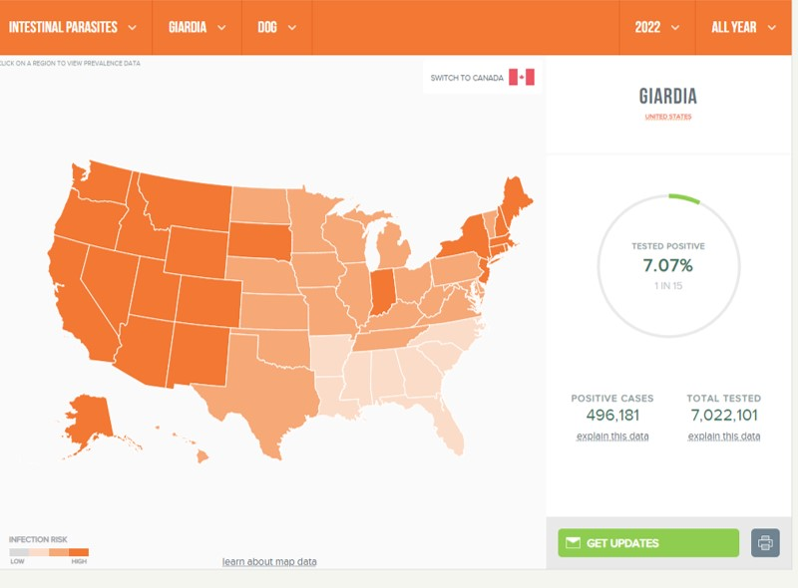
Giardia Epidemiology
Prevalence / Geography
Risk Factors
High density situations (catteries, kennels, shelters, dog parks)
Younger animals
Infected “house mates”
Risk Factors for Refractory cases
co-infections:
Giardia/Cryptosporidium
Giardia/Tritrichomonas

Slide 17
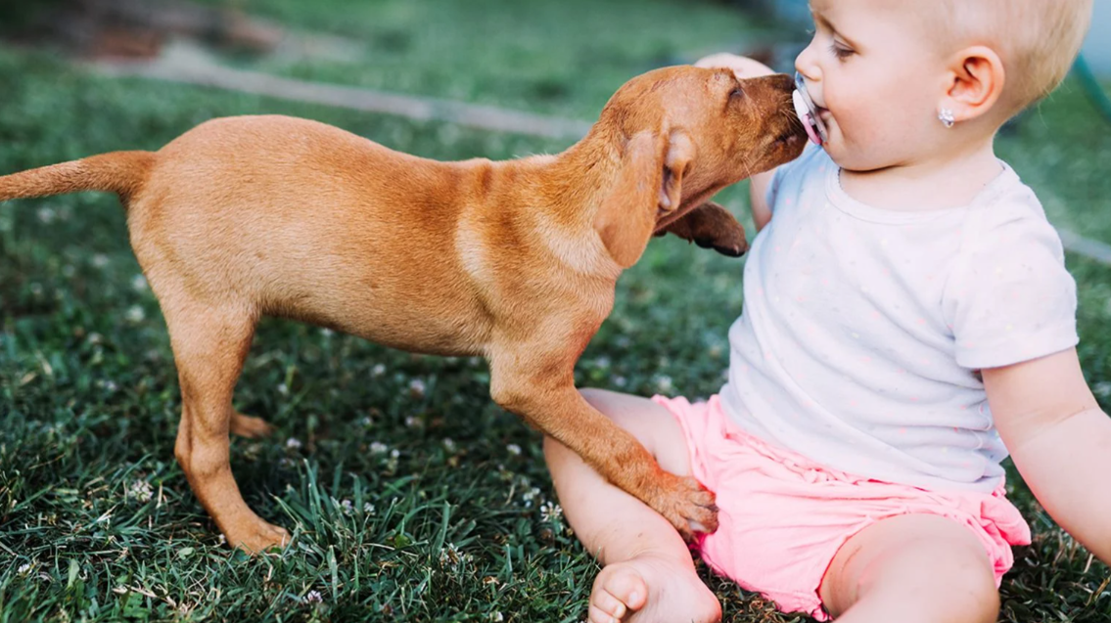
baby in to see me
Giardia Zoonosis
Giardia grouped by assemblages A-H
Most assemblages are host specific –zoonosis rare
Assemblage C & D (dogs)
Assemblage F (cats)
Some concern for immunodeficient people
Will do, thx! Isn’t she so cute!

Slide 18
Giardia Zoonosis –refer clients to CDC

Slide 19
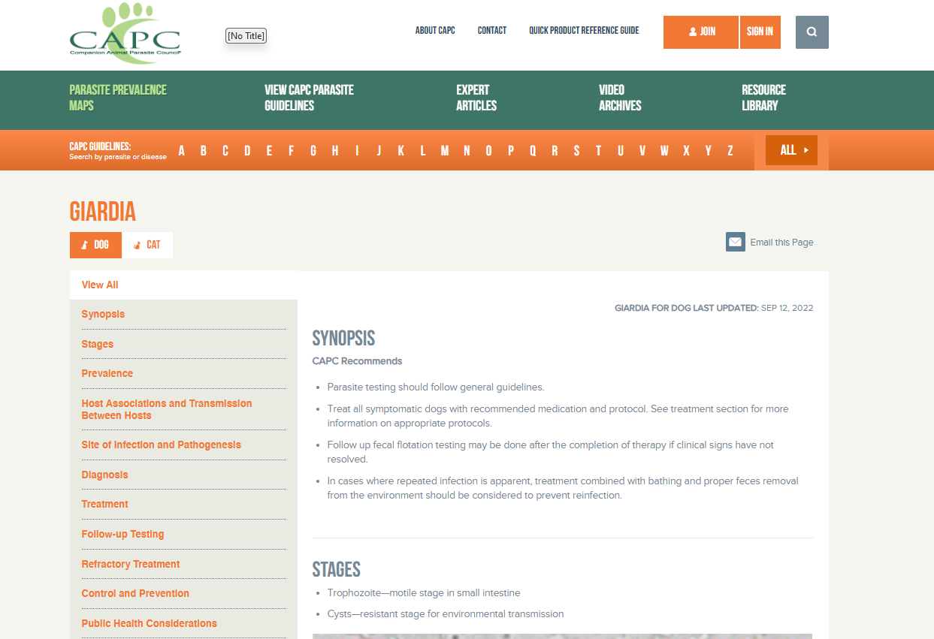
https://capcvet.org/guidelines/giardia/

Slide 20
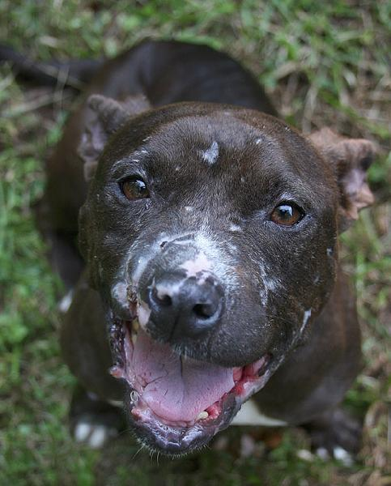
Bailey
4-year-old FS APBT
1 week history of lethargy
Got into a fight with another pit bull about 4 weeks ago

Slide 21
Physical Examination Findings
T:102.0
HR: 96 bpm
RR: 24 bpm
Pale MM
CRT <2 sec
Splenomegaly

Slide 22
Bailey’s
CBC

Slide 23
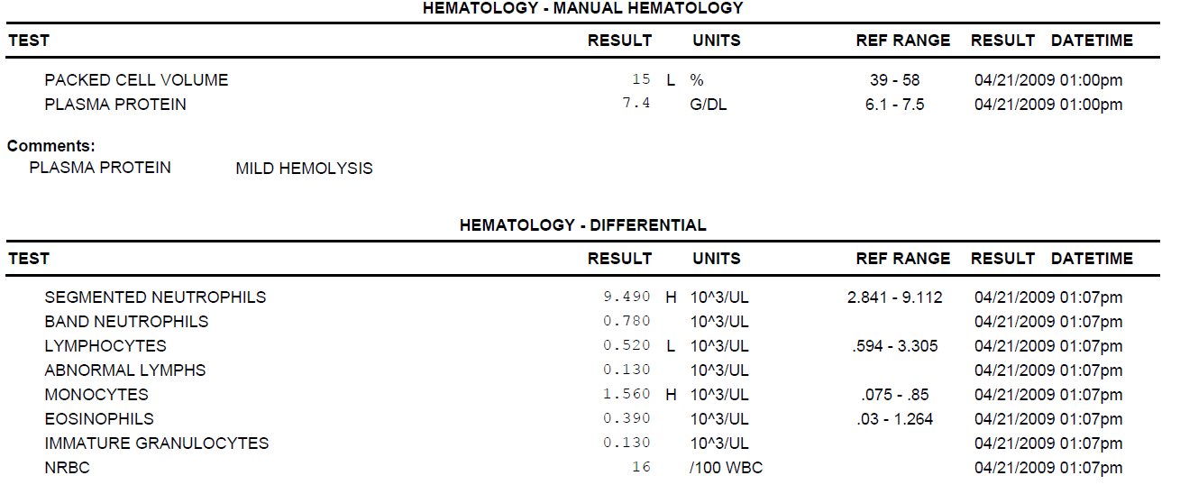
Bailey’s
CBC

Slide 24
What now?
Interpretation:
Splenomegaly
Anemia (regenerative) thrombocytopenia
mild neutrophilia
mild lymphopenia
monocytosis
Differential diagnosis:
Additional Diagnostics:

Slide 25
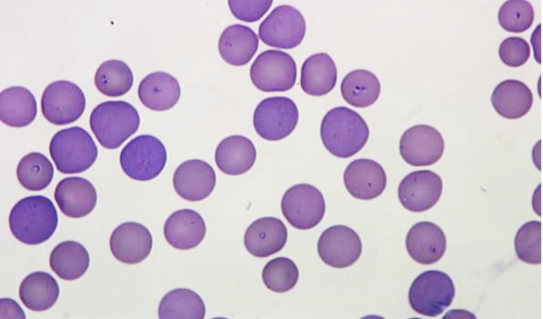
What Diagnostic tests would you choose to look for a blood-borne protozoa?

Slide 26
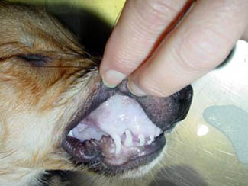
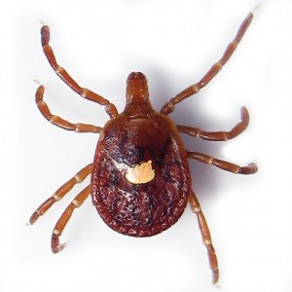
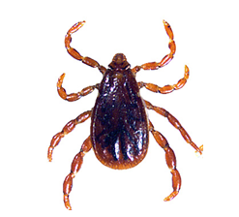
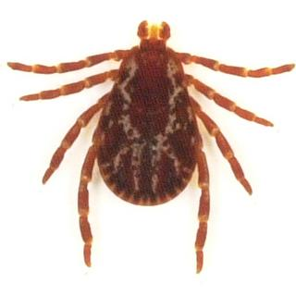
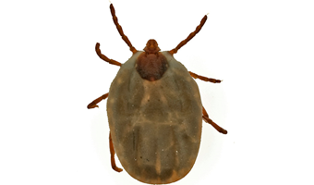
Babesia spp.
Babesia spp. are vector-transmitted protozoal parasites
Infect and replicate in blood cells
Amblyomma americanum
Dermacentor variabilis
Rhipicephalus sanguineus
Haemaphysalis spp.

Slide 27
Name the 4 types of protozoal pathogenesis we discussed

Slide 28
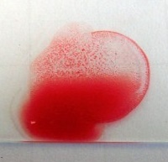
Babesiosis Pathogenesis
1. Autoimmune Reactions
Autoantibodies directed against host erythrocytes and platelets (IMHA)
2. Direct destruction of erythrocytes during multiple asexual cycles is cause of disease

Slide 29
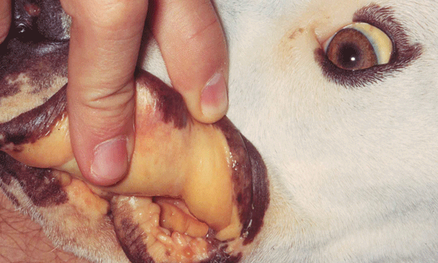
Babesiosis Clinical Signs
Acute or chronic
History
Any age dog
Lethargy
Depression
Pale mucous membranes (MM)
Discolored urine
Dog fight/bite
Tick attachment
Blood transfusion
Physical Exam Findings
Fever
Splenomegaly
Pale MM
Lymphadenomegaly
Jaundice
Normal?
Notes:
Dogs can present with acute disease (may have more severe symptoms) or they may be chronically infected, with milder symptoms.
These are some of the more common presentations and PE findings to know

Slide 30
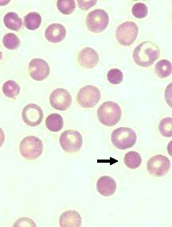
Babesiosis Common Hematological findings
Thrombocytopenia (more common)
Anemia
Spherocytes
If it looks like IMHA You’d better think about Babesia!
Autoagglutination
Notes:
IMHA = immune mediated hemolytic anemia (low red blood cells, damaged RBCs = spherocytes)
ITP = immune mediate thrombocytopenia (low platelets)
Why is thrombocytopenia more common with a pathogen that infects RBCs? It’s not clear what is causing the low platelets (thrombocytopenia) but could be:
Sequestration in the spleen
Immune-mediated destruction of platelets

Slide 31
Babesiosis Biochemical findings
+/- Hyperglobulinemia
+/- Hyperbilirubinemia
+/- Increased liver enzymes (mild)
+/- Mild azotemia
No pathognomonic biochemical findings!

Slide 32
Babesiosis Diagnosis
Parasite visualization
Serology (testing for antibodies)
PCR (will allow you to speciate the Babesia spp.)
All 3 tests are useful, but PCR is probably the “best test” if you choose only 1

Slide 33
Diagnostic Findings
PCR+ Babesia gibsoni
Piroplasms on blood smear
Serology not performed

Slide 34
Treatment: Babesia spp.
Babesia species | Piroplasm Size | Recommended Rx
B. canis | Large | Imidocarb dipropionate
B. vogeli (B. canis vogeli)
B. rossi
B. coco
B. gibsoni | Small | Azithromycin + Atovaquone
B. conradae
B. vulpes
Optimal treatment is different for large vs. small Babesia spp.
Notes:
Knowing the species is important when choosing the optimal treatment.

Slide 35
Treated with AA for 10 days
Two days post treatment
Hct = 16 → 25
Platelets = 144 → 170
Mild neutrophilia resolved
PCR (-) 60 days after tx
PCR (-) 90 days after tx
Notes:
Full hematologic recovery may take 2-4 weeks,

Slide 36
Recommendations to owners?
Tick (and HW) prevention
Avoid dog fighting
Babesia may never fully clear

Slide 37
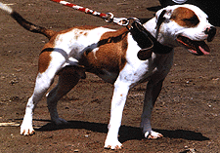
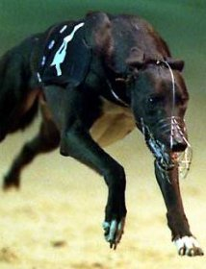
Babesia Epidemiology
Worldwide distribution (B. gibsoni and B. vogeli)
Not Zoonotic
Any dog breed can become infected
Breed
Babesia vogeli (greyhounds)-R. sanguineus kennel ticks
Babesia gibsoni (bully breeds) –dog-to-dog transmission
Dog bite
Exposure to ticks
Transfusions
Splenectomy
Risk Factors for Canine babesiosis
APBT = American Pit Bull Terrier

Slide 38
Have Questions?
baquroll@ncsu.edu
Illustration by Allie Brosh, http://hyperboleandahalf.blogspot.com/
Notes:
If you email me with a question, I will send the question and answer to the entire class but will keep you anonymous. So, don’t be shy!

