Slide 1
Lab Safety
Lab Coats
Safety Glasses
Gloves
NO Food or Drinks

Slide 2
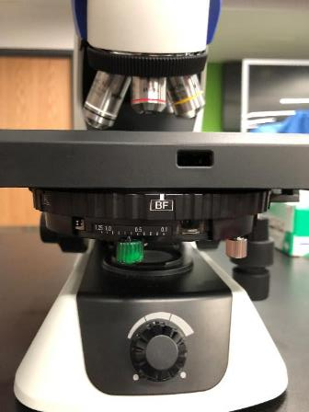
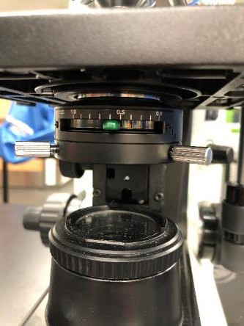
Microscope Illumination Substage Diaphragm
Marked with green paint
New Microscopes
Old Microscopes

Slide 3
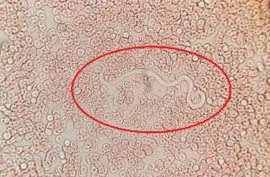
Heartworm Microfilaria diagnostics
Blood Drop
Quick & Cheap
Only about 35ul blood
=> less sensitive
Microscopy
Can visualize MF with the 4x or 10x Objectives

Slide 4
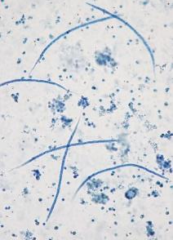
Heartworm Microfilaria diagnostics
Modified Knotts Test
Relatively quick & cheap
Use 1ml blood
=> more sensitive
Lysing Solution
2% formalin solution
H2O to lyse RBC’s
Formalin to fix MF
Microfilaria Suppression Test
Test for resistant strain of HW
Diphenhydramine + Steroids
Prevent anaphylaxis
Draw Blood for Modified Knotts test
Treat with Macrocyclic Lactone
Do Knotts test with pre-treatment blood
Count all MF from 1 ml sample
7 days later draw blood & repeat Knotts test
Results <75% reduction then suspect resistance
Microscopy
Can visualize MF with the 4x or 10x Objectives

Slide 5
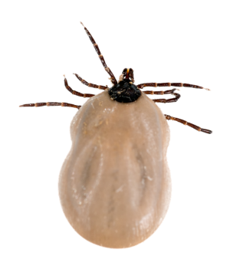
FYI
SNAP 4DX Plus (ELISA for antigen and antibody detection)
SNAP 4DX Plus is a POC ELISA that tests for vector-borne disease
Canine blood, plasma or serum is added to the device
It detects antigen from female Dirofilaria immitis (heartworm)
It detects antibodies to tick-borne pathogens
Anaplasma phagocytophilum
Anaplasma platys
Ehrlichia canis
Ehrlichia ewingii
Borrelia burgdorferi (Lyme dz)
(+) control
Anaplasma
Ehrlichia
Heartworm (HW)
Lyme

Slide 6
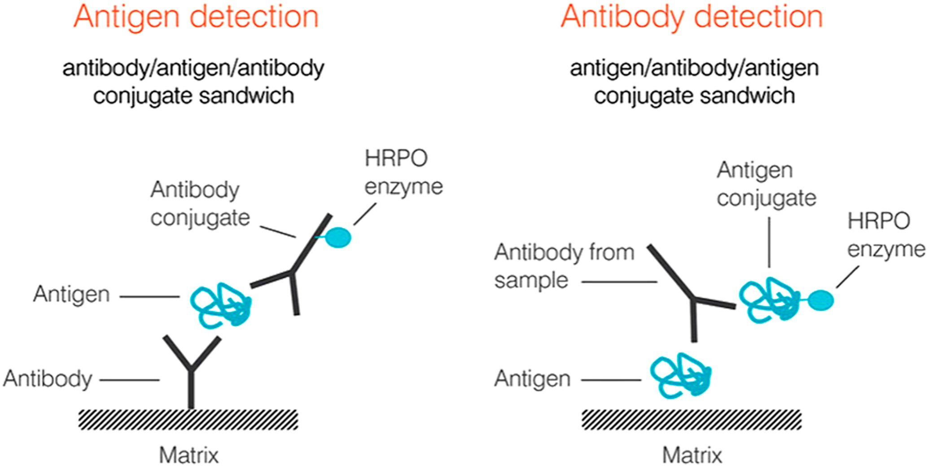
FYI
SNAP 4DX Plus (ELISA for antigen and antibody detection)
Antibodies against tick-borne pathogens (Indirect ELISA)
Antigen from Heartworm (Sandwich ELISA)
conjugate
from sample
sample
Fixed
Fixed
(peptide)
(pathogen peptides)

Slide 7
FYI
SEROLGY DIAGNOSTICS
Y
1. Detect antibodies made by the animal → exposure or a cross-reaction with a similar organism.
Y
Y
Y
Y
Y
Y
Y
Y
2. Not optimal for detecting acute infections. WHY?
Y
Y
Y
Y
3. Useful for discrimination between genera (i.e. Anaplasma vs. Ehrlichia)
4. Duration of antibodies present after a pathogen has been cleared varies

Slide 8
FYI
SNAP 4DX Plus Tick-borne Seropositive Considerations
Exposure (only antibodies!) to Anaplasma spp., Ehrlichia spp.,or B. burgdorferi
2. Does not detect antibodies induced by Lyme vaccinations.
3. Seropositive and symptomatic (fever, pale, painful joints etc) → treat.
4. Seropositive and asymptomatic (no overt PE abnormalities) → follow up dx
Complete blood count (CBC)
Serum biochemical panel (SBP)
Urinalysis (UA)
consider PCR or quantitative serology tests
anemia, thrombocytopenia, hyperglobulinemia, elevated liver values, abnormal renal values, proteinuria
treat
5. Dogs can remain positive for years (even though pathogen has been cleared)
Notes:
CBC (by a reference lab including a slide review), serum chemistry profile, urinalysis (preferably by cystocentesis with some saved for culture and urine protein:creatinine ratio if needed).
IF the dog has laboratory findings supporting disease (anemia, thrombocytopenia, hypoalbuminemia, hyperglobulinemia or proteinuria) then treatment is indicated.
IF the dog does not have laboratory findings supporting disease, treatment may not be indicated.
Client education and involvement in the decision whether to treat is critical. Regardless of whether treatment is instituted, yearly screening of the labwork as previously described is indicated.

Slide 9
FYI
SNAP 4DX Plus positive next year..
You do not need to treat the same blue dot every year in asymptomatic dogs, BUT you do need to perform follow up testing (CBC, Biochem, UA)
Communication to the client?
Seropositivity up to 2 years (?) without re-exposure
Not sure why some dogs remain seropositive for so long
antibodies to these peptides can linger and can mask results from new exposures
sometimes stealthy TB pathogens chronically infect some dogs
some dogs may be reinfected (antibodies likely do not prevent reinfection)
Notes:
Some individuals can maintain antibody titers in the absence of infection for years (sometimes a lifetime)
There does not appear to be immunity to re-infection, so it is nearly impossible to distinguish persistent antibodies from re-infection.

