Slide 1
VMP 930 Veterinary Parasitology
Mites
(answers)

Slide 2
Poultry Mite Quiz
Poultry Mite Characteristics: Compare and Contrast the Poultry Mites – Dermanyssus gallinae v/s Ornithonyssus sylviarum.
B
____ 1. On Birds During the Day
____ 2. Surveillance Program
____ 3. Wild bird hosts
____ 4. Inspect Cracks & Crevices
____ 5. Temporary Zoonosis
____ 6. Northern Fowl Mite
____ 7. Decreased productivity
A. Dermanyssus gallinae
B. Ornithonyssus sylviarum
C. Both
C
C
A
C
B
C

Slide 3
Poultry Mite Quiz
Poultry Mite Characteristics: Compare and Contrast the Poultry Mites – Dermanyssus gallinae v/s Ornithonyssus sylviarum.
C
____ 1. Anemia
____ 2. Congregate Around Bird’s Vent
____ 3. Populations can increase rapidly
____ 4. Roost Mite
____ 5. Chickens are primary treatment target
____ 6. Biosecurity v/s fomite transmission
B
A. Dermanyssus gallinae
B. Ornithonyssus sylviarum
C. Both
C
A
B
C

Slide 4
Minor Mites Quiz
A few mites to remember: Match the common and scientific names
C
____ 1. Canker Ear Mite of Rabbits A. Notoedres sp.
____ 2. Mange on Bovine Tail-head B. Otodectes sp.
____ 3. Scaly-Leg Mite of Poultry C. Psoroptes sp.
____ 4. Mange Mite of Cats D. Chorioptes sp.
____ 5. Scab Mite of Sheep E. Knimedocoptes sp.
____ 6. Ear Mite of Pets
D
E
A
C
B

Slide 5
Questions: Otodectes v/s Notoedres
A
____ 1. Ear mite of cats & dogs
____ 2. Pruritic → Alopecia + Excoriations → Pyoderma
____ 3. Starts on Ear Pinna, Head, Neck
____ 4. Skin Scrape
____ 5. Ear Swab & Otoscope
____ 6. Aural hematoma
____ 7. Rare, highly contagious mange mite of cats
____ 8. External Ear Canal
C
B
A. Otodectes cynotis
B. Notoedres cati
C. Both
B
A
A
B
A

Slide 6
Sarcoptes scabiei General Questions
True or False
1. Although there are host specific variants (or subspecies) of Sarcoptes scabiei, interspecific host infections are uncommon and transient, unless there is an immunocompromised status.
True
False
2. Eggs of Sarcoptes scabiei are easily eliminated by miticides; so repeat treatments are a waste of time & money.
True
3. Sarcoptes scabiei is transmitted via direct contact with other hosts or environmental fomites

Slide 7
Sarcoptes scabiei Scabies mite (General)
Match Clinical signs with Acute or Chronic scabies
B
___ 1. Hyperkeratosis, severe skin thickening with fold formation and crust buildup
___ 2. Intense Pruritus
___ 3. Papulocrustous eruptions with yellow crusts, excoriation, erythema, lichenification, and alopecia.
Acute, primary disease
Chronic, generalized disease
Both
C
A
Multiple Choice
B
___ 1. For Sarcoptes scabiei, lesions typically start on the:
A. Dorsal-Caudal region of the back
B. Ear pinna, elbows, hocks, and ventrum.
C. Front and Back Legs

Slide 8
Sarcoptes scabiei suis Scabies mite of Swine
Fill in the Blank
1. List one Economic “Pathology” that may be caused by Sarcoptes scabiei suis. ____________________________
Poor growth/weight gain
Poor feed conversion
Destruction of pens & equipment
2. The original source of Sarcoptes scabiei suis infections to piglets is ________________ .
The Nursing Sow

Slide 9
Sarcoptes scabiei canis Scabies mite of Dogs
Fill in the Blank
1. What clinical sign is considered pathognomonic of a Sarcoptes scabiei infection in dogs?
______________________________________________
Involvement of the elbows and hocks
Intense Pruritus
2. The sudden-onset of _______________is a common clinical sign of Sarcoptes scabiei infections.
3. What is the name of the scabies that occurs in well-groomed but itchy dogs ? _______________
“Scabies incognito”

Slide 10
Demodex canis
Demodectic Mange of Dogs
Fill in the Blank
1. Although Demodex canis normally occurs in small numbers and is normal fauna, what is the cause of demodectic mange?
___________________________________________________________________
Overgrowth of the mite population because the host’s immune system cannot limit the mite population.
Pododemodicosis
2. Often a complication of generalized demodicosis, _________________ is a digital, interdigital, plantar disease that always includes pyoderma.

Slide 11
Demodex canis
Demodectic Mange of Dogs
True or False
False
Demodicosis is spread by direct contact with a mangy dog?
False
Demodicosis is contagious / zoonotic?
Multiple Choice
C
____ 1. How do dogs first become infested with the mite Demodex canis?
A. Direct Contact with a Mangy Dog
B. Groomed with an Infested Dog Brush
C. Mom to Nursing Puppies
D. From the Bedding of a Mangy Dog

Slide 12
Demodectic mange: Disease Presentation
What are characteristics of each form of disease presentation for Demodectic mange?
B
A. Generalized Demodicosis
B. Localized Demodicosis
____ 1. Dz of puppies
____ 2. Prognosis guarded, intractable
____ 4. Mainly involves only the lips, face, forelegs
____ 5. Folliculitis, Furunculosis
____ 6. Most often resolves spontaneously
____ 7. Chronic DZ
A
B
A
B
A

Slide 13
Types of Demodicosis
Which characteristics are seen in each type of Demodectic mange?
B
____ 1. Localized Demodicosis develops into Generalized Demodicosis
____ 2. Heat-cycle Demodicosis
____ 3. No spontaneous cure as dog matures
____ 4. Due to an Immature immune system
____ 5. Mite-Specific Immuno-incompetence
____ 6. Stress or Medical Event-mediated Demodicosis, often transient
____ 7. Spay or Neuter dog with this presentation
C
Localized Demodicosis
Juvenile-onset Demodicosis
Adult-onset Demodicosis
B
A
B
C
B

Slide 14
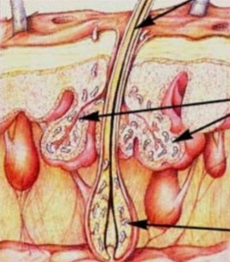
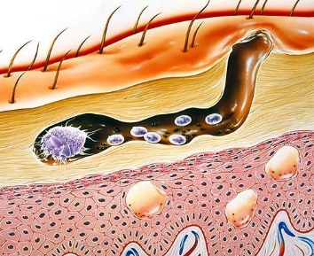
Canine Mange Mites Demodex v/s Sarcoptes
Genus & Common Names?
Diagnostic technique?
Demodex canis
Follicle Mite
Red Mange
Skin Scrape,
Trichogram
Sarcoptes scabiei
Scabies Mite
Scabies
Skin Scrape

Slide 15
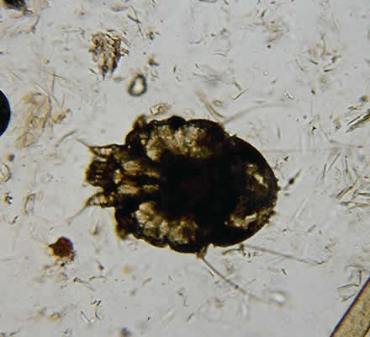
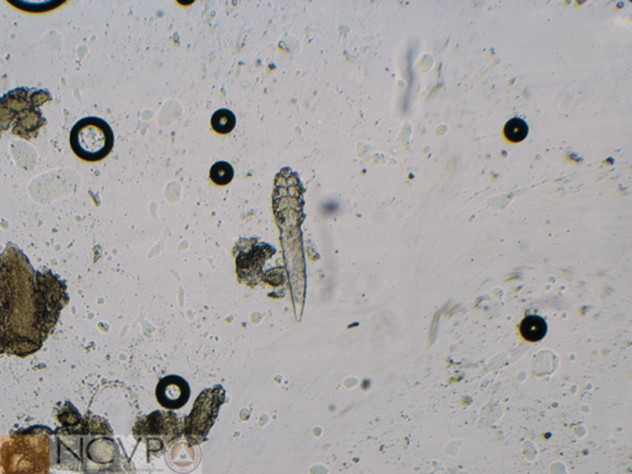
Canine Mange Mites Demodex v/s Sarcoptes
Identify?
Sarcoptes
Demodex

Slide 16
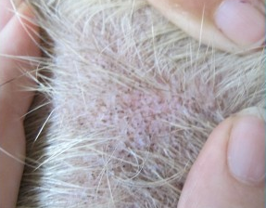
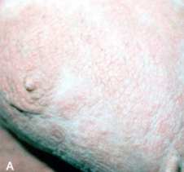
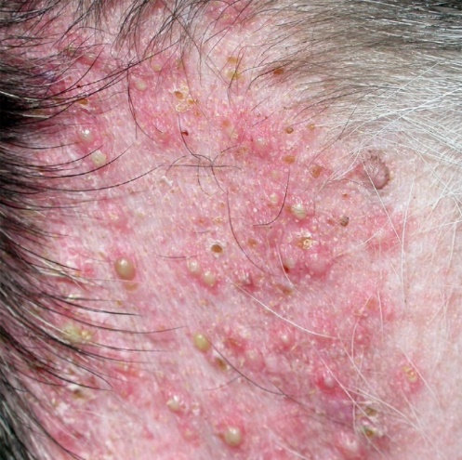
Canine Mange Mites Demodex v/s Sarcoptes
Diagnosis ?
Alopecia,
Comedones
Alopecia,
Erythema,
Lichenification
Alopecia,
Erythema,
Pustules
Demodex
Sarcoptes
Demodex

Slide 17
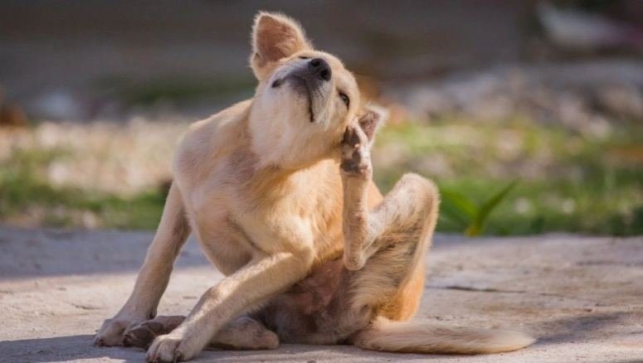
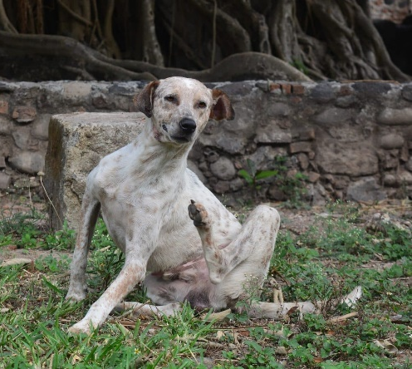
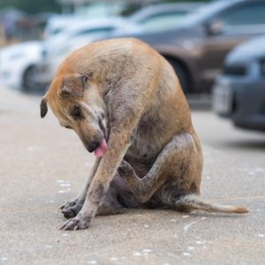
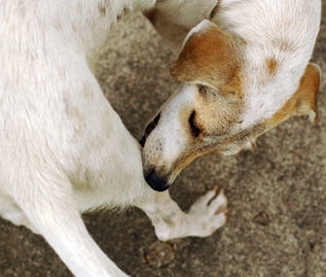
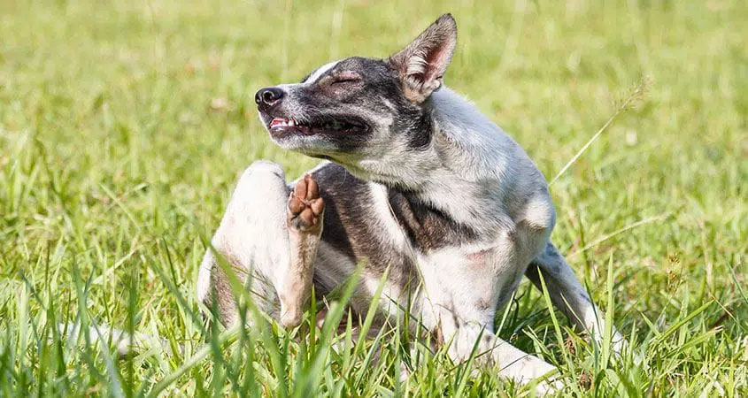
Canine Mange Mites Demodex v/s Sarcoptes
Clinical Sign?
This is a close pack of stray dogs.
Pruritus
Contagious
Which mange mite?
Sarcoptes

Slide 18
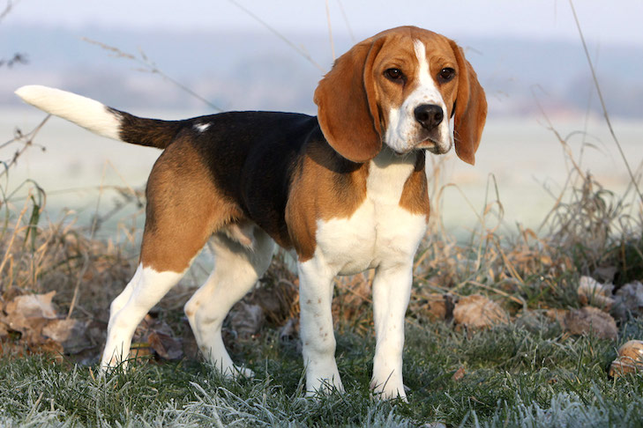
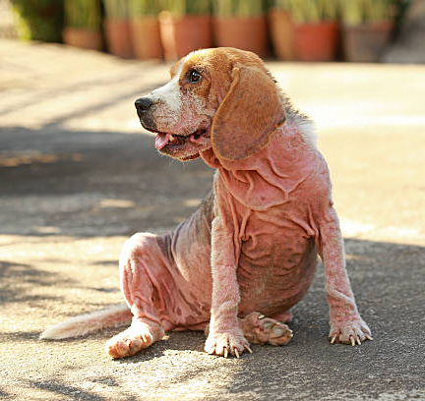
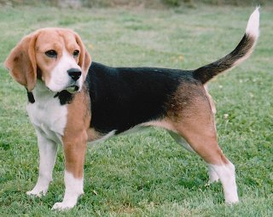
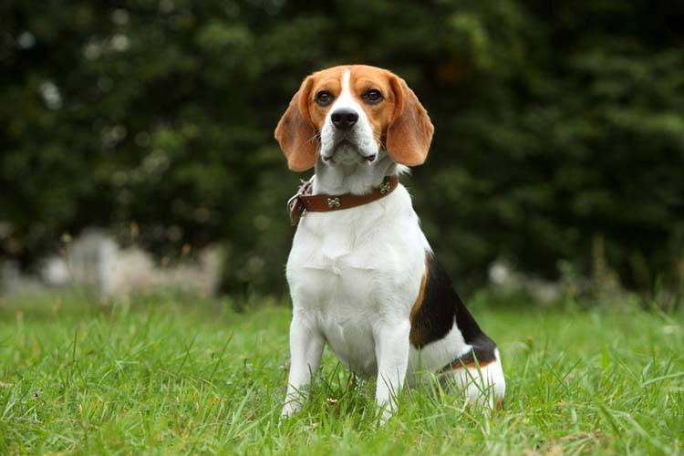
Canine Mange Mites Demodex v/s Sarcoptes
This is a close pack of hunting dogs.
Clinical Sign?
+/- Pruritus
Not Contagious
Which mange mite?
Demodex

Slide 19
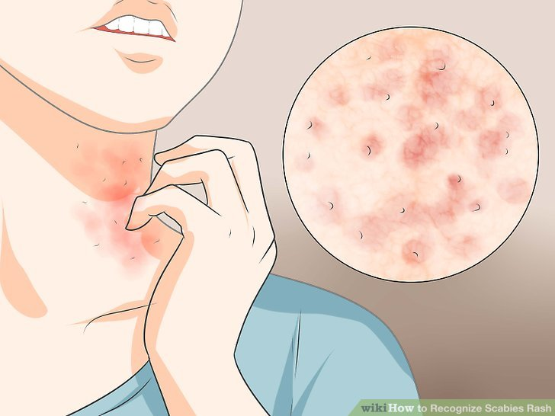
Canine Mange Mites Demodex v/s Sarcoptes
Clinical Sign?
Which mange mite?
Client Pruritus
Sarcoptes
Temporary Zoonosis

Slide 20
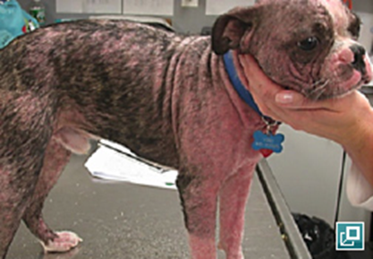
Canine Mange Mites Demodex v/s Sarcoptes
Chronic presentation, which mange mite?
Sarcoptes
Demodex

