Slide 1
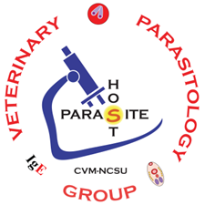
Animals in Health & Disease Veterinary Parasitology
Introduction

Slide 2
Name 8 Parasites
1
2
3
4
5
6
7
8

Slide 3
Parasites in Practice
In a veterinary practice how much time & effort is spent on Parasite issues?
What parasites are often diagnosed in a veterinary practice?
What parasites are managed prophylactically?
What growing issue has made managing some parasites difficult?
Which parasites are currently showing _____________?

Slide 4
Parasitism
Intimate relationship between two hetero-specific organisms, in which the parasite, usually the smaller symbiont, is metabolically dependent on the host.
One symbiont (host) is harmed, while the other symbiont (parasite) benefits.

Slide 5
Parasite Groups
Hemoflagellates
Infectious diseases
Microbiology
Virology
Bacteriology
Mycology
Parasitology
Protozoology
Helminthology
Entomology
Mucoflagellates
Protozoa
Coccidians
Piroplasms
Trematodes
Cestodes
Helminths
Nematodes
Acanthocephalans
Ticks
Mites
Arthropods
Lice
Fleas
Flies

Slide 6
Life Cycle Terminology
AHD: Parasitology

Slide 7
Life Cycle Terms
Types of Life Cycles
Direct life cycle - parasite does not require an intermediate host.
The infective stage (egg, cyst, or larva) is in the environment.
Indirect life cycle - parasite requires an intermediate host.
Facultative Indirect life cycle – parasite may use a paratenic host
Paratenic host is not necessary (Facultative = “Optional”)
Parasite Stages (in general)
Larval stage - sexually immature form of the parasite
Adult stage - sexually mature form of the parasite
Hosts
Definitive host (primary host) - animal infected by the sexually mature parasite
Intermediate host - animal infected by larval stage(s) that continue development, but do not mature
Vector - transmits a pathogen from one host to another
Mechanical vector – not necessary for pathogen development (facefly proboscis)
Biological vector - necessary for pathogen development (tick)
Paratenic host (transport host) - host infected by a larval stage that does not develop further.
Aberrant host (dead-end host) – host that is accidently infected and does not transmit parasite further.

Slide 8
Helminth Life Cycles
Life Cycle Type
Direct Life Cycle
Hosts
Definitive Host
Oxyuris equi is the equine pinworm that causes pruritus of the perianal region, resulting in alopecia and a bald tail-head.
Parasite Stages
Adult
Ovum or Ova
Host Specificity
High
Zoonotic
No
Direct Life Cycles have a single host (Definitive Host) and do not require an Intermediate Host to complete the parasite's life cycle.
Many Direct Life Cycles involve fecal-oral transmission.
The Definitive Host is the host in which the Adult or sexually mature parasite resides.
For some parasitic worms, Ova (eggs) are produced by Adult worms and the Ova are passed in the feces.
An Ovum provides a protective shell in which an Infective Larvae develops.
The Ova are often the diagnostic stages for many parasites.

Slide 9
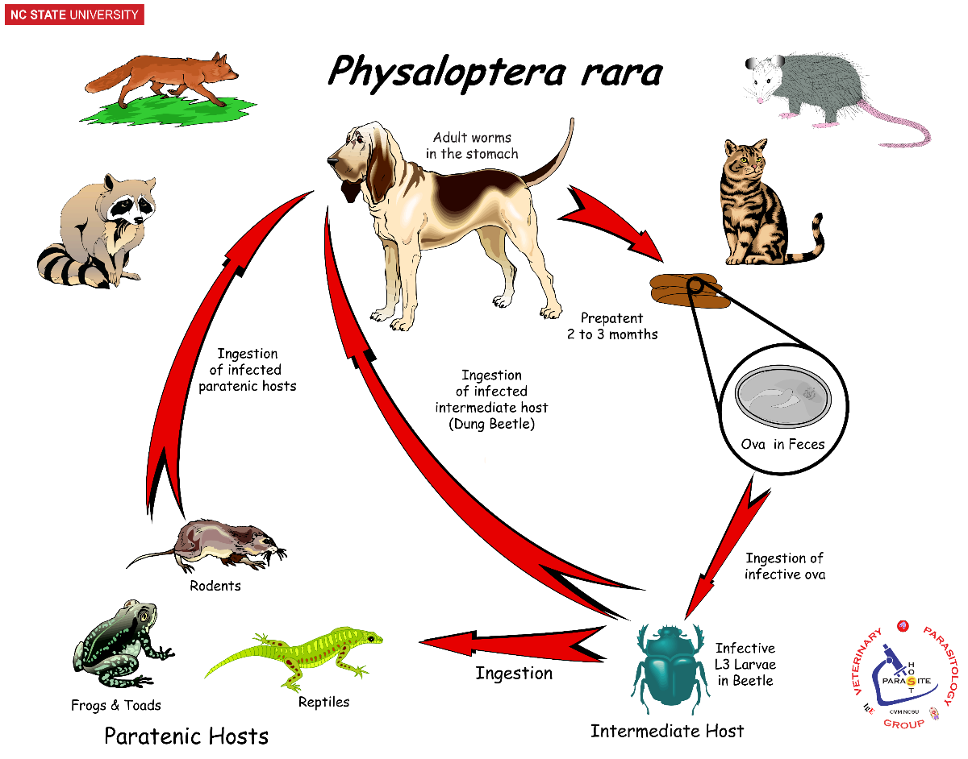
Helminth Life Cycles
Life Cycle Type
Indirect Life Cycle
Hosts
Definitive Host
Intermediate Host
Paratenic Host
Sylvatic Host
Reservoir Host
Physaloptera rara is a stomachworm of pets and wildlife. It may cause gastritis with gastric ulcers.
Parasite Stages
Adult
Ovum or Ova
Infective larvae
Arrested larvae
(Hypobiotic larvae)
Host Specificity
Low
Zoonotic
No
An Indirect Life Cycle requires an Intermediate Host in which development of the parasite is necessary.
Non-domestic Definitive Hosts are called Reservoir Hosts or Sylvatic Hosts.
Infective Larvae may develop within the Intermediate Host to later infect the Definitive Host.
A Paratenic Host is not required for the development of the parasite but may transport Arrested Larvae to the Definitive Host.

Slide 10
Helminth Life Cycles
Ostertagia ostertagi is called the brown stomach worm of cattle. Larvae and adult worms cause dysfunction of the abomasal mucosa, resulting in diarrhea, anorexia, and protein catabolism.
Life Cycle Type
Direct Life Cycle
Pasture-borne Parasite
Hosts
Definitive Host
Parasite Stages
Adult
Ovum or Ova
Free-living larvae
Infective larvae
Arrested larvae
(Hypobiotic larvae)
Host Specificity
High
Zoonotic
No
Many pasture-borne parasites, such as Ostertagia spp., have Direct Life Cycles.
When Ova are passed in the feces, Free-living Larvae hatch and develop on pasture.
The Free-living Larvae (L1 & L2) eventually develop into Infective Larvae (L3), which are accidentally ingested by the Definitive Host while grazing.
After ingestion, the Infective Larvae develop in the abomasal mucosa and become Arrested Larvae, also known as Hypobiotic Larvae.
Arrested Larvae will re-activate & re-emerge into the lumen of the abomasum and become Adult worms.

Slide 11
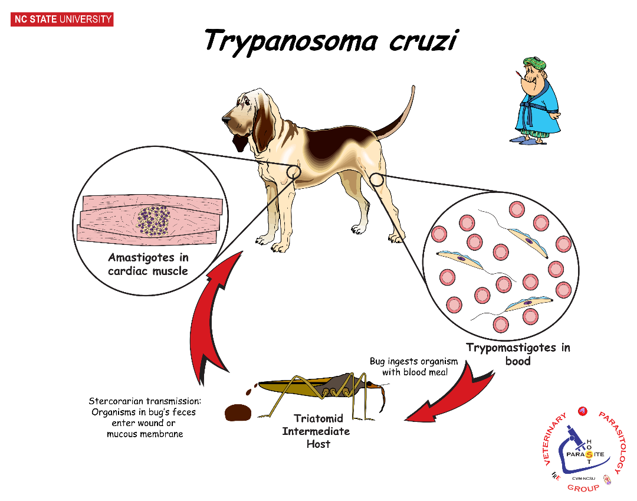
Protozoan Life Cycles
Hemoflagellates
Life Cycle Type
Indirect Life Cycle
Continuous Life Cycle
Trypanosoma cruzi is a vector-borne pathogen transmitted by triatomine bugs ("kissing bugs") that can cause Chagas disease. Its tropism for cardiac muscle often causes damage to the heart.
Hosts
Definitive Host
Intermediate Host
Vector
Life Cycle Processes
Binary Fission
Clonal Replication
Parasite Stages
Asexual Stages only
Amastigote
Trypomastigote
Epimastigote
Hemoflagellates, such as Trypanosoma cruzi, have Indirect Life Cycles, which includes a mammalian Definitive Host and an insect Intermediate Host.
The insect Intermediate Host is also called the Vector for the protozoan.
The protozoa multiply asexually by Binary Fission or Clonal Replication, resulting in Asexual Stages Only.
Without control by host immunity, some parasites, like Trypanosoma cruzi, will continue to multiply until they overwhelm the host. This is called a Continuous Life Cycle.
Life Cycle forms, for Trypanosoma cruzi, include Amastigotes in the mammalian tissues, Trypomastigotes in the mammalian blood, and Epimastigotes in the insect gut.
Host Specificity
Low
Zoonotic
Yes

Slide 12
Protozoan Life Cycles
Mucoflagellates
Life Cycle Type
Direct Life Cycle
Hosts
Definitive Host
Parasite Stages
Asexual Stages only
Trophozoite
Cyst
Giardia spp. are protozoa parasites that infect the gastrointestinal tracts of animals and can cause diarrhea. Giardia cysts are transmitted via fecal-oral route.
Life Cycle Processes
Binary Fission
Clonal Replication
Host Specificity
High
Zoonotic
No
Mucoflagellates, such as Giardia canis, have Direct Life Cycles, which only requires the Definitive Host.
The protozoa multiply asexually by Binary Fission or Clonal Replication, resulting in Asexual Stages Only.
Life Cycle forms include an active Trophozoite with in the Definitive Host and a Cyst that contaminates the environment.
The Definitive Host is infected by ingesting the Cyst stage.

Slide 13
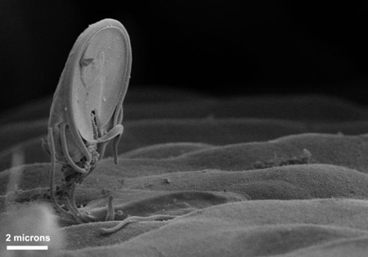
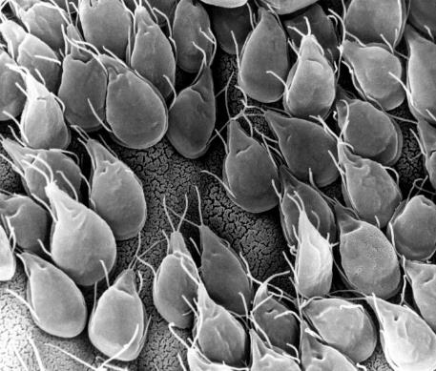
Like viruses and bacteria, replication is necessary for pathology caused by protozoa.
Pathology:
Host organ dysfunction
Replication
(binary fission)
Giardia sp.

Slide 14
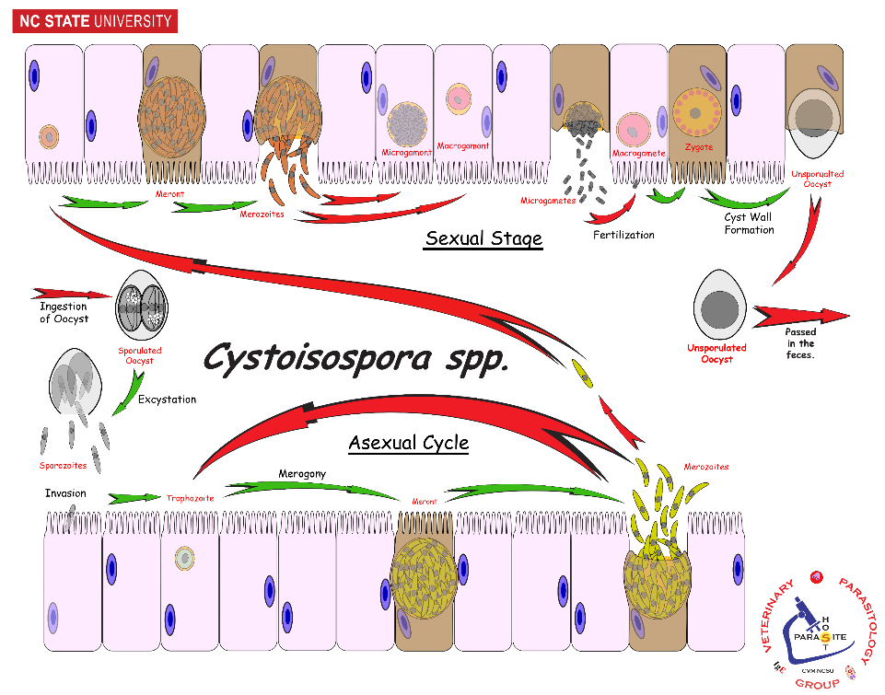
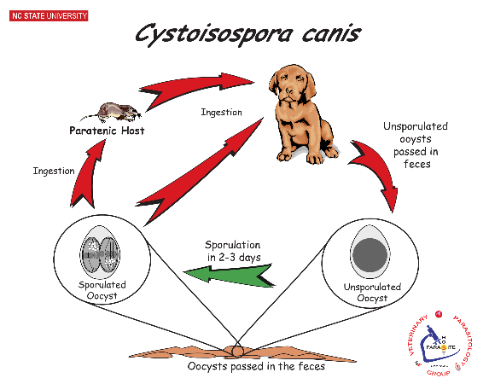
Cystoisospora spp. are protozoa parasites that infect the gastrointestinal tract of carnivores, causing diarrhea primarily in young or immunocompromised animals. It is transmitted via fecal-oral route and can be prevented with proper sanitation.
Protozoan Life Cycles
Coccidia
Life Cycle Type
Direct Life Cycle
Single Direction Life Cycle
“All In – All Out”
Facultative Indirect Life Cycle
Asexual Cycle
Sexual Cycle
Hosts
Definitive Host
Paratenic Host
Parasite Stages
Unsporulated Oocyst
Sporulates Oocyst
Sporozoites
Meront
Merozoites
Gametocytes
Zygote
Host Specificity
High
Zoonotic
No
Life Cycle Processes
Binary Fission
Sporulation
Merogony
Gametogony
Fertilization
Most coccidians have Direct Life Cycles, which only requires the Definitive Host and fecal-oral transmission.
However, some coccidia, like Cystoisospora spp., have Facultative Indirect Life Cycles, which provides the use of unnecessary Paratenic Hosts to maintain the life cycle. Paratenic Hosts harbor Cystozoites which infect the Definitive Host upon ingestion.
Coccidians utilize Sexual & Asexual Cycles within the Definitive Host.
Some parasites have a Single Direction Life Cycle. Once the life cycle is completed then all organisms are gone ---“all in – all out”.
Unsporulated Oocysts are passed in the host’s feces. These go through Sporulation, resulting in an infective Sporulated Oocysts
After being ingested, the Sporulated Oocyst releases Sporozoites which invade gut cells. This begins the Asexual Cycle: Sporozoites multiply by Binary Fission or Merogony producing a Meront full of Merozoites.
The Sexual Cycle occurs when Merozoites differentiate into Gametocytes via Gametogony. After Fertilization, the resulting Zygote develops into an Unsporulated Oocyst to be passed out in the feces.

Slide 15
Arthropod Life Cycles
Life Cycle Type
Simple Metamorphosis
1-HostTick
2-HostTick
3-Host Tick
Dermacentor variabilis is called the American Dog Tick. Besides causing irritation, blood loss and Tick Paralysis, this tick is also a vector for Rickettsia rickettsia (Rocky Mountain Spotted Fever).
Parasite Stages
Eggs
Larvae
Nymphs
Adults
Male
Female
Host Specificity
Low
Like other arachnids, ticks have eight legs, except for the six-legged larvae.
Ticks develop from Larvae to Adults through a process of Simple Metamorphosis.
Simple Metamorphosis is when all life stages of an arthropod look similar, except for size and minor differences.
Engorged Female ticks drop off the host and deposit Eggs in the environment.
Six-legged Larvae hatch from these Eggs and feed on a host. The larvae develop and molt to become eight-legged 1st Nymphs, which also feed.
After feeding, the 1st Nymph develops and molts into the 2nd Nymph. Like wise, the 2nd Nymphs feed, develop, and molt into Adult ticks.
Male and Female Adult ticks feed and mate on the host. The engorged Female then drops off the host to lay Eggs in the environment.
Dermacentor variabilis is a 3-Host Tick because it feeds on 3 different hosts. Other species of ticks are 1-Host or 2-Host Ticks.
Zoonotic
Yes

Slide 16
Arthropod Life Cycles
Life Cycle Type
Simple Metamorphosis
Hemimetabolous
Trichodectes canis is a chewing louse of dogs. Chewing Lice feed on skin, fur, feathers, and debris; and cause general irritation, pruritus, and alopecia. Other lice are Sucking Lice, which feed on blood.
Parasite Stages
Nits
Nymphs
Adults
Male
Female
Host Specificity
High
Zoonotic
No
Lice develop from Nymphs to Adults through a process of Simple Metamorphosis or Hemimetabolous development.
Simple Metamorphosis occurs when all life stages have a similar appearance, except for size.
Male & Female Lice mate on the host and the Female louse cements Eggs (aka Nits) on the hair or feather shaft of the host.
Nymphs hatch from the Nits, then feed and molt to the next stage. There are usually several molts before reaching the Adult stage.
All stages, from Nits to Nymphs to Adults, remain on the host.

Slide 17
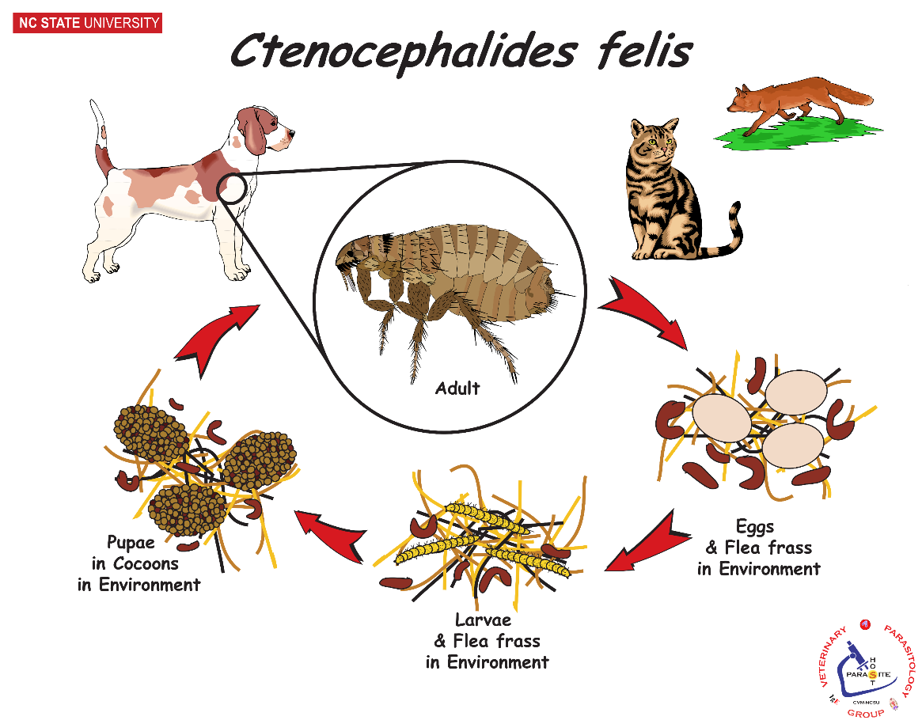
Arthropod Life Cycles
Life Cycle Type
Complex Metamorphosis
Holometabolous
Ctenocephalides felis is called the Cat Flea but is found on dogs as well as many other hosts. Fleas cause irritation, pruritus, alopecia, blood loss, and Flea Allergy Dermatitis (FAD).
Parasite Stages
Eggs
Larvae
Pupae
Puparium
Adults
Male
Female
Host Specificity
Low
Fleas develop from Eggs to Adults through a process of Complex Metamorphosis or Holometabolous development.
Complex Metamorphosis occurs when the life stages have a dissimilar appearance.
Male and Female fleas feed and mate on the host. Eggs are deposited on the host; but fall off into the environment.
In the environment, Larvae hatch from the Eggs and develop through 3 Larval Stages via 2 molts.
The caterpillar-like Larvae feed on environmental debris.
The 3rd Larval Stage builds a cocoon (aka Puparium) in which the Pupa develops into Adult fleas.
When a host passes by, the Adult flea will emerge from the Puparium and attack the host.
Zoonotic
Yes

Slide 18
Basic Concepts
AHD: Parasitology

Slide 19
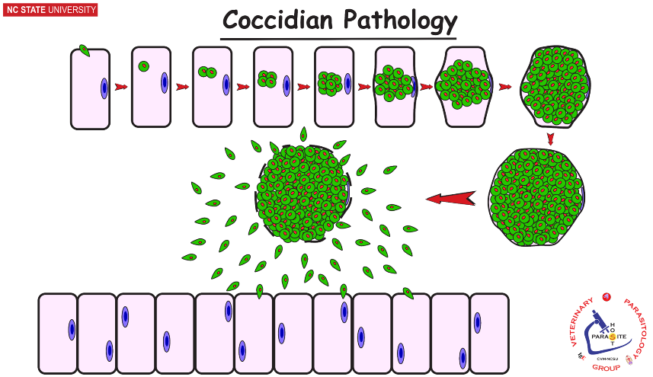
Parasite Pathogenesis
Pathogenesis (how the pathogen causes disease)
Production or Development of Disease
Forms of Pathogenesis
Trauma
Direct destruction of the host cells or tissues
Eimeria, Babesia, Sarcoptes, Haemonchus, Small Strongyles
Indirect destruction of host cells or tissues
Tritrichomonas, Giardia, Ascaris
Organ occlusion
Parascaris, Dirofilaria, Heterobilharzia, Babesia
Nutrient Robbing
Tapeworms, Ascaris
Excretion of Toxins or Other Pathogens
Fasciola, Nanophyetes
Interactions with host immune / inflammatory responses
Demodex, Dirofilaria, Leishmania, Fleas
Traumatic destruction of epithelial cells

Slide 20
Parasite Impact on Host
Parasite effects on hosts are a continuum
Parasite number and pathogenicity determine disease state
No effect on host
Subclinical
no obvious signs; subtle performance losses
Clinical
disease manifestation
Clinical judgement: “Is the parasite’s effect on the patient important enough to justify treatment?”

Slide 21
Infection ≠ Infectious ≠ Disease
Infection = presence of an agent that has the potential to cause disease
Infectious = host capable of transmitting infection to another host
(“Contagious” in virology)
v/s Infective = parasite's stage capable of invading the next host
Disease = the occurrence of dysfunction / pathology
Infection ≠ Infectious ≠ Disease

Slide 22
Infection, Disease, and/or Infectious?
A. The dog showed no adverse symptoms to the 2 female Dirofilaria immitis in its pulmonary arteries.
B. A lamb with 1,000 juvenile Haemonchus contortus in its abomasum suffers from severe anemia.
C. A cat, suffering small bowel diarrhea, passes Giardia cati cysts in its stool.
D. After using the bathroom, she was horrified to see that she had passed several active segments of the beef tapeworm, Taenia saginata.
E. Eimeria sp. oocysts are found on a dog’s annual wellness visit.

Slide 23
Other Concepts
Host Specificity
Degree of Host-Parasite compatibility
An inverse relationship of compatibility (á Specificity = â Host species)
High Host specificity
Parasite can infect only one or a few host species
(Oxyuris, Lice, Eimeria, sexual stages of Toxoplasma)
Low Host Specificity
Parasite can infect several or many host species
(Physaloptera, Fleas, asexual stages of Toxoplasma)
Prepatent v/s Patent
Prepatent Period (PPP) – developmental / maturation time needed between time of infection to the production of offspring. Determines the timing of treatment for control measures.
Patent - an infection where sexually mature parasites are generating offspring.
Zoonosis - an animal disease transmitted to humans
Notes:
These are the different life cycle strategies that we will discuss for the various protozoa pathogens. You will not be quizzed about these terms directly.
This slide is meant to introduce you to the life cycle strategies.

Slide 24
Clinical Thought Exercise
AHD: Parasitology

Slide 25
Controlling Parasites
Assume you are working at a Wildlife Rehab facility.
1. Regarding the concern for re-infection & build-up of the parasite population; Rank the following 3 parasites on basis of concern? (low, moderate, high)
2. What would you generally do to control reinfection?
Sanitation or Pest Control

Slide 26
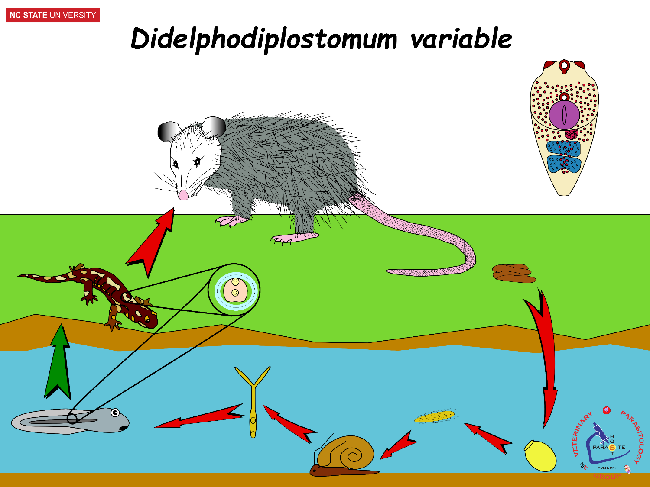
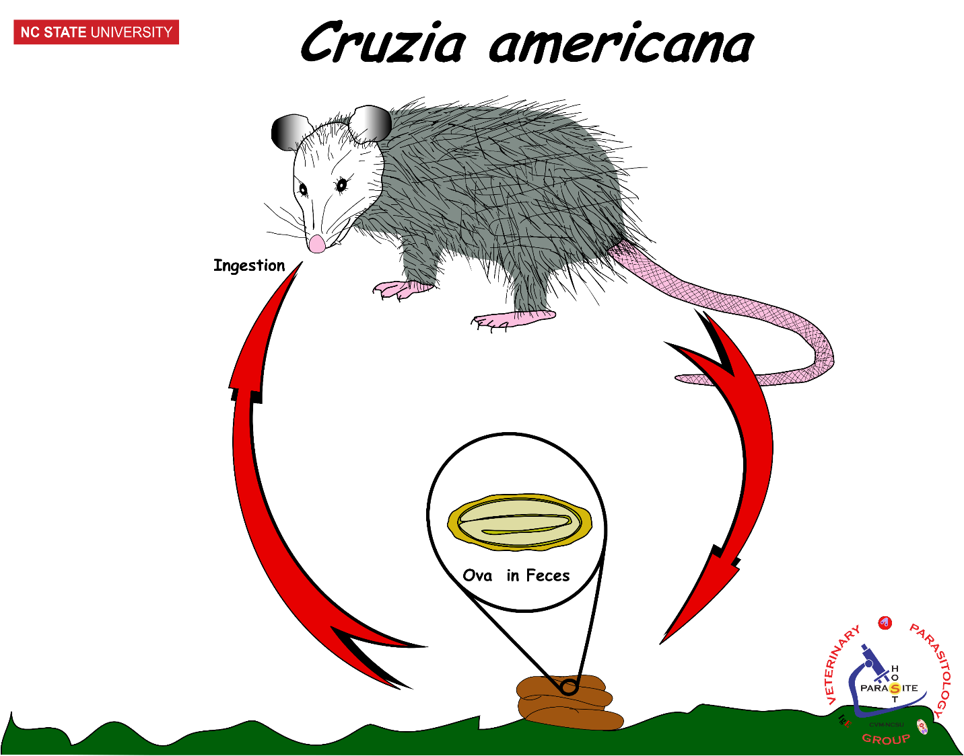
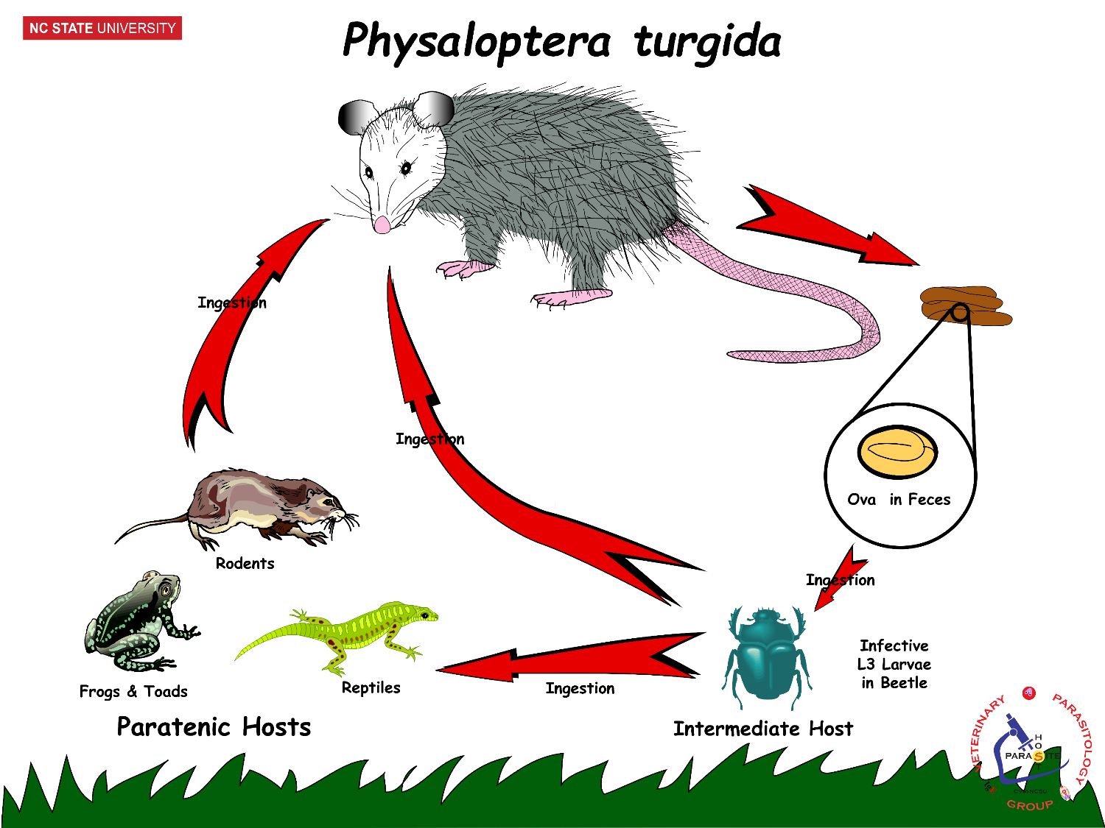
Concern for reinfection,
build up of large
parasite population
in the host ?
+ low concern
++ moderate concern
+++ high concern
Primary Control Effort?
Sanitation
Pest Control
Notes:
High Concern,
Direct LC,
Quick build up w/o sanitation

Slide 27
Take-Home Summary
AHD: Parasitology

Slide 28
Take Home
Importance of knowing life cycles for successful clinical cases and disease control.
Concepts that should become “second nature”:
Infection v/s Infectious v/s Disease
Host Specificity: Low v/s High
Life Cycles: Direct v/s Indirect
Prepatent v/s Patent
Parasite Stage: Larva, Infective Larva, Adult
Hosts: Definitive v/s Intermediate v/s Paratenic
Zoonosis

Slide 29
