Slide 1
VMP 930 Lecture 15a
Nematode anatomy and physiology:
Morphology terms
Function
Notes:
This lecture presents a very brief overview of nematode anatomy and physiology to help your comprehension of terms used in publications about parasites; and, in subsequent lectures and tests.

Slide 2
General anatomy and physiology
Objective - Define anatomical terms with regard to function in the worm.
pseudocoelom - body cavity, fluid-filled under pressure so that worm can move when muscles contract. Movement is essential for nematode survival.
dorsal and ventral cords - major nerves. Target of many anthelmintic (deworming) drugs. Nerve function is essential for survival.
lateral cords - excretory system.

Slide 3
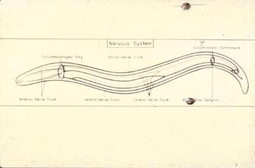
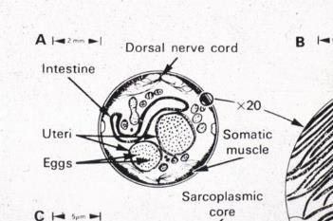
General anatomy and physiology
Longitudinal section
Cross section
Movement inside host
Movement outside host

Slide 4
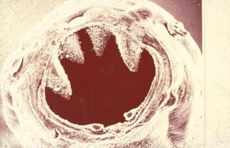
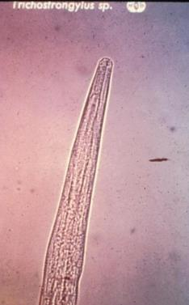
General anatomy and physiology
Digestive system: Buccal cavity with or without teeth.
Well developed or vestigial.
Notes:
Nematodes acquire nutrition by ingestion through the buccal cavity at the anterior end. Process requires functional nervous system. Worm identification to genus and species often determined by morphology of the buccal cavity.

Slide 5
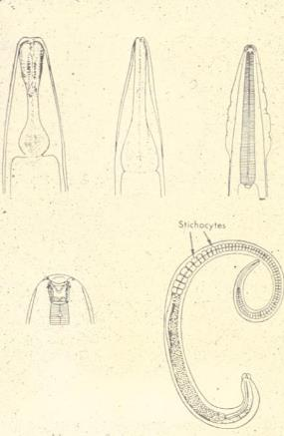
General anatomy and physiology
Esophagus: various forms identify larval stages and characterize families of nematodes.
a. rhabditiform b. strongyliform c. filariform d. stichosome
a
b
c
d
Notes:
This is just a quick reference for frequently used terms found in descriptions of nematodes. Rhabditiform = two muscular areas separated by a narrow stricture. Strongyliform = single muscular area at terminus of the esophagus. Filariform = long thin (lacking significant muscle) entire esophagus length. Stichosome = donut shaped cells (stichiocytes) surrounding esophagus lumen.

Slide 6
General anatomy and physiology
3. intestine is a straight tube, no bends.
4. anus near posterior end.
Notes:
Nematodes have a tubular organ lined with absorptive cells running from the end of the esophagus to the anus.

Slide 7
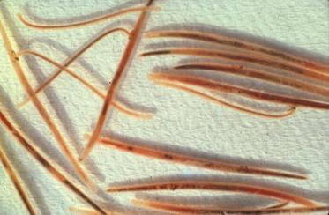
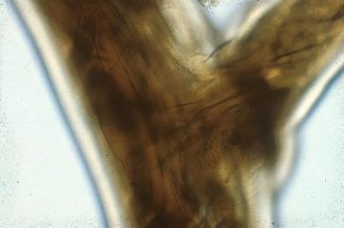
General anatomy and physiology
All nematodes in this course only reproduce sexually, except Strongyloides.
Adult stage nematodes are male or female, not hermaphroditic like flat worms.
male
female
female
male
female
male
Male grasping female with his copulatory bursa

Slide 8
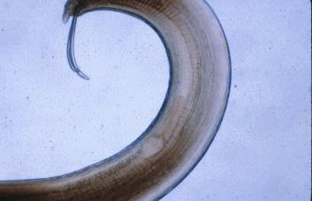
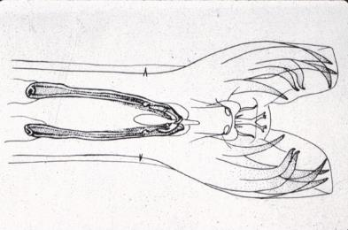
General anatomy and physiology
Males, smaller than females, have copulatory bursa for grasping female and copulatory spicules for guiding sperm. Long, tubular, winding reproductive tract.
spicules
spicules
bursa
Notes:
Male testis, seminal vesicle and vas deferens are one continuous reproductive tract terminating at the cloaca at the posterior end of the worm. Size and shape of spicules and the copulatory bursa are characteristics used to identify genus and species of a nematode.

Slide 9
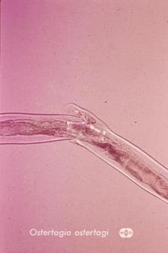
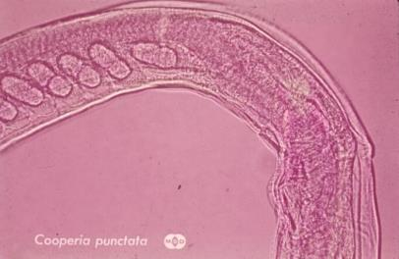
General anatomy and physiology
Females have a long tubular reproductive tract opening to outside at a vulva that may be anterior, posterior or mid body.
Vulvar flap
ova
vulva
Notes:
The location of the vulvar opening and the presence or absence of a vulvar flap covering the vulvar opening are important morphological characteristics for identification of nematode genus and species.

Slide 10
Discussion Question
How many different functions of nematodes depend on an intact nervous system?
In other words, if you were developing a new drug to kill nematodes what might you measure to select candidate compounds?

Slide 11
VMP 930 Lecture 15b
Order Rhabditida; Genus: Strongyloides
Objectives:
Describe the life cycle, especially routes of infection and how these are different in very young hosts compared to adult animals.
Know the host age when it is most susceptible to patent infections with clinical signs.
Know how to diagnose in different host species.
Notes:
Strongyloides sp. causes a disease of neonatal and very young animals where patent infections are associated with diarrhea and sometimes respiratory signs. Nematodes in the Order Rhabditida can have adult male and female worms reproducing in the environment outside of the host. No other parasitic nematodes studied in this course have free living adult worms outside of the host.

Slide 12
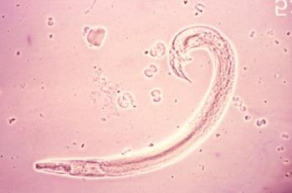
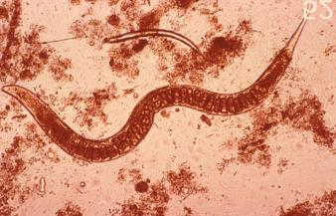
Order Rhabditida: Focus on the genus Strongyloides
Exclusive to this nematode order: sexually reproducing free-living stage and parthenogenic adult parasitic stage. www.cdc.gov/dpdx/strongyloidiasis/
Free-living male,
note spicule
Free-living female, note ova
Notes:
Strongyloides is the one exception for the rule that in this course nematodes create offspring only by sexual reproduction. There are two adult female (produce offspring) forms: one in the host small intestine, and the other a free-living adult female form that lives in the soil and has sex with an adult male to produce offspring.

Slide 13
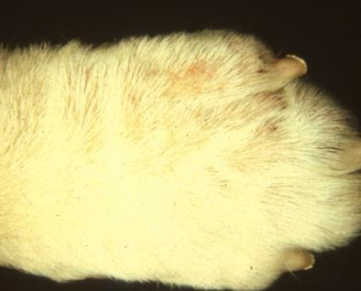
Order Rhabditida Focus on the genus Strongyloides
Rhabditic mange – larval stages of free-living Rhabditis strongyloides penetrates skin
Also associated with Strongyloides sp. Skin penetration.
Rhabditic mange
Notes:
Rhabditis strongyloides is a free-living (non-parasitic) nematode closely related to Strongyloides. Its larval stage can penetrate skin and cause inflammation, usually of the paws of dogs kept on wet straw bedding.

Slide 14
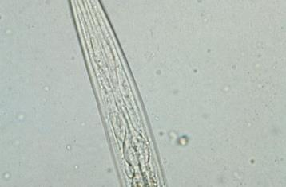
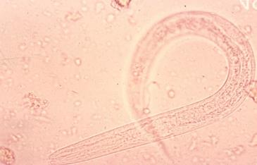
Order Rhabditida Focus on the genus Strongyloides
Free living adults have rhabditiform esophagus
Parasitic adults small, only adult females found in small intestine of host, long filariform esophagus
Notes:
The two adult female forms are morphologically distinct, as you might guess given their very different habitats (host small intestine and soil). Rhabditiform esophagus for feeding on soil organisms. Filariform esophagus has limited feeding capacity.
Adult parasitic female worms are found embedded in the mucosa of the small intestine. They are only 5 – 7 mm long. There are no parasitic adult male worms.

Slide 15
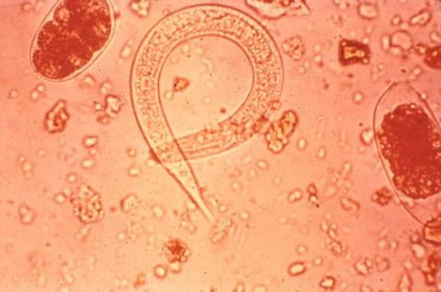
Order Rhabditida Focus on the genus Strongyloides
Females produce egg with L₁
L₁: hatches quickly
See L₁ in fresh feces of human and dog
See larvated egg in other host species
Diagnostic importance?
Pathogenic importance?
L₁ in human feces
Notes:
Strongyloides sp. adult parasitic females produce either first stage larvae or ova containing a larva. These offspring are generated by parthenogenesis; i.e., there is no male fertilization of the parasitic female.
Strongyloides stercoralis infects primates and dogs and the females produce first stage larva that are found in fresh feces. Other Strongyloides species that infect horses, pigs and ruminants are host specific, and these different species of Strongyoides have adult females that produce ova with a larva inside; these larvated ova are found in fresh feces.

Slide 16
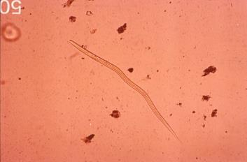
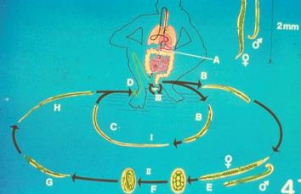
Order Rhabditida Focus on the genus Strongyloides
Homogonic cycle
L₁ to infective (skin penetrating) L₃ within 24 hours.
Autoinfection by skin penetration can lead to hyperinfection.
Infective larva
Notes:
This complex life cycle is also drawn out in your printed lecture notes. Primates, including humans, are susceptible to a process called autoinfection that can lead to hyperinfection, which can result in severe disease with heavy burdens of adult female worms. Autoinfection occurs when first stage larvae in feces quickly molt twice to become infective third stage larvae while still in contact with the perianal skin.

Slide 17
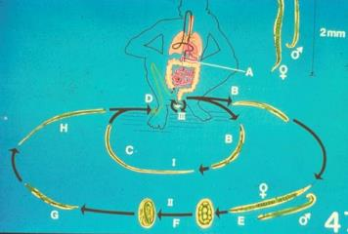
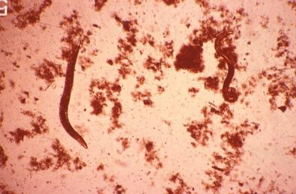
Order Rhabditida: focus on the genus Strongyloides
Heterogonic cycle
L₁ to free-living adult females and males that produce more new L₁.
Increases number of infective L₃ in environment (soil/bedding).
Free-living adults in soil.
“E” above
Notes:
Free-living adult males and females mate to produce offspring and expand number of infective larvae in soil and bedding. Skin penetration by infective larvae can lead to heavy worm burdens in young animals, and build up of arrested infective larvae in the tissues of the adult female host.

Slide 18
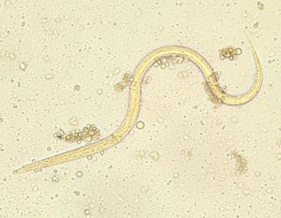
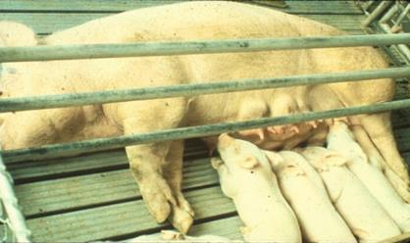
Order Rhabditida Focus on the genus Strongyloides
Lactogenic route of infection.
Infective larva in milk
Notes:
Infective arrested (hypobiotic) larvae in the tissues of mature female hosts can activate (come out of arrest) and migrate to mammary glands, and pass in milk to nursing offspring.

Slide 19
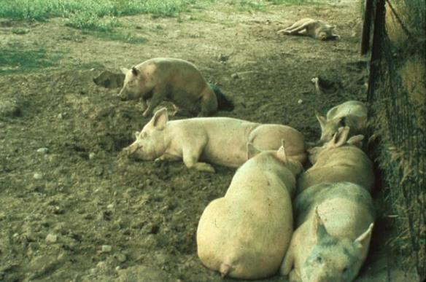
Order Rhabditida Focus on the genus Strongyloides
Skin penetrating route of infection.
Infective larvae in soil
Notes:
Skin penetration by infective L3 larvae can establish large worm burdens in young animals as well as re-establish arrested infective larvae in adult hosts to pass on to nursing offspring.

Slide 20
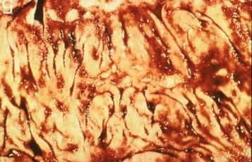
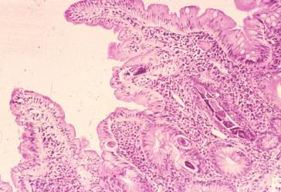
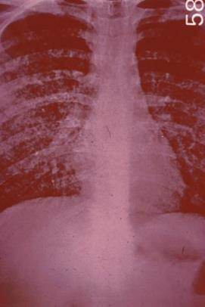
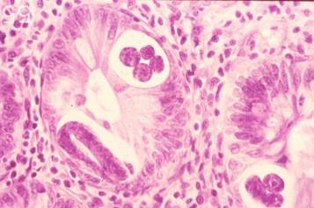
Pathological lesions – Strongyloides
Parasitic adult females
Enteritis response to adult females
Parasitic adult females
Lung reaction to migrating larvae
Notes:
Small (5-7mm) adult female worms are found deep in the mucosa of the small intestine. Infective larvae from skin penetration or ingestion with milk migrate by tracheal migration through lungs to be coughed up and swallowed to establish as adults in the small intestine. Passage through lungs on repeating basis can lead to hypersensitivity reaction in lung tissue.

Slide 21
Pathological lesions – Strongyloides
Larval migration to lungs and on to intestine via trachea in neonatal and young animals.
In adult animals larval migration to mammary tissue and arrest until onset of lactation in females.
Immunosuppressed adult host susceptible to hyperinfection and clinical signs.
Otherwise the occurrence of clinical signs limited to neonatal and young animals.

Slide 22
Diagnosis and control: Strongyloides
Diagnosis: eggs containing larva in fresh feces of most host species. Exception: in dog, cat and man L₁ are found in fresh feces.
Mother infects newborn with milk containing L₃. Mother will be fecal test negative. Babies will be shedding eggs or L₁.
How does mother get infected?
Treat the babies to control the transmission. Until fecal negative.

Slide 23
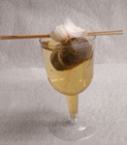
Baermann technique
Step 1: Place a 10-g or larger fecal sample in the center of a double layer of cheesecloth or gauze.
Step 2: Wrap the edges around the fecal sample to make a pouch and secure it with the rubber band.
Step 3: Pass a pencil or applicator sticks through the elastic band and suspend the pouch containing the fecal sample over the bowl of the hollow stem wine glass.
Step 4: Fill the wine glass completely with tepid tap water. Be sure not to let the corners of the fecal packet hang over the sides of the wine glass because they act as a wick for water.
Step 5: Allow the glass to sit for at least eight hours and preferably overnight.
Step 6: Remove the feces and discard.
Step 7: Using a transfer pipette or 1-ml syringe with a needle attached, aspirate a small amount water from the very bottom of the hollow stem of the glass.
Step 8: Place a few drops on a slide, add a cover slip, and examine the slide under a microscope
Anne M. Zajac, DVM, PhD, DACVM (parasitology), Meriam Saleh, PhD, VETERINARY MEDICINE 2013
Notes:
The details of the Baemann technique presented on this slide are for your future reference. You will not be tested on this, just remember that Baermann technique is for finding motile larvae in feces such as Strongyloides from primates and dogs and cats.

Slide 24
Treatment: Strongyloides (FYI not on test)
Fenbendazole, 50mg/kg 5 days. For dogs. May add moxidectin as monthly treatment.
Macrolid anthelmintics (ivermectin, and other avermectins). For humans and pigs.
Febantel for horses used at 50 mg/kg.
Oxibendazole for horses at 15 mg/kg.
The above dosage/drug information is FYI, not for testing.

Slide 25
Discussion Question
How do nursing foals infect their mothers with Strongyloides?

