Slide 1
VMP 930 Veterinary Parasitology
Nematodes
Questions
Nematodes

Slide 2
Helminth Groups
Such questions would be on the Final Exam, not the Nematode exam.
Match Worm with Worm Group
___ 1. Taenia sp.
___ 2. Paragonimus sp.
___ 3. Macracanthorhynchus sp.
___ 4. Ostertagia sp.
Nematode
Trematode (fluke)
Cestode (tapeworm)
Acanthocephalan
Multiple Choice
___ 1. Which Cestode infects the intestine of Horses?
A. Strongylus vulgaris
B. Habronema sp.
C. Anoplocephala sp.

Slide 3
Nematode Larval Migrations
Match Type of Larval Migration with its Respective Association.
___ 1. Paratenic host.
___ 2. Larvae migrate to the lungs, up the respiratory Tree, and are swallowed back to the intestine to become adult worms.
___ 3. May lead to Transmammary Transmission.
___ 4. Larvae migrate to the body tissues and arrest.
___ 5. Puppy ingests an infective egg of Toxocara canis.
___ 6. Small strongyles arrest in the gut mucosa of a horse.
Tracheal Migration
Somatic Migration
Mucosal Migration

Slide 4
Important concepts
A parasitological feed-back mechanism in which the adult population in the lumen inhibits the reactivation and emergence of the arrested larvae from the gut mucosa.
Circle the name of the parasitological concept that matches the description below.
Resistance
Larval Storms
Refugia
Premunition

Slide 5
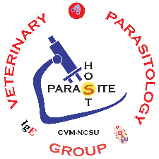
Pasture-borne Nematodes
Questions
Nematodes

Slide 6
Terms / Concepts
Matching: Match each term with its corresponding concept.
A. Resistance B. Refugia C. Premunition D. Larval Storms
___ 1. The portion of a population of parasites that eludes the dewormer at the time of a treatment event. Also known as the portion of a worm population that is susceptible to a dewormer.
___ 2. The ability of worms in a population to survive treatments that are generally effective against the worms.
___ 3. The loss of ________, may result in post-treatment pathology caused by the reactivation of arrested L4s after the elimination of adult worms via a deworming treatment.
___ 4. The release of large numbers of L3s from fecal pats, which cause pathology in hosts soon after a rainstorm event following a dry period.
___ 5. A parasitological feed-back mechanism in which the adult population in the lumen inhibits the reactivation and emergence of the arrested larvae.
___ 6. Often caused by the over-use or under-dosing of a dewormer.

Slide 7
Pasture-Borne Life Cycle
Fill-in–the-Blank
How do grazing hosts become infected with pasture-borne nematodes?

Slide 8
The Host
Fill-in–the-Blank
_______ In general, 80% of pasture contamination is contributed by 20% of Herd.
– True or False ?
In general, ______________ are more likely to become heavily infected and seriously affected by parasites.
- Young & Naïve hosts or Older hosts?

Slide 9
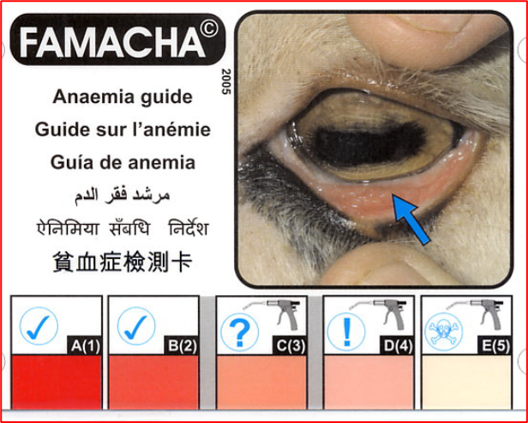
Deworming v/s Adult worms
Matching: Match each type of deworming with its associated scenario.
___ 1. A subclinical horse with a FEC* above specified threshold
___ 2. Regularly scheduled deworming based on PPP**
___ 3. Host showing severe clinical pathology
___ 4. A subclinical goat with a FAMACHA score of D(4)
___ 5. Calf with intense diarrhea and anorexia
___ 6. Used to promote refugia and delay resistance
___ 7. Has led to overuse of dewormers and resistance
*FEC = Fecal Egg Count; **PPP – PrePatent Period
A. Salvage deworming
B. Selective (Tactical) deworming
C. Strategic deworming

Slide 10
Informative Ova
Matching: Match each type of Fecal Diagnostics with its associated use.
A. Fecal Egg Count
B. Fecal Egg Count Reduction Test
C. Both
___ 1. Utilizes the McMasters technique
___ 2. Used to identify Hosts with High Contamination Potential
___ 3. Informs about the presence of Dewormer Resistance
___ 4. Used at end of grazing season to check efficacy of one’s deworming program
Multiple Choice: Choose the best answer.
___ 1. When is the best time to check the efficacy of one’s pasture-borne nematode control program?
A. Beginning of Grazing Season
B. Middle of Grazing Season
C. End of Grazing Season

Slide 11
Fecal Pat
Multiple Choice: Choose the best answer.
___ 1. Which environmental conditions are most detrimental to the free-living stages (ova, L1s, L2s, L3s) of pasture-borne nematodes?
A. High Humidity & Low Temperature
B. Low Humidity & High Temperature
C. Mild Humidity & Mild Temperature

Slide 12
Pasture Management
Matching: Match each type of pasture management with its associated characteristic.
___ 1. Requires much fencing for multiple small pastures.
___ 2. Seldom move herd
___ 3. Avoids Overgrazing
___ 4. Limits Excessive Pasture Contamination with Parasites
___ 5. Not good for Pasture Health nor Parasite Control
___ 6. Allows better recovery of Forage
___ 7. Move herd when grass is eaten down to 4 inches.
A. Continuous Grazing
B. Planned Intensive Grazing

Slide 13
L3s: Treat & Move Rotation
Multiple Choice: Choose the best answer.
___ 1. Which Treat-&-Move Strategy is most likely to produce a monoculture population of Resistant Nematodes?
___ 2. Which Treat-&-Move Strategy inhibits the development of Refugia?
A. Treat & Move
B. Treat, Wait, & Move
C. Move, Wait, & Treat

Slide 14
L3s: Co-grazing Strategies
Matching: Match each type of co-grazing with its associated characteristic.
___ 1. Relies on Host Specificity limitations of the parasite.
___ 2. Relies on Age-Related Immunity (Acquired Immunity) of the host.
___ 3. Horse & Goats grazed together
___ 3. Calves on a pasture first, followed by adult Cows
___ 5. L3s ingested by and die within a non-susceptible host.
___ 6. Cow with Calf at her side
A. Interspecific co-grazing
B. Intraspecific co-grazing
C. Both

Slide 15
Arrested L4s
Multiple Choice: Choose the best answer.
___ 1. Which Life Cycle Stage encysts in the tissues of the host, then later reactivates to be the source of Spring Rise and Periparturient Rise?
A. Ova B. L1s C. L2s D. L3s E. L4s F. Adults
Matching: Match each parasitological event with its associated characteristic.
___ 1. L4s re-activate and become adult worms that produce eggs that contaminate spring pastures.
___ 2. Treat herd at the end of grazing season with larvicide to reduce over-wintering arrested L4s.
___ 3. Reactivation of L4’s after removal of adult worm population.
___ 4. Treat dame before and after parturition.
___ 5. Herd shows this rise at the beginning of the grazing season.
A. Spring Rise
B. Periparturient Rise
C. Both A & B
D. Loss of Premunition

