Slide 1
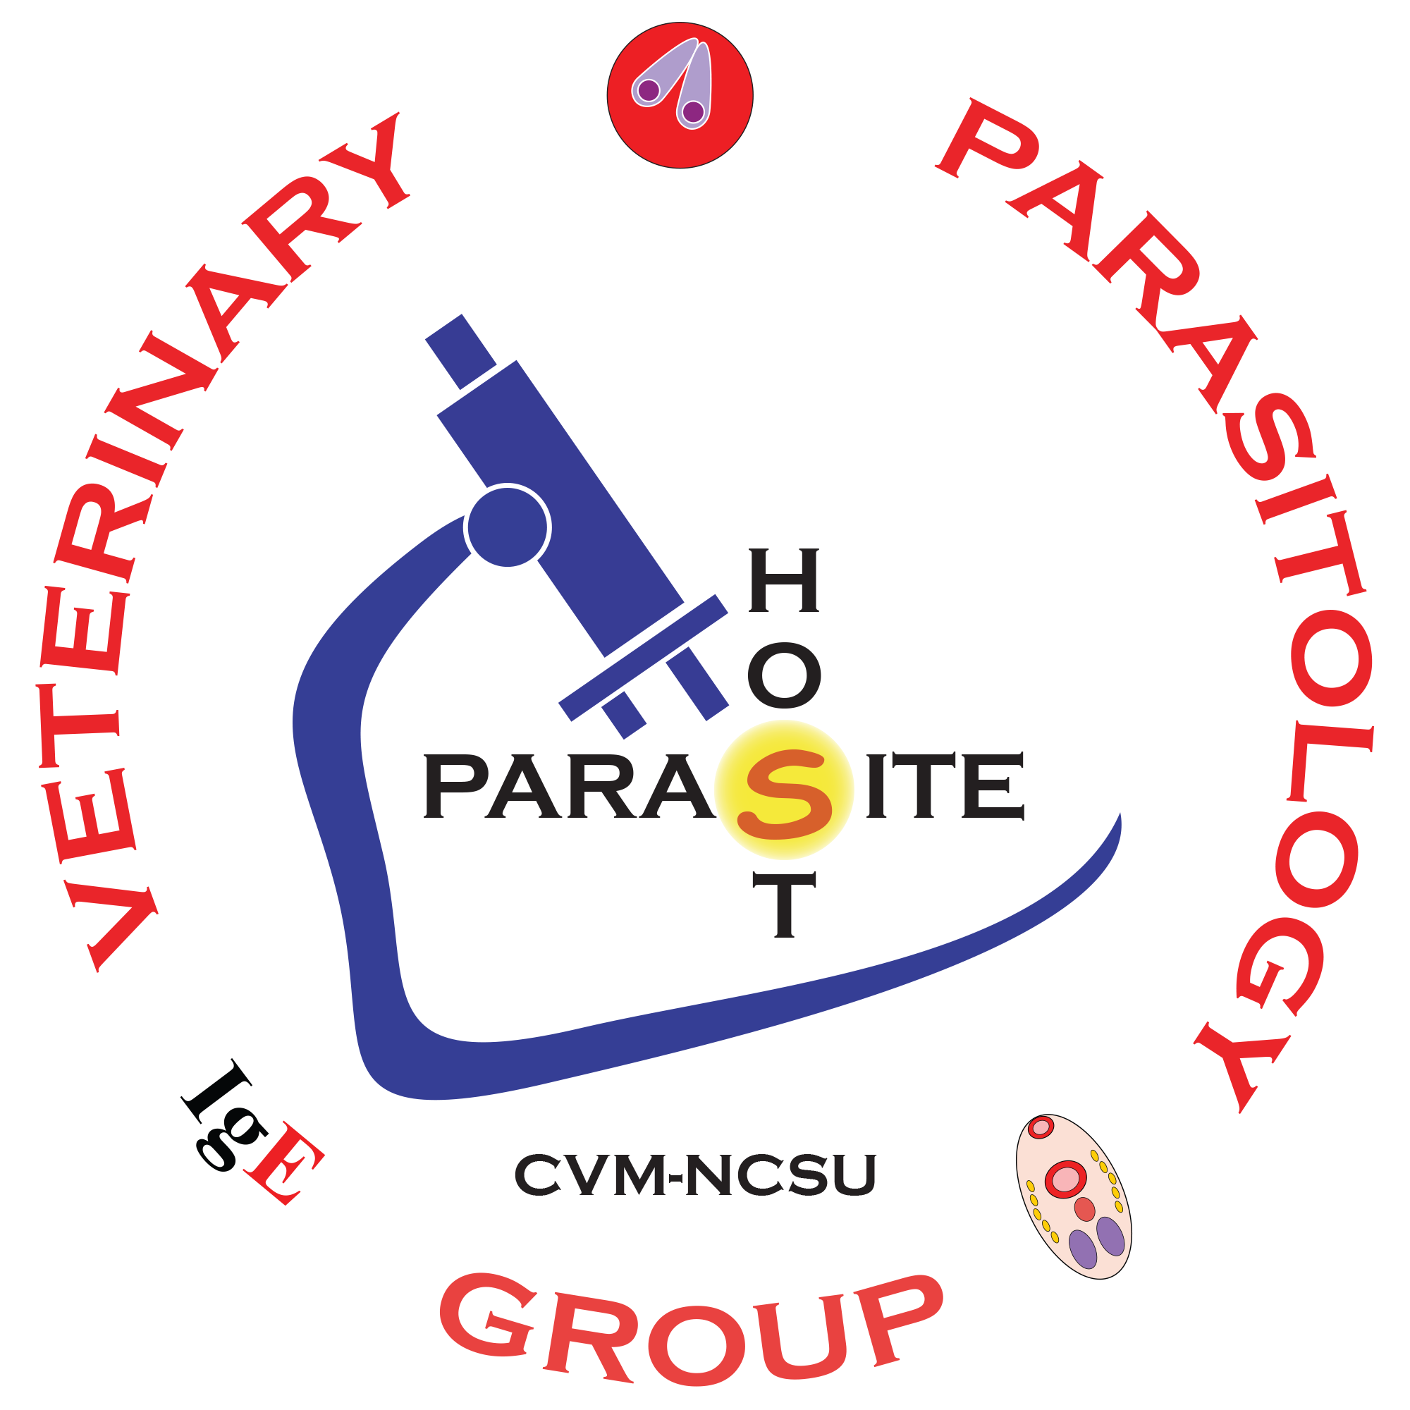
Ostertagia ostertagi
Questions
Nematodes : Strongylids : Trichostrongyles

Slide 2
Primary GINs
Matching: Match each parasite with its associated characteristic.
___ 1. A primary GastroIntestinal Nematode
___ 2. Brown Stomach Worm
___ 3. Most economically important helminth of Cattle
___ 4. Pasture-borne Parasite
___ 5. Causes a disease of calves & young cattle
A. Haemonchus contortus
B. Small Strongyles
C. Ostertagia ostertagi
D. All the above (A, B, C)
True or False
_____ : Acquired Immunity is an important advantage for cattle against GINs, allowing cattle over 2 years old to suffer little to no pathology caused by Ostertagia ostertagi.
_____ : Currently, another advantage for the management of Ostertagia ostertagi, is that dewormer resistance has not been reported for O. stertagi.

Slide 3
Ostertagia ostertagi Pathology & Clinical Signs
Check box: Check the Boxes that apply to the Pathology & Clinical Signs of Ostertagiasis.
dysfunction of the gastric (abomasal) mucosa leading to increased pH; the interruption of digestion, causing a negative nitrogen balance and a systemic increase in protein catabolism.
Acute Anemia and Death
Anorexia, Weight-loss, Stunted Growth
Calves during their 1st & 2nd grazing seasons
Severe colic with potential aortic aneurysm
Hypoproteinemia with bottle-jaw & edema
Profuse & Persistent Watery Diarrhea
Calves with an excessive respiratory rate, frequent coughing, crepitation, harsh bronchial sounds, & air hunger.
Abomasum with Moroccan Leather appearance at necropsy.

Slide 4
Ostertagiasis Type I v/s Type II
Matching: Match each Type of Ostertagiasis with its associated characteristic.
___ 1. The primary cause of pathology is growth, development, and emergence of L4 larvae in the gastric glands.
___ 2. Low Morbidity, High Mortality
___ 3. L4s don’t arrest
___ 4. L3s ingested late 1st grazing season; Pathology early 2nd grazing season
___ 5. Treat 1st grazing season calves, early in the 1st grazing season with an adulticide.
___ 6. Sudden acute pathology due to mass reactivation of arrested L4s.
___ 7. Pathology during Summer & Fall in Cool Region (aka North, ex. Iowa).
___ 8. Pathology in young calves (weanlings).
A. Type I Ostertagiasis
B. Type II Ostertagiasis
C. Both Type I & Type II

Slide 5
Ostertagiasis Type I v/s Type II
Matching: Match each Type of Ostertagiasis with its associated characteristic.
___ 1. Southern Calves grazed in the spring and moved to Northern Feed-lots have pathology in the Fall.
___ 2. Pathology during Fall in Arid Region (aka South, ex. Arizona).
___ 3. High Morbidity, Low Mortality
___ 4. Treat 2nd grazing season calves, late in 1st grazing season with a larvicide.
___ 5. L4s arrest and reactivate later.
___ 6. L3s ”trickle-in” while grazing, thus a slow, progressive pathology.
___ 7. L3s ingested early 1st grazing season; Pathology mid to late 1st grazing season.
___ 8. Pathology in older calves (yearlings).
A. Type I Ostertagiasis
B. Type II Ostertagiasis
C. Both Type I & Type II

Slide 6
Ostertagia ostertagi Control: Pasture Management
Good or Bad: Good or bad pasture management practices for cattle.
A. Good
B. Bad
___ 1. Naïve calves on pasture after older calves.
___ 2. Cow / Calf operations that graze cows and their calves side-by-side.
___ 3. Mix young calves and older calves
___ 4. Naïve calves on fresh pasture before older calves.
___ 5. Use the same pasture for calves every year.

Slide 7
Trichostrongylus colubriformis Pathology & Clinical Signs
Check box: Check the Boxes that apply to the Pathology & Clinical Signs of Trichostrongylus colubriformis.
Protracted Watery Diarrhea.
Acute Anemia and Death
Anorexia, Weight-loss, Stunted Growth
Black Scours
Fly Strike
Moroccan Leather
Dingleberries and Dags

Slide 8
Minor GINs
Matching: Match each Minor GINs with its associated characteristic.
(One blank has more than one answer.)
___ 1. Abomasum or Stomach.
___ 2. Protracted watery diarrhea, anorexia, weight-loss
___ 3. Small Intestine
___ 4. Horses
___ 5. The Bankrupt worm
___ 6. Ruminants
___ 7. May cause issues with co-grazing Horses & Sheep
___ 8. Shows resistance to Macrocyclic Lactones in Cattle
___ 9. Post-winter Larval storms due to mass hatching of over-wintered eggs.
___ 10. Deworm young hosts early in the spring.
A. Trichostrongylus axei
B. Trichostrongylus colubriformis
C. Nematodirus sp.
D. Cooperia sp.
E. All the above

