Slide 1
VMP 930 lecture 20a
Order Ascaridia
Toxocara canis and Toxocara cati

Slide 2
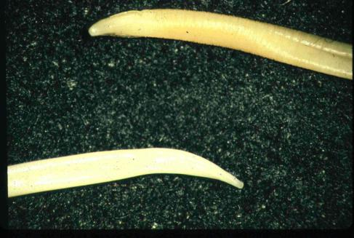
Order ASCARIDIDA (Ascarids)
Adult worms in small intestine are large!
mouth surrounded by 3 fleshy lips
Host-specific, adult stage
Toxocara canis in dogs
Toxocara cati in cats
Ascaris suum in pigs
Parascaris in horses
Baylisascaris in raccoons

Slide 3
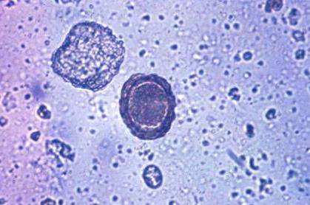
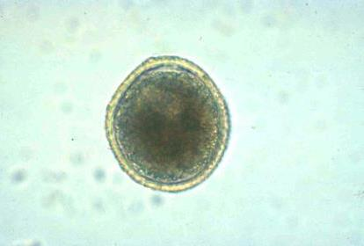
Order ASCARIDIDA (Ascarids)
Eggs are thick-walled (highly resistant), distinctive, contain a single cell. Can persist in soil for years!
Toxocara egg
Ascaris suum egg
thick rough shell
thick rough shell
Notes:
One of the most important features of most ascarids is the long-lived eggs produced in large numbers by female worms. The highly resistant egg protects an infective larva inside.

Slide 4
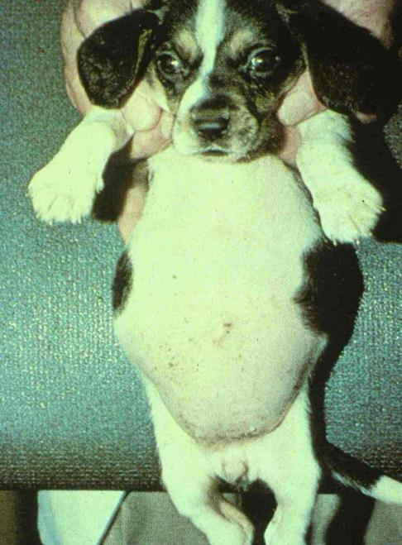
Pot-belly typical of large worm-burden in young
Notes:
Very young hosts show a pot-belly appearance when harboring large numbers of worms as shown here. This is seen in puppies, foals, piglets and human babies.

Slide 5
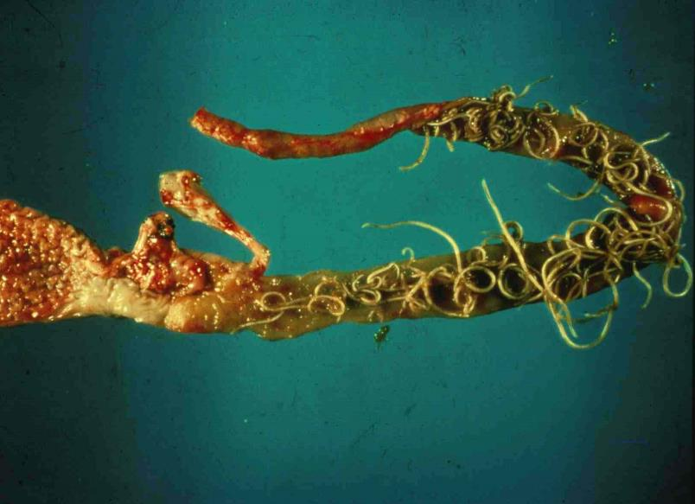
Toxocara canis in duodenum
Notes:
This figure shows the location of adult worms in the duodenum. Large numbers of worms in puppies can lead to adult worms being vomited or passed in feces.

Slide 6
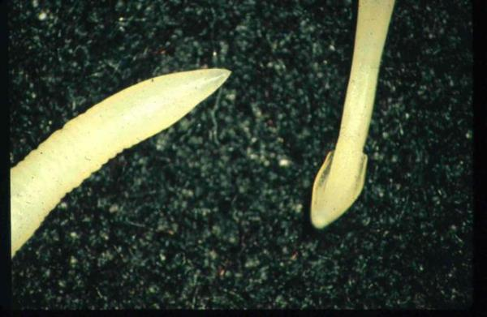
Toxocara canis
very common parasitic problem in dogs
thick, white, large 50-180 mm adult worms
anterior end: cervical alae are expanded
i.e. ‘arrowhead’ worms
posterior end of female
cervical alae at anterior end

Slide 7
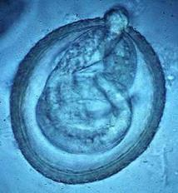
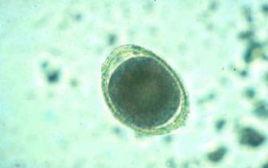
Toxocara canis
Life Cycle
Adult worms live in the small intestine
Female worms produce a large number of eggs
1 cell develops into an infective larva within the eggshell in ~4 weeks
‘Egg’ is ingested
Approx. 4 weeks
egg from fresh feces
L₃ hatching
(in lab experiment)

Slide 8
Toxocara canis: Route of Infection
Direct: Ingestion of infective egg containing larva. Ascarid L₃ are infective when they hatch from egg in the small intestine.
Indirect: Ingestion of paratenic host which contains larva

Slide 9
Toxocara canis: Route of Infection
Larva from ingested eggs can take one of 2 routes depending on host age.
1. tracheal migration results in development of adult worms in the small intestine mostly in puppies under 3 months of age.
2. somatic migration results in infective larvae becoming arrested in tissue of mature dogs.

Slide 10
Toxocara canis: Route of Infection
Larvae from ingestion of a paratenic host containing infective larvae in its tissues.
Usually results in adult worm development without larval migration outside of the intestinal mucosa in a dog of any age.

Slide 11
Toxocara canis: Route of Infection
Reactivation of arrested larvae in tissues of the mother dog during pregnancy
Leads to transuterine infection of the puppies.
Puppies have patent infections as soon as 3 weeks after birth.
Transuterine infection does NOT occur in cats.

Slide 12
Toxocara canis: Prepatent Period
Prepatent period
3 - 5 weeks
~5 weeks if infection starts with ‘egg’ stage
~3 weeks if in utero infection
~3 weeks if ingestion of paratenic host

Slide 13
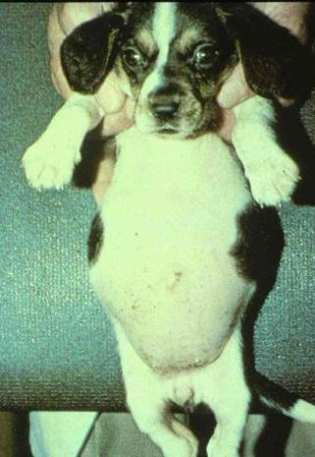
Pathogenesis & Clinical Signs
Gastroenteritis
Inflammation
hypersensitivity
Abdominal pain, pot-bellied, poor coat
Fetid, mucoid diarrhea
Respiratory signs are rare

Slide 14
Diagnosis
Observation of Clinical signs
Fecal
can be negative unless > 3-5 weeks old
Adult worms in vomit or in feces

Slide 15
Treatment & Control
Adults and larvae in intestines - many drugs effective
Arrested larvae - drugs less effective
Deworm dam (timing of monthly prophylaxis)
Deworm newborn puppies
start at 2-3 weeks till monthly heartworm preventative started
Environment
Clean surfaces, dispose of feces
wash hands thoroughly after handling

Slide 16
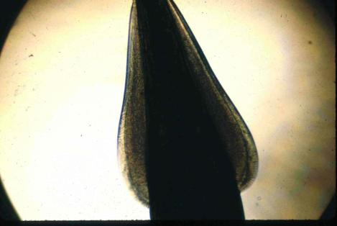
Toxocara cati
small intestine of cats
similar to T. canis but …
More prominent cervical alae
Adult cats often get patent infections by ingestion of paratenic (transport) hosts
Transmission to kittens:
transmammary transmission is important but queen must have been infected during pregnancy
no transuterine transmission
PPP ~ 8weeks from ingested egg
Cervical alae

Slide 17
Toxocara cati
Treatment of kittens from 6-8 weeks of age
Pyrantel, fenbendazole, ivermectin
Visceral larva migrans in humans
Avoid contaminated sand boxes and gardens

Slide 18
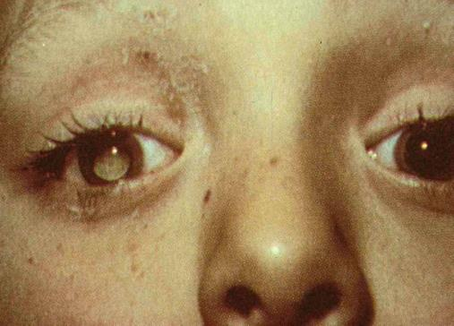
Zoonosis: Visceral larva migrans
Migration of larvae in tissues of aberrant host (ex. Humans)
ingestion of infective egg
Beware cat frequented sand boxes and gardens
Ocular larvae migrans
children with granulomatous reaction to larvae in eye
14% of people have antibodies to Toxocara

Slide 19
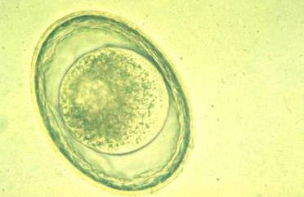
Toxascaris leonina
<1% prevalence - dogs, cats
eggs oval, smooth shell
Infection
ingestion of eggs or infected
paratenic host only
PPP 8-10 weeks
mild clinical signs
no visceral larva migrans

Slide 20
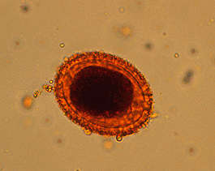
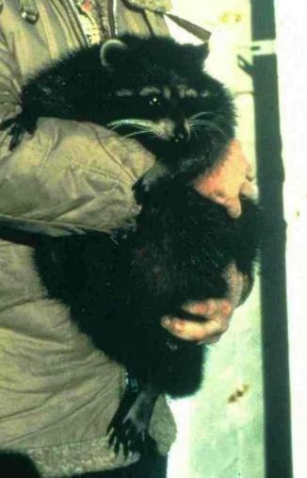
Baylisascaris procyonis
Baylisascaris egg
Raccoons
May infect dogs exposed to raccoon latrines
Very aggressive visceral larva migrans, neurological signs
Granular shell surface

Slide 21
VMP 930 lecture 20b
Parascaris equorum in horses

Slide 22
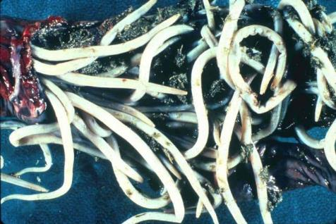
Parascaris equorum
The Ascarid of horses
Common on breeding farms
Target of routine deworming starting at 2-3 months of age.
Why at this age?
small intestine of young horses < 2 yrs
adult worms are large, thick-bodied
This figure shows a ruptured small intestine that occurred shortly after a first-time deworming of a 4-month-old foal.

Slide 23
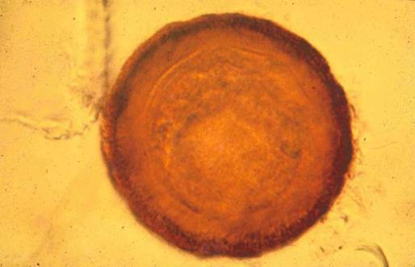
Parascaris equorum
Transmission
Ingestion of an infective egg is the ONLY route of infection
Fresh passed eggs require 10 – 14 days to develop infective larva within eggs.
Notes:
Fresh passed eggs require 10 – 14 days to develop infective larva within eggs.

Slide 24
Parascaris equorum
Life Cycle
Egg containing infective larva (takes ~10-14 days)
Larvae migrate to liver, lungs, coughed up and swallowed, returning to the small intestine in 2-4 weeks after ingestion
Prepatent period ~ 80 days
Notes:
Remember this prepatent time (~80 days). It is the reason for starting routine deworming of foals at 2 – 3 months of age.

Slide 25
Parascaris equorum
Pathogenesis
Respiratory problems
congestion due to parasite antigens/allergy
migration of larvae
Intestinal problems
enteritis, obstruction, perforation

Slide 26
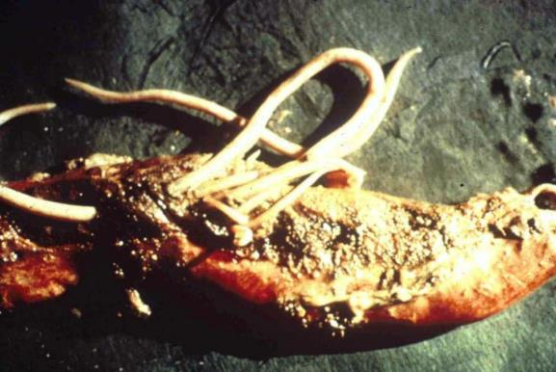
Parascaris equorum
Clinical signs:
diarrhea – odorous
potbellied appearance
rough hair coat
respiratory signs
Suboptimal Growth

Slide 27
Parascaris equorum
Treatment & Control:
clean environment
adult worms are very fecund
eggs are very resistant and sticky!
mare: clean teats & udder
deworm foal at 2-3 months, q 2 months till ~1 year of age.
Drug resistance to avermectins is common.

Slide 28
Parascaris equorum
If you suspect a heavy infection, do NOT use a potent drug at full dosage (e.g. benzimidazole). WHY?

Slide 29
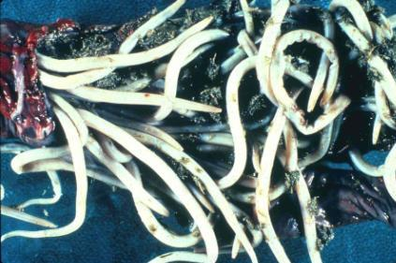
Parascaris equorum
If you suspect a heavy infection, do NOT use a potent drug at full dosage (e.g. benzimidazole). WHY?
LARGE worms causing impaction, anaphylaxis.
So, use a lower dose or mild drug + mineral oil
(For a clinical presentation of the consequences see: “What is your diagnosis?” in Supplemental Course Materials at https://parasitology.cvm.ncsu.edu/vmp930/supplement/parascaris_impaction.pdf )

Slide 30
VMP 930 lecture 20c
Ascaris suum in pigs
Ascaridia in birds

Slide 31
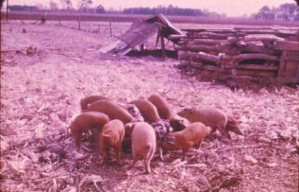
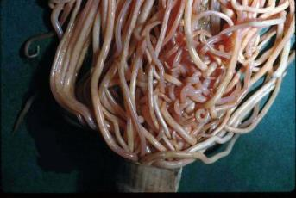
Ascaris suum
Ascarid of Pigs
Eggs: thick shelled, rough, brownish, oval
1 female can produce 200,000 eggs/day
Potential for large Ascaris suum infections
Ascaris suum egg
egg from fresh pig feces
Impaction of pig jejunem with Ascaris suum
Notes:
No opportunity for transmission in confinement reared pigs because of sanitation and short time pigs are in finishing pens.

Slide 32
Ascaris suum
Life Cycle
Only 1 route of infection:
INGESTION of infective egg
requires 10-14 days for egg to be infective
Larvae migrate, coughed up and swallowed back into the small intestine in 7-8 days p.i.
Prepatent period ~ 60 days
Notes:
This same life cycle is used by Ascaris suum, Ascaris lumbricoides (human), and Parascaris equorum.

Slide 33
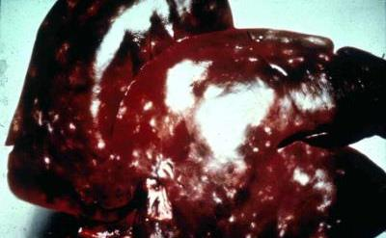
Ascaris suum
PATHOGENESIS
Especially with repeated infection
Lungs
hemorrhage, edema, eosinophils/cells
Liver
focal fibrosis = ‘milk spots’
$ loss, even though edible
Intestine
hypertrophy of muscle layer
(causes distended abdomen and poor nutrient absorption)
Focal fibrosis

Slide 34
Ascaris suum
CLINICAL SIGNS
coughing = ‘thumps’, rapid, shallow expiration
stunted growth
diarrhea

Slide 35
Ascaris suum
Treatment & Control
clean environment - adult worms are very fecund, eggs are very resistant and sticky!
deworm sows 2 weeks before farrowing & wash thoroughly to get rid of those sticky eggs
most drugs work
PYRANTEL kills newly hatched larvae in the intestine when it is used as a feed additive
Avermectin and benzimidazole class of drugs should kill migrating and adult stages
Notes:
Be sure to check efficacy of avermectin and benzimidazole classes of drugs for possible drug resistance by Ascaris suum. There are reports of albendazole resistance in human Ascaris.

Slide 36
Ascaridia sp.
One ascarid of birds
Adults inhabit the Small intestine
Relatively large worm, 5 – 10cm
Males have distinctive pre-anal sucker
Only route of infection is by ingestion of egg
prepatent time = 4-8 weeks
Pathology is in young birds (< 3 months)
hemorrhagic enteritis, anemia and diarrhea
blockage with heavy burdens

Slide 37
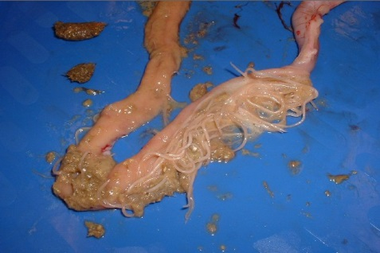
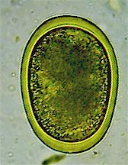
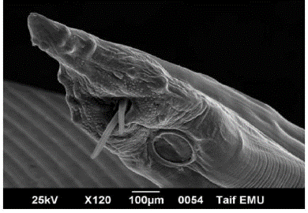
Ascaridia galli
Posterior of male Ascaridia
Pre-cloacal sucker
Oval egg with smooth thick shell
Ascaridia in small intestine of a bird
Notes:
Easy to identify at postmortem exam by location and size of adult worms. Ova are difficult to distinguish from Heterakis gallinarium (cecal ascarid)

Slide 38
Heterakis gallinarum
Another ascarid of birds
AKA “Cecal Worm”
cecum of chicken, turkeys, etc.
bird is infected either by
ingestion of egg containing infective larva
OR
infected transport host - earthworm
Heterakis is relatively NON-pathogenic
but it can carry a protozoa (Histomonas) that is deadly for turkeys.

Slide 39
Heterakis gallinarum in turkeys
Heterakis gallinarum
eggs & larvae are
carriers of a protozoa, Histomonas meleagridis
severe ‘blackhead’ disease in turkeys only;
(not in chickens)
inflammation/necrosis of cecum & liver
high mortality
Blackhead disease in turkeys
Pathology
inflammation/necrosis of cecum & liver
High mortality
Doesn’t affect chickens
Epidemiology
Etiological agent = Histomonas meleagridis (protozoan)
Heterakis eggs and larvae are carrieirs of Histomonas.
Turkeys become infected when they ingest Heterakis eggs or larvae, which carry Histomonas.

Slide 40
Heterakis gallinarum in turkeys
To control ‘blackhead’ disease
Must control Heterakis nematode infections:
Deworm
Clean up the environment
Don’t house turkeys with chicken, or use areas that previously housed chickens

