Slide 1
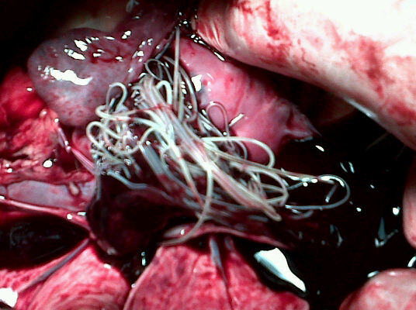
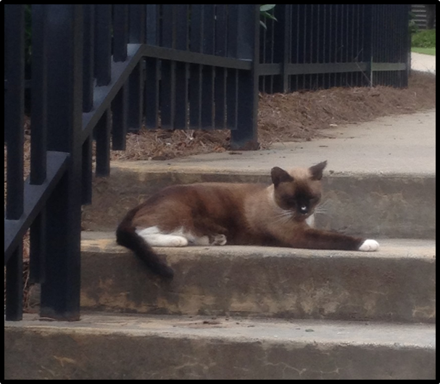
Heartworm: Biology through Prevention

Slide 2


The Ivory Tower

Slide 3
Outline
Prevalence-Dog/Cat
Life Cycle-Dog/Cat
Pathology-Dog/Cat
Signs-Dog/Cat
Diagnosis-Dog/Cat
Treatment-Dog/Cat
Prevention-Dog/Cat

Slide 4


Slide 5
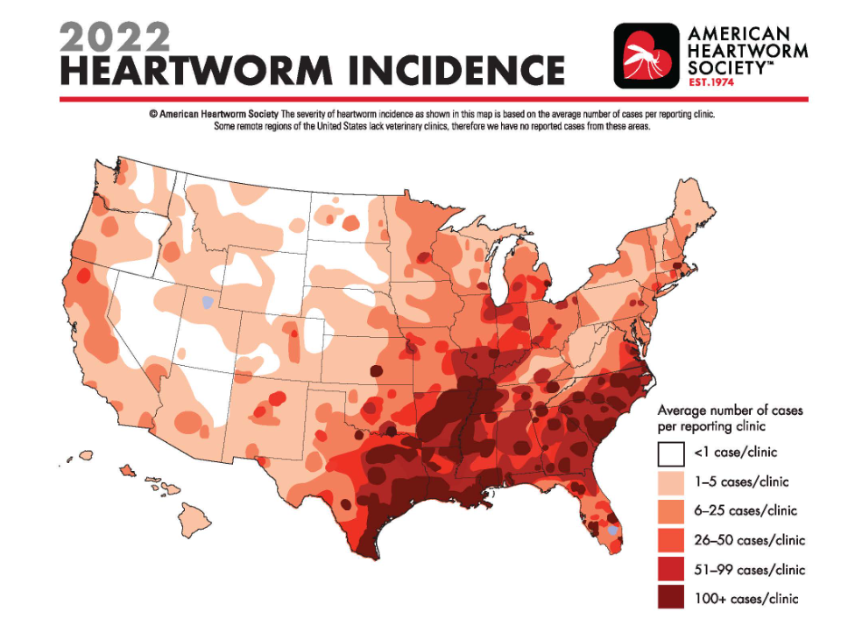

Slide 6

www.capcvet.org

Slide 7
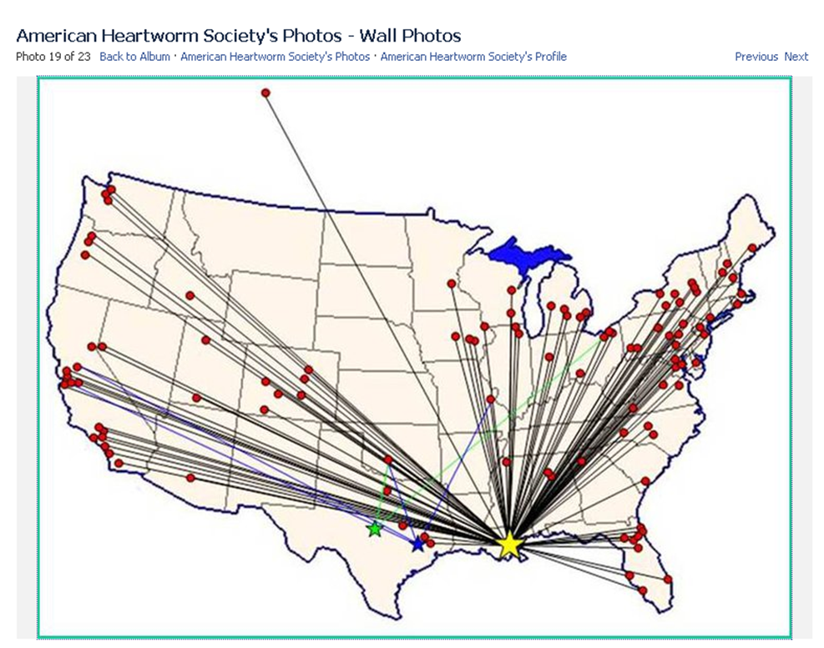

Slide 8
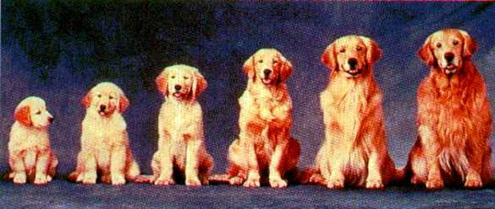
All Ages susceptible to infection

Slide 9
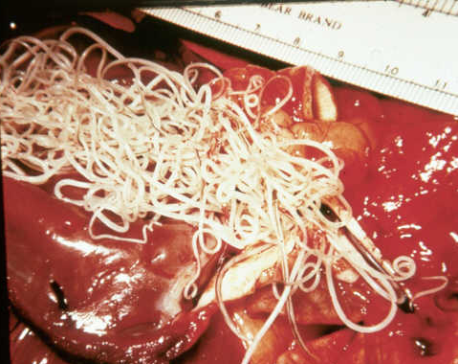
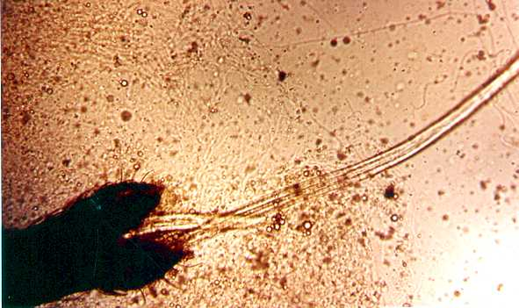
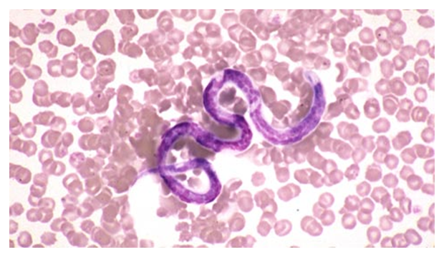
Dirofilaria immitis: Important Stages
Adult worms
  Females 10 –12 inches
  Males 4 – 6 inches
  May live for 5 - 7 years in dogs
  Pulmonary arteries
Microfilariae (MF)
  ~ L₁ ( > 300 μm )
Larvae develop in mosquito IH
  MF to L₃
  Infective, third-stage larvae L₃ ( 1 mm)
L₃ to adult in DH

Slide 10
Remember:
Microfilariae
are not
L3s

Slide 11
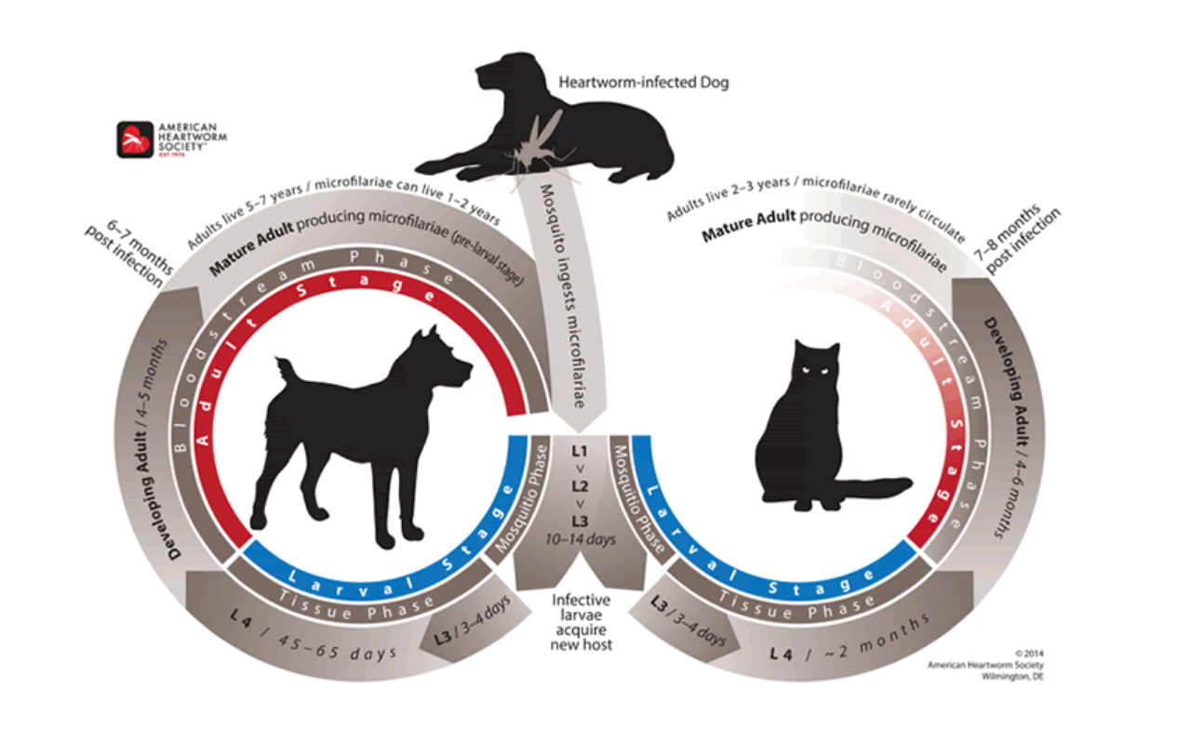
Melarsomine
Prevention

Slide 12
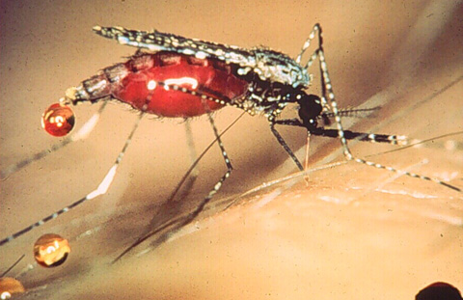
Dirofilaria immitis & Vector
http://cal.vet.upenn.edu/projects/merial/introduction/images/mosquitof.jpg

Slide 13
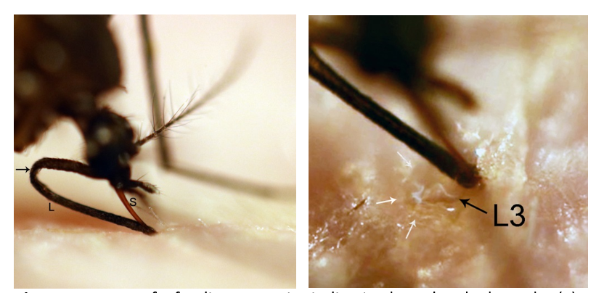
Courtesy of Dr. Steve Jones

Slide 14
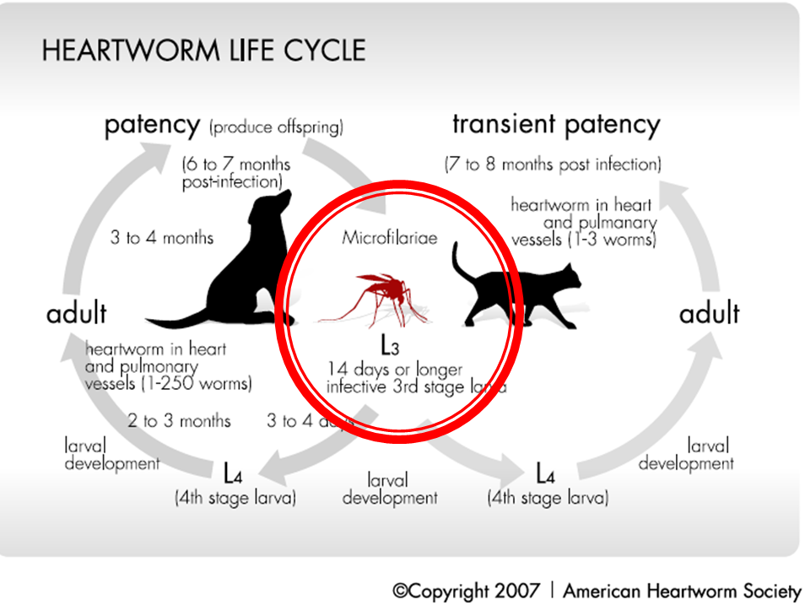
Dirofilaria immitis Life Cycle

Slide 15
Most of what we know…
AJVR Dec. 1982

Slide 16
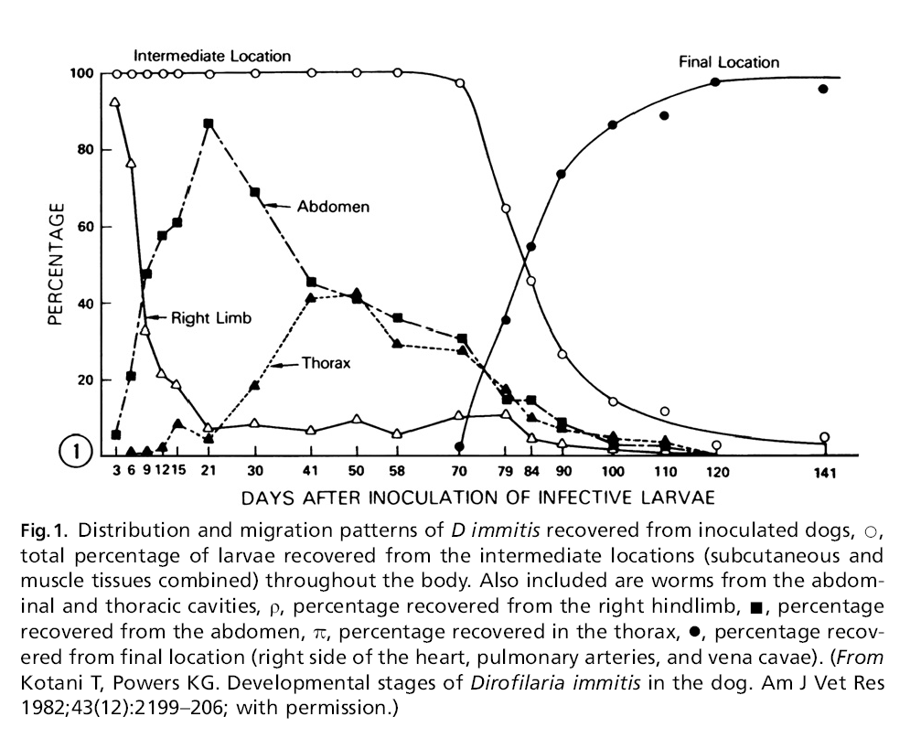

Slide 17
Important Life Cycle Facts-CANINE
Normal development from L1 to L3 in the mosquito is 10-14 days
L3 is the infective stage
By day 70 (juvenile adult stage), they are in the pulmonary vessels
  THIS MEANS DAMAGE CAN START.
Adults by 6 months
  Start producing microfilariae (the babies)

Slide 18
Dirofilaria immitis Life Cycle

Slide 19
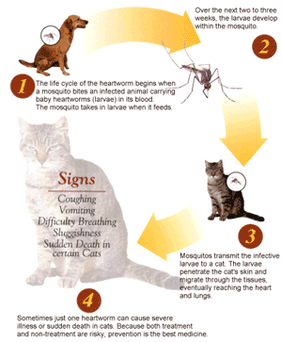
Life Cycle of D. immitis in Cats
Life cycle the same but takes longer to complete (7-8 months)
Adult worms do not live as long in cats (2-3 yrs) as they do in dogs (5-7 yrs)
Cats more likely to have aberrant migration of worms
  Aberrant migration of worms to ectopic sites (CNS, eyes, body cavities, arteries other than pulmonary, skin, etc.)

Slide 20
Life Cycle of D. immitis in Dogs vs. Cats
 | Dog | Cat
Time to Adulthood | 6-7 months | 7-8 months
Microfilaremia | Yes | transient
Aberrant migration | Rare | Eyes, CNS
Numbers present | Few to many | <5
Lifespan | 5-7 years | 2-3 years

Slide 21
Feline HWD-Life cycle
Few worms can cause life-threatening Dz
  Cats usually infected with < 5 worms
  Diagnosis more difficult
    may be only 1 - 2 female worms present, if any
Cats only have a transient microfilaremia
  < 5% of infected cats are MF + at time of exam
  become infected from mosquitoes that have fed on infected dogs

Slide 22
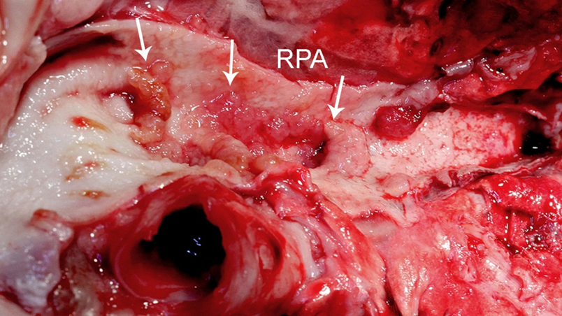
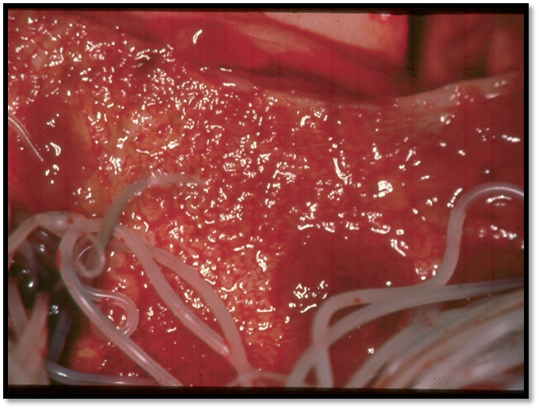
Courtesy of Dr. Steve Jones

Slide 23
Pathology
Multiple organ disease
  heart, lungs, liver, kidney
Severity of disease can depend on:
  Numbers of adult worms
    More is not better
  Duration of infection
    Longer is worse
  Individual host response

Slide 24
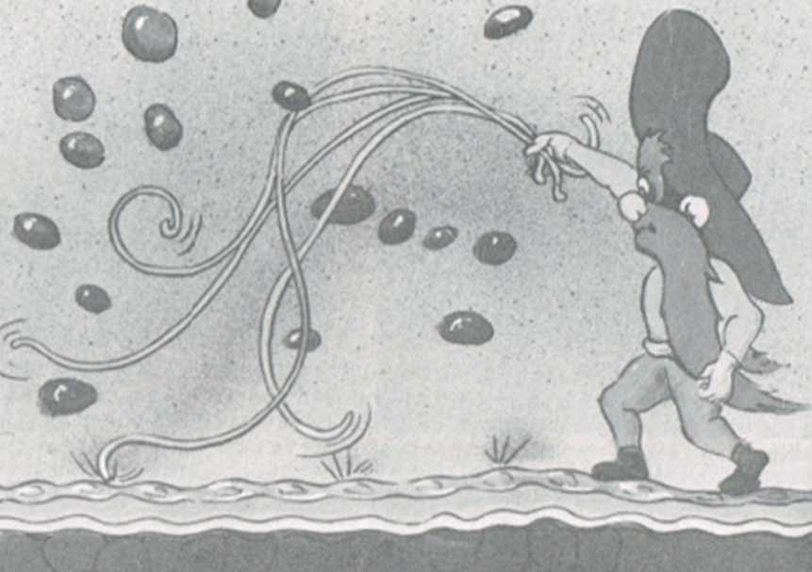


Pulmonary arterial disease
  Inflammation
    Endarteritis
  Villous thickening of tunica intima
    1 - 3 months after worms arrive in heart
From “Heartworm Disease in Dogs and Cats”
by Rawlings

Slide 25
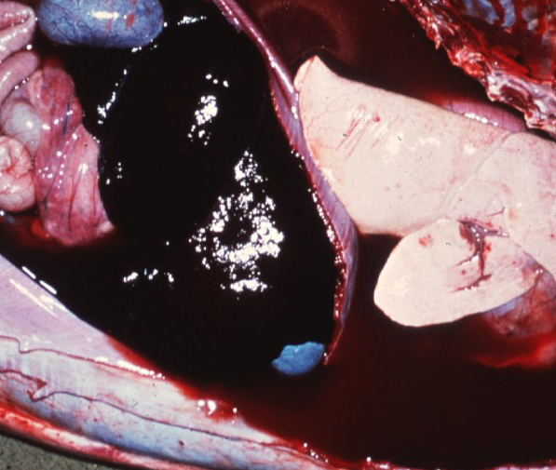
Pathology
Thickening of vessels
Loss of vessel elasticity
Leads to increased pressure
  chronic, passive congestion and pulmonary hypertension
    right heart enlargement
    hepatomegaly
    congestive heart failure -- ascites

Slide 26
Damage

Slide 27
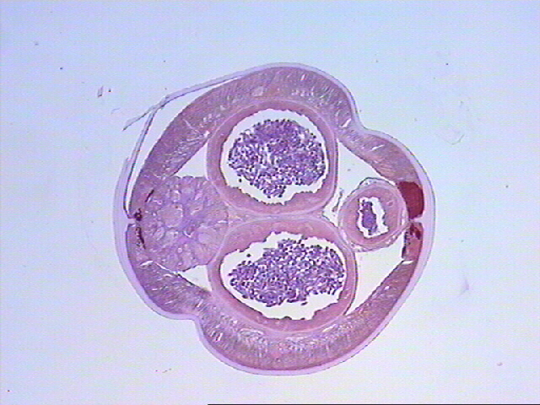
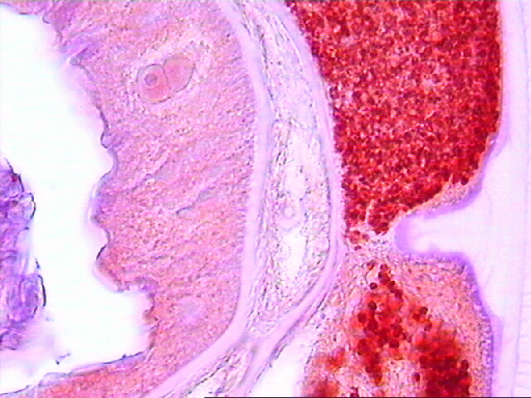
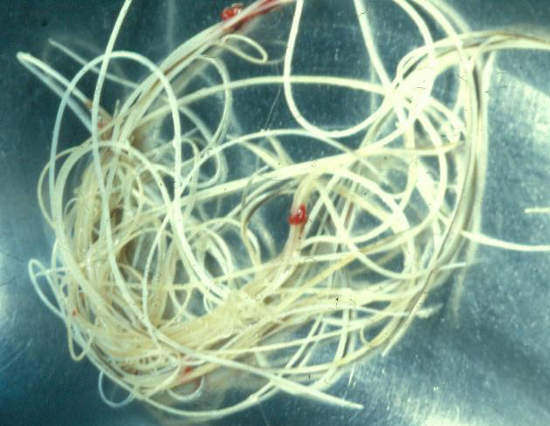
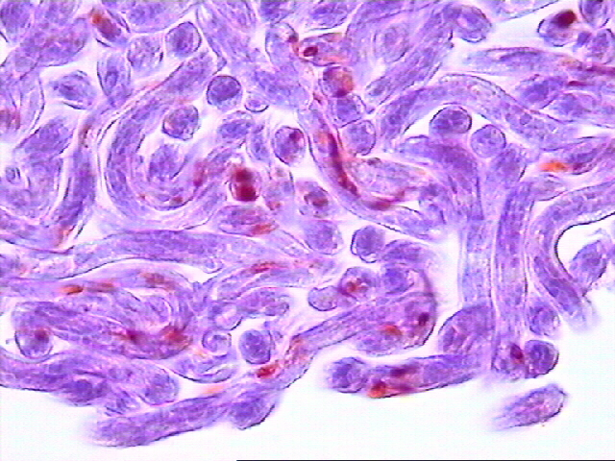
Most species of Filarioid nematodes harbour
bacterial endosymbionts named Wolbachia
Wolbachia in the lateral chords
Wolbachia in mf
Dirofilaria immitis
Immunohistology by Laura Kramer

Slide 28

Wolbachia: A component of inflammatory disease pathogenesis in filarial infections
Important role in pathogenesis of filarial diseases
Wolbachia-associated proteins
  induce innate inflammatory responses by macrophages and neutrophils

Slide 29
Feline HWD: Pathophysiology
3 stages of Disease
Worms reach lung blood vessels (3 – 4 months post infection) they induce an acute inflammatory response
-HARD“heartworm-associated respiratory disease”
-DDx asthma
2. When mature worms begin to die the degenerating worms induce pulmonary inflammation and thromboembolism
3. Chronic respiratory disease
1.
2.
3.

Slide 30
Manifestation of Pathology
Clinical signs
  Acute
    Caval Syndrome

Slide 31
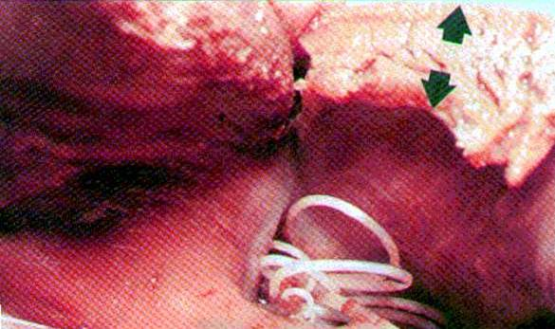
Caval Syndrome
Large numbers of worms
  obstruct blood flow through tricuspid valve
Rapid onset
Death usually within 12 - 72 hours

Slide 32
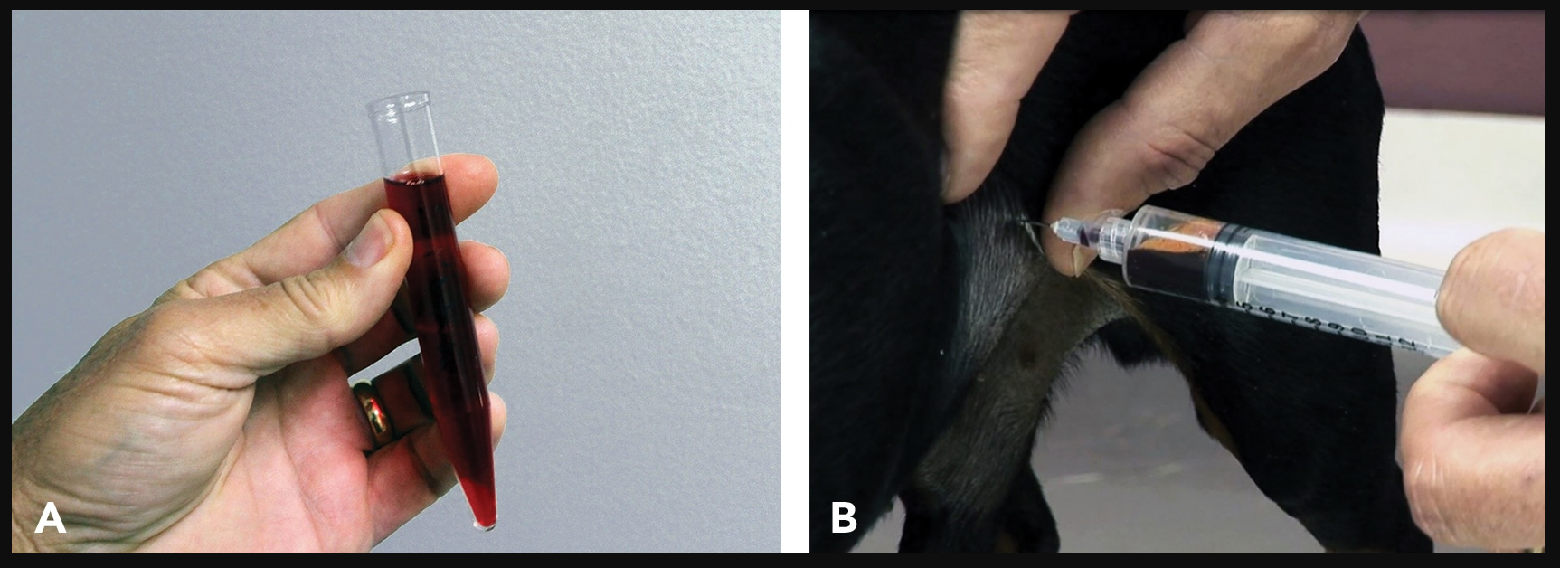
Caval Syndrome-Hemoglubinuria

Slide 33
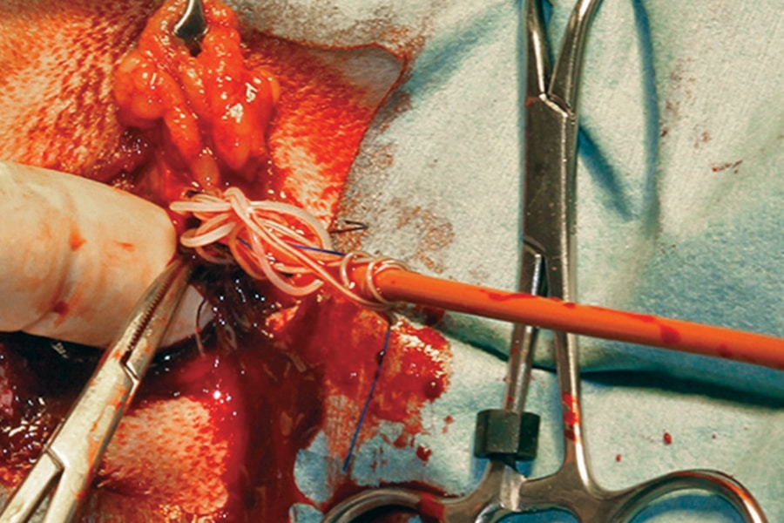
Caval Syndrome
Poor candidates for treatment
TOC = surgical removal of worms via jugular vein

Slide 34
Manifestation of Pathology
Clinical signs
  Acute
    Caval Syndrome
  Chronic

Slide 35
Determinants of Clinical Consequences
Relative # of worms
Individual’s reaction to parasite
Duration of infection
EXERCISE / ACTIVITY LEVEL
Courtesy of M. Ames

Slide 36

Assessing the patient
History, PE, exercise tolerance
Immunodiagnosis/+/- test for MF
Serum Chemistry/Hematology
  Liver Function
UA
Radiography
Cardiac US and ECG

Slide 37
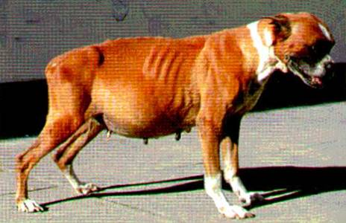
Chronic Heartworm Disease-Signs
May be asymptomatic
Symptomatic
  mild to moderate
    chronic cough
    dyspnea
    decreased exercise tolerance
  moderate to severe
    syncope
    hemoptysis
  severe
    congestive heart failure

Slide 38
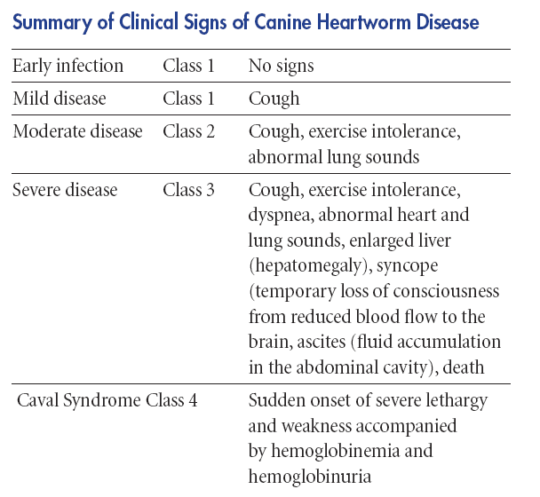
Summary of Clinical Signs-CANINE
O O
)
O O
___
O O
)
X X
)

Slide 39
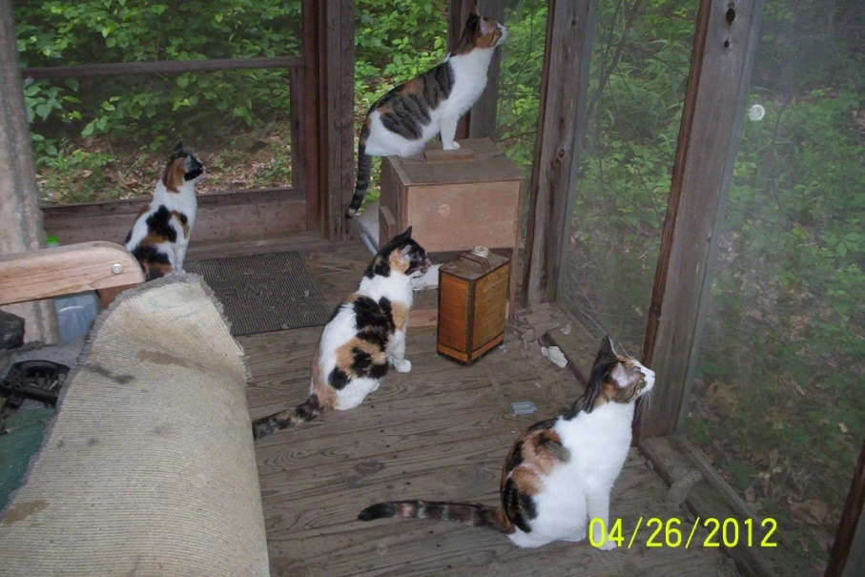
Feline HWD
Clinical Presentation
About 33% of all cases reported in cats housed totally indoors
  Are they really indoors?
  No such thing as an outdoor-only mosquito

Slide 40
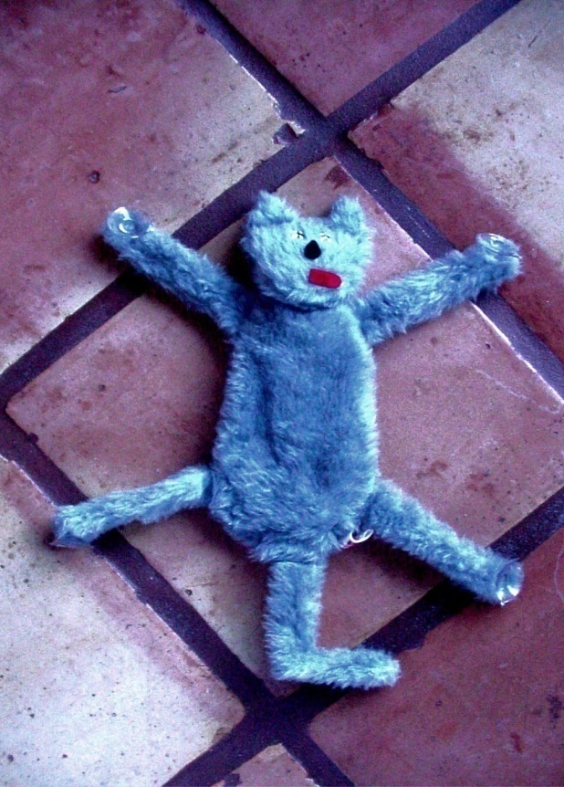

Feline HWD
Clinical Signs
Infected cats can be asymptomatic
  Some infected cats have severe disease
Common signs with chronic disease:
  coughing, dyspnea
  vomiting unrelated to eating
  lethargy, anorexia, weight loss
  systolic heart murmur
Infrequent signs – acute disease
  respiratory distress, hemoptysis
  ataxia, seizures, blindness
  sudden death

Slide 41
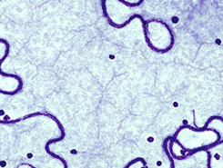
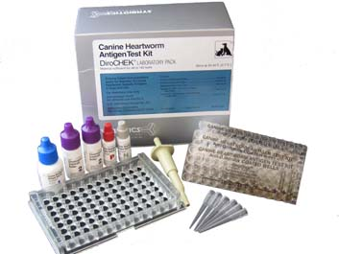
Testing
Microfilaria
Antigen

Slide 42

When should I test?
You suspect the animal has heartworm
Routine annual exam
Test immediately!

Slide 43

Routine testing
Routine
  Screening
  Changing products
False negatives
  Light infections
  Male infections
  Test instructions not followed
  Immature females

Slide 44
Immunodiagnosis of HW Infections
Adult Heartworm Antigen Kits
DETECTS FEMALE UTERINE ANTIGEN
Highly sensitive and specific for infections
CAN DETECT AS EARLY AS 6 MONTHS
Detects only infections with female worms
  single sex infections w/ only males not detected
  does not detect prepatent infections (< 5 mo.)
  older worms produce more antigen
Can be used to determine effectiveness of adulticidal treatment

Slide 45
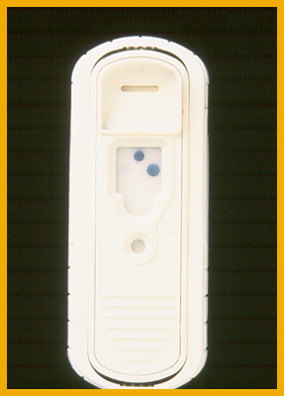

Types of Immunodiagnostic Tests
  ELISA
  Immunochromatographic (lateral flow)
    uses colored gold colloidal particles tagged to monoclonal antibodies to visualize the presence of adult worm Ag

Slide 46
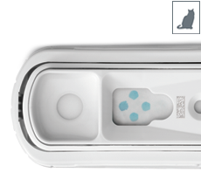
Feline HWD – Immunodiagnosis
Antigen Tests
Same tests available as for dogs but much less sensitive
  Few females
    Low worm burden
    Could be male only infection
Positive test=diagnostic
Negative test is not definitive
  Pursue other methods of diagnosis

Slide 47
Feline HWD – Immunodiagnosis
Antibody Tests
Highly sensitive
  detect infections by 2 -3 months PI
BUT -- titers remain high for extended periods after death of worms
Positive test indicates a cat has been infected
  NOT -- that it has adult worms in the heart and lungs
Negative test strongly suggests that cat is not infected and has not been infected recently

Slide 48
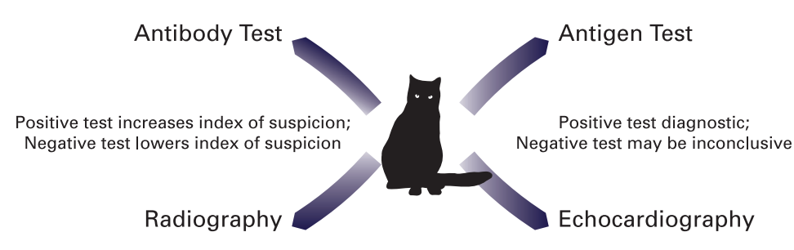
HW testing in cats-Summary
Combining results from Ag and Ab tests achieves greater sensitivity than using either test alone

Slide 49
When should I test?-CANINE
0
6
infection
Ag/MF
Months post-infection
Practically, you are going to test at 6 months

Slide 50
YOU Won’t detect infection during the prepatent time
0
6
infection
MF
2-3
Months post-infection

Slide 51
When should I test puppies?
L3s
Heartworm prepatent period
0
1
2
5
6
7
8
6-8
Start
Prev.
Test Puppies
Ag/MF
Puppy age in months

Slide 52
Testing
Microfilaria
Antigen

Slide 53
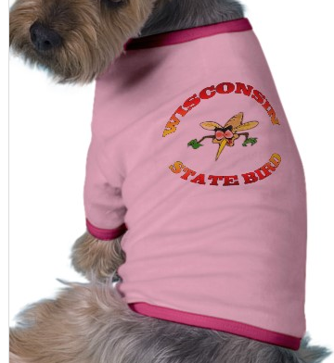
Why MF test?
Confirms (+) Ag test
Identifies reservoir of infection

Slide 54
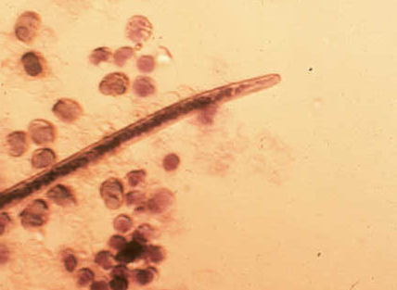
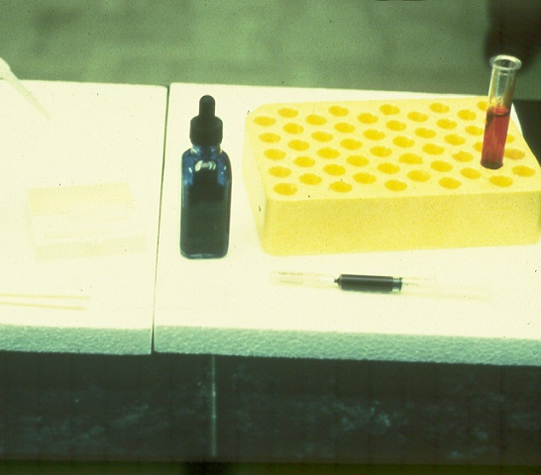
Diagnosis: Detection of microfilariae
Examination of blood for MF
  direct smear - detects ~75% of patent infections
  concentrations techniques
    Knott test
  Must differentiate MF of D. immitis and A. reconditum

Slide 55
Diagnosis: Detection of microfilariae
Why does this not matter in a cat?

Slide 56
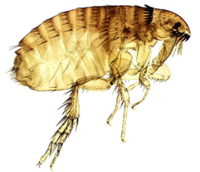
Acanthocheilonema (Dipetalonema) reconditum
Adult worms in subcutaneous tissue
Microfilariae in blood
Transmitted by fleas
Nonpathogenic
Major importance
  Must differentiate MF of D. immitis and A. (D.) reconditum

Slide 57
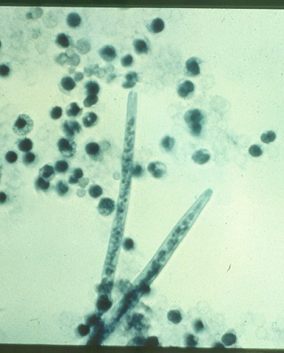
Identification of MF
 | D. immitis | A. reconditum
Length (microns) | 286-340 (usually >300) | 258-292 (always < 300)
Shape of anterior end | tapered | blunt (broom handle)
Number present | few to many | usually few
Movement (direct smear) | stationary | progressive
A. r.
D. i.

Slide 58
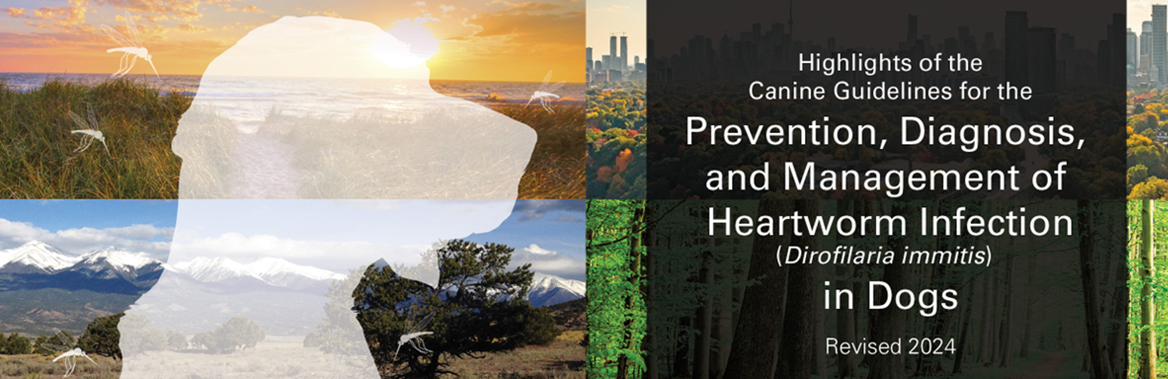

Slide 59
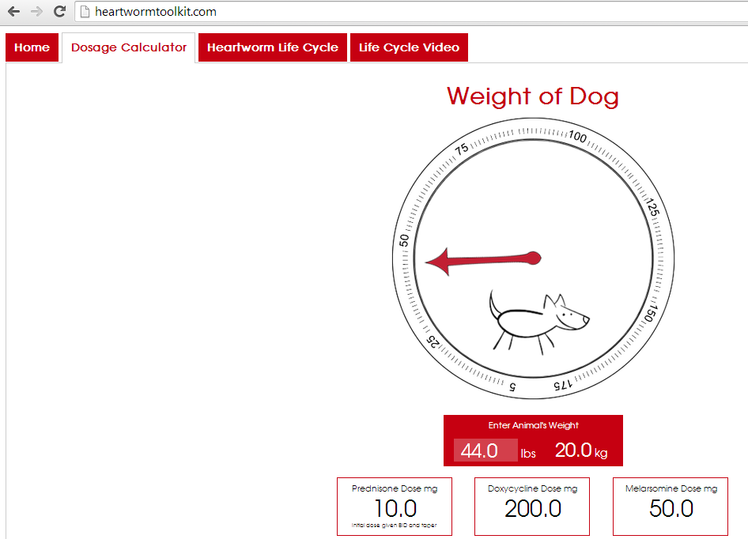
Keeping it all straight

Slide 60
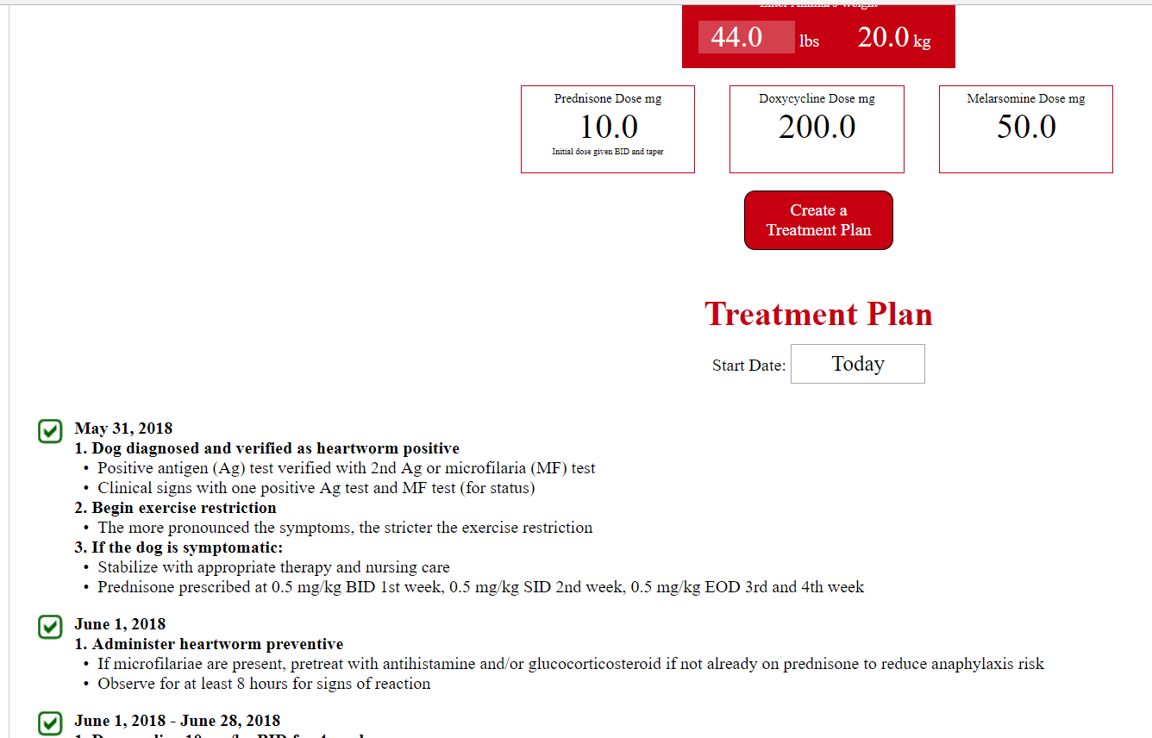
heartwormtoolkit.com

Slide 61
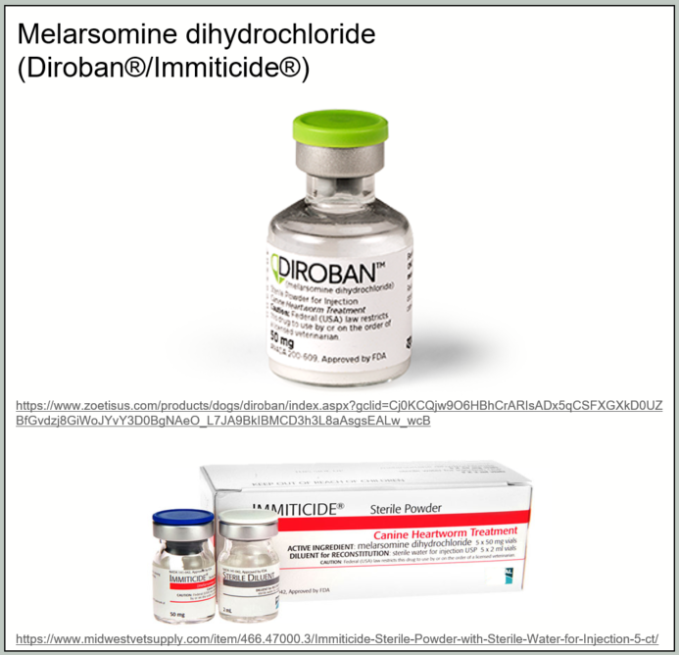

Slide 62

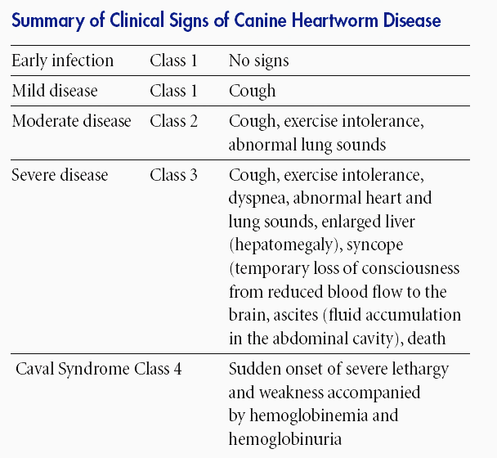
O O
)
O O
___
Pulmonary thromboembolism (PTE) after treatment
O O
)
X X
)

Slide 63
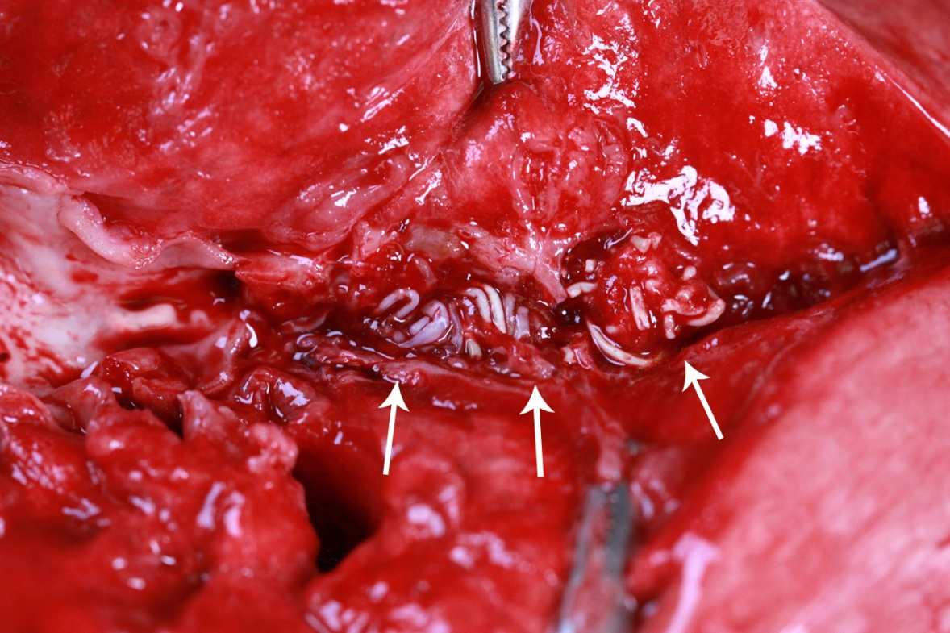
Courtesy of Dr. Steve Jones

Slide 64
Pulmonary Thromboembolism
More worms, more pathology
Clinical Signs of embolism = fever, cough, hemoptysis
Usually evident within 7-10 days but may occur for up to 4 weeks post-Tx

Slide 65

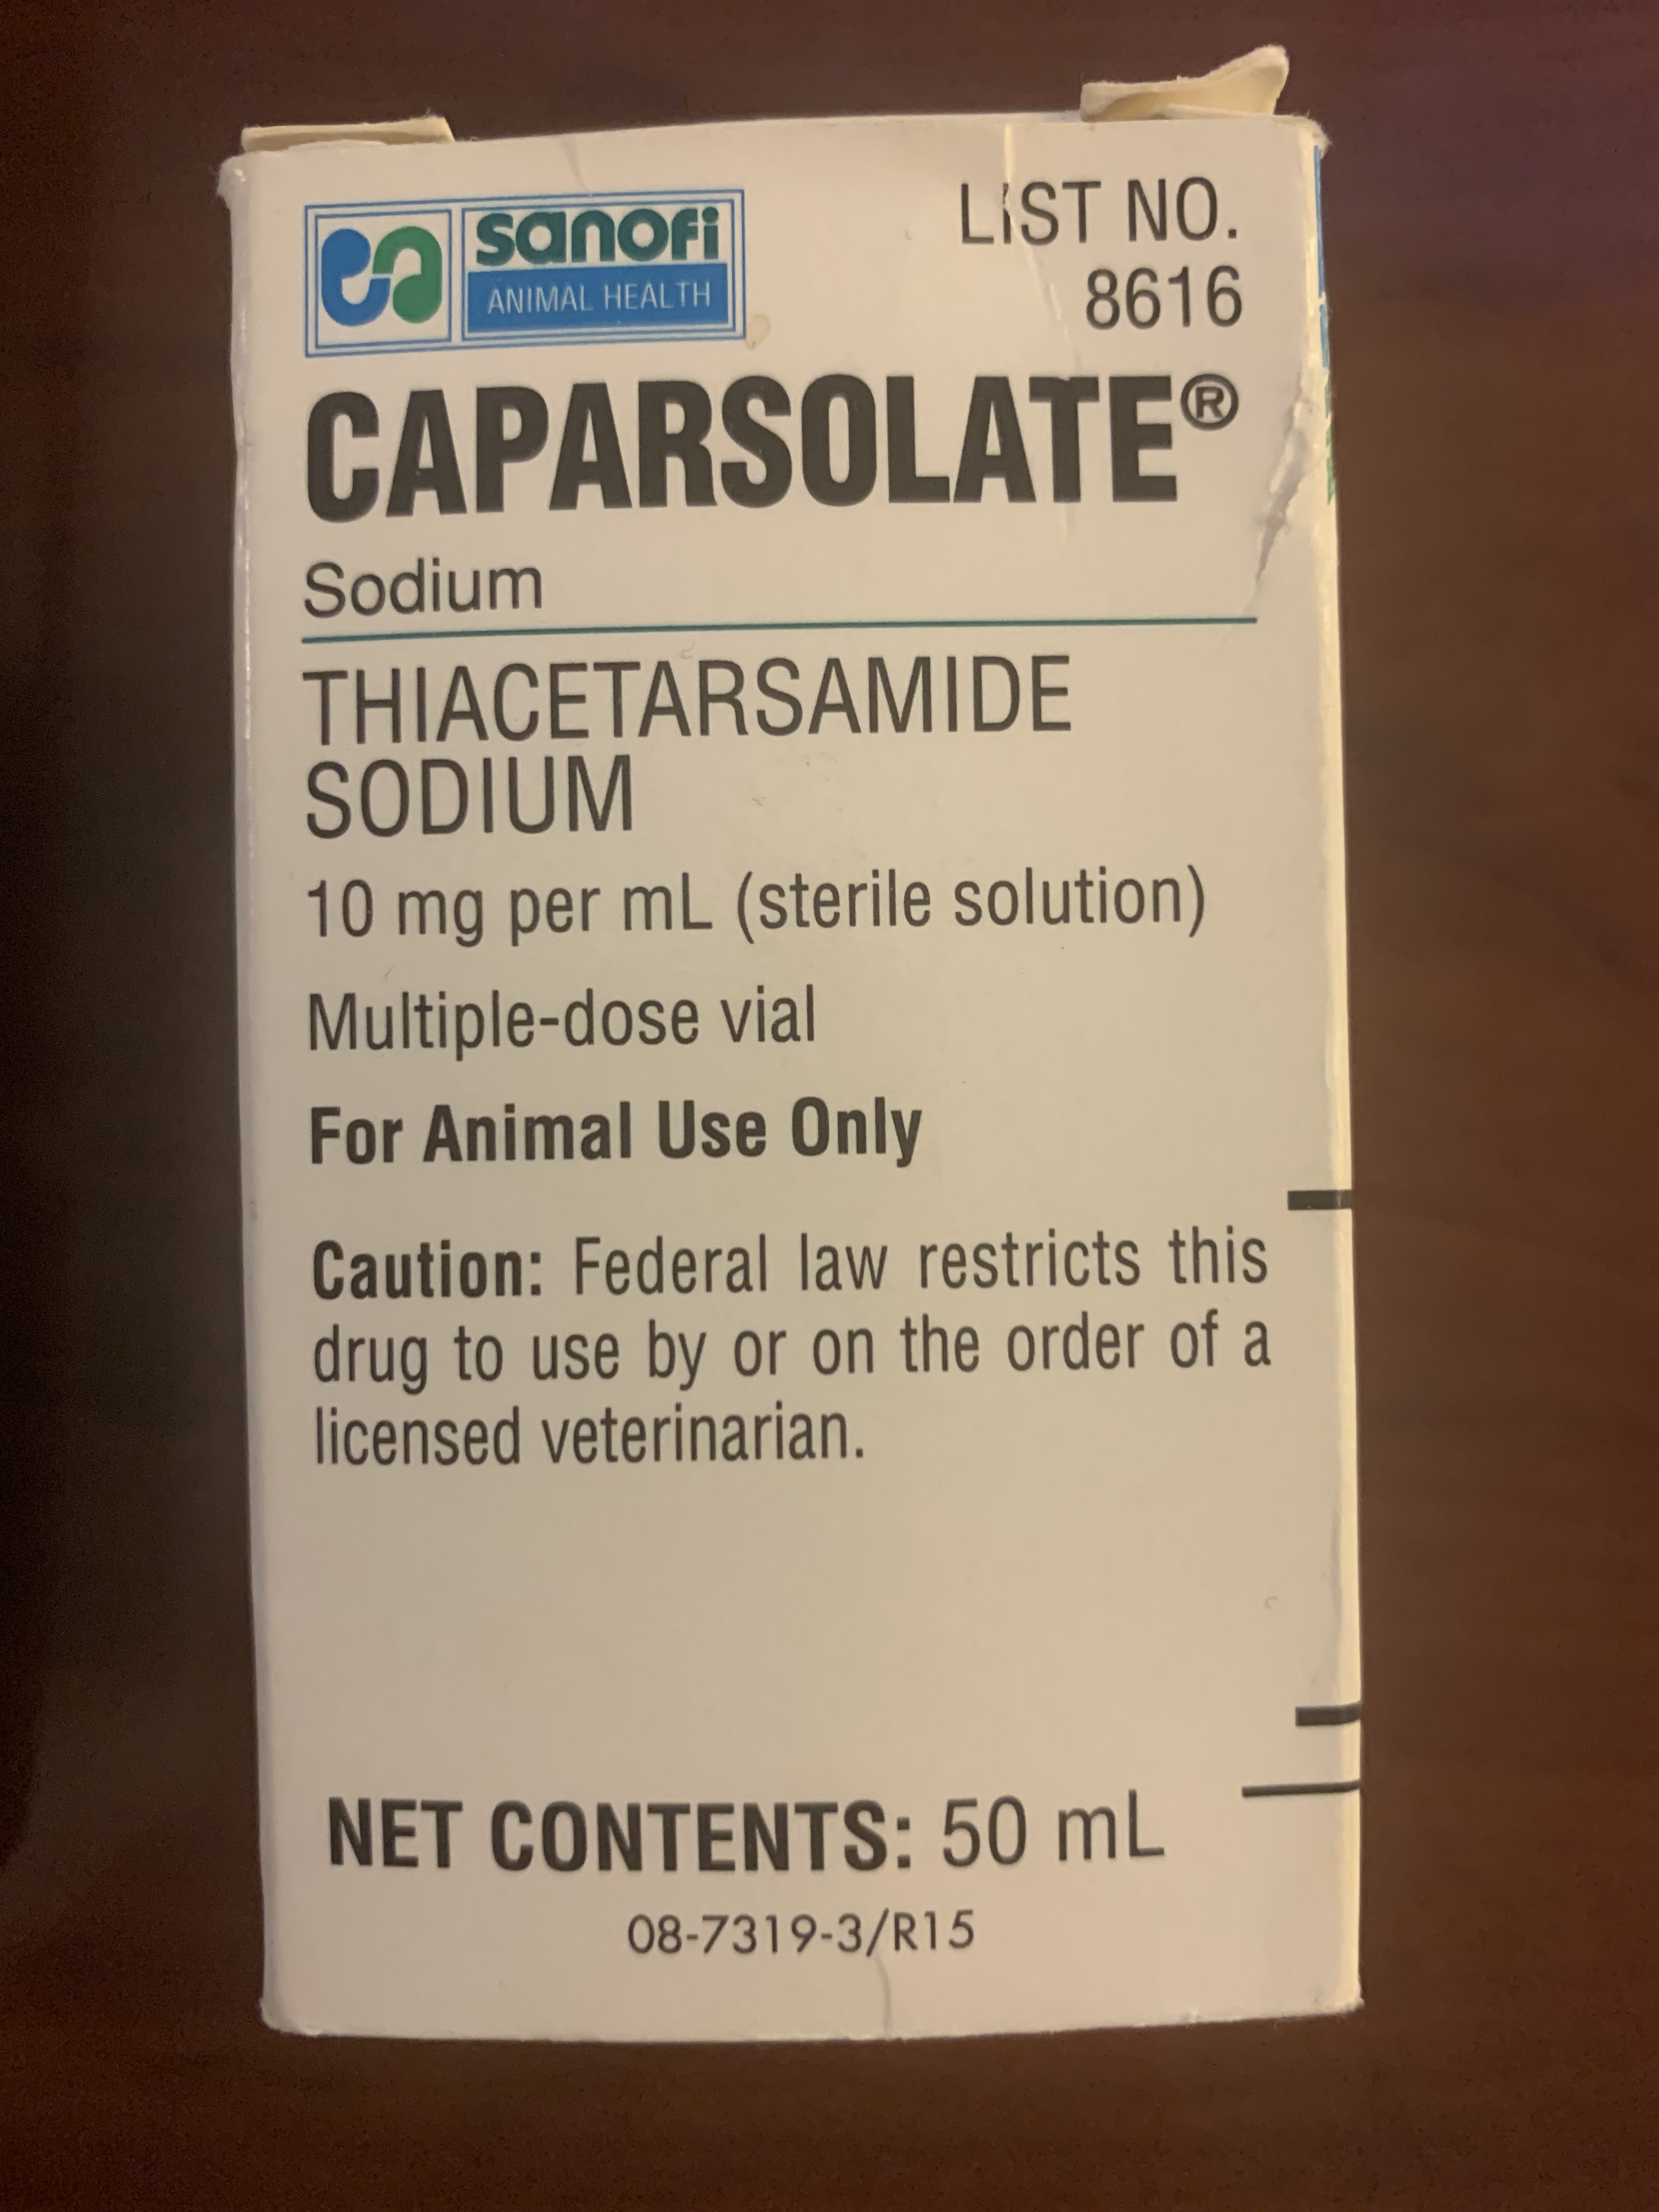
No Known Tests Are Predictive For When Thromboembolism Will Occur
PTE and adulticide therapy
  pulmonary damage
  inevitable consequence of successful adulticide therapy
  The potential reason people have become scared of adulticide therapy

Slide 66
Adulticide Therapy
Melarsomine dihydrochloride (Immiticide®/Diroban®)
  standard 2-dose regimen
    2 IM injections, each at 2.5 mg/kg, 24 hr apart
  3-dose regimen dogs
    1 injection at 2.5 mg/kg, 1 month later give 2 dose regimen
    increase in safety and efficacy with 3-dose regimen
    RECOMMENDED
Repeat HW Ag test at 9 months after treatment to confirm treatment success
  AHS recommended

Slide 67
The 2-dose vs. 3-dose protocol
Melarsomine
Melarsomine
Ag +
mf test
Ag +
mf test
I II
I II/III
0 1
0 1
DAYS
MONTHS

Slide 68
Efficacy and Safety of 3-Dose Schedule for Melarsomine
Standard 2-dose regimen
  Kills >90% of adult worms and 4-month-old larvae
Alternate or 3-dose regimen
  First dose kills ~50% of worms
    Diminishes degree of insult to pulmonary vasculature and tissue
  Remaining 2 doses 1-2 months later gives ~99% efficacy on adult worms
BOTTOM LINE: 3-DOSE KILLS MORE WORMS

Slide 69
2-dose
5 worms
2-dose
50 worms
3-dose
5 worms
Still alive

Slide 70
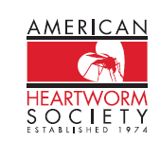
Current Rec’d of AHS For Improving
Safety of Heartworm Treatment
Use 3-injection protocol for all heartworm infections
Start ML preventive at time of diagnosis prior to melarsomine Tx
  Prevent further infection
Per AHS guidelines

Slide 71
Heartworm Treatment Summary
But it is not that simple…
Immiticide
I II/III
ML
ML
ML
ML
ML
Ag +
mf test
0 1 2 3 4
MONTHS

Slide 72
Doxycycline
Wolbachia
  Endosymbiont of filarial worms
Potentially reduces risk of thromboembolism (Kramer et al. Vet Para. 176 pp. 357-360)
For 28 days prior to adulticide treatment
10 mg/kg BID for 28 days

Slide 73

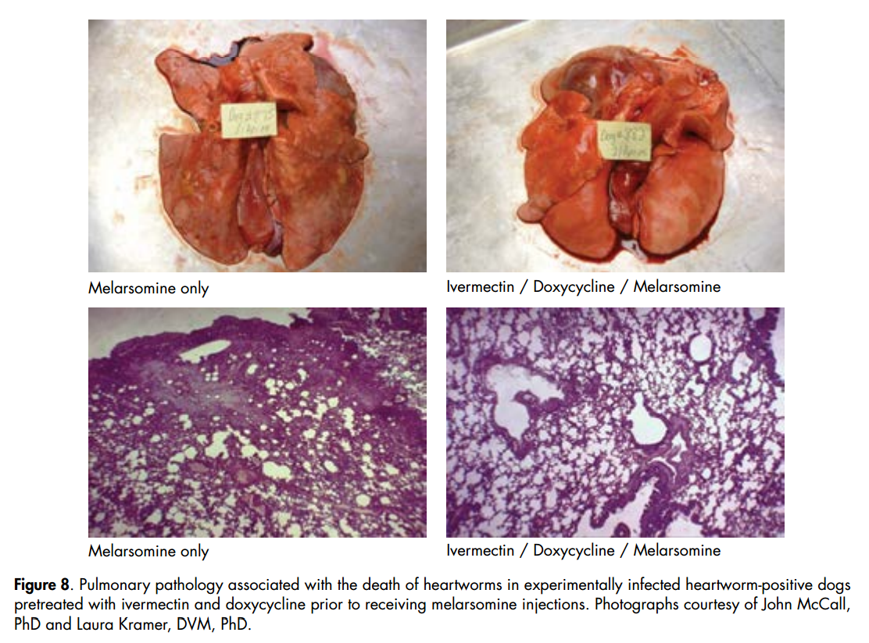

Slide 74

Heartworm Treatment Summary
Immiticide
I II/III
ML
ML
ML
ML
ML
Ag +
mf test
0 1 2 3 4
MONTHS

Slide 75
Why the extra month?
X
X
X
X
Melarsomine
I II/III
Steroids
Steroids
Doxy
0 1 2 3 4
MONTHS
PREVENTIVE

Slide 76
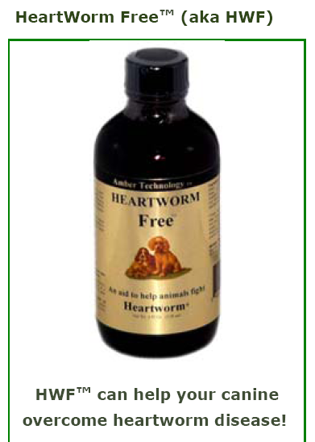
Other medications
Herbal medicines
  None are effective
NSAIDs/Aspirin
  Not recommended
Steroids
  Prednisone
    0.5 mg/kg BID for 1st week
    0.5 mg/kg SID for 2nd week
    0.5 mg/kg q48 h for 1-2 weeks

Slide 77
Heartworm Treatment Summary
Immiticide
+/-Steroids
I II/III
ML
ML
ML
ML
ML
Ag +
mf test
Steroids
Steroids
0 1 2 3 4
MONTHS

Slide 78

EXERCISE RESTRICTION
Diagnosis
  Reduced activity
Treatment
  After 1st dose
  6-8 weeks post-Tx
  Total of 10-12 weeks
-

Slide 79
Exercise restriction
Ag +
mf test
Melarsomine
I II/III
ML
ML
ML
ML
ML
Worm death
Doxy
0 1 2 3 4
MONTHS

Slide 80
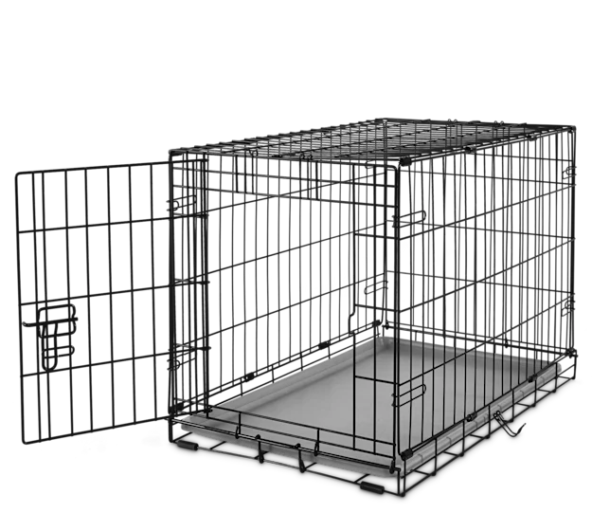


Slide 81


Slide 82

2 doses melarsomine
9 months post treatment=positive

Slide 83

Feline HWD
Treatment
NO satisfactory treatments
  arsenical drugs are highly toxic in cats
Severely affected cats have poor prognosis
Prophylaxis with monthly ML
Steroids

Slide 84


Slide 85

Heartworm Prophylaxis
RECOMMENDED YEAR ROUND
Monthly ML treatments kill L3 and L4 stages with virtually 100% efficacy
  THIS STRATEGY IS DESIGNED TO ALLOW THE DOG TO BECOME INFECTED AND THE PREVENTIVES THEN KILLS ALL RECENTLY ACQUIRED WORMS
99%
>>75%

Slide 86
Macrocyclic lactones-Dogs
Oral
  Ivermectin
  Milbemycin oxime
  Moxidectin
Topical
  Moxidectin
  Selamectin
Injectable
  Moxidectin
Oral
  Ivermectin
  Milbemycin oxime
  Moxidectin
Topical
  Moxidectin
  Selamectin
  Eprinomectin
Injectable
  Moxidectin

Slide 87


Macrocyclic lactones and collies
Sensitivity first seen with high doses of IVM
  16x prophylactic dose
  Seen with other MLs
Often seen with concentrated livestock preparations

Slide 88


Slide 89

Monthly Prophylaxis As Adulticidal Treatment- “Slow-kill”
Monthly administration of macrocyclic lactone with Doxycycline
  Topical or injectable moxidectin
  Ivermectin
  Prophylactic dosages for multiple months
  Surviving worms appear to be moribund
  Different time periods in different studies.
Disadvantages

Slide 90
Exercise restriction
Ag +
mf test
Melarsomine
I II/III
ML
ML
ML
ML
ML
Worm death
Worm death ????????
Doxy
0 1 2 3 4
MONTHS

Slide 91

Summary
Follow AHS protocols
Always consider the patient

