Slide 1
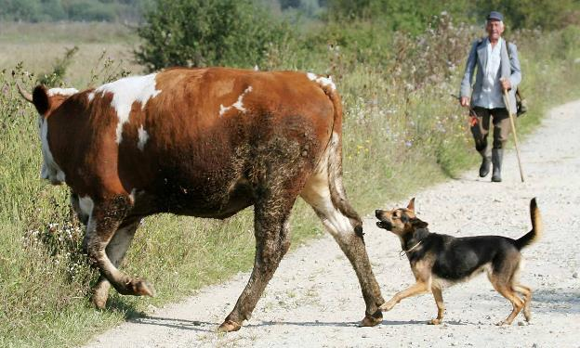
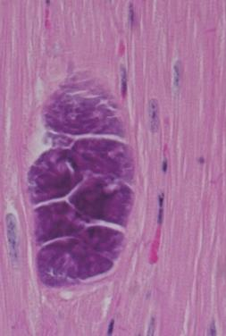
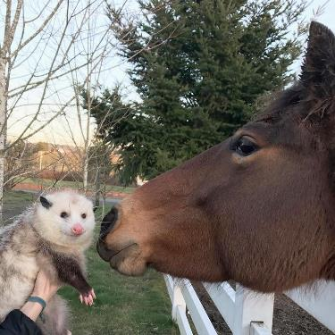
Systemic Apicomplexans (part 2)
Sarcocystis cruzi
and
Sarcocystis neurona

Slide 2
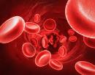
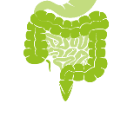
(know terms on this slide)
Parasitic
Protozoa
Grouped by Infection Site and Motility
Apicomplexa
(sg =Alveolates)
Flagellates
(sg = Excavates)
blood/
tissue
Blood apicomplexa (piroplasms)
Hemoflagellates
Babesia spp.
Trypanosoma cruzi
Cytauxzoon felis
Leishmania infantum
Systemic apicomplexa (coccidia)
systemic
Toxoplasma gondii
Trypanosoma cruzi
Neospora caninum
Leishmania infantum
Sarcocystis spp.
intestines
Intestinal apicomplexan (coccidia)
Mucoflagellates
Cryptosporidium parvum
Tritrichomonas foetus
Tritrichomonas blagburni
Eimeria spp.
Cystoisospora spp.
Giardia spp.

Slide 3
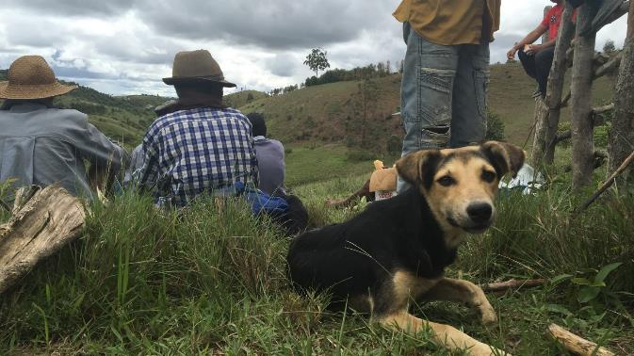
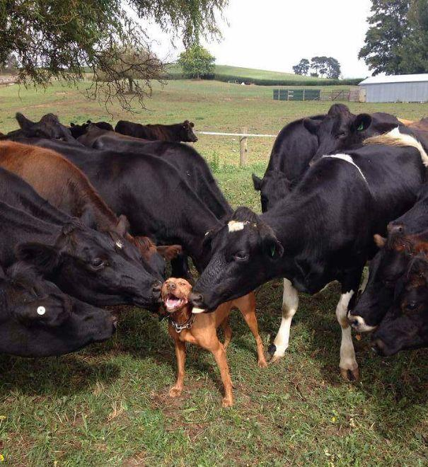
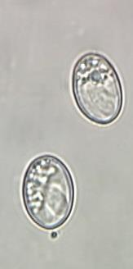
Sarcocystis cruzi
Canine coccidan
Causes disease in cattle
Indirect Life Cycle

Slide 4
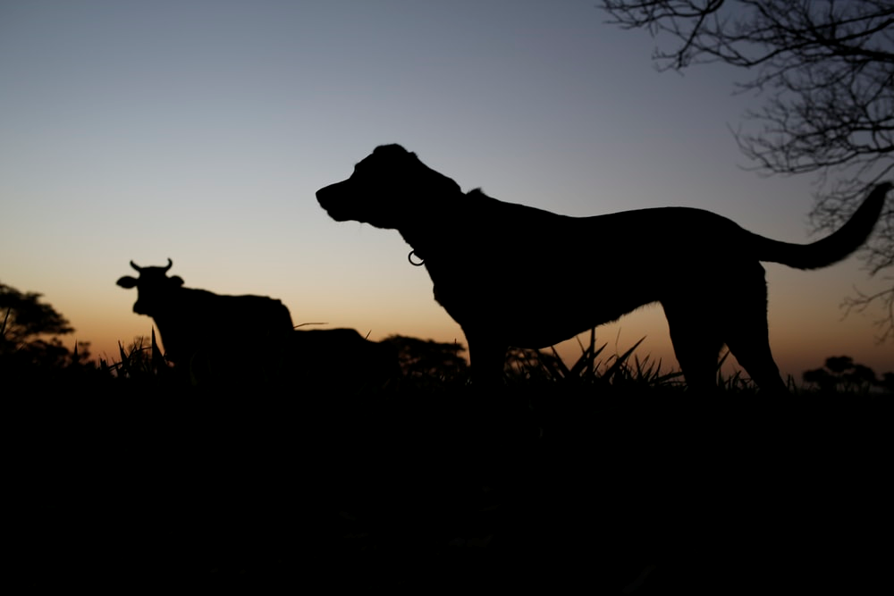
Learning Objectives: Sarcocystis cruzi
Life cycles: understand components of the Indirect Life Cycle.
Transmission: know specified routes of transmission: dog-to-cow, cow-to-dog.
Pathogenesis: understand that tachyzoite replication in endothelial and muscle cells cause disease and bradyzoites form cysts in muscle for chronic latent infections
Clinical signs: understand the highlighted clinical signs in cows.
Diagnosis: know how to diagnose it in a dog and a cow
Control: Know the highlighted practices to control S. cruzi
Zoonosis: not zoonotic

Slide 5
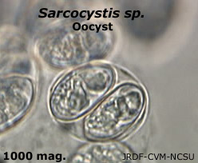
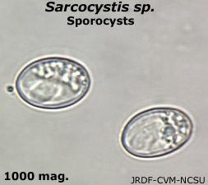
Morphology: Sarcocystis cruzi
Sporocyst are in feces
Thin-walled oocysts sporulate and rupture in dog’s GI tract
Sporocysts are shed in feces and are infective immediately
small, oval, smooth coat, no polar cap; 4 sporozoites
Sporulated oocyst
sporocysts
sporocyst
sporocyst
Notes:
Understand that sporocysts are the infective form of Sarcocystis cruzi for cattle (i.e. they ingest these from dog feces). You will not be asked to id these in lecture exams

Slide 6
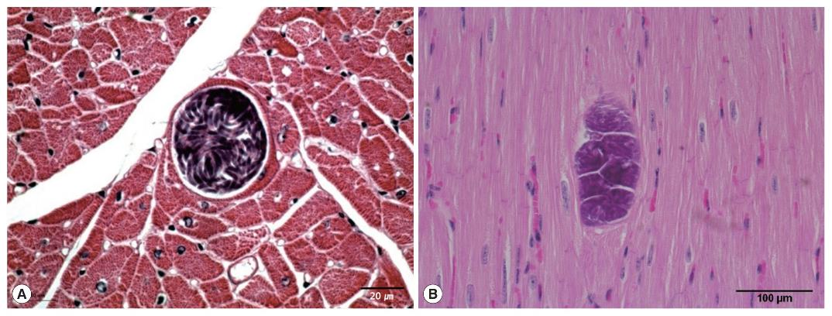
Morphology: Sarcocystis cruzi
Sarcocysts = bradyzoites replicating in muscles cysts
Infective to the definitive host (carnivores)
Facilitate persistent infection (immune system doesn’t clear)
The Korean Journal of Parasitology 2018; 56(2): 121-127.
Notes:
Light micrographs of S. cruzi sarcocyst in the cardiac muscles of Korean native cattle. No tissue reaction. H-E stain. Scale bar=20 μm (A), 100 μm (B).
Understand that sarcocysts are the infective form of Sarcocystis cruzi for dogs (i.e. they ingest these in cattle tissue). You will not be asked to id these in lecture exams

Slide 7
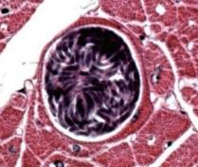
Obligate Indirect Life Cycle
Definitive Host = canids
only sexual reproduction (no asexual repro in DI)
sporocysts
Sarcocysts
(bradyzoites in tissue cysts)
Intermediate Host = cattle
only asexual reproduction
Notes:
Understand that this is an indirect life cycle (2 hosts)

Slide 8
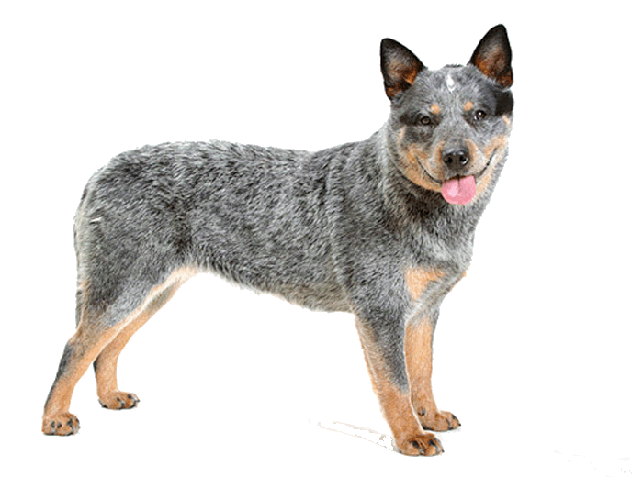
Indirect Life Cycle: Sarcocystis cruzi
Canids
Obligate Indirect Life Cycle
Definitive host – Canids(Dog, Coyote, Wolf, etc.)
Intermediate Host – Cattle
Transmission
carnivorism, ingestion of sarcocysts in cattle tissue
Invasion
Bradyzoites invade canine intestinal cells, start gamatogony
NO ASEXUAL reproduction occurs in the dog
Only SEXUAL repro to make oocysts (sarcocyts are inside the oocyst)
Notes:
Notice there is no asexual reproduction in dogs. This means they will likely have no clinical signs from a S. cruzi infection. Asexual reproduction can generate a lot of organisms quickly, thus can cause a lot of cellular and tissue damage (pathogenesis). Sexual reproduction generates the infective sporocysts passed in feces.

Slide 9
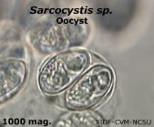
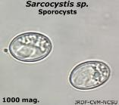
Indirect Life Cycle: Sarcocystis cruzi
Canids
Sexual reproduction only occurs in canids (definitive hosts)
Gametogony
Oocysts sporulate in the gut lumen, rupture and release sporocysts
Dissemination
Sporocysts exit the host in the feces
Infectious immediately
Very resistant and remain infectious for several months if kept cool and moist.

Slide 10
Indirect Life Cycle: Sarcocystis cruzi
Cattle
Transmission
Ingestion of a sporocyst from canid feces
Invasion
Sporozoites cross intestines and enter vascular endothelial cells and muscle cells.
Asexual reproduction – in vascular endothelial and muscle cells
Tachyzoites (fast replication) destroy cells causing acute severe disease
Bradyzoites (slow replication) form sarcocysts (over months)
Sarcocysts (muscle cysts) remain viable for the life of the intermediate host.
Notes:
For cattle, understand they are infected by eating sporocysts which then get into the vascular endothelial and muscle cells (this is why we see severe clinical disease in cows).
Eventually the tachyzoites slow down replication and can remain as bradyzoites in muscles as chronic, latent infection (waiting to be eaten by dogs to complete the cycle).

Slide 11
Pathogenesis: S. cruzi
Intestinal Phase in Canids – no pathology.
Systemic Disease in Cattle
Direct destruction vascular endothelial cells and muscle cells
Acute immune response
Zoites throughout the vascular endothelium and muscles = immune reaction and inflammation

Slide 12
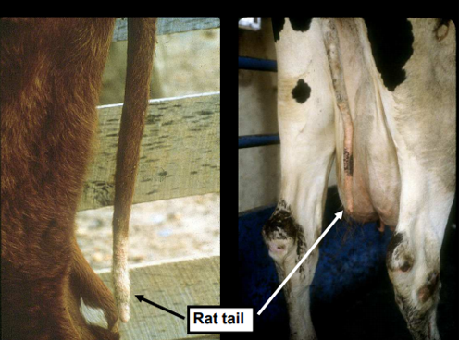
Clinical Disease: S. cruzi
Systemic Sarcocystosis -- cattle only
http://old.iss.it/binary/crlp/cont/Fayer_Sarcocystis.pdf
Acute disease in calves
Myositis
Sporadic abortions, still births
Disease ~4-6 weeks post-ingestion of sporocysts
Immune status of the host and the dose of sporocysts determine clinical disease.
Notes:
Know that S. cruzi causes systemic sarcocystosis which can include acute severe disease in calves, myositis, and abortions
Other clinical signs may include protracted fever, lymphadenopathy, anorexia, cachexia, muscle spasms, hyper-excitability, diarrhea, hyper-salivation, weakness, hair loss around eyes, neck and tail switch (“rat-tail”)

Slide 13
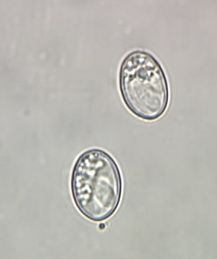
Diagnosis: S. cruzi
Dogs – sporocysts on a routine fecal exam
Cattle – serology, usually necropsy

Slide 14
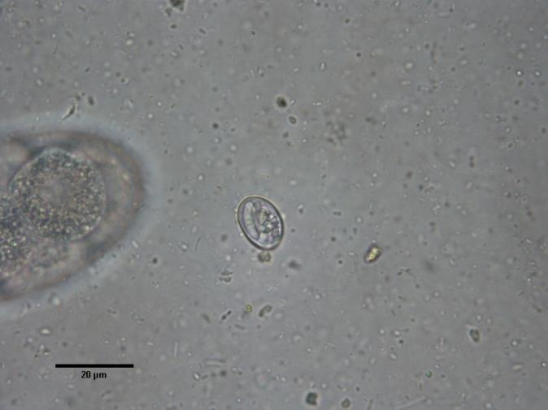
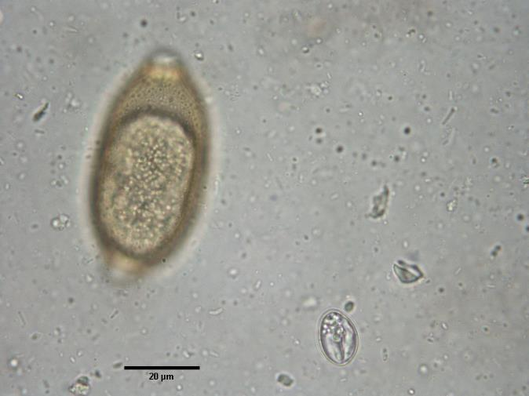
Sarcocystis sporocyst in dog feces
FYI
Notes:
Tritrichuris whipworm next to sporocysts

Slide 15
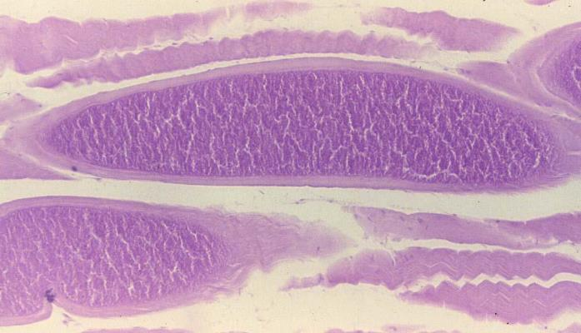
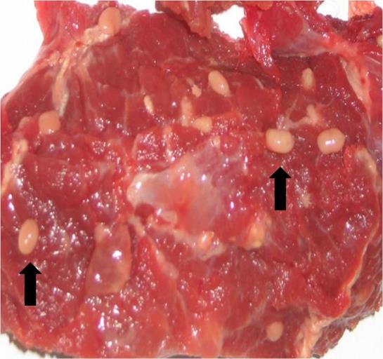
Sarcocyst in Muscle (histology/gross)
FYI
Sarcocystis aucheniae in Llama
http://praca-w-niemczech.info/imalsdrm-sarcocystis.html
https://www.merckvetmanual.com/musculoskeletal-system/sarcocystosis/overview-of-sarcocystosis
Notes:
FYI: Merozoites from this second generation subsequently invade the muscle fibers and develop into the typical sarcocysts.
Sarcocysts give rise to the banana-shaped infective bradyzoites found in mature cysts beginning 2–3 mo after infection.
Sarcocysts of some species are easily visible with the unaided eye (S aucheniae, S hirsuta, S gigantea).

Slide 16
Treatment: S. cruzi
FYI
Dogs
None – not necessary
Cattle
Amprolium may provide some prophylactic protection
Treatment against sarcocysts is ineffective

Slide 17
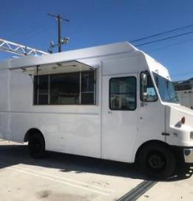
Epidemiology, Control & Zoonosis S. cruzi
Epidemiology: distributed worldwide in cattle
Control: wild and domestic canid populations
Don’t let dogs have access to raw meat, offal or dead animals
Not Zoonotic
Offal Falafel
Notes:
Offal = entrails

Slide 18
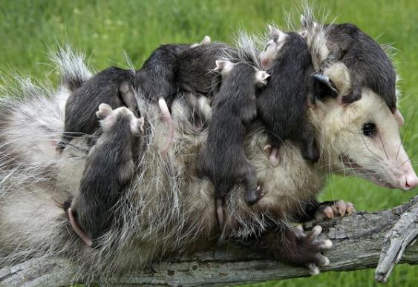
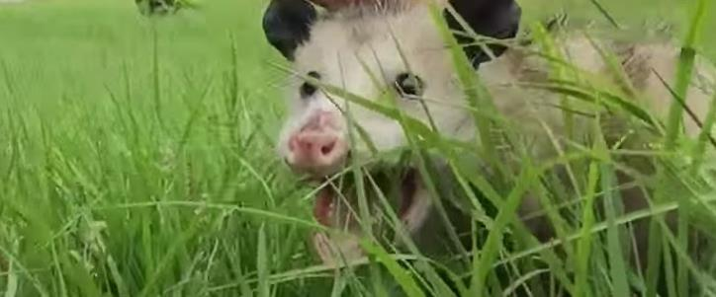
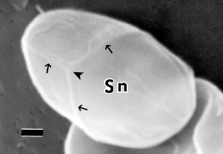
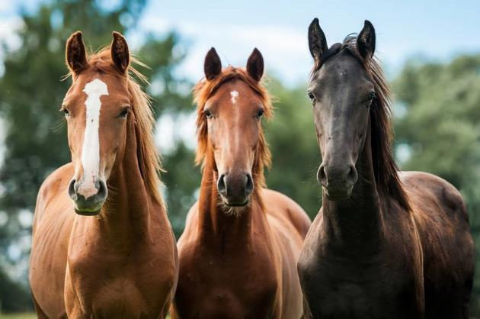
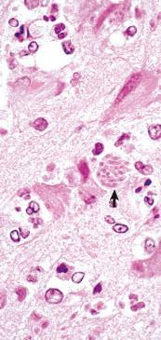
DOI: http://dx.doi.org/10.1645/GE-230R
http://www.baltimorepestanimal.com/opossumdisease.html
Sarcocystis neurona
Opossum coccidan
Causes Equine Protozoal Myeloencephalitis (EPM)
Indirect Life Cycle
© Gregorita Ko

Slide 19
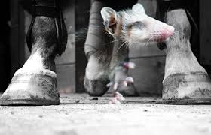
Learning Objectives: Sarcocystis neurona
Life cycles: understand specified components of the Indirect Life Cycle (sylvatic lifecycle occurs within wildlife) and understand how the horse becomes infected.
Transmission: know routes of transmission: opossum-to-horse.
Pathogenesis: understand the methods of disease in the horse.
Clinical signs: understand the specified clinical signs (3 As) in horses related to Equine Protozoal Myeloencephalitis (EPM)
Diagnosis: understand best method to diagnose horses and why serology testing by itself may not confirm EPM.
Treatment: know the specified information about length of time for treatment and how effective treatment is.
Control: Know the highlighted practices to control S. neurona
Zoonosis: not zoonotic

Slide 20
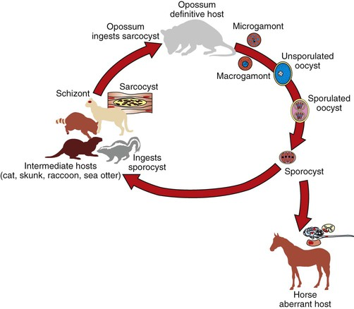
Sarcocystis neurona
Opossum is definitive host.
It must ingest mature sarcocysts from intermediate host to complete the life cycle.
FYI: these specific intermediate hosts
Obligate Indirect Life Cycle: S. neurona Sylvatic (wild animals)
Horse = aberrant host. Sarcocysts do not develop in the horse.
https://veteriankey.com/common-equine-diseases/
Notes:
In the aberrant intermediate hosts like the horse, pathogen S. neurona infects the brain and spinal cord, and any part of the central nervous system (CNS) may be affected.

Slide 21
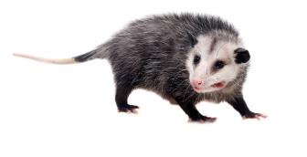
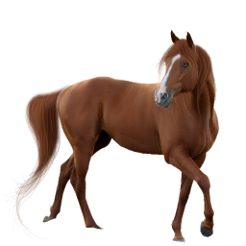
Life Cycle: S. neurona Sylvatic (wild animals)
Obligate Indirect Life Cycle
Definitive host (DH) – Opossum (North and South American)
Intermediate Host (IH) – other small mammals and birds
Transmission
Opossum (DH) ingests sarcocysts in muscle of IH (small animals)
IH ingests sporocysts from opossum feces
Accidental (aberrant) host – horse ingest sporocyst from opossum feces
Asexual stages disseminates primarily to neural tissue
Systemic disease

Slide 22
Pathogenesis: S. neurona
Intestinal Phase in Opossum – no pathology.
Systemic Disease in Horses
a predilection for neural tissue (neurons and leukocytes of the brain and spinal cord)
Zoites → direct destruction of host neural cells
Acute immune response / inflammation
FYI: other protozoa (T. gondii, N. caninum, others may cause EPM-like symptoms in horses)

Slide 23
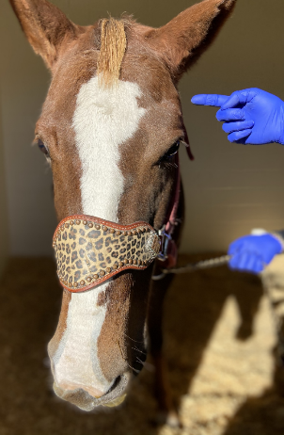
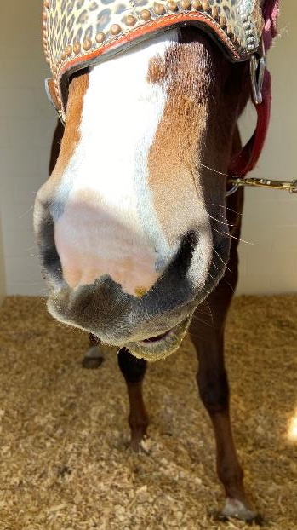
“Dusty”
15-year-old Quarter horse gelding
Purchased 6 mo prior to presentation.
Occasionally tripping but worsened the week prior to presentation; droopy lip
rDVM performed EPM serology titers which were negative
Presented for neuro evaluation
Credit: Dr. Kimberly Young –NC State
Notes:
Dusty, a 15 year old Quarter Horse gelding, presented to NCSU Equine Medicine Services on 12/17/19 for further evaluation of neurological deficits. The owners purchased Dusty about 6 months ago and have been noticing him to trip periodically. The owners reported that the tripping has gotten worse as of last week, at which time they also noticed that Dusty had developed a droopy left lip and more profound ataxia.
The primary veterinarian performed an EPM test (serum IFAT) last week; the results came back the day prior to presentation as zero titer

Slide 24
“Dusty”
Physical Examination
Vitals WNL, Tº100
Mild corneal ulcer OS (left)
Neurological and Gait Exam
Facial nerve paralysis
Ataxic all 4 limbs
CP deficits
Hypermetria forelimbs
Toe drag left hind/fore
Backing instability
Neuro Grade 3-4 out of 5
EPM horses are usually afebrile, nonpainful, rarely have mentation changes, bloodwork usually normal.
Notes:
Cranial nerve exams
Can they see, hear, smell, chew, swallow
Head position normal
Atrophy
Asymmetry
On presentation, Dusty was alert and responsive. However, he is ataxic on all four limbs, much worse on the left side, especially on the left hind, with marked toe dragging. There was a left facial nerve paralysis, with a decreased to absent menace response and no palpebral response. A mild corneal ulcer was also noted on the left eye with fluorescein uptake. A wooden splinter about 3 centimeters was removed from the left side of the face about 5 centimeters cranioventrally to the left eye. Dusty’s vital parameters were within normal limits. The temperature was 100F. The heart rate was 44 bpm. The respiratory rate was 20 bpm. No murmurs or arrhythmias were noted on cardiac auscultation. Thoracic auscultation was unremarkable. Borborygmi were present in all 4 quadrants. Mucous membranes were light pink with CRT less than 2 seconds. Digital pulses were within normal limits.
Grade 3 – Easy to see at a walk, look like a drunken camel at a trot, very obvious at a canter but they do not fall.
Grade 4 - Very ataxic – will fall especially in tight circles or backing. Usually will refuse to go any faster than a walk

Slide 25
Clinical Disease: S. neurona Equine Protozoal Myeloencephalitis (EPM)
3A’s Ataxia, Asymmetry and Atrophy
Asymmetry = a symptom that is worse on one side of the body than on the opposite side (commonly seen in muscle development).
Ataxia = inability to coordinate movement.
Atrophy = muscle deterioration
Notes:
Know the 3A’s Ataxia, Asymmetry and Atrophy
The most frequent sign is gait abnormality, related to CNS involvement. The most frequent brain or cranial nerve deficits observed in horses appear to be head tilt, depression, facial nerve paralysis and difficulty swallowing, upper airway dysfunction such as dorsal displacement of the soft palate and laryngeal hemiplegia

Slide 26
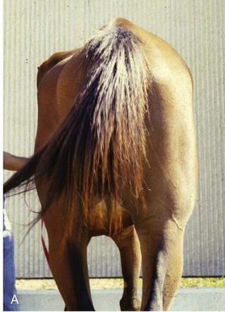
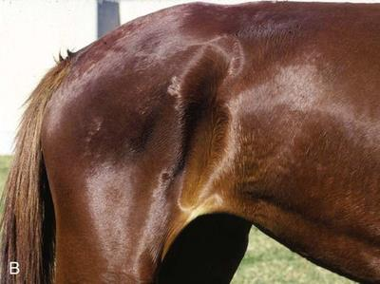
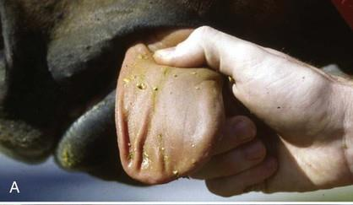
S. neurona
EPM
muscle Atrophy
and Asymmetry

Slide 27
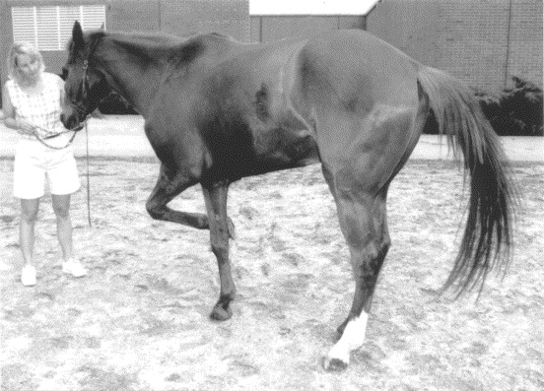
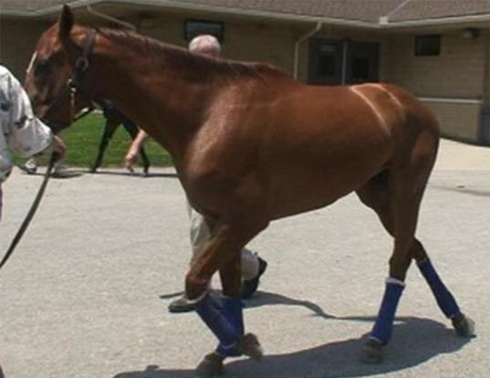
Sarcocystis neurona (EPM)
Ataxia
http://www.sciencedirect.com/science/article/pii/S0304401700003848#FIG2
http://www.sciencedirect.com/science/article/pii/S0304401715000448

Slide 28
FYI: Differential Diagnoses for EPM
Cervical vertebral stenotic myelopathy
Orthopedic disease
Hepatic encephalopathy
Neoplasia
Trauma
Equine Motor Neuron Disease
Infectious (EEE, WEE, WNV, EHM, Neuroboreliosis)
Temporohyoid osteoarthropathy (THO) = middle ear disease
Notes:
Equine motor neuron disease (EMND) typically occurs in older horses that have been vitamin E deficient for more than 18 months. It affects lower motor neurons, the nerves that supply the direct neurological input into all muscles.
THO = “middle ear disease”, associated with the articulation (the temporohyoid joint) from the hyoid apparatus and the skull.
It is characterized by a proliferation of the bone surrounding the joint and which can lead to joint fusion.

Slide 29
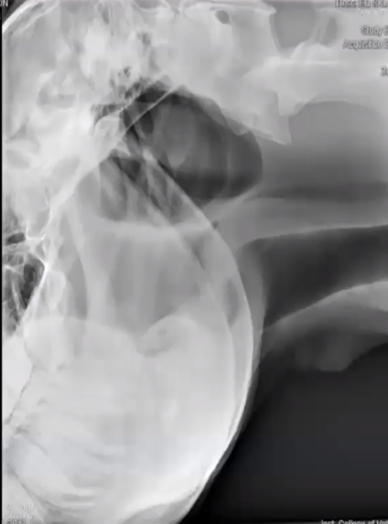
“Dusty”
Primary Differential
Temporohyoid osteoarthropathy (THO)
Diagnostics Performed
CBC/SBP - unremarkable
Radiographs – unremarkable
Upper airway endoscopy - unremarkable
Computed tomography - unremarkable
Ruled-out THO
CSF analysis
Infectious disease testing
Notes:
Given Dusty’s unilateral facial paralysis and ataxia with a negative blood test for EPM, temporohyoid osteoarthropathy (THO) was the top differential. Due to lack of evidence for THO on radiographs and endoscopy, Dusty was hospitalized for CT.
THO = “middle ear disease”, associated with the articulation (the temporohyoid joint) from the hyoid apparatus and the skull. It is characterized by a proliferation of the bone surrounding the joint and which can lead to joint fusion.

Slide 30
Diagnosis: EPM
Combine neurological clinical signs with serology dx Don’t diagnose with serology alone because many horses are exposed to Sarcocystis species but don’t get EPM
Gold Standard is serology on both serum and CSF:
ELISA Surface Antigen Test SnSAG 2, 4/3 (most accurate)
SnIFA
Serum : CSF Ratio interpretation (FYI)
<100 is highly diagnostic of clinical EPM
>100 negative
=100 equivocal results and lab will do additional calculations
Notes:
You are usually trying to differentiate primary musclo-skeletal disorders and other neurologic diseases from EPM
The problem with just running serology is that many horses are exposed to S. neurona and other Sarcocystis spp., develop antibodies but never develop clinical disease. So if you have a sero+ horse with neuro signs, it’s a possibility the horse has EPM but it might be some other neurologic disease (not related to S. neurona) and the horse just has antibodies from a previous exposure to sarcocystis spp.
Reed SM, Howe DK, Morrow JK, et al. Accurate Antemortem Diagnosis of Equine Protozoal Myeloencephalitis(EPM) Based on Detecting Intrathecal Antibodies against Sarcocystis neurona Using the SnSAG2 and SnSAG 4/3 ELISAs. J Vet Intern Med 2013; 27:1193-1200

Slide 31
“Dusty”
CSF analysis
- cytologically unremarkable
- mild mononuclear pleocytosis (11 WBC/uL)
Serology (serum and CSF)
- S. neurona ELISA (SAG2,4/3)
- Serum titer 1:500
- CSF titer 1:320
- Serum (500):CSF (320) ratio = 1.6
- N. hughesi ELISA negative
FYI: Neospora hughesi can also cause EPM in horses (seroprevalence 3-10%)

Slide 32
Sarcocystis neurona serology (cont)
In general,…
Don’t trust a seropositive with serum alone to diagnose EPM because so many horses are exposed to S. neurona but don’t develop EPM
Do trust a seronegative with serum alone to rule out EPM because indicates the horse was not exposed to S. neurona
rDVM performed EPM serology titers on Dusty, which were seronegative!
?
Notes:
Dusty was seronegative by rDVM. This is why the vets at NC State initially pursued other causes for the neuro signs.
Reasons for Dusty’s early seronegative results could be false negative or an acute infection where antibodies weren’t detectable.
When antibodies were eventually detected, Dusty’s titers were relatively low compared to other EPM horses.

Slide 33
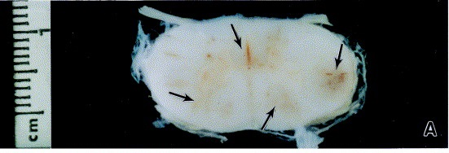
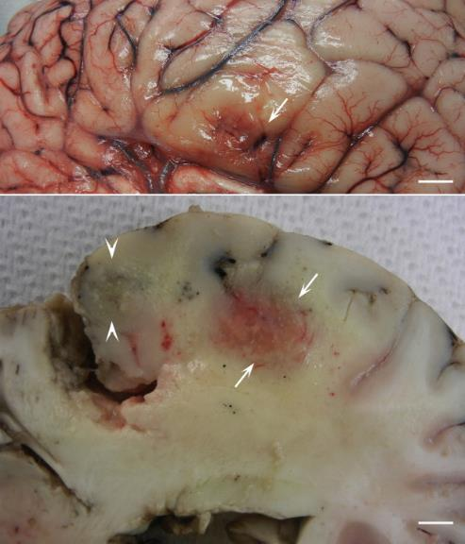
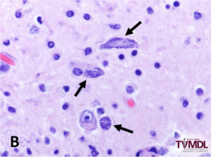
FYI
Sarcocystis neurona
Necropsy / Histology
http://www.sciencedirect.com/science/article/pii/S0304401700003848#FIG2
http://www.sciencedirect.com/science/article/pii/S0304401715000448
https://tvmdl.tamu.edu/2018/03/16/equine-protozoal-myeloencephalitis-epm-diagnosed-horse/
Notes:
FYI

Slide 34
EPM Treatment
3 FDA approved treatments
Ponazuril (Marquis®), diclazuril, (Protazil®),and pyrimethamine/sulfadiazine (Rebalance®).
Treat until clinical signs resolve, then 1 month after that = long treatment period (6-8 wks).
Anti-inflammatories; supportive care
Improvement in 60%, complete recovery in up to 20%, relapse in 20% (not likely to clear organism)
Notes:
I want you to know that treatment until clinical signs resolve can take 1 to 2 months and be very expensive. You will see improvement in most horses and likely won’t clear the organism. Don’t need to know percentages.

Slide 35
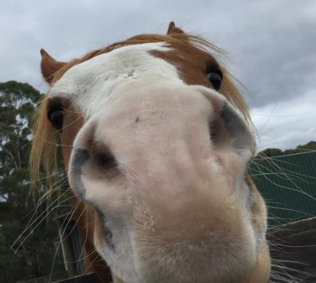
“Dusty”
Treatments
Ponazuril (anti-coccidial)
Vitamin E and flunixin meglumine (anti-inflammatories)
Tarsorrhaphy (suture eyelid closed)
Clinical signs resolved!

Slide 36
Epidemiology, Control & Zoonosis: S. neurona
AAEP Infectious Disease Guidelines: Equine Protozoal Myeloencephalitis
Geography: confined to the Americas (opossum Didelphis virginiana and D. albiventris distribution)
Seroprevalence ranges 15-89%, but <1% develop disease
Risk Factors:
young(1-5yr), old (>13 yr), Thoroughbred, Standardbred and Quarter Horse breeds are over-represented
Stress and immunosuppression
Control: prevent access of opossums to horse-feeding / watering areas
Fallen fruit should be removed from horse pastures. Why?
Zoonosis: no reports of human infections
Infection in dogs, cats and sea mammals (otters) reported
Notes:
Do not kill or trap opossums. This will not work. Unless you remove what is attracting opossums and other animals to your yard then more animals will come. The best thing to do is to encourage animals to leave the area on their own by removing the attractants.
Immunosuppression (Stress, advanced age, parturition, injury) pathogen enters nervous system
The pathogenesis of S. neurona in horses is unclear because it has been difficult to reliably induce the disease experimentally in horses
Horses used for competition or racing had a much higher incidence than those used for pleasure or breeding. Certain breeds including Thoroughbreds, Quarter Horses and Standardbreds are over-represented as are young horses, though all breeds and ages can be affected. Parasite dose and strain, immune function and physiologic stress (including strenuous exercise) are all thought to play a role in pathogenesis. A common model for inducing EPM is long-distance transport further supporting the role of stress in the pathogenesis of this disease
Among the risk factors, geography, age and breed were the main factors. Seroprevalence varied from 68% in the west, 81% in the mid-west, 82% in the northeast and 84% in the south.

Slide 37
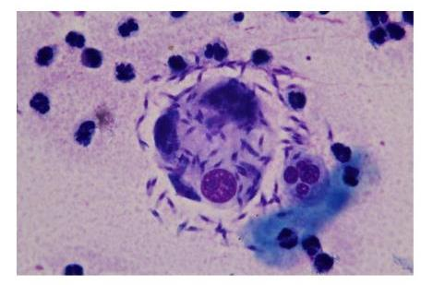
FYI: Sarcocystis infections in small animals
6-month-old, MN lab mix adopted from shelter in rural TN
Fever, generalized ataxia (~1 mo duration, waxing and waning)
2 large subcutaneous nodules
Hospitalized for 5 days, nodules and neurological signs worsened.
Dog did not respond to clindamycin and was euthanized
Lymph node aspirate was PCR+ for
S. neurona
DDx for protozoal dermatitis in dogs =
L. infantum, Caryospora spp., Neopspora caninum, Toxoplasma, gondii and Sarcocystis spp.
Lymph node aspirate
Notes:
This was a consult that came to us in the VBDDL. It was the first time I had seen these organisms in a dog’s lymph node aspirate. We used a PCR test that amplifies most apicomplexa and discovered it was S. neurona.

Slide 38
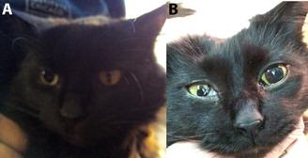
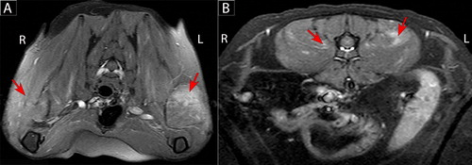
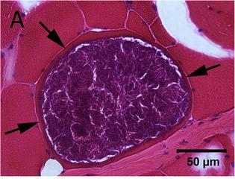
A 6-year-old male neutered domestic longhair cat presented for changing anisocoria and progressive gait abnormalities
Infectious Dz Tests:
Toxoplasma -neg
Cryptococcus -neg
Coronavirus -neg
FelV/FIV –neg
Bartonella henselae -POS
MRI
thoracolumbar vertebral column
Sarcocystis cyst in a muscle fiber
PCR+: Sarcocystis spp. closely related to S. felis,
S. caninum and S. artica
Notes:
thoracolumbar vertebral column –epaxial muscles

Slide 39
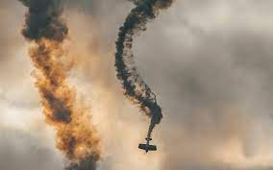
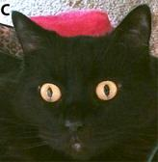
Castel, A., Olby, N. J., Breitschwerdt, E. B., Thomas, B., Maggi, R. G., & Shelton, G. D.. "Co-infection with Bartonella henselae and Sarcocystis sp. in a 6-year-old male neutered domestic longhair cat with progressive multifocal neurological signs." Veterinary Quarterly 39.1 (2019): 168-173.
The cat was treated with:
Trimethoprim Sulfadiazine
meloxicam
buprenorphine
pradofloxacin
Eventually added pyrimethamine
Two years later, the cat remained neurologically normal with symmetrical pupils with only residual signs of mild dysphagia (swallowing probs)
Notes:
One week later, the cat developed paresis in three limbs.
Five days later, the cat became non-ambulatory tetraparetic, lethargic, painful and anorexic.

Slide 40
FYI: Systemic Apicomplexa disease in small animals
Consider systemic apicomplexa in small animals with…
congenital, cutaneous, generalized (pneumonia, myositis, etc.), or neurological clinical signs
(especially when associated with immunosuppressive treatments)
Case Reports:
Skeletal muscle myositis in dogs (S. caninum and S. svanai)
Pneumonia in dogs (Sarcocystis spp, and N. caninum)
Encephalitis in dogs (S. neurona)
Hepatitis in dogs (S. canis, S. svanai, and other Sarcocystis spp.)
Cutaneous infections in dogs and cats (Neospora, Toxoplasma, Sarcosystis)
Congenital infections in dogs (S. neurona and N. caninum)
Neurological diseases cats and dogs

Slide 41
DISCUSSION
Name three protozoal pathogens that cause abortion in cattle.
Which one can cause transgenerational infections?
Which one has a direct life cycle?
Notes:
How long was he treated

Slide 42
Have Questions?
barbara_qurollo@ncsu.edu
Illustration by Allie Brosh, http://hyperboleandahalf.blogspot.com/

